Slide 1
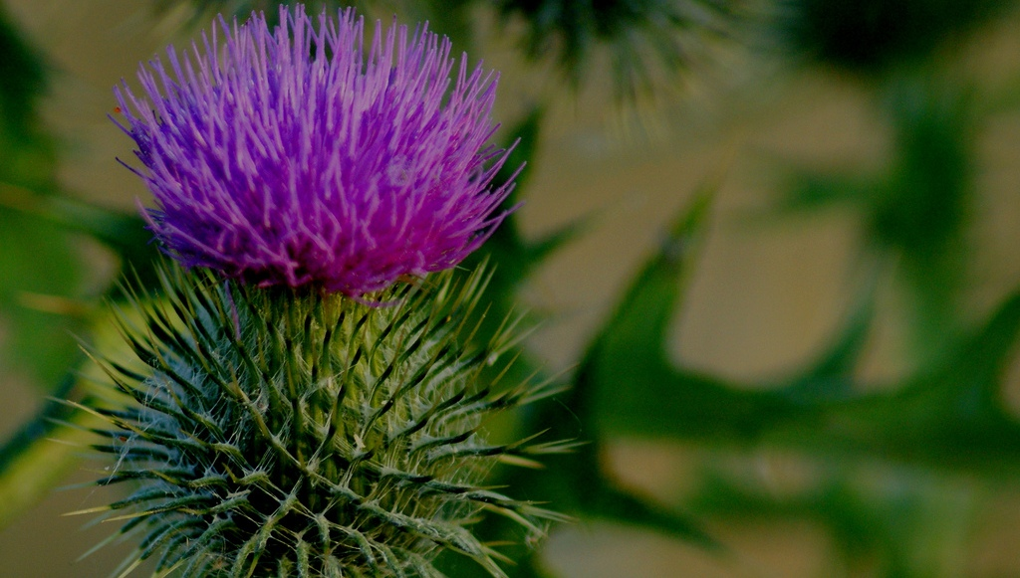
Scotland
Решитько Юлия Ивановна,
учитель английского языка
МБОУ СОШ № 3, г. Чехов

Slide 2
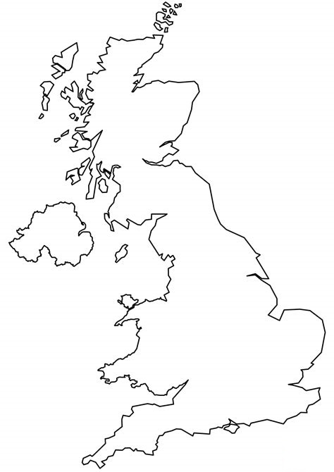
UK. Where is Scotland? Let’s find!
Notes:
Примеры целей
В конце этого занятия вы сможете:
сохранять файлы на веб-сервере группы;
перемещать файлы в разные расположения на веб-сервере группы;
предоставлять общий доступ к файлам на веб-сервере группы.

Slide 3
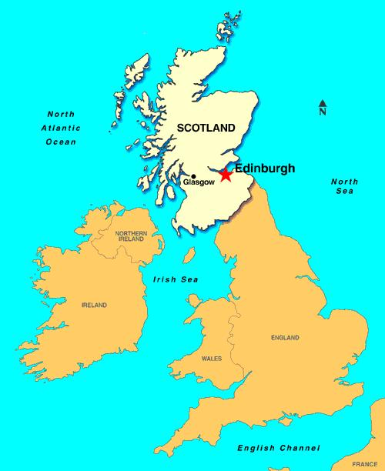
Scotland. Edinburgh.
The total area of the country is 78,772 square kilometres.
It’s a third of the land mass of Britain.
The population – 5,47 million people.
The capital - Edinburgh.

Slide 4
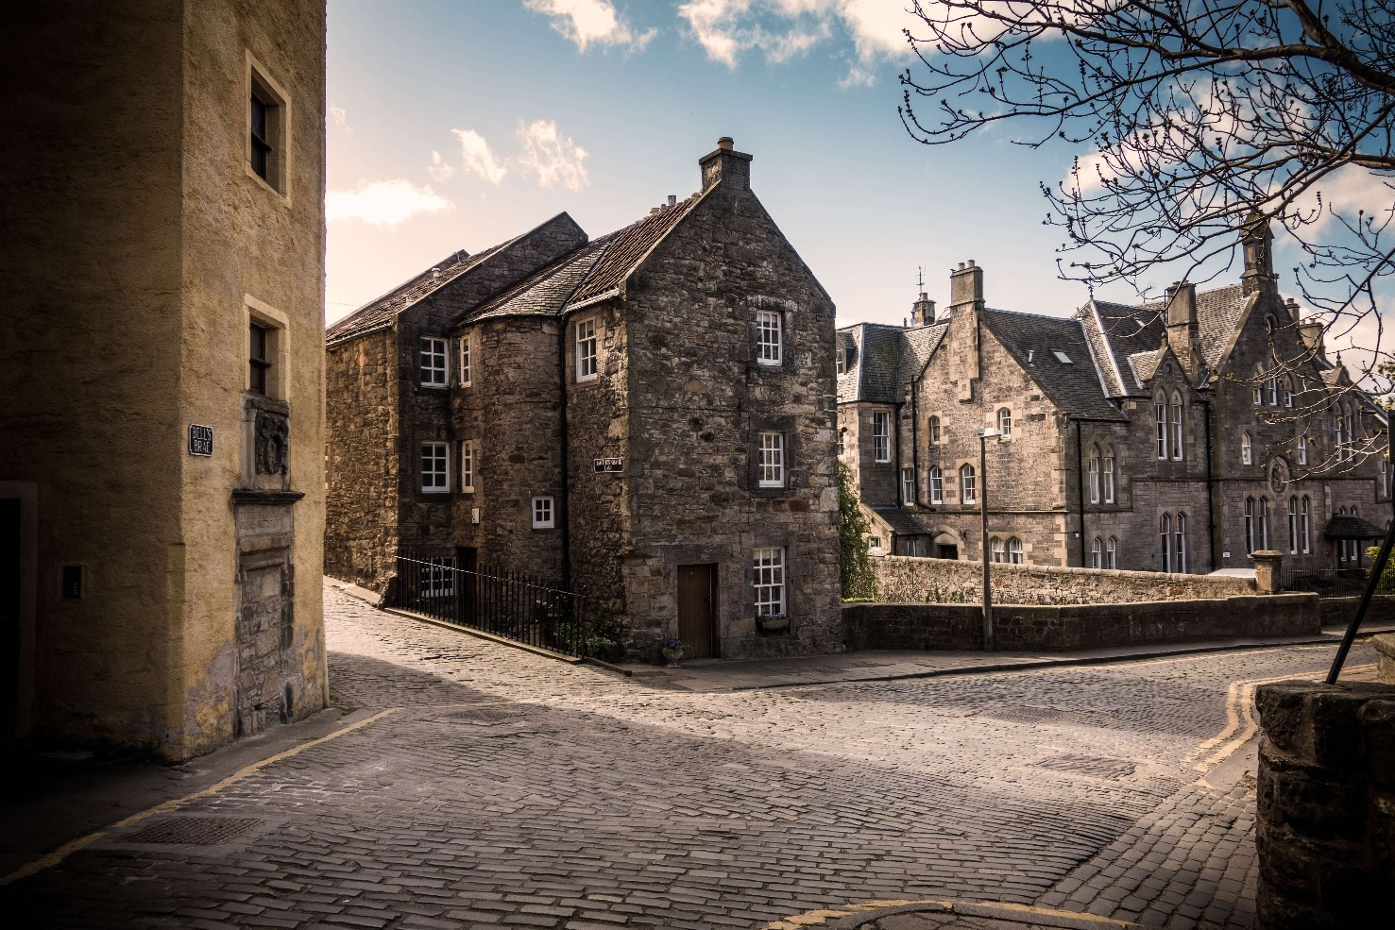
Edinburgh
“Burgh” is a Scottish word for borough (a small town).

Slide 5
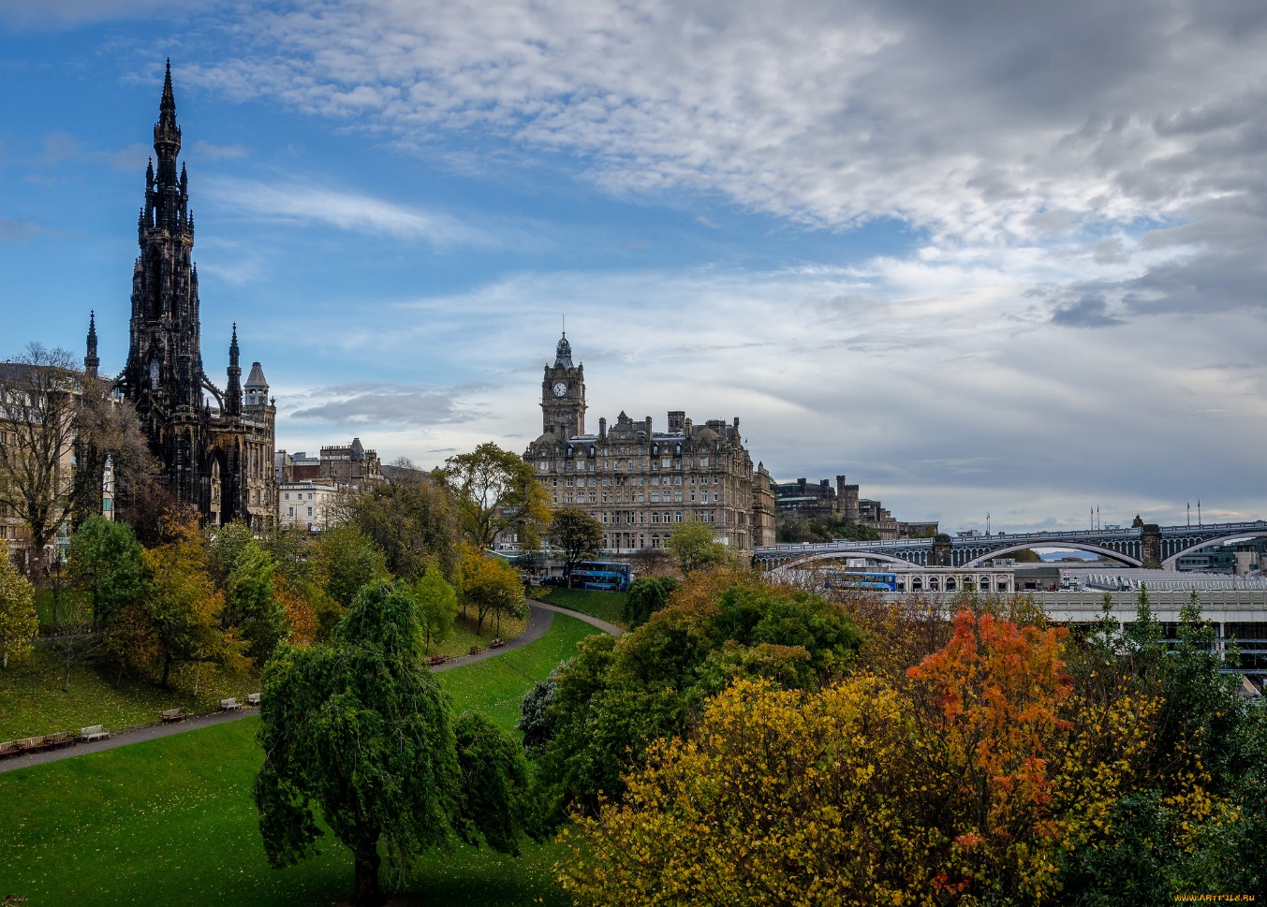
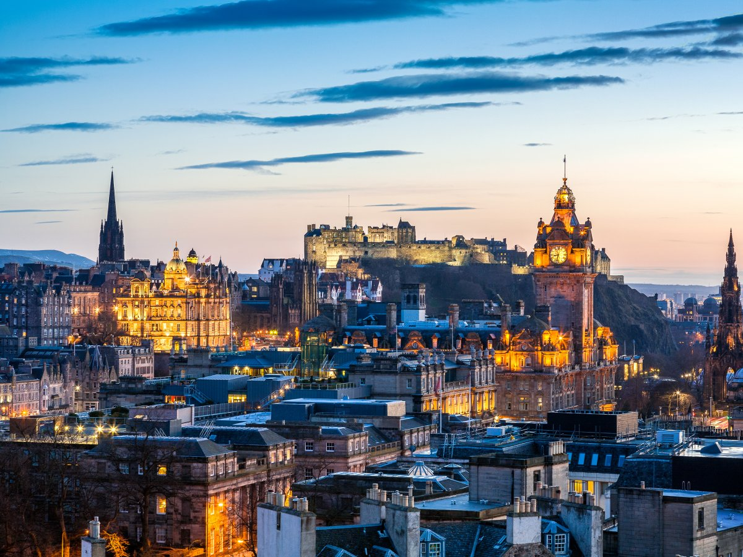
Edinburgh is the capital of Scotland.

Slide 6
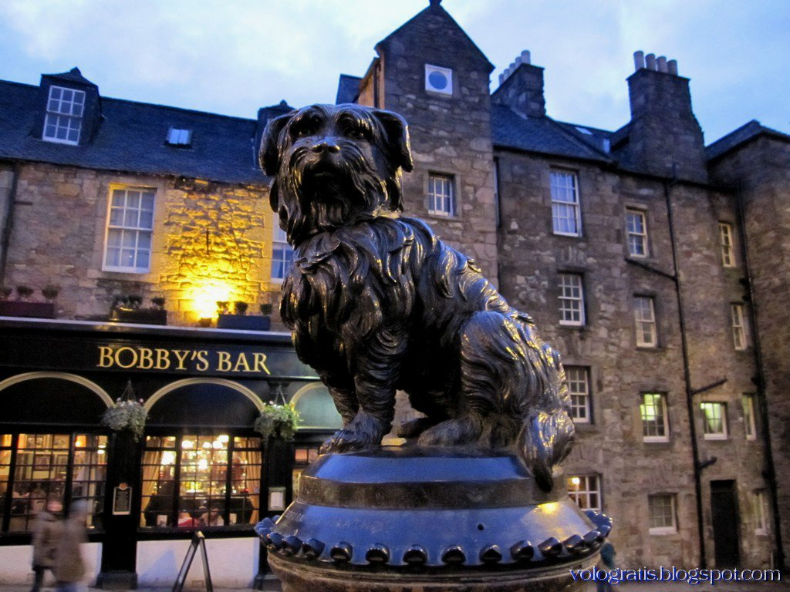
Greyfriars Bobby
There is an unusual monument in Edinburg. It is to a dog who watched over his master’s grave for 14 years. This monument was erected to immortalize the devotion of a dog to his master even after his master’s death.

Slide 7
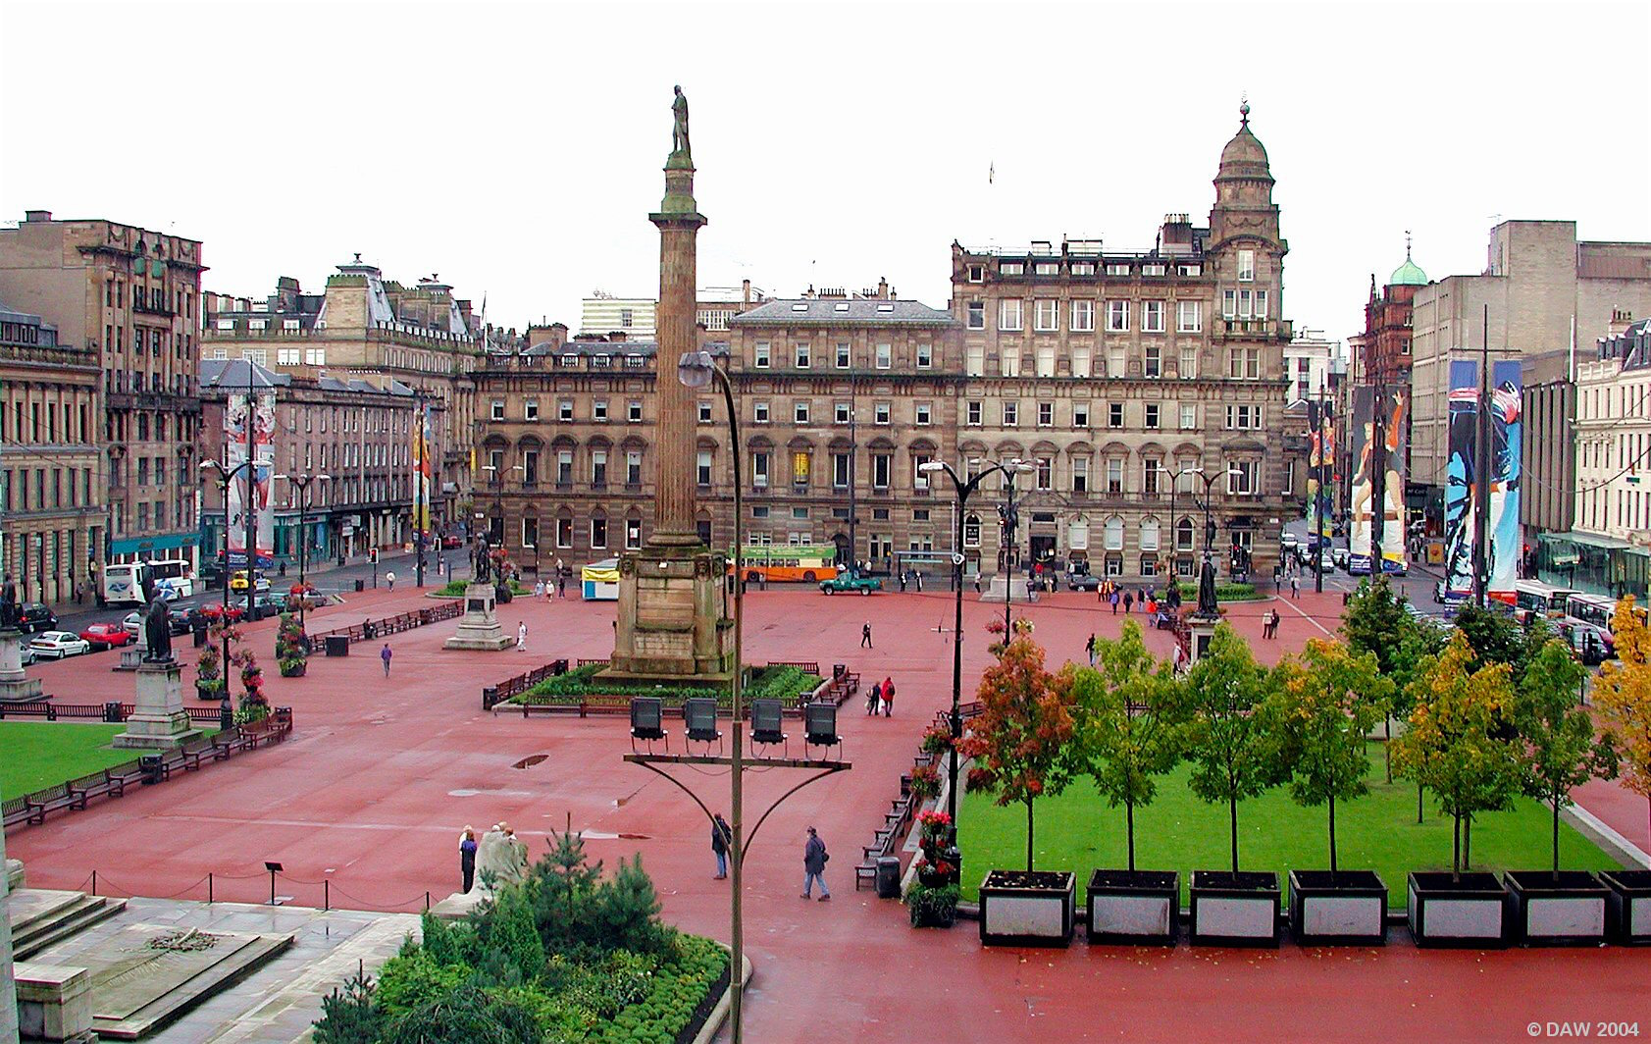
Glasgow.

Slide 8
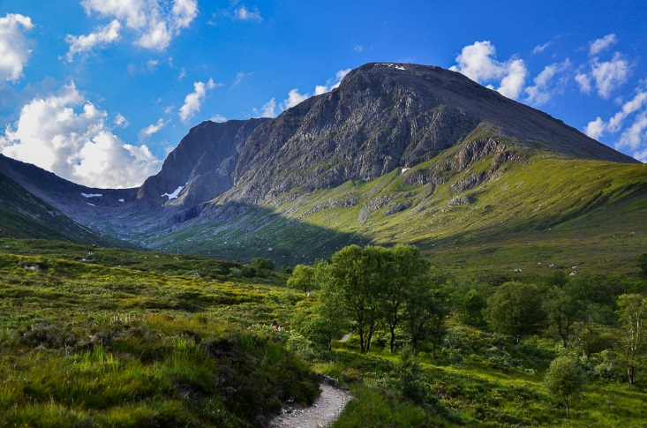
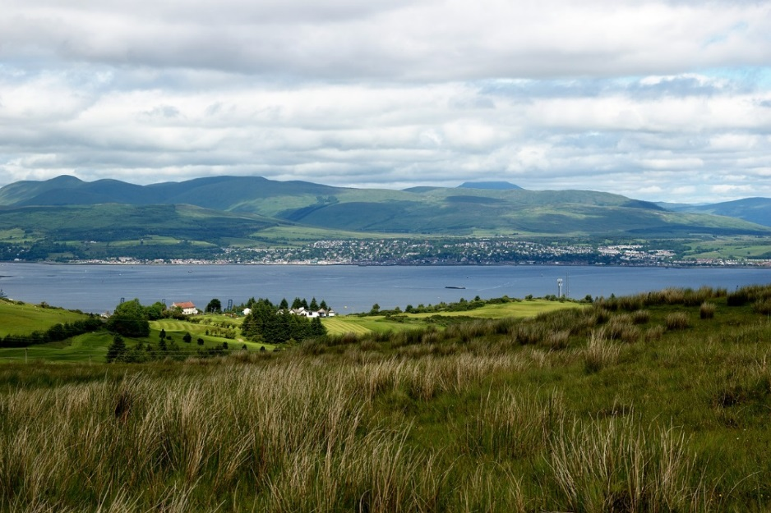
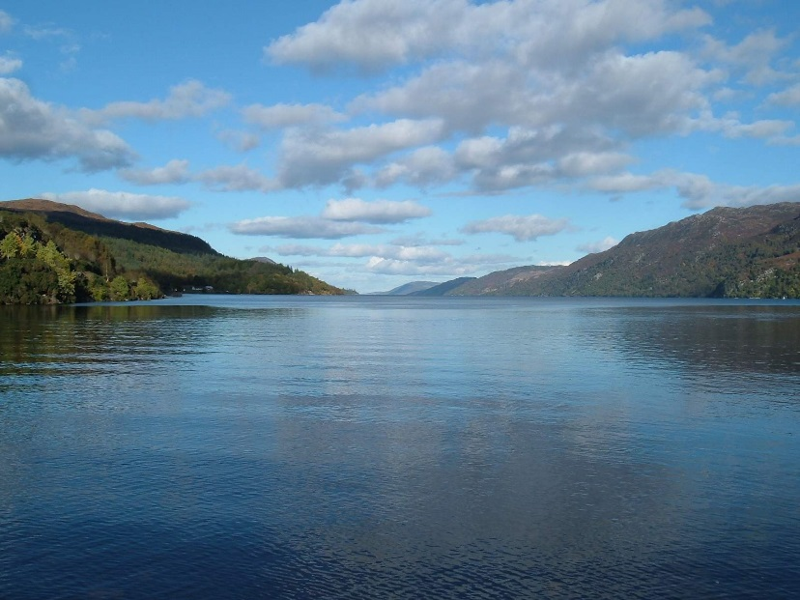
Ben Nevis
Clyde
Loch Ness

Slide 9
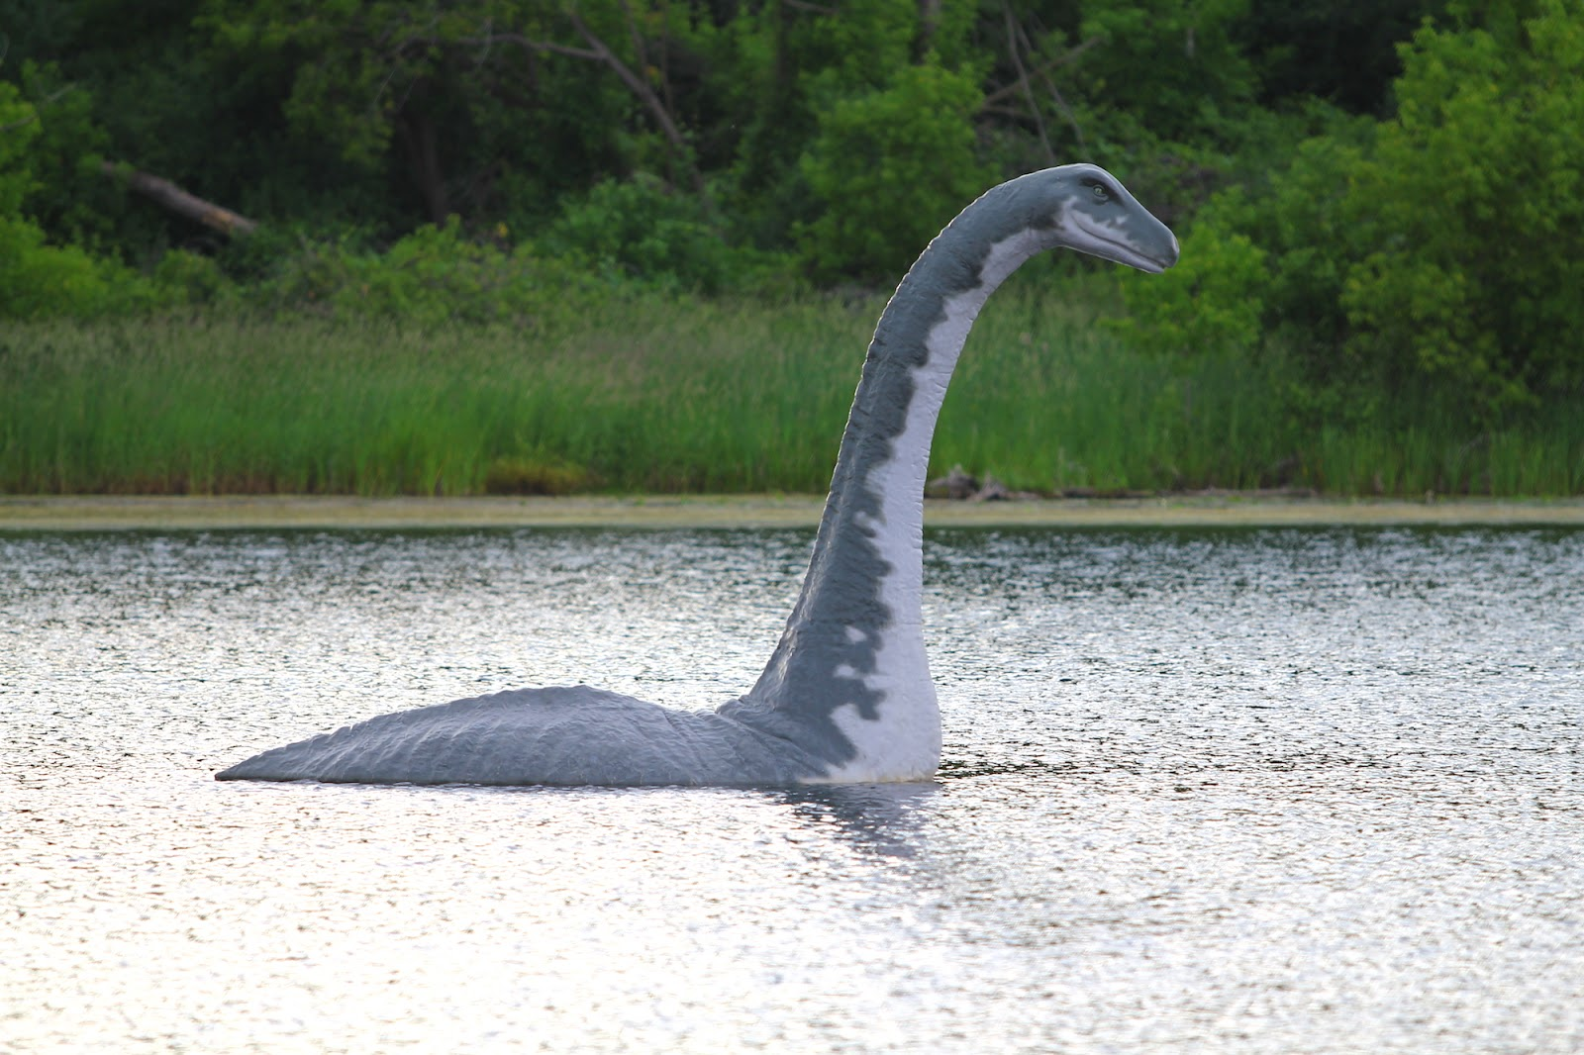
Nessie

Slide 10
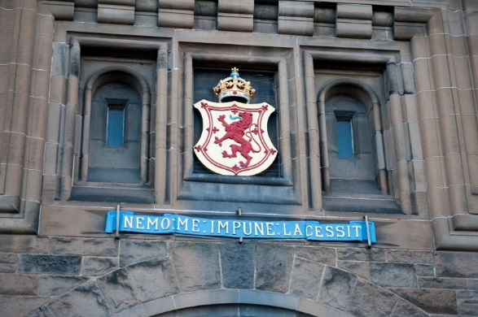

Slide 11
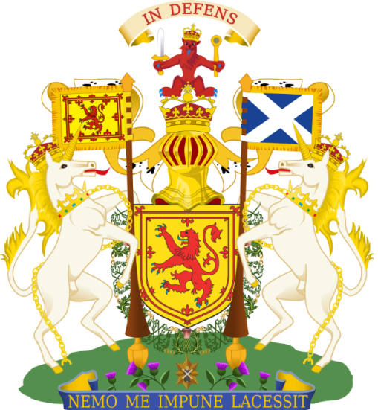
Подумайте, какой можно сделать вывод о народе Шотландии на основании этой цитаты.
Девиз Шотландии
“Nemo me impune lacessit”,
или
"Никто меня не тронет безнаказанно".
Notes:
Описывать занятия нужно вкратце.

Slide 12
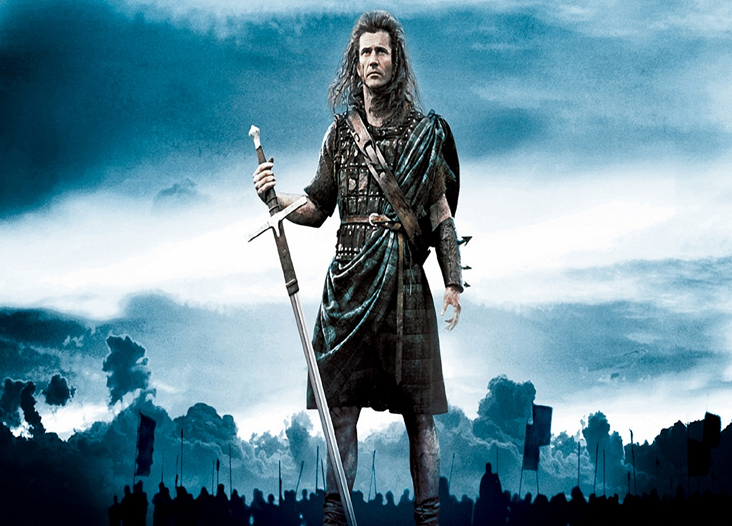
This nation is…
Brave - отважный
Fearless - неустрашимый
Dignified - гордый
Courageous - смелый
Independent- независимый
Stalwart - непоколебимый

Slide 13
Mac / Mc
A lot of Scottish family names begin with Mac or Mc – like Macdonald, MacMilian or McHale. “Mac” means «son of» and people with this name usually feel they belong to the same family or clan.

Slide 14

The flag of Scotland.
The flag of Scotland features a white saltire, a crux decussate (X-shaped cross) representing the cross of the Christian martyr Saint Andrew, the patron Saint of Scotland on a blue field.

Slide 15


Slide 16
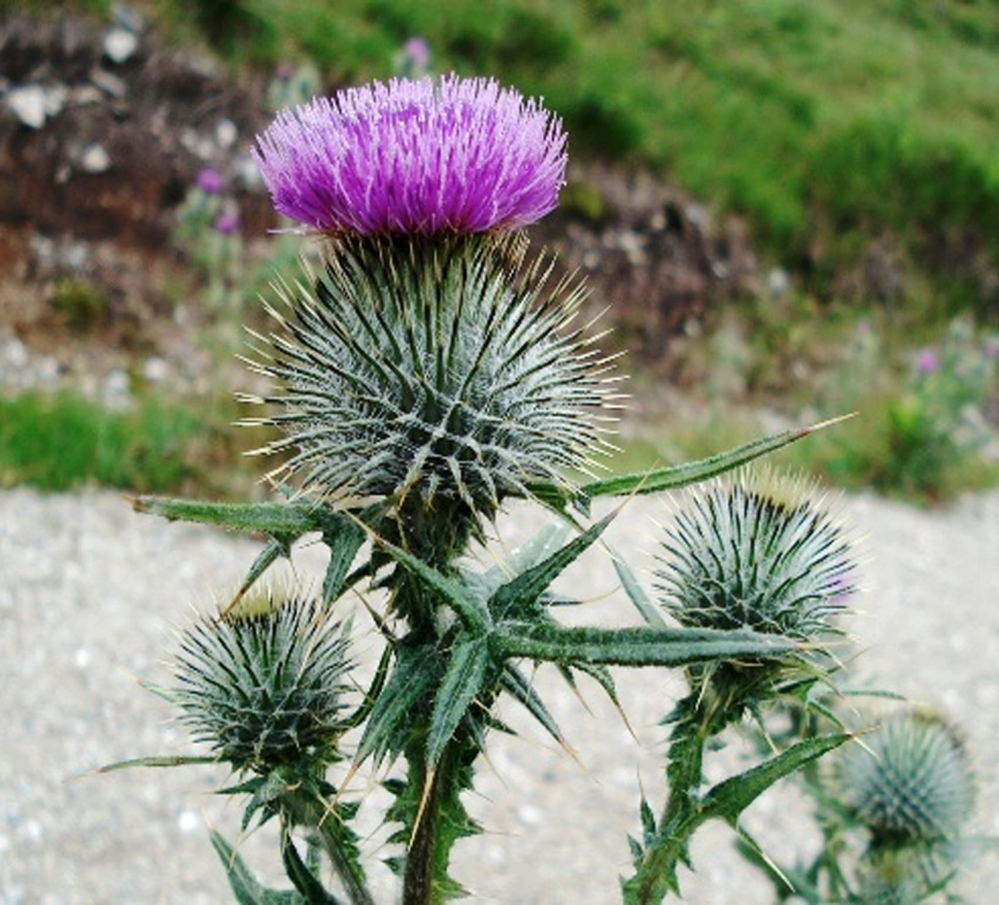
Thistle.
The thistle is the national emblem of Scotland.
Why did the Scottish people choose thorny plant as the national emblem of their country?

Slide 17
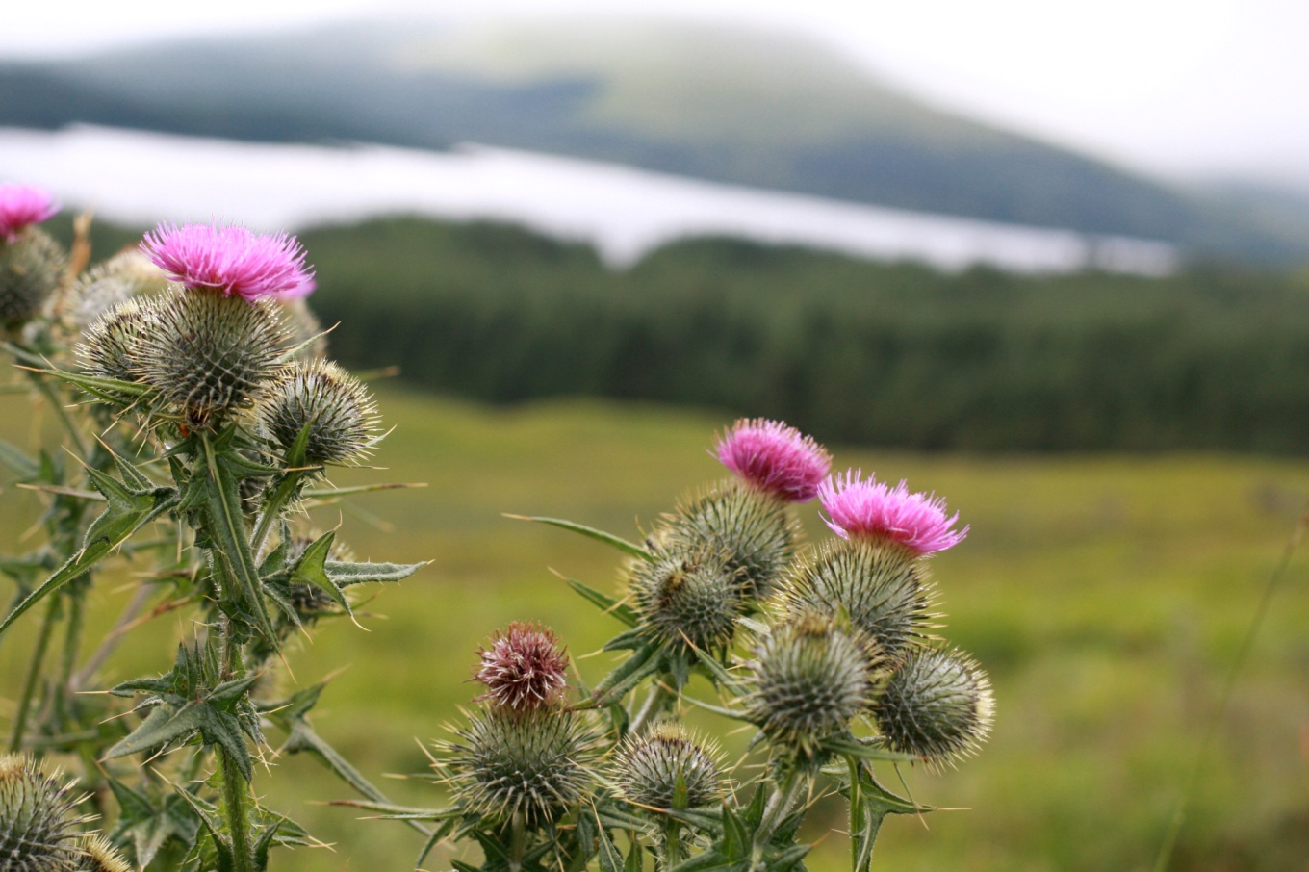
The answer is interesting.
The people chose the thistle as their national emblem because it saved their land from foreign invaders. During a surprise night attack by the invaders the Scottish soldiers were awakened by the shouts of the invaders as their bare feet touched the thorns of the thistles in the field they were crossing.

Slide 18
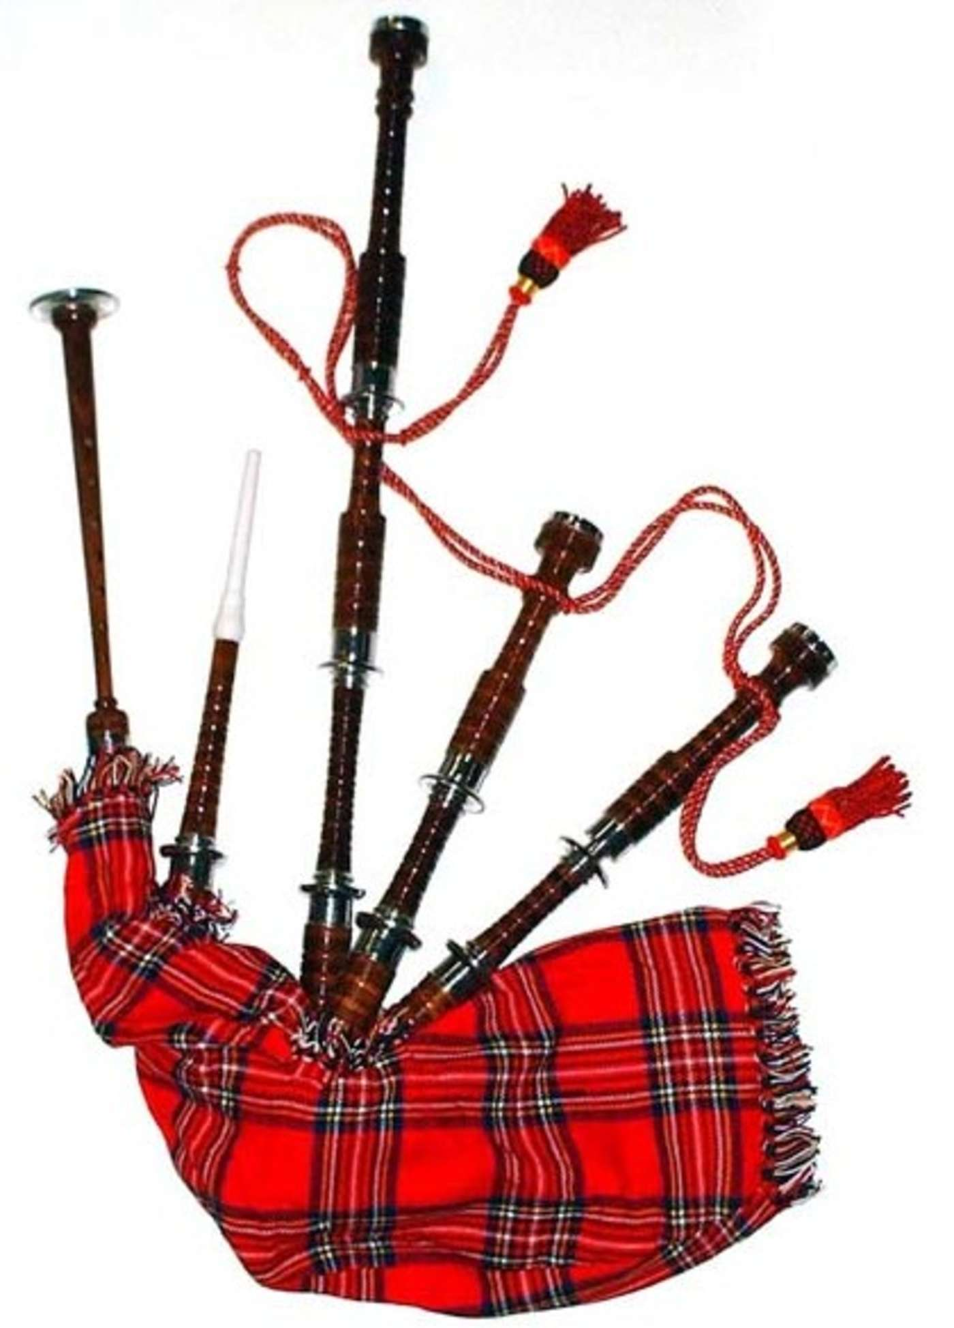
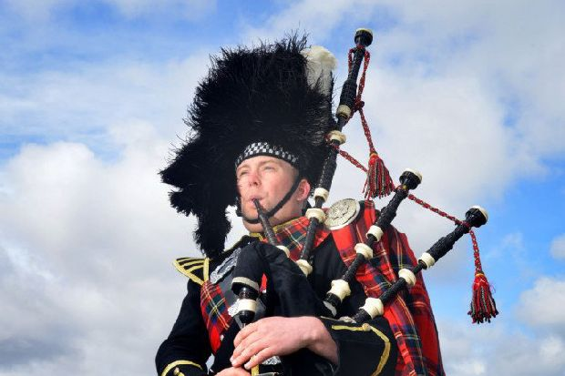
The bagpipe is the national instrument of Scotland.

Slide 19
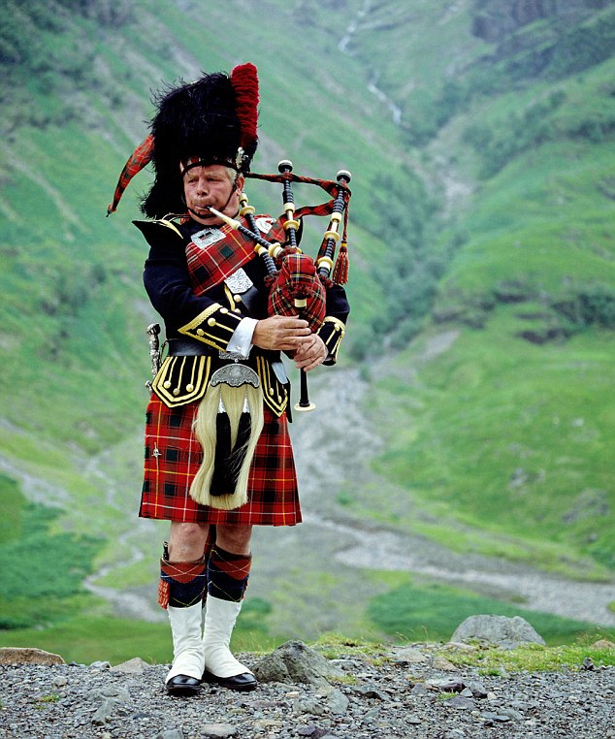
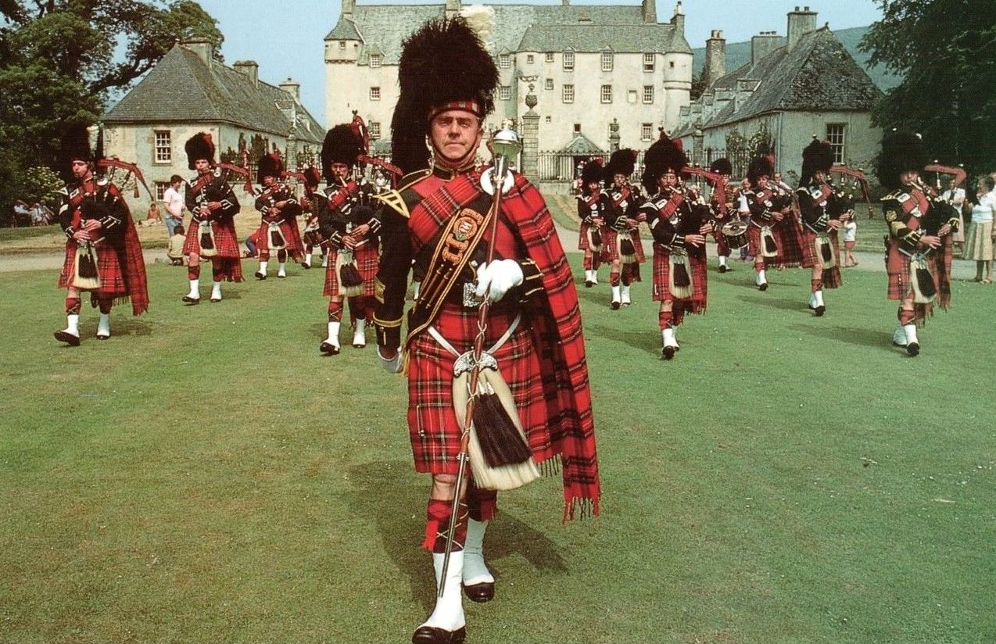
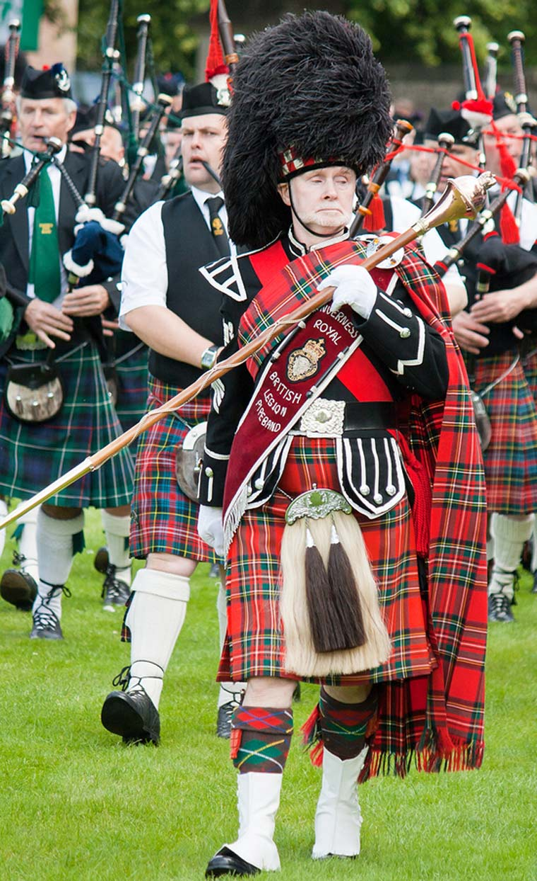
Kilt. Tartan.

Slide 20
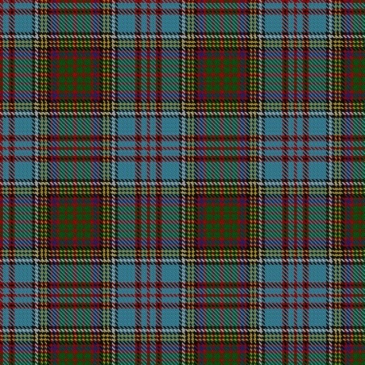
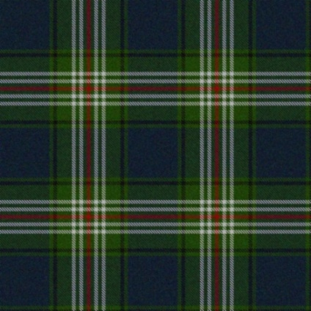
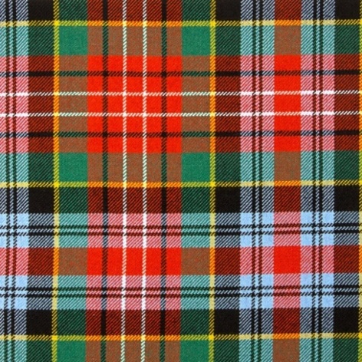
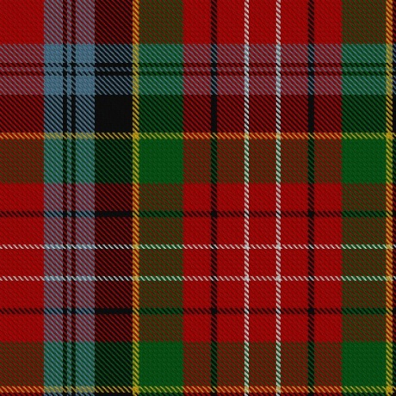
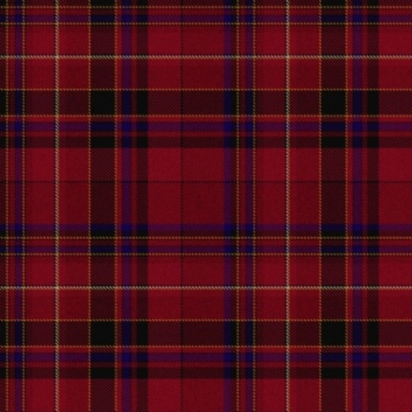

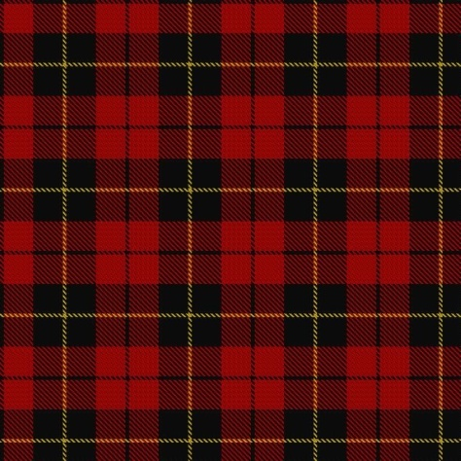


Tartan.

Slide 21
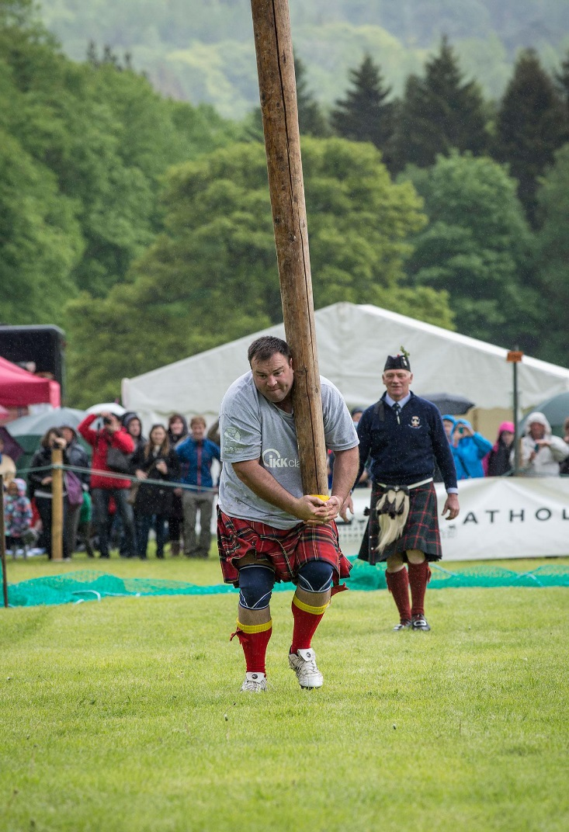
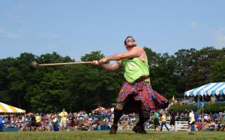
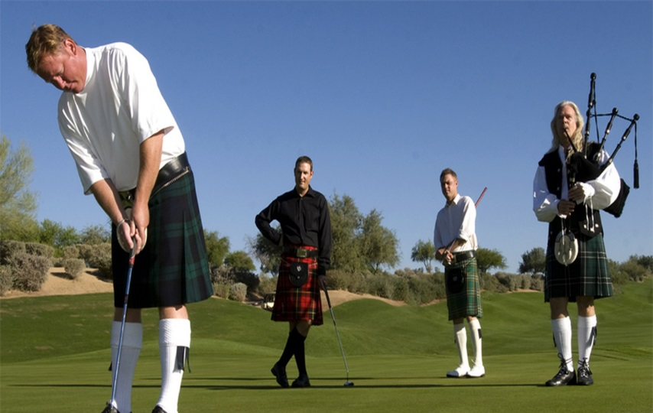
Sport and recreation.

Slide 22
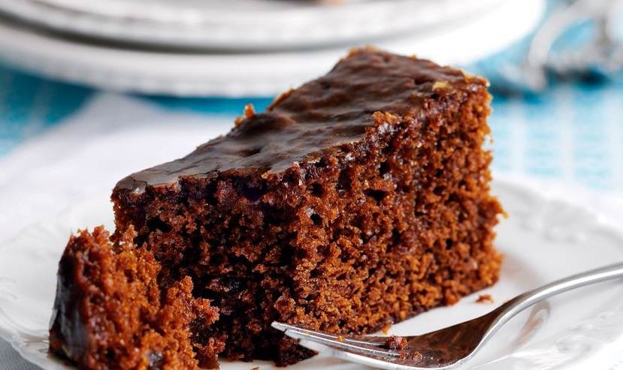
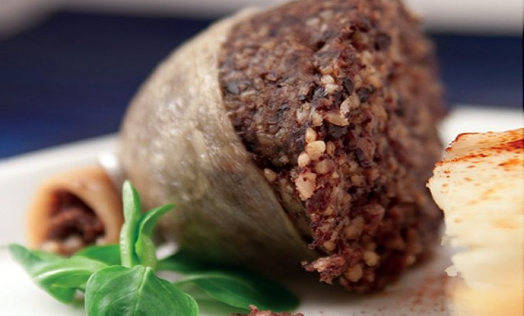
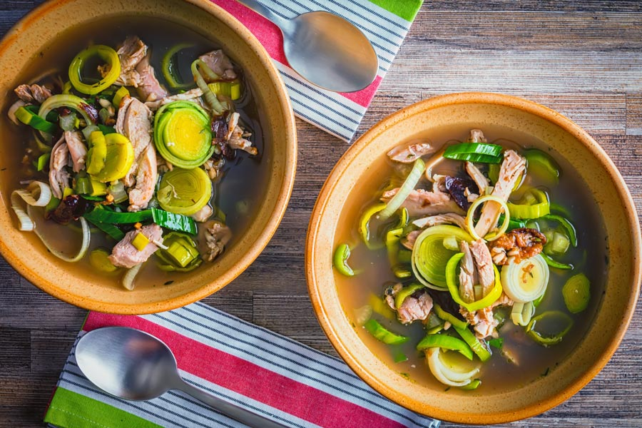
Scottish cuisine.
Ginger Cake
Haggis
Cock-A-Leekie

Slide 23
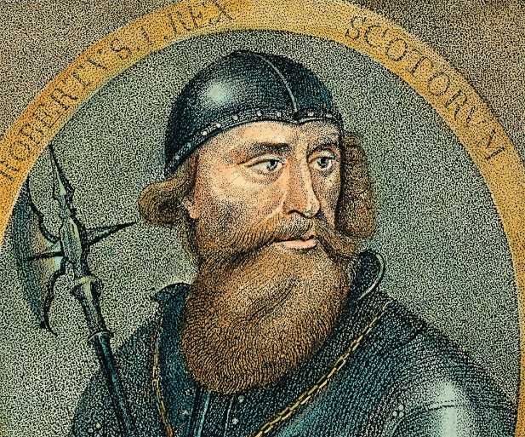
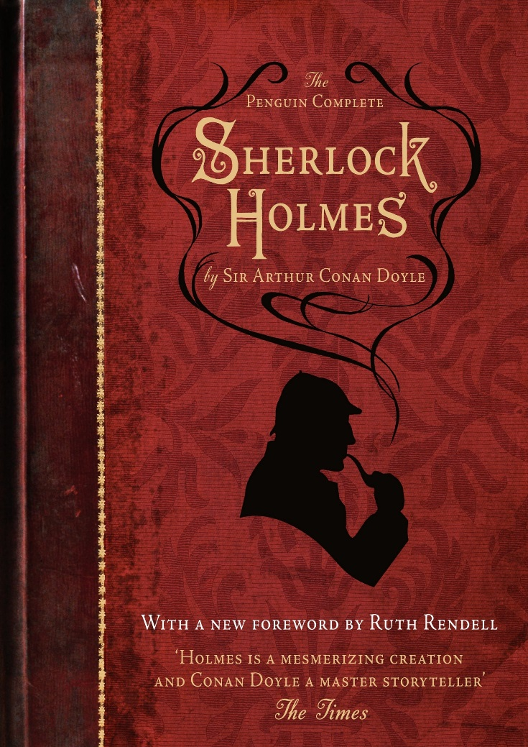
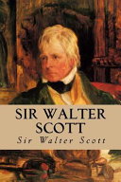
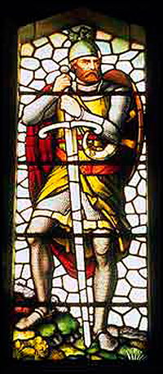
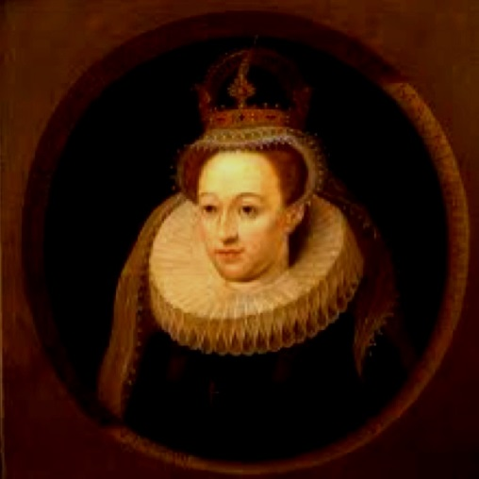
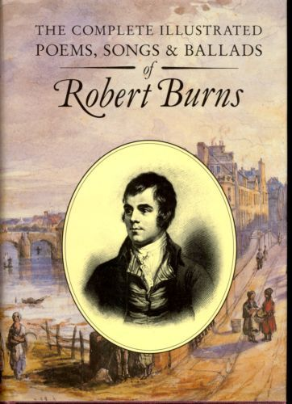
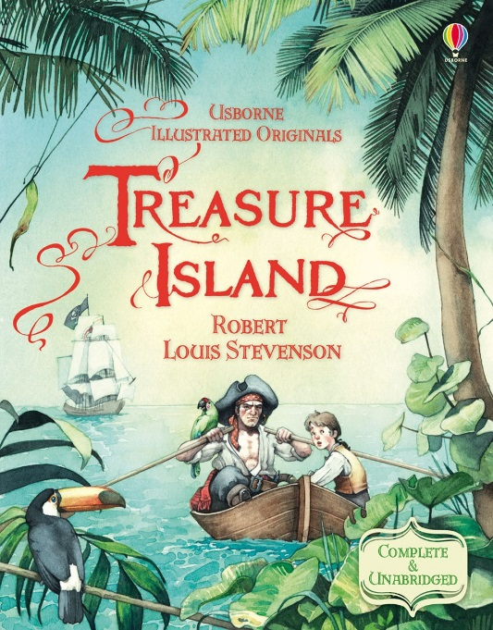
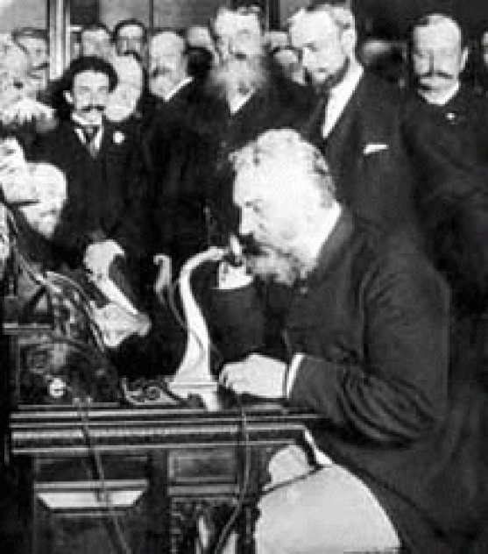
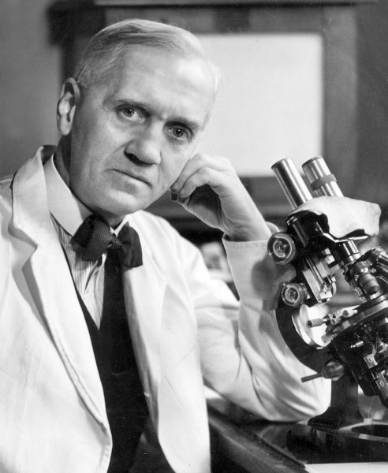
The famous people of Scotland.

Slide 24
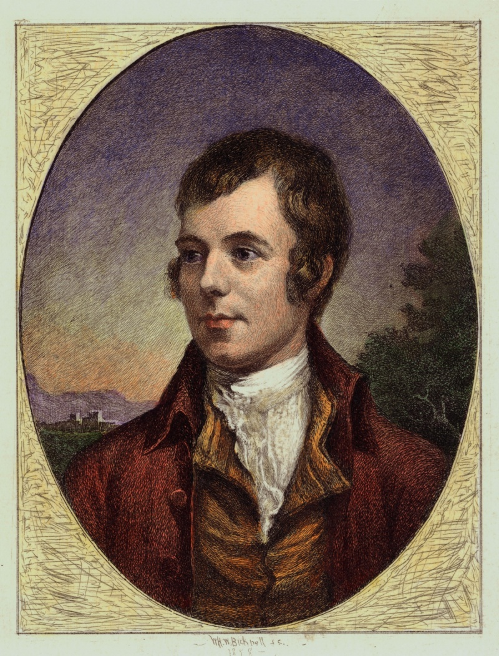
Robert Burns (1759-1796)
A Scottish poet and lyricist. He is widely regarded as the national poet of Scotland and is celebrated worldwide.

Slide 25
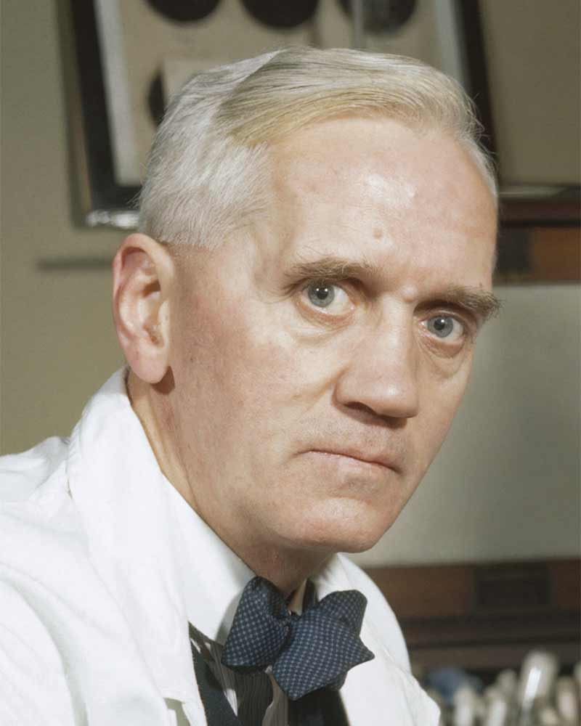

Alexander Fleming (1881-1955)
Biologist, physician, microbiologist, and pharmacologist.

Slide 26
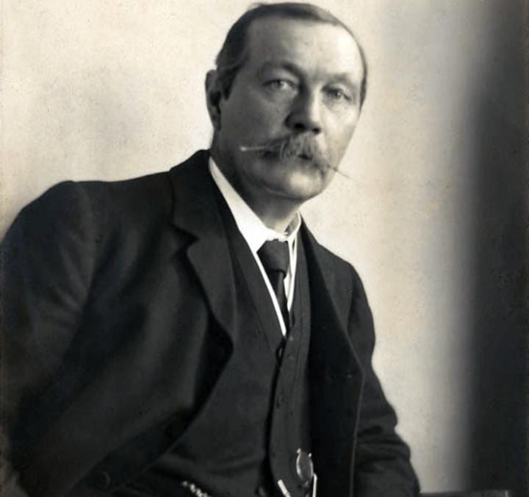
Conan Doyle (1859-1930)
A British writer, who created the character Sherlock Holmes.

Slide 27
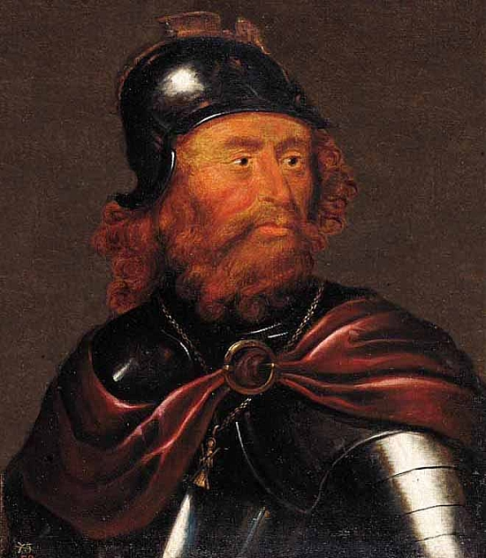
Robert Bruce(1274-1329)
The king of Scotland from 1306 till his death.
Robert was one of the most famous warriors of his generation, and eventually led Scotland during the First War of Scottish Independence against England.

Slide 28
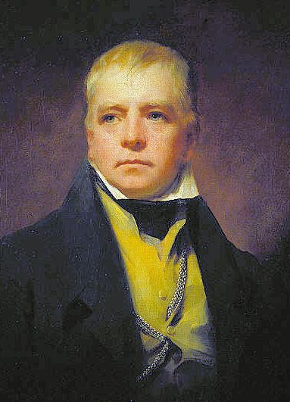
Walter Scott (1771-1832)
A Scottish historical novelist, poet, playwright and historian.
A great master of the historical novel.

Slide 29
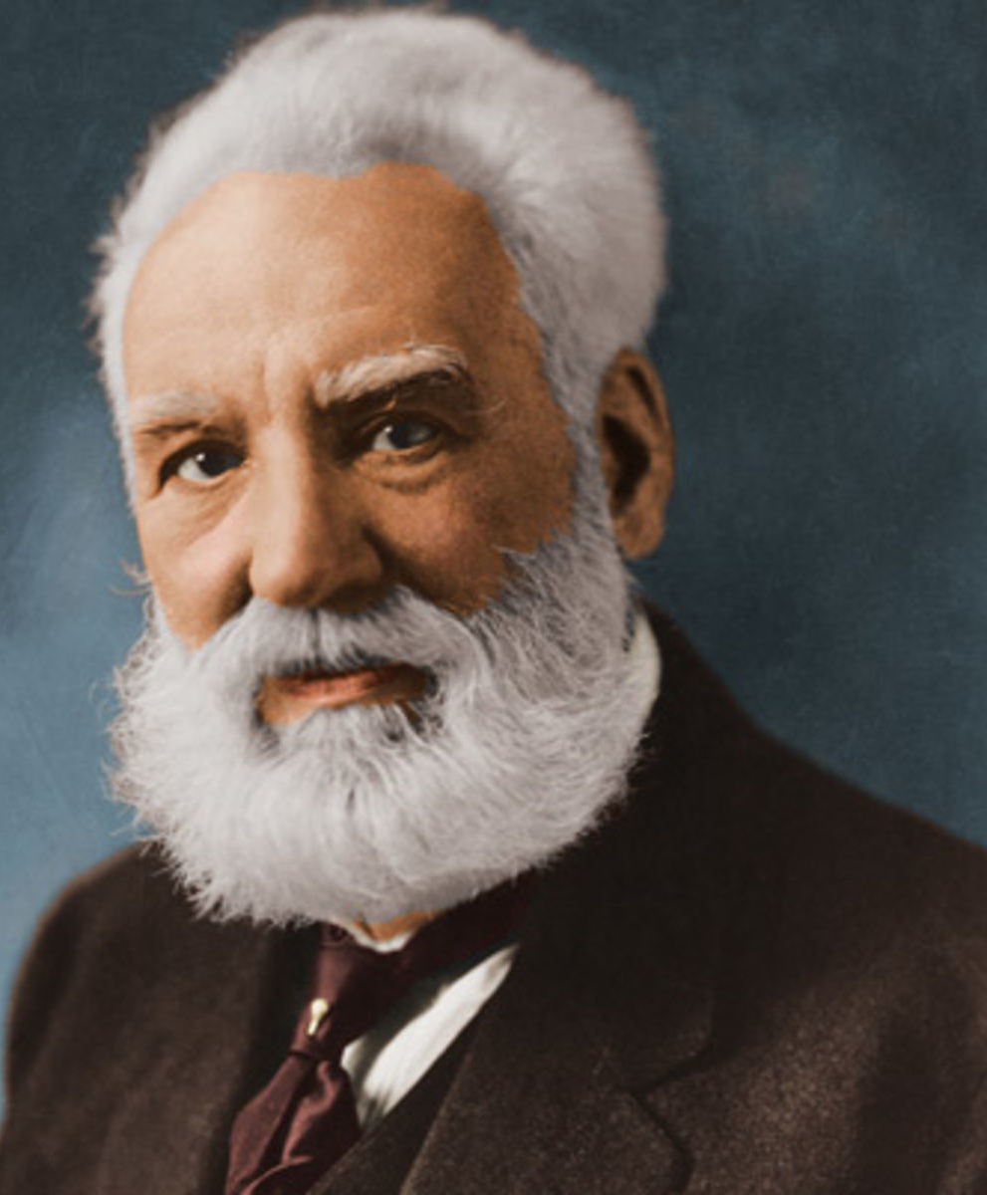
Alexander Graham Bell
(1847-1922)
Inventor, scientist, and engineer. The famous Scottish inventor of the first telephone.

Slide 30
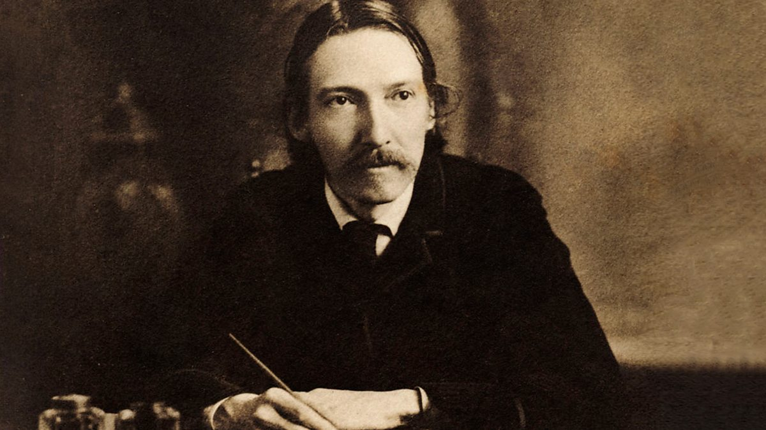
Robert Louis Stevenson (1850-1894)
The writer known for his stories and books of adventure.

Slide 31

Mary Queen of Scots (1542-1587)
One of the most famous queens in Scottish history.

Slide 32

William Wallace
(1272-1305)
A national hero who fought for his people’s rights and welfare.

Slide 33
Test you knowledge
What is the capital of Scotland?
Name the famous lake in Scotland.
Which inventions were made by Scotsmen?
What is the national emblem of Scotland?
What Scottish famous people do you know?
What Scottish national dishes do you know?
What kinds of sport are the most popular in Scotland?
Name the national musical instrument.
What is the tartan?
What can you say about Scottish names?

Slide 34

Thank you!

