Slide 1
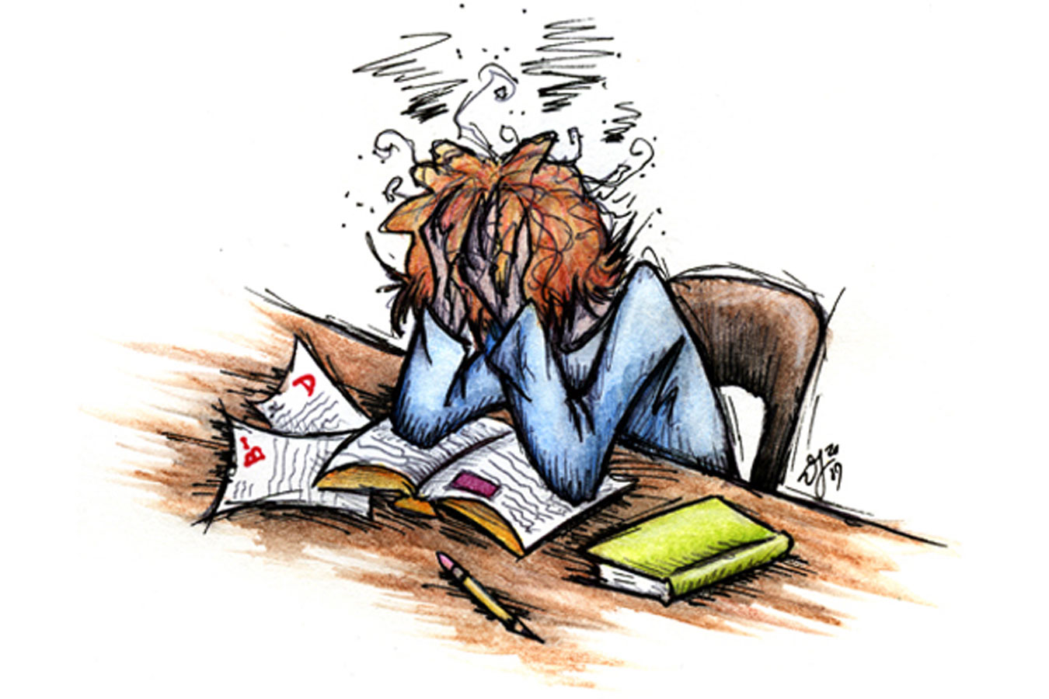
Stressed out!

Slide 2

What stress is
In a nutshell, “stress” is the way our bodies and minds react to life`s changers

Slide 3
Causes of stress
Difficult life situation
Jobs
Intensive tempo of life
Sitting exams
Crowds of people

Slide 4
Effects of stress
Health problems
Ill-being of our bodies
Terrible feelings and emotions
Problems with minds
Family problems

Slide 5
How to deal with stress
Take control and remember your A,B,Cs
A is for action
B is for bear it
C is for cope

Slide 6
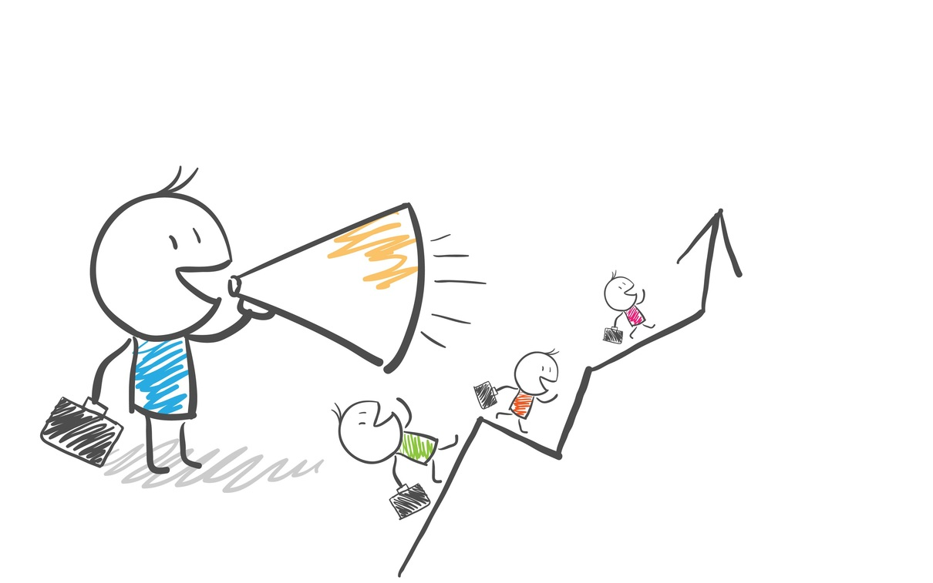
A is for Action
You can take action when stress is created by something you can control!
-

Slide 7
Try to break tasks down into smaller “chunks”
Deal with one thing at a time in order of priority
Ask a friend or a family to help you lighten the load

Slide 8
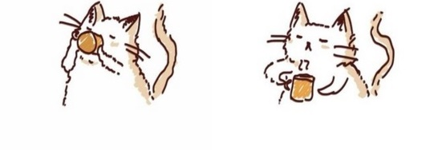
B is for bear it
If there`s nothing you do, you`ll just have to “grin and bear it”!
Saying that you`re “pulling your hair out” or that your workload “is killing you” will only make you feel worse!

Slide 9
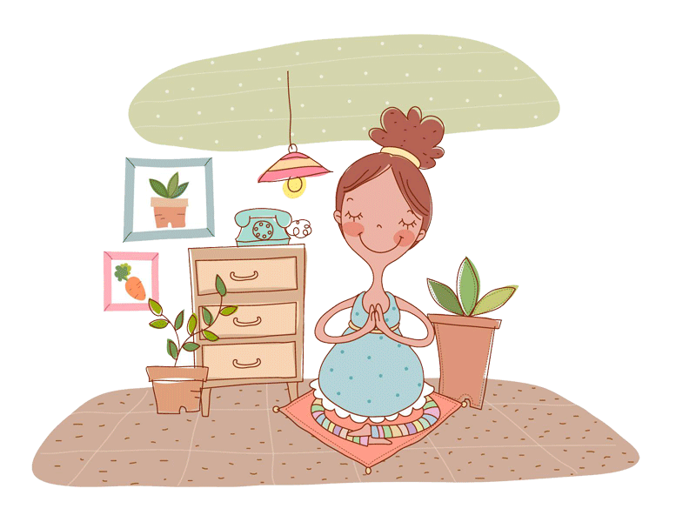
Grin and bear it
Learn how to control
your thoughts
Take slow deep breaths and count to ten
Analyze the problem rationally
Try to keep things in perspective

Slide 10
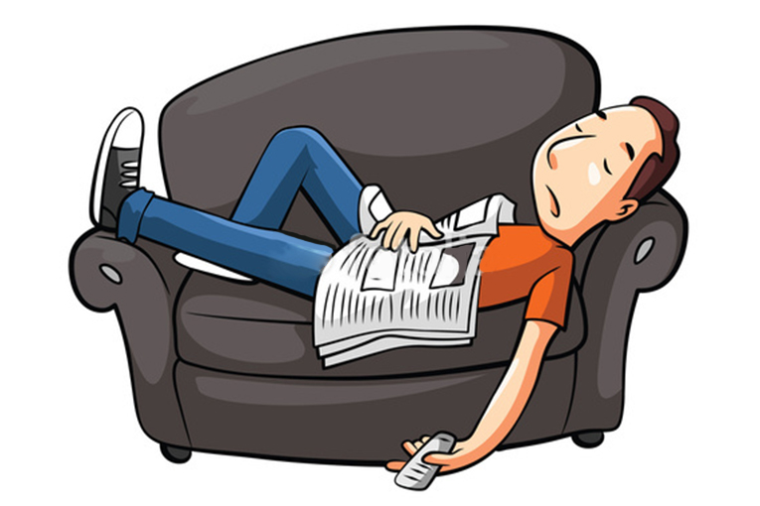
C is for cope
-

Slide 11
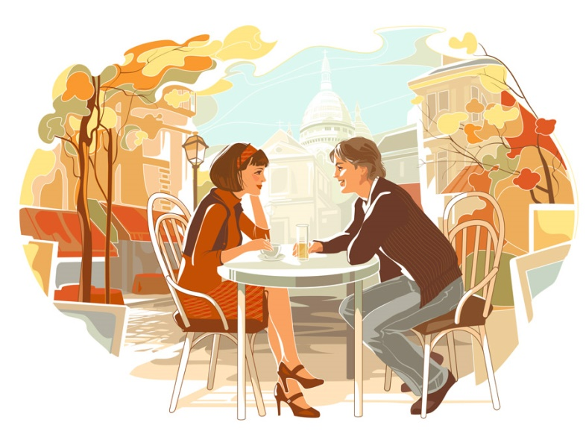
Find ways to handle your stress
Do something relaxing (such as going for a walk or for a coffee with a friend)
Get enough sleep
Exercise and eat regular (nutritious meals are all essential for coping with stress)

Slide 12

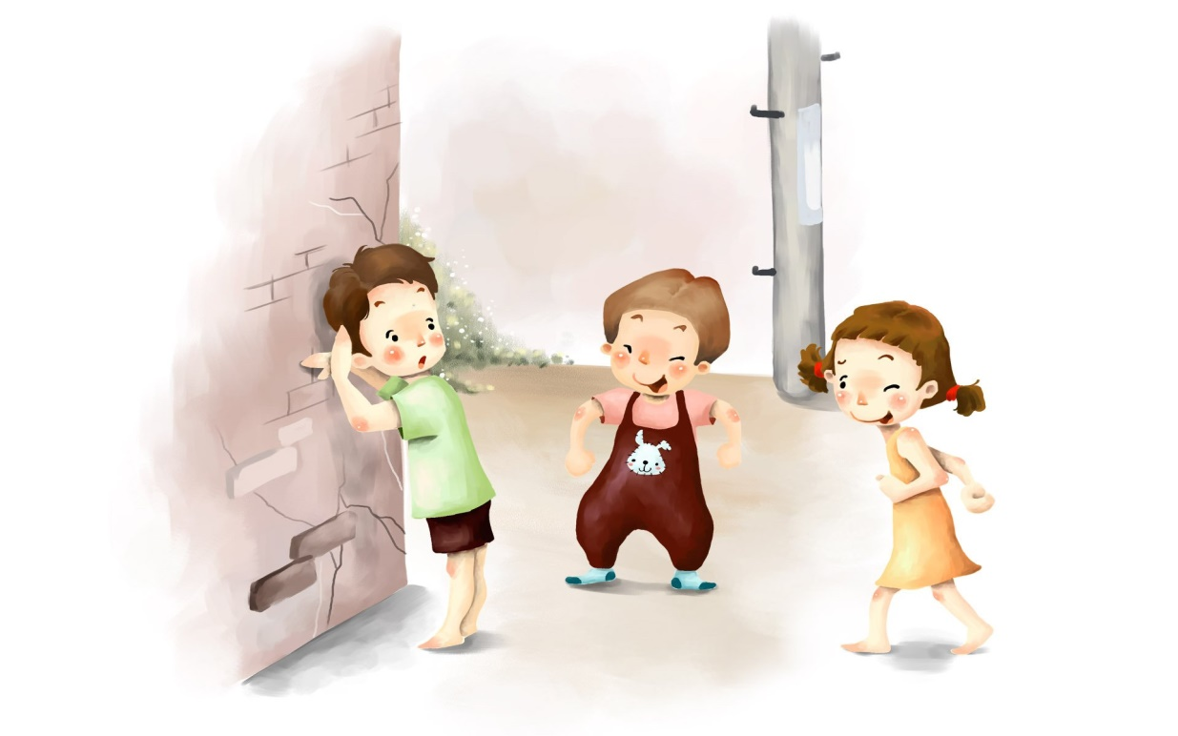
You don`t have to let your problems rule your life!

Slide 13
Thank you for attention!

