Slide 1
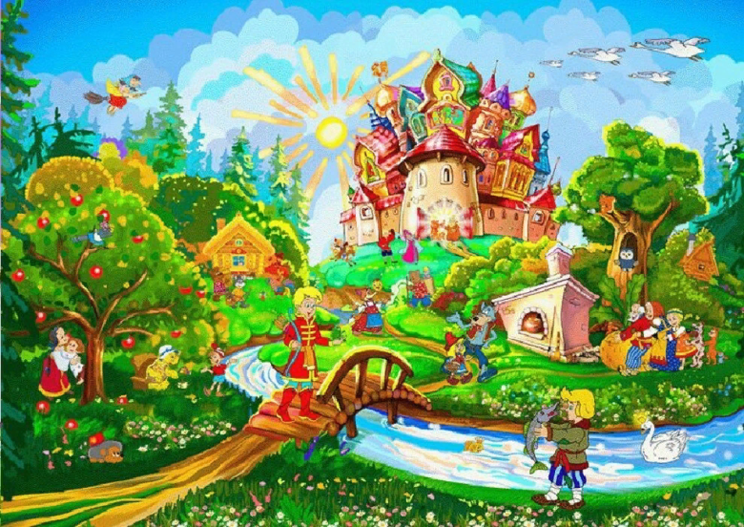
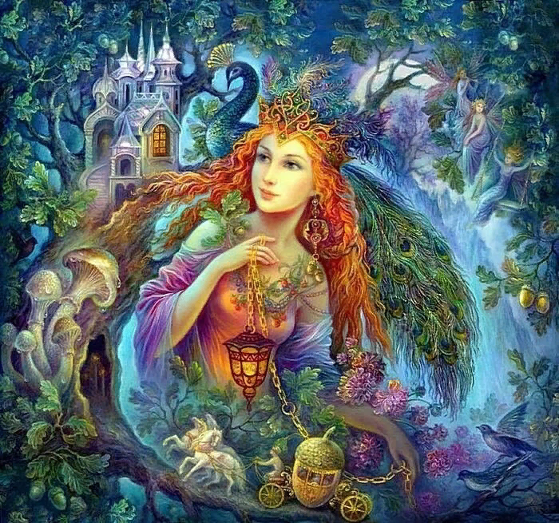
The World of Fairy Tales
В мире сказок
Презентацию подготовила учитель английского языка ГБОУ ШКОЛА №2070 г. Москвы Горяинова Виктория Викторовна

Slide 2
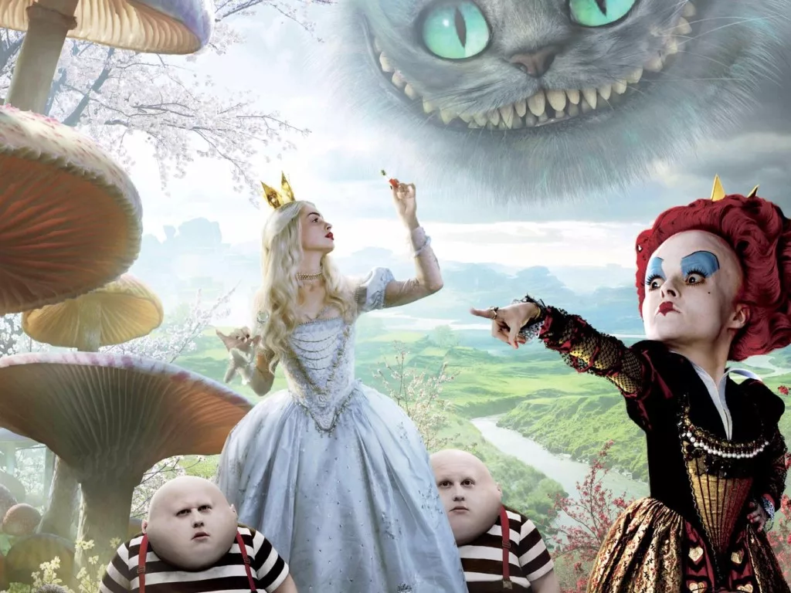
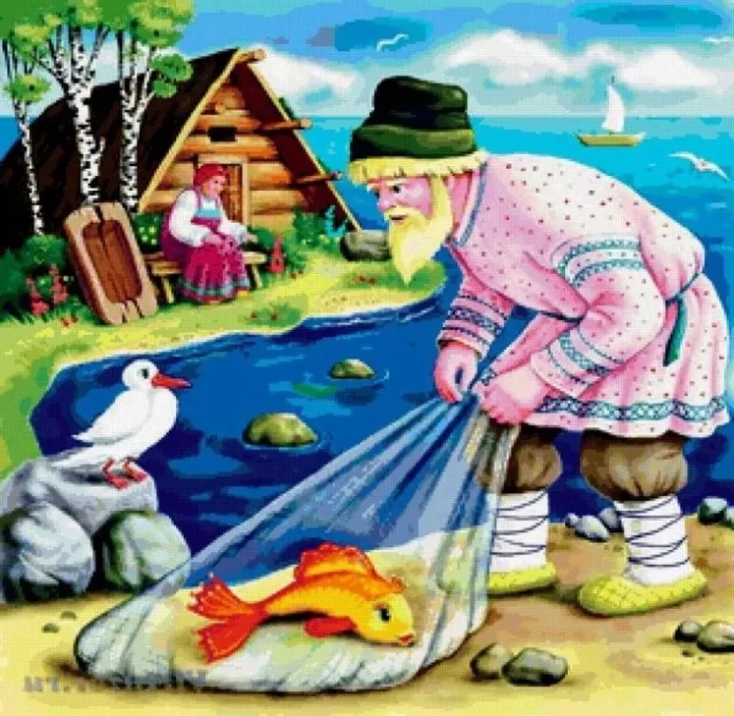
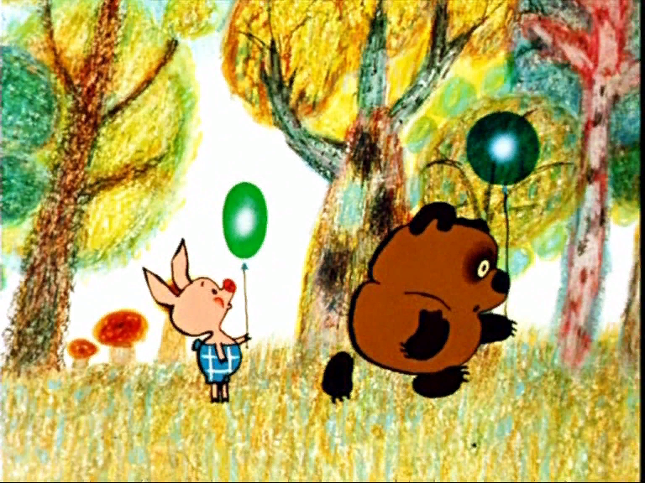
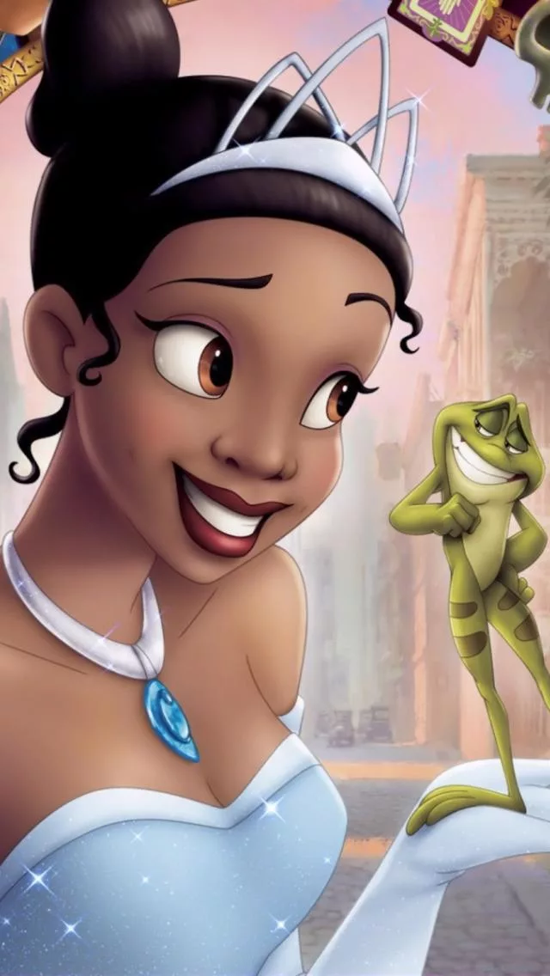
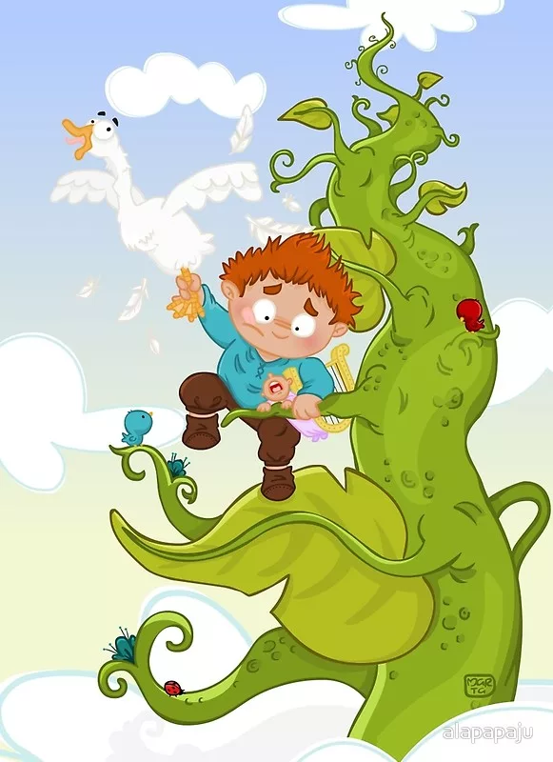
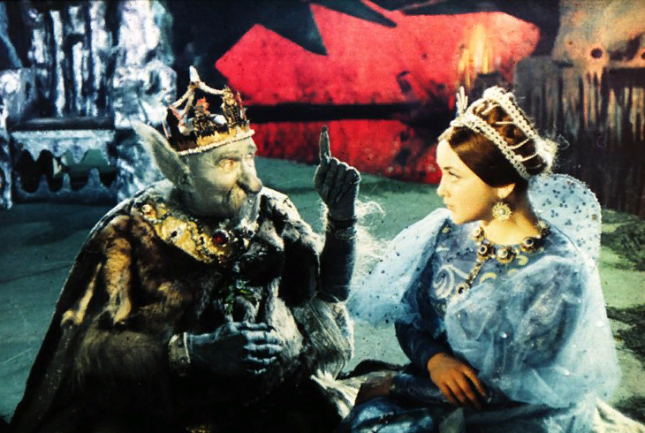
Name fairy-tales
1
2
3
4
5
6

Slide 3
Name fairy-tales
1. Alice in Wonderland
2. The golden fish
3. Winnie-the-Pooh
4. Varvara-Krasa
5.The Frog princess
6. Jack and the beanstalk
1. Алиса в стране чудес
2. Золотая рыбка
3. Винни-Пух
4. Варвара-Краса
5. Царевна-лягушка
6. Джек и бобовое зернышко

Slide 4
MATCH THE NAME OF FAIRY TALE AND THE COUNTRY IT COMES FROM
English fairy tales Russian fairy tales
Tales: Alice in Wonderland,
The Frog Princess, Vassilissa the Beautiful, Jack and the Beanstalk ,
The Star Child, Golden Fish, Three bears, Tom Thumb, Goldilocks and Three bears,
A Turnip.

Slide 5
Fairy-tales and the countries
Alice in Wonderland
The Frog Princess
Jack and the Beanstalk
The Star Child
Tom Thumb
Goldilocks and Three bears
English fairy-tales

Slide 6
Fairy-tales and the countries
Vassilissa the Beautiful
Golden Fish
Three bears
A Turnip
Russian fairy-tales

Slide 7
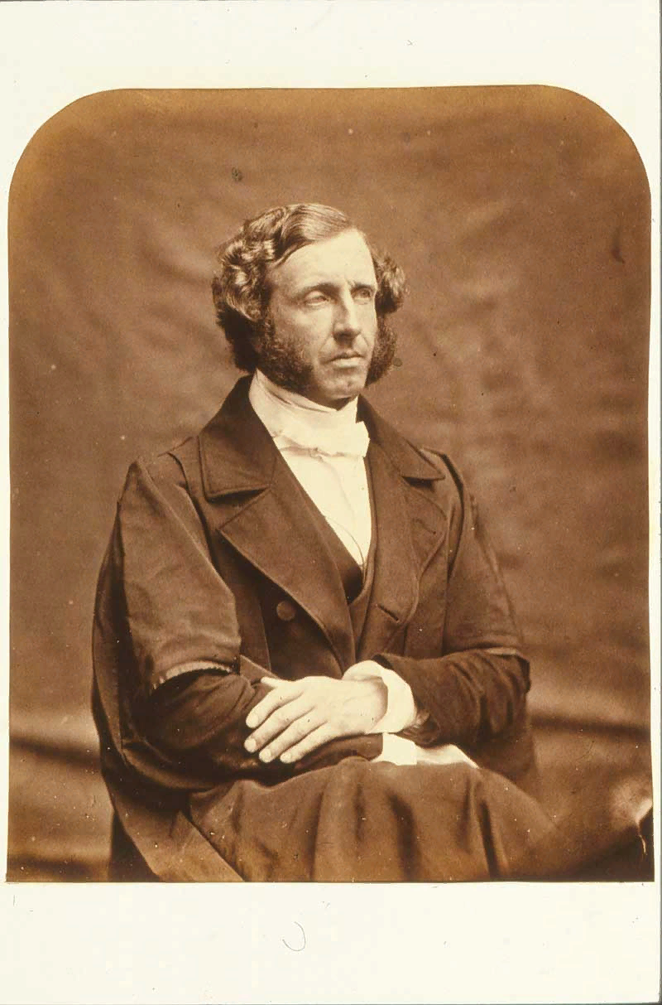
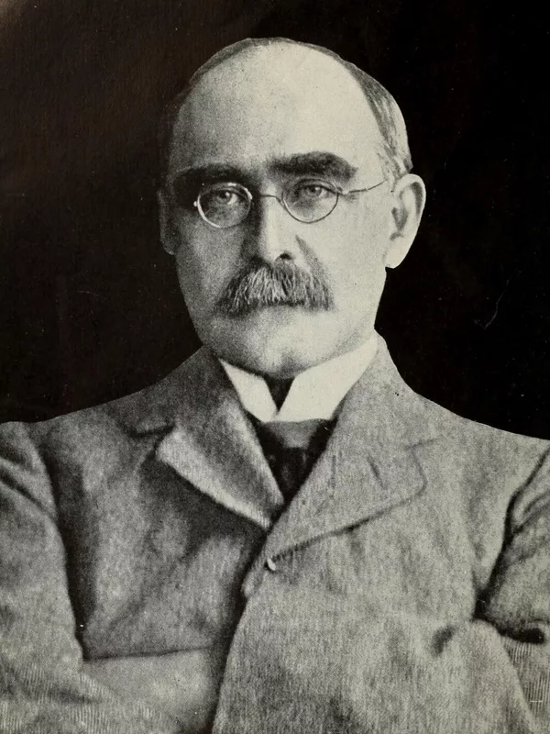
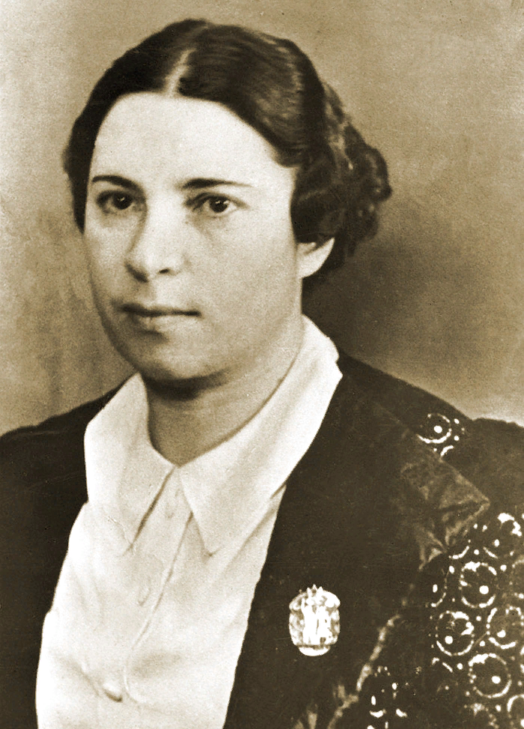
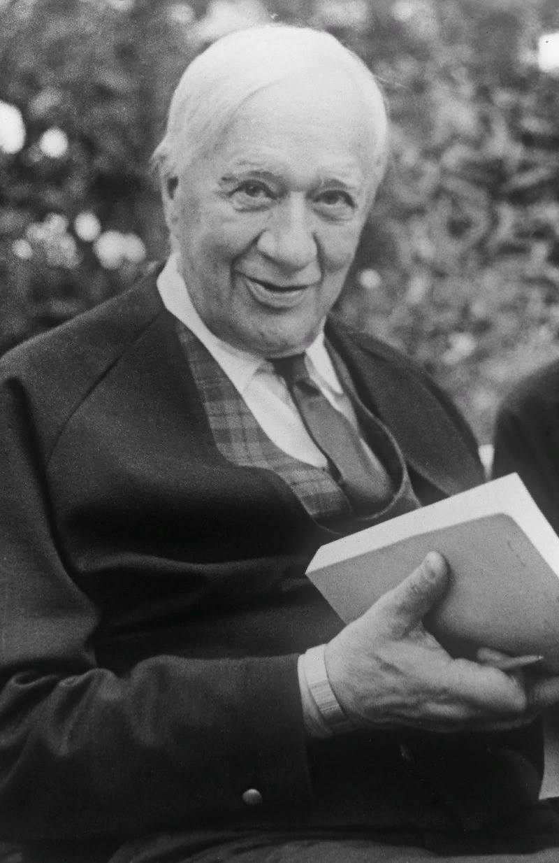
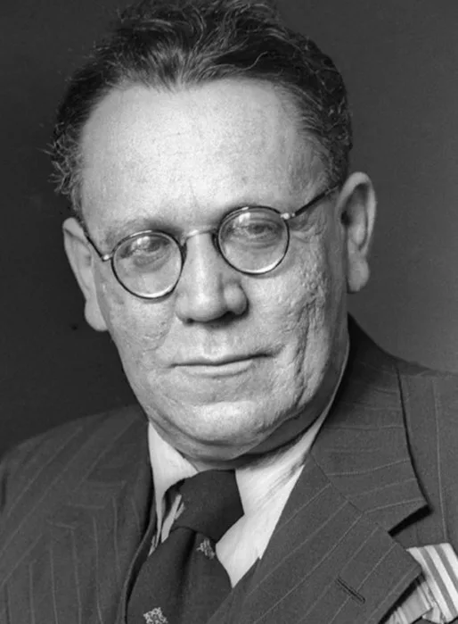
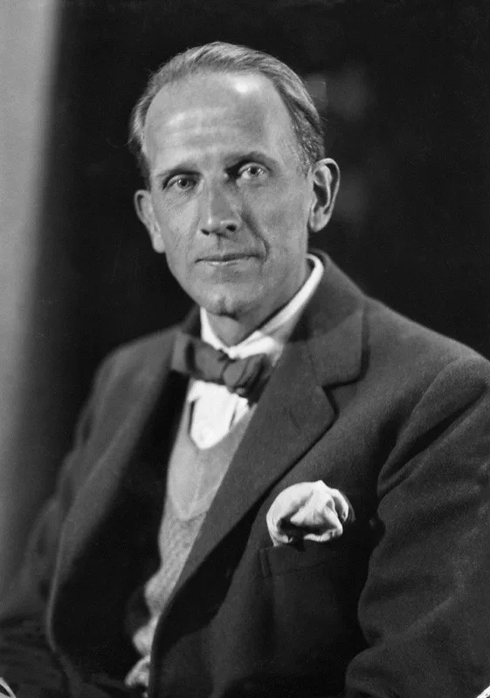
are These famous writers english or Russian
2
4
3
1
5
6

Slide 8
Famous english and russian Writers
1. Lewis Carroll
2. Rudyard Kipling
3. Barto Agniya
4. Chukovskiy Korney
5. Marshak Samuil
6. Alan Milne
1. Льюис Керролл
2. Редьярд Киплинг
3. Агния Барто
4. Чуковский Корней
5. Маршак Самуил
6. Алан Милн

Slide 9

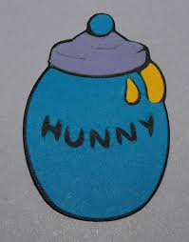
A Bureau of Finds

Slide 10
A Bureau of Finds
Alice
Winnie-the-Pooh

Slide 11

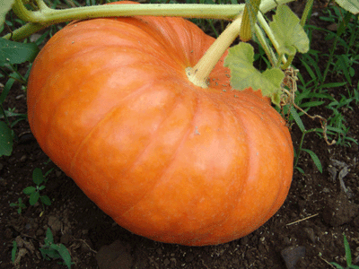

Slide 12
Snow white
Cinderella

Slide 13
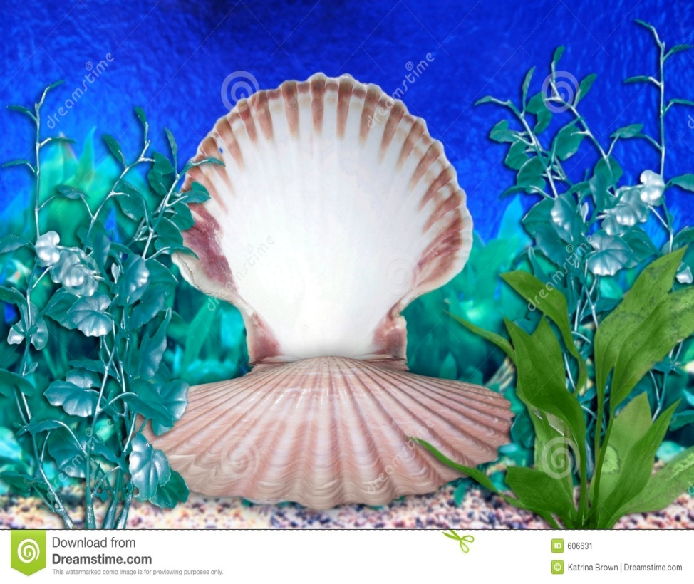
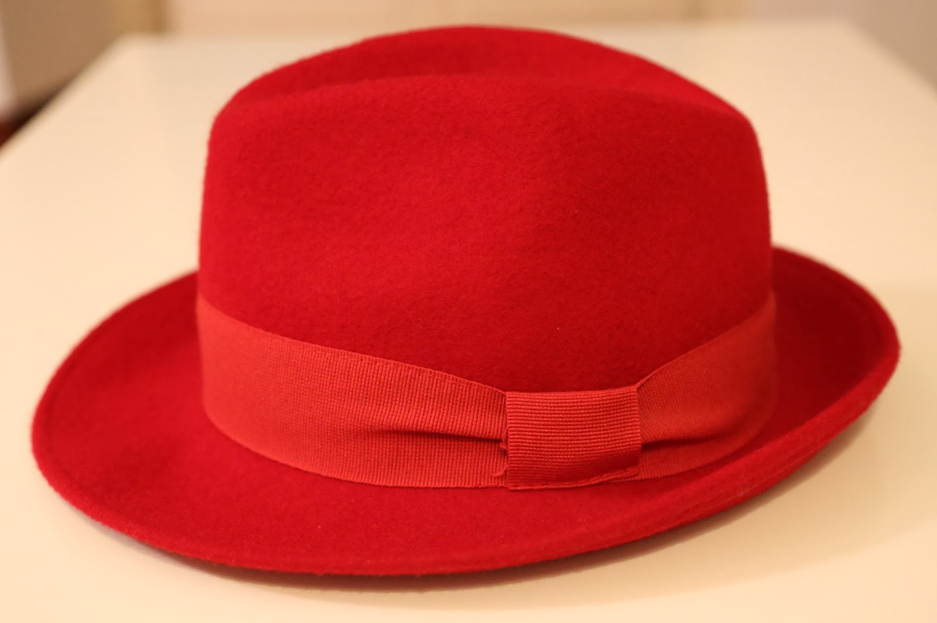
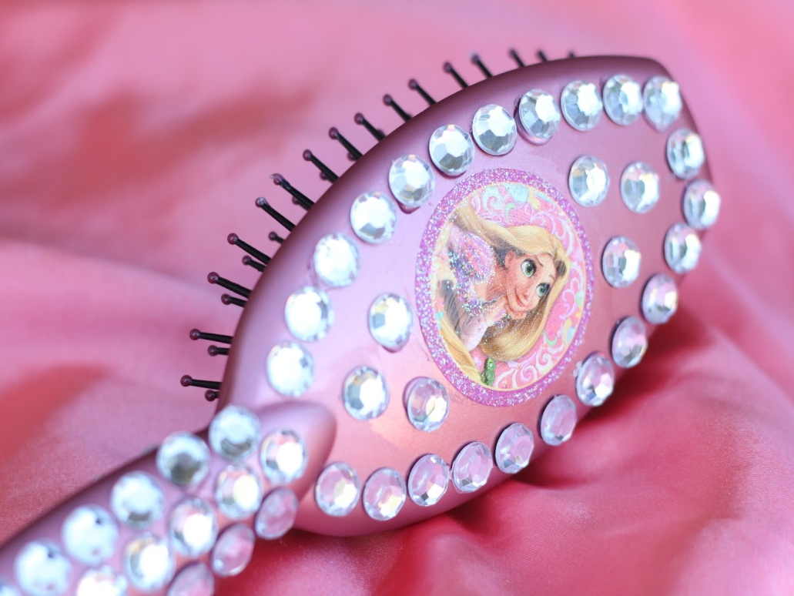

Slide 14
Red Riding Hood
Mermaid
Rapunzel

Slide 15
Guess The Fairy Tale
1st team: "…this time she found a little bottle on it and tied round the neck of the bottle was a paper label with the words "DRINK ME, "beautifully printed on it in large letters. It was all very well to say "Drink me, "but the wise little girl was not going to do that in a hurry;”
2nd team: "He lived in the forest. He climbed and he climbed, and as he climbed he sang a little song to himself: Isn’t a funny How a bear likes honey? Buzz! Buzz! Buzz! I wonder why he does.”
Alice in Wonderland
Winnie-the-Pooh

Slide 16
Guess The Fairy Tale
1st team: "Peter wanted to talk to the fairies, but to his surprise they all ran away and hid when he came near. They shouted "There is a boy in the park.” Peter thought for a moment that he was the boy because he was a bird.”
2nd team: "Remember said the fairy godmother you must leave the ball before the clock strikes twelve because at midnight the magic ends. "Thank you fairy godmother” said the girl and she climbed into the coach”
Peter Pan
Cinderella

Slide 17
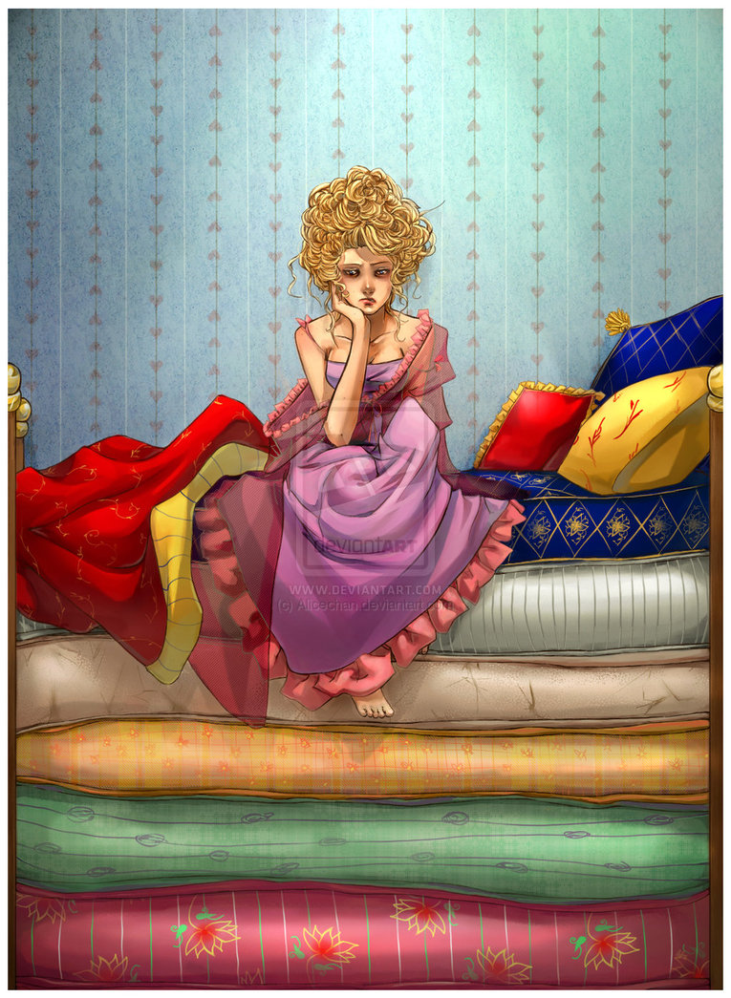
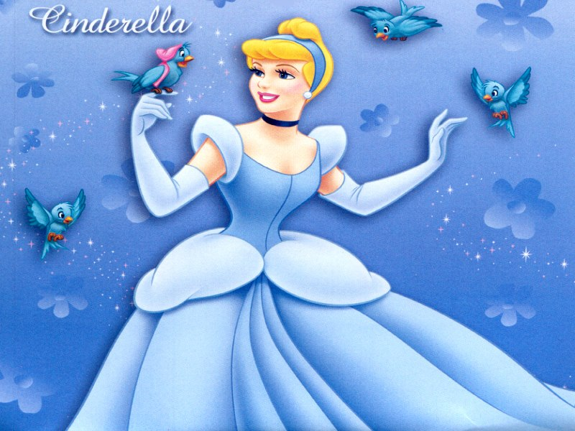
Put the sentences in the correct order
(Восстановите сказку в правильном порядке)
The Princess and the Pea Cinderella

Slide 18
The Princess and the pea
She slept very bad and was very tired. She was very wet and dirty. When the princess wanted to sleep the prince put a pea in her bed. One night, the weather was very bad and cold. Once there was a prince who was looking for a real princess In the end he came home, he was very sad. He found many beautiful princesses but he didn’t like them. Somebody knocked at the door. When the prince opened the door he saw a princess. The prince knew it was a real princess.

Slide 19
The Princess and the pea
Once there was a prince who was looking for a real princess. He found many beautiful princesses but he didn’t like them. In the end he came home, he was very sad. One night, the weather was very bad and cold. Somebody knocked at the door. When the prince opened the door he saw a princess. She was very wet and dirty. When the princess wanted to sleep the prince put a pea in her bed. She slept very bad and was very tired. The prince knew it was a real princess.

Slide 20
Cinderella
The prince and she got married and they lived happily.
The Prince found the shoe and went to every house to find the girl who lost that shoe. She went to the ball and danced with the prince.
He found a beautiful girl who lost that shoe. Once upon a time there lived a young beautiful girl.
The prince was going to have a great ball. The girl was not happy because her stepmother didn't like her. Fairy godmother turned the girl’s ugly dirty dress into a beautiful one, she turned her shoes into glass slippers and a pumpkin into a carriage.
She did all the hard work, washed the dishes, tidied the rooms and cooked.
She ran out at midnight and lost a shoe on the way out.

Slide 21
Cinderella
Once upon a time there lived a young beautiful girl. The girl was not happy because her stepmother didn't like her. She did all the hard work, washed the dishes, tidied the rooms and cooked. The prince was going to have a great ball. Fairy godmother turned the girl’s ugly dirty dress into a beautiful one, she turned her shoes into glass slippers and a pumpkin into a carriage. She went to the ball and danced with the prince. She ran out at midnight and lost a shoe on the way out. The Prince found the shoe and went to every house to find the girl who lost that shoe. He found a beautiful girl who lost that shoe. The prince and she got married and they lived happily.

Slide 22


