Slide 1
Arts and Crafts of the Sakha in Botulu Ethnographical Museum
Nikolayeva Kunney-Kuo,
the 10th form, Botulu Secondary School
Teacher Boeskorova O.P.

Slide 2
The subject of the research: The spiritual and material culture of the people.
The object of the research: Sakha, Russian and English names of the exhibits of Botulu museum.
The aim: Create a practice-oriented project "Arts and Crafts of the Sakha in Botulu Ethnographical Museum“.
The tasks:
1. Learn to project.
2. Systematize the language material.
3. Form the metasubject skills.
4. Develop the socio-cultural and communicative competence.
5. Be interested in native and foreign languages.
6. Preserve historical heritage of the native people.

Slide 3
The actuality: In the context of globalization of the modern world the study and preservation of spiritual and moral, intellectual and material culture of the world should come to the fore.
The novelty and originality: Presentation of the material on the basis of cultural and historical precedents of local museum.
Theoretical value: The study of the linguistic and cultural realities of a specific topic in the field of folk art.
Practical value: Comparing Sakha, Russian, English variants of the words, developing skills to make an excursion in English.
Methods: Analysis, comparison, generalization, classification, design.

Slide 4
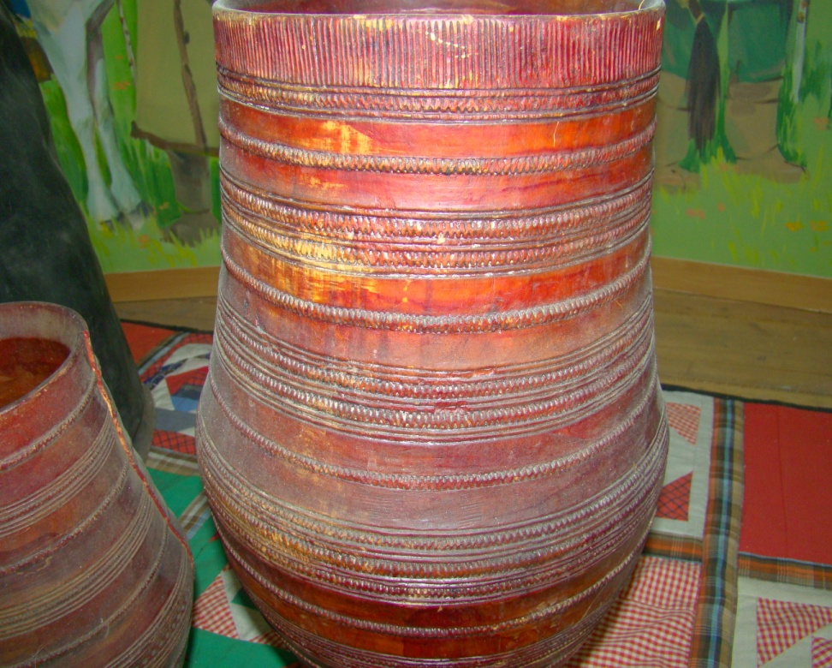
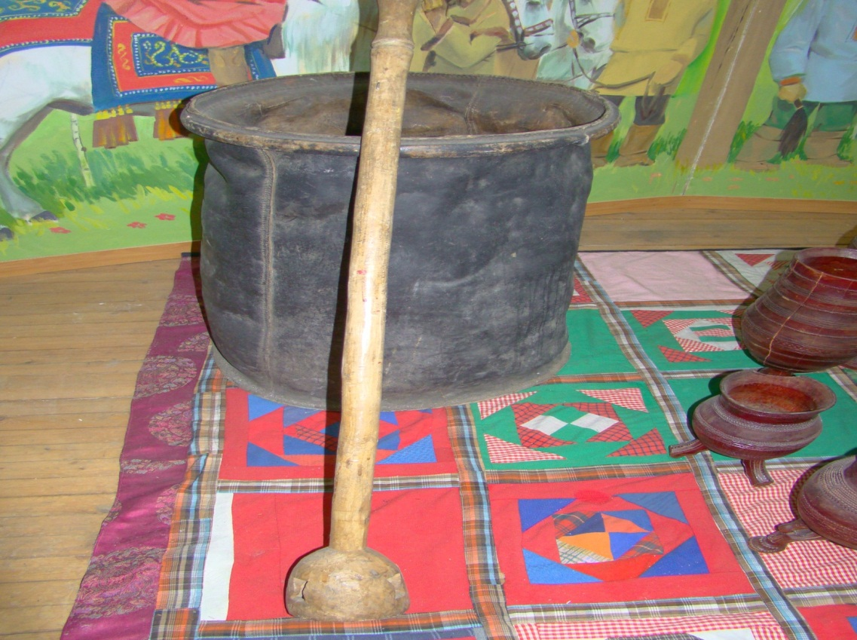
Botulu Museum of Ethnography
Vessel for Kumys
Симиир
Сосуд для кумыса
Kumys Blender
Кымыс ытыйар ытык
Мутовка для взбалтывания кумыса
Choron, drinking vessel
Чороон
Чорон

Slide 5
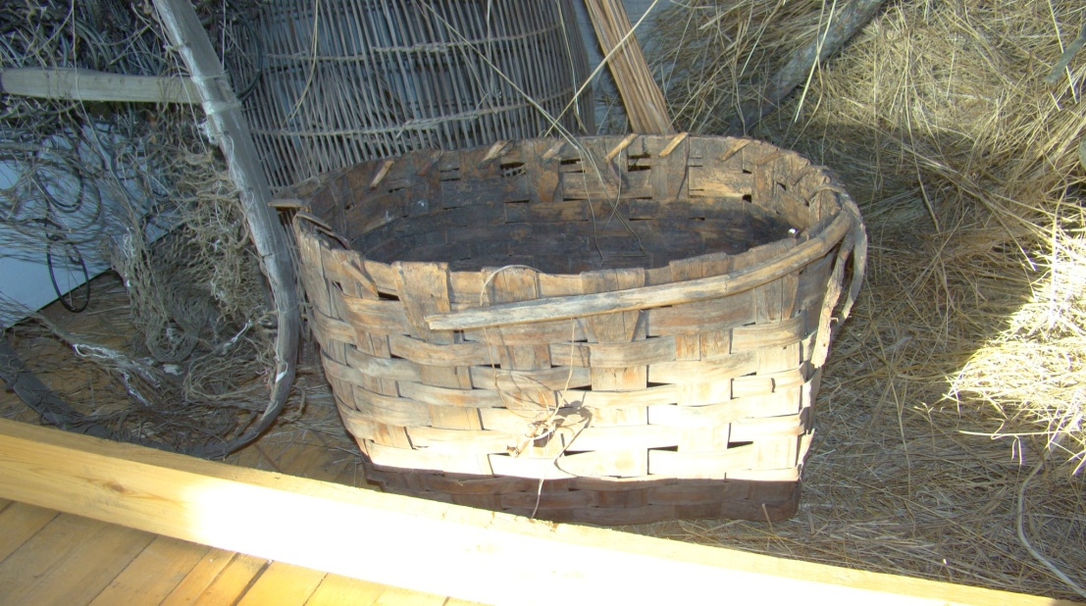
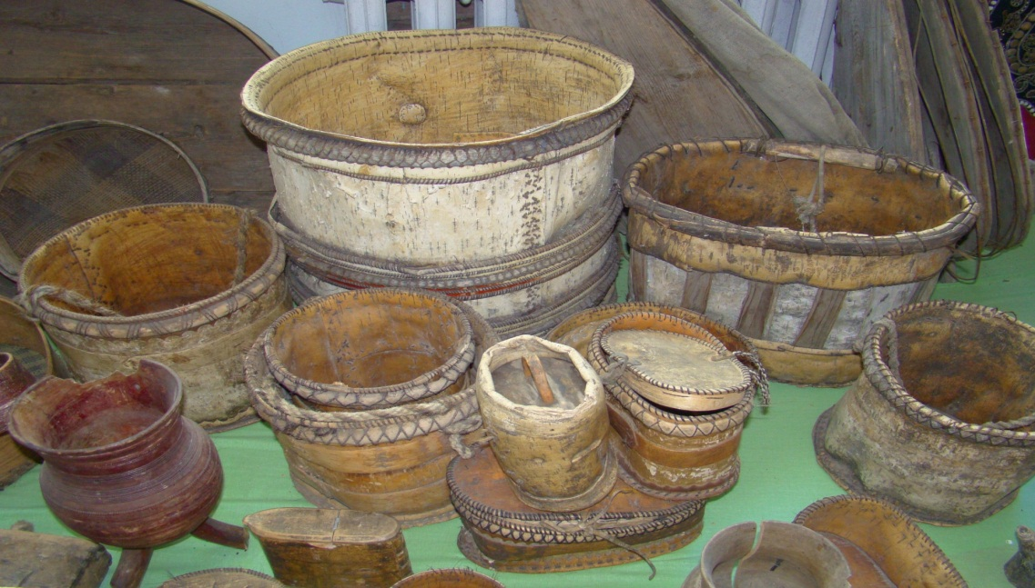
Botulu Museum of Ethnography
Birch bark Bucket
Туос ыаҕас
Берестяное ведро
Birch bark Bowl
Чабычах
Посуда для молочных продуктов
Dish for Fish
Тымтай
Корзина

Slide 6
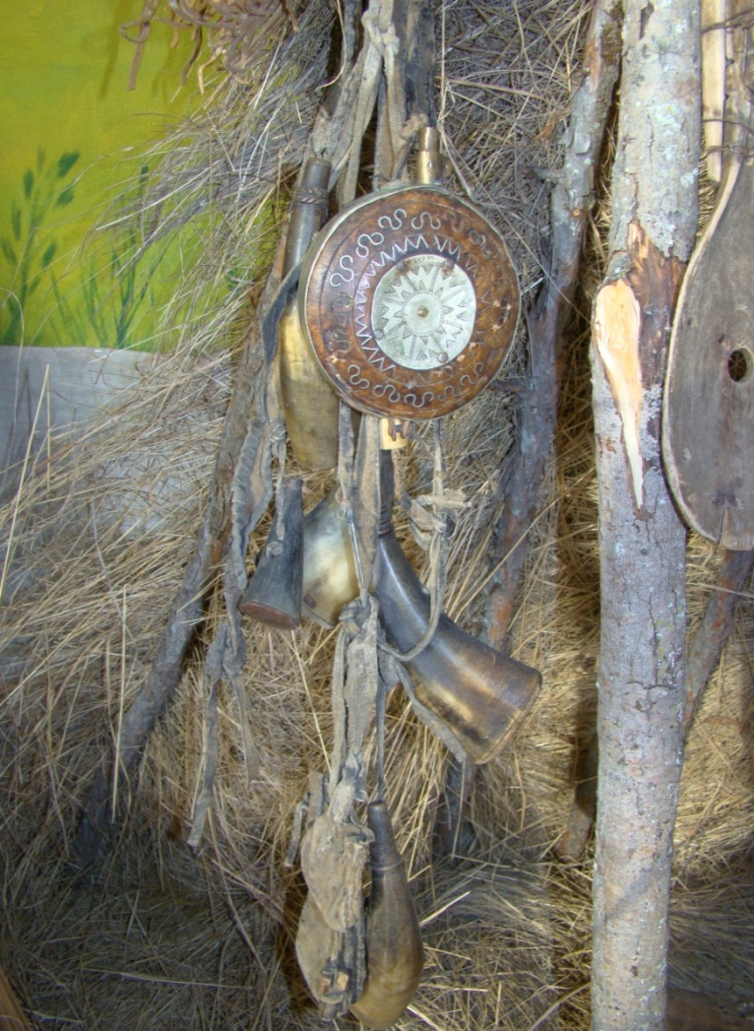
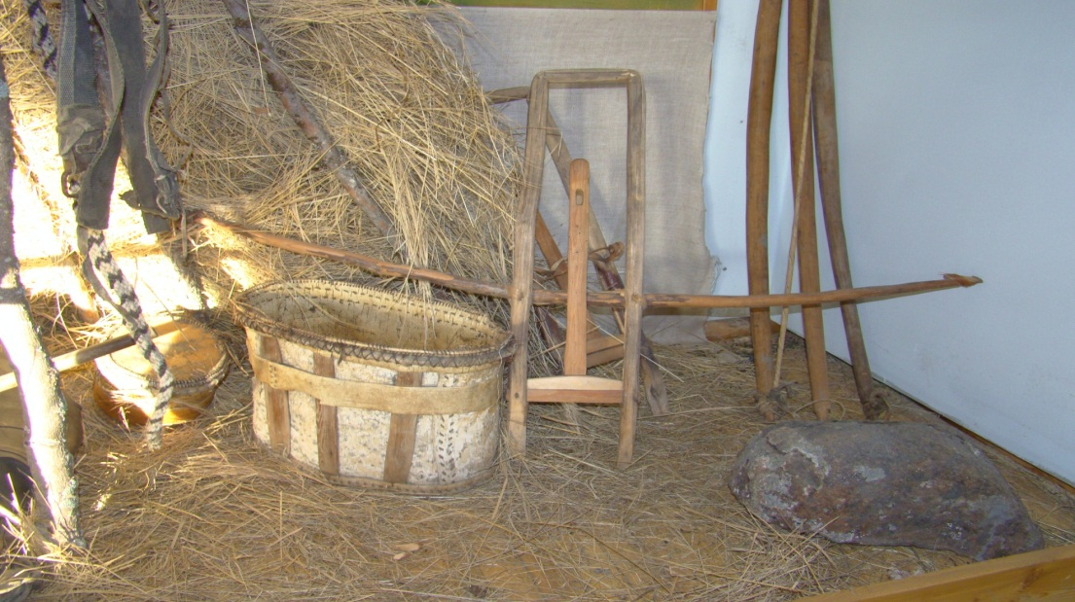
Botulu Museum of Ethnography
Powder Flask and Measurement
Буорах кутар иhит, кээмэй муос
Пороховница, мерка
Hunting Spear
Айа
Самострел

Slide 7
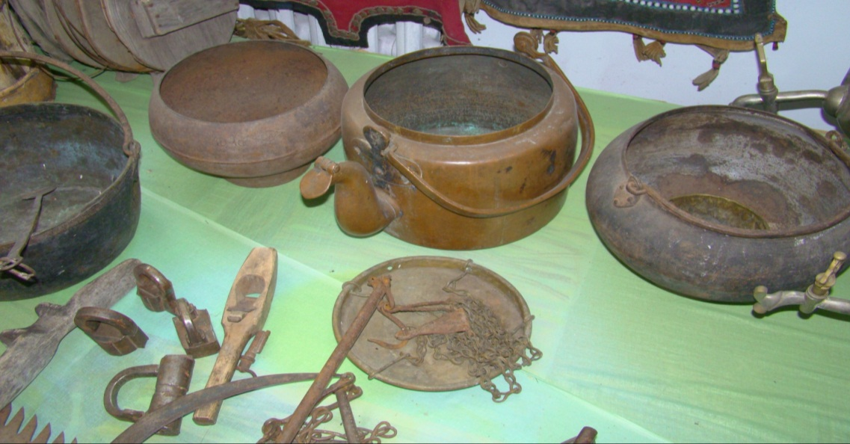
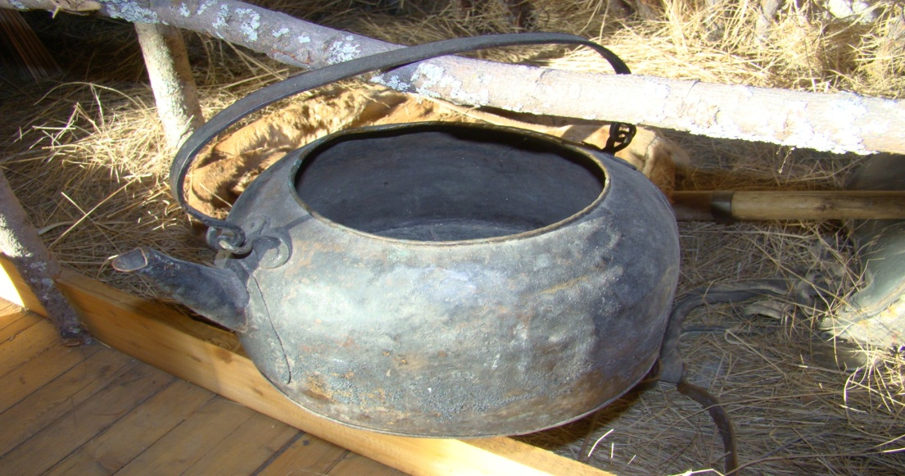
Botulu Museum of Ethnography
Utensils
Дьиэ тээбиринэ
Домашняя утварь
Copper Teapot
Алтан чаанньык
Медный чайник
Dishes
Иһит-хомуос
Посуда
Lock
Күлүүс
Замок
Balance skales
Ыйааһын
Весы

Slide 8
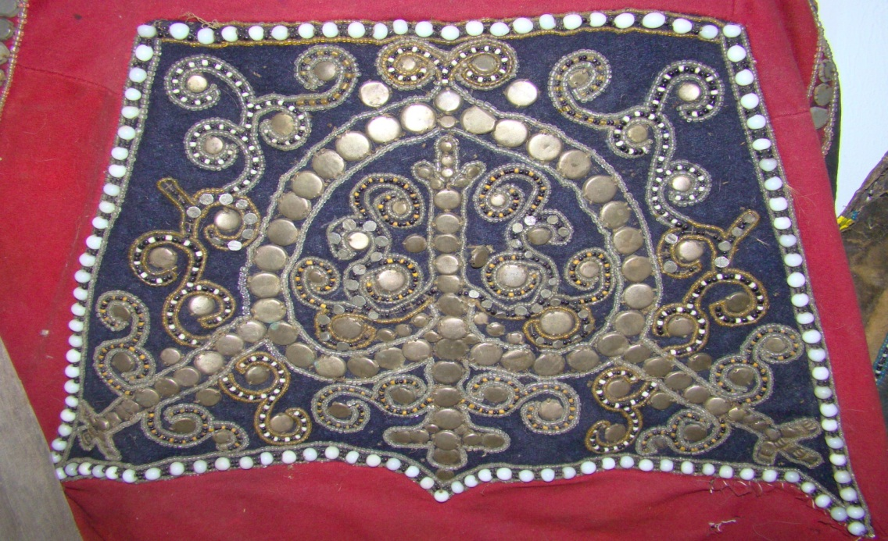
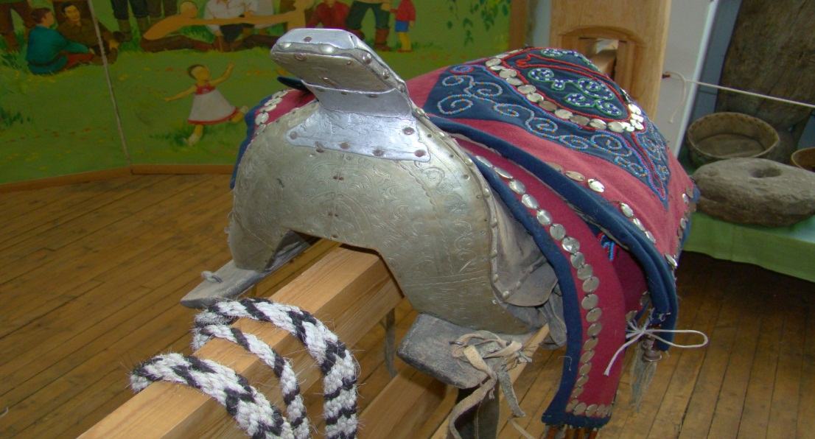
Botulu Museum of Ethnography
Horse Back Cover
Чаппараах
Чепрак
Yakut Horse Saddlery
Ат тэрилэ
Конское убранство
Lyrated Ornament
Көҕүөр ойуу
Мотив лиры

Slide 9
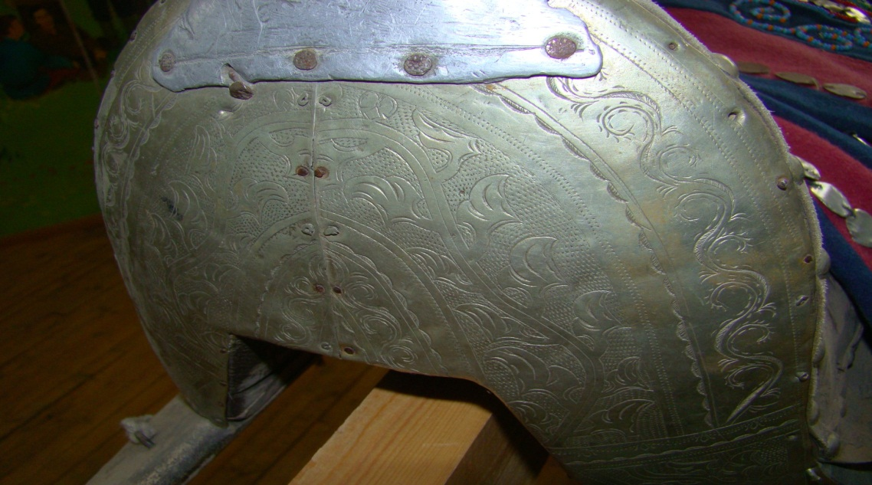
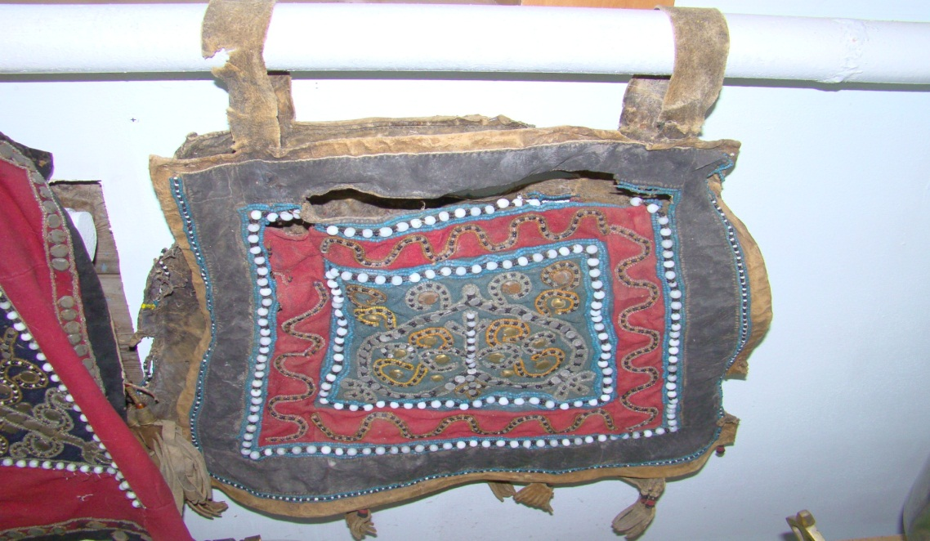
Botulu Museum of Ethnography
Man’s Saddle
Эр киhи ыҥыыра
Седло мужское
Saddle Bag Cover
Бэрэмэдэй сабыыта
Узорная покрышка переметной сумы
Woman’s Saddle
Дьахтар ыҥыыра
Седло женское

Slide 10
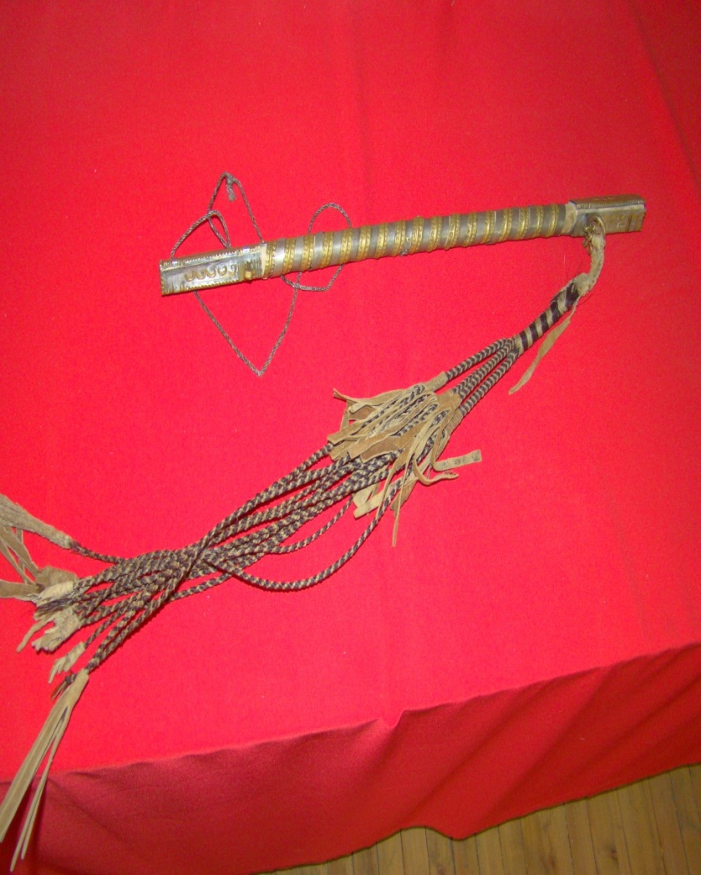
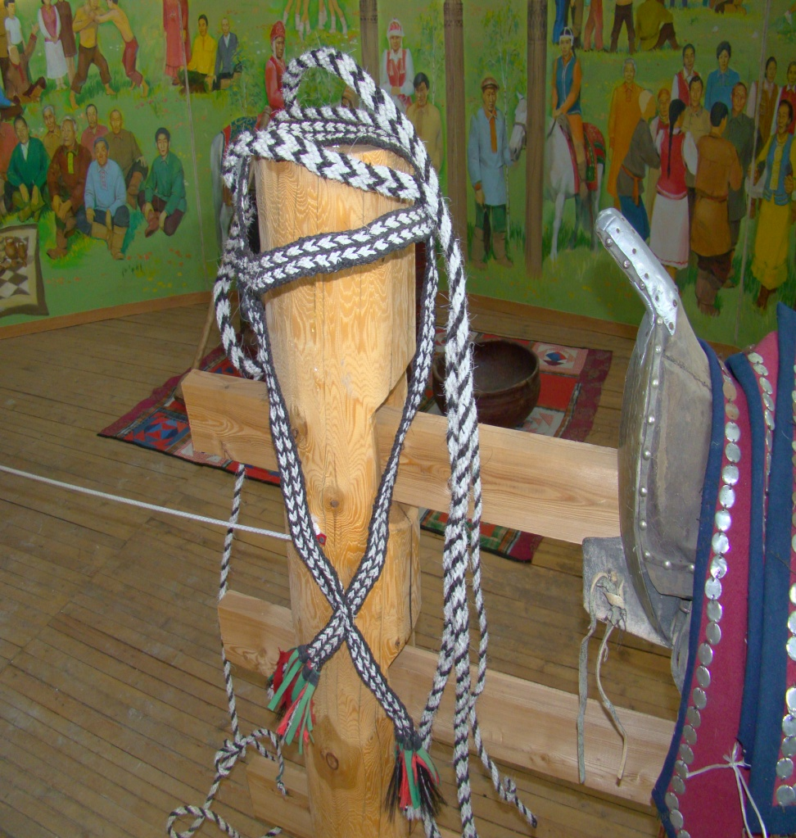
Botulu Museum of Ethnography
Thong
Кымньыы
Плеть
Horse Bridle
Ат сулара
Узда

Slide 11
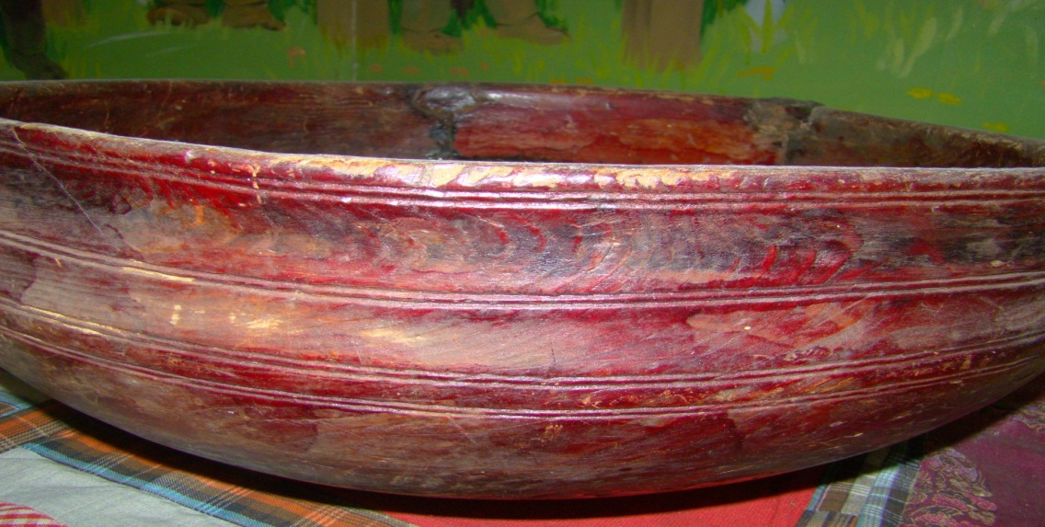
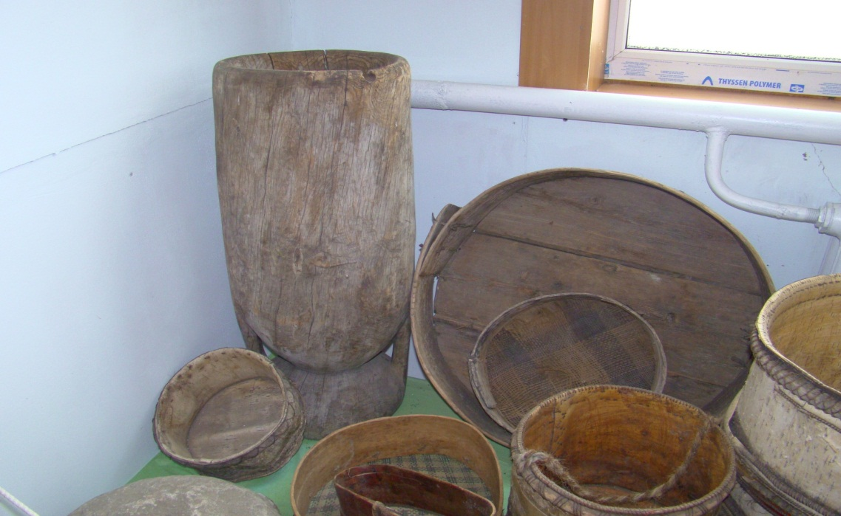
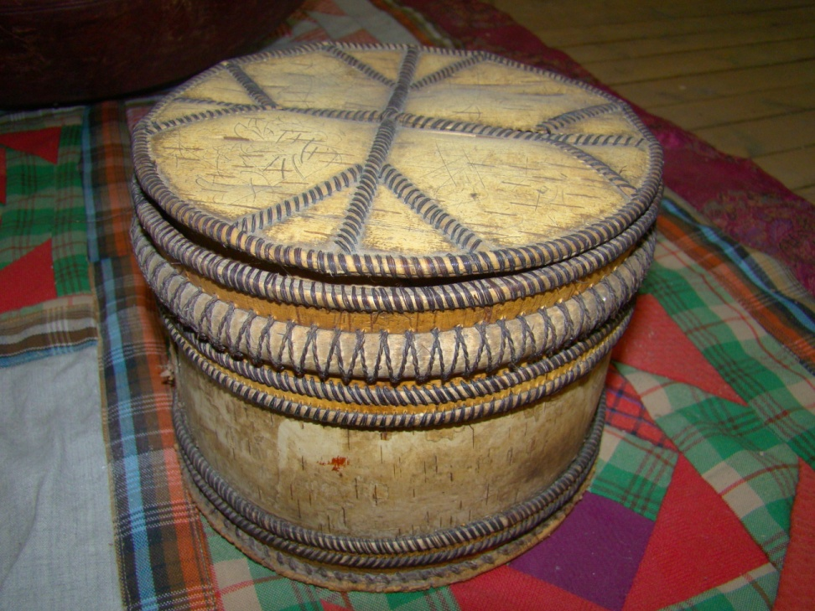
Botulu Museum of Ethnography
Mortar
Кэлии
Ступа
Bolter
Сиитэ
Сито
Wooden Bowl
Мас кытах
Большая чаша
Etui
Маллаах иhит
Короб для принадлежностей рукоделия
Grain
Бүтүн бурдук
Зерно
Wholemeal flour
Мэкиинэлээх бурдук
Непросеянная мука

Slide 12
Conclusion:
Folk art of every nation is unique and style is formed through centuries.
Ordinary and simple things were of great importance and served to a man to survive.
Our ancestors not only simply survived but they found necessary to create beauty around.
Craftsmen accurately gained the link between functional, ornamental and graphic parts of the object.
National arts and crafts demonstrate traditional picture of the world of Sakha.
Result:
Creating and presentation of a practice-oriented project "Arts and Crafts of the Sakha in Botulu Ethnographical Museum“.
Comparison and enrichment of Sakha, Russian, English vocabulary in ethnography.
Possibility to make an excursion in English language.

