Slide 1
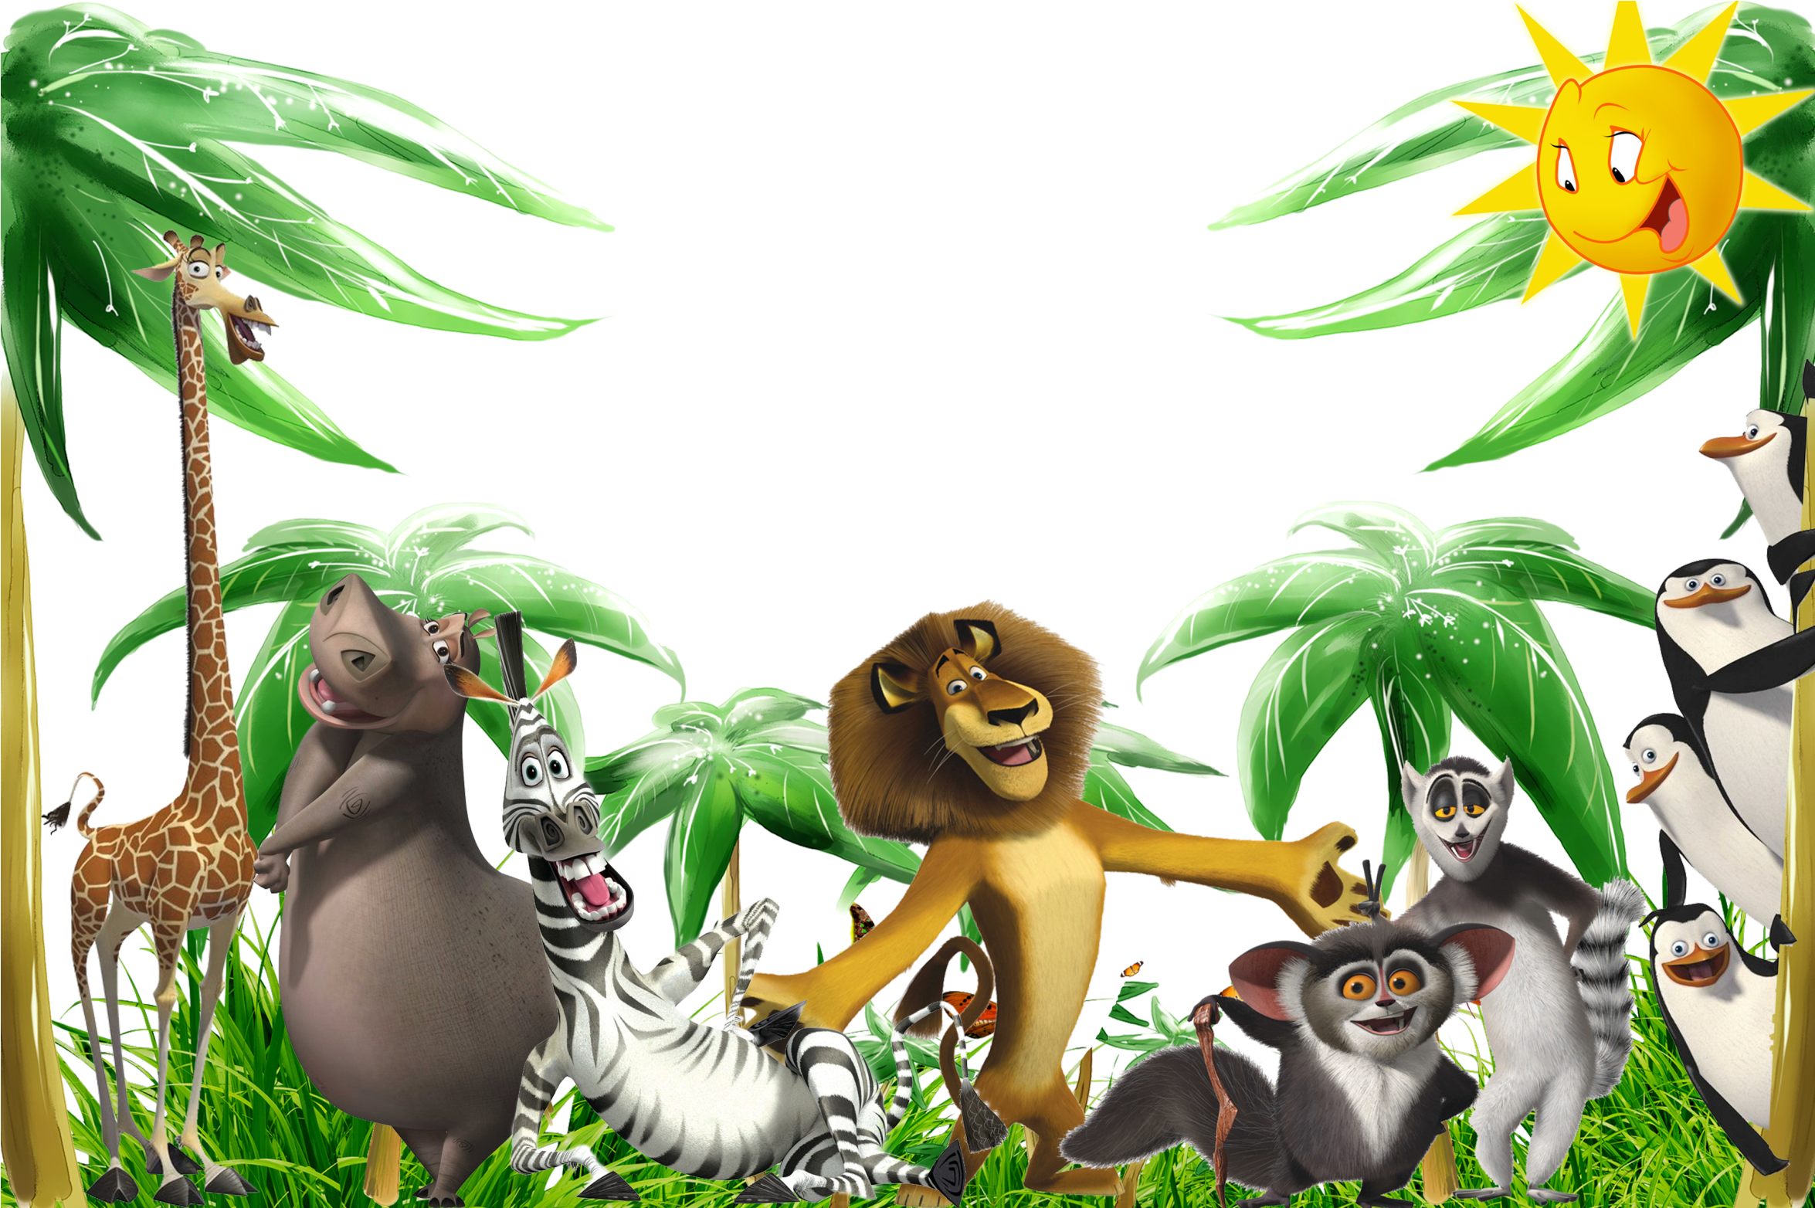
ГБОУ Гимназия 1507 ОШО № 930
Открытый урок
Amazing creatures
Учитель английского языка: Адамова Лейла Абдулгамидовна

Slide 2
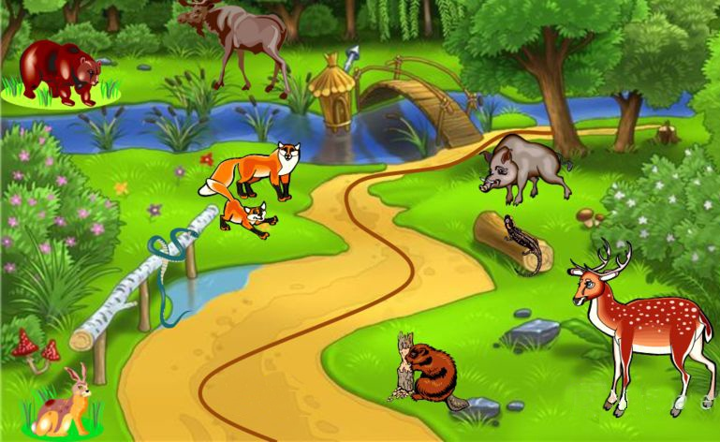


9.Cinquains
Finish
8. Describe the animal
7.Grammar
6.Rules
5.Riddles
4. Animal
species
3. Crossword
puzzle
2.Quiz
1. Name the animals
Start

Slide 3
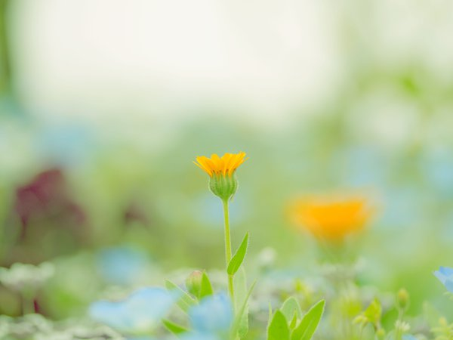

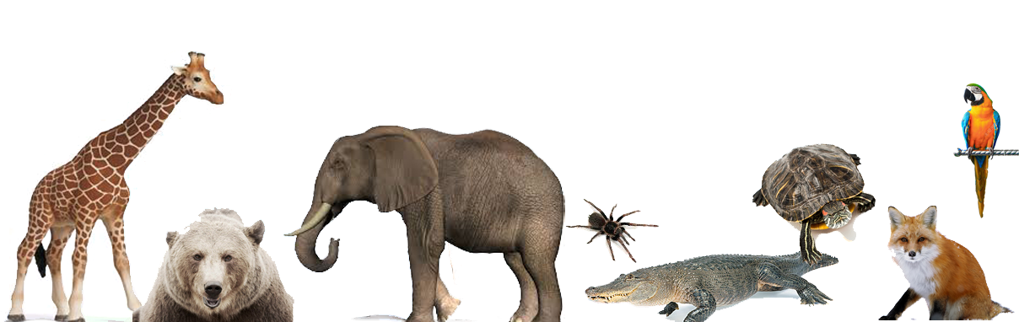
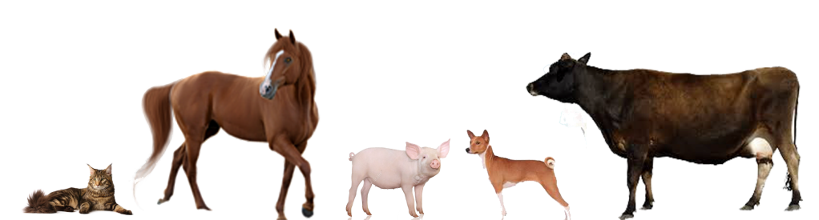
Station 1.
Look. Read. Remember.
Hippo|ˈhɪpəʊ| - бегемот
Snake (sneɪk) - змея
Lizard [ˈlɪzəd] - ящерица
Mosquito[məsˈkiːtəʊ] -москит, комар
Wasp [wɔsp] – оса
Neck (nek)- шея
Paw (pɔ:)- лапа
Ear (ɪə) - ухо
Fur (fɜ:) - мех, шерсть, шкура
Beak (bi:k) - клюв
Feather (ˊfeðə) - птичье перо
Horn (hɔ:n) - рог
Claw (klɔ:) -коготь
Hummingbird (ˊhʌmɪŋbɜ:d) - колибри
Giraffe [ʤɪˈrɑːf] - жираф
Rhino - |ˈrʌɪnəʊ|- носорог
Seal (si:l)- тюлень
Butterfly [ˈbʌtəflaɪ] - бабочка
Dragonfly [ˈdræɡənflaɪ] - стрекоза
Bat (bæt) - летучая мышь
Fly [flaɪ] – муха
Beetle [ˈbi:tl] – жук
Grasshopper [ˈɡrɑ:sˌhɔpə]-кузнечик
Ant [ænt] – муравей
Ladybird [ˈleɪdɪbз:d]-божья коровка
Koala (kəυˊɑ:lə) -коала
Tail (teɪl)- хвост
Mane (meɪn) – грива
Trunk (trʌŋk) хобот
Goose[guːs]- гусь
Tortoise[ˈtɔːtəs] - черепаха
Sheep[ʃiːp] - овца
Peacock [ˈpiːkɔk] - павлин
Bear - [bɛə] - медведь
Goat [gəʊt] - коза, козел
Leopard[ˈlepəd] - леопард
Cheetah[ˈʧiːtə] - гепард
Whale[weɪl] - кит
Budgie [ˈbʌʤɪ] -волнистый попугай
Guinea pig [ˈgɪnɪpɪg] -морская свинка

Slide 4

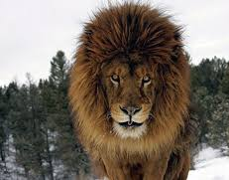
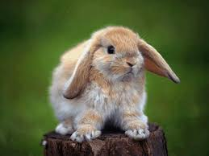
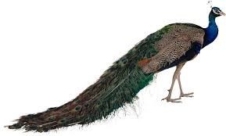
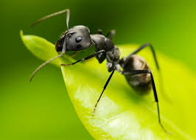
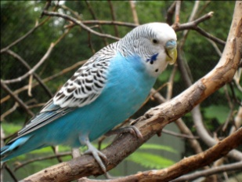
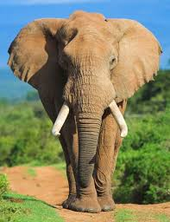
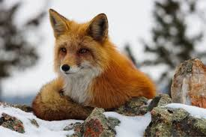
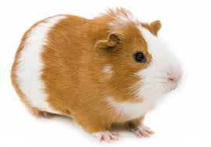
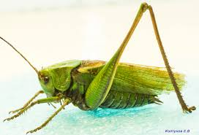
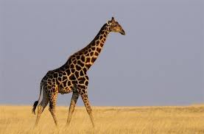
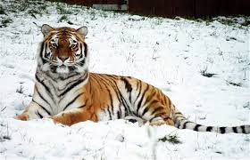
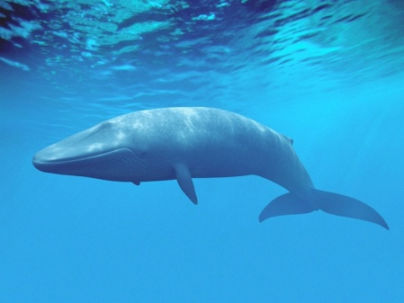
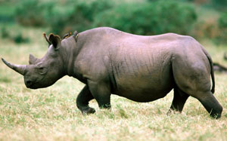
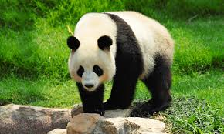
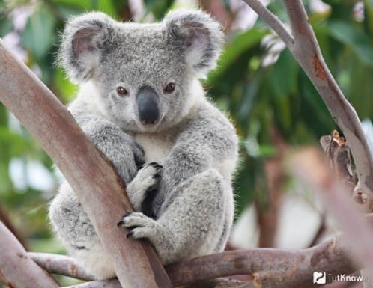
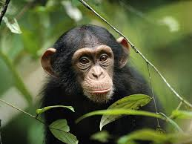
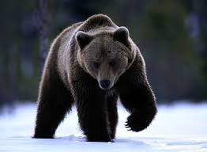
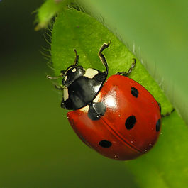
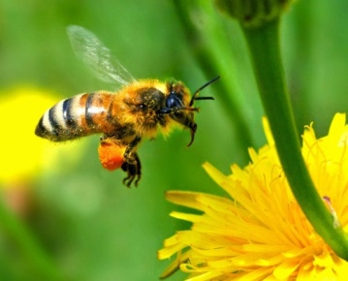
Name the animals
1
5
2
3
4
9
7
8
10
6
12
13
14
11
18
15
16
19
17

Slide 5
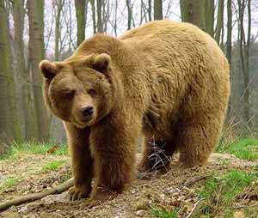
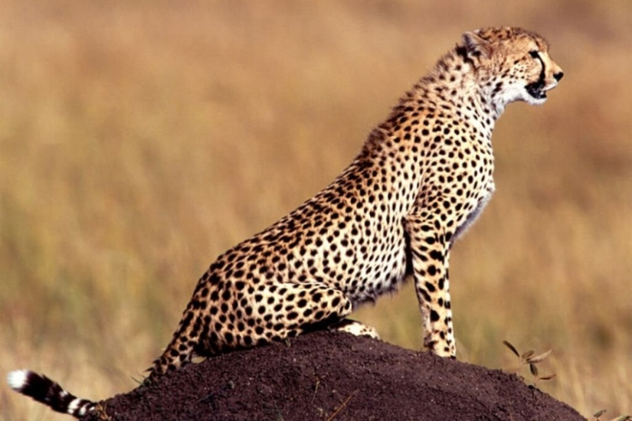
Station 2
Quiz
Which animal is the
fastest ?

Slide 6
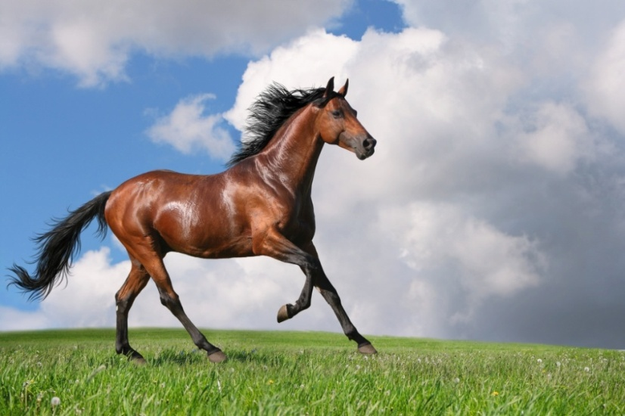
2) Which animal has got the longest neck?

Slide 7
3) Which animal is the biggest?

Slide 8
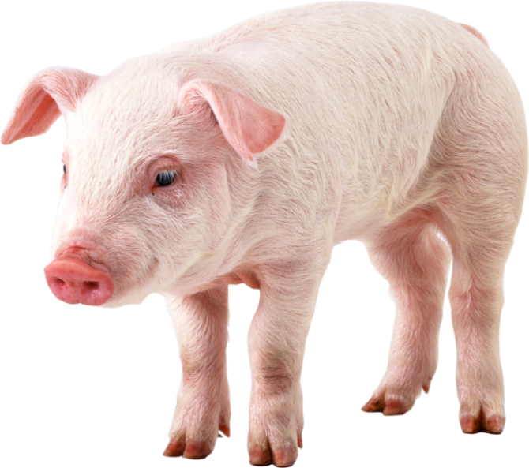
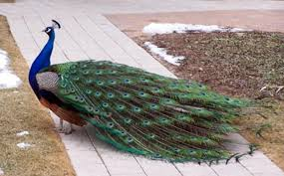
4) Which animal is the most beautiful?

Slide 9
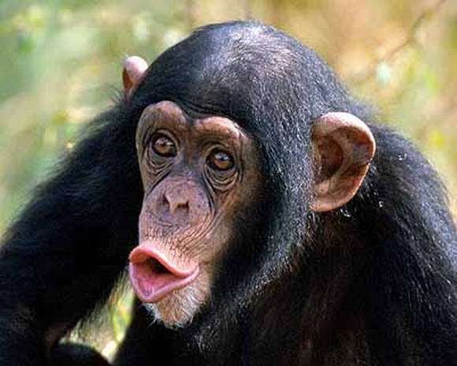
5) Which animal is the funniest?

Slide 10
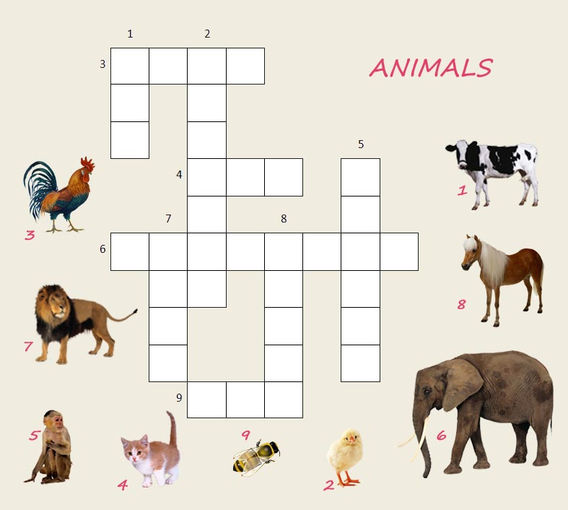
Station 3
Crossword puzzle

Slide 11
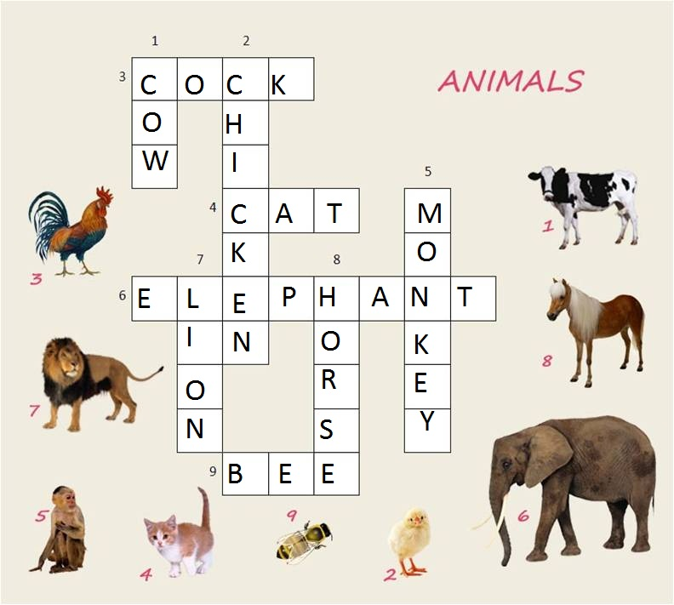
Keys

Slide 12
Station 4
Animal species
Divide these words into 5 groups
lizard fly paw tortoise horse budgie hummingbird bat penguin cheetah cow lion butterfly panda mane monkey goat horn beetle beak trunk whale ear wasp snake rhino cobra ladybird leopard frog cock ant wing peacock mosquito
Mammals | Birds | Reptiles | Insects | Parts of the body
? | ? | ? | ? | ?

Slide 13
Check your answer
Mammals | Birds | Reptiles | Insects | Parts of the body
bat whale leopard monkey cheetah goat cow horse lion rhino panda | cock budgie peacock hummingbird penguin | lizard snake tortoise cobra frog | fly wasp ant beetle butterfly ladybird mosquito | mane ear paw horn wing beak trunk

Slide 14

I am yellow and brown.
I have 4 long legs and a very long neck.
I like to eat green leaves.
I am a … G
As red as fire,
With a fuzzy(пушистый) tail.
It likes long walks.
It is a … F
Station 5
Riddles
1
I live in the woods.
I’m very big and furry.
I have a big nose, a little tail and four legs.
I like to eat fish and berries(ягоды).
I am a…B
4
I live in lakes and rivers.
I eat fish and birds.
I have four legs and a long tail.
I have lots of pretty teeth.
I am a... C
I’m very, very big.
I like to eat peanuts (арахис) and hay (сено).
I have four legs and two big ears.
My long nose is called a trunk.
I am an… E
2
3
I am small and shy.
I have eight legs.
I eat bugs.
I catch them in my web.
I am a… S
I have four legs and a tail.
I have no teeth.
I can swim and dive underwater.
I carry my house around with me.
I am a… T
7
5
I have a tail.
I can fly.
I'm covered in colorful feathers.
I can whistle and I can talk.
I am a... P
6
8

Slide 15
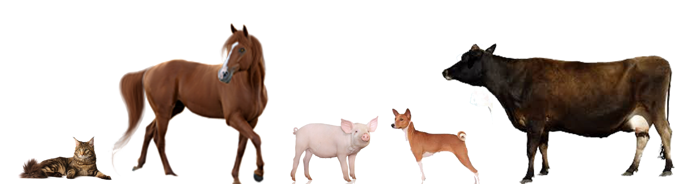
I live on a farm.
I am pink.
I have a little tail.
My nose is called a snout.
And I say “Oink, oink”.
I am a ….P
I am a big
farm animal.
I can be black, white
or brown.
I like to eat green grass.
I give milk.
I can say “Moo, moo”.
I am a….C
I have 4 legs and a long tail.
I like to run fast.
I let you ride
on my back.
I eat hay (сено).
And say “Neigh, neigh”.
I am a ….H
3
1
I have 4 legs and a tail.
I am very smart.
I like to play with you.
When I see a cat,
I say “Woof, woof”
I am a ….D
I am a pet.
I am soft and furry.
I like to sleep and drink milk.
I don’t like mice and dogs.
I say “Meow, meow”.
I am a ….C
2
4
5

Slide 16

Station 6
Rules
Put the words into plural form
Singular | Plural
A sheep
A rhino
A mouse
An ox
A bee
A fish
A butterfly

Slide 17
Keys
Singular | Plural
A sheep | sheep
A rhino | rhinos
A mouse | mice
An ox | oxen
A bee | bees
A fish | fish
A butterfly | butterflies

Slide 18

Choose the correct item
Station 7
Grammar
1) Dolphins … in the sea.
a)live b)lives
2) The Bengal tiger … in India.
a)live b) lives
3) Elephant … heavy things on its back.
a)carry b)carries
4)Penguins … .
a) don’t fly b) doesn’t fly
5) Crocodiles … fast.
a) moves b)move
6)My budgie … some words.
a) speaks b)speak

Slide 19
Make up the sentences as many as you can
Horse
Parrot |  | swim
Leopard |  | run
Koala | can | fly
Whale | can’t | speak
Seal |  | dive
Ladybird |  | climb
Penguin
Example:
A horse can run, but it can’t climb.

Slide 20
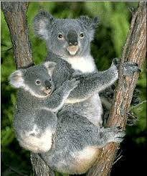

]
Koalas – furry friends
Pre-reading exercise
marsupial [mɑːˈsjuːpjəl] сумчатый
liquid [ˈlɪkwɪd] жидкость
eucalyptus [juːkəˈlɪptəs] эвкалипт
cute [kjuːt] привлекательный, милый
b) Reading
Read the text about koalas and underline the correct word.
Then listen and check your answers.
They are cute, they are soft, but they are wild and they don't /doesn’t make good pets. You may think they are bears, but they aren't. Koalas are Australia's most popular marsupial [mɑːˈsjuːpjəl] mammals/ reptile. They have /has got big round ears and a black nose. They have got sharp claws/paws for climbing. They have got grey/black fur. They have got short, strong arms and legs. They eat eucalyptus [juːkəˈlɪptəs] leaves. They live in trees.
Do you know that koala means “no water”? They never drink/drinks, but they get all the liquid from eucalyptus leaves. They swim very well. They sleep during the day.

Slide 21
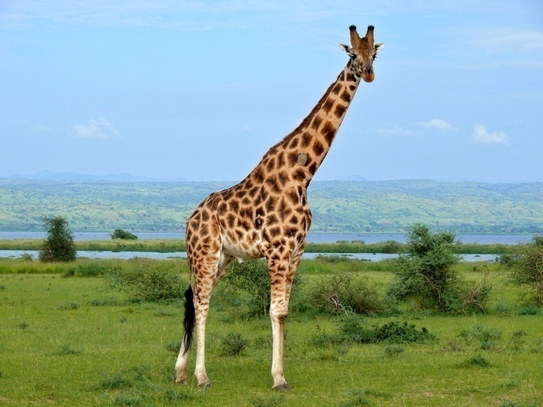
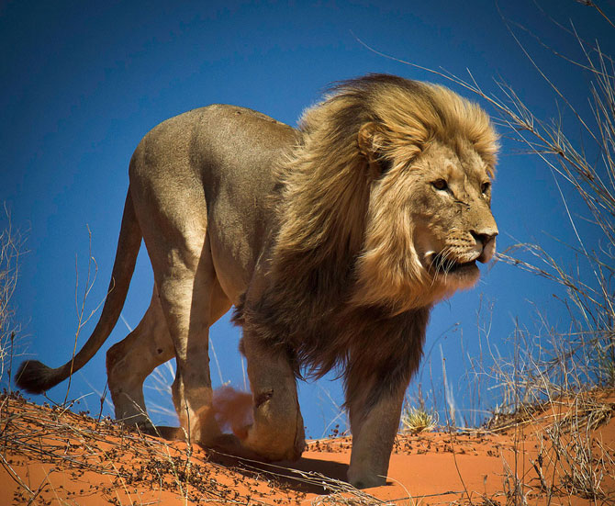
Station 8
Describe the animal

Slide 22
Station 9
Cinquains
Правила написания синквейна:
1. Первая строка - одним словом обозначается тема (имя существительное).
2. Вторая строка - описание темы двумя словами (имена прилагательные).
3. Третья строка - описание действия в рамках этой темы тремя словами (глаголы, причастия).
4. Четвертая строка - фраза из четырех слов, выражающая отношение к теме (разные части речи).
5. Пятая строка - это синоним из одного слова, который повторяет суть темы.
Make up as many cinquains as you can
For example:
Pets
Kind, funny
Run, jump, play
They live with people
Our friends.

Slide 23

Thank you for your attention and
circle one of the things:
1.Моя работа на уроке:
1. 2. 3. 4. 5.
2.Всё ли я понял на уроке:
1. 2. 3. 4. 5.
3.Урок был интересным:
1. 2. 3. 4. 5.

Slide 24
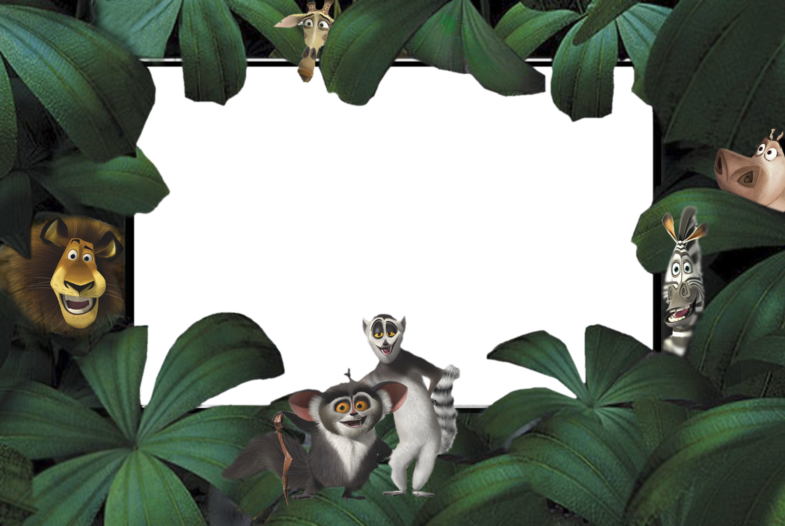
The lesson is over. Good-bye!

