Slide 1
ИНТЕГРИРОВАННЫЙ УРОК В 7 КЛАССЕ ПО ПСИХОЛОГИИ И АНГЛИЙСКОМУ ЯЗЫКУ
Педагог – психолог – Пронькина Татьяна Артуровна
Учитель английского языка – Попова Елена Анатольевна
МБОУ гимназия №1 города Белово Кемеровской области

Slide 2
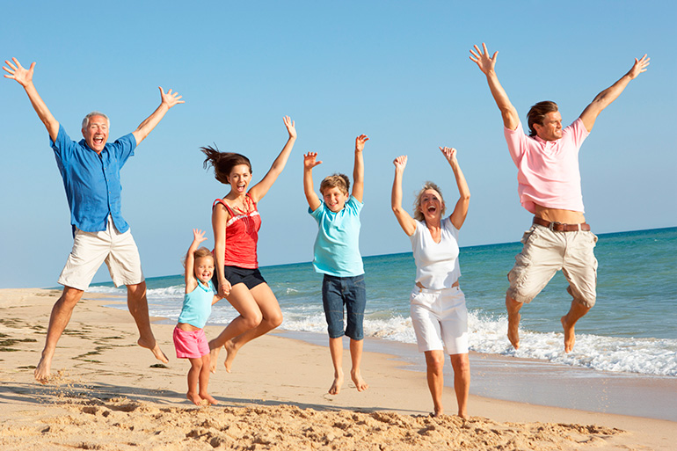
Plain, gold, animal, computer, building, health, books, weather, hobby, country

Slide 3
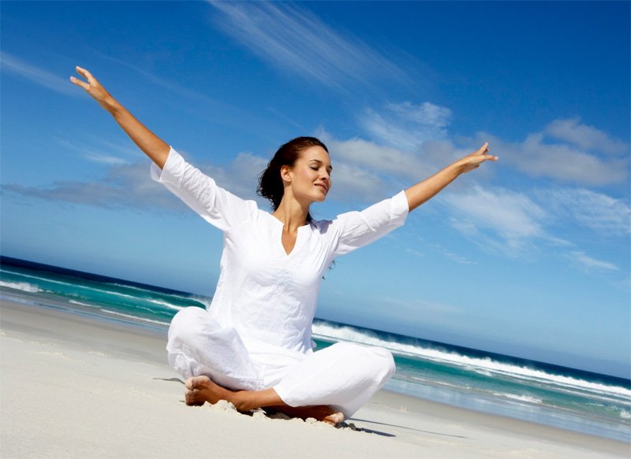
Health is the greatest wealth

Slide 4
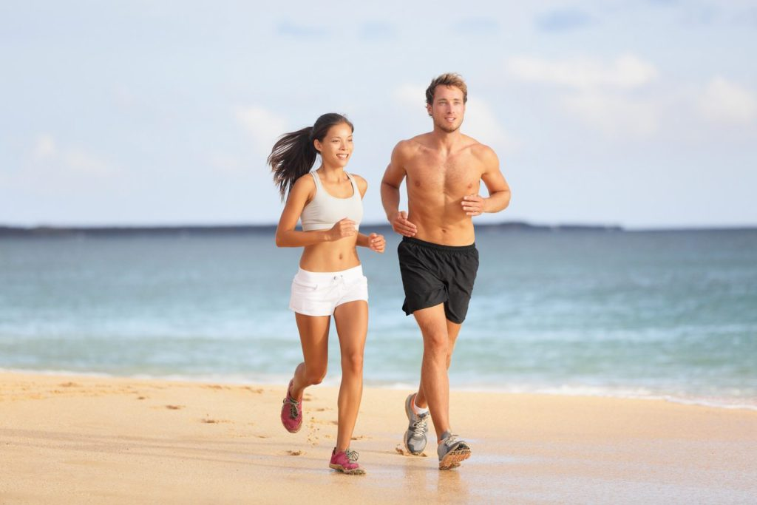
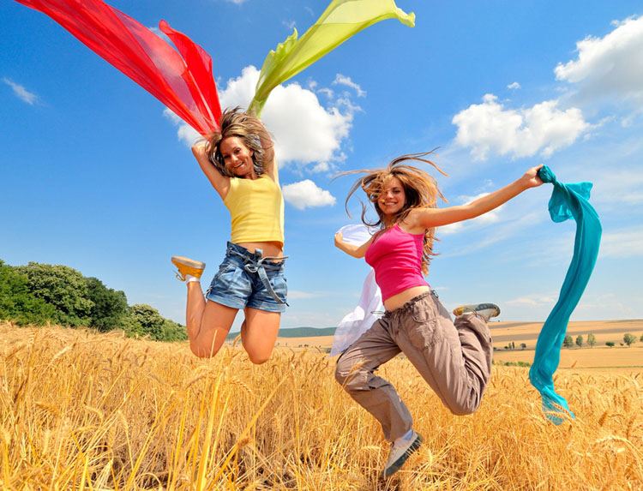
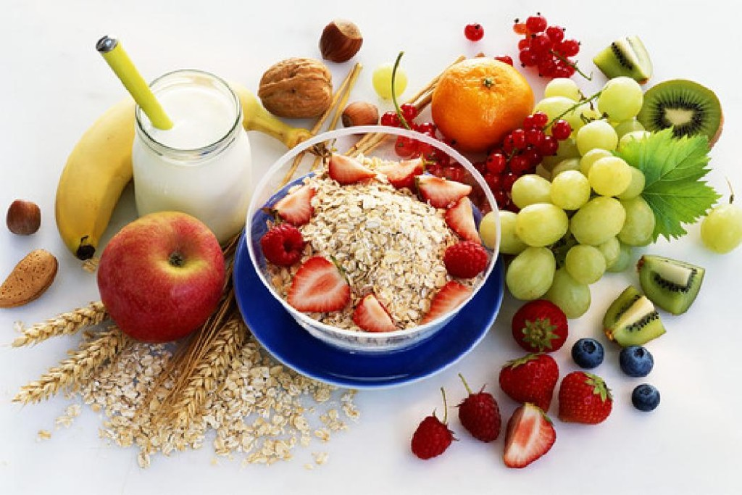
Three whales of health

Slide 5
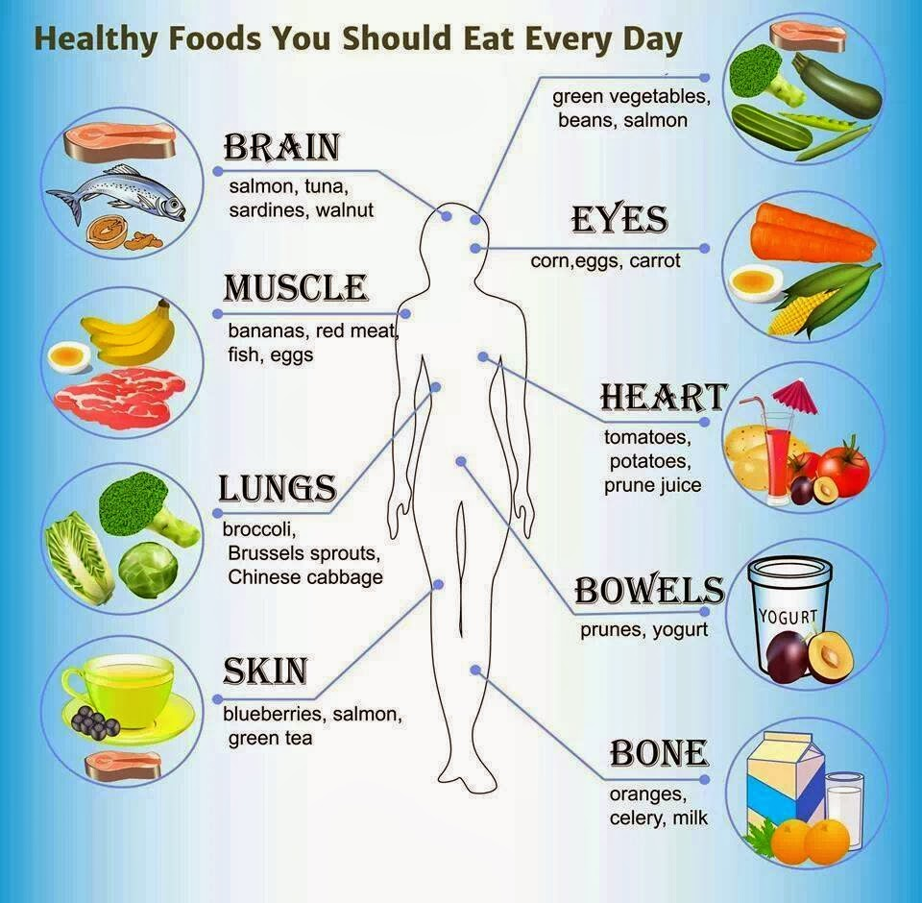
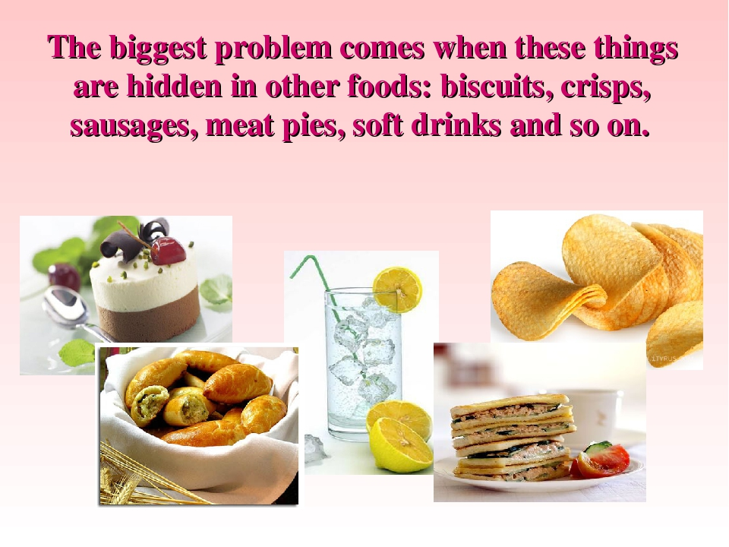
Our food

Slide 6


Slide 7
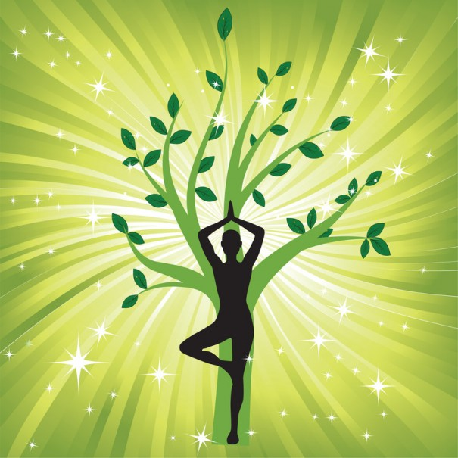
«Здоровье - это как деньги, мы никогда не имеем истинного представления о его ценности, пока не потеряем его.» Джош Биллингс

Slide 8
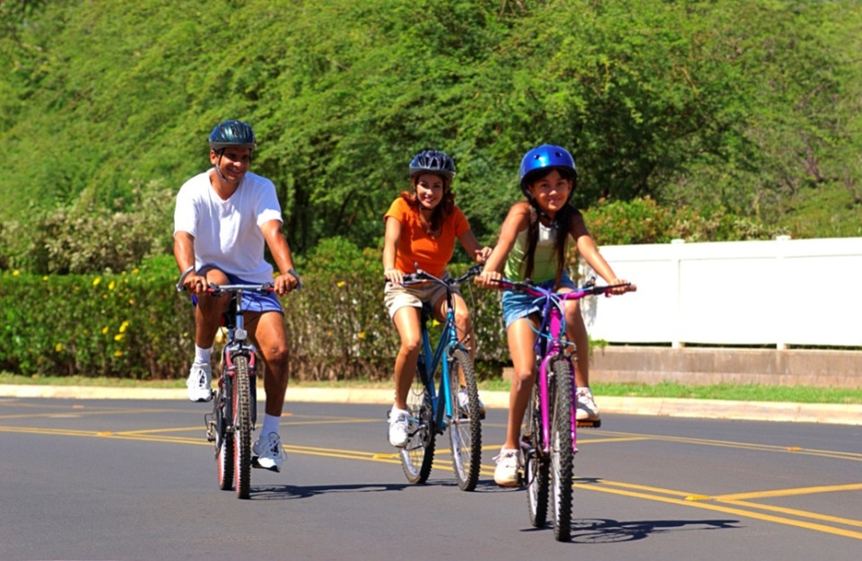
«Здоровье - это не просто отсутствие болезни.» Ханна Грин

Slide 9
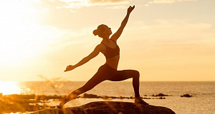
«Ваше тело – это храм, но только если вы относитесь к нему как к храму.» Астрид Алауда

Slide 10
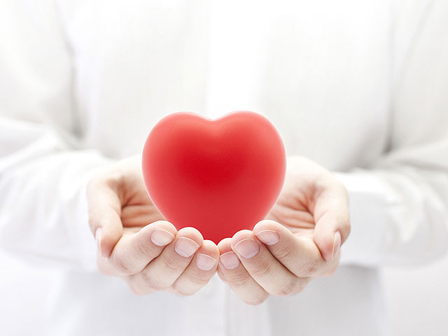
«Услышьте свое сердце. Сердце – ваше здоровье.» Терри Гуиллеметс

Slide 11
Laughter is the best medicine.
An apple a day keeps a doctor away.
Good health is above wealth.
A sound mind in a sound body.
Early to bed and early to rise
makes a man healthy, wealthy and wise.
Wealth is nothing without health.
A change is as good as a rest.
Don’t worry, be happy.

Slide 12


Slide 13
Психосоматика
(др.-греч. ψυχή — душа и σῶμα — тело)
направление в медицине и психологии, изучающее влияние психологических факторов на возникновение и течение соматических (телесных) заболеваний.

Slide 14
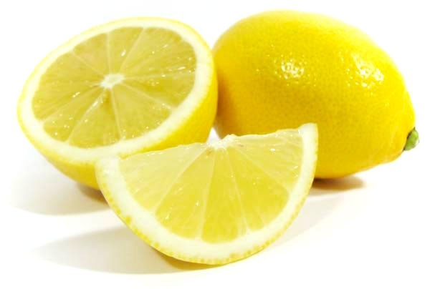

Slide 15


Slide 16
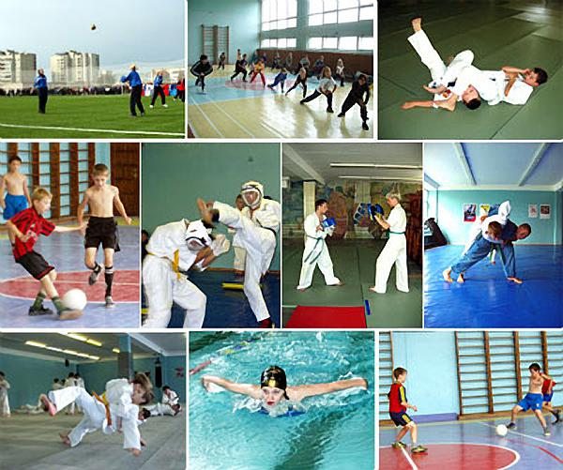
Sports is Important in Our Life

Slide 17
Questions:
1. Do you do your morning exercises every day?
2. How do children and grown-ups take care of their health?
3. Are a lot of different competitions held at schools?
4. Do you go in for sports?
5. Are there any popular kinds of sports in our country?
What are they?
6. What is your favourite sport?
7. Where do you prefer to rest?
8. Do your friends go in for sports?
9. Do you like winter or summer sports?
10. Our hobbies help us in our life, don't they?

Slide 18
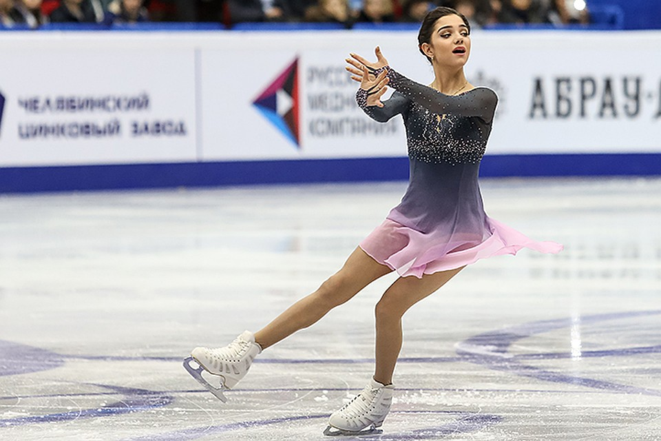
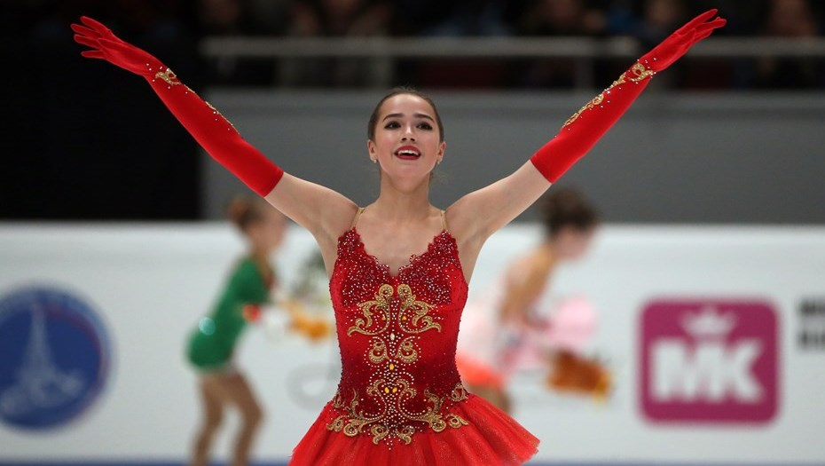
Figure-skating

Slide 19

Hockey

Slide 20

Football

Slide 21
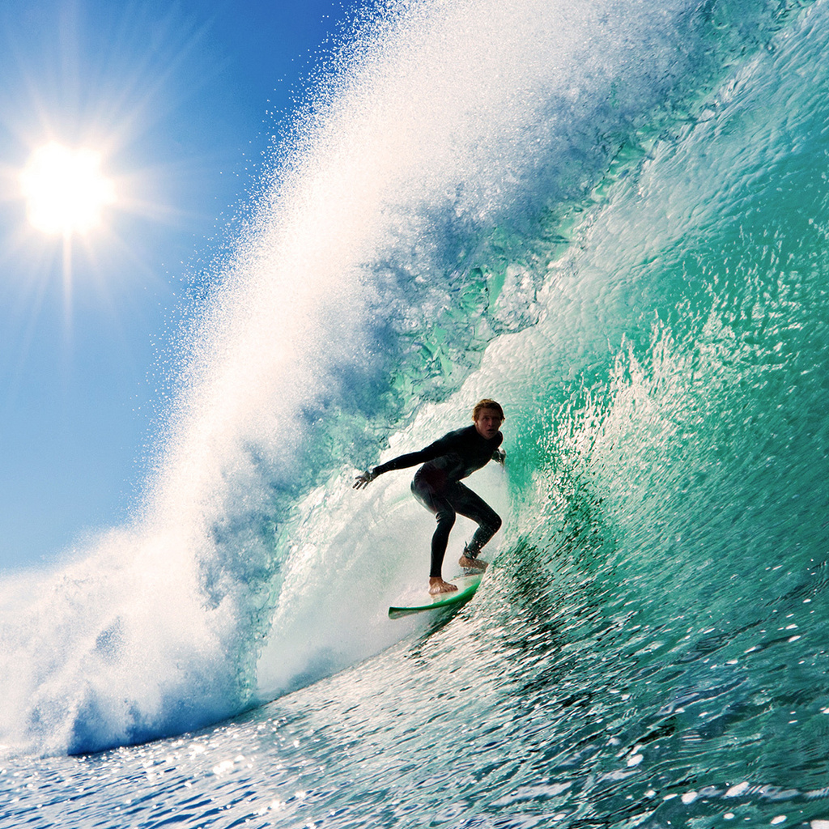
Windsurfing

Slide 22
A healthy lifestyle
You should
You shouldn’t
Eat fruit and vegetables.
Walk in the park.
Do some gymnastics in the morning.
Have the latest meal not later than 7 p.m.
Take vitamins.
Go in for sports.
Change mental and physical activities.
Sleep not less than eight hours a day.
Smoke
Go to bed after 11 p.m.
Eat hamburgers and «hot dogs».
Eat too many sweets, cakes, chips.
Do lessons late at night.

Slide 23

In order to be healthy
Eat useful food Control your
emotions
Do sports

Slide 24


Slide 25


