Slide 1
The world’s best friend is you
The Earth needs a friend,doesn’t it?
Учительница английского языка
Овакимян асмик самвеловна

Slide 2
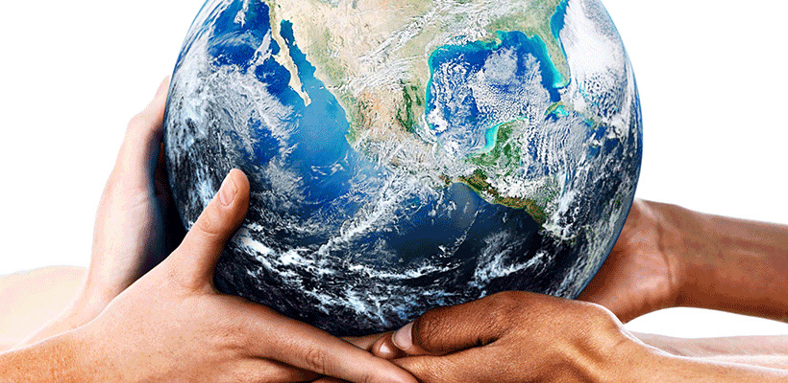
Our earth

Slide 3
Complete using the words in the boxes.
climate , forecast, insect, mammal, wildlife
I don’t see a lot of ........................because I live in a big city.
Humans and monkeys are different types of …………………….
I wish I lived in a country with a warmer…………………..
If it’s got six legs,it’s probably a/an ………………………..
Have you heard what the weather ………………….. Is for tomorrow?

Slide 4
Complete by changing the from of the word in capitals.
They closed the airport because it was so ………………(FOG).
High winds can be very …………………………………...(DESTROY).
Lots of……………………(NATURE) things are poisonous to humans.
Air ………………. (POLLUTE) isn’t really a serious problem where we live.
Isn’t ……………………………..(GARDEN) a bit of a boring hobby?
The submarine went down to a ………………………(DEEP) OF 200 METRES.
The island isn’t square – it’s almost completely ………………………..(CIRCLE).
Is it ………………………………(DANGER) TO SWIM IN THAT LAKE?

Slide 5
Forest are essential for life on earth
They help us breathe.
They keep Earth cool.
They make it rain.
They fight flooding.
They clean up dirty air.
They muffle noise pollution.
They feed us.
They give us medicine.
They help up make things.

Slide 6
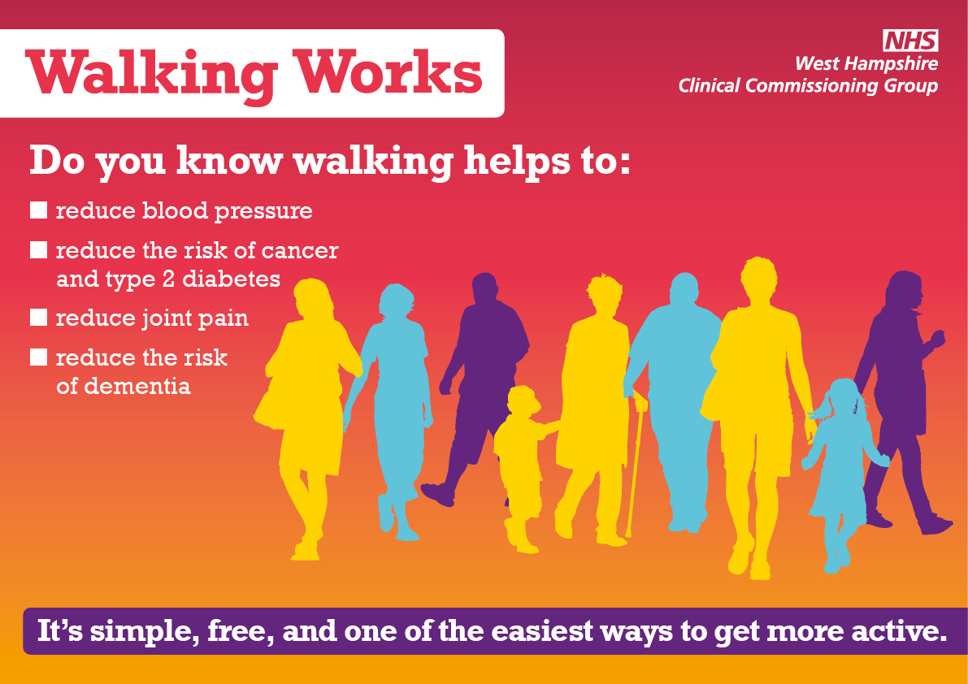
Forest therapy – a walk a day keeps the doctor away…

Slide 7
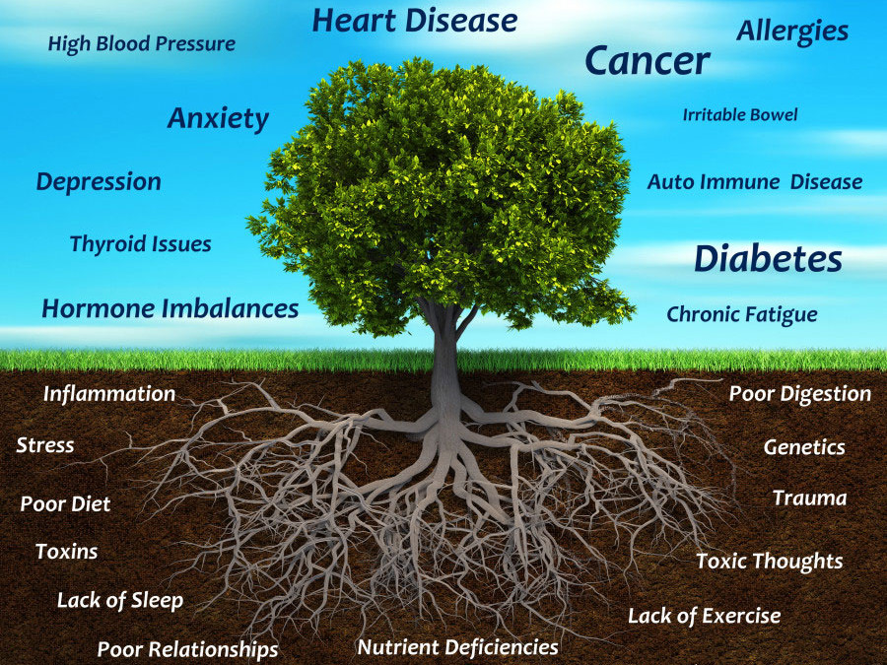

Slide 8
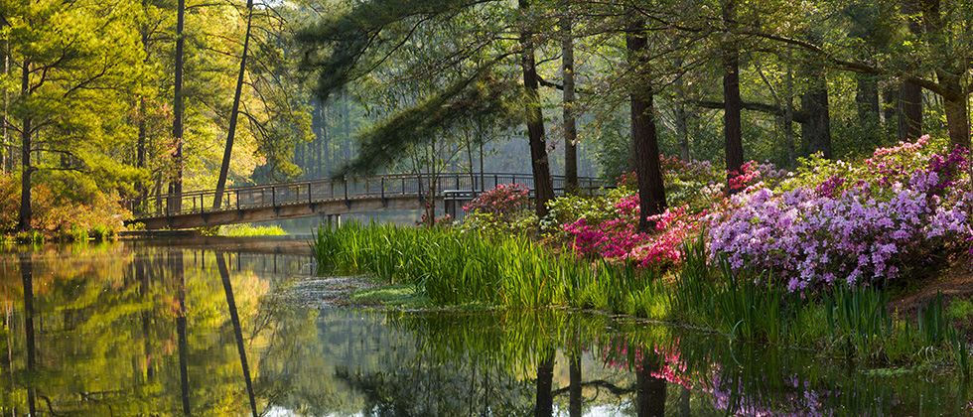
Nature and men are tied together

Slide 9
DEFORESTATION SLOGANS
Stop deforestation to save the nation from pollution.
Trees are source to fresh oxygen, never cut trees.
Save forests for better and healthy future.
Deforestation destroys many homes of birds and animals,just stop it.
Trees you burn will never return.
Plant some trees instead of cutting them,they have life too.

Slide 10
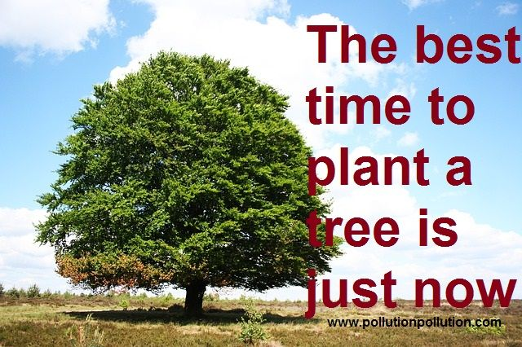

Slide 11
