Slide 1



English tenses
Present Continuous and
Present Simple

Slide 2

to be
I
am
we
are
you
are
he
is
they
are
she
is
it
is
щёлкнуть по местоимению, появится глагол.

Slide 3
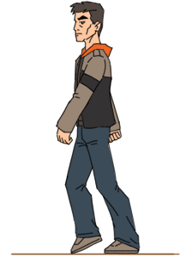



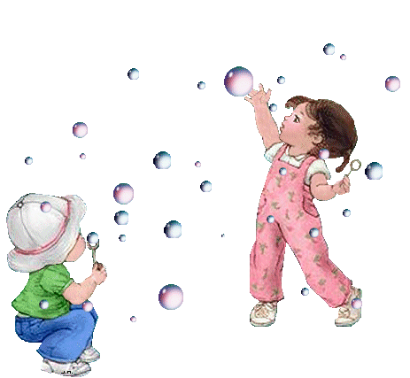
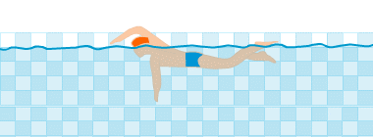
-ing
go -
going
jump -
jumping
run -
running
swim -
swimming
play -
playing
read -
reading

Slide 4
What is he doing?
He is painting.

Slide 5
I am running.
What are you doing?

Slide 6
What is he doing?
He is swimming.

Slide 7

What is she doing?
She is playing on the beach.

Slide 8
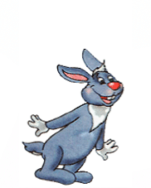
What are you doing?
. . .
We are jumping.

Slide 9

What are they doing?
They are going for a walk.

Slide 10
What am I doing?
You are reading a book.

Slide 11


Slide 12

Вопросы

Slide 13
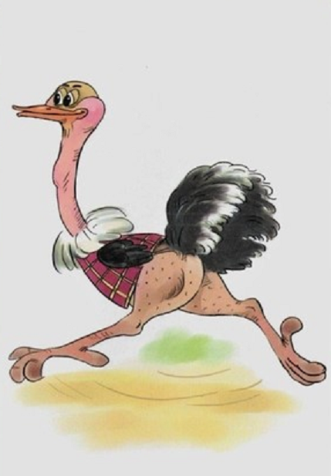
Is it swimming?
No, it isn’t.

Slide 14


Is he reading?
Yes, he is.
Is she swimming?
No, she isn’t.

Slide 15

Are you playing?
Are they jumping?
Yes, they are.
No, I am not.

Slide 16

Правило

Slide 17

Present Continuous
now, at the moment
am
is V-ing
are

Slide 18
like/likes
I
we
you
they
he
she
it
like
likes

Slide 19




like/likes
I
he
like
it
she
likes
You
they
we
щёлкать по местоимению, появится глагол.
При щелчке по глаголу –он исчезает

Slide 20
Вопросы

Slide 21
do/does
I
we
you
they
Do
like?
he
she
it
Does
like_?
щёлкать по местоимению, появится глагол. По второму щелчку - исчезнет

Slide 22

Отрицание

Slide 23
do not =
don’t
does not =
doesn’t

Slide 24
I we you they
he
she
it
doesn’t
don’t
щёлкать по местоимению, появится глагол

Slide 25
I don’t like football.
He doesn’t like tennis.

Slide 26
go-
[z]
plays
do-
does
goes
play-
[s]
read-
reads
give-
gives
work-
works
[iz]
watch -
watches
brush -
brushes

Slide 27
Правило

Slide 28
Present Simple
every day , usually
V V-s
he, she, it
do does

Slide 29

Сравни

Slide 30
Present Continuous and Present Simple
now, at the moment
every day, usually
V V-s
he, she ,it
do does
am
is V-ing
are
щёлкать по подзаголовку.

Slide 31
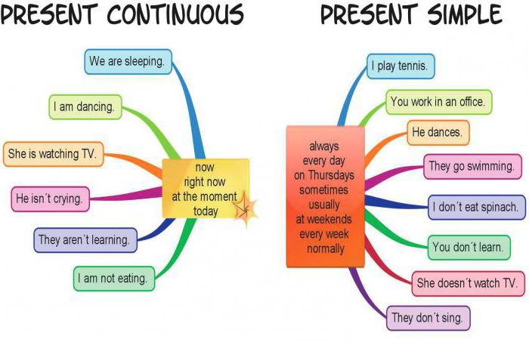

Slide 32
Используемые ресурсы
https://cdn.lifehacker.ru/wp-content/uploads/2017/06/english_1498396196-1140x570.jpg
http://repetitor.org.ua/media/1532892.jpg
https://blog.stanis.ru/img/30016.gif
http://www.playcast.ru/uploads/2017/02/17/21680406.gif
http://ds_gptz_5.gptz.zabedu.ru/files/org/1285/5426a3676b9c9.gif
http://mirpozitiva.ru/uploads/posts/2017-03/1489244866_krol.gif
http://99px.ru/sstorage/86/2016/04/image_861704161649497929267.gif
http://ocls.kyivlibs.org.ua/gaidar/g_koleydockop_2015/2015_05_27/school_boy_reading_book.gif
https://www.koshkimira.ru/images/191.gif
http://99px.ru/sstorage/1/2016/06/image_10606160007581002006.gif
http://rusaliir.narod.ru/dog_walks_man.gif
https://image.jimcdn.com/app/cms/image/transf/none/path/s3185a5c87f99ac3f/image/i057d309e98b8844c/version/1279376532/image.gif
https://grischenkonatalia.files.wordpress.com/2016/01/question.gif
https://img-fotki.yandex.ru/get/4307/marya-foygl.37/0_254cf_43d192e1_L
https://www.smusd.org/cms/lib3/CA01000805/Centricity/Domain/1742/school-animation-pencil.gif
https://www.kursoteka.ru/course/2893
https://avatars.mds.yandex.net/get-pdb/881477/eb301ec0-32c5-419d-8c04-51f2e9cedfca/orig
http://blestiashky.narod.ru/1/smayl56.gif
https://ru.savefrom.net/#url=http://youtube.com/watch?v=HrHqq8xJiU4&utm_source=youtube.com&utm_medium=short_domains&utm_campaign=www.ssyoutube.com

