Slide 1
Save Nature
Save planet Earth For Future Generation
Teacher: Hasmik Hovakimyan
E-mail: hasmik.hovakimian@rambler.ru
School № 84 n/a Kh. Abovyan

Slide 2

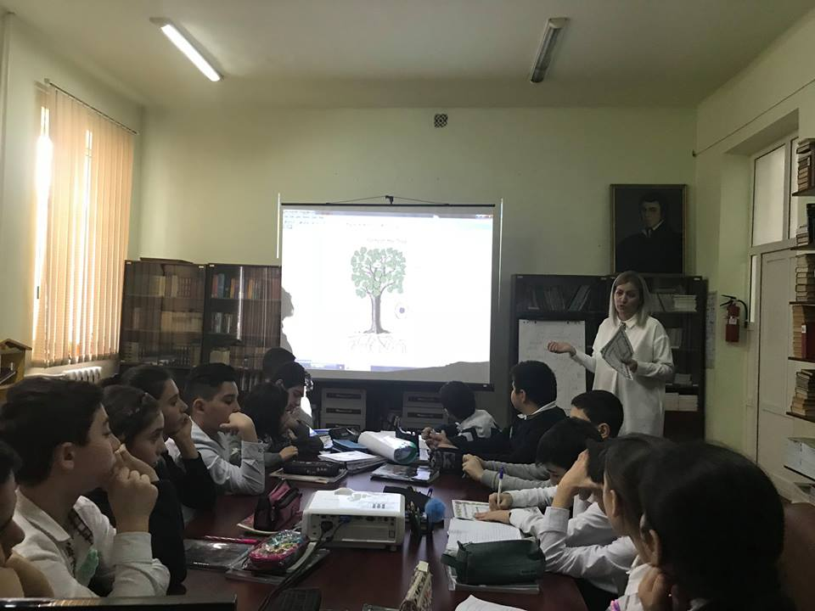
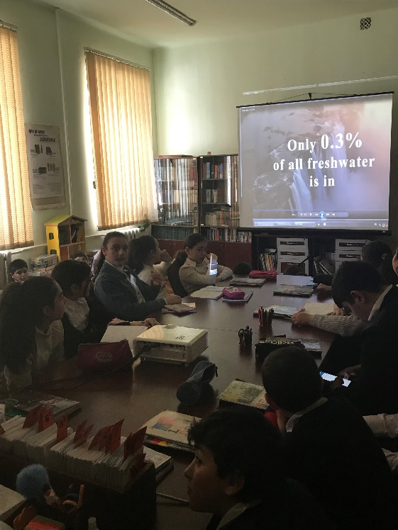
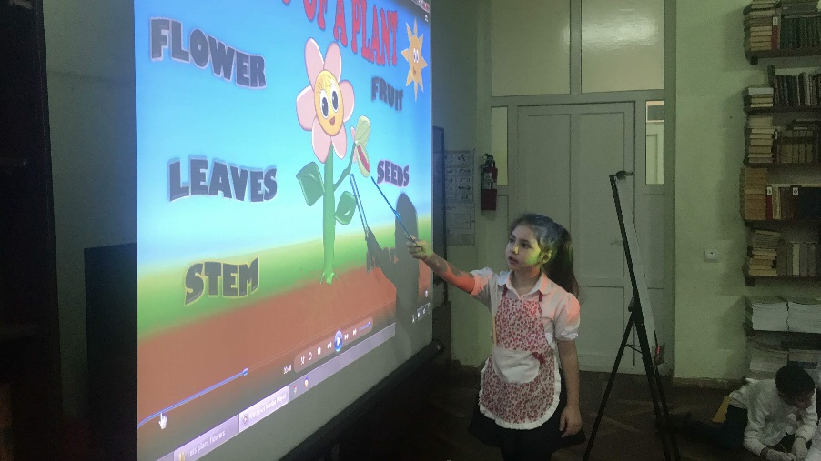
Let’s plant flowers!
This year we worked on a project entitled!
Save Planet Earth For Feature Generation!
Save Forests! Save Trees
Save water! Water is life!

Slide 3
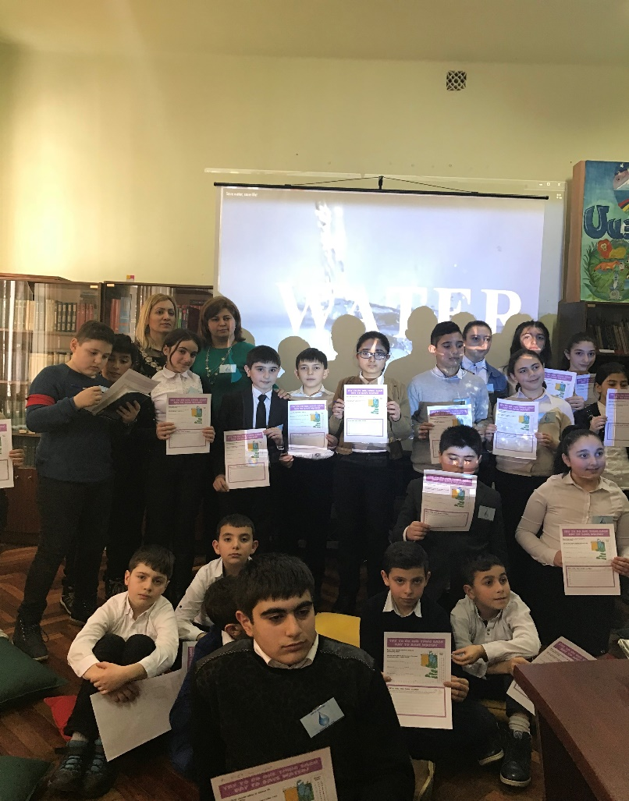
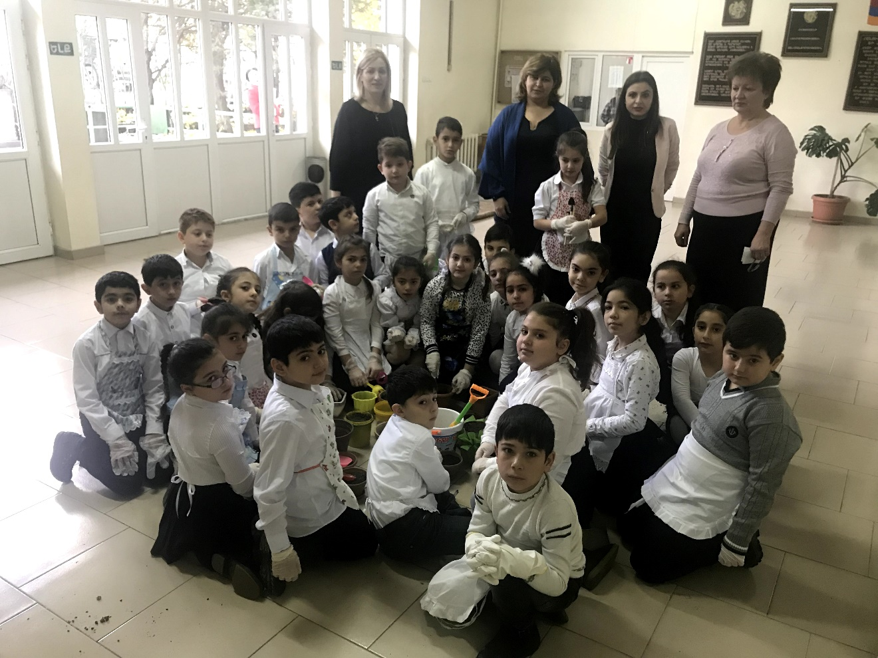
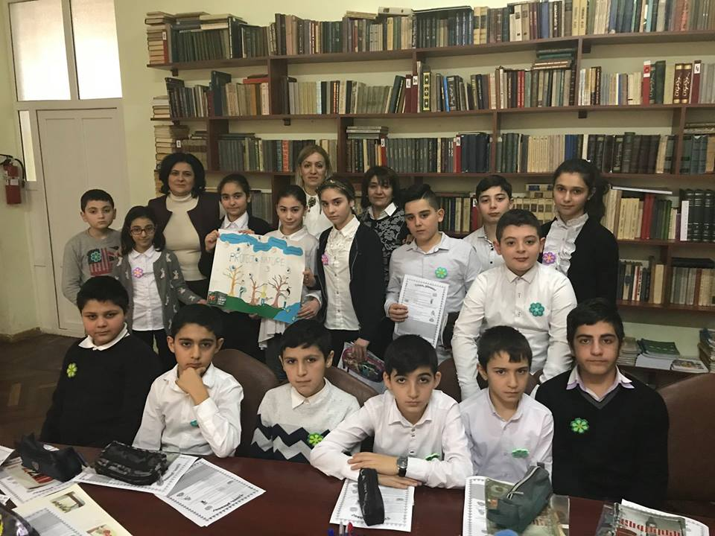
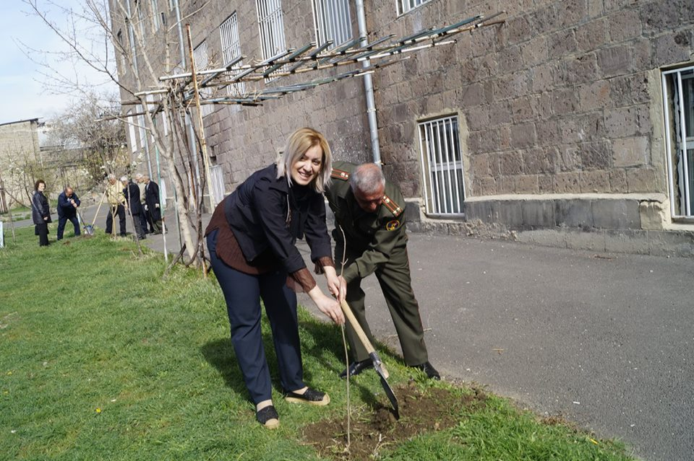

Slide 4
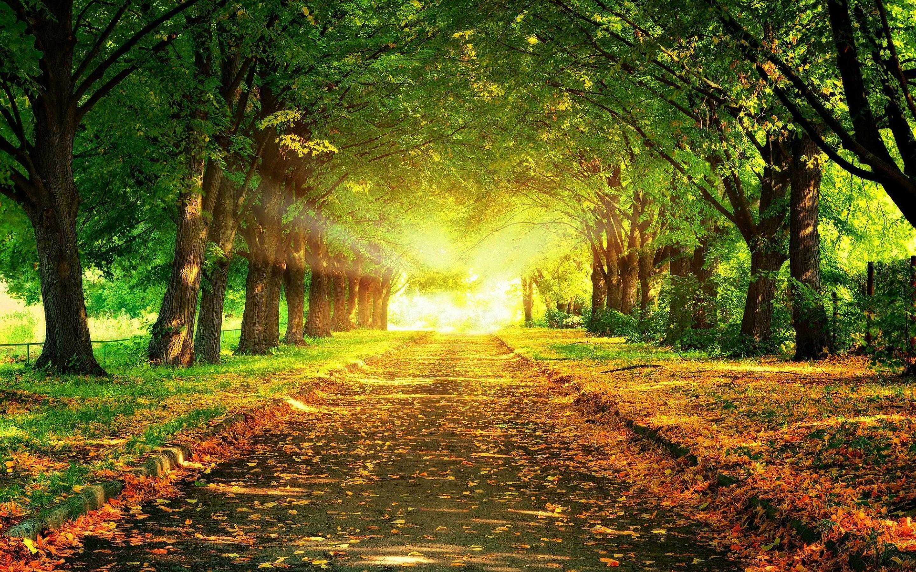
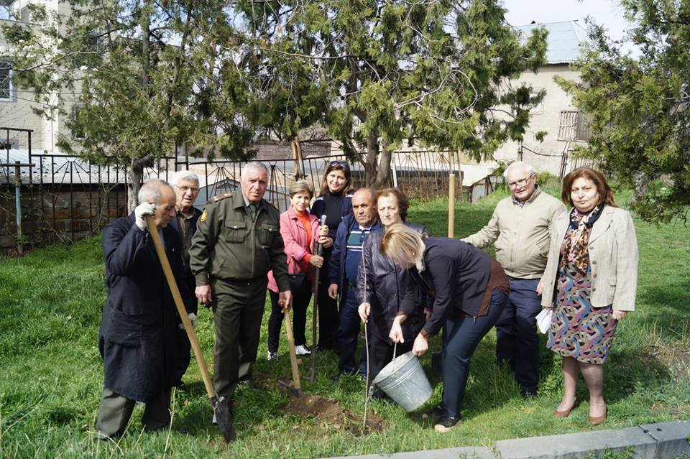
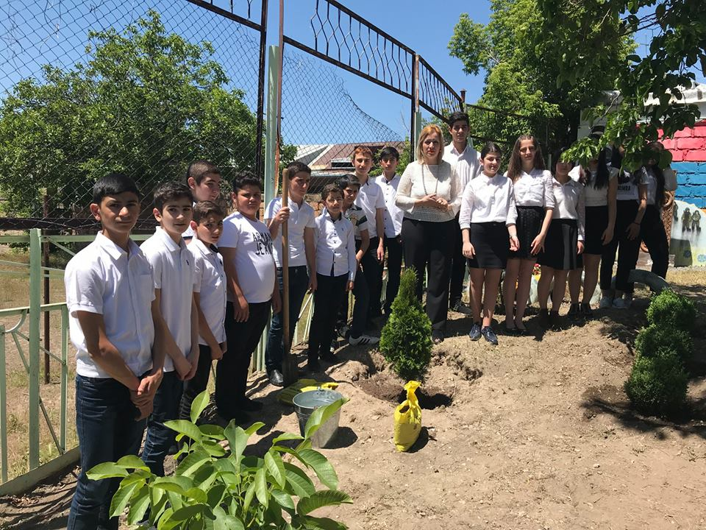
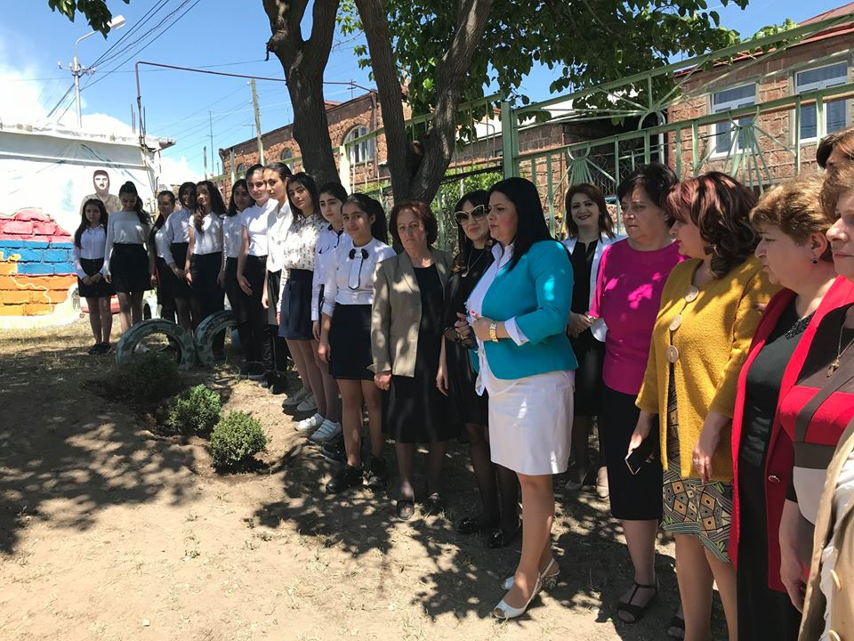
Let’s plant trees

Slide 5
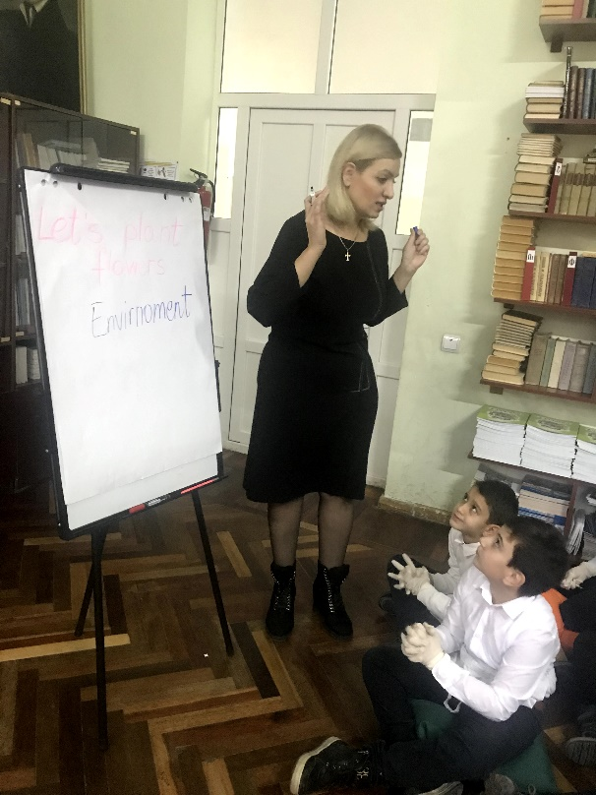
What is environment?
It consists of everything we see around
like trees
plants
flowers
animals
birds
people
People like mother, neighbours, friends.
Animals like pet dogs and cats.
The fishes in the ponds, trees with birds, butterflies on red roses, green grass below.
Blue sky above all make the environment.

Slide 6
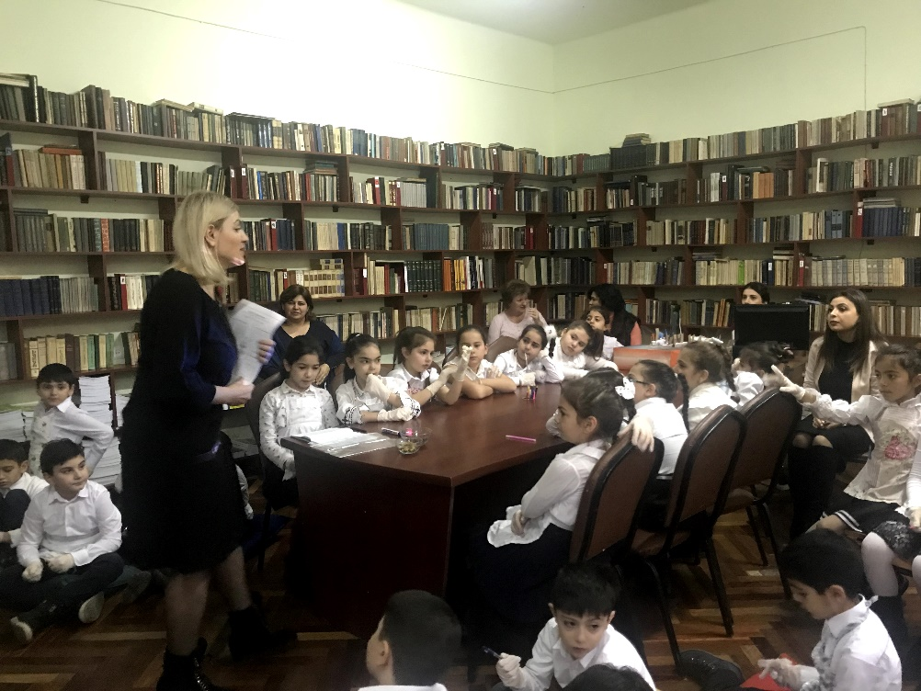
Enviornment provides us with
Air that we breath
Water that we drink
Food that we eat
Clothes that cover our body

Slide 7
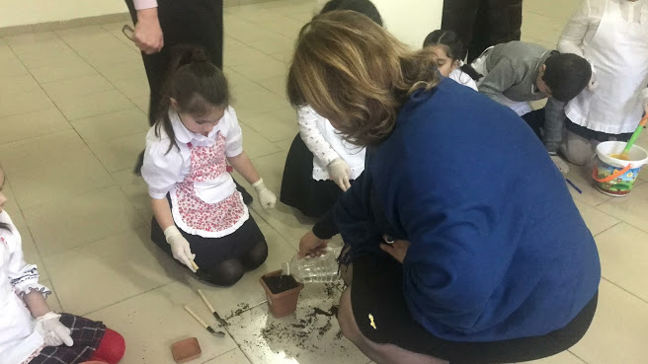
Let’s help to keep the environment clean
Never throw chocolate papers or garbage on the roads,on the grounds.
Always throw waste and garbage in a dustbin.
Water the plants every day as they give us food, the air we breath.

Slide 8
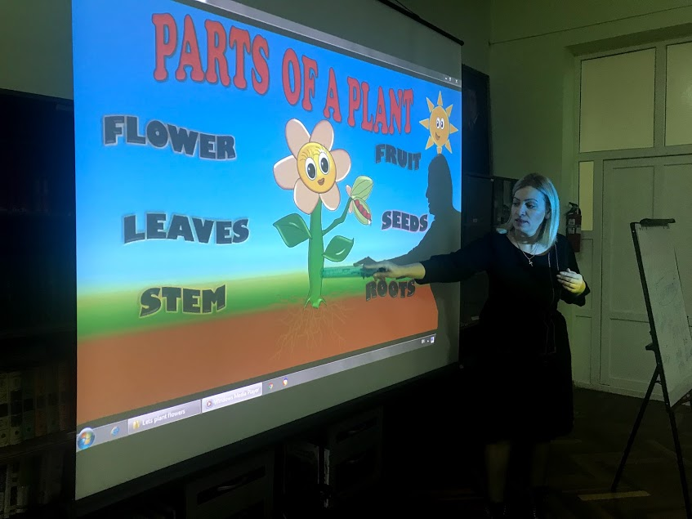
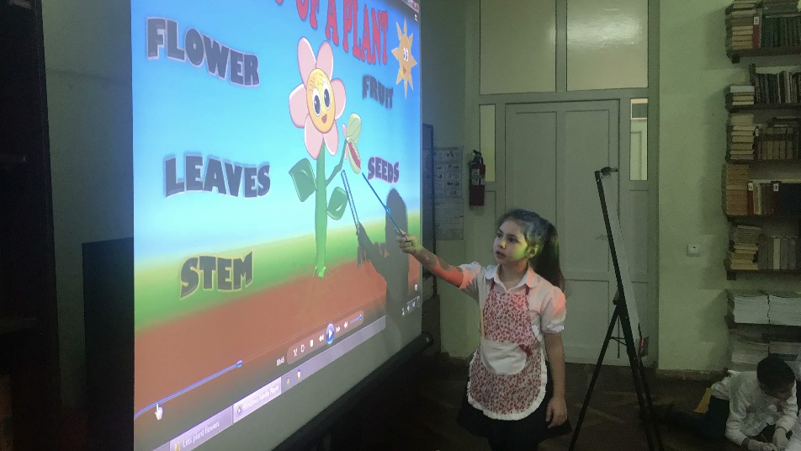
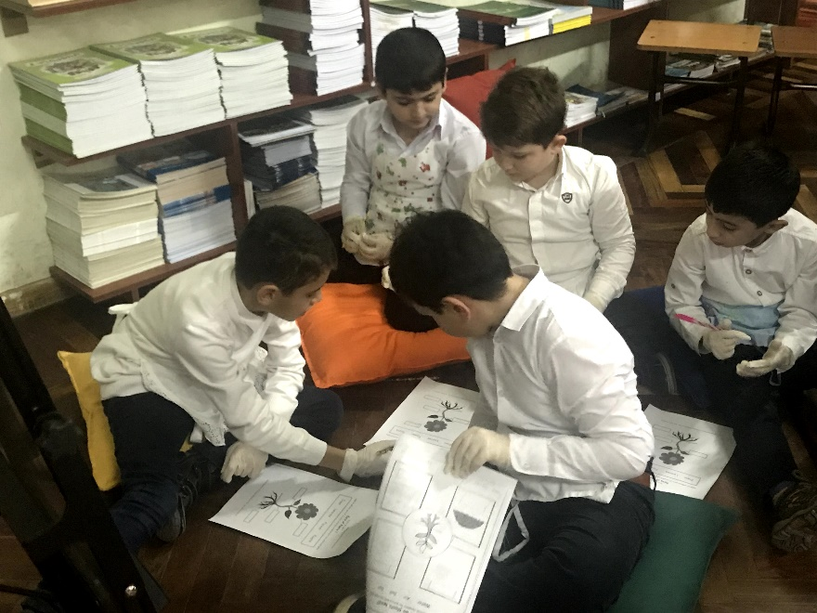
The parts of the plants

Slide 9
Why do we need plants?
Plants take carbone dioxide out of the air.
Plants release oxygen into the air which we need to breath
Plants produce food that is healthy for us to eat.

Slide 10
What do plants need to grow?
Sun
Soil
Water
Air

Slide 11
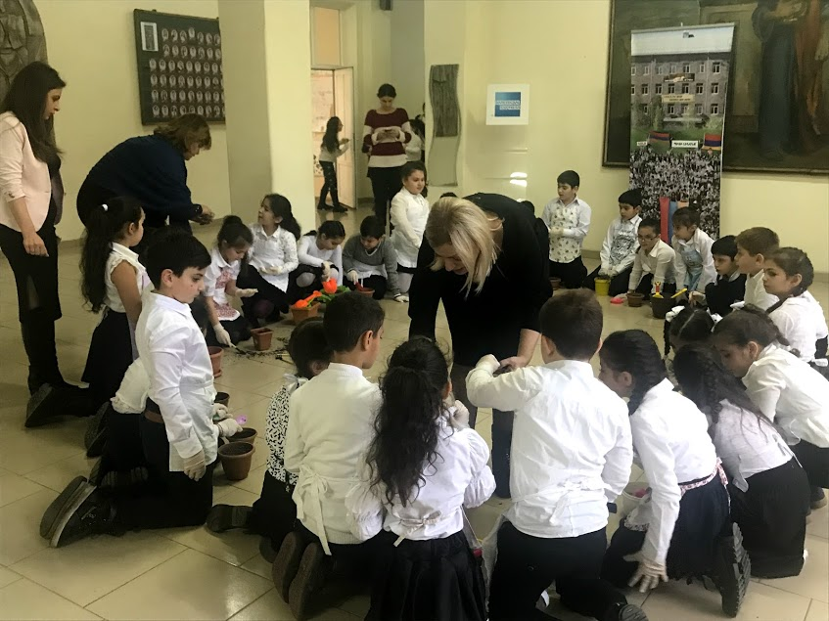
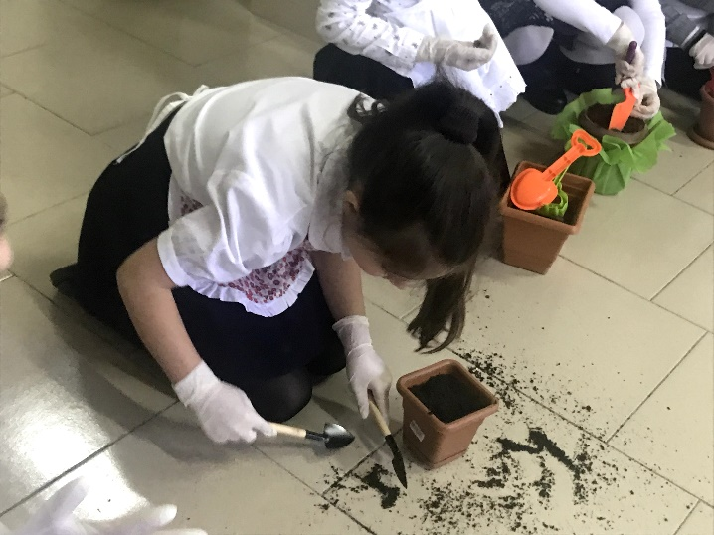
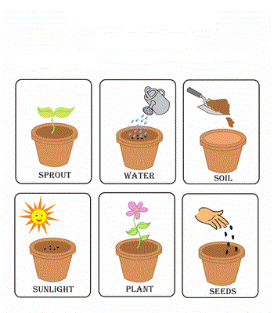
How do plants grow?

Slide 12

We will always remember these words
Save the Earth with farmers
Save the Earth with hard work
Save the Earth with goodness
Save the Earth with smile and love!

Slide 13
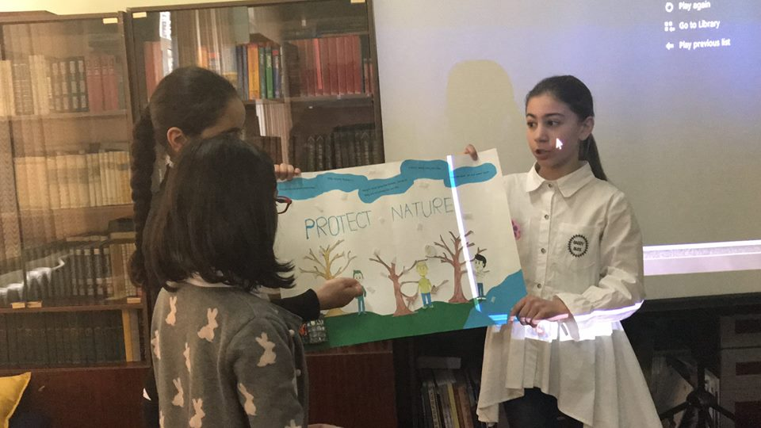
Forest
Let’s save our forest
Children, you are welcome to an amazing journey to a forest, a wonderful place.
Forests are essential for life on Earth.They cover 1/3 of the earth`s surface and contain an estimated 3 trillion trees.

Slide 14
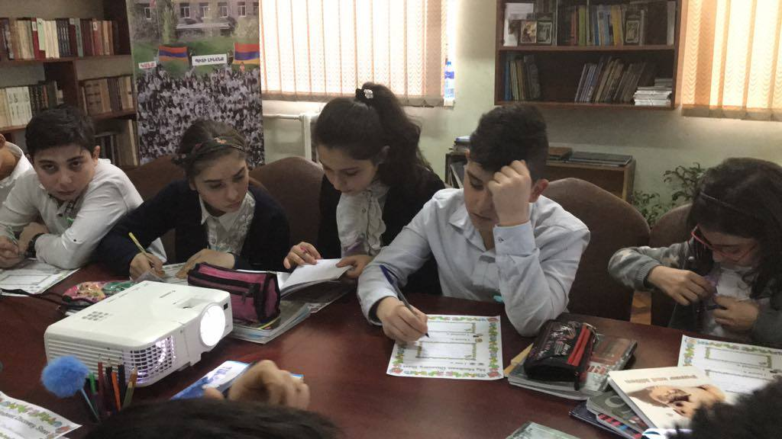
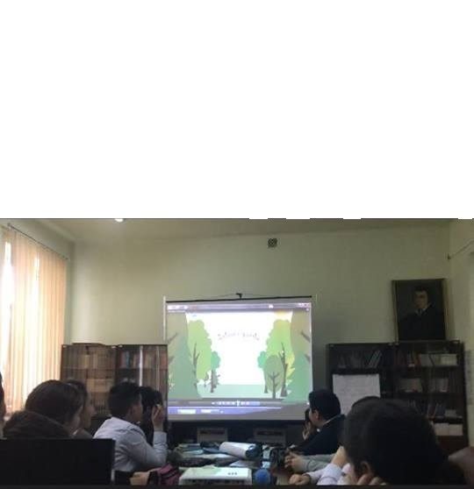
Rainforests are very important,there are a lot of animals,plants.It rains 200 hundred days there.

Slide 15
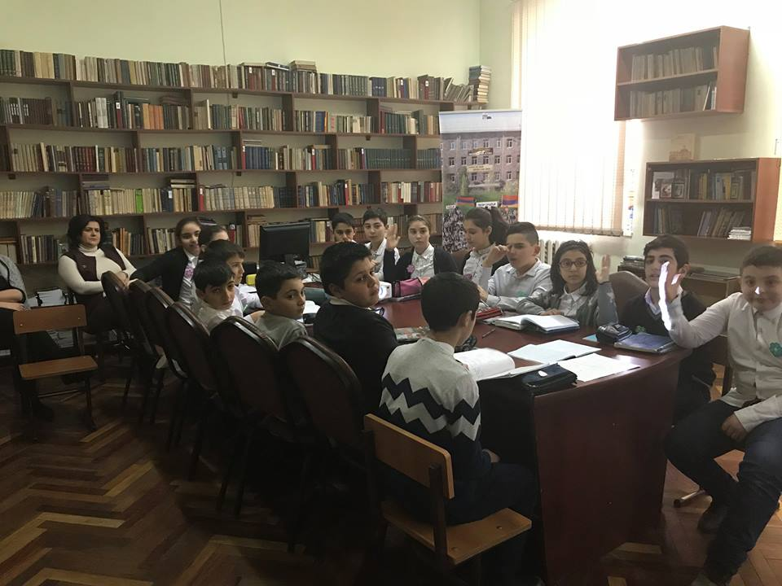
What is deforestation?
The act of cutting down or burning the trees an area.

Slide 16
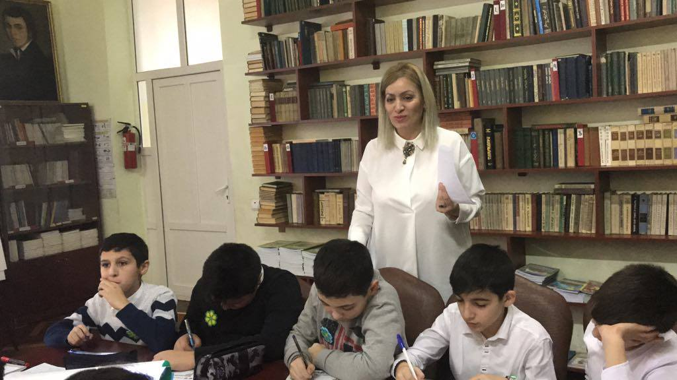
Save our forests

Slide 17

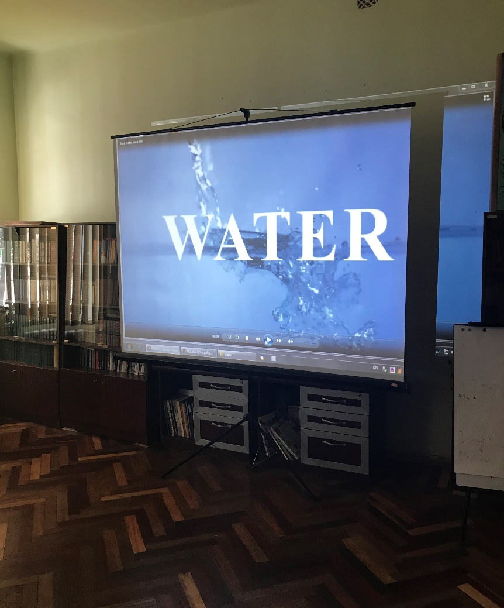
Water
Water is the most precious gift of nature to humanity. Earth is often called “Water Planet” because it is the only planet in our solar system which has liquid water on its surface.

Slide 18
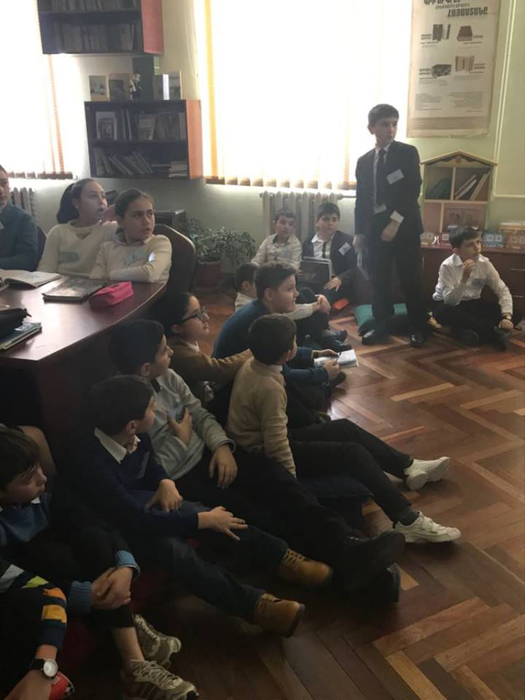

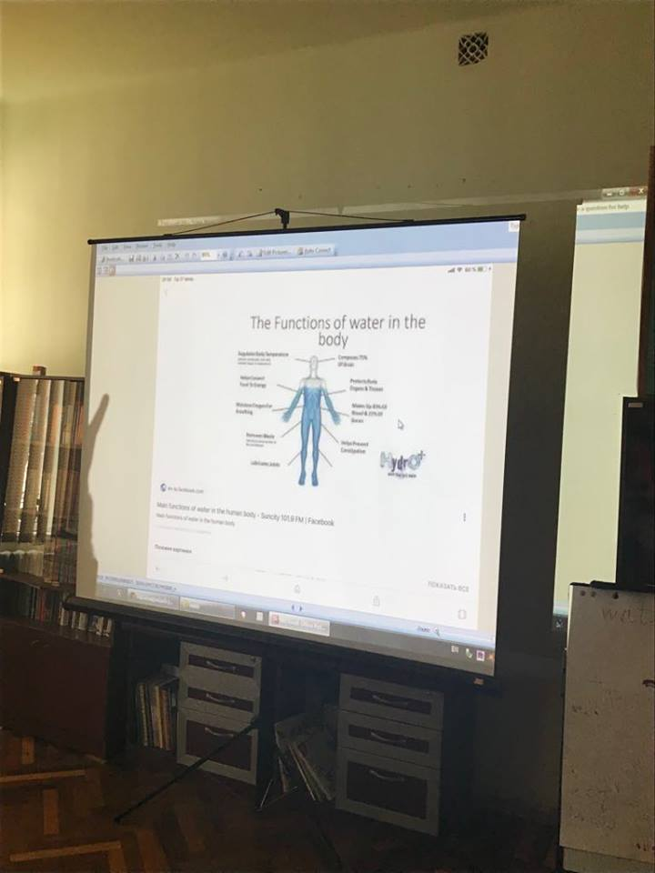
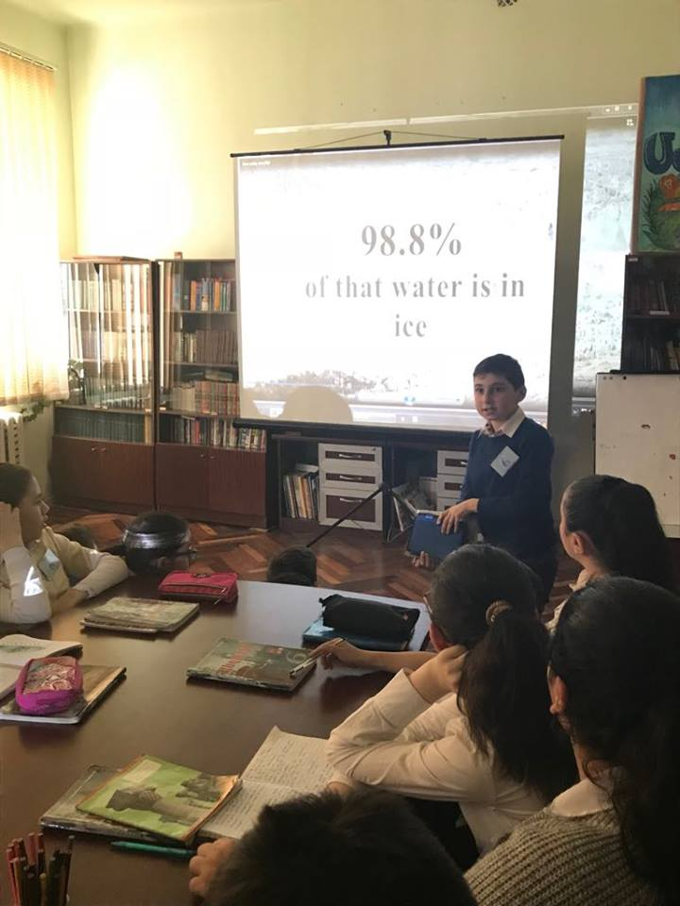
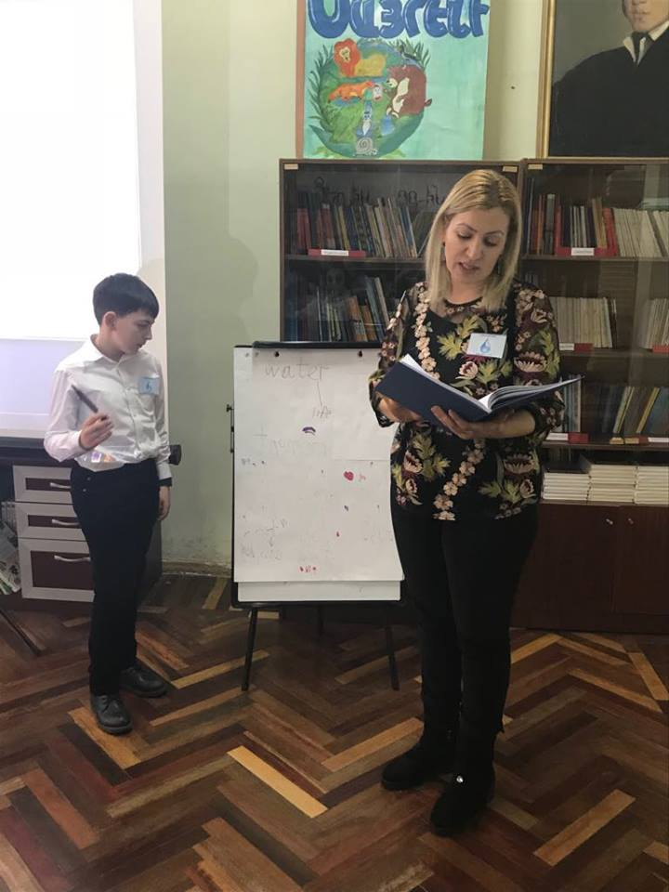
Children’s turn

Slide 19
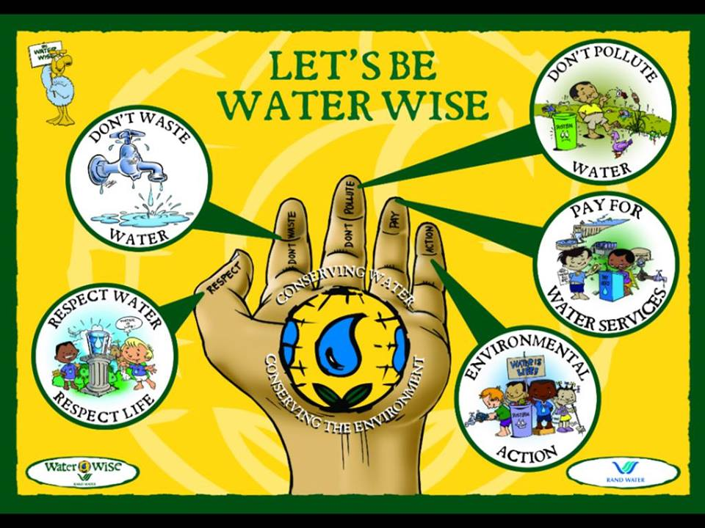
Close the water tap while brushing teeth.
Wash the fruits and vegetables in one pan instead of washing separate.
Take a shower instead of a bath if you are keeping it short.
Use dishwashes and washing machines only on full loads.

Slide 20
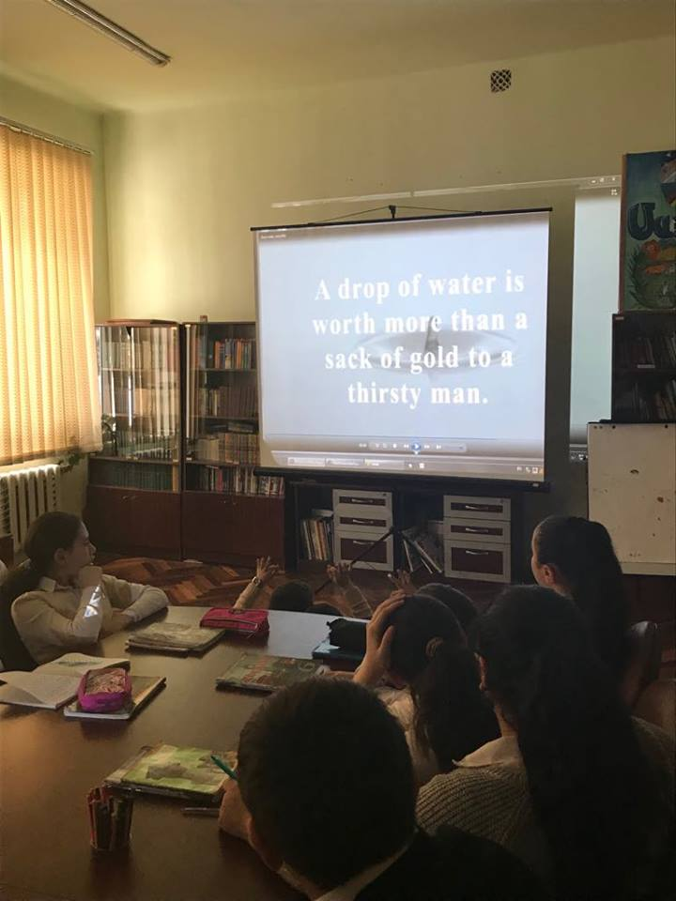
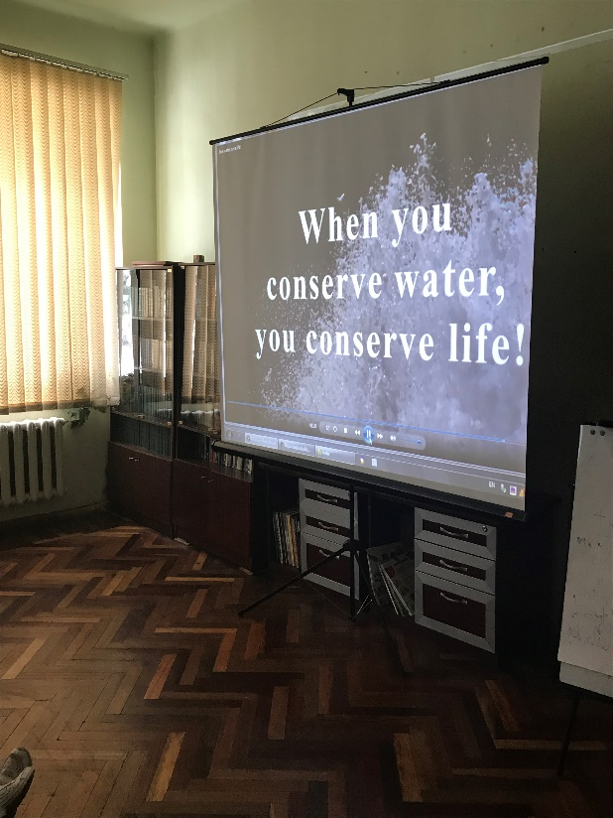
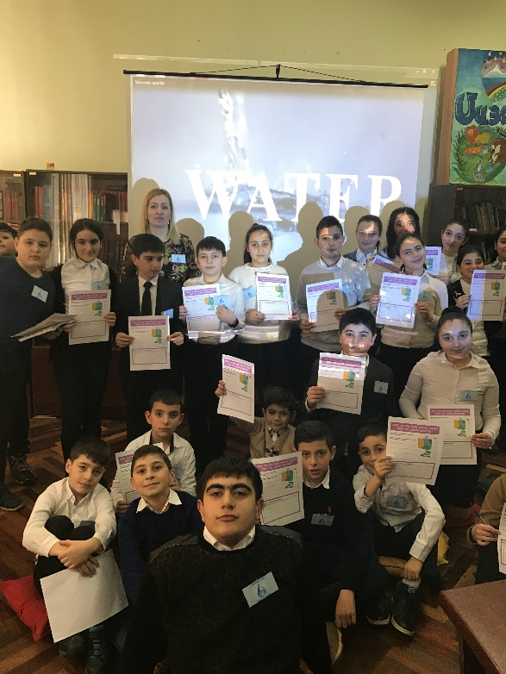


Slide 21
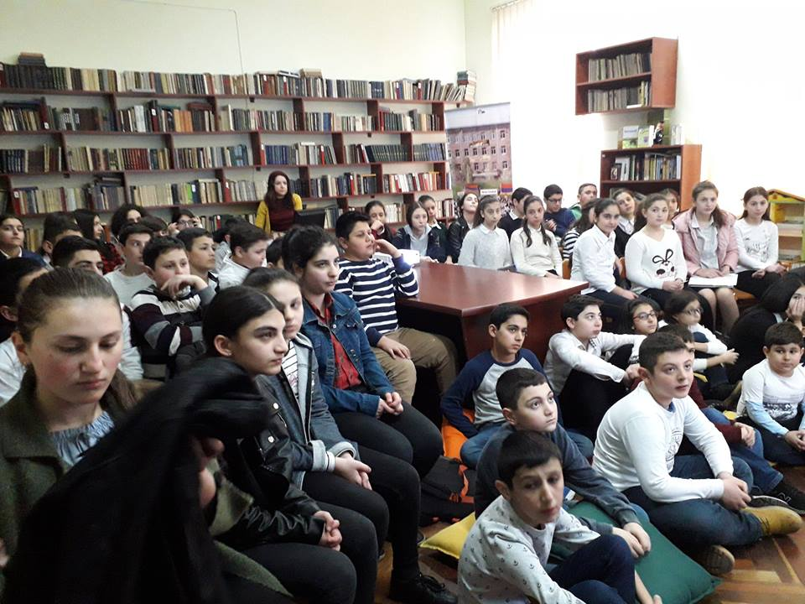
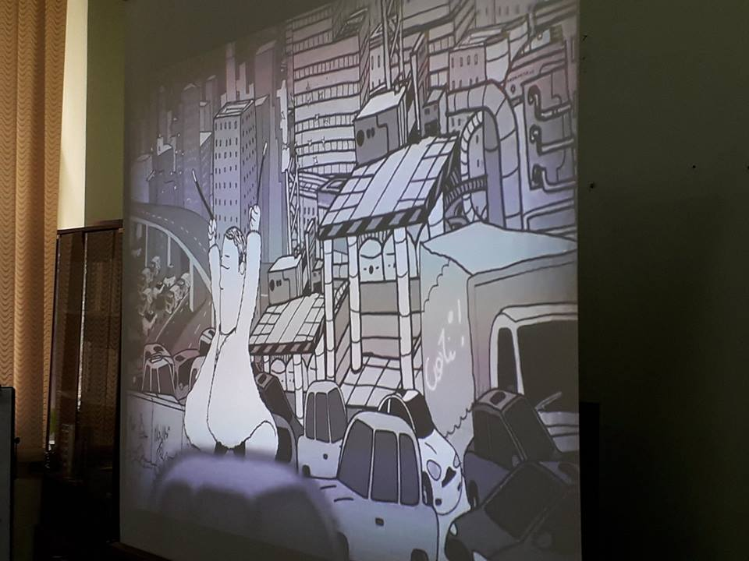
Pollution
Polluted air is a community problem.Air becomes polluted in many ways.Cars, trucks, buses and airplanes are among the worst polluters.

Slide 22
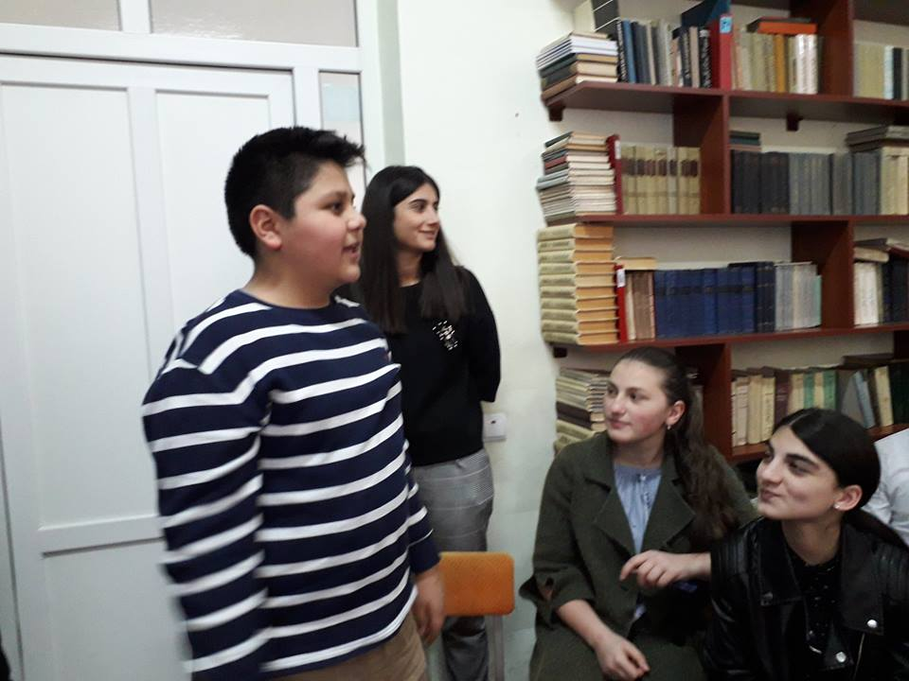
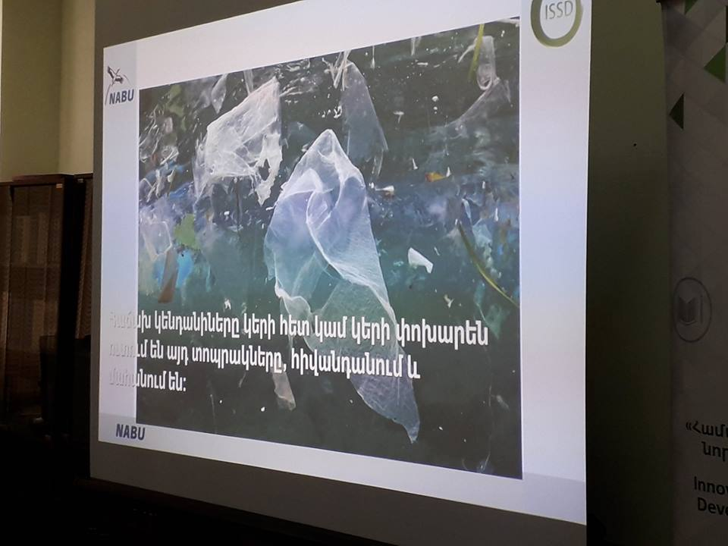
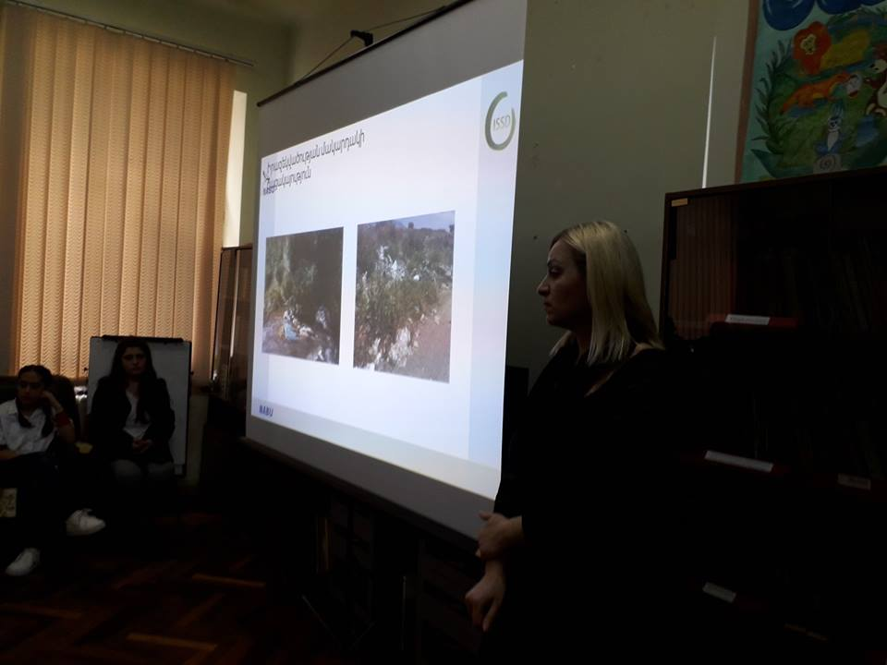
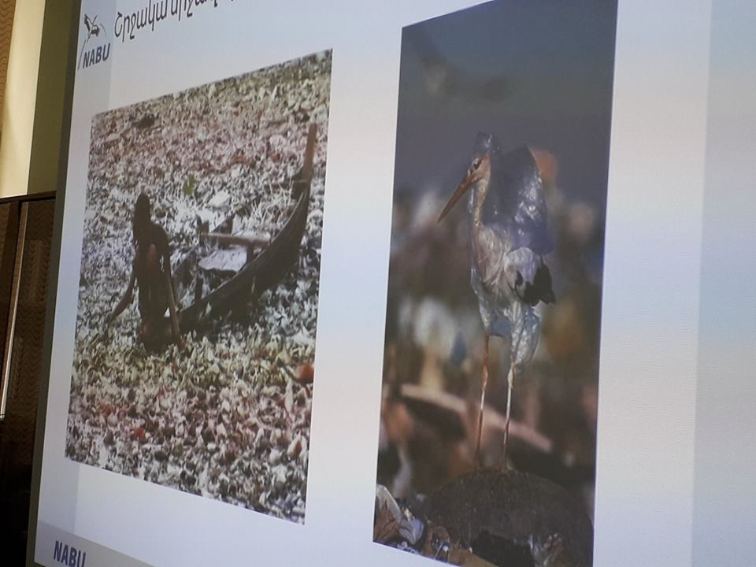
Sources of Water Pollution
Water pollution is caused by dumping wastes into lakes, rivers and other bodies of water.

Slide 23
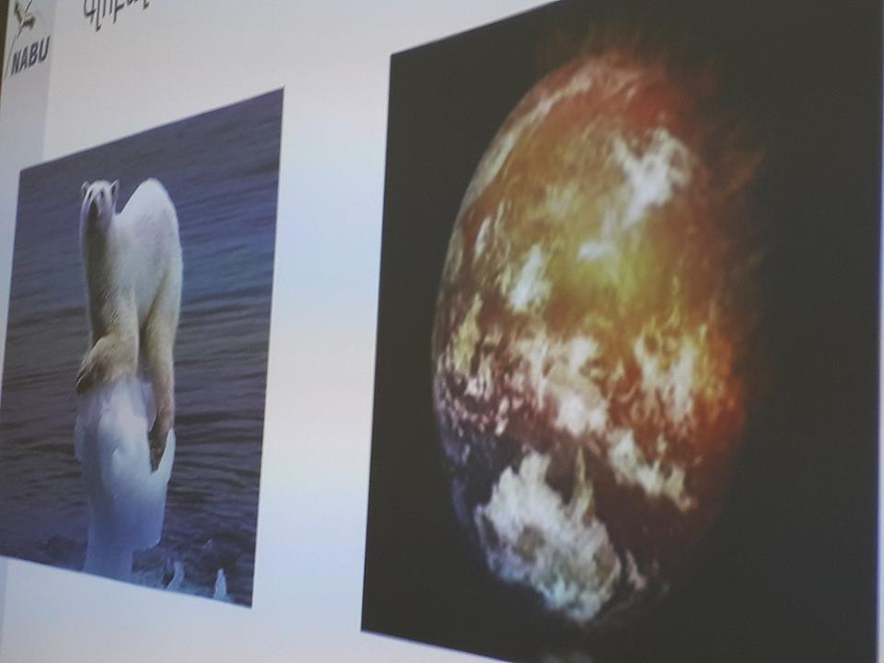
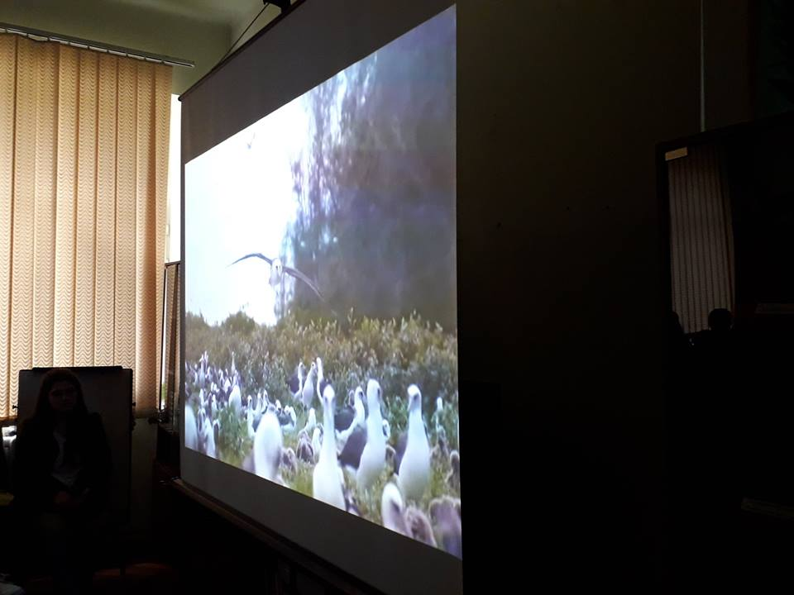
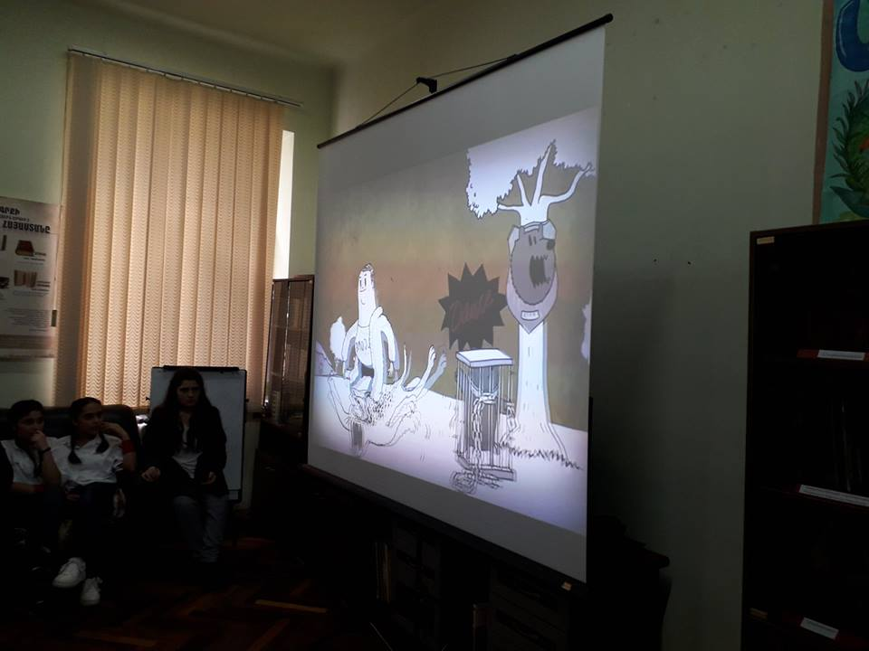
Global warming
Disappearing of animals and birds

Slide 24
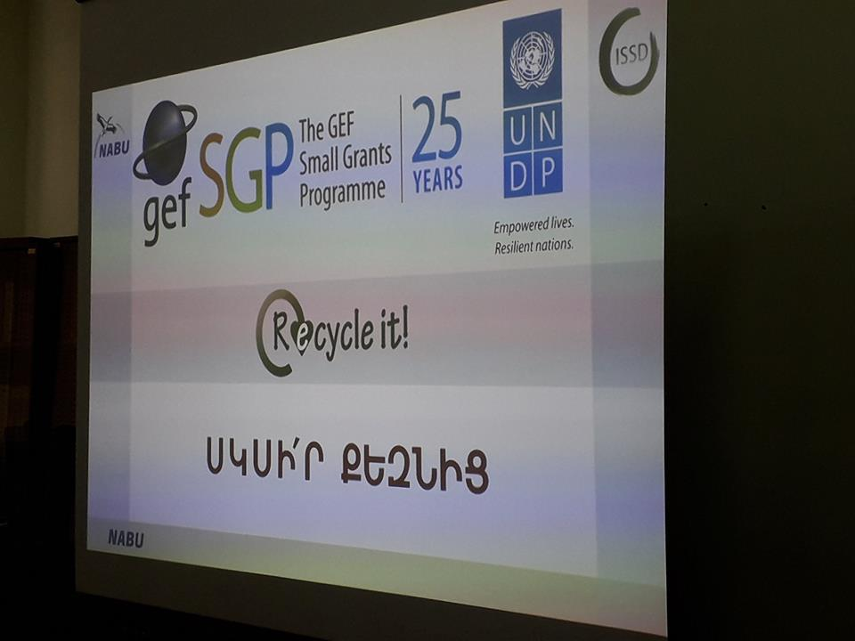
Now we are making so much garbage that in many places there is not enough room to bury it all. We have to act fast and cut down the amount of garbage we make. We can recycle and reject. If we recycle and reject we will produce a lot less garbage and help to keep our planet green.

Slide 25
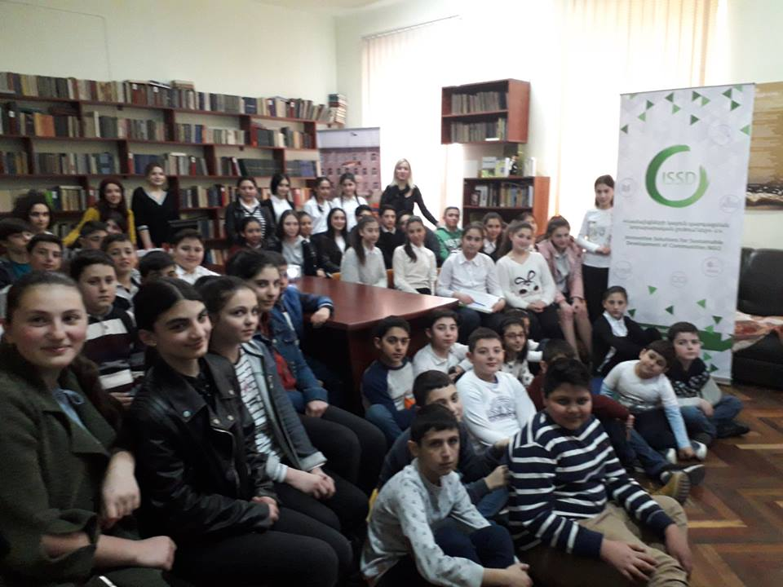
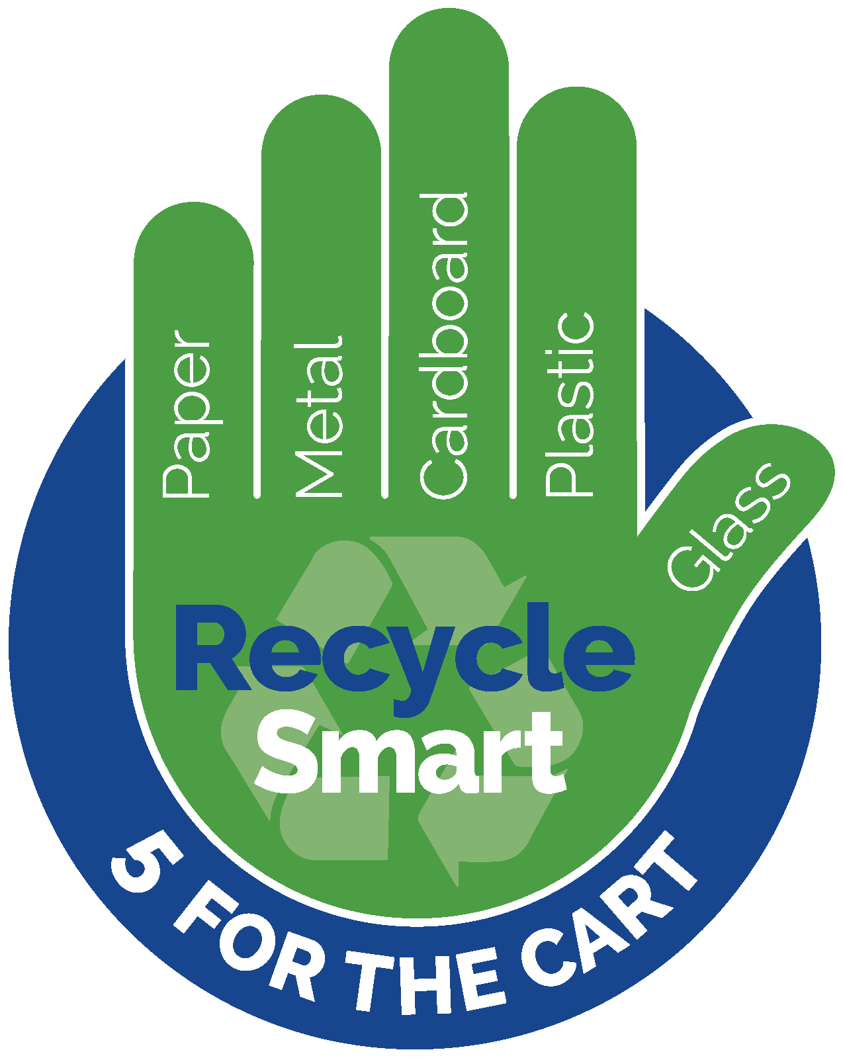
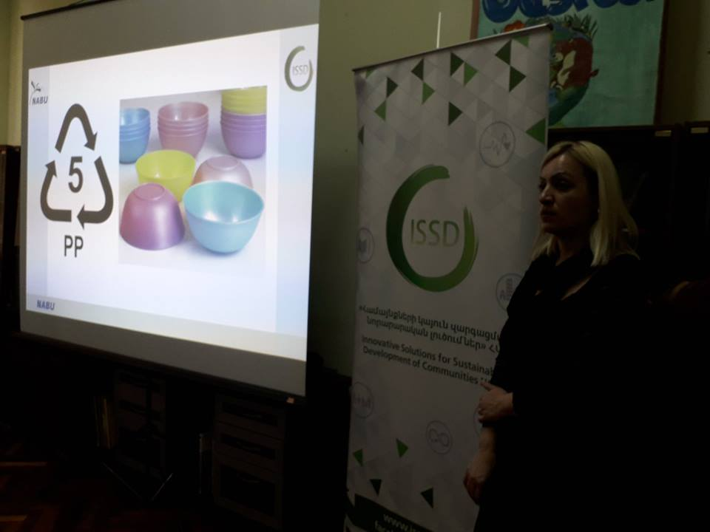
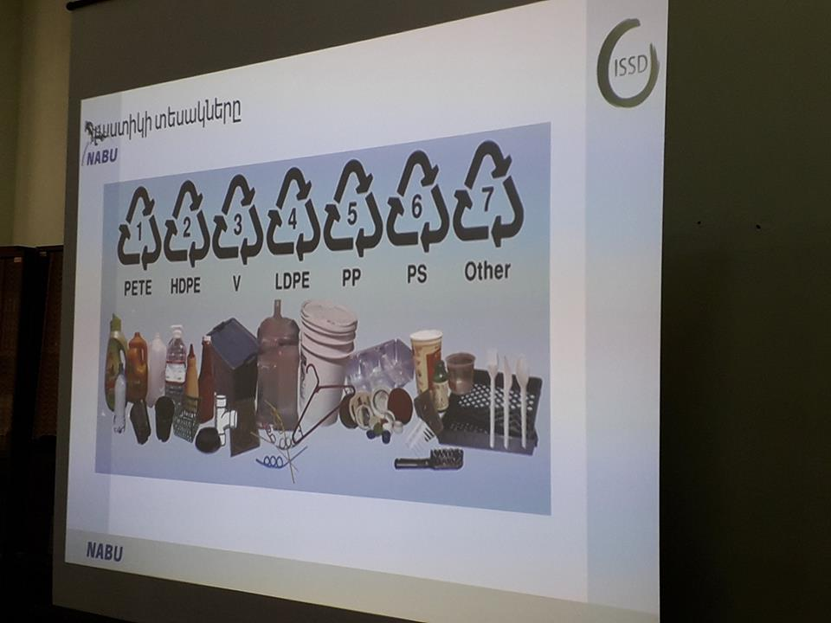

Slide 26


