Slide 1
«ENVIRONMENTAL POLLUTION» -
«ЗАГРЯЗНЕНИЕ ОКРУЖАЮЩЕЙ СРЕДЫ»

Slide 2
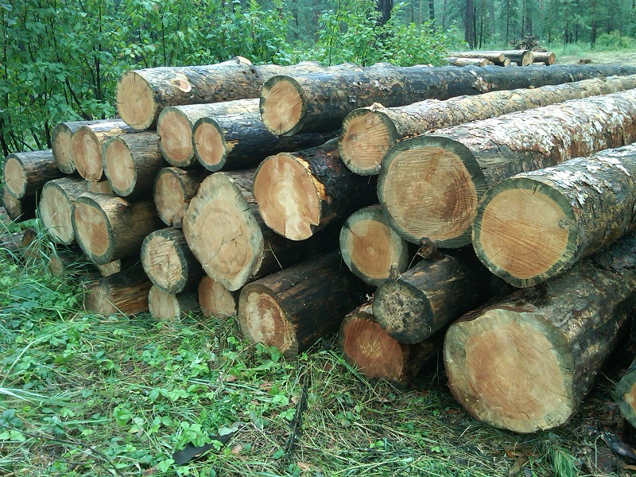
People cut down trees

Slide 3
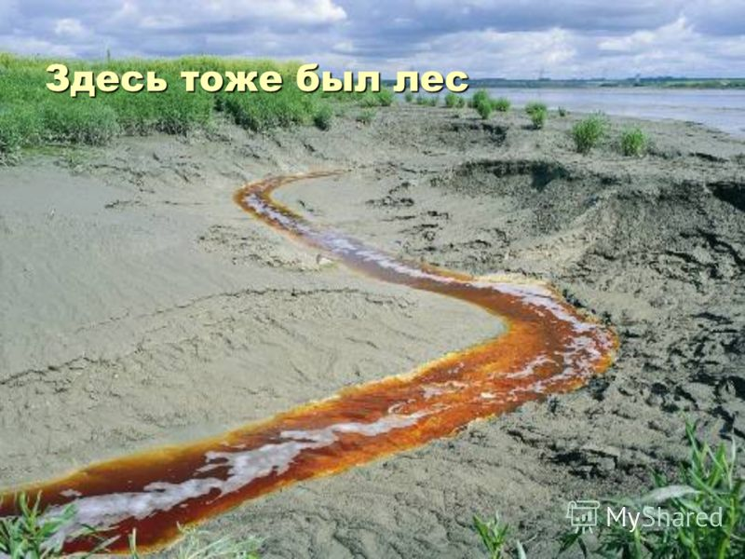
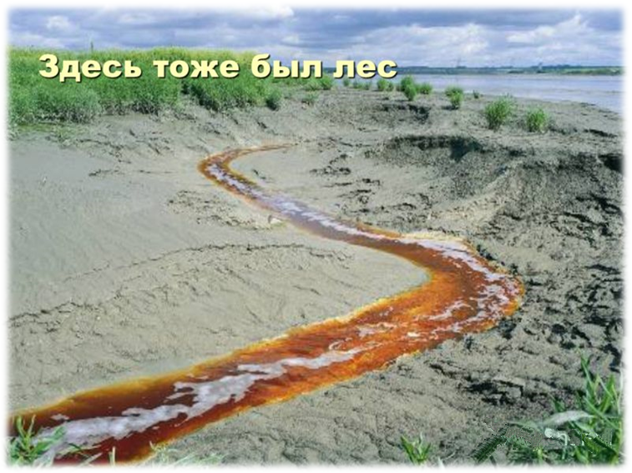
There was a forest here too
fhf

Slide 4
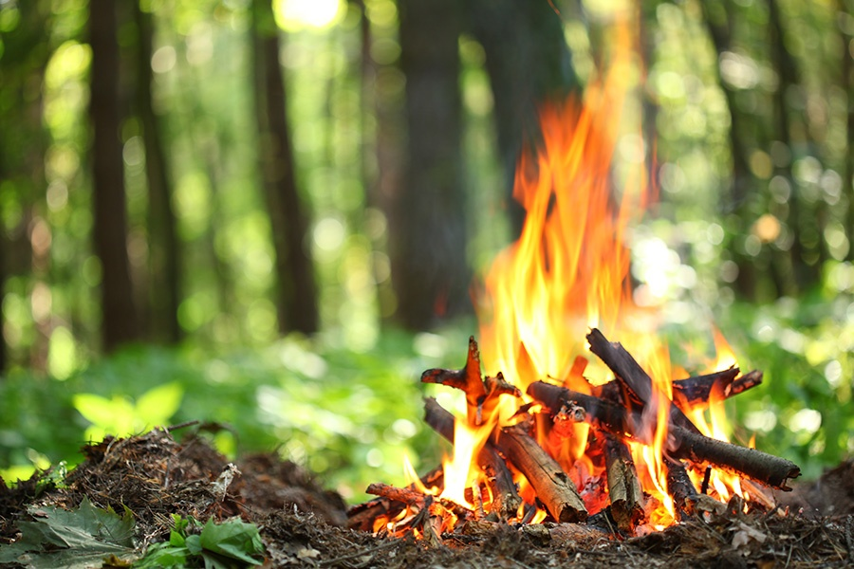
People make wood fires

Slide 5
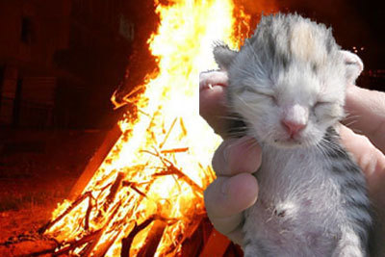
Wood fires kill wood animals

Slide 6
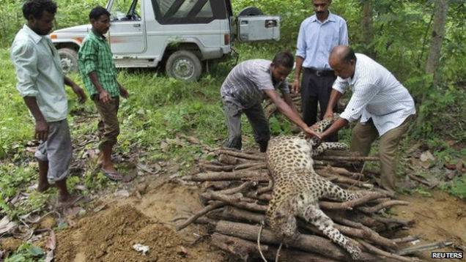
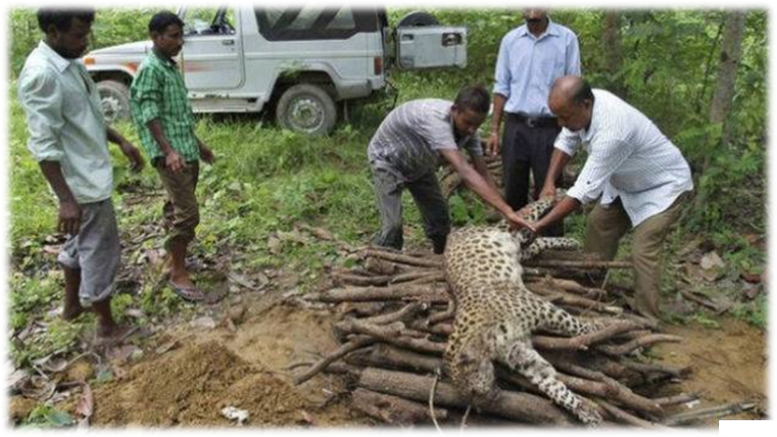
People kill rare animals, for example, leopards

Slide 7
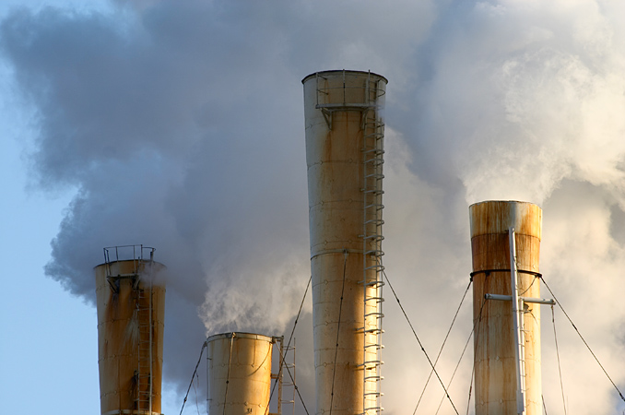
Factories discharge much of the material that pollutes air and water

Slide 8
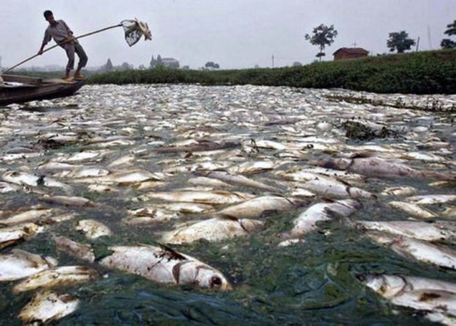
Badly polluted water kills fish and other marine life

Slide 9
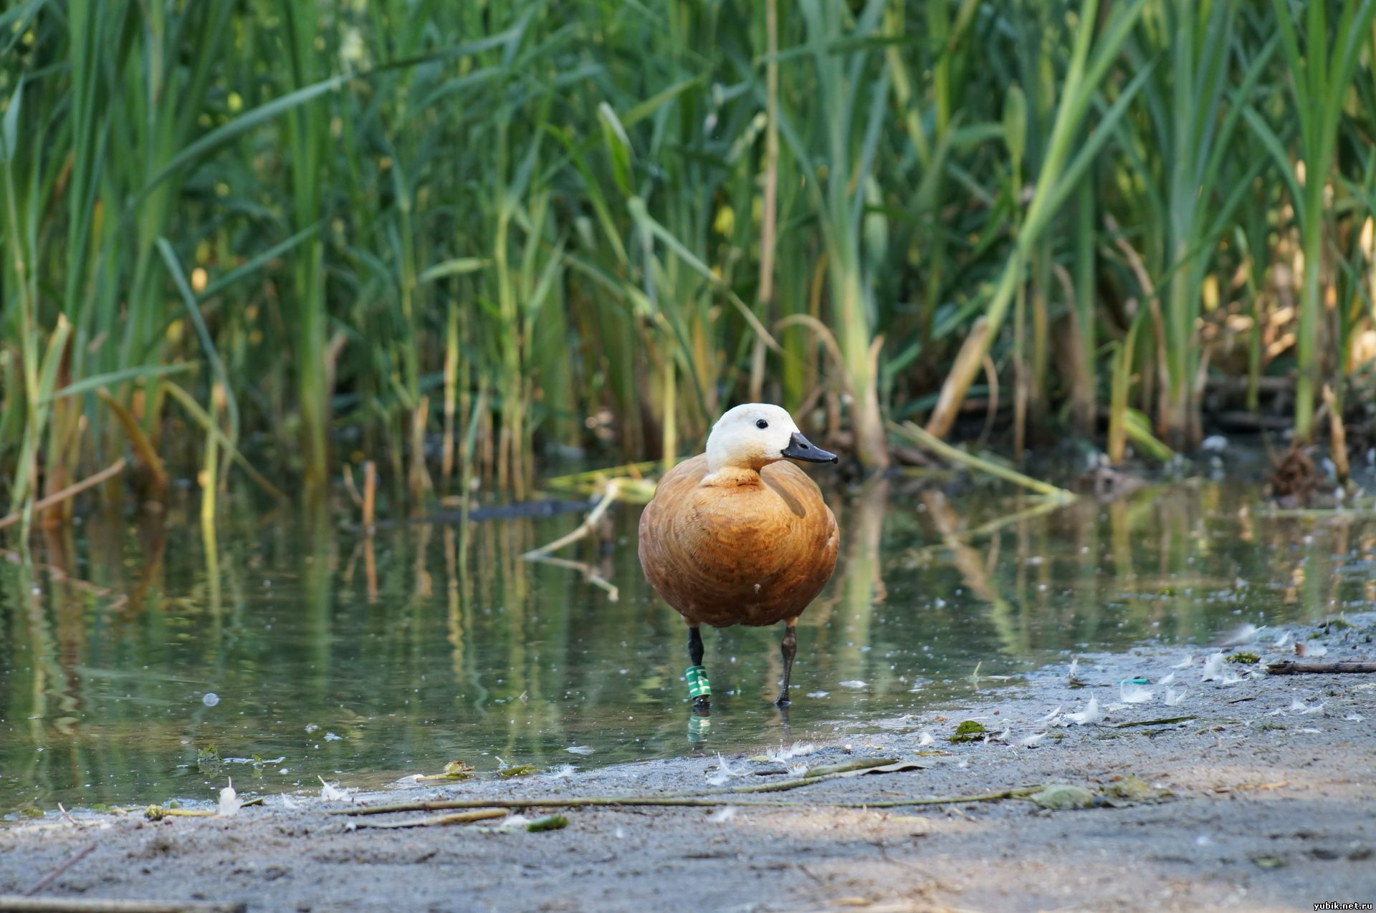
Polluted water can cause illness and even death to birds

Slide 10
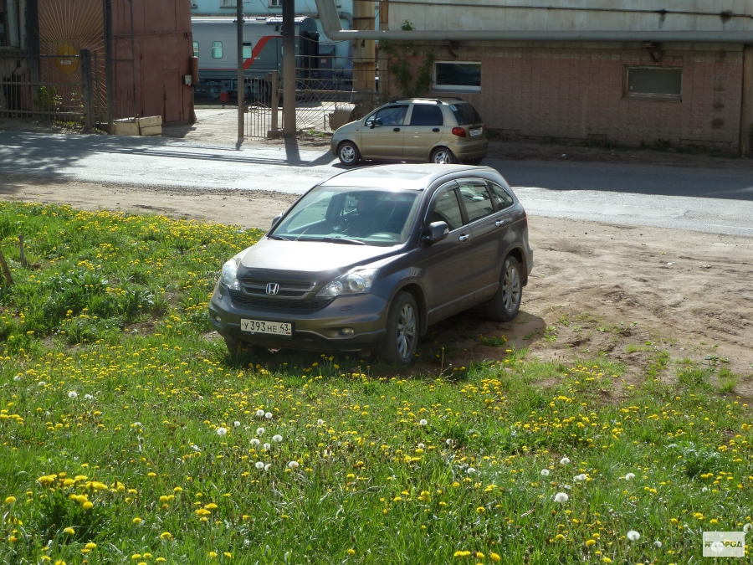
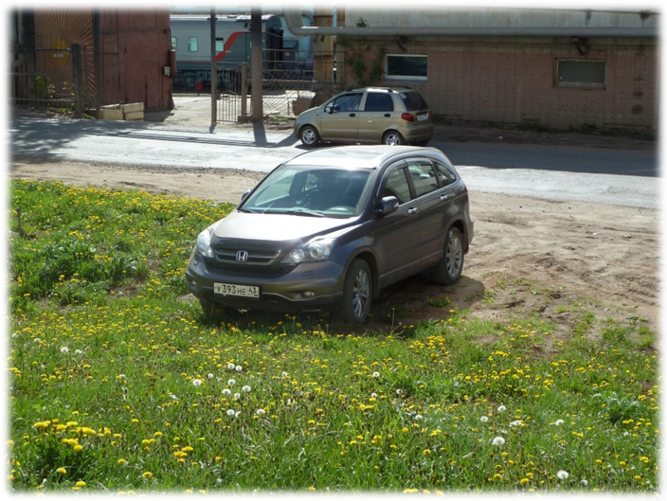
People operate motor vehicles that fill the air with the noise

Slide 11

A lawn is not a place for parking

Slide 12
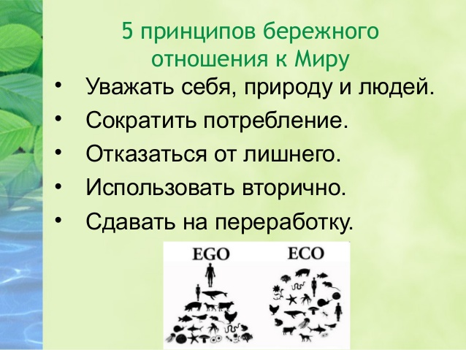
Five principles of careful attitude towards the world:

Slide 13
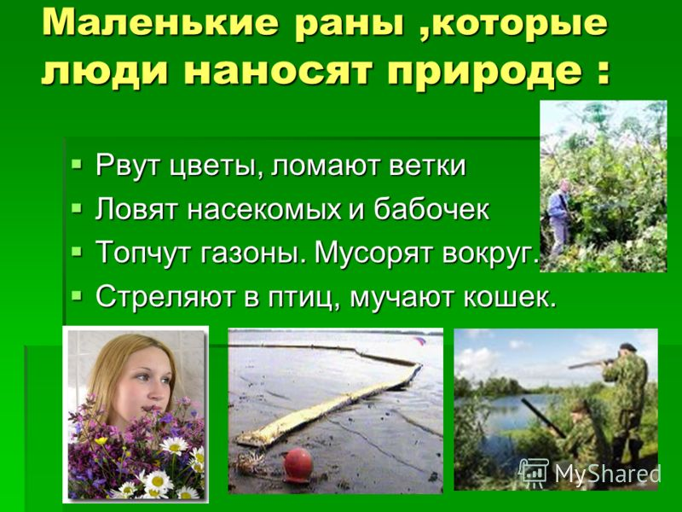
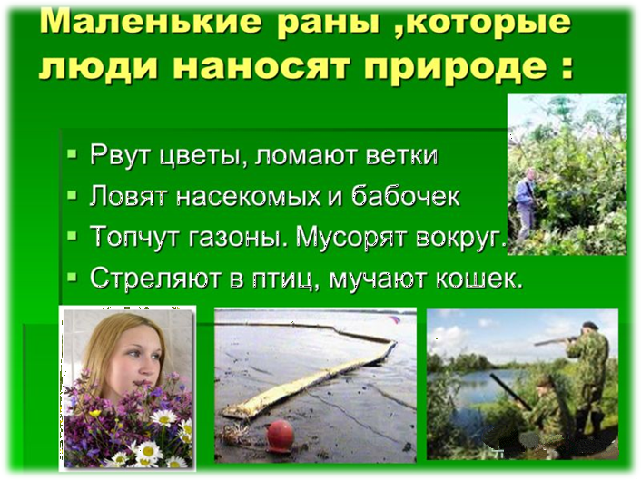
Small wounds that people inflict
on nature:

Slide 14
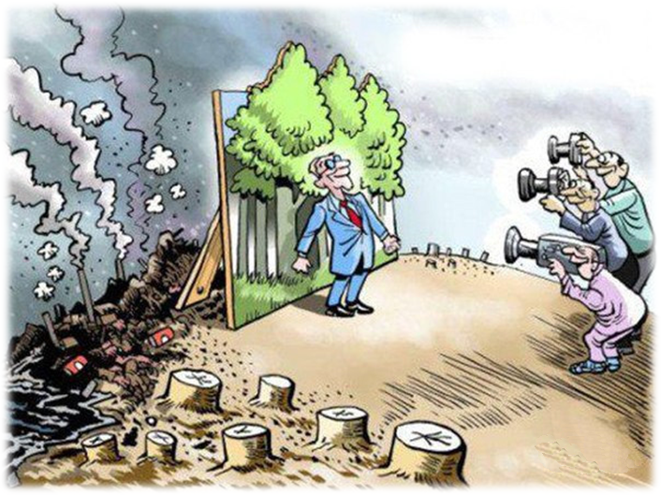
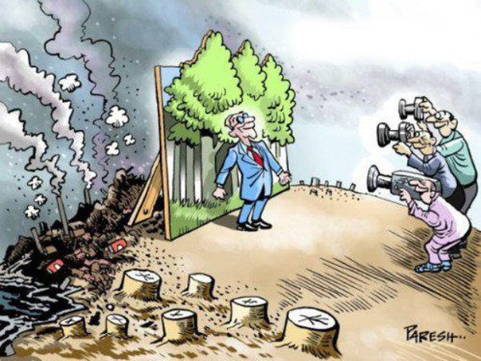
Do you like to lose our naturally beautiful world?
– No, I don’t.
I don’t like to lose our naturally beautiful world.

Slide 15
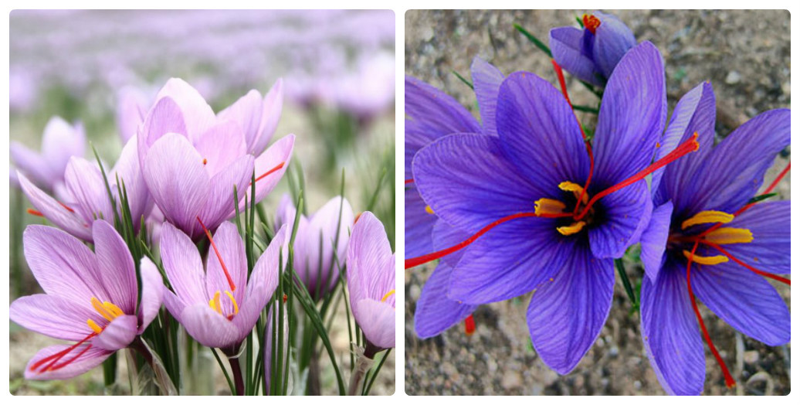
Do you like to smell naturally beautiful rare flowers?
– Yes, I do. I like to smell naturally beautiful rare flowers.

Slide 16
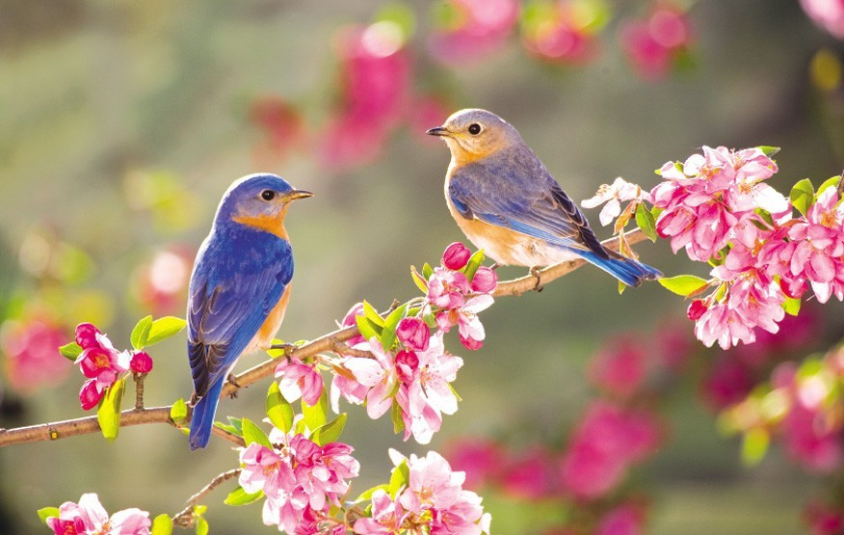
Do you like to listen to naturally beautiful rare birds?
– Yes, I do. I like to listen to naturally beautiful rare birds.

Slide 17
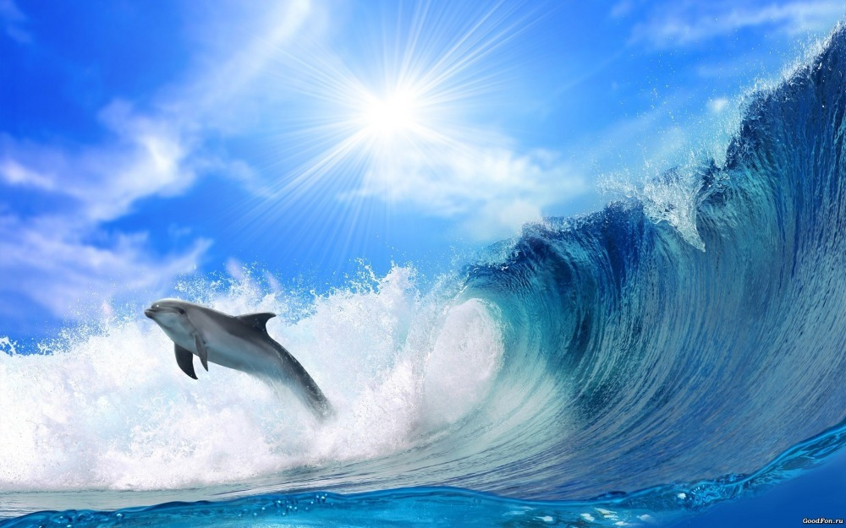
Do you like to swim with naturally beautiful dolphins?
– Yes, I do. I like to swim with naturally beautiful dolphins.

Slide 18
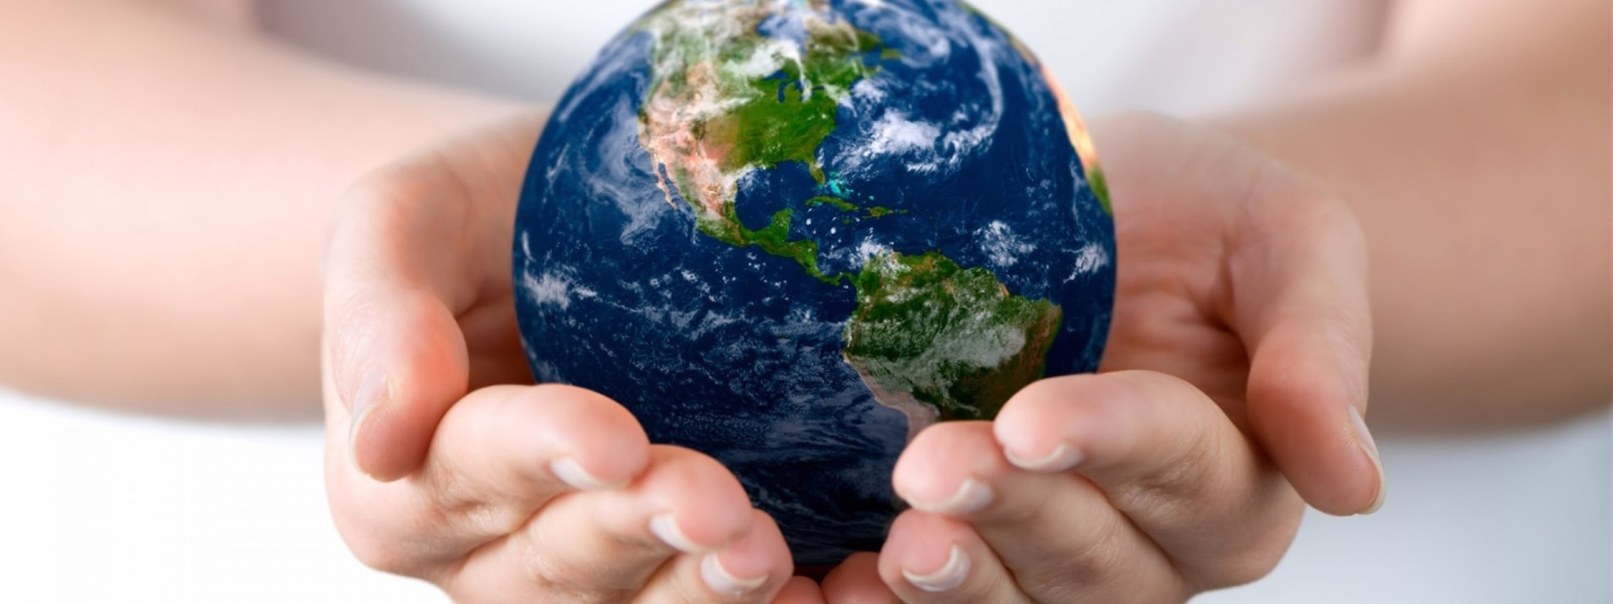
Everything is in your hands!

