Slide 1
My family!
13_25 6_1_13_9_ 12_ 25

Slide 2
Family!
mammy
daddy

Slide 3
Family!
grandpa
grandma

Slide 4
Family!
sister
brother

Slide 5
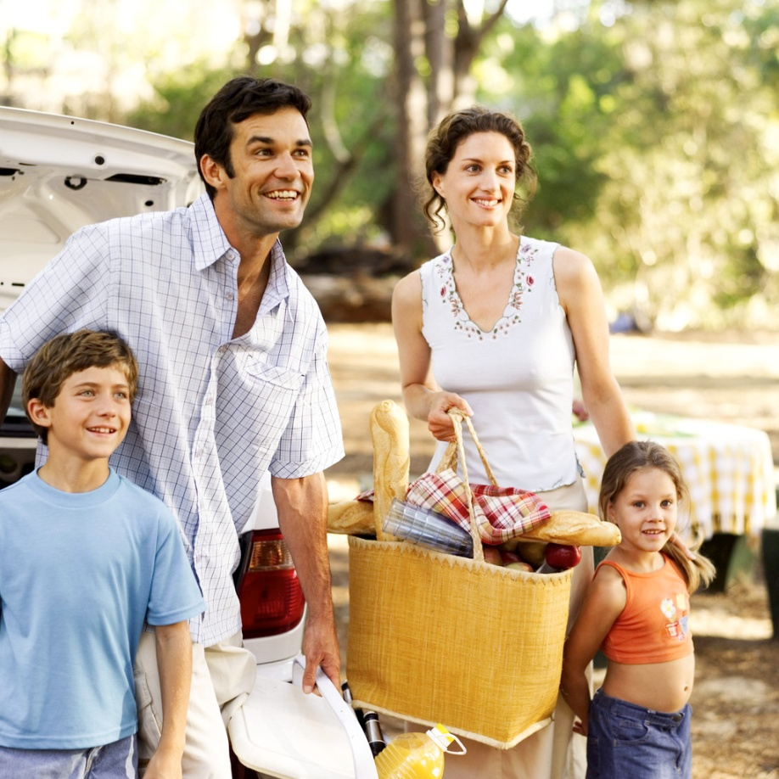
Давайте познакомимся!
This is my…..

Slide 6
Activity time

Slide 7
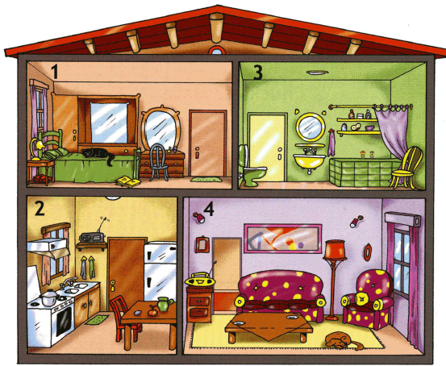
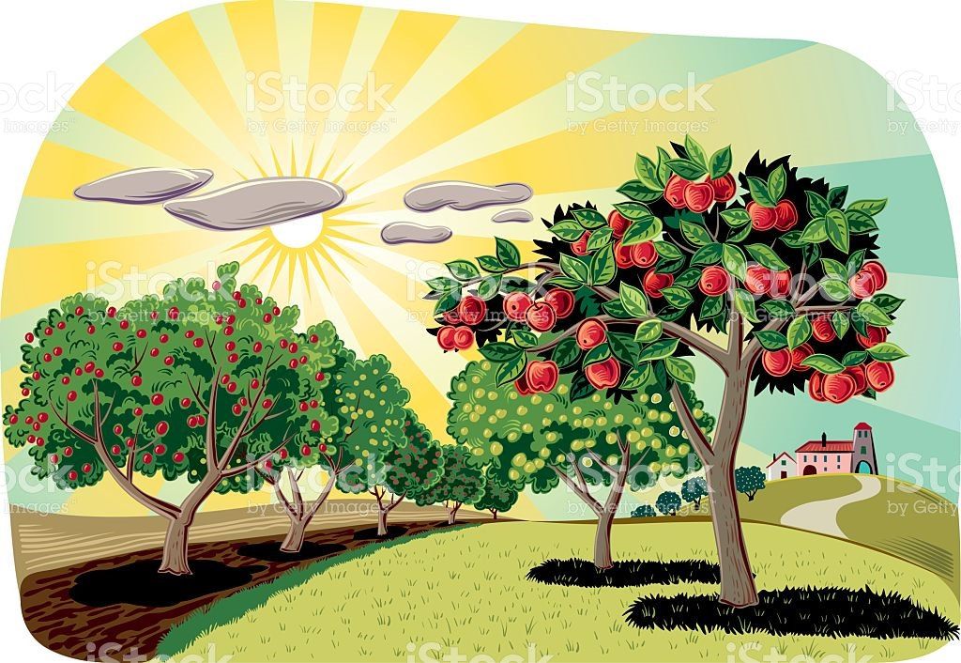

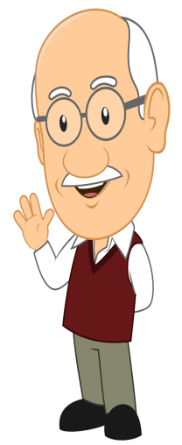

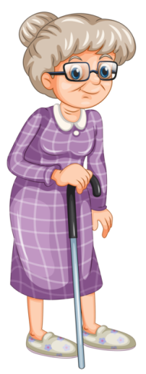
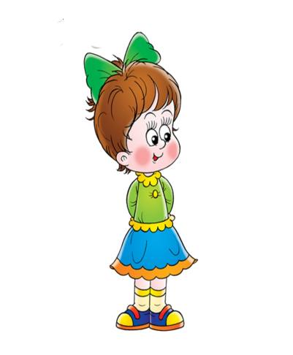
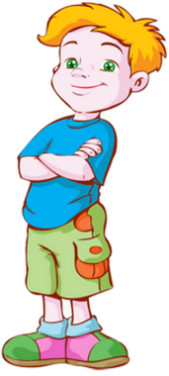








Where is Mummy?

Slide 8

A card for Mummy
Dear Mummy!
I love you very much.

Slide 9
Lets sing a song!
Показать мультик с песенкой!

