Slide 1

THE WORLD IS OUR HOME

Slide 2
Now ask the beast and they will teach you,
And the birds of air and they will tell you,
And the fish of the sea shall declare unto you
Who among these does not know
That the hand of the Lord has done this?
In whose hand is the life of every living thing.

Slide 3
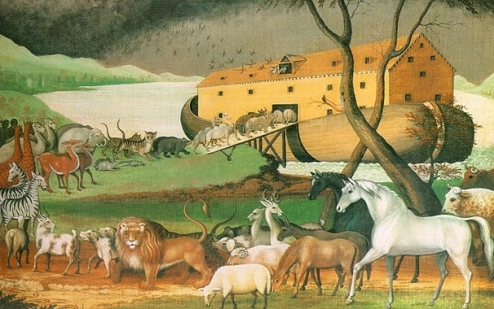

Slide 4
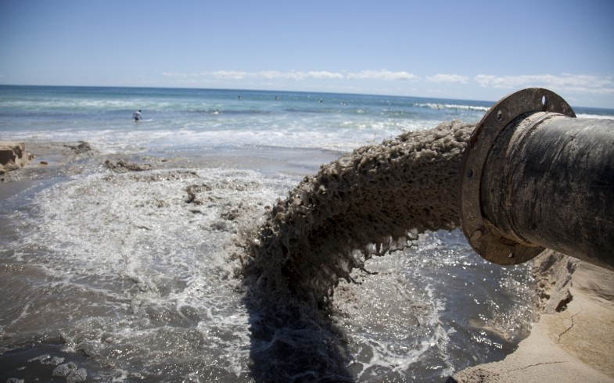
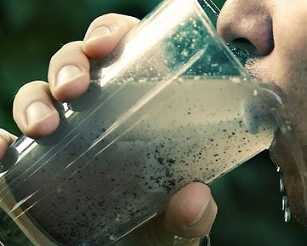
Environmental problems

Slide 5
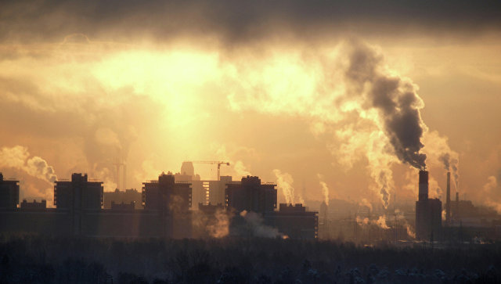
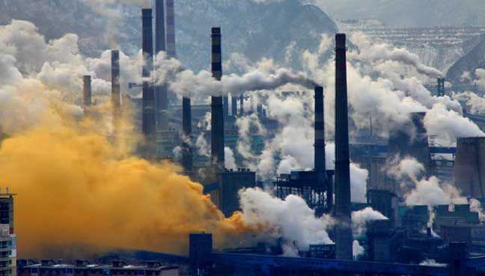

Slide 6
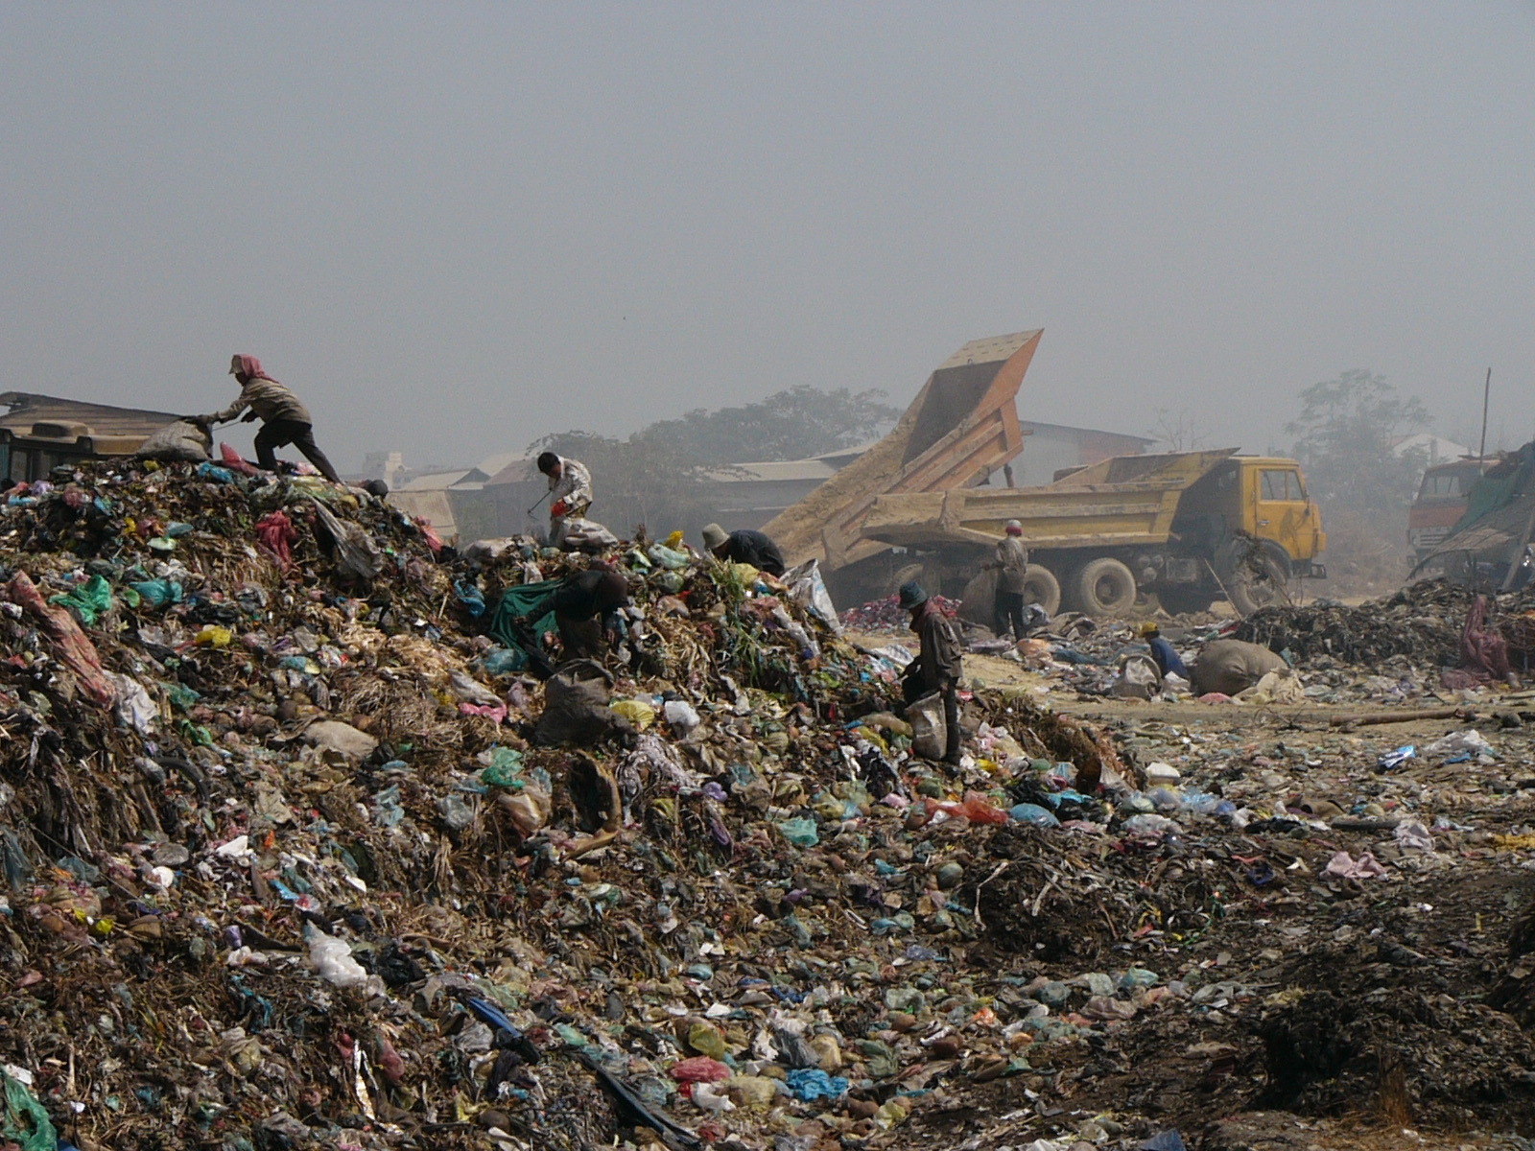

Slide 7
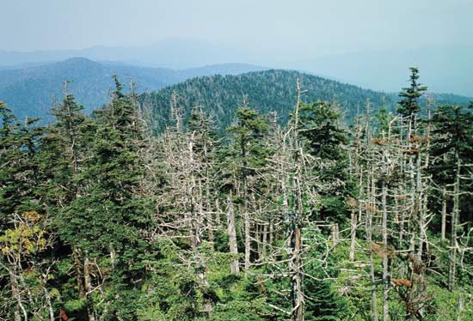
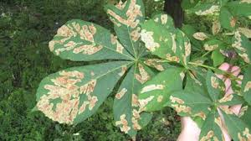
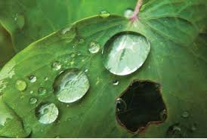

Slide 8
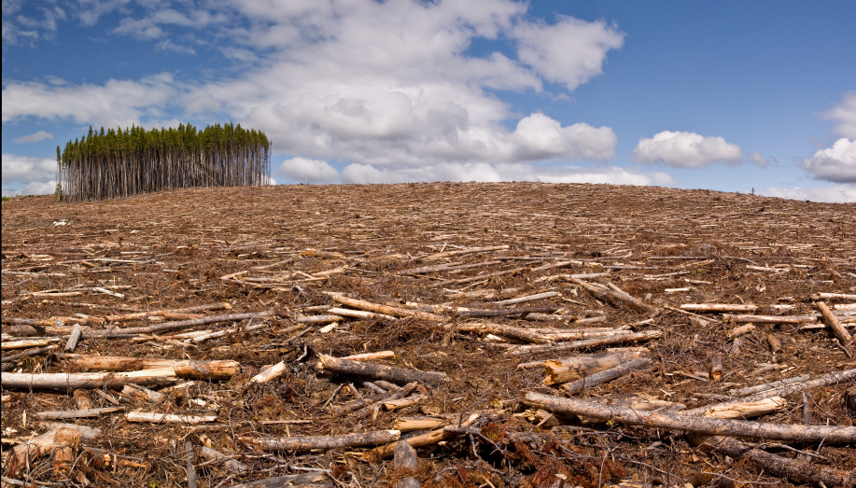
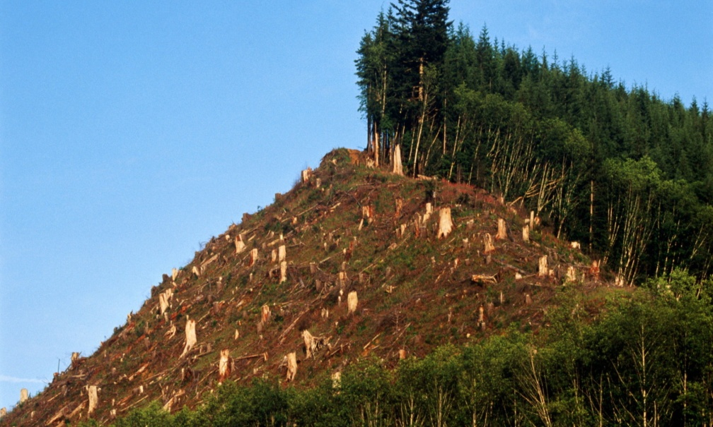
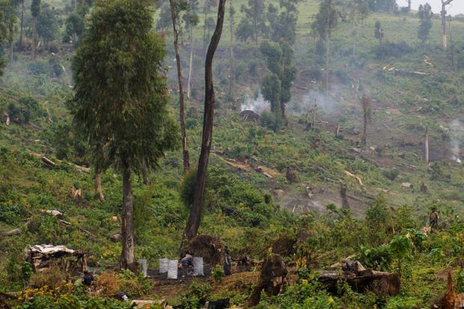
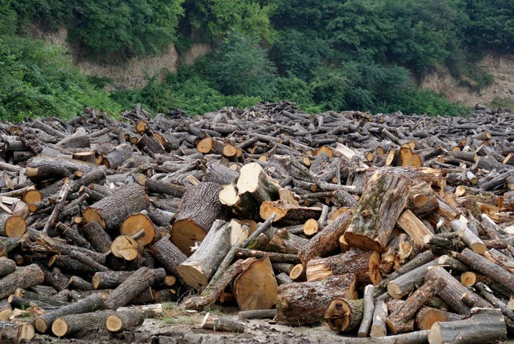

Slide 9
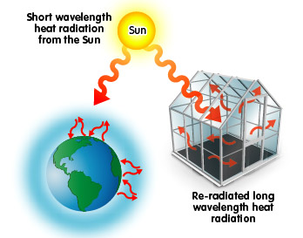

Slide 10
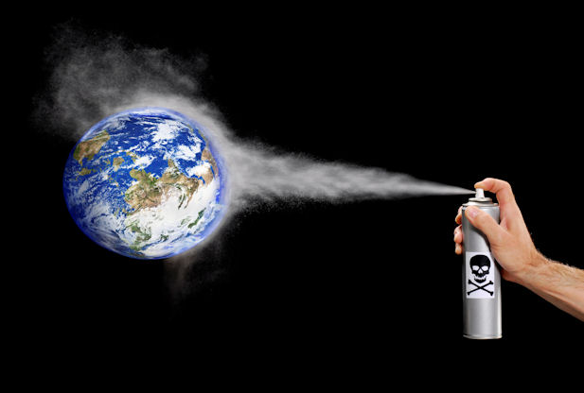
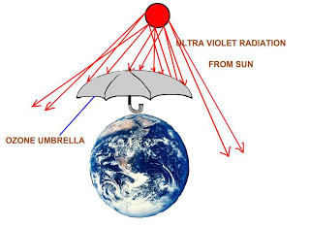

Slide 11
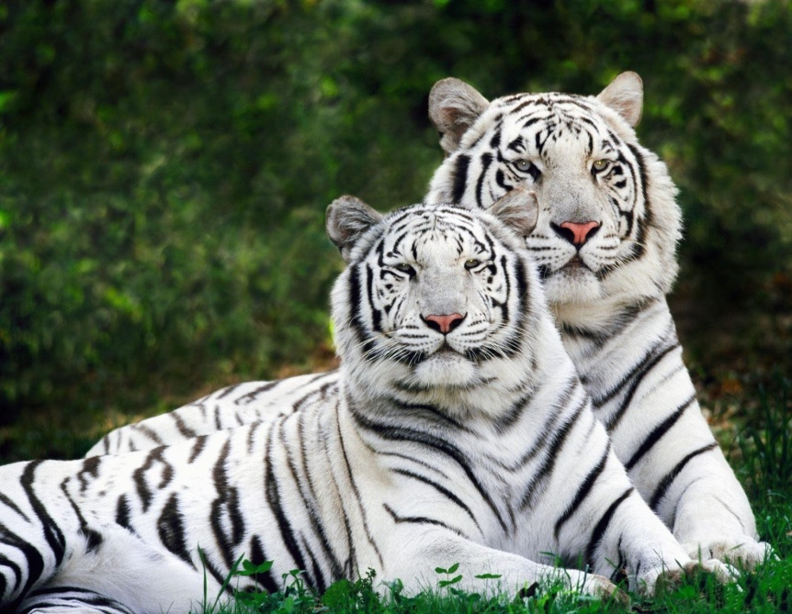
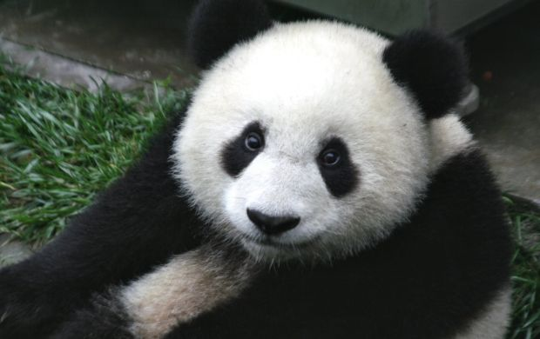
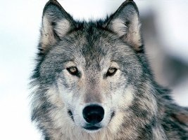
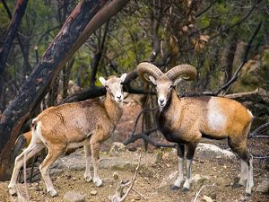

Slide 12
As to me the topics are very interesting for me,and what about you?
Now I want to know what are you going to do at the lesson?

Slide 13
To develop my reading skills
To develop my speaking skills
To develop my grammar skills
To improve my pronunciation
To learn new words and expressions
To learn to sing
To get a good mark
To protect our land
To plan trees and flowers
To look after animals

Slide 14

So I wish you good luck. Let’s start our lesson

Slide 15
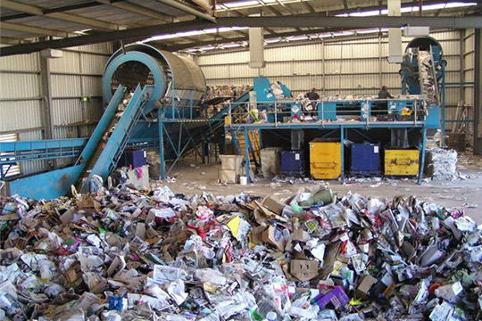
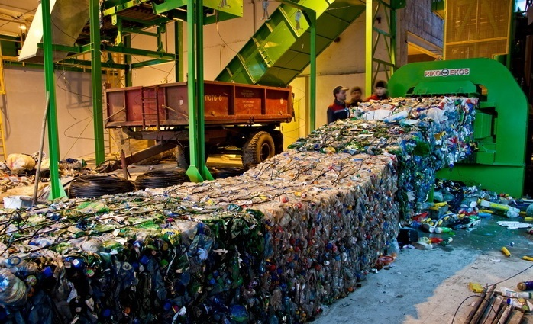
The main reason of pollution is rubbish
If we recycle and reject we will produce a lot less garbage and help to keep our planet green.

Slide 16
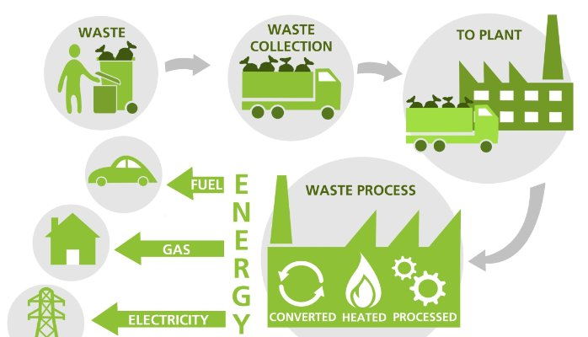

Slide 17
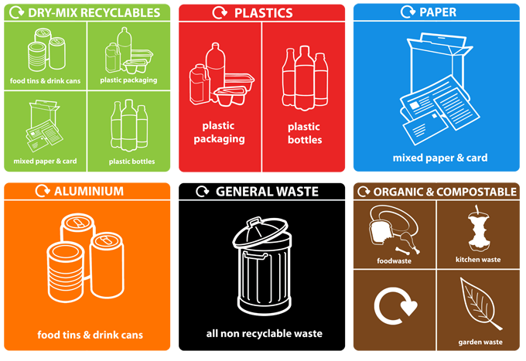

Slide 18
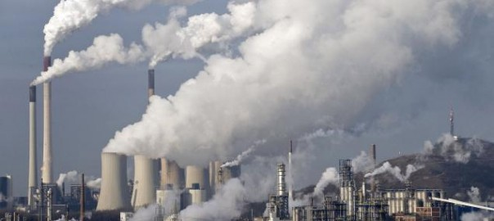
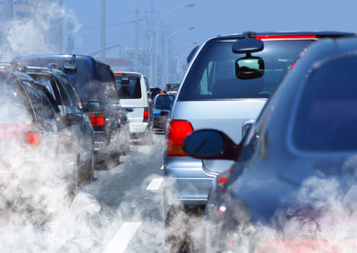

Slide 19
Air pollution
What must we do?
What can people do to stop pollution of our environment?
How can we help to prevent pollution of the environment?

Slide 20
Increase tax on petrol
Close the city centre to traffic
Create special roads for bicycles
Build new metro stations
Use electric cars
Plant trees

Slide 21
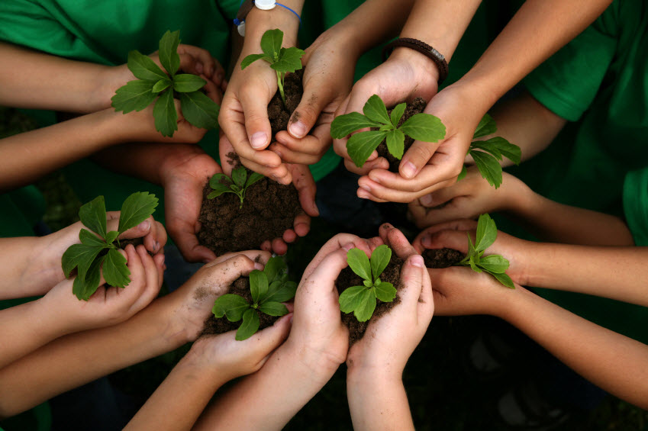

Slide 22
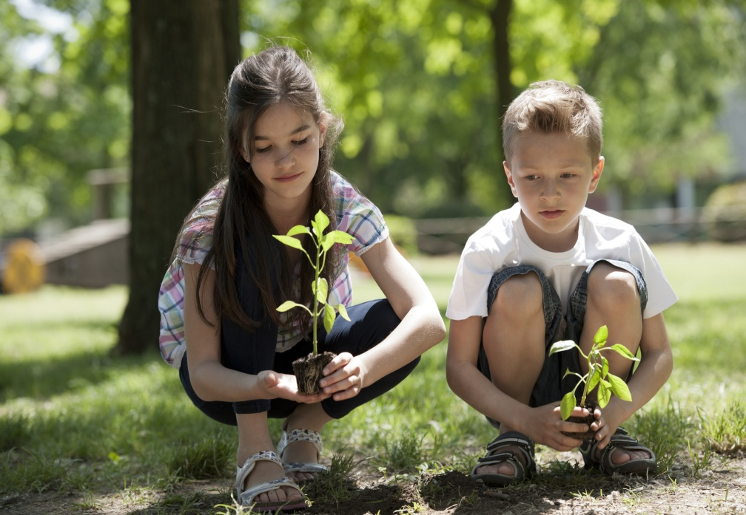
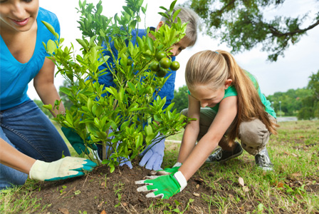
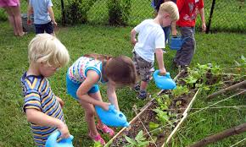
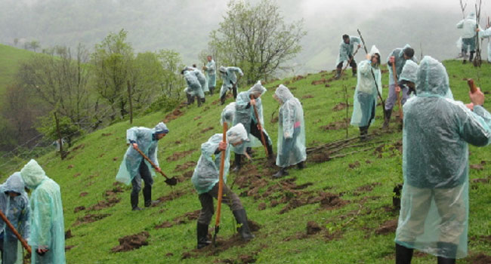

Slide 23
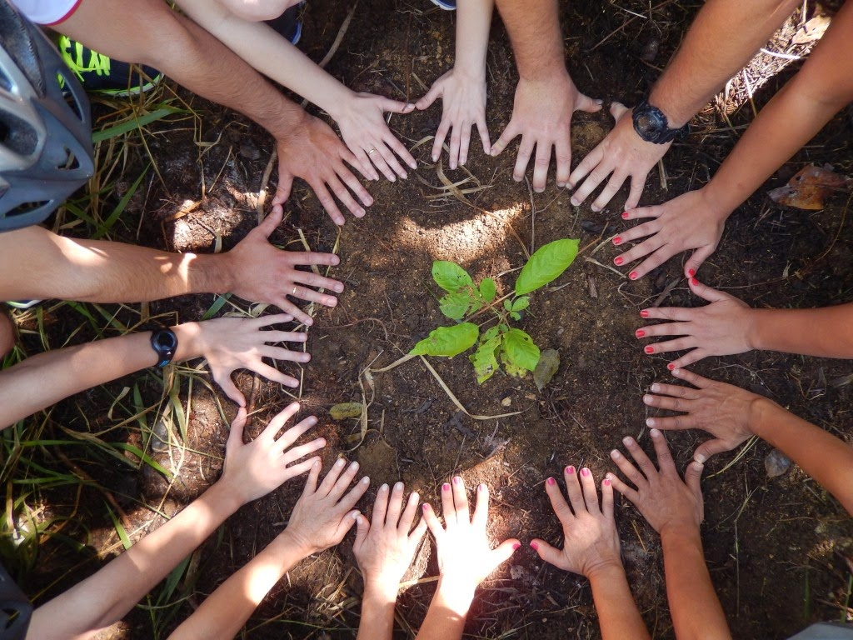

Slide 24
Wye do people like trees?
Why are trees one of the most valuable parts of the environment?

Slide 25
They offer shade and shelter which in turn reduce the amount of energy needed to heat and cool nearby buildings.
They give us a lot of fruit to eat and the place for children to play.
They remove impurities from the air we breath.
Urban trees provide a home for birds,small animals and butterflies.

Slide 26
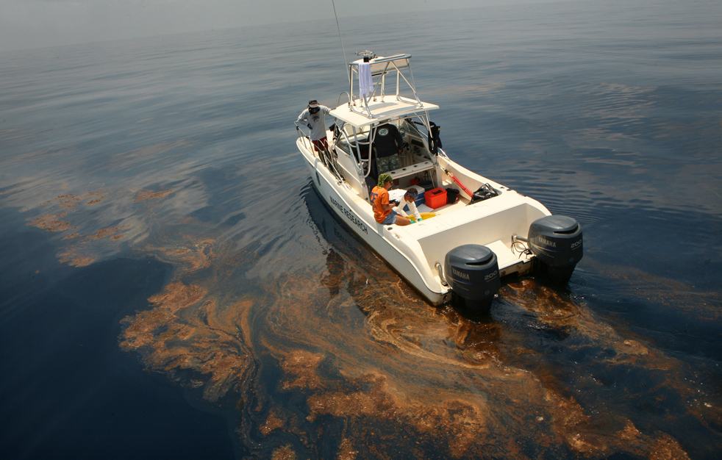
The seas are in danger

Slide 27
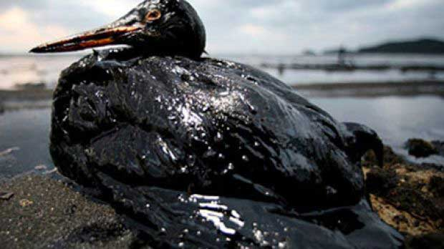
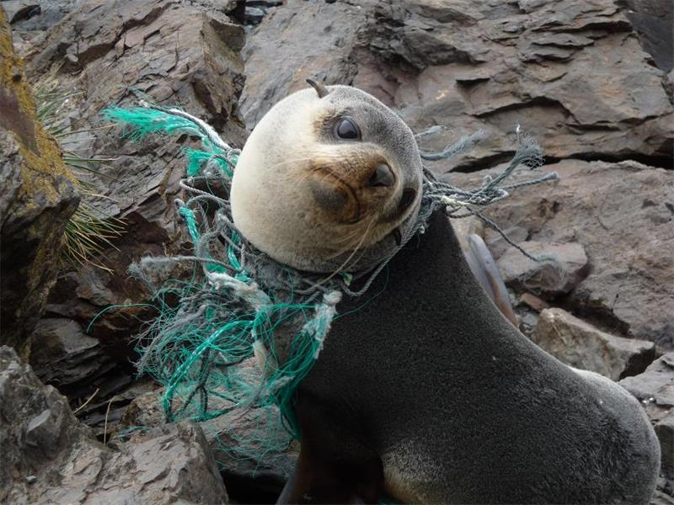
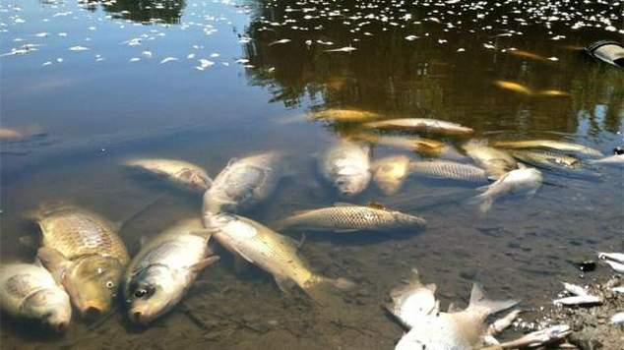

Slide 28
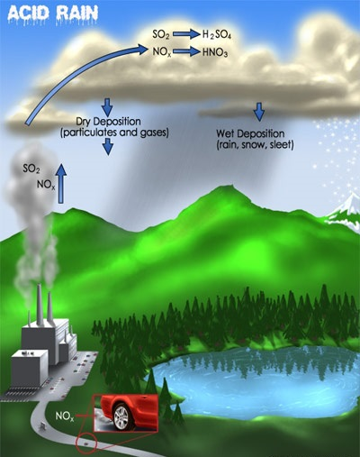
Another source of global danger is acid rain
What causes acid rain?
Natural causes:volcanoes and decaying vegetation.
Human causes:Factores and other productions using fossil fuels.
What is in acid rain?
Acid rain consist of gasses.
These gasses react in atmosphere with water, oxygen and other chemicals to form various acidic compounds.

Slide 29
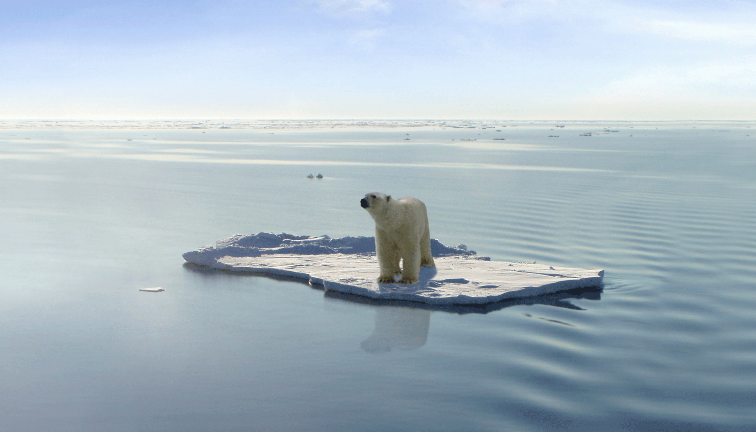
Dissappearing animals

Slide 30
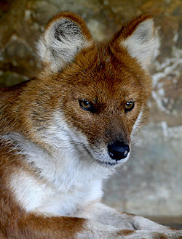
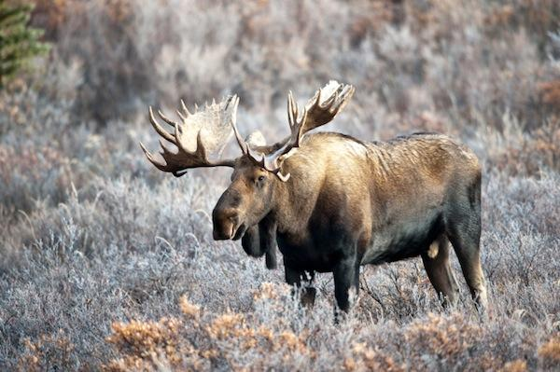

Slide 31
International organizations
Greenpeace
The World wildlife
Friends of the Earth Trust
The United States Society of Ecological Economics
The European Ecological Federation
United nations Environment Programme
International Association For Landscape Ecology

Slide 32
Brush your teeth, but turn off the tap.
Take a shower, don’t have a bath
Walk or ride your bike to school
Recycle paper, that’s the rule.
Unplug the TV, switch off the lights,
Go out with friends, don’t surf all night,
Give old clothes to charity
Join a green group
Plant a tree.
Can you understand?
What do we have to do?
There’s only one world,
It’s up to me and you!

Slide 33
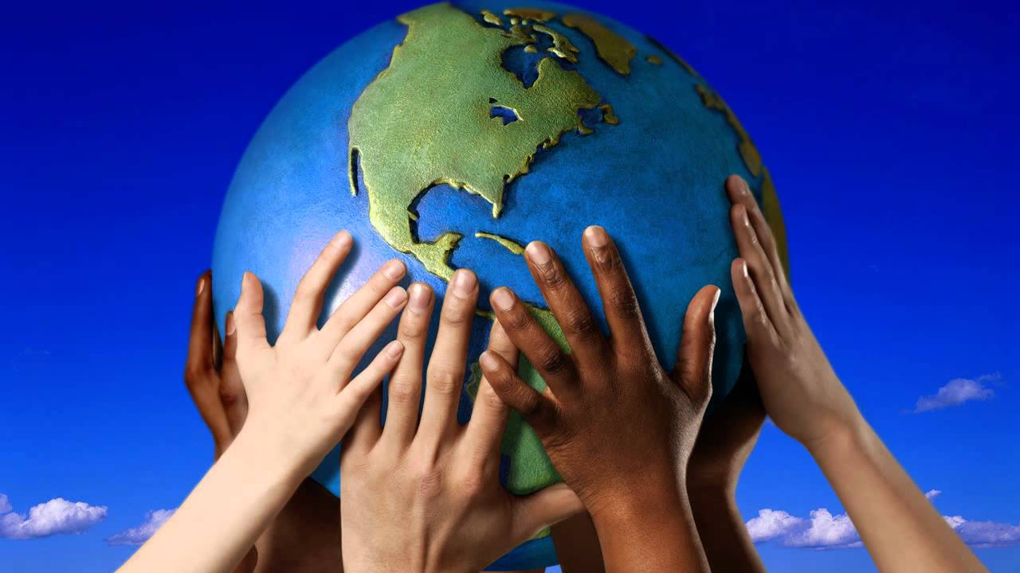
THANK YOU

