Slide 1
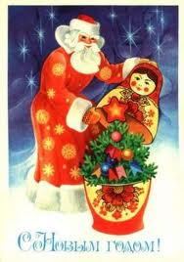
The Russian National Holidays
And Festivals
Agafonov Alexander
7 “ V ”
Teacher: Shcherbinina N. M.
Moscow

Slide 2

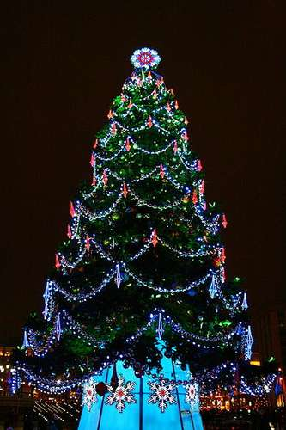







About Russian Holidays
There are a lot of holidays in Russia! They are: New Year, Russia Day, Orthodox Christmas, Maslenitsa, Victory Day, Day of People’s Unity, Easter and many, many others. When people celebrate these holidays they eat traditional food, sing, dance…

Slide 3

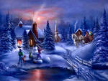
NEW YEAR
The 1st of January is the day when Russian people celebrate New Year. People decorate their houses and new year trees.The Russians eat traditional food. This is the day when gifts are given by Ded Moroz.

Slide 4

Russia Day
The 12 of June is the day when Russian people celebrate Russia Day. We celebrate the day when Russia became an independent country; the Republic of Russian Federation formed after the break up of the Soviet Union in 1991. This is an official holiday.

Slide 5

Maslenitsa
This festival marks the end of winter and the beginning of spring. During this festival people make pancakes, sing traditional songs and dance traditional dances or go visiting each other.

Slide 6

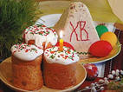
Easter
On this spring day people prefer to go outdoors and take part in all kinds of outdoor activities.

Slide 7
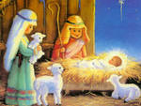

Orthodox Christmas
The 7 of January is the day when Russian people celebrate Orthodox Christmas. This day is celebrated with all-night services in church.

Slide 8

Victory Day
It celebrates the end of the Soviet Union’s participation in World War II in Europe. Parades and processions of veterans are held in big cities. People lay flowers in Moscow’s Park Pobedi and at the Tomb of the Unknown Soldier.

Slide 9

International Women’s Day
This is a day off. Probably the busiest people on this day are flower-sellers. Men and young boys try to please their mothers, sisters and friends by giving them presents, flowers and chocolates.

Slide 10
References
Student’s Book “ O.V.Afanasyeva , I.V.Mikheeva”
www.caoinform.ru
m. izotov.promodg.ru
www. foto.lib.ru
www. giport.ru
www.art-apple.ru
www.neo-kids.ru
images.yandex.ru
basik.ru
gusi.yanoo.ru
www.intersocium.com

