Slide 1
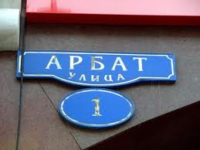
Old Arbat
The presentation of
Mikhaylovoy Elizavety.
Теасher-Shcherbinina N

Slide 2
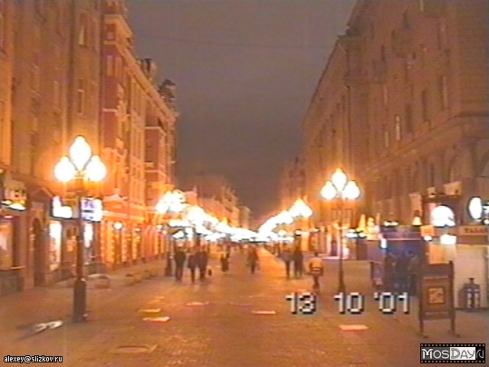
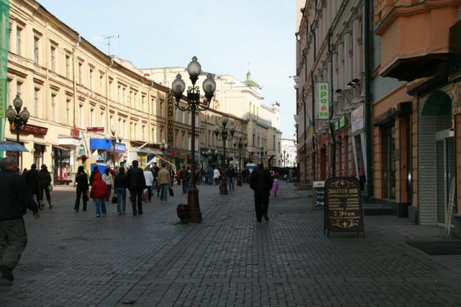
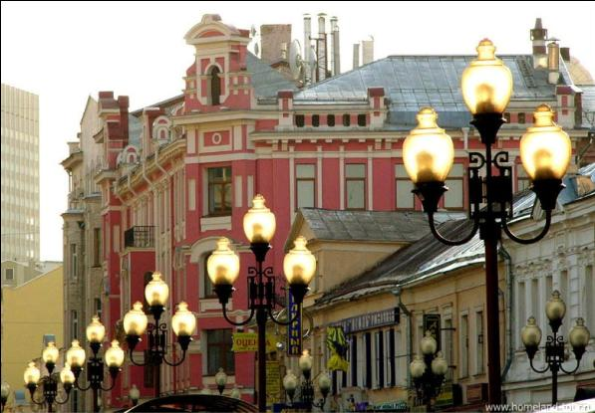
Old Arbat is one of the oldest and one of the most famous streets of Moscow.

Slide 3
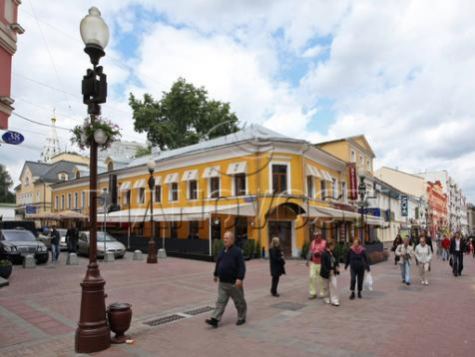
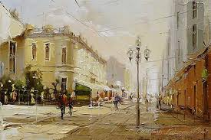
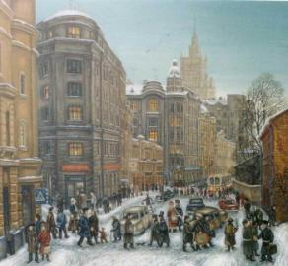
It was built as a living street without shops. First shops appeared in this street at the end of the IX century. The houses of many floors turned up there at time too.

Slide 4
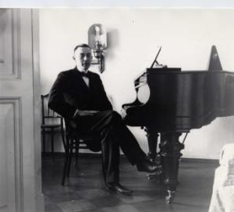
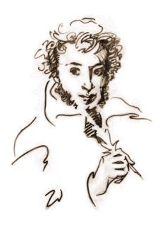
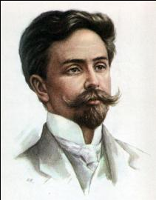
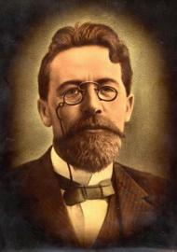
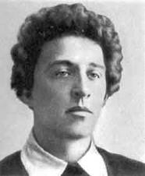
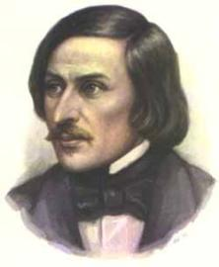
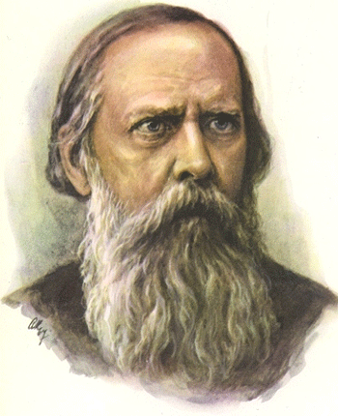
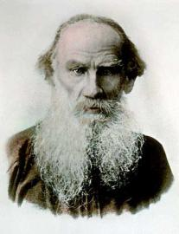
Doctors, writers, lawyers lived there. At different time A. Pushkin, S. Rakhmaninov, A. Skryabin, N. Gogol, L. Tolstoy, M. Saltykov – Tschedrin, A. Chehov, A. Block and others lived in Arbat and visited it.

Slide 5
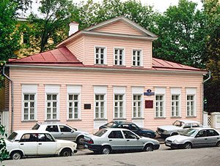
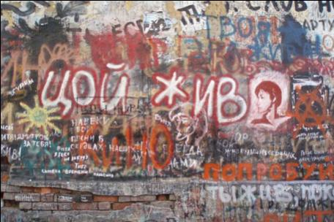
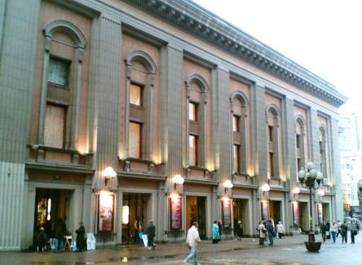
Now there is the Vahtangov theatre, the Pushkin’s museum, the Lermontov’s museum, the Tsvetaeva museum. There is also a wall of V. Tsoy’s remembrance.

Slide 6
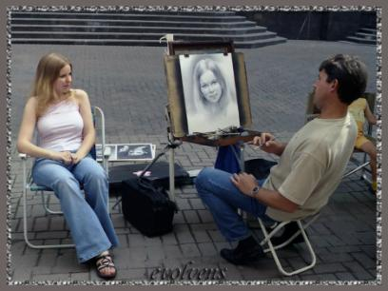
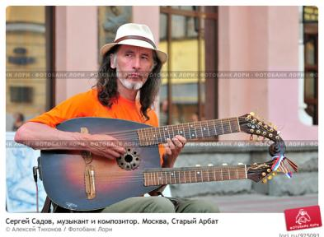
Nowadays Arbat is a centre of cultural life of our capital, a lot of musicans, poets and artists gather in it.

