Slide 1
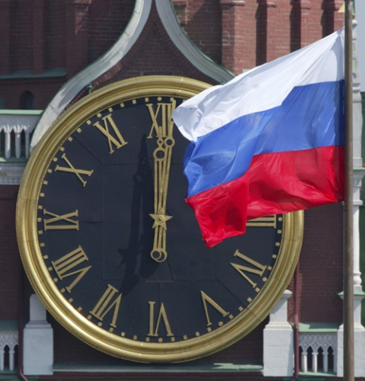
Russian customs, traditions and holidays

Slide 2
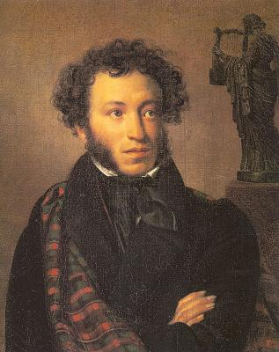
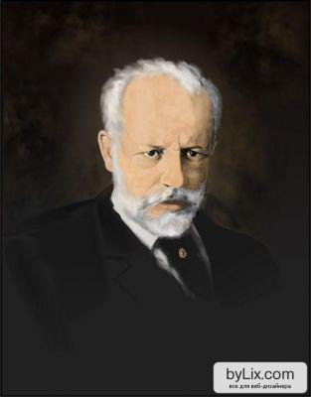
Russian people
Almost every nation and country has a reputation of some kind. The Englishmen are reputed to be cold, reserved, rather naughty easy-going and fond of sport. They are the nation of stay-at-homes. «There is no place like home», they say.We know much about English traditions and customs but now I’d like to say a few words about the traditions of my native land-Russia. First, about Russian people. To my mind, the main traits of their characters which differ them from other people are hospitality, their «open heart», «golden hands», wise Russian fairytales reflect this wisdom. Our people are hardworking, patient, never loosing hope for better life. The Russians are the talented nation. Russia gave the world beautiful names of Pushkin and Lermontov, Chaikovsky and Repin, thousands of names of world famous poets, writers, composers, scientists. All of them are the pride of the nation because they sand the beauty of our nature and people.

Slide 3
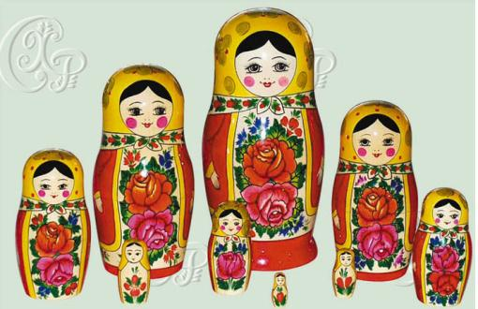
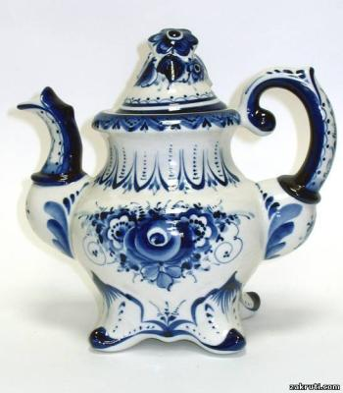
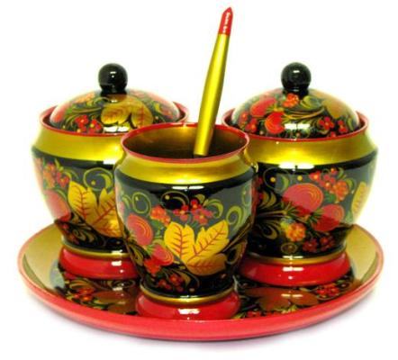
Creation
Besides these great names in literature and music, our country is famous for Russian traditional specific crafts,its skilled craftsmen. Painted boxes of Palekh, colored shawls of Pavlov Posad, clay toys of Dymkovo, laces of Vologda are known all over the world. The names of Gzhel and Khokhloma are considered to be the symbols of Russia as well as matryoshkas and samovars. The history of khokhloma goes back into the 17th century. Producing of tableware-dishes, spoons, mugs was begun at that time in the villages of Suomino and Khokhloma in the Nizhniy Novgorod Province,on the banks of the great Russian river Volga. Many carpenters, painters have been working since then reviving traditions of old masters. The Khokhloma style is characterized by using plant elements in painting the tableware. The prevailing colors are black, yellow, golden, green and red. And nowadays this craft is sure to be saved, it will be developed and brought into the future by the new generation of painters.

Slide 4
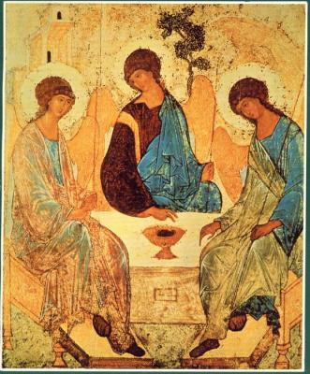
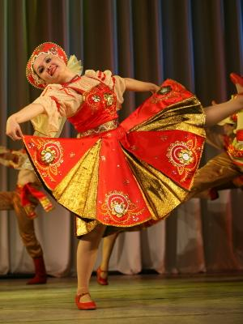
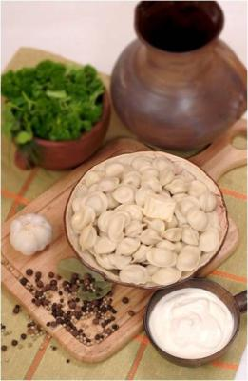
Customs
The reviving of old crafts is connected with the reviving of the traditional arts of all people inhabiting our big country. There are 100 of them. They revive their culture, costumes, dances and language. It is the revival of our souls. Now we celebrate the forgotten holidays - Troisa, Maslenitsa, Easter. We again sing Russian folk songs and chastushki, dance Barinya and perform khorovods, ride in troikas. Traditional Russian cooking is world-famous for such dishes as okroshka, shi, pelmeni, kurnik, kvass. We begin to build and reconstruct churches. The example of it is the building of the Cathedral of Christ the Savior in Moscow. It is the symbol of reviving human feelings, national pride and patriotism.

Slide 5
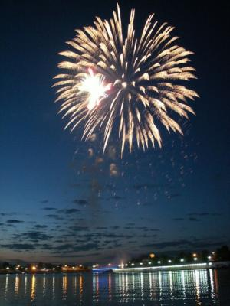
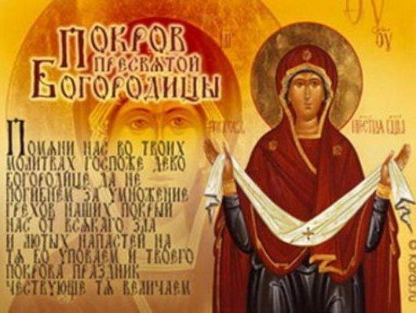
Holidays and traditions
The Russian love for holidays is known all over the world. We adore holidays, indeed. But who does not? Perhaps our love for holidays is special for its indiscrimination – anything goes, just give us a chance to break the daily working routine and indulge into the surfeits of merry-making, eating and drinking. Of course, every holiday is good in its own way and we are not indifferent to their meaning and ritual side. Yet, it is not rare in this country that holidays vary both their attributes and meaning.
Thus, Russian holidays present a mixture of new and old, religious and secular, professional and private. National holidays reflect multicolored Russian history. Christian traditions were combined with pagan ones and therefore strongly connected to the seasons and agricultural cycle. Church holidays were mixed with those introduced during the communist regime. And we do not mind: every holiday deserves celebration. When a national holiday falls on a weekend day people enjoy additional day-off because it is considered to be unfair to miss either a holiday or a weekend. Here is an outline of our major holidays.

Slide 6
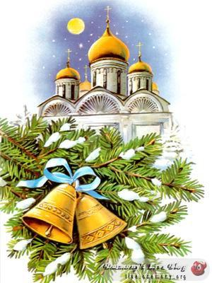


The New Year and Christmas
January 1 - The New Year
The New Year is the first in calendar and in popularity. It will be true to say that now the New Year is a greater holiday than Christmas in Russia. Long before December 31 sparkling fir trees appear in the streets, shops, offices and houses, bringing the joy of festive preparations and hope for happy miracles in the coming New Year. It is time to make wishes and presents to all friends and relatives. Children are looking forward for Father Frost (actually he is Grandfather Frost - Ded Moroz in Russian) and his granddaughter Snow Maiden (Snegurochka) to arrive at night and leave presents under the fir-tree. The grown-ups traditionally stay up for the whole night, making merry with friends and relatives.
The New Year celebrations slip to Christmas festivities and go on till January 8 - all these days from December 31 to January 8 are official days off now.
January 7 - Christmas Russian Christmas comes two weeks later than in other countries, on January 7. This difference is due to the Orthodox Church that follows the Julian (old style) calendar. However, our 'spacious soul' cannot but feel with the rest of the world celebrating this fairy holiday on December.
Christmas came to Russia in X century to substitute for pagan festivities of the winter solstice. Traditionally, people celebrated the Christmas Eve (January 6) with their families. The next day, however, carousing and merrymaking started, including masqueraded visits to neighbors with song singing, round-dancing and playing traditional games. Russian Christmas is rich with beautiful traditions. One of them is called Kolyadki. At Christmas night young people put on fancy dresses, gather in a noisy crowd and go in every house on their way, singing carols and merry songs. Hosts of the houses thank singers with all the kinds of sweat stuff like candies, chocolates and pastry. Among other Christmas traditions are wishes of wealth and happiness for everybody and snowball games.
It was a custom for young ladies to tell fortune on these days; lots of fortunetelling methods have kept till days - yet they are not so widely used, of course. In Soviet times they abolished Christmas as an official holiday. In spite of that, it was still secretly celebrated by many people.

Slide 7
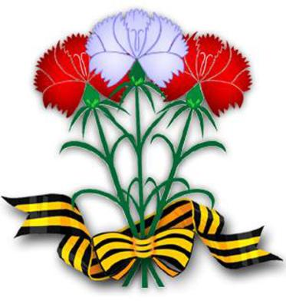
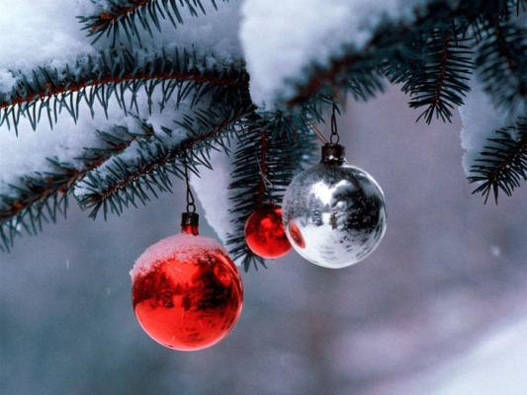
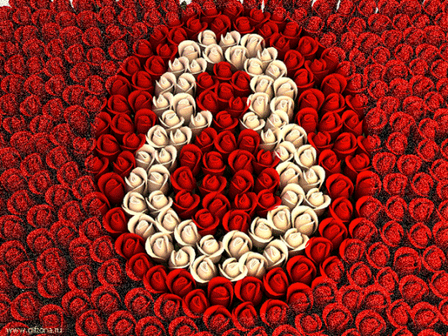

The Old New Year's Day,Man's Day and International Women's Day
January 14 - The Old New Year's Day Sounds strange, doesn't it? For Russia it is quite OK. Discrepancy between church calendars leads to the fact that January 14th corresponds to January 1 in the Julian calendar. And for those people who celebrate Christmas on 7 of January it is logical to meet the New Year seven days later. Others prefer not to lose a good chance to welcome the New Year twice.
February 23 - Man's Day Until recently this holiday was known as the Soviet Army Day but nowadays it has become a holiday for all men by analogy with the similar Women's Day. All men and boys are praised as eventual defenders and helpmates.
March 8th - International Women's Day
Russian women adore this holiday, when attention and care of men is guaranteed. On this day, it is traditional for men of all ages to give presents and flowers to women. Particular attention is paid to women inside their families.
Russian women hardly ever recollect that this holiday originated as a day of rebellion of women struggling to equal their rights with the men's ones. At a second International Socialist Women's Conference organized in Copenhagen in 1910 Klara Zetkin, a champion of women's rights, proposed to fix a day of the struggle for women's rights, i.e. for equal opportunities.
As years went by, the holiday lost its original purpose and meaning, though in many countries it is the time for the feminists' rallies and the day of the struggle against the opposite sex.
In Russia, on the contrary, it is a day of affection and concord between the sexes. In a way, it is similar to such holidays as Valentine's Day and Mother's Day. It is a lovely holiday celebrating the beauty of women blossoming and nature awaking in spring.

Slide 8
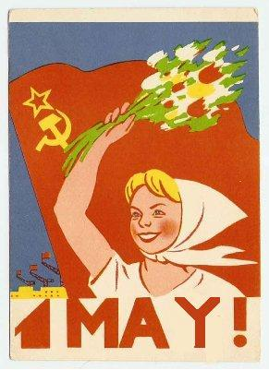
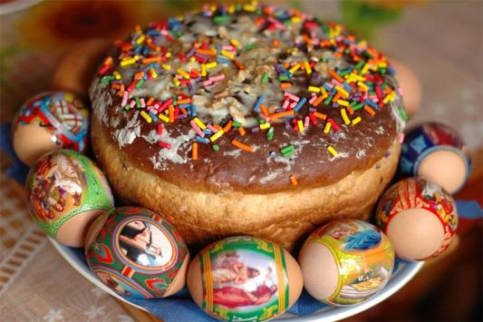
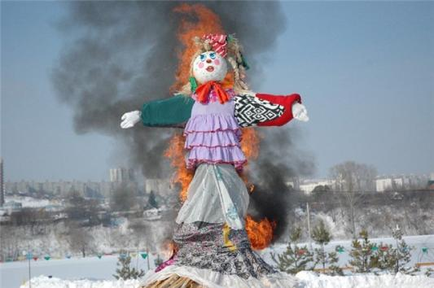
Maslenitsa, Paskha and Mayday
Spring - Maslenitsa (Shrovetide, Pancake week) By the end of winter, right before the Lent comes a Pancake week. It is a celebration of the sunlight and spring. A century ago Maslenitsa was a merry, wild and widely celebrated holiday similar to the carnival in Western countries. It was a time of games and contests especially horse racing and fistfights. A big doll of straw was burned as the final act of saying goodbye to the already passed winter. Through the whole week people cooked pancakes (bliny) served with honey, caviar, fresh cream and butter. Nowadays the celebration is not so diversified but people do treat themselves and their guests with tasty pancakes.
Spring - Russian Orthodox Easter (Paskha)
Paskha is the highest celebration of the Orthodox Church. At midnight the church service starts.
It is a good time for visiting friends and relatives. People greet each other with words "Christ is risen" and "Indeed risen..." and treat each other with brightly colored boiled eggs, a symbol of Easter. The holiday table is served with such specialties as paskha (rich mixture of sweetened curds, butter and raisins) and kulich (Easter sweet bread). May 1 - Mayday The Mayday holiday on the1st of May started to be regularly celebrated in Russia since 1890. Until recently this holiday was called the International Solidarity Day of Workers and was one of the major Soviet holidays, widely celebrated by people all over the country with Mayday parades with bright banners, balloons and spring flowers. During the Soviet rule demonstrations of workers and even military parades were held on the 1st of May on the Red Square, Moscow. On the second day of the holiday mayovkas – alfresco public merrymaking - traditionally took place. In the 1990s the holiday lost its ideological meaning in Russia and in 1992 it was renamed into the Holiday of Spring and Work.

Slide 9
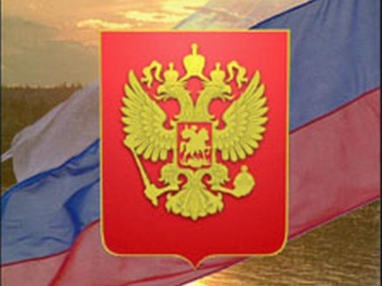
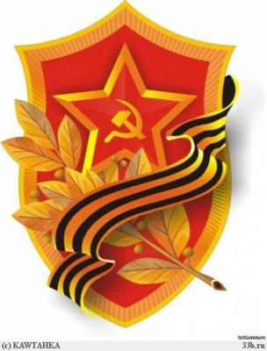
Victory Day and Independence Day
May 9 - Victory Day The 9th on May is a very significant nationwide holiday of the victory of the Soviet people over fascist Germany in the Great Patriotic War. Honoring the memory of soldiers who rescued the world from fascism, the Russians solemnly celebrate this holiday starting from 1945. However, it was declared an official day off not before 1965. In the course of time the celebrating ceremonies of the Victory Day have somewhat changed: the military parades, which were held annually before, are nowadays arranged only in the good round figure years; and there are no longer the earlier indispensable demonstrations of workers held on the 9th of May. Still, the holiday keeps up its meaning, commemorating the millions of people fallen in World War II. There are both joyful and mournful moments in this holiday: meetings of veterans, laying wreaths to the monuments of Glory and beds of honors, the minute of silence, and the night salute in celebration of the victory over fascism. June 12 - Independence Day The Independence Day of Russia or the Day of Russia is one of the "youngest" public holidays in this country. On the 12th of June 1990 in the course of sovereignty of the republics of the USSR the 1st Congress of People's Deputies of RSFSR adopted the Declaration of the state sovereignty of Russia. In 1994 this day was declared as the national holiday. Officially it is the most important modern public holiday in the country, but for most of the Russians it remains just a formality.

Slide 10
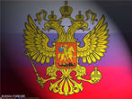
The presentation was made by Krylova Ksenia

