Slide 1
Russian Symbolism
Made by:
Nastia Dmitrieva(7B)

Slide 2
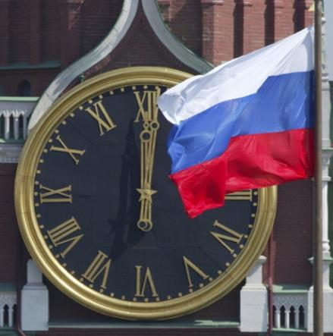
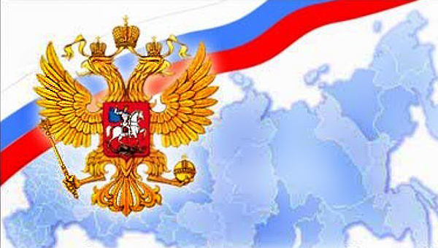
I'd like to tell you about Russian Symbolism

Slide 3


At first I'll tell you about the flag

Slide 4
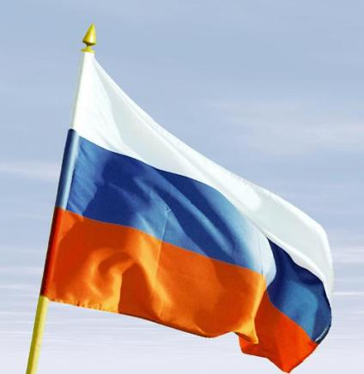
At first I'll tell you about the flag
The flag at first was used as a banner for the dealer and warships and became official only in 1896.

Slide 5

At first I'll tell you about the flag
When the Soviet Union existed it had another flag (you can see it on this picture).

Slide 6
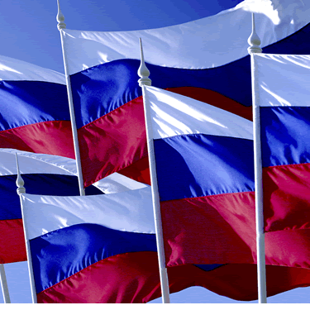
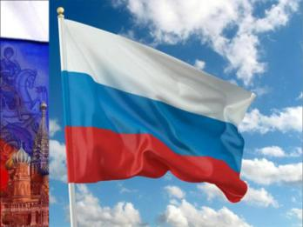
At first I'll tell you about the flag
Only after disintegration of the Soviet Union in 1991,three-color has been returned.

Slide 7
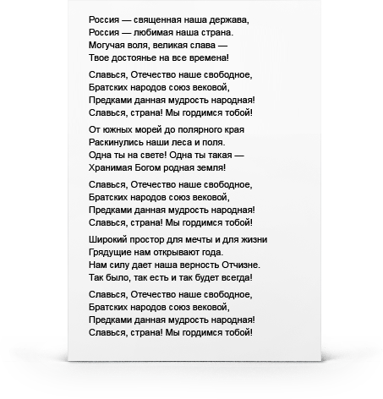
The Hymn
Every country has it's own hymn and Russia has it too.

Slide 8
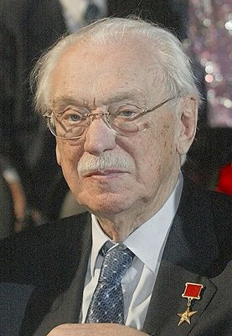
The Hymn
Russia had two hymns and all of them were written by Sergey Mikhalkov.

Slide 9

The Hymn
Russia was in need for a new hymn in 1990 after the crash of the Soviet Union.

Slide 10
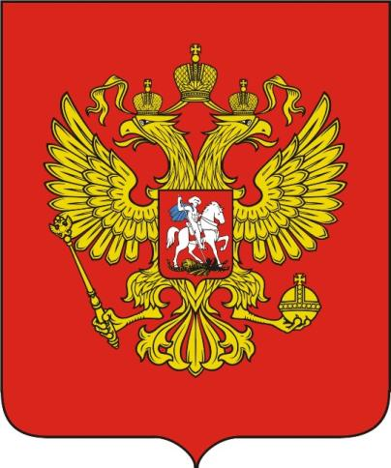
The Arm
The two-headed eagle was accepted by Ivan III after his marriage with Bizantian princess Sofia Pelogu in 1472.

Slide 11
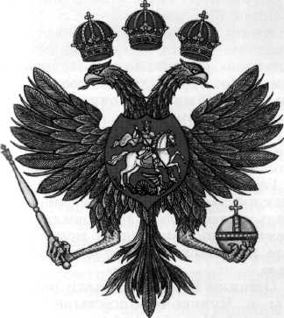
The Arm
The arm was changed during the domination of Romanov Michael Feodorovich.The two-headed eagle was decorated by three crowns for the first time in 1625.

Slide 12
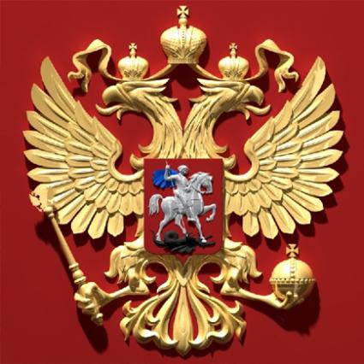
The Arm
The modern arm of Russia was confirmed by the decree of the president in 1993.

Slide 13
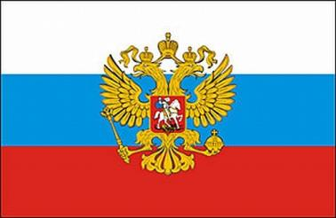
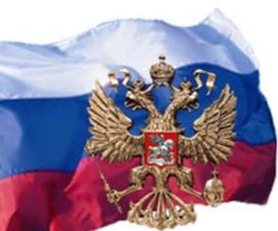
It is very short information about Russian Symbolism, but I think this information should be known by every man who lives in Russia.

Slide 14


