Slide 1
Repeat English sounds

Slide 2
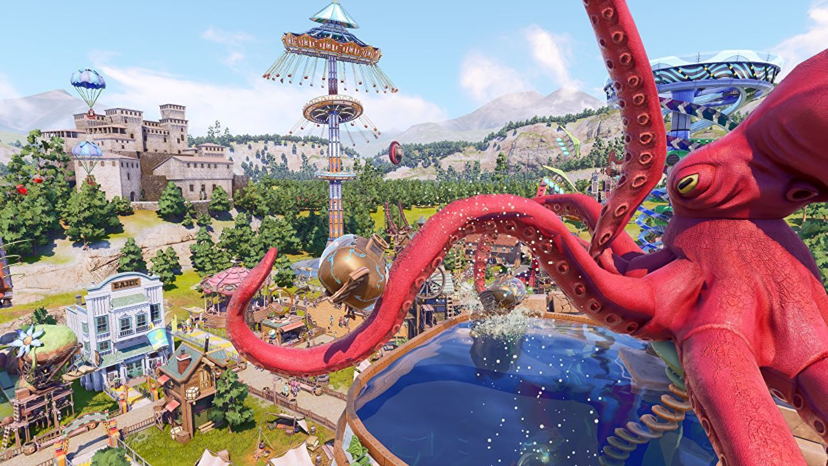
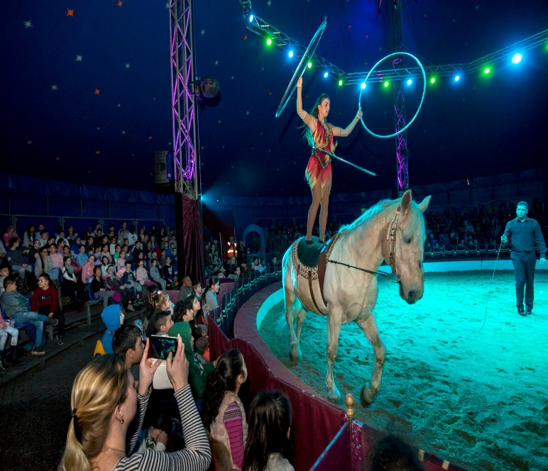
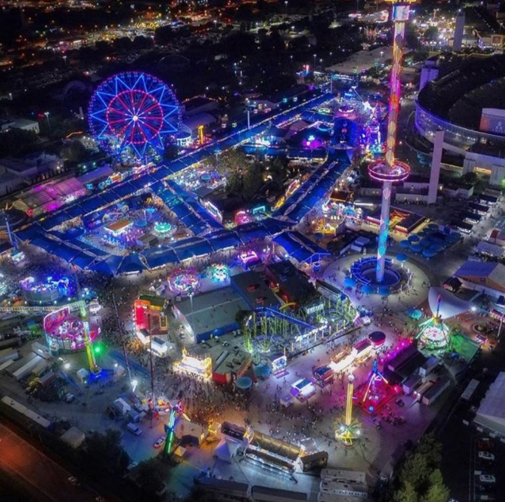
Fun starts here!
Look at the title. Where can you have fun?
Theme Park
Circus
Fun Fair

Slide 3
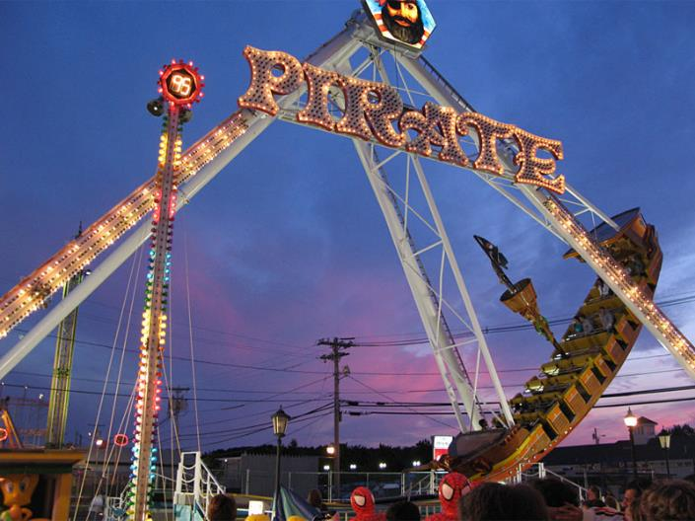
fly in a pirate ship

Slide 4
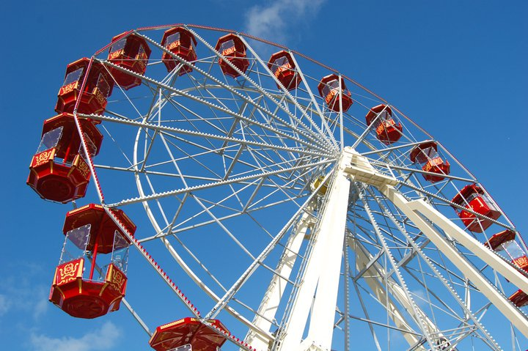
ride on the big wheel

Slide 5
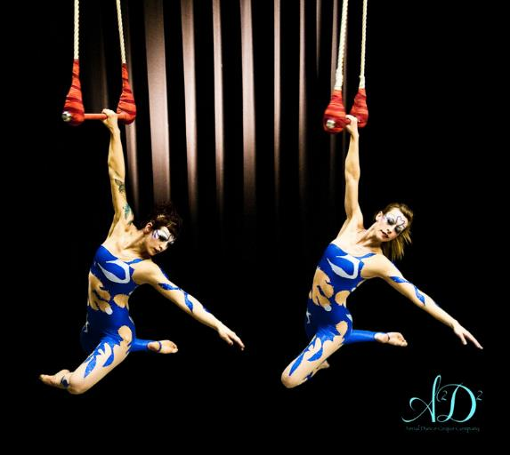
see trapeze artists

Slide 6
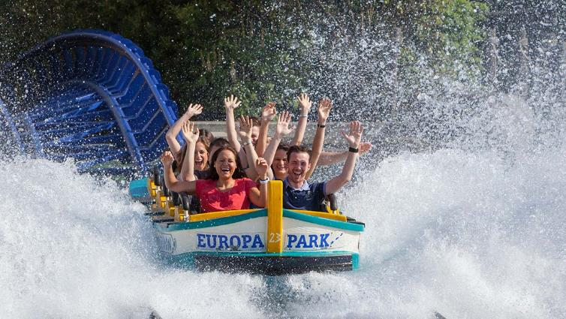
go on a water ride

Slide 7
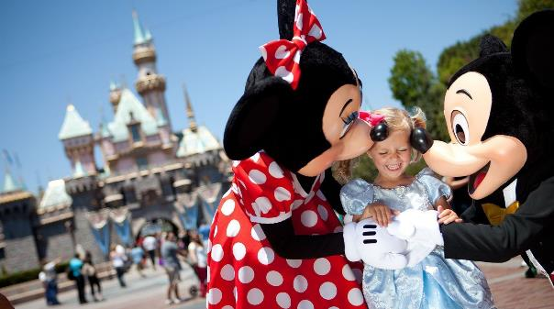

shake hands with cartoon character

Slide 8
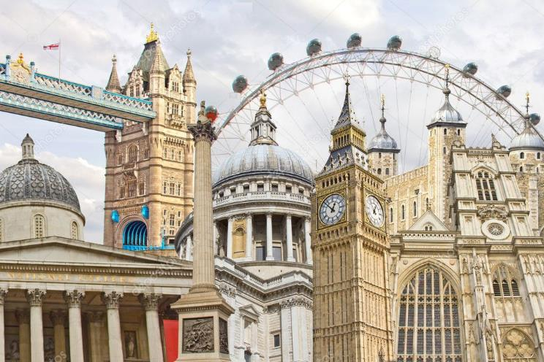
See famous landmarks

Slide 9
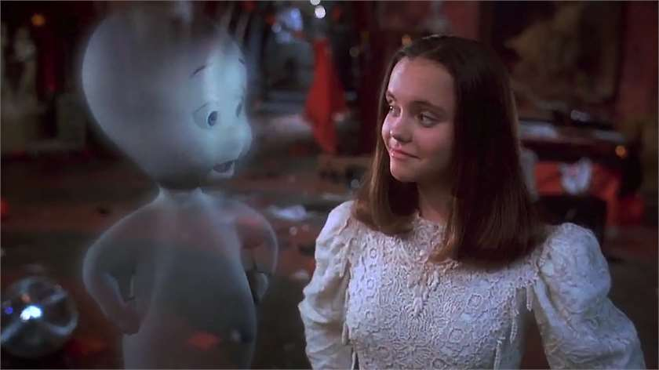
meet a ghost

Slide 10
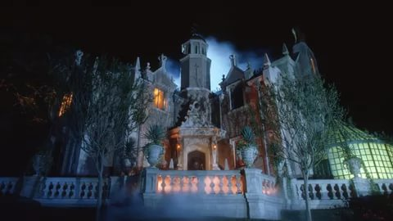
explore the haunted mansion

Slide 11
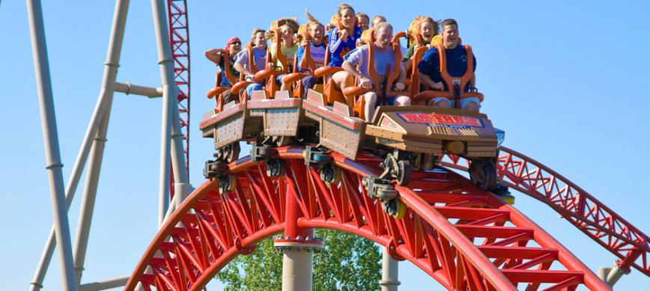
ride on a rollercoaster

Slide 12
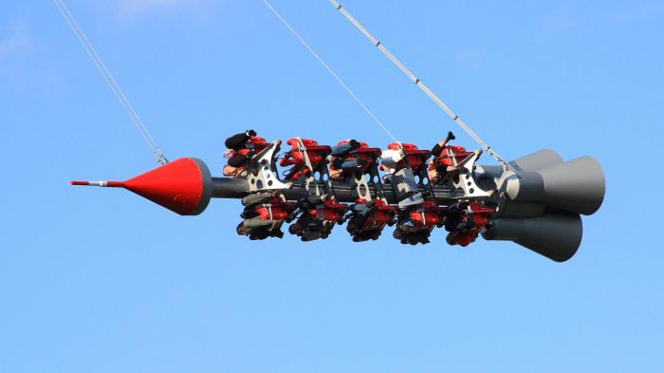
go on a rocket journey

Slide 13
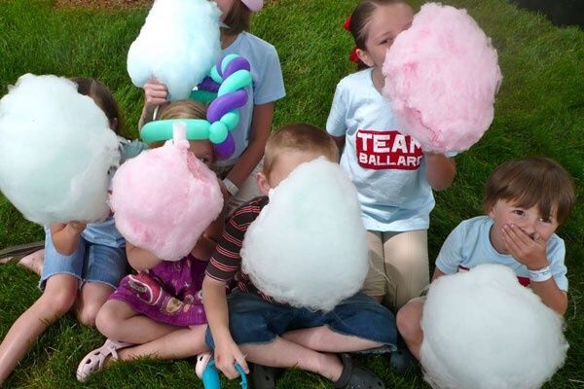
eat candy floss

Slide 14
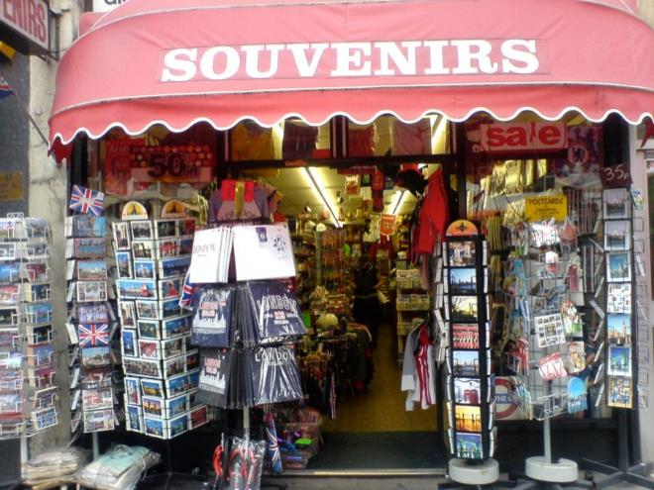
go souvenir shopping

Slide 15
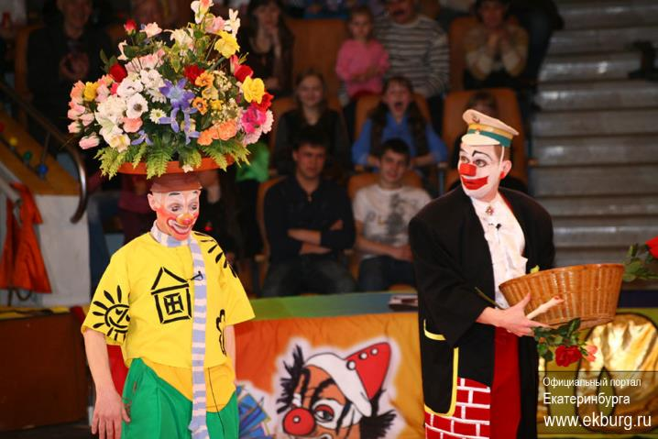
see clowns performing tricks

Slide 16
Match the activities to these places.
Ex. 1. Match the activities to places.
Fun Fair
Circus
Theme Park
to go on a water ride
to see trapeze artists
to see clowns performing tricks
to shake hands with cartoon character
to explore a haunted mansion
to eat candy floss
to fly in a pirate ship
to go on a rocket journey
to ride on the big wheel
to meet a ghost
to ride on a rollercoaster
to see famous landmarks

Slide 17
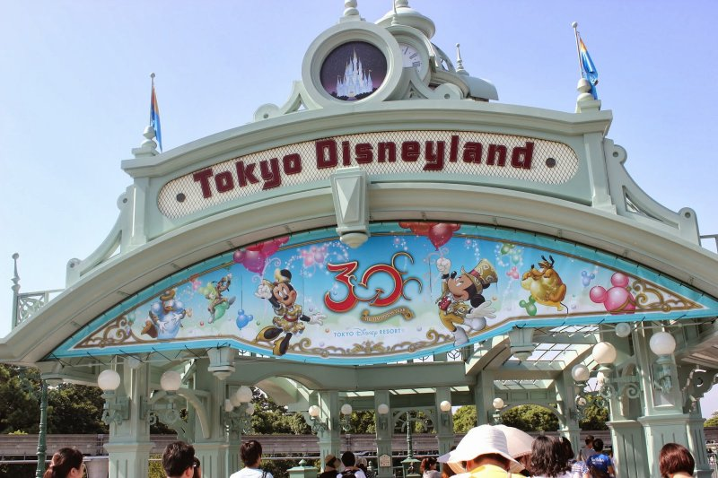
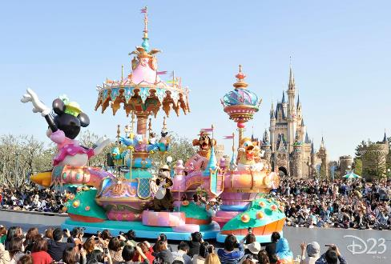
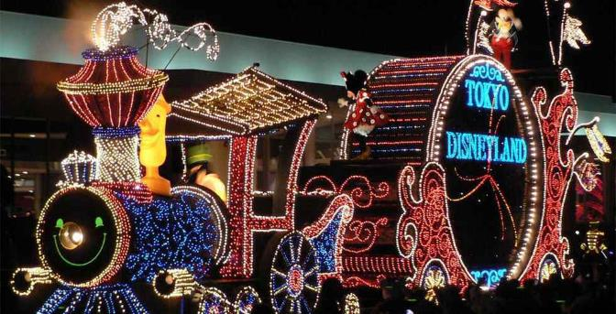

Slide 18
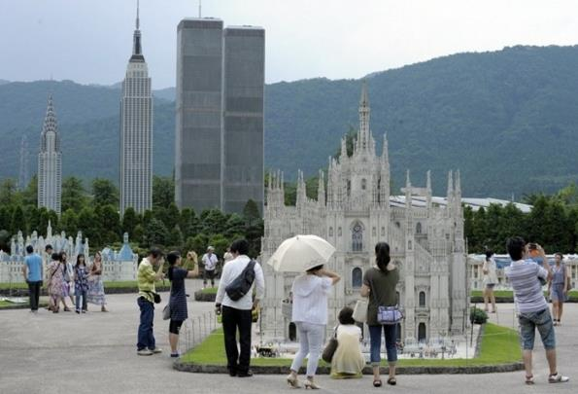
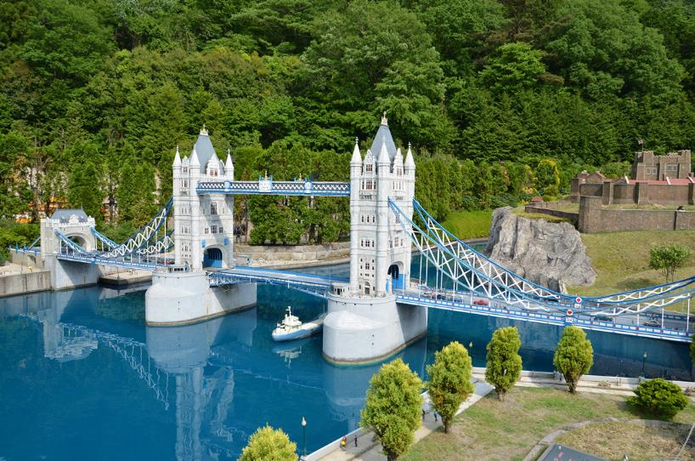
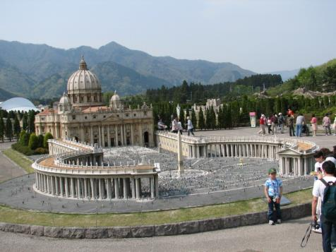

Slide 19

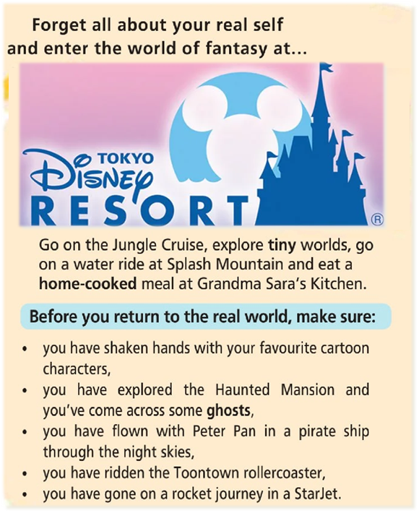
Read and listen.
Read and listen.
крошечный
домашний
привидение

Slide 20
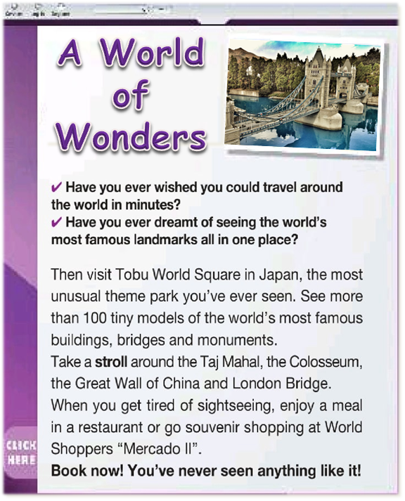
Read and listen.
Read and listen.
прогулка

Slide 21
What have you learnt today?
I have learnt .....
- new lexical words
- how I can have fun
- new theme parks
- some information about Tokyo and Japan
- how to answer the questions

Slide 22
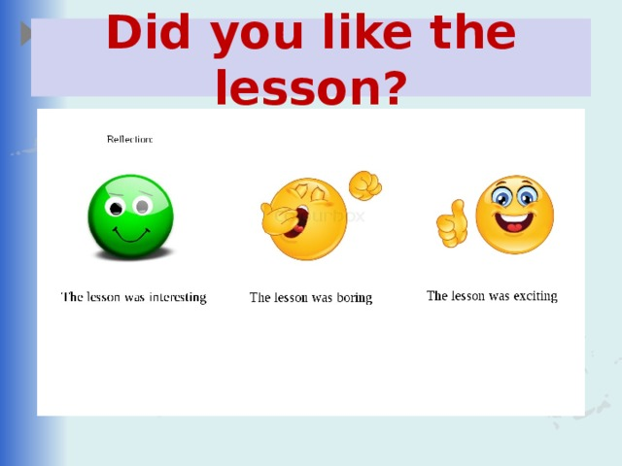

Slide 23
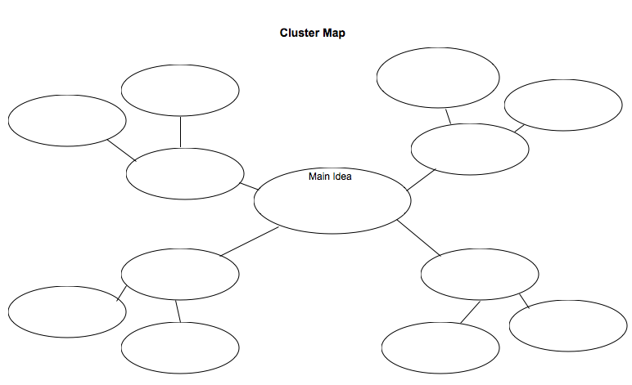
Make up a claster. Tell your classmates how do you have fun.

