Slide 1
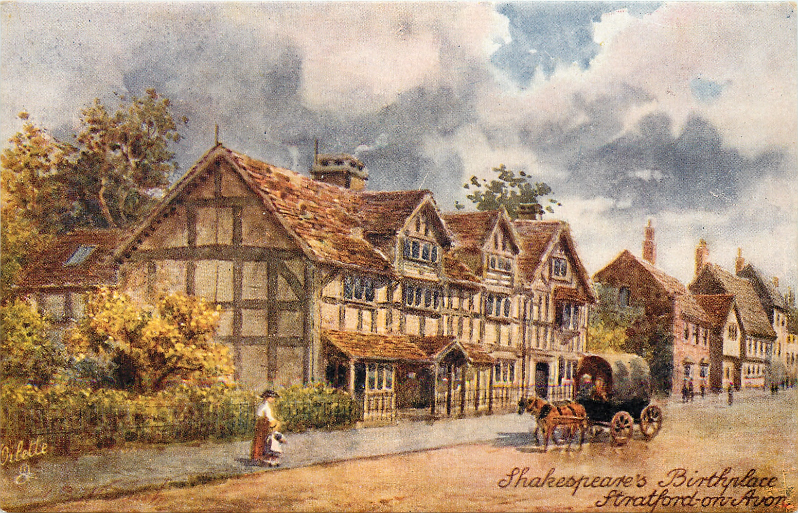
William Shakespeare:
A game tour in the footsteps of the Poet

Slide 2
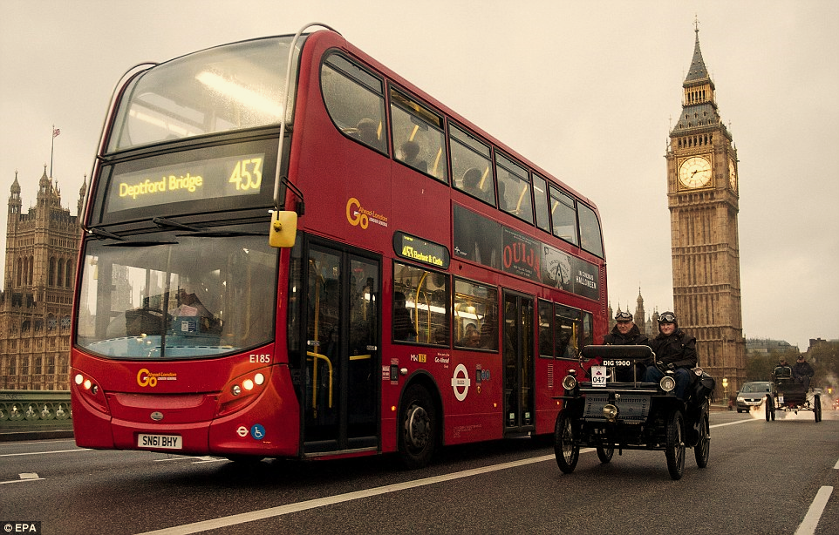
Dear guests,
Hurry up and take a seat on our tour bus, which will take you to meet the poet who has become one of the symbols of the Great Britain! So, we're going to Stratford-upon-Avon.
Enjoy the tour!

Slide 3
Слайд для воспроизведения видео (Приложение 1)

Slide 4
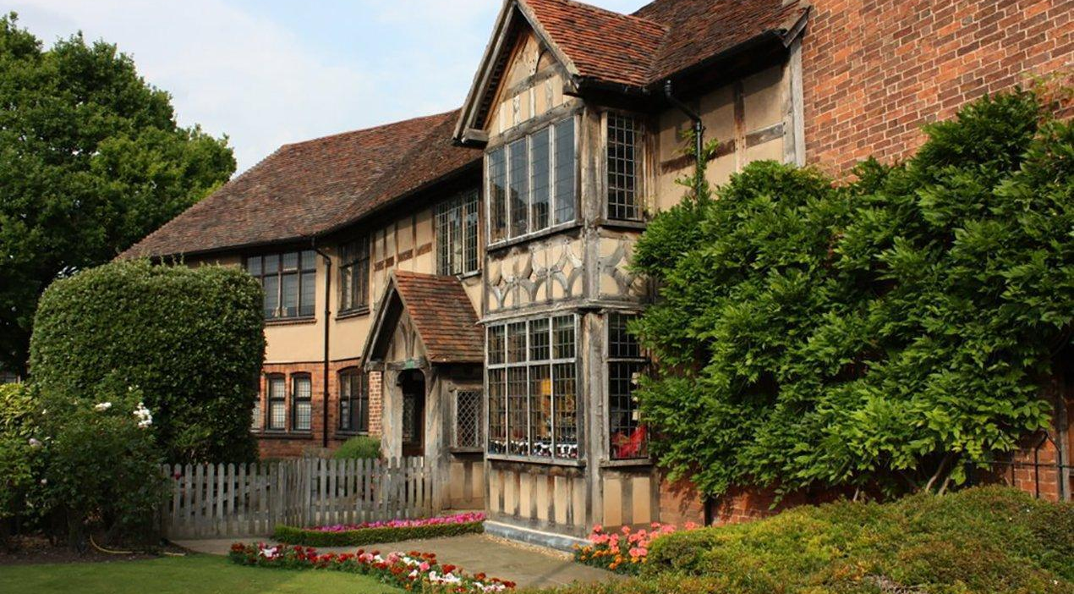
William Shakespeare House Museum in Stratford-upon-Avon

Slide 5
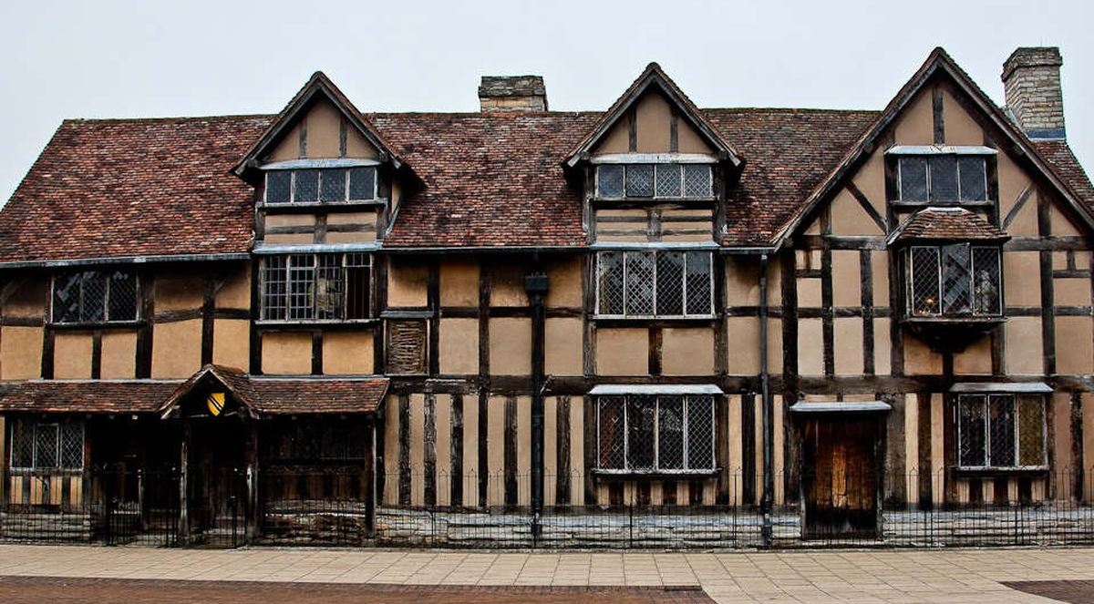
The house of William Shakespeare's father John Shakespeare: outside view

Slide 6
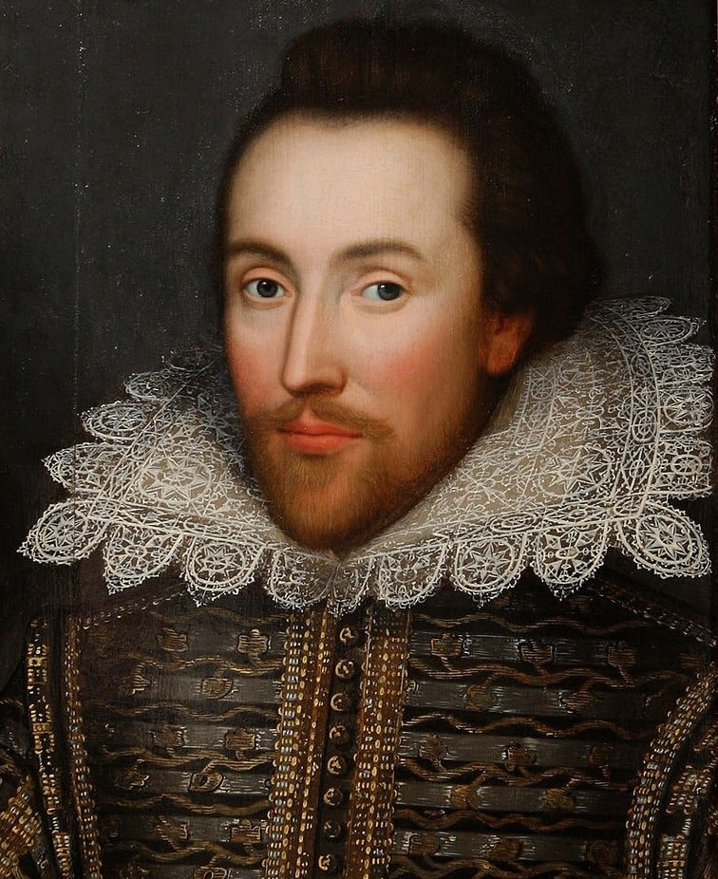
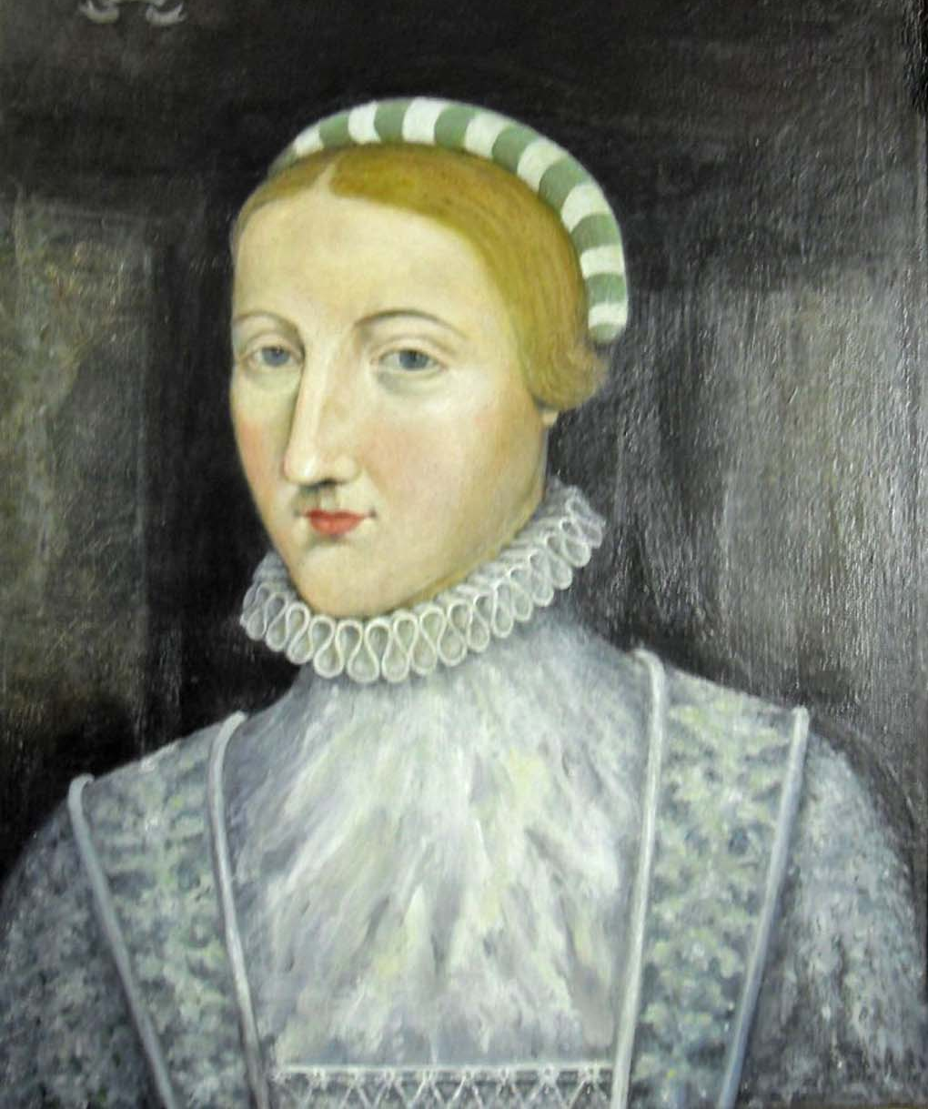
A recently discovered portrait of an Elizabethan (1610) in the family collection
Shakespeare's Wife - Anne Hathaway

Slide 7
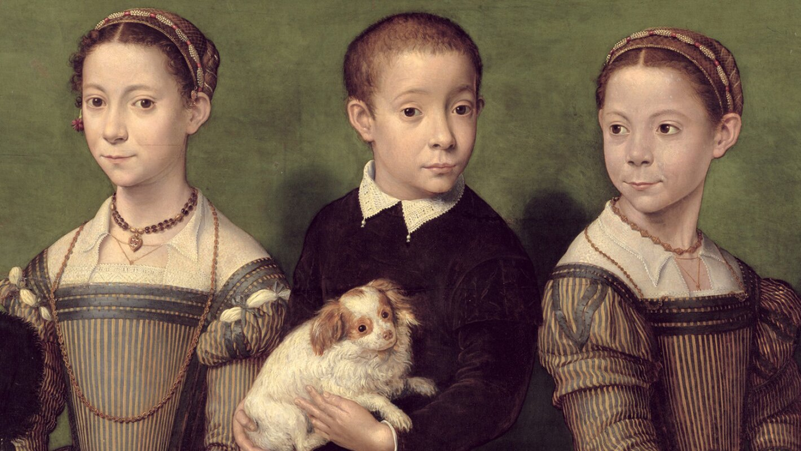
Alleged portrait of Shakespeare's children: Susannah and the twins Hamnet and Judith

Slide 8
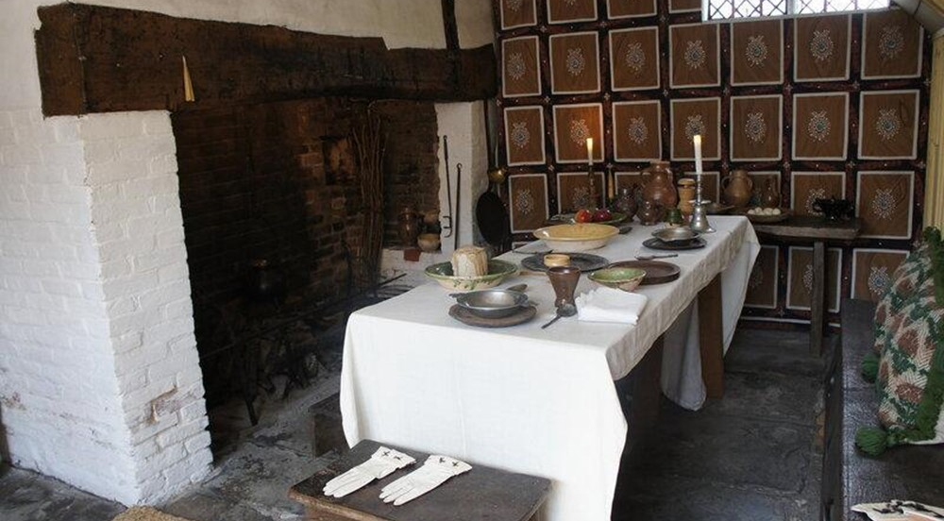
Dining room on the ground floor of the house

Slide 9
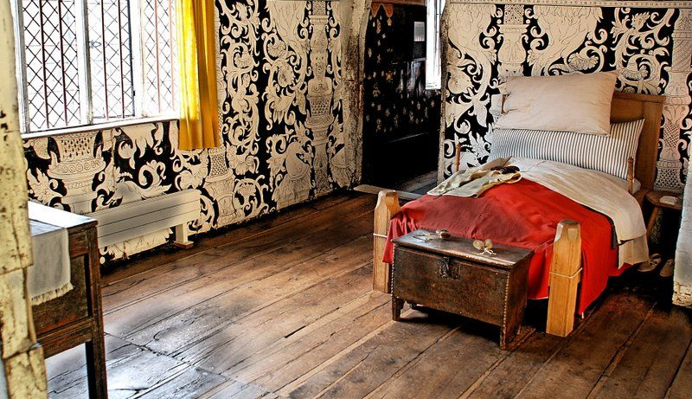
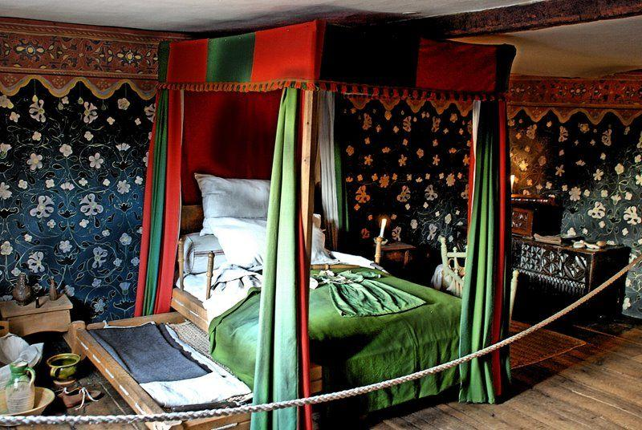
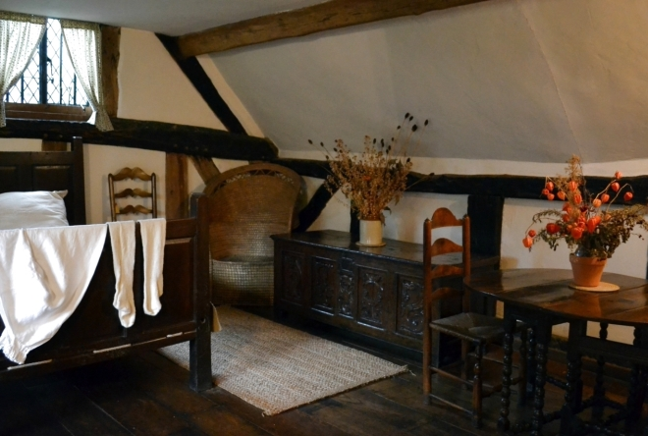
Three small bedrooms on the main floor of the house

Slide 10
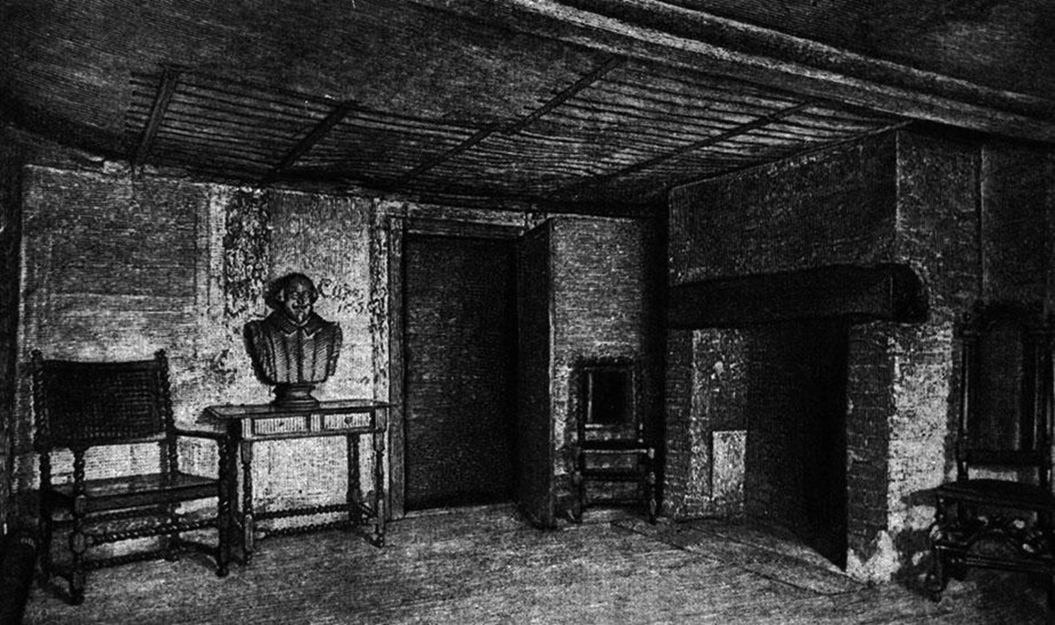
The room where William Shakespeare was born

Slide 11
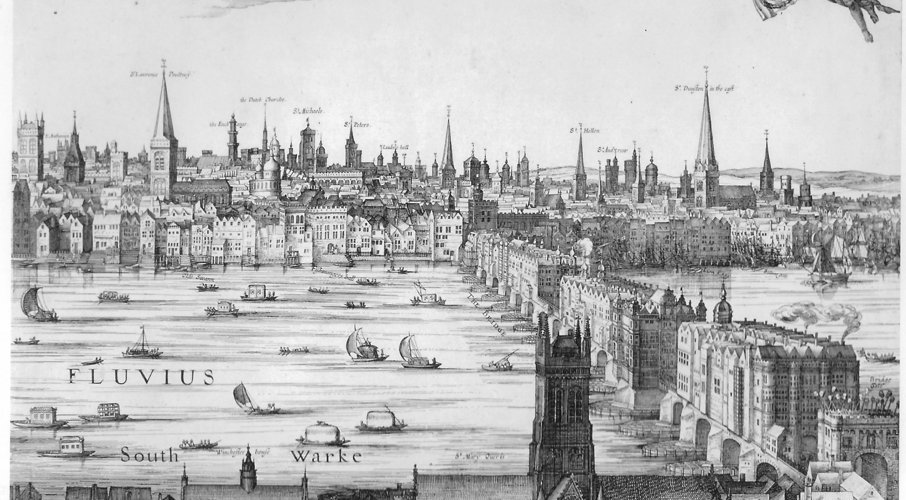
It is said that William escaped with a travelling theatre to London

Slide 12
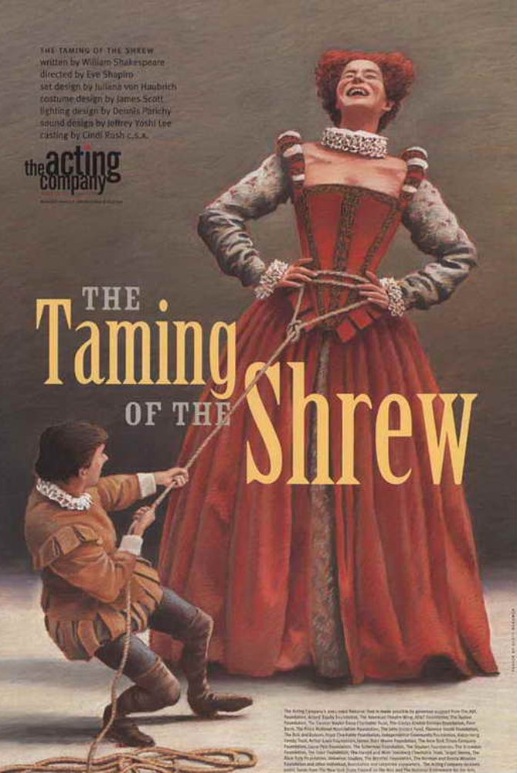
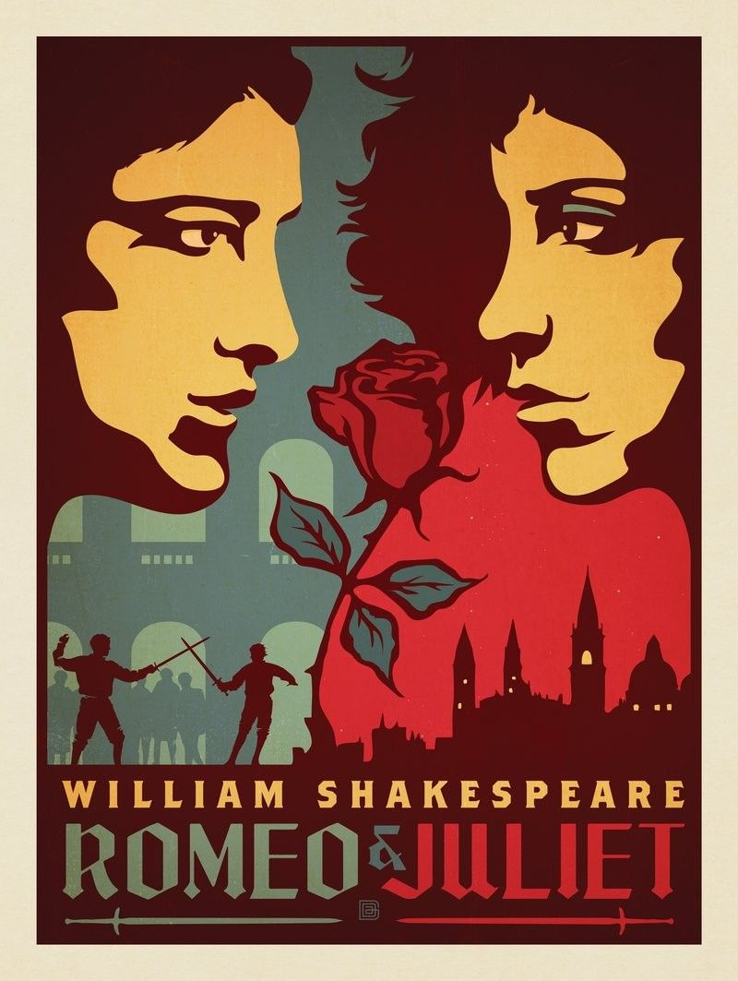
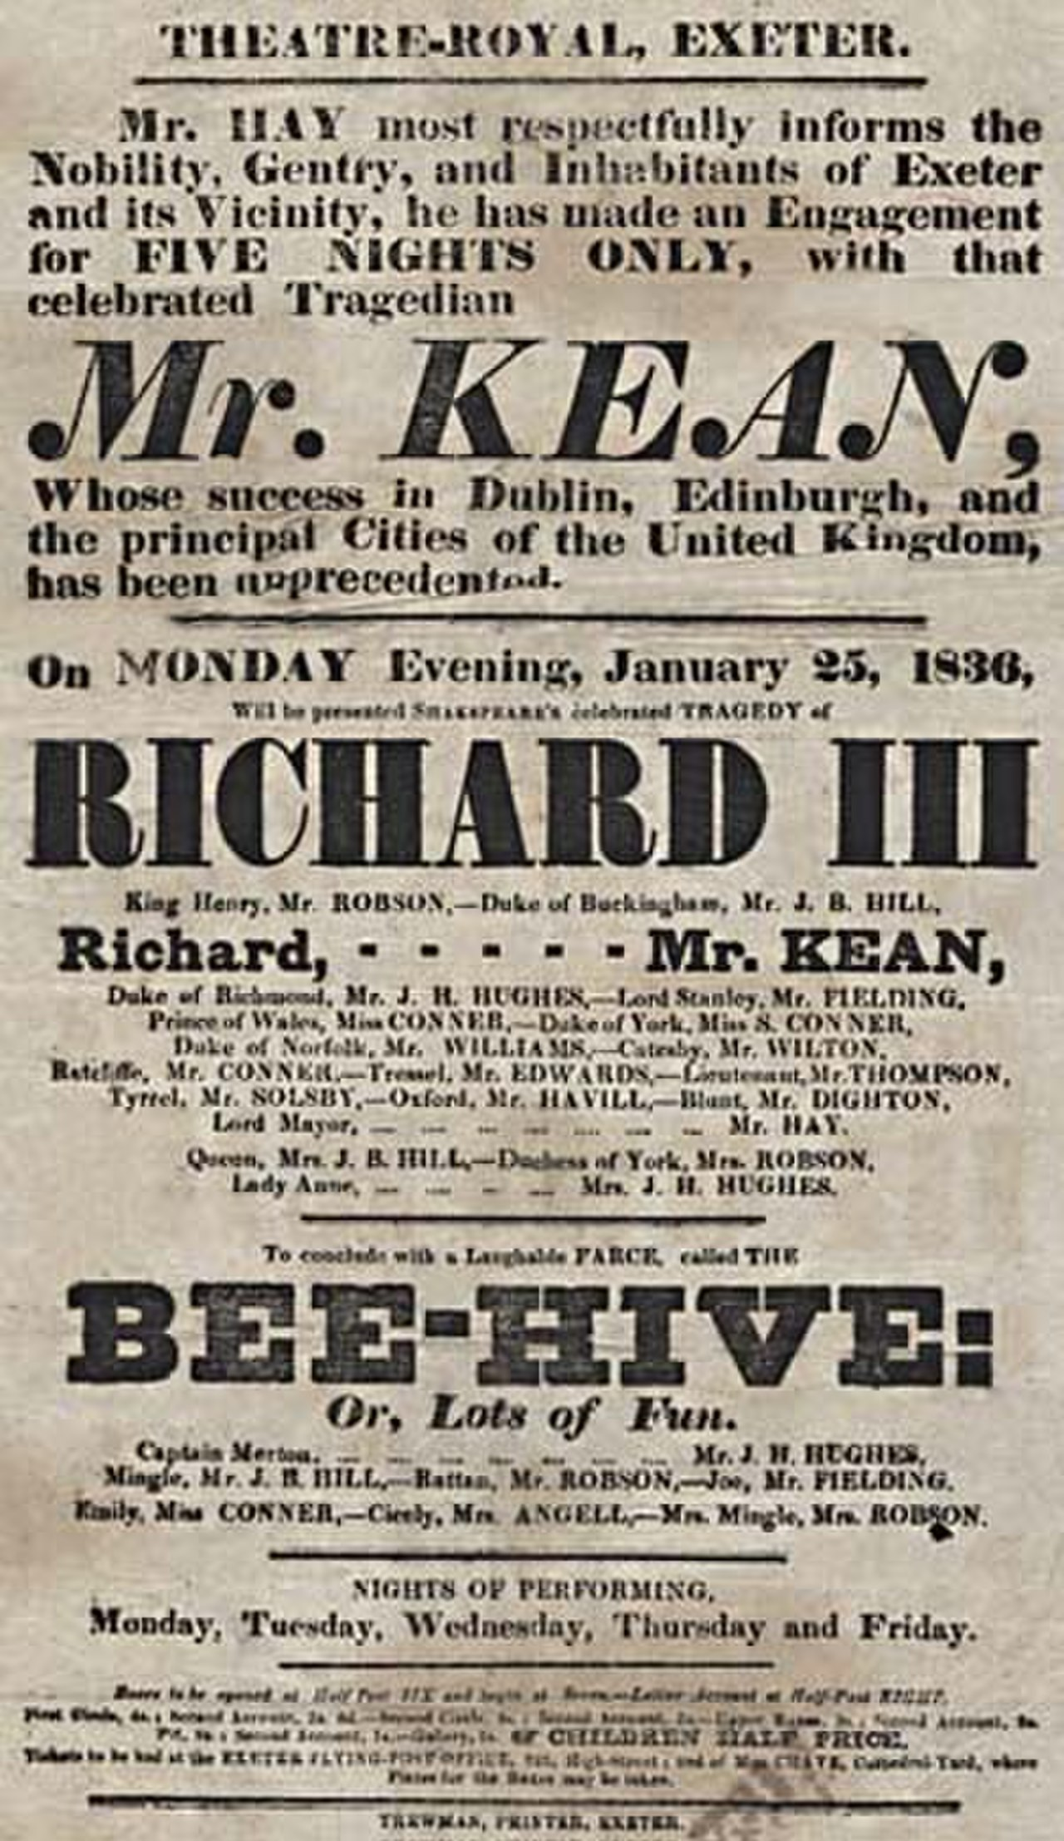

Posters of Shakespeare's works

Slide 13
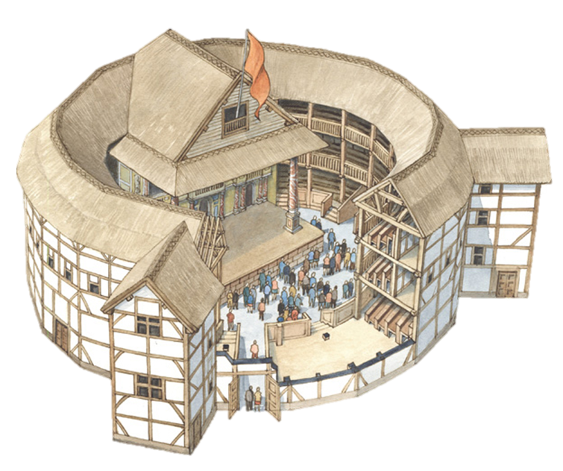
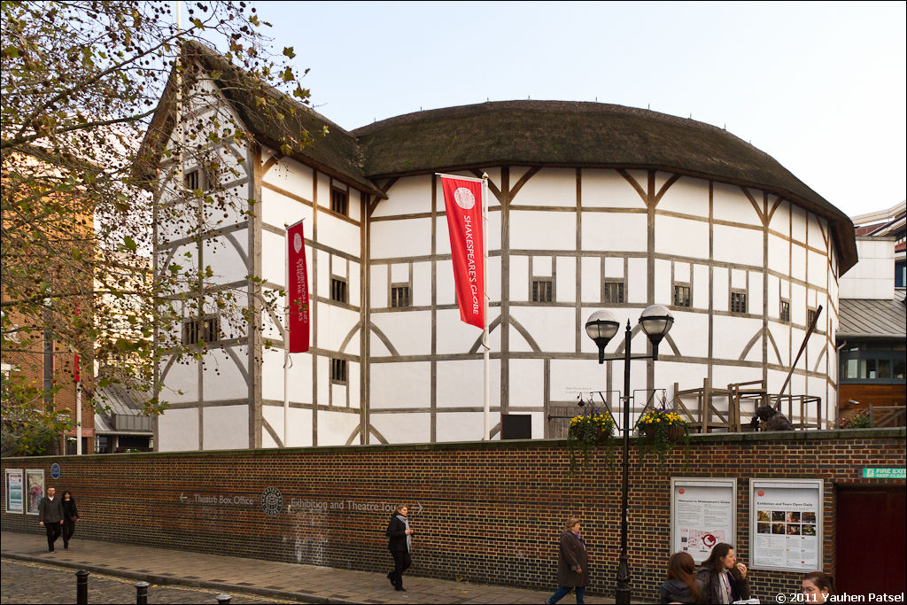
From 1595 Shakespeare is mentioned as co-owner of Lord Chamberlain's Troupe, and four years later as co-owner of the Globe Theatre

Slide 14

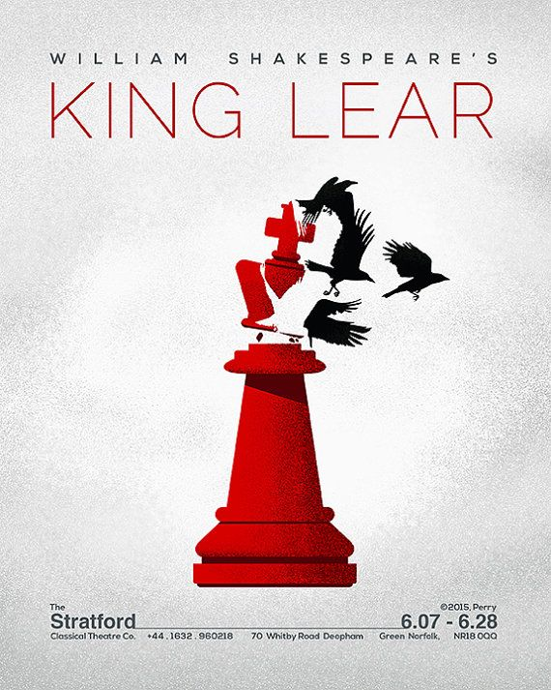
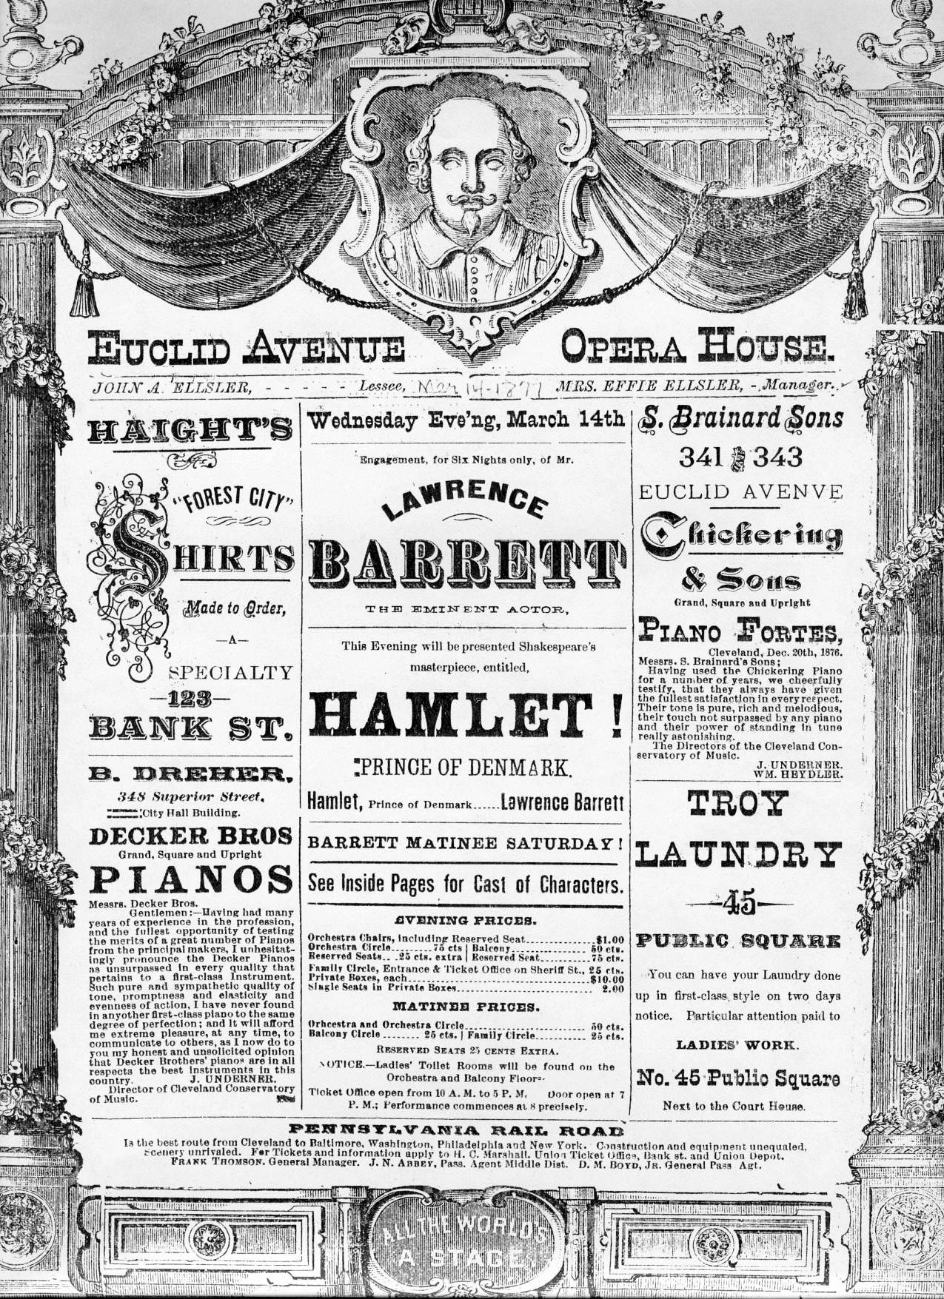
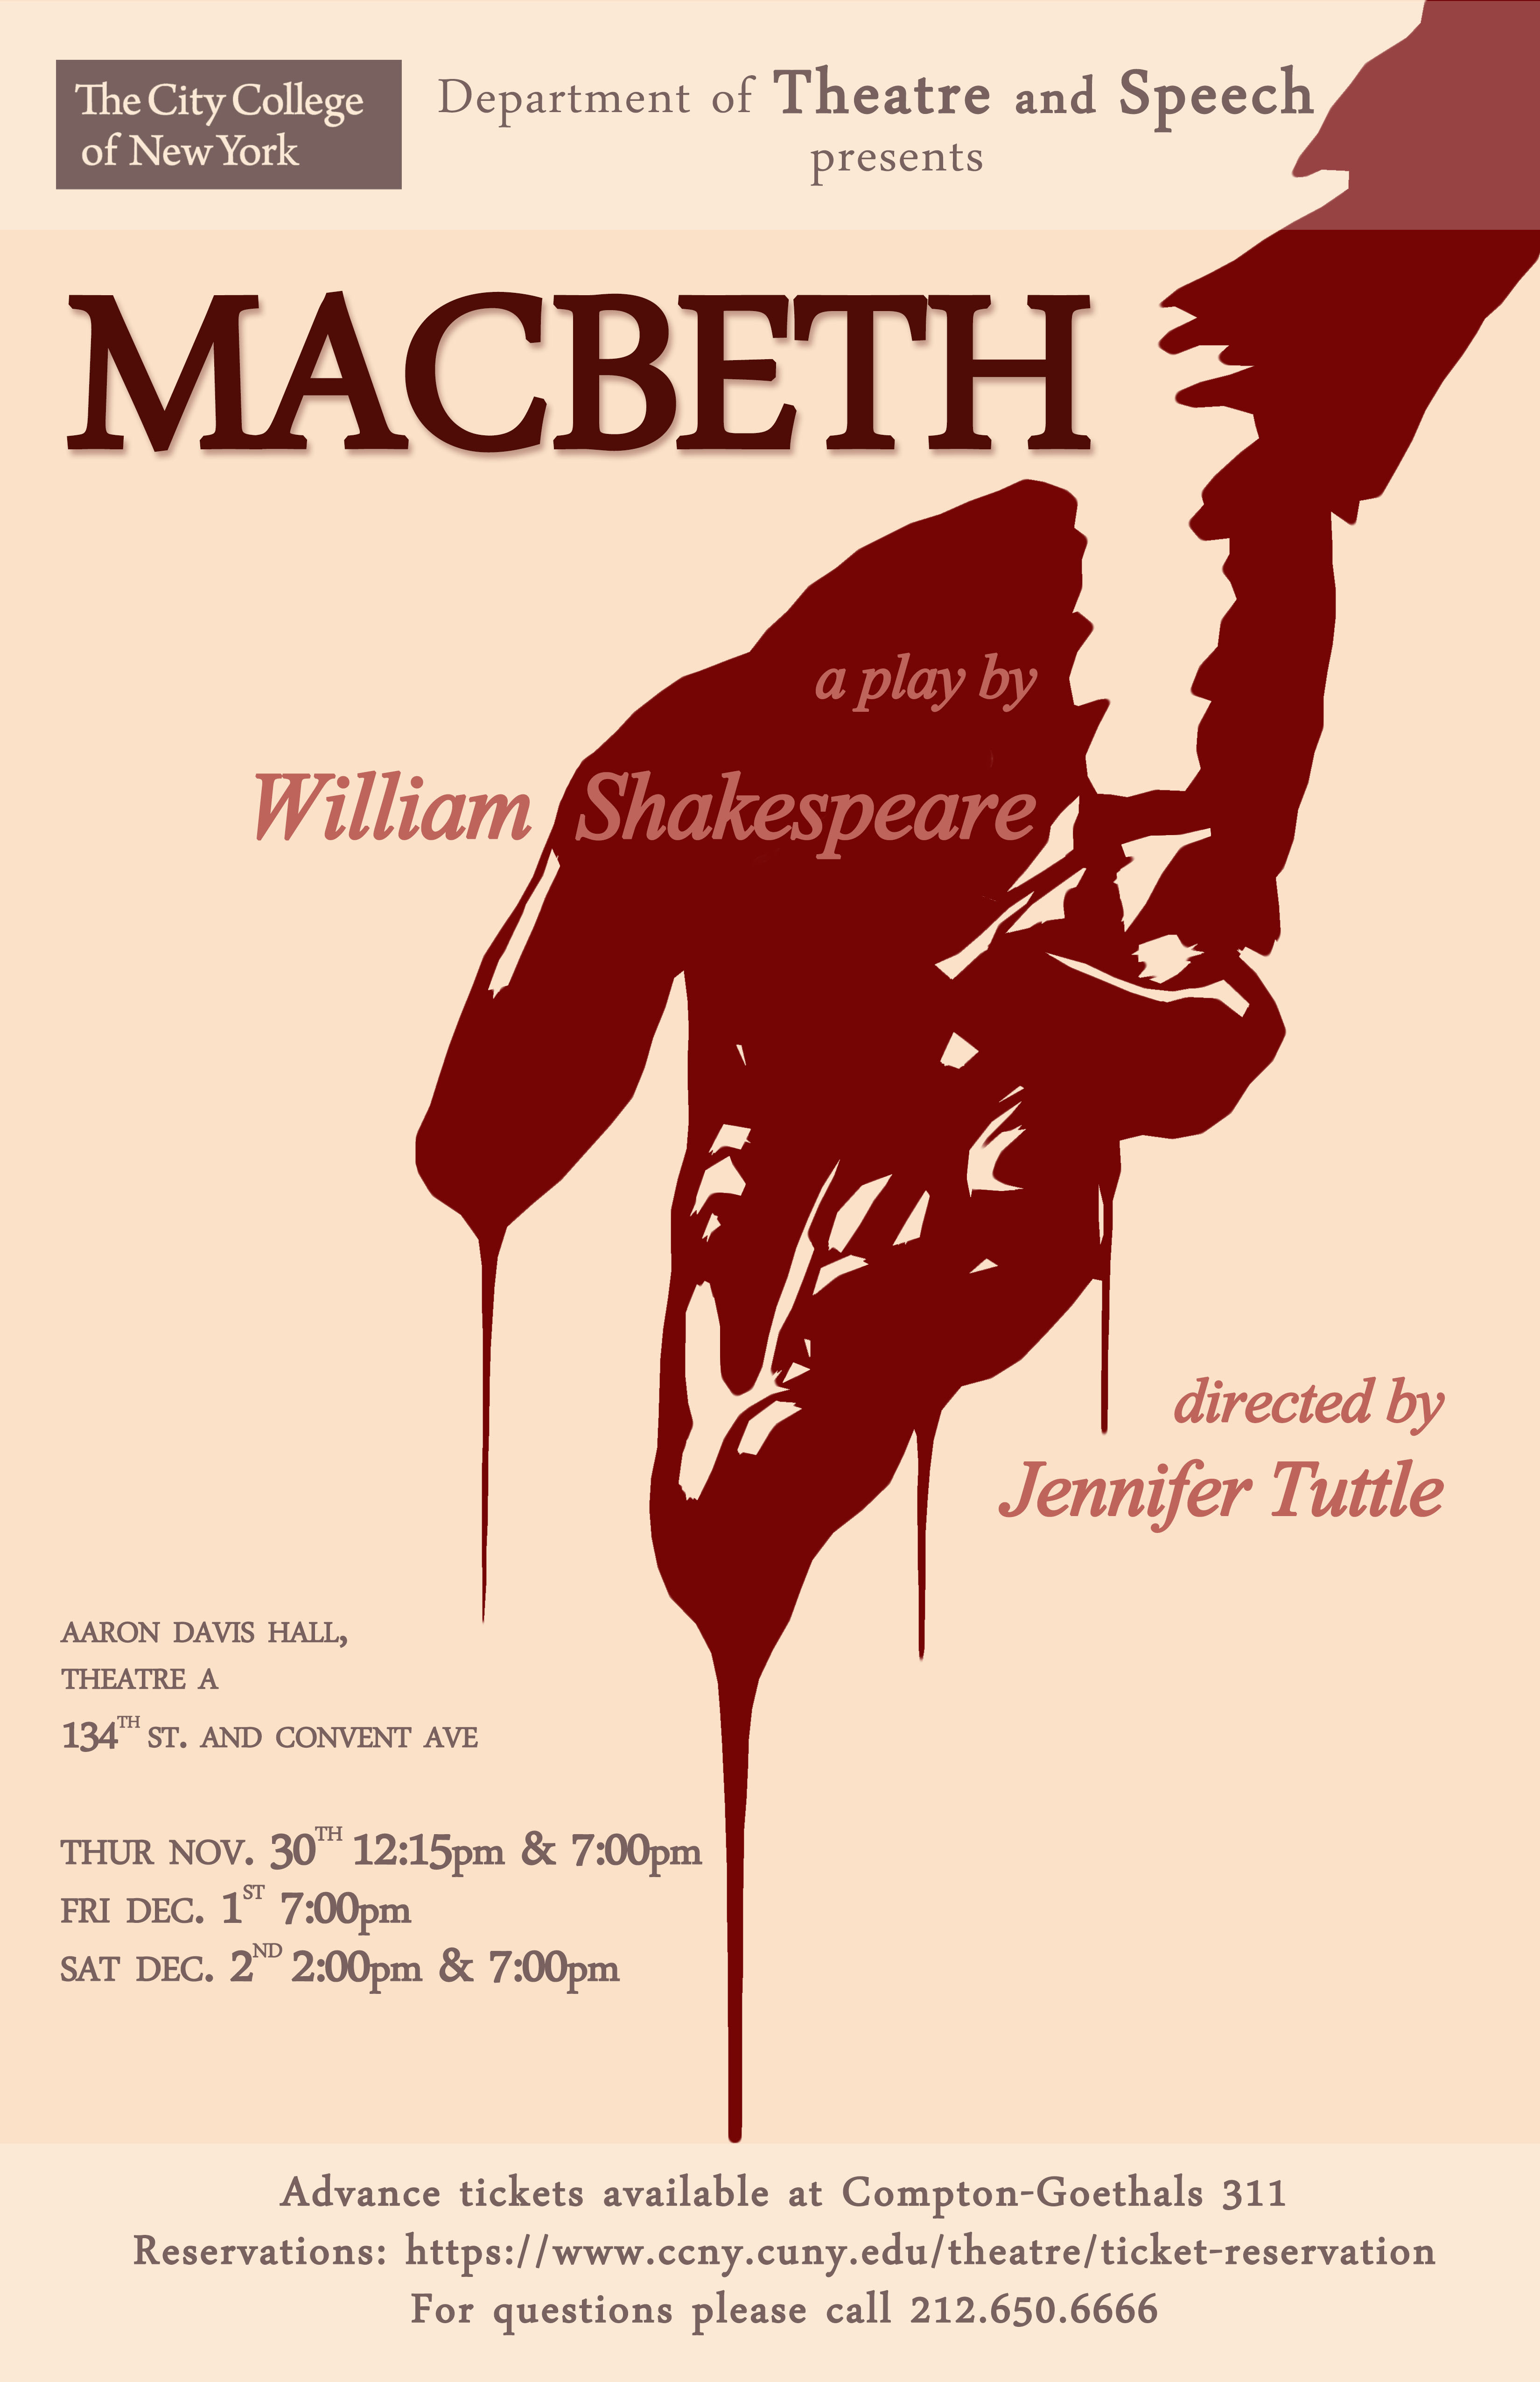
Posters of Shakespeare's works

Slide 15
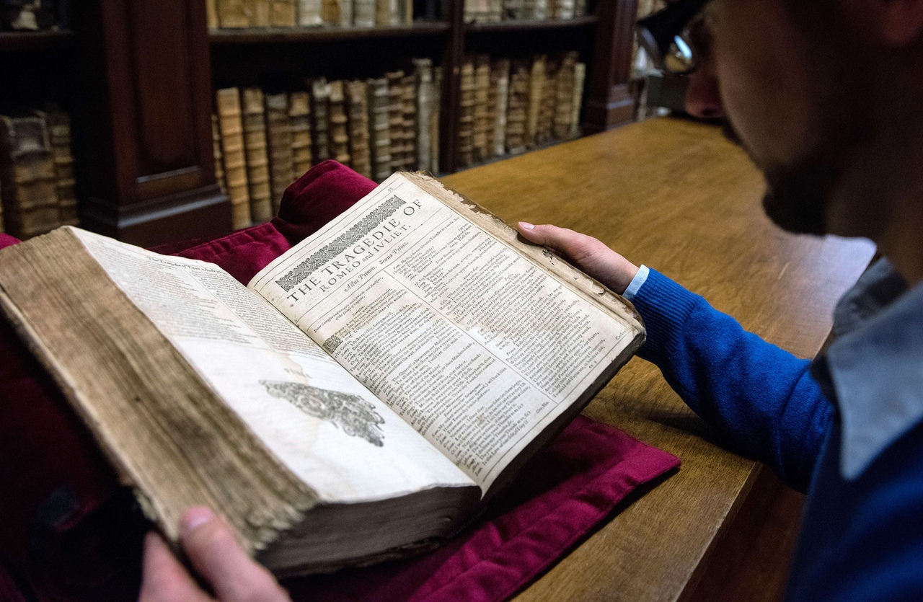
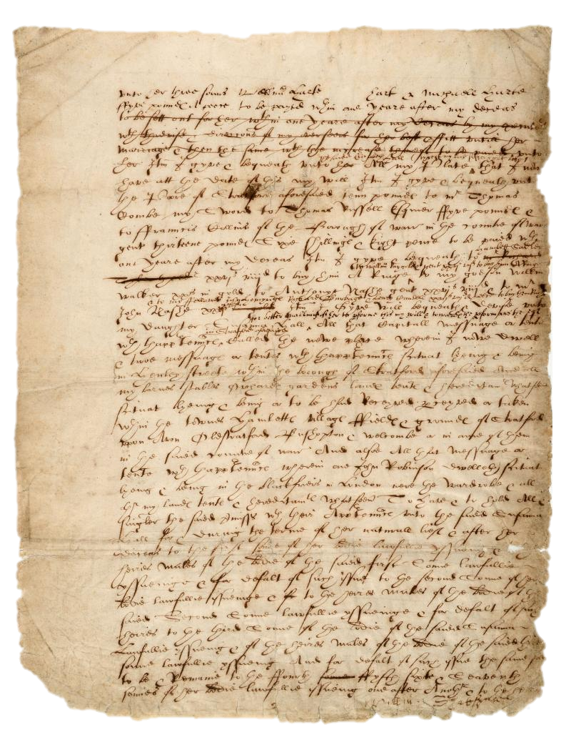
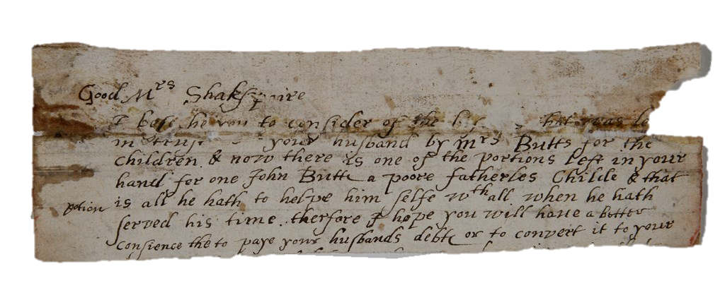
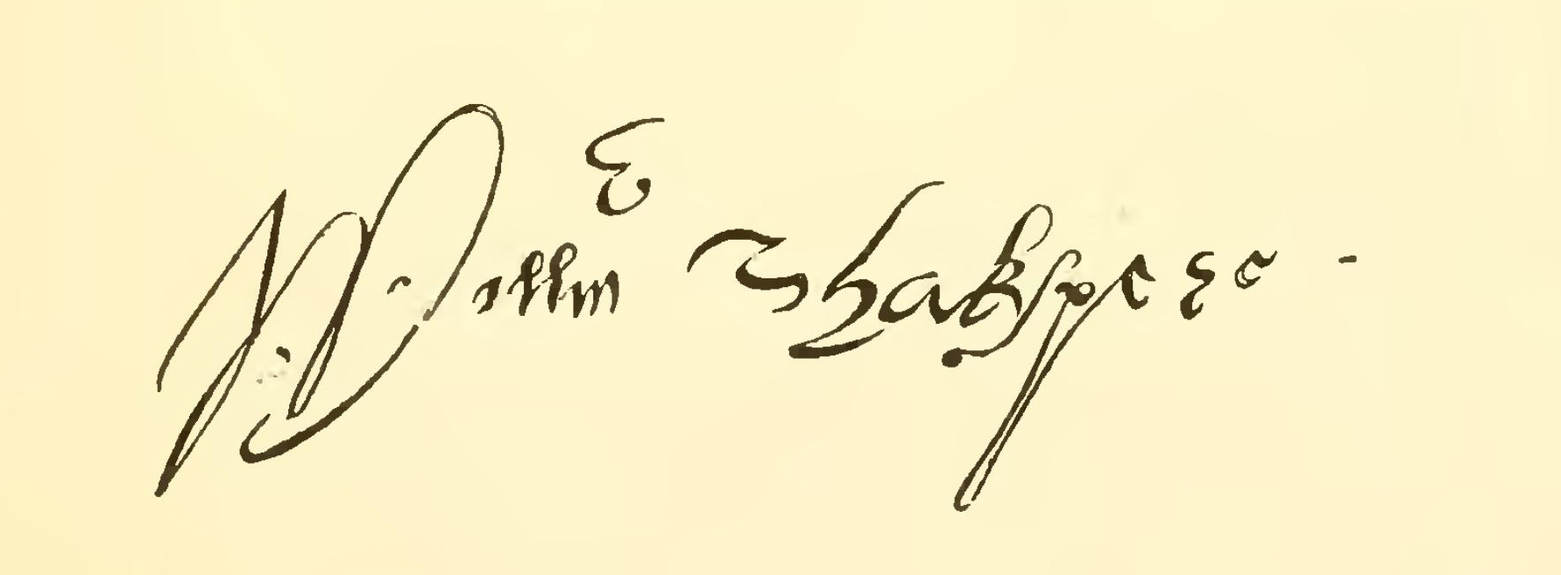
Under the name "William Shakespeare" were published 37 plays, 154 sonnets, 4 poems. Most of the writings were written over a period of 24 years from 1589 to 1613

Slide 16
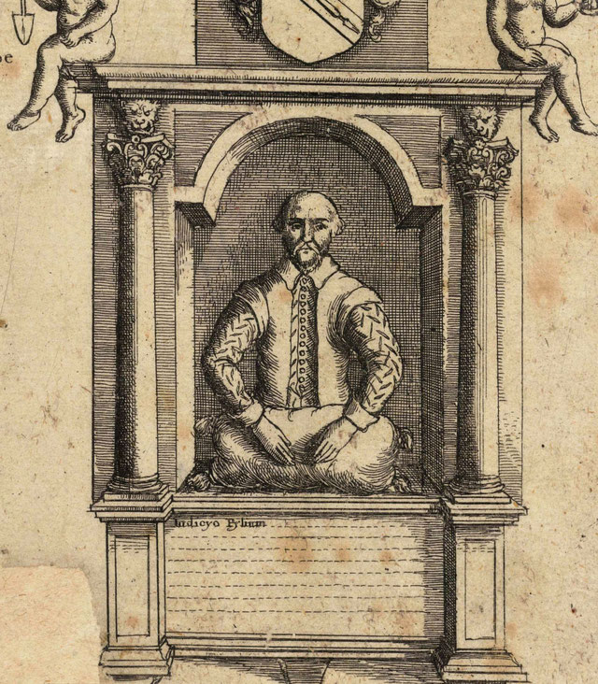
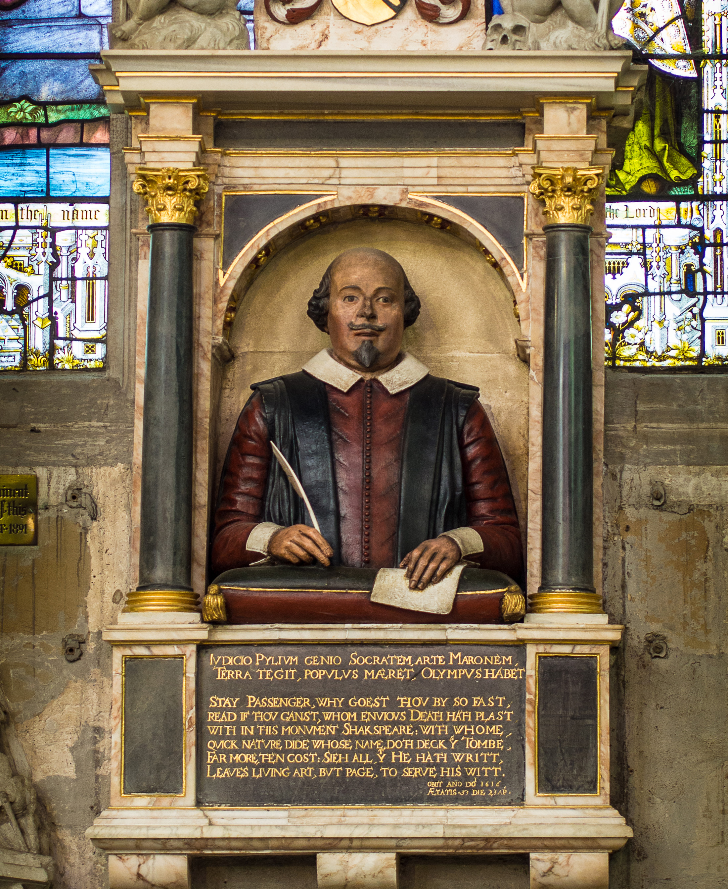
Good friend for Jesus sake forbear
To dig the dust enclosed here.
Blessed be ye man yt spares thes stones,
And cursed be he yt moves my bones

Slide 17









Thin ?
Thick ?
Aphorisms

Slide 18

28.04.2023
The case of the real William Shakespeare

Slide 19


Suspect | Educated | Aristocrat | Informed about court life | Travelled extensively | Studied jurisprudence, ancient literature, philosophy | Familiar with nautical terminology, military affairs | Familiar with the theatre and literature | Graduated from Cambridge or Oxford
Francis Bacon
Edward de Vere, 17th Earl of Oxford
Christopher Marlowe
Roger Manners, 5th Earl of Rutland and his wife Elizabeth
William Shakespeare | ?
Queen Elizabeth I

Slide 20
WHEN
WAS SHAKESPEARE BORN AND WHEN DID HE DIED?

Slide 21
HOW
IS THE WRITER'S SURNAME TRANSLATED?

Slide 22
WHAT
DO THEY CHANGE ON SHAKESPEARE'S TOMBSTONE EVERY YEAR?

Slide 23
GUESS
...
WHY DIDN'T SHAKESPEARE INCLUDE BOOKS IN HIS WILL?

Slide 24
WHY
WERE THERE ONLY MEN IN THE THEATRE?

Slide 25
MIGHT
AN ORDINARY ACTOR HAVE BEEN A GREAT PLAYWRIGHT?

Slide 26
«MUCH ADO ABOUT NOTHING»

Slide 27
«TO BE OR NOT TO BE: THAT IS THE QUESTION…»

Slide 28
«ALL THE WORLD’S A STAGE,
AND ALL THE MEN AND WOMEN MERELY PLAYERS»

