Slide 1
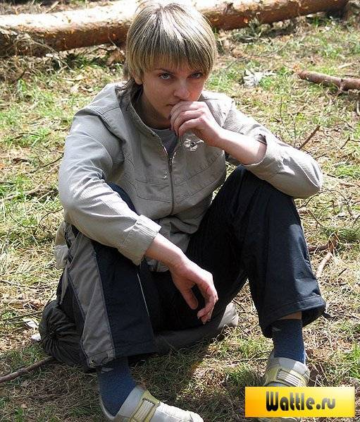

Slide 2
Money problem
Problems with parents
School problems
Teenagers’ Problems
Free time problem
Problems with friends
Health problems
Problems with bad habits
Love problems

Slide 3
Remember we care for you.

Slide 4
What do the teenagers want?
- to be independent- быть независимыми
- to be taken seriously- относиться серьезно
- to do well at school- успевать в школе
- to be treated with respect- быть уважаемым
- to express one’s own individuality- выражать собственную индивидуальность
- to try to change the world to the best- пытаться изменить мир к лучшему
- to rebel against the society- восстать против общества
- to reject everything- отвергать все
- to enjoy life- наслаждаться жизнью
- to earn enough money- зарабатывать деньги
- to overcome all the life problems- преодолевать все жизненные проблемы

Slide 5
Traits of character
Sociable, tolerant, selfish, shy,
hard-working, strong-willed, ambitious, energetic, independent, enthusiastic, nervous, honest, indifferent, quick-minded

Slide 6
wonderful
Being young is terrible because…
difficult

Slide 7


