Slide 1
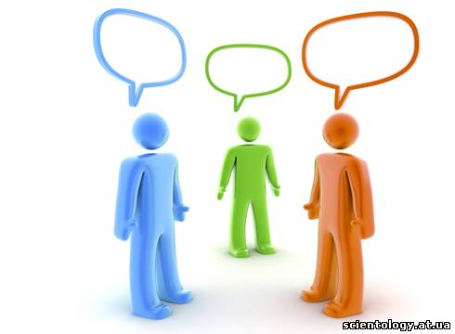
CLUB of the Merry and Quickwitted

Slide 2
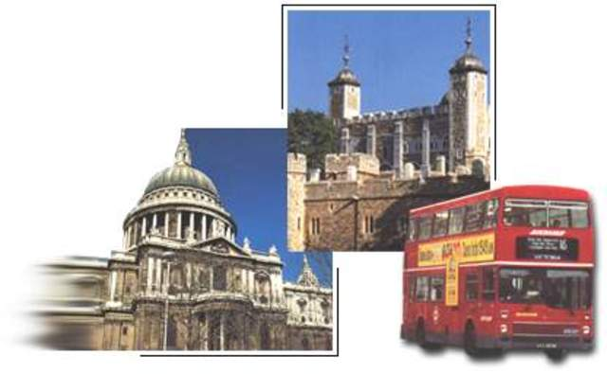
TRAVELLING

Slide 3
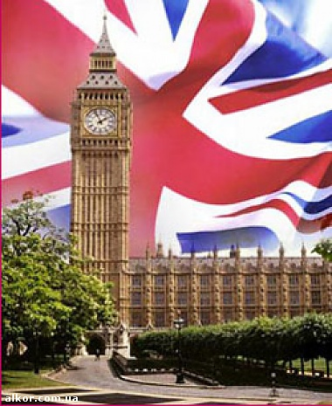
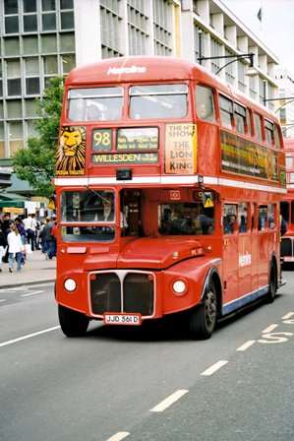

Slide 4
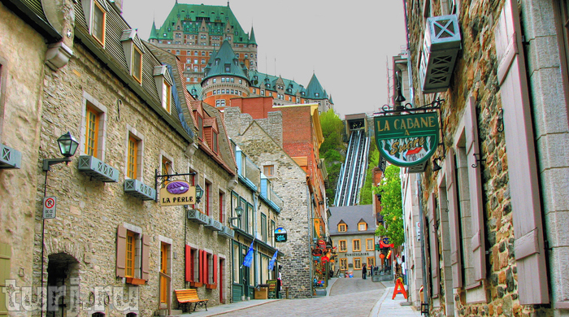

Slide 5
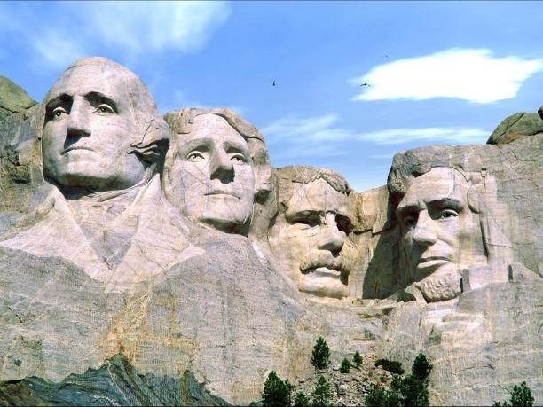

Slide 6
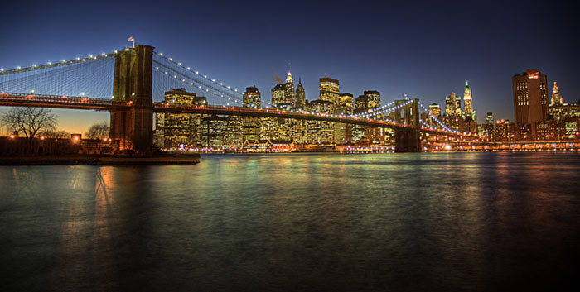

Slide 7
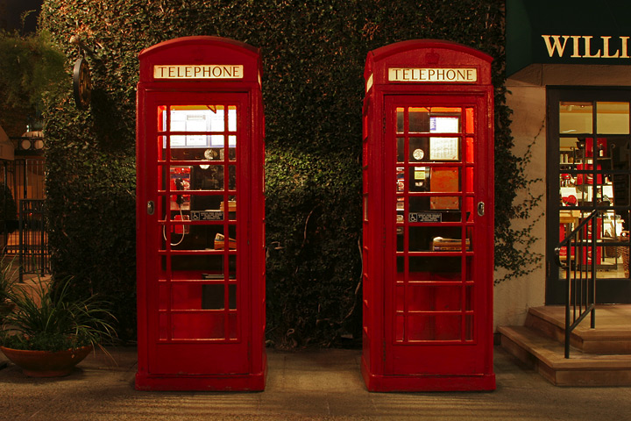

Slide 8
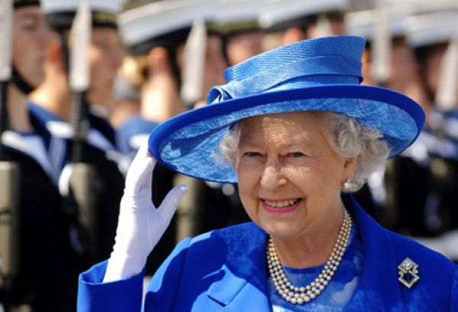

Slide 9
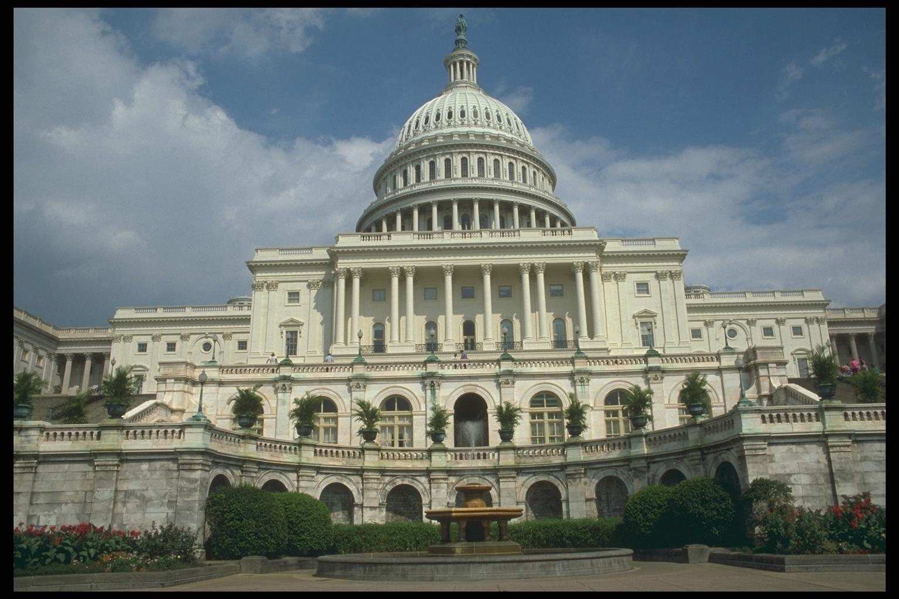

Slide 10
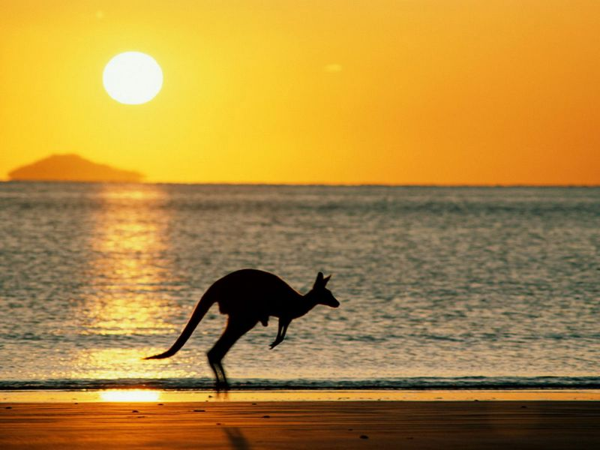

Slide 11
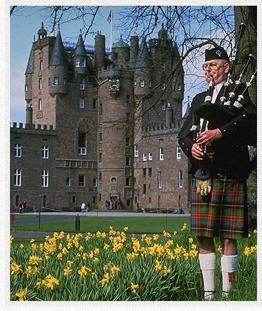
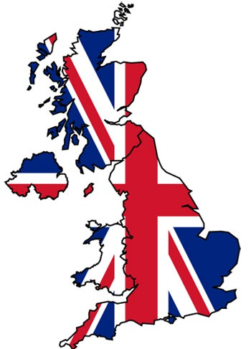

Slide 12
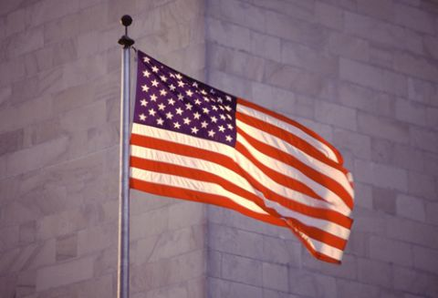

Slide 13
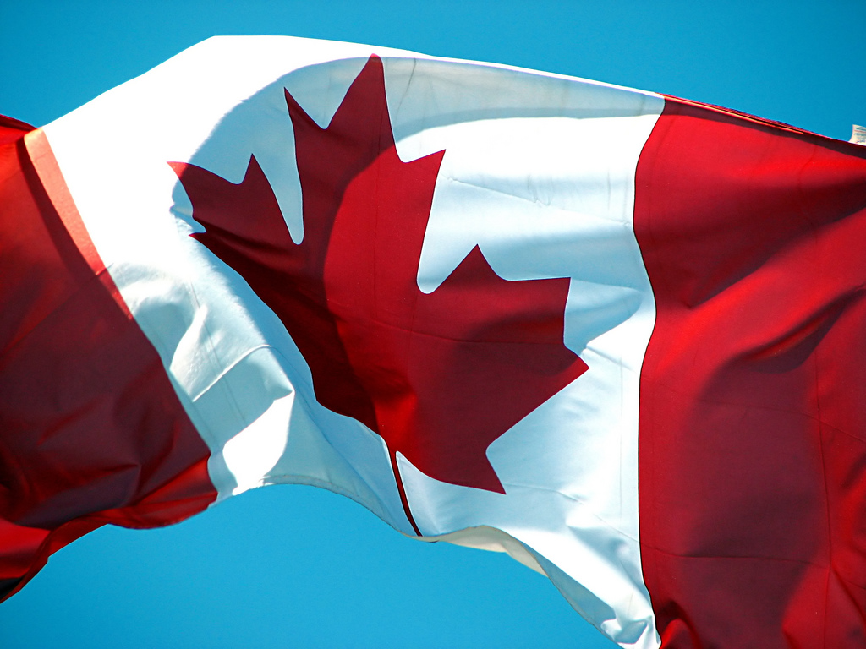

Slide 14
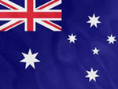
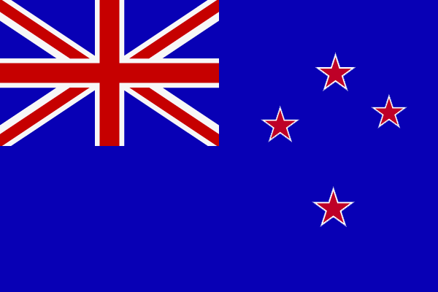

Slide 15
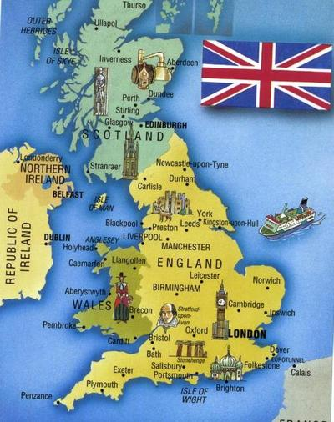
Where is Great Britain situated?
On the British Isles

Slide 16
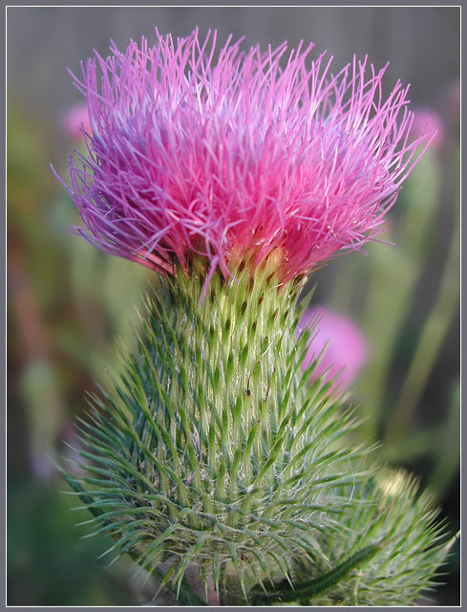
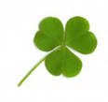
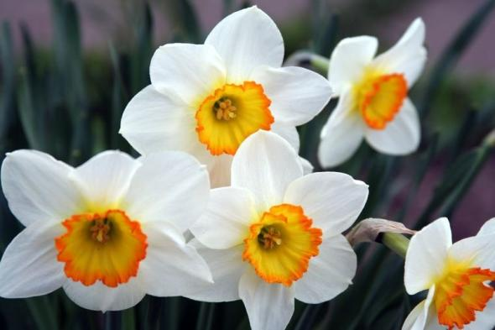
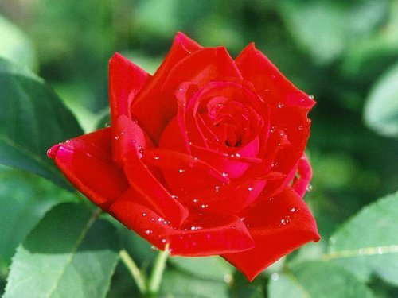
What are the four parts of Great Britain?
Northen Ireland
Scotland
Wales
England

Slide 17
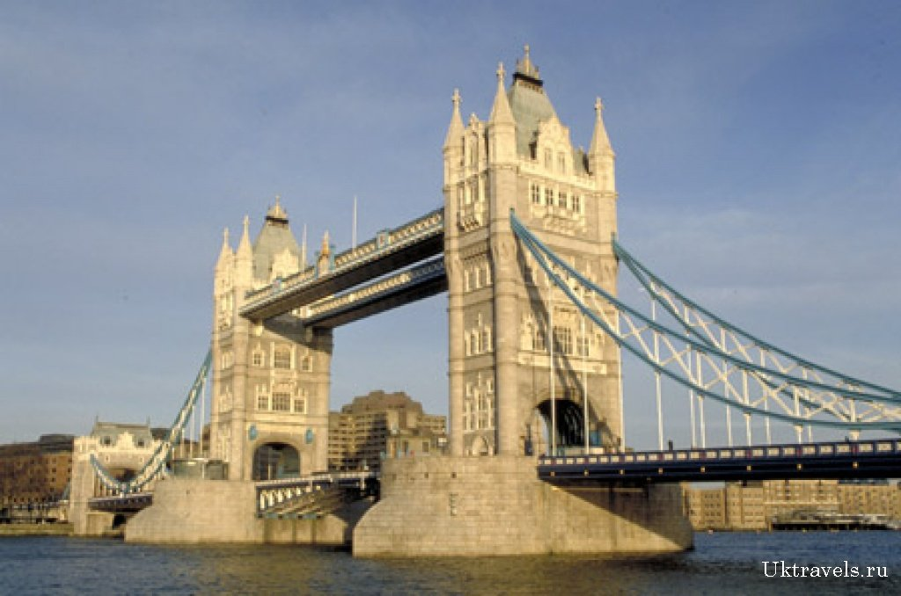
What is the full name of Britain?
The United Kingdom of Great Britain and Northern Ireland

Slide 18
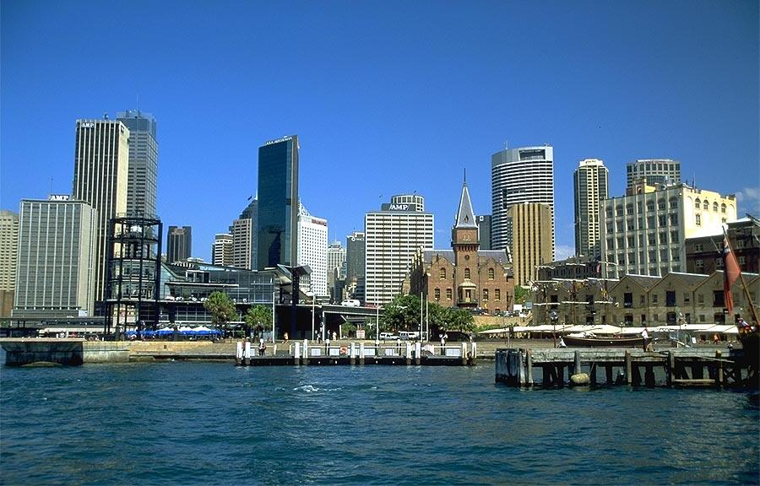
What is the only country in the world which occupies a whole continent
Australia

Slide 19
What is the capital of Australia?
Canberra

Slide 20
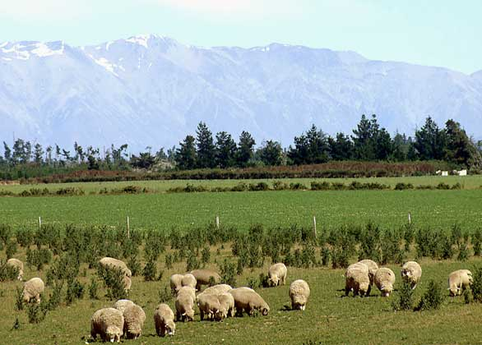
What country is sometimes called “The World’s Biggest Farm “
New Zealand

Slide 21
What languages are spoken in New Zealand?
English and Maori

Slide 22
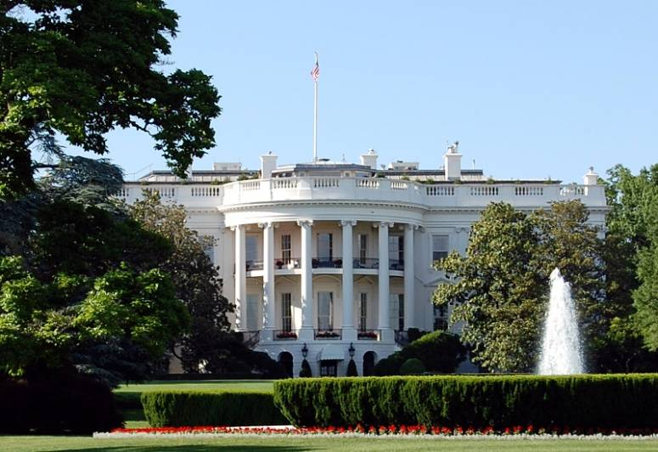
Which country stretches from the Atlantic Ocean in the east to the Pacific Ocean in the west?
the USA

Slide 23
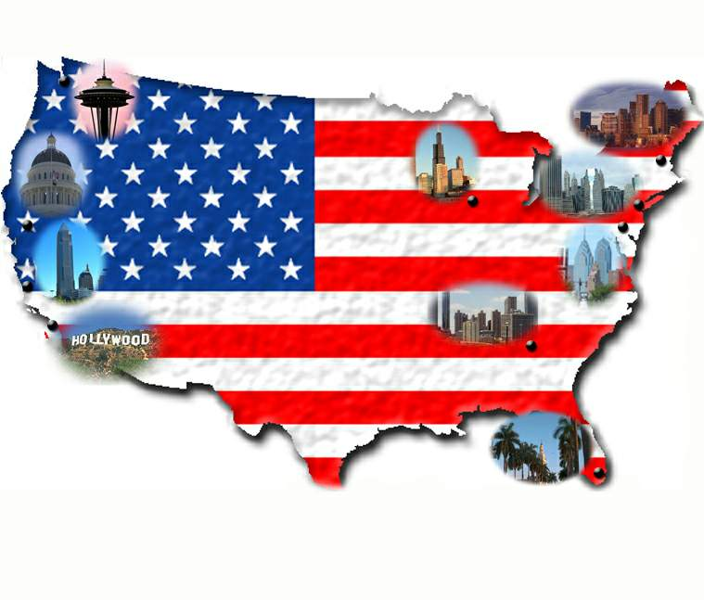
What motto do the USA have?
In God We Trust

Slide 24
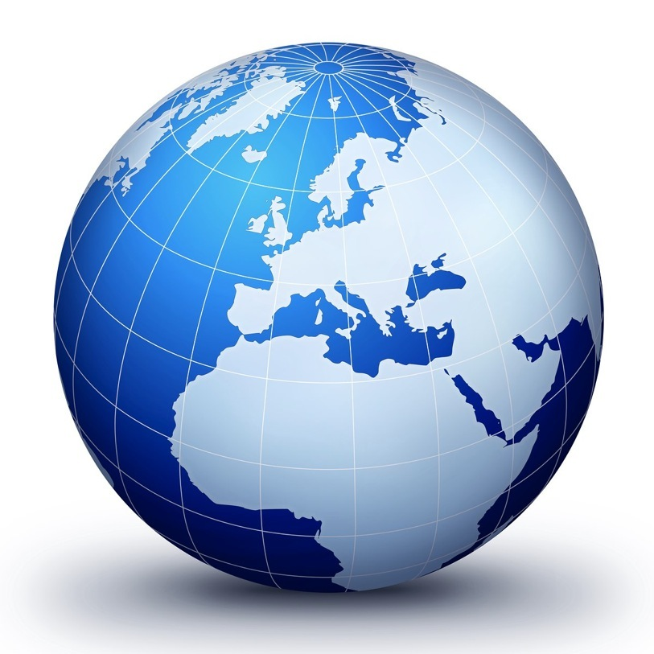
What is the second largest country in the world?
Canada

Slide 25
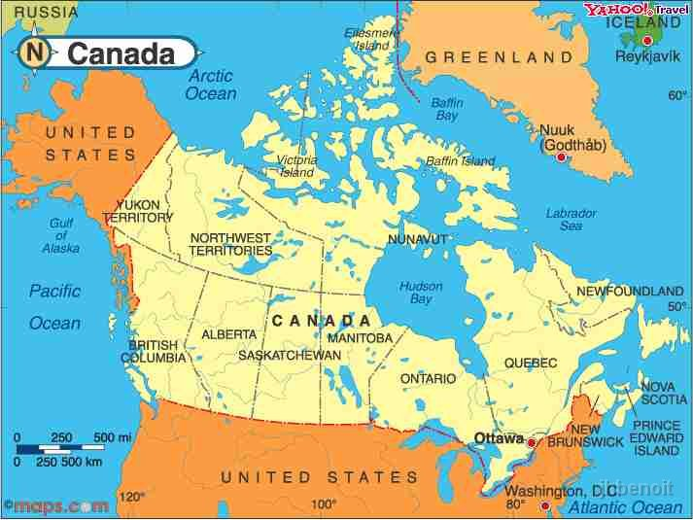
What is the official emblem of Canada?
the maple leaf

Slide 26
What official languages are spoken in Canada?
English, French

Slide 27
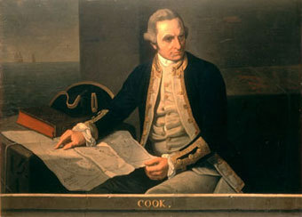
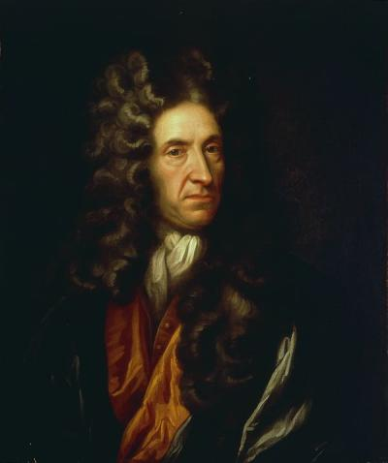
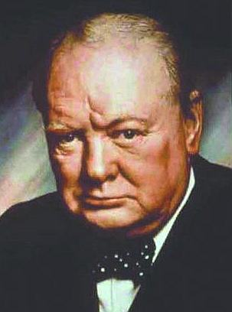
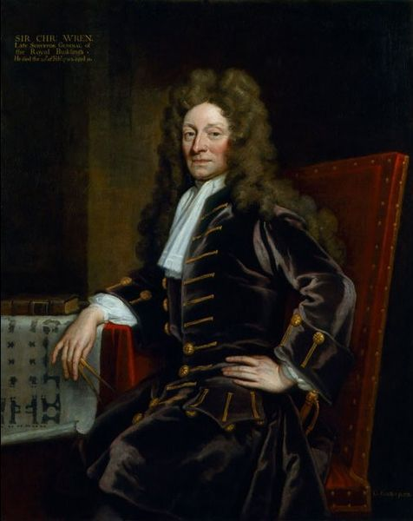
Famous People

Slide 28
He discovered Australia.
Captain James Cook

Slide 29
An English writer, whose most famous novel is “Robinson Crusoe”
Daniel Defoe

Slide 30
He was the prime minister of Great Britain during World War II.
Sir Winston
Churchill

Slide 31
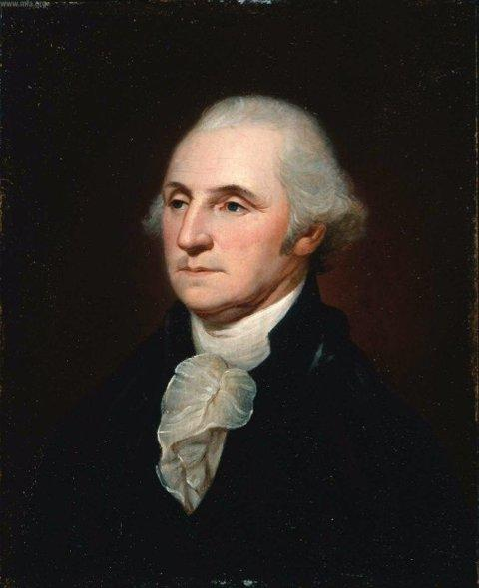
He was the first person to be elected the President of the United States
George
Washington

Slide 32
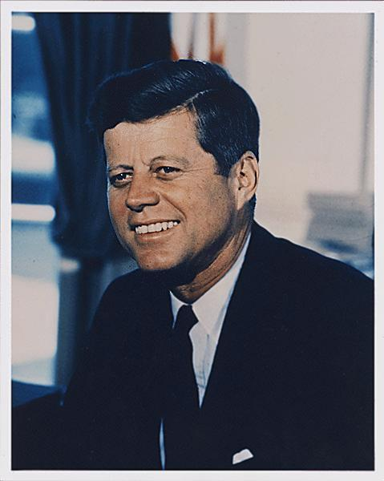
He was the youngest president the USA has ever had, but he was assassinated in 1963.
John Kennedy

Slide 33
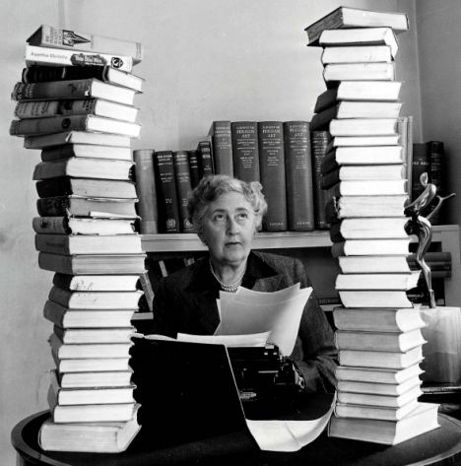
An English writer of popular books and plays who wrote 75 detective stories.
Agatha Christie

Slide 34
He was the architect of the famous St. Paul’s Cathedral.
Sir Christopher Wren

Slide 35
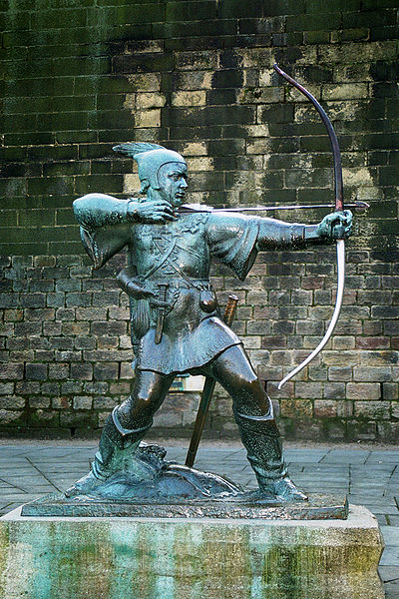
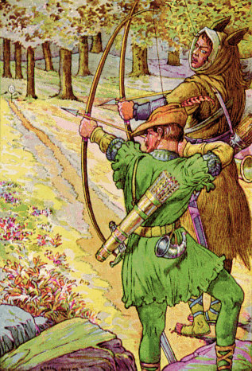
He was the National Hero of Britain, the defender of the poor people.
Robin Hood

Slide 36
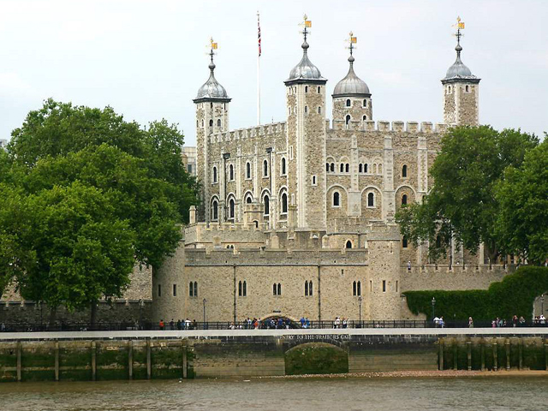
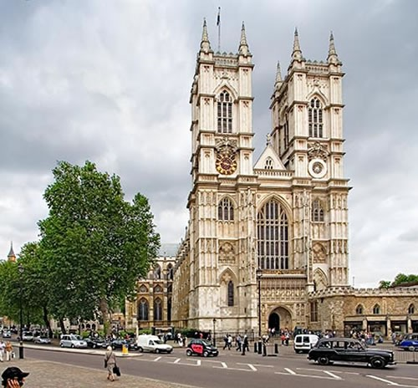

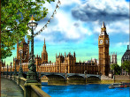
Tourist Sight and Attraction

Slide 37
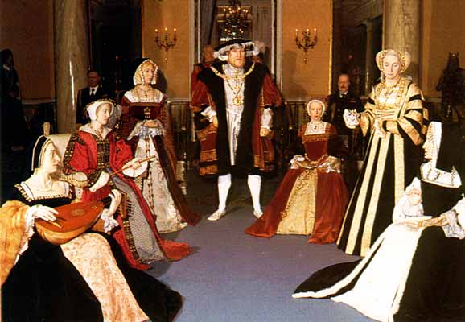
Here you can see wax models of famous people.
Tussauds
Madame Tussauds

Slide 38
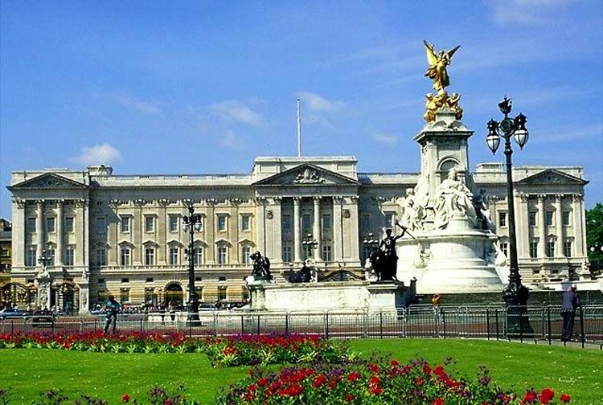
This is the Queen’s residence in London.
Buckingham Palace

Slide 39
This building was rebuilt by Christopher Wren after the Great Fire of London in 1666. It has a famous “Whispering Gallery”
St. Paul’s Cathedral

Slide 40
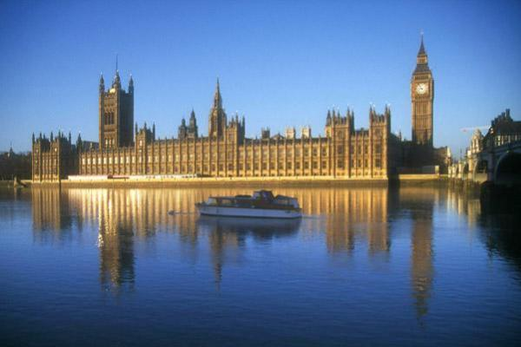
MPs debate and ague here? And there is a clock tower with a famous bell in it.
The House of Parliament

Slide 41
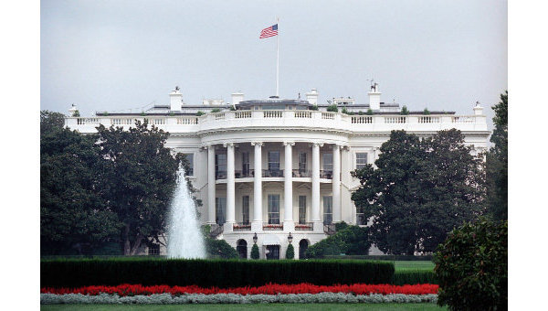
It is the oldest public building in Washington, DC, and the beautiful home of every president of the USA.
The White House

Slide 42
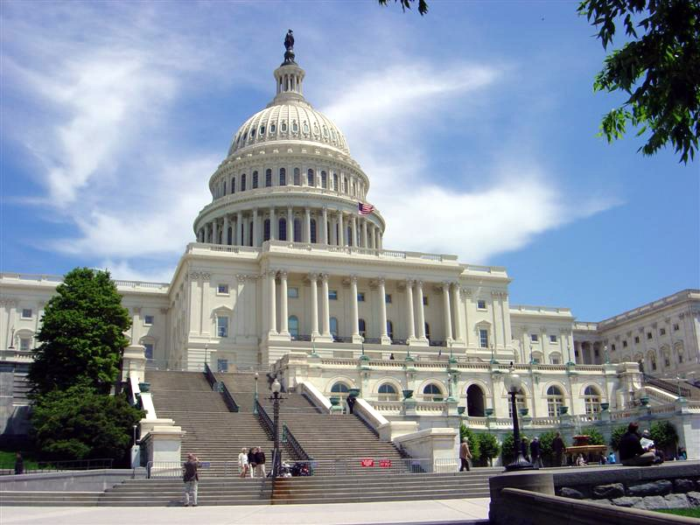
It is the tallest building in Washington, D.C., and this is where laws are made.
The Capitol

Slide 43
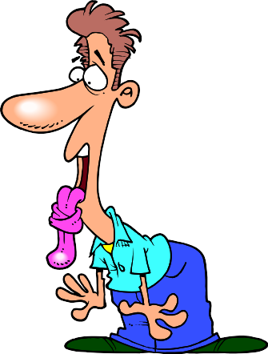
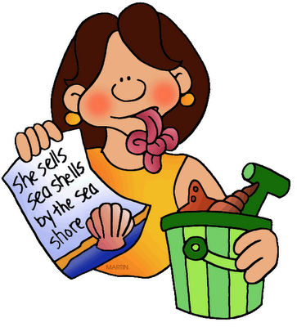
Tongue-twisters
She sells sea-shells on the seashore.
Peter Piper picked a peck
of pickled peppers.
-Sister Suzie sits and sews
sailor’s shirts.
Robert Rowley rolled a round roll round.
- Unique New York.
-Six selfish shellfish.

Slide 44
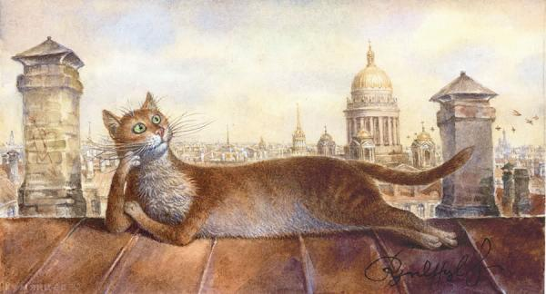
A Man and His Cat.
Long, long ago there lived a man who had no family. He had no wife and no children. He had only a cat. The man liked his cat very much and the cat liked him, too. Every day when the man had dinner the cat sat on a chair at the table. The cat had its plate and the man always put some meat or fish into the cat’s plate. Sometimes he gave the cat some soup or milk with some bread in it.
One day the cat came into the room and……

Slide 45
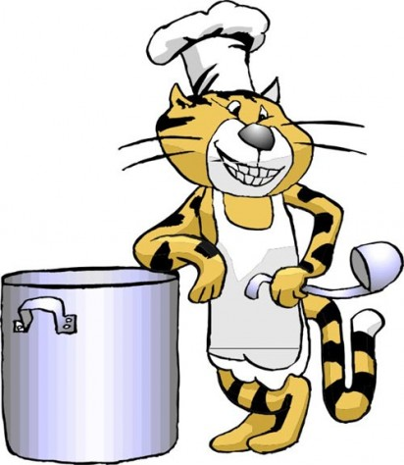
One day the cat came into the room and… put a large rat into the man’s plate. You see, the cat wanted to thank the man for the food that the man had given it every day for a number of years.

Slide 46


