Slide 1
Titanic
Chapter 1-3

Slide 2
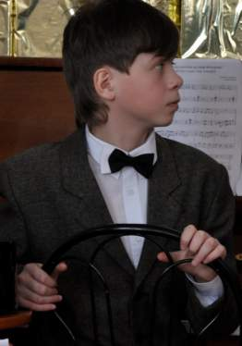

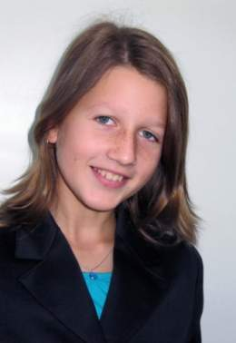
done by:
Kharina Alexandra Smelkov Denis Korshunova Olga

Slide 3
1. Choose the correct item
1) Where was the Titanic found?
A) in South Atlantic
B) in Pacific Ocean
C) in North Atlantic

Slide 4
1. Choose the correct item
1) Where was the Titanic found?
A) in South Atlantic
B) in Pacific Ocean
C) in North Atlantic

Slide 5
1. Choose the correct item
2) When was she found?
A) in 1984
B) in 1985
C) in 1986

Slide 6
1. Choose the correct item
2) When was she found?
A) in 1984
B) in 1985
C) in 1986

Slide 7
1. Choose the correct item
3) How many people made the Titanic?
A) 16 500 people
B) 15 000 people
C) 1000 people

Slide 8
1. Choose the correct item
3) How many people made the Titanic?
A) 16 500 people
B) 15 000 people
C) 1000 people

Slide 9
1. Choose the correct item
4) Where was the Titanic made?
A) in Belfast
B) in New York
C) in London

Slide 10
1. Choose the correct item
4) Where was the Titanic made?
A) in Belfast
B) in New York
C) in London

Slide 11
1. Choose the correct item
5) Where did the third class passengers
live?
A) A Deck
B) E Deck
C) B Deck

Slide 12
1. Choose the correct item
5) Where did the third class passengers
live?
A) A Deck
B) E Deck
C) B Deck

Slide 13
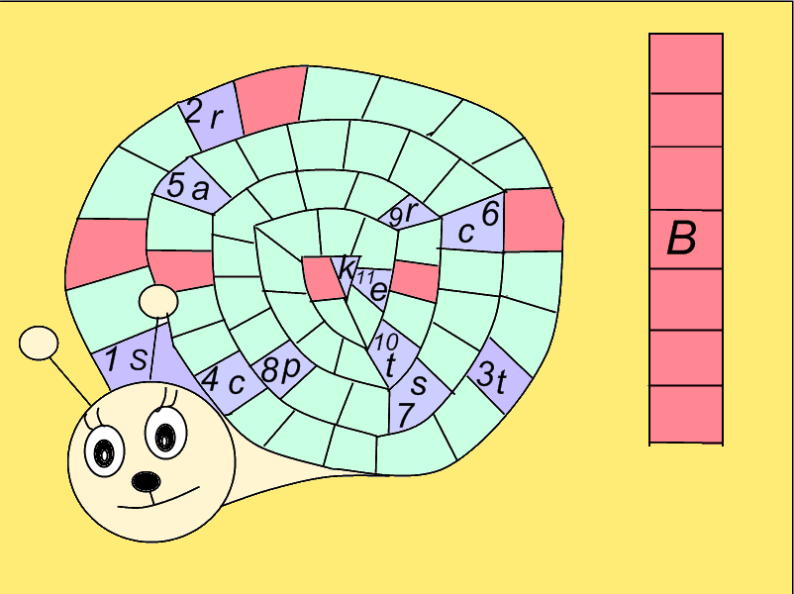
2. Solve the crossword
1. Who was Frederick Fleet?

Slide 14
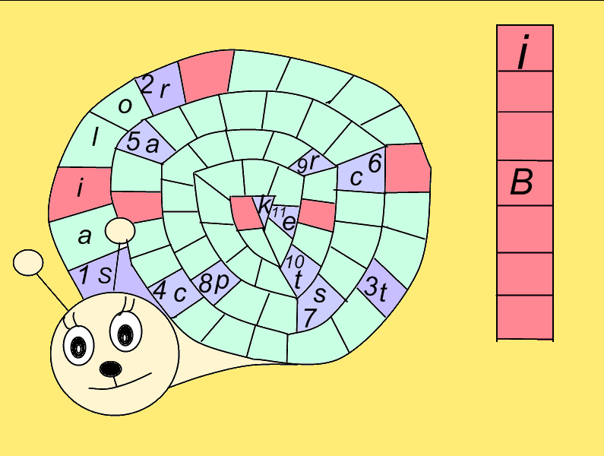
2. Where did the first class passengers eat?

Slide 15
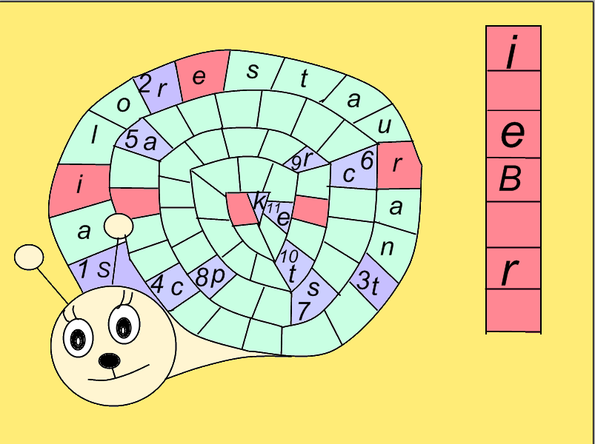
3. What was the name of the ship?

Slide 16
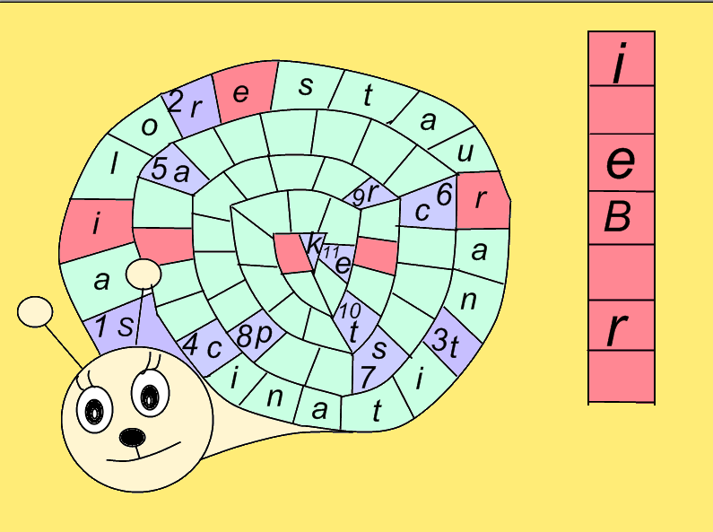
4. Where did some French
and American sailors see Titanic?

Slide 17
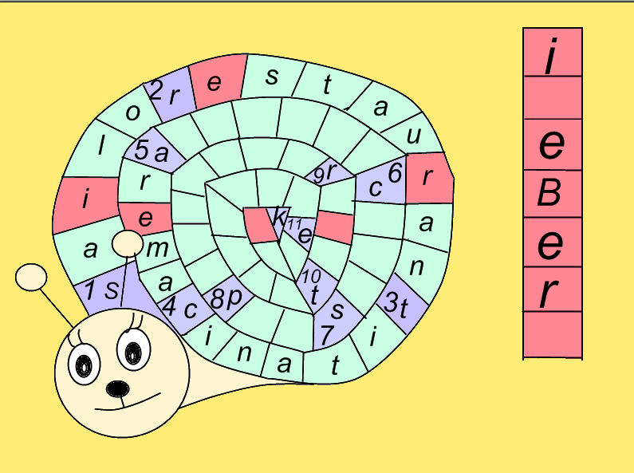
5. Where did the Titanic
settle down?(ocean)

Slide 18
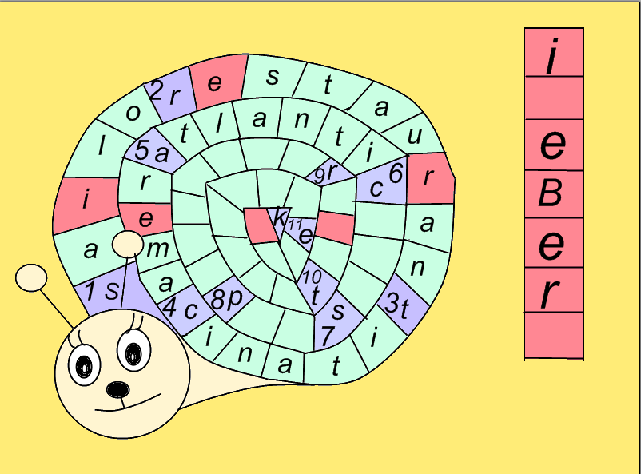
6. How were the rich
passengers divided from others?

Slide 19
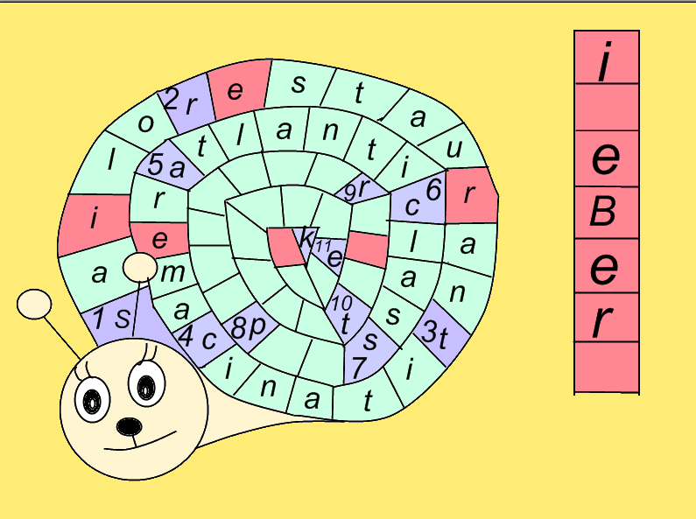
7. What was the Titanic?

Slide 20

8. How were the people
on the board of the ship called?

Slide 21
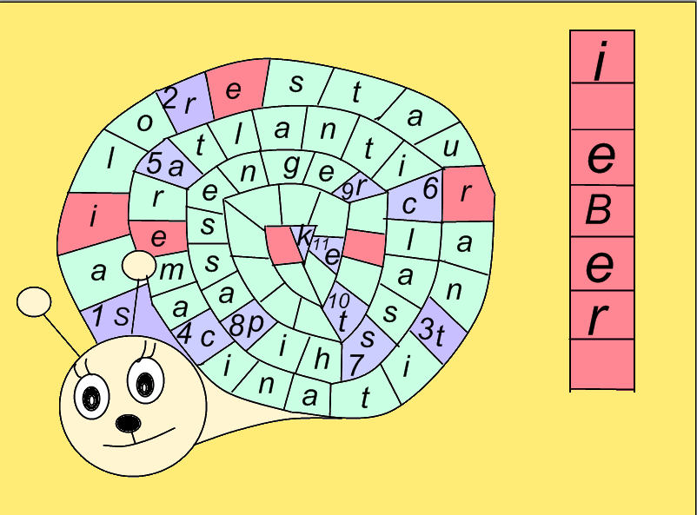
9. Where did the iceberg
go along the ship?(side of the ship)

Slide 22
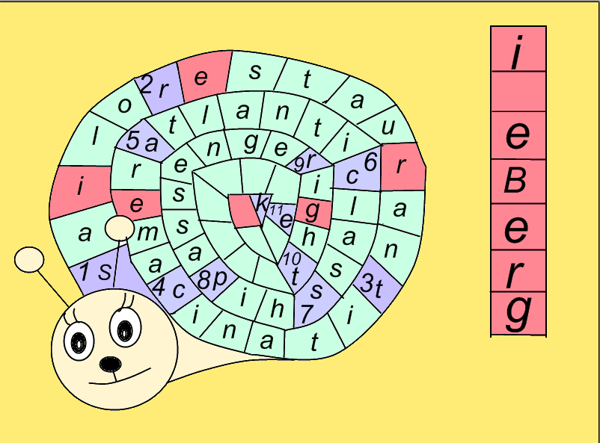
10. When the sailor saw
the iceberg, he said about it on the ...

Slide 23
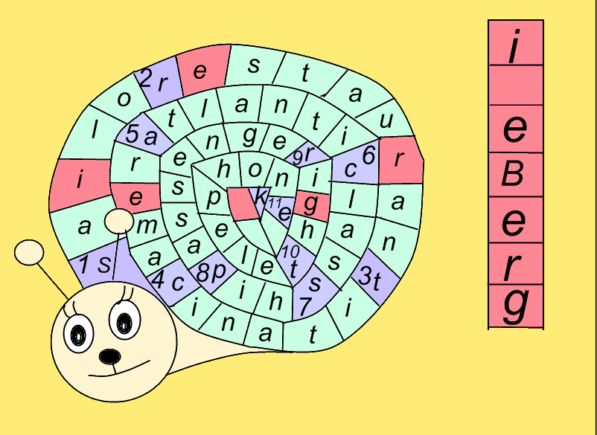
11. Where did the third class
passengers live?( without -)

Slide 24
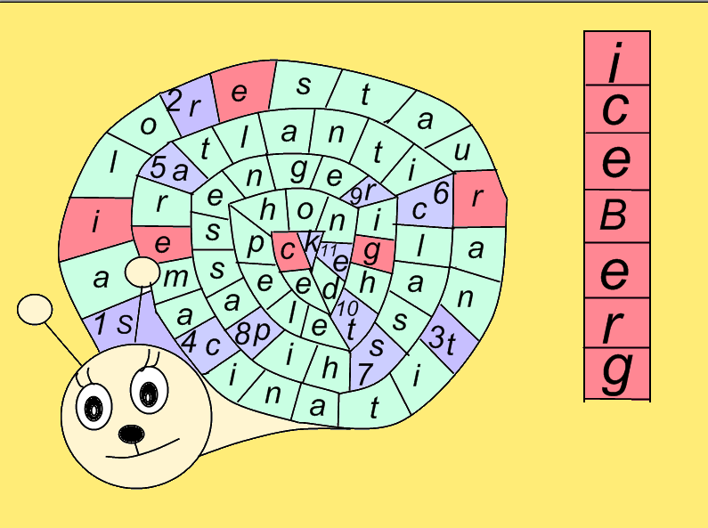

Slide 25
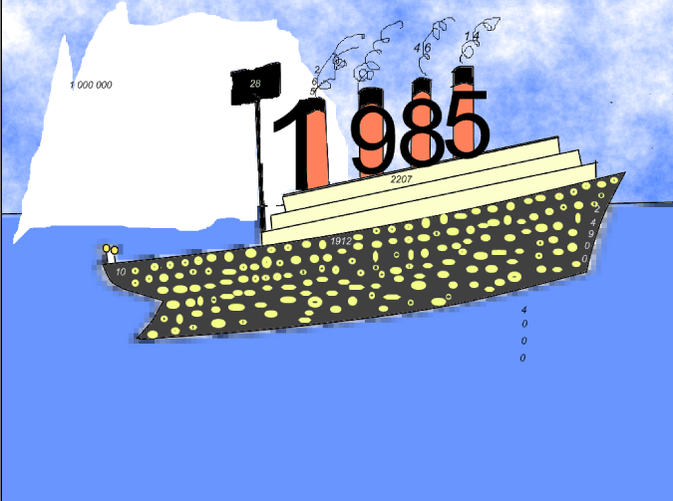
3.Find numbers and fill it in the gaps
She was ... metres long

Slide 26
3.Find numbers and fill it in the gaps
She was 265 metres long

Slide 27
And .. metres across

Slide 28
And 28 metres across

Slide 29
The ship could go at ..
kilometres an hour

Slide 30
The ship could go at 46
kilometres an hour

Slide 31
On April .. the Titanic went from
Southampton to Cork

Slide 32
On April 10 the Titanic went from
Southampton to Cork

Slide 33
She was made in ....

Slide 34
She was made in 1912

Slide 35
It was nearly .... metres
under the sea

Slide 36
It was nearly 4000 metres
under the sea

Slide 37
It was found in ....

Slide 38
It was found in 1985

Slide 39
There were .... people on the ship

Slide 40
There were 2207 people on the ship

Slide 41
Iceberg was very big,
a ....... tons of ice

Slide 42
Iceberg was very big,
a 1 000 000 tons of ice

Slide 43
It was the biggest ship
in the world - ..... tons

Slide 44
It was the biggest ship
in the world – 24 900 tons

Slide 45
On the night of .. April
the Titanic crashed the Iceberg

Slide 46
On the night of 14 April
the Titanic crashed the Iceberg

Slide 47


The end

