Slide 1
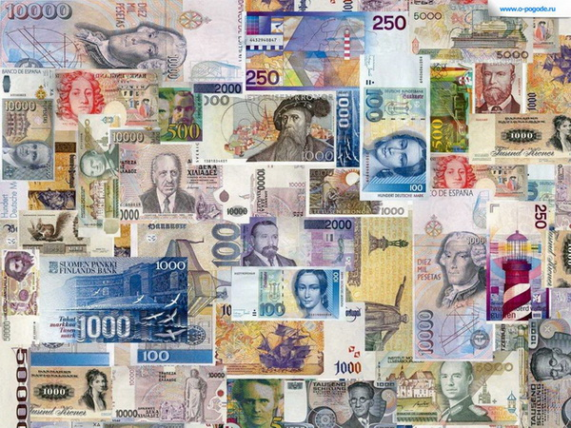
MONEY-MAKING SECRET

Slide 2




?

Slide 3

Money-making opportunities

Slide 4


?

Slide 5

Making money with internet marketing

Slide 6




?

Slide 7
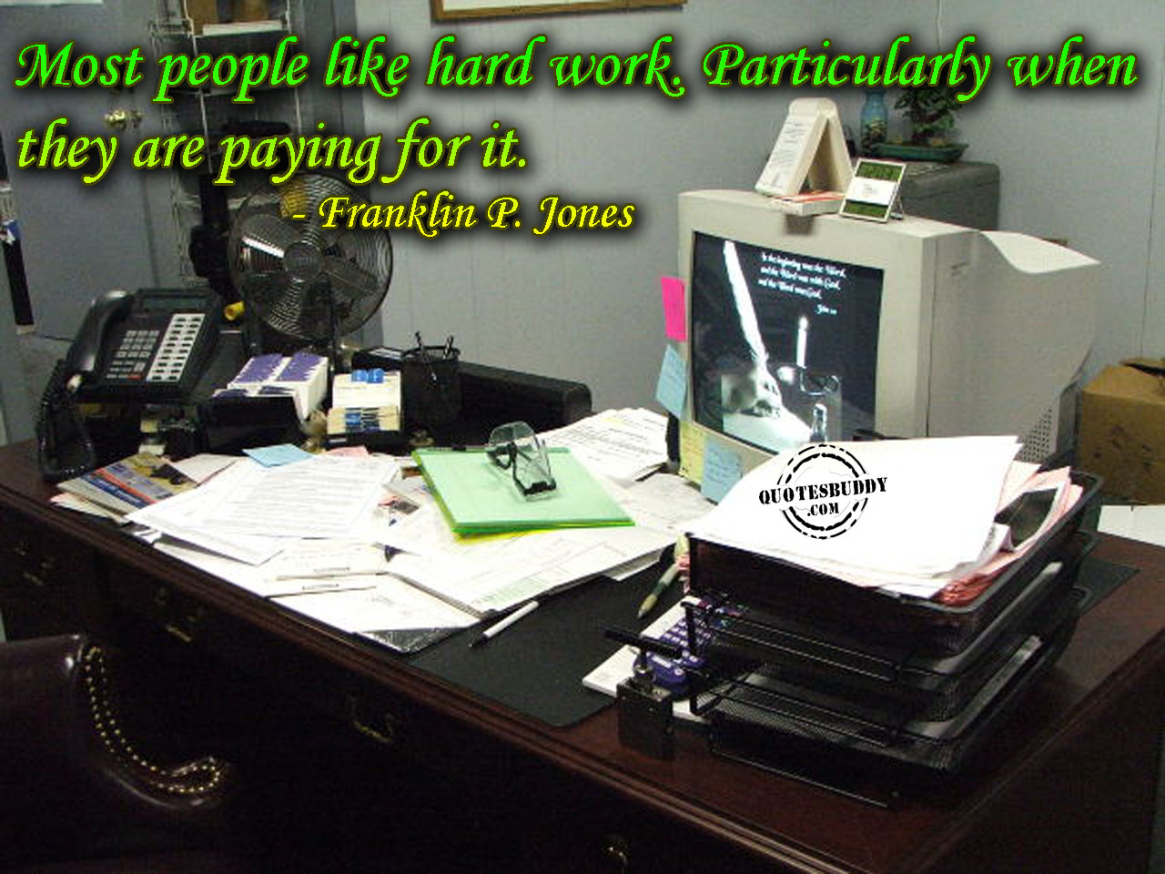
The secret is that it takes hard work

Slide 8


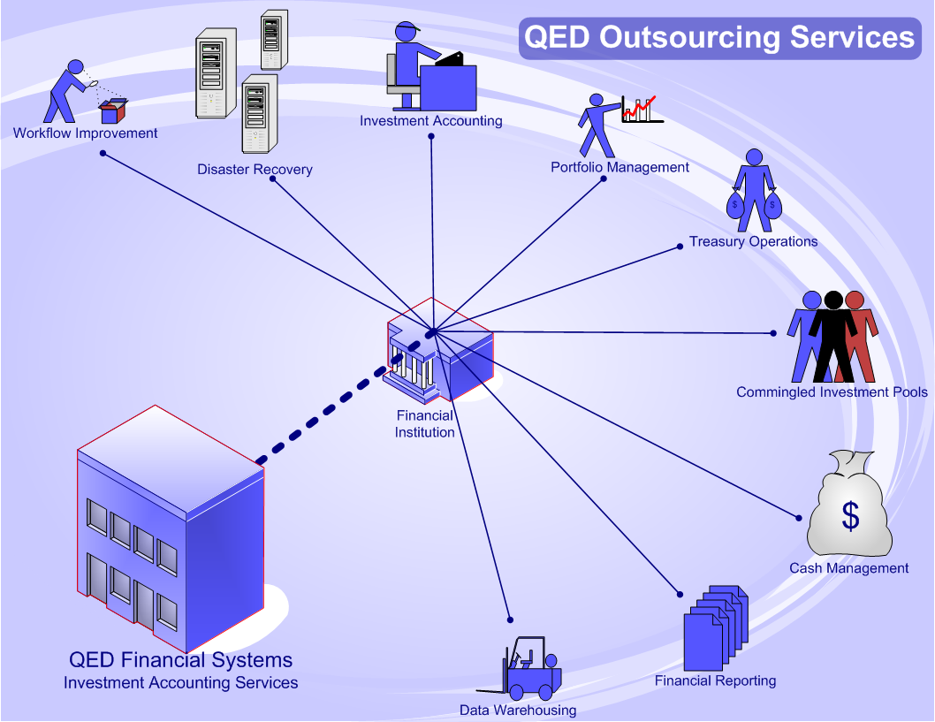
?

Slide 9

Outsourcing

Slide 10




?

Slide 11

competition

Slide 12
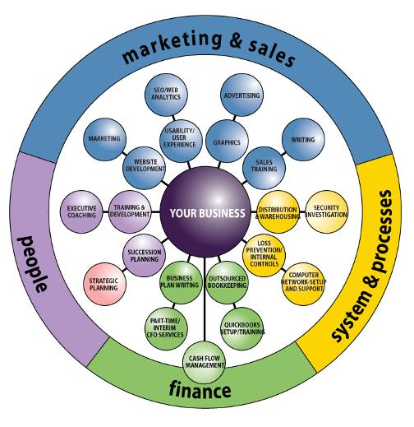



?

Slide 13

Model your business around

