Slide 1
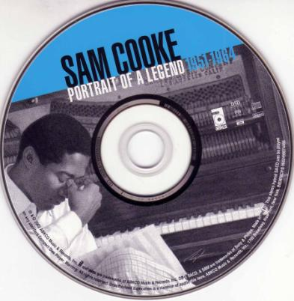
WONDERFUL WORLD
Sam Cooke

Slide 2
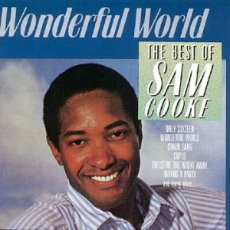
WONDERFUL WORLD
Sam Cooke was born in Mississippi, a state in the southern United States. He had seven
brothers and sisters. When he was little, he sang with his family in a group called The
Singing Children.

Slide 3
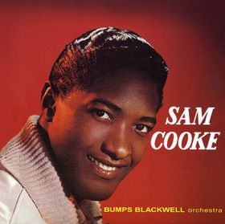
WONDERFUL WORLD
Later, he sang gospel music (religious music) in his church. Then he
began to sing popular music. His music is called soul music. Soul music is a mix of
gospel music and rock and roll. Sam Cooke is called the King of Soul because he was
one of the first to play soul music.

Slide 4
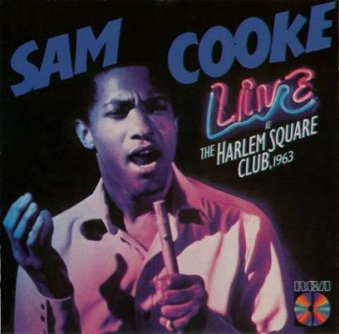
WONDERFUL WORLD
Sam Cooke first sang “Wonderful World” in the 1950s. It is about a high school student
who isn’t a very good student, but who knows a lot about love.

Slide 5
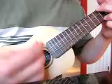

Slide 6
WONDERFUL WORLD
algebra | a type of math class that uses letters and signs to talk about numbers, for example, “X + Y = Z”
history | a class where you study things that happened in the past
biology | a class where you study living things: plants and animals
geography | a class where you study countries, oceans, cities of the world
trigonometry | a class where you study the parts of a triangle
slide rule | a kind of calculator
an “A” student | a very good student
claim | say that something is true

Slide 7
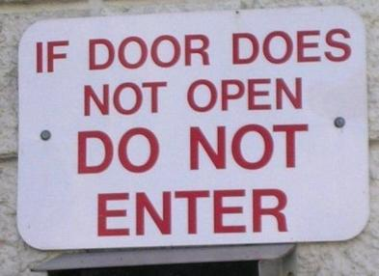

WONDERFUL WORLD
Subject do/does not main verb
Don’t know much about …
We don’t eat fish.
She doesn’t like coffee.
They don’t work.
Tigers don't live in the desert.
Rice doesn't grow in dry soil.

Slide 8
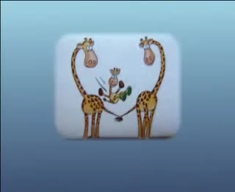
Is the singer a good student or a bad student?
Why do you think so?

Slide 9
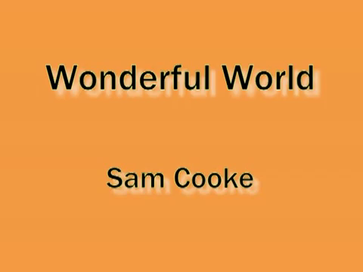
Make a list of what the singer doesn’t know, make a list of what the singer does know.

Slide 10
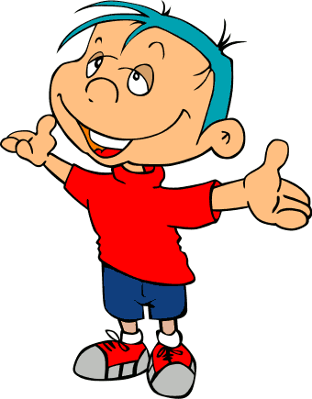

WONDERFUL WORLD
Doesn’t know | Does know
The singer wants a young girl that he knows to love him.
Do you think the girl is a good student or a bad student?
Why?

Slide 11
Write three things that you know about.
What do you know about?
Write three things that you don’t know much about.
What don’t you know about?
What doesn’t he (she) know about?
I know a lot about English. | I don’t know much about Italian.
What does he (she) know about?
Maria knows a lot about food. | She doesn’t know much about plants.

Slide 12

WONDERFUL WORLD

