Slide 1
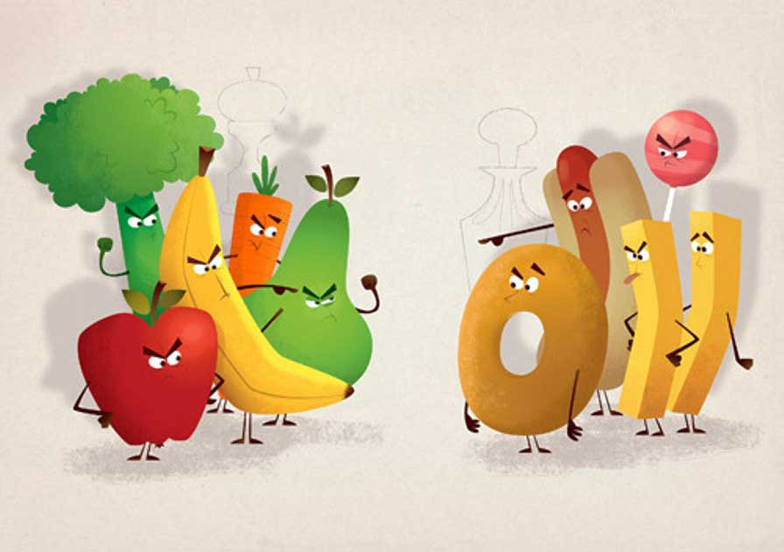
HEALTHY
FOOD
VS
JUNK
FOOD

Slide 2
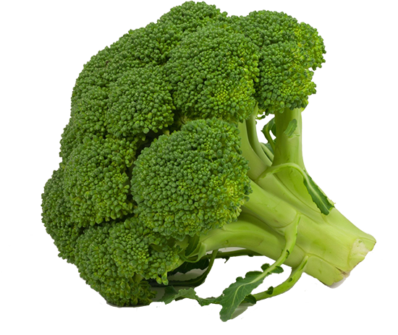
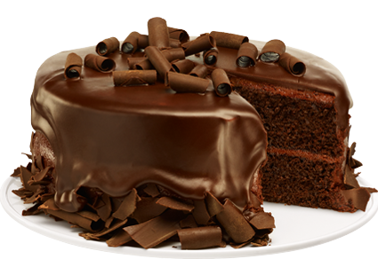
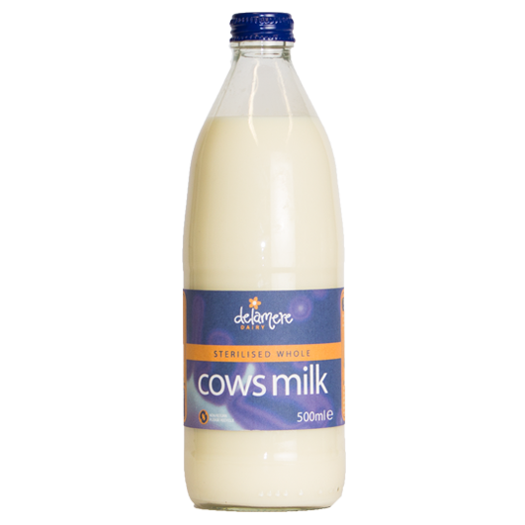
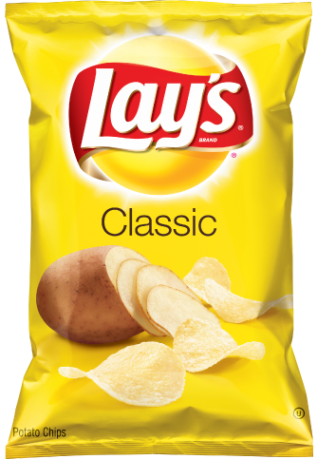
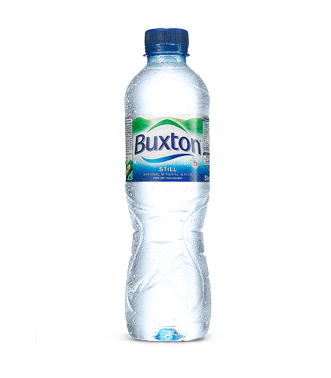
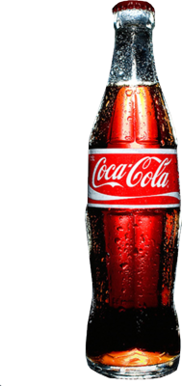
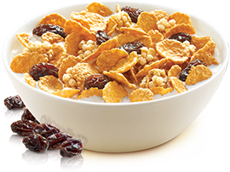
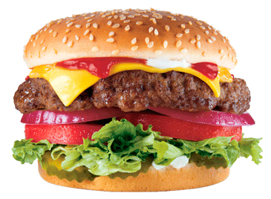
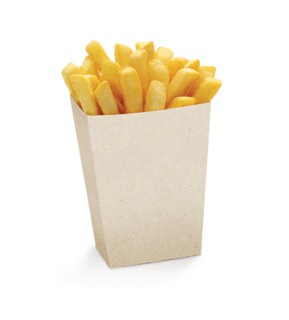
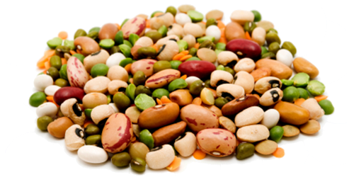
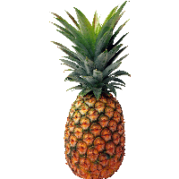
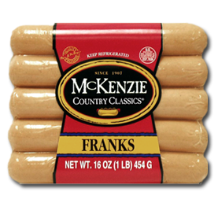
HEALTHY
FOOD
JUNK
FOOD
milk
cola
crisps
mineral water
hamburger
broccoli
cereals
beans
cake
chips
pineapple
sausages

Slide 3
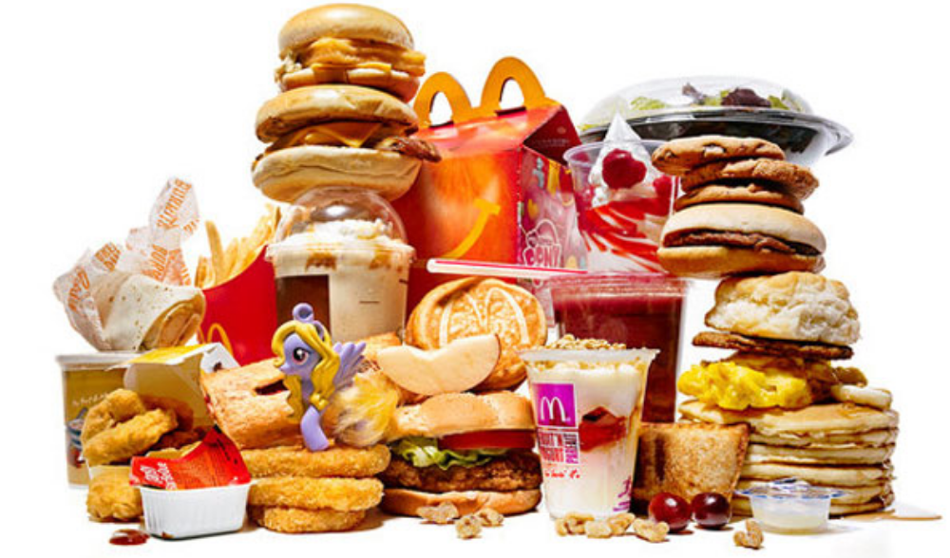
What do you think JUNK FOOD is?
Sweets, hamburgers, hot dogs, crisps, soft drinks and other kinds of convenience food are called JUNK FOOD

Slide 4
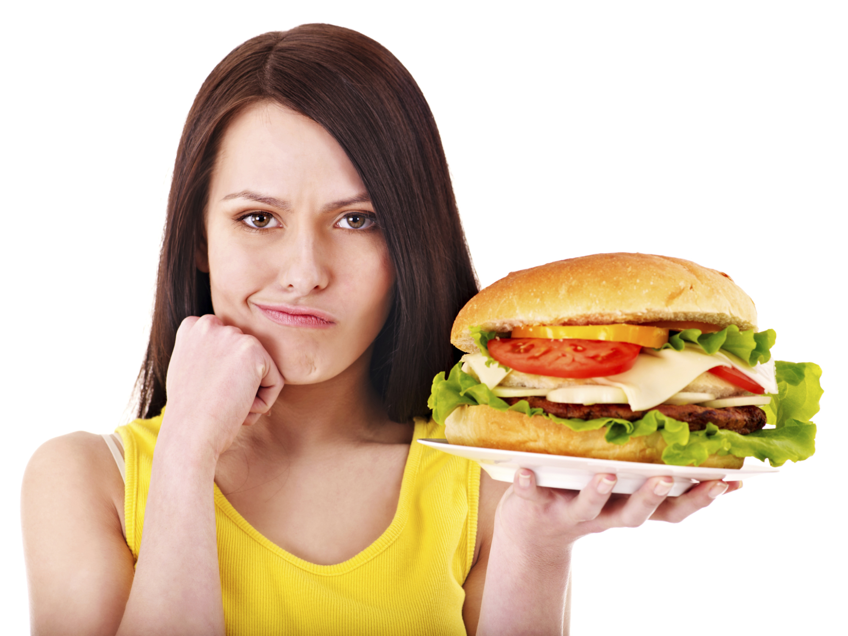
What's wrong with JUNK FOOD?
Too much fat!
Too much fat in the diet will cause people to put on weight and get fat or obese. Being overweight is a risk to the health of the heart and can cause other diseases, even cancer.

Slide 5
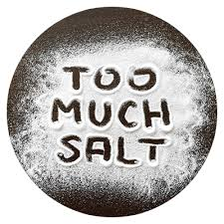
What's wrong with JUNK FOOD?
Too much salt!
People get more salt than they need when they eat junk food. There aren’t any good things in too much salt for our health.

Slide 6
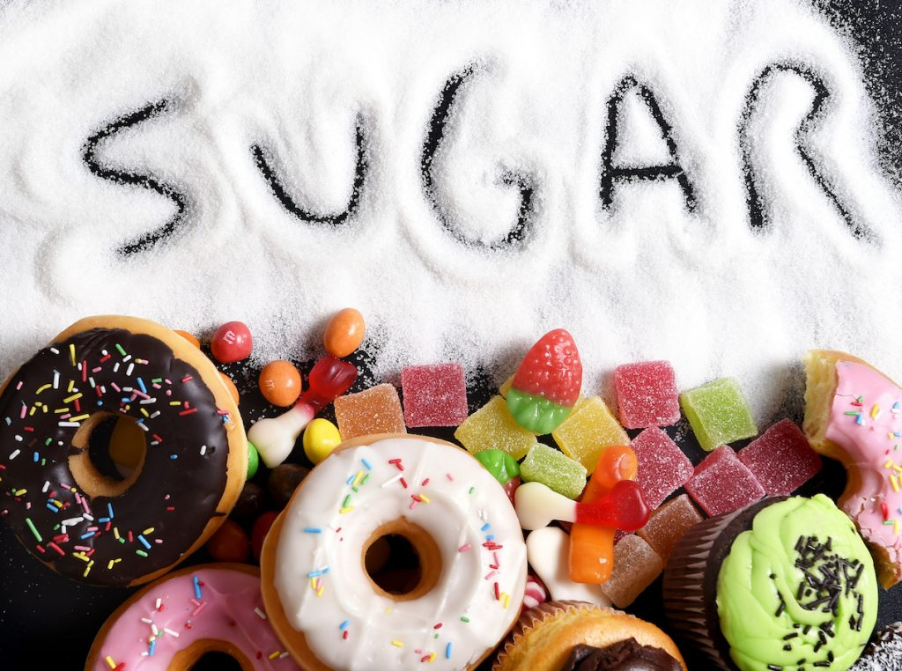
What's wrong with JUNK FOOD?
Too much sugar!
Biscuits, cakes and sweets all have very much sugar. That's what makes them taste so good! But too much sugar makes people fat, spoils the teeth, is bad for the blood and may cause other diseases.

Slide 7
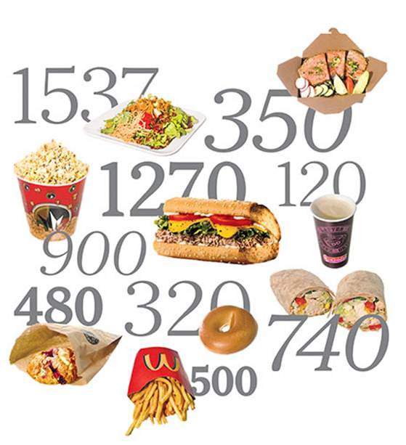
What's wrong with JUNK FOOD?
Too much calories!
Junk food is high-calorie and low in nutritional value. That’s why you’re consuming too much energy but not using it up through day to day activities. The extra calories are stored in the body as fat.

Slide 8
Match the words with their definitions
Word | Definition
1) soft drink
2) crisps
3) to put on weight
4) obese
5) convenience food
6) to spoil
7) cancer
8) a nutritional value
9) high-calorie
10) to store
11) to consume
12) to use up
c) sweet non-alcoholic carbonated water
e) salty little fried pieces of potatoes
g) get more kilos
a) very very fat
l) a complete meal, that has been pre-prepared commercially
b) make smth bad
d) very bad disease which is hard to cure
k) value expressed in calories
i) an amount of calories more than needed
j) to keep
f) to spend calories
h) to use supplies

Slide 9

“Foods You Thought
Were Healthy But Actually Aren't”

Slide 10
TRUE, FALSE or NOT STATED
1 Fast food salads calories can be equal to the burger's one
2 Pre-bottled smoothies contain up to 20 grams of sugar only
3 Instant oatmeal has additional carbos
4 Flavors adds 12 grams of sugar to an instant oatmeal
5 Veggie chips has 100 grams of fats
6 Protein bars contain more than 40 grams of carbos
T
F
NS
T
NS
T

Slide 11
“Calories In Junk Food
Vs
Healthy Food”

Slide 12
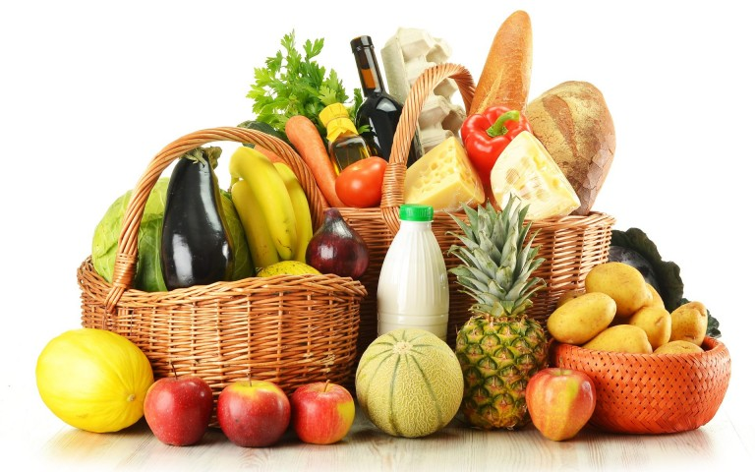
What HEALTHY FOOD is?
A variety of foods that give you the nutrients you need to improve your health, feel good, and have energy is called
HEALTHY FOOD

Slide 13
QUESTIONNAIRE
Are you a healthy eater?

Slide 14
QUESTIONNAIRE
1. How many meals do you have a day?
a) 5-6
b) 4
c) 3
d) 2

Slide 15
QUESTIONNAIRE
2. How often do you eat breakfast?
a) Every day
b) 2-3 times a week
c) Once a week
d) What’s the breakfast?

Slide 16
QUESTIONNAIRE
3. How often do you eat something at
night just before going to bed?
Never
Sometimes
3-6 times a week
Every day

Slide 17
QUESTIONNAIRE
4. How often do you eat junk food?
Never
Sometimes
Once a week
Every day

Slide 18
QUESTIONNAIRE
5. How many glasses of water do you
drink every day?
4-6
2-3
1
None

Slide 19
KEY
Count your points.
for each option a – 3 points
for each option b – 2 points
for each option c – 1 points
for each option d – 0 points

Slide 20
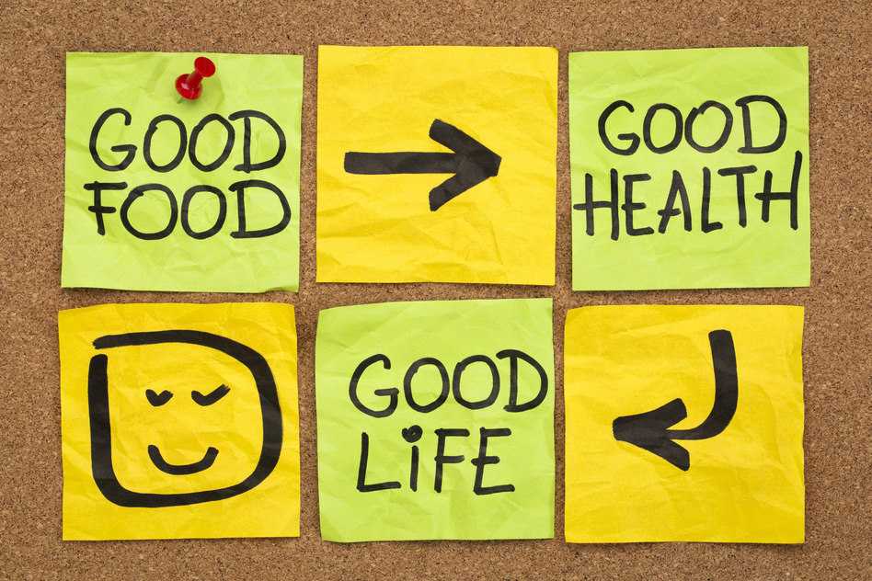
KEY
10 – 0 points:
Think about your daily diet!
15 – 11 points:
Great! You eat healthy.

Slide 21


Slide 22
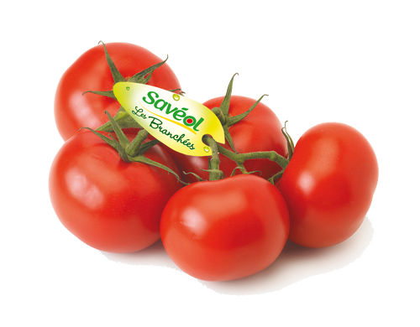
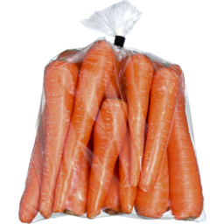
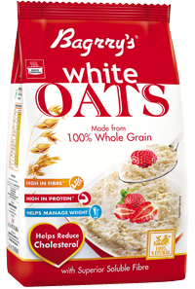
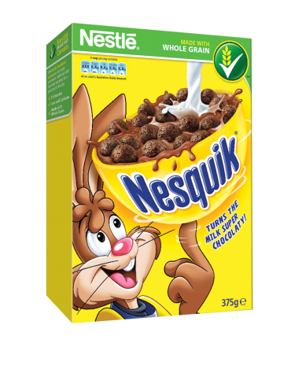
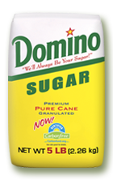
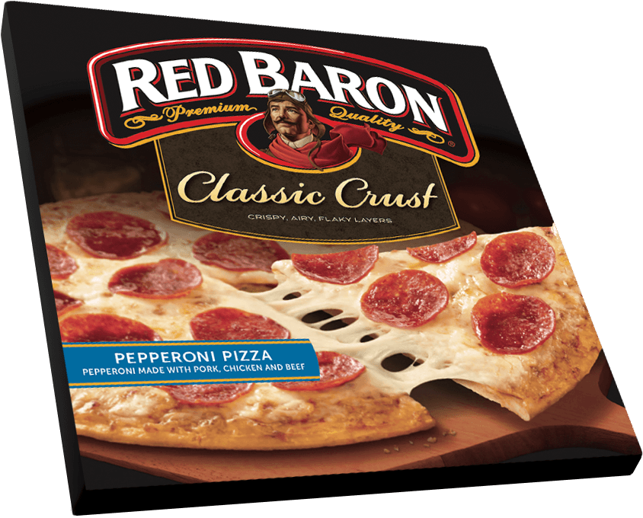
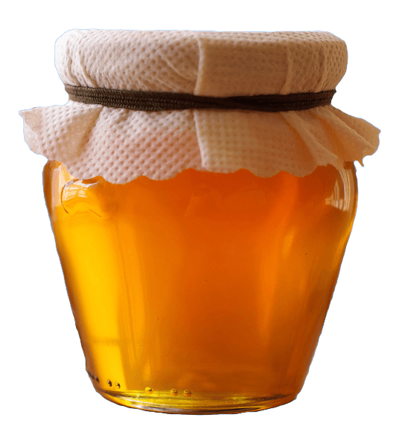
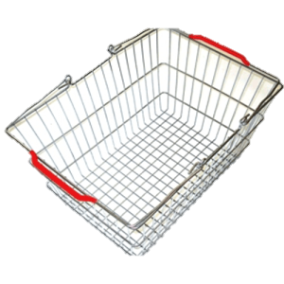
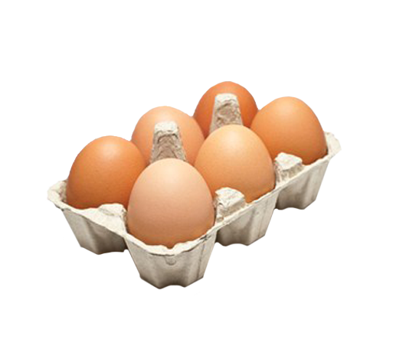
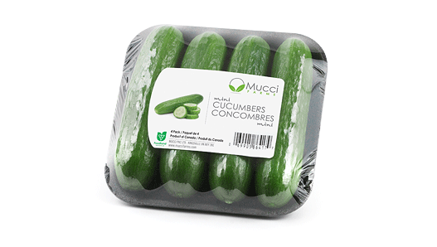
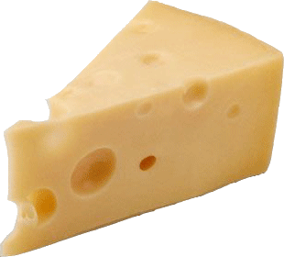
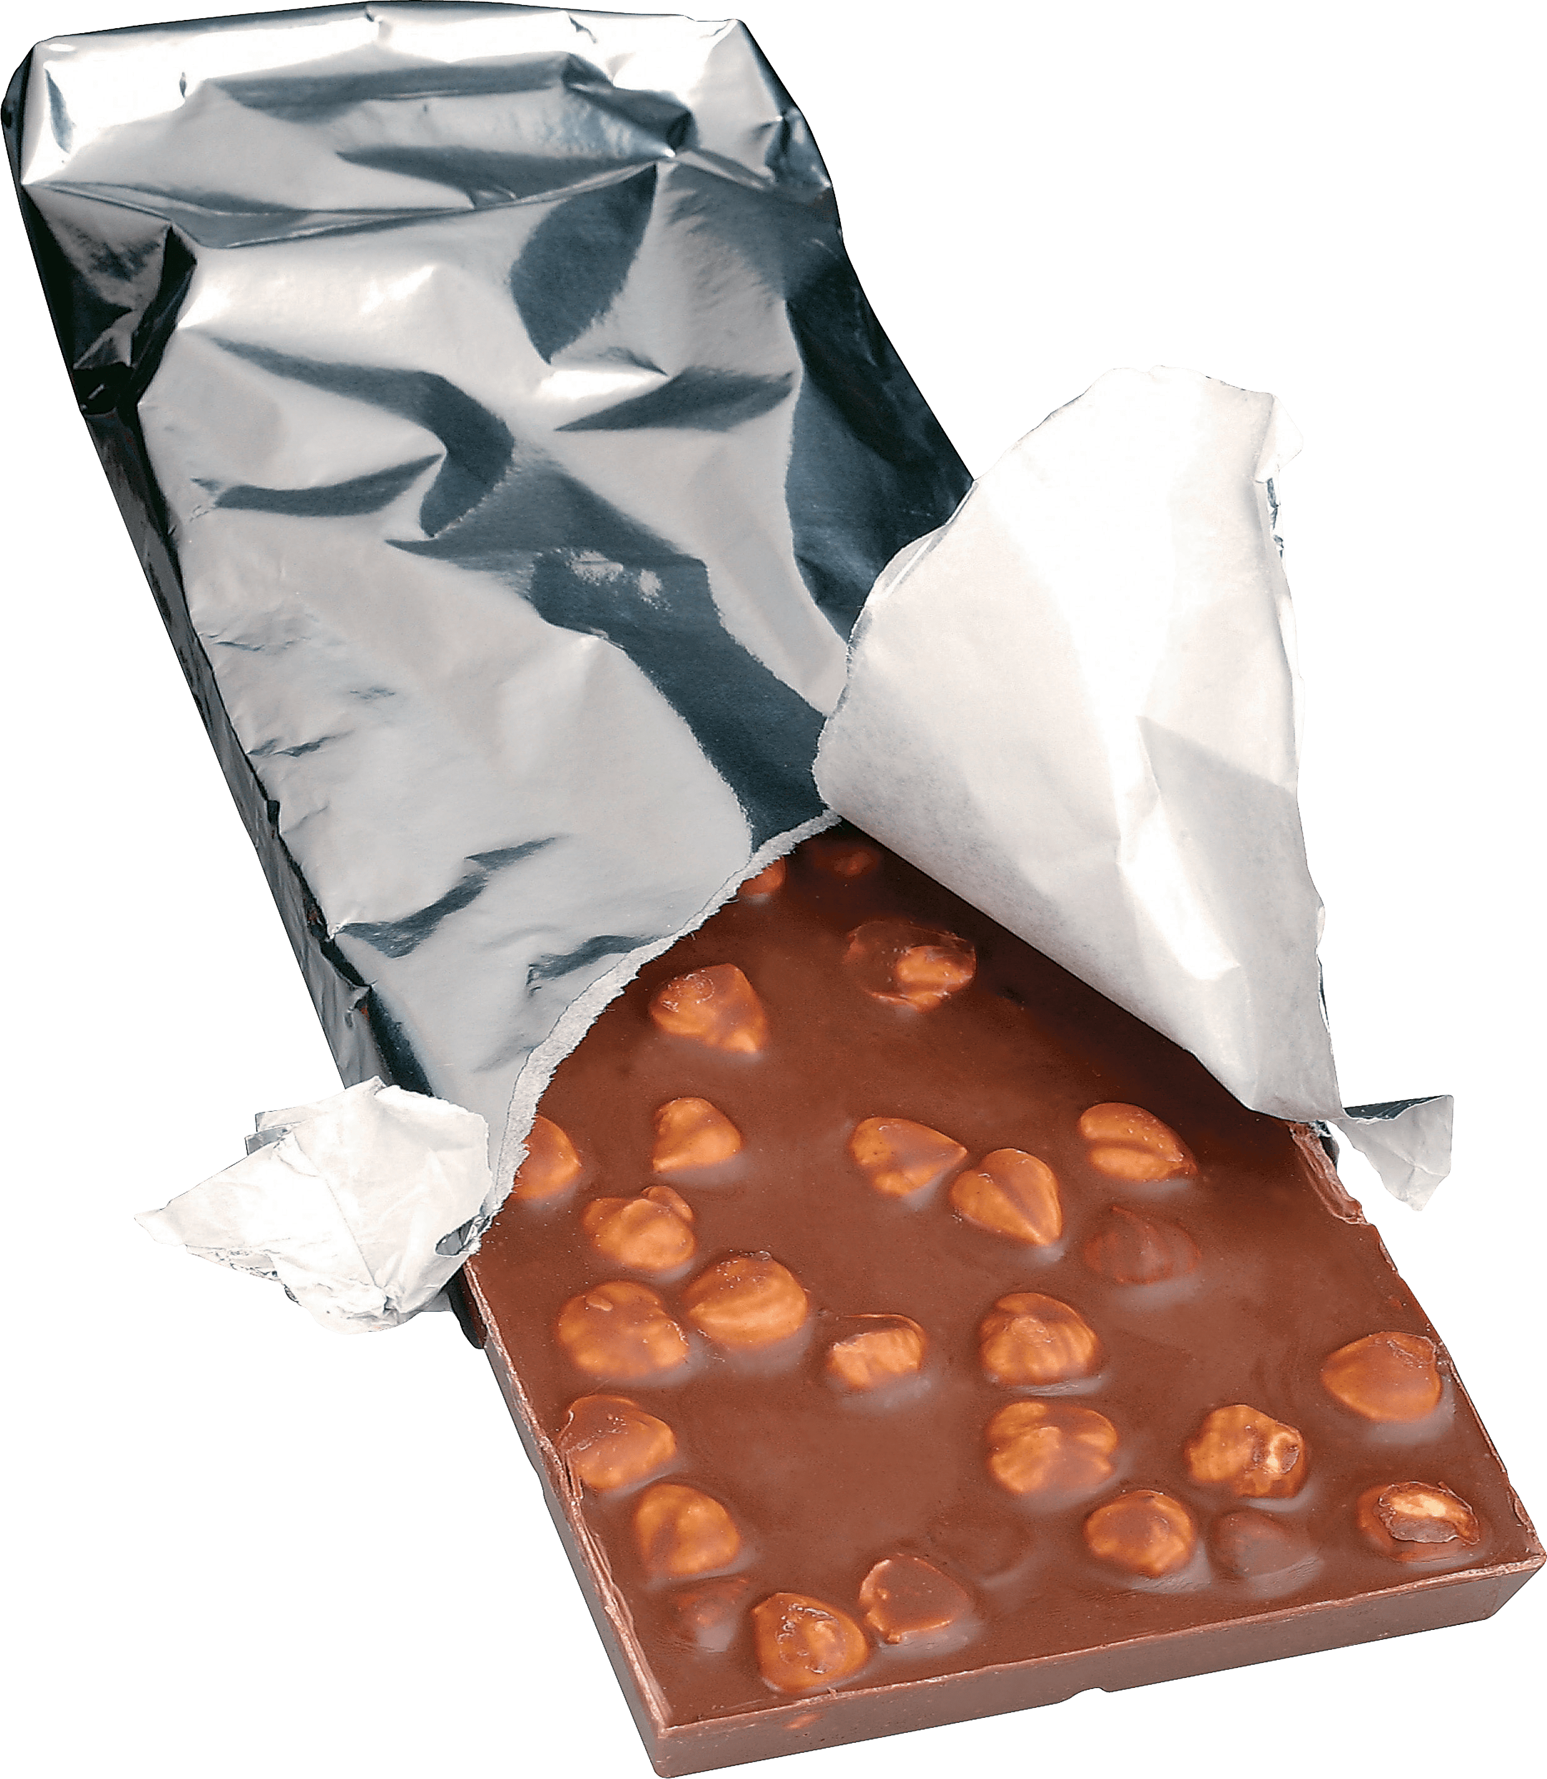
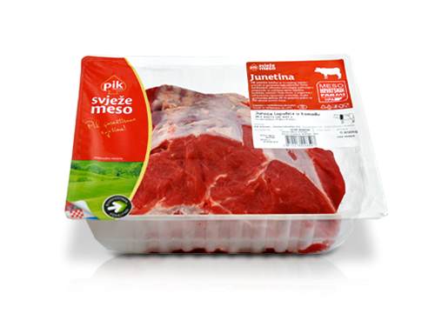
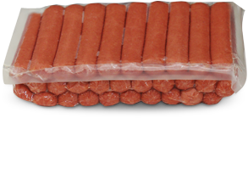
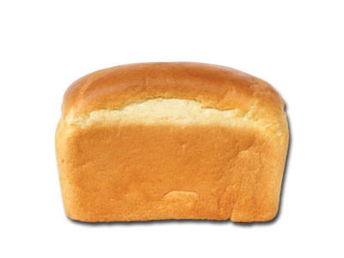
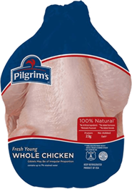
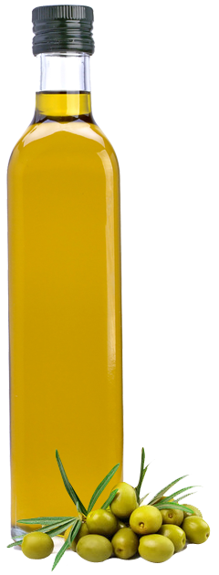
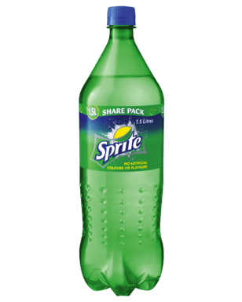
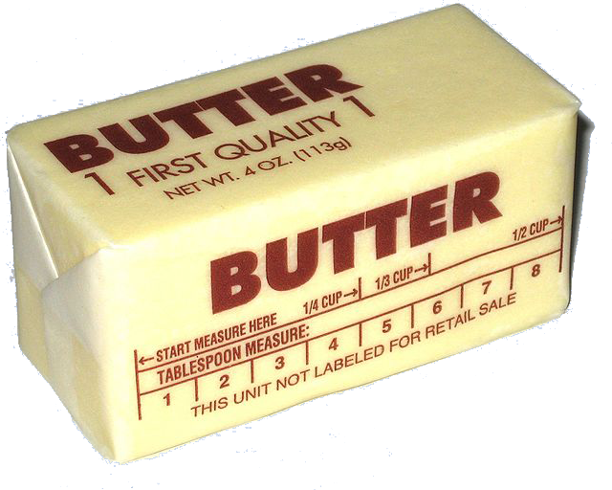


Slide 28
Be Healthy!

