Slide 1
Celebrations

Slide 2
The plan of the lesson:
Speaking about your favorite celebrations
Listening
Reading
Writing (A postcard to a friend)
Reflection

Slide 3
When do people celebrate these holidays?
1.Highland games 2.The Festival of Lights 3.Christmas 4.New Year s Day 5.Saint Valentine s Day 6.The White nights | 14 th of February 25 th of December the first Saturday of September In late autumn The 21s t of June The 31 st of December

Slide 4
When do people celebrate these holidays?
1.Highland games | the first Saturday of September
2.The Festival of Lights | In late autumn
Christmas | 25 th of December
4.New Year s Day | The 31 st of December
5.Saint Valentine s Day | 14 th of February
The White nights | The 21s t of June

Slide 5
Christmas Eve –канун Рождества
Santa Claus – Санта Клаус
Norway - Норвегия
Londoners - лондонцы
Trafalgar Square – Трафальгарская площадь
Storkings -чулки

Slide 6
What do people do on that day?
1.The Festival of Lights | a)Visitors from all over the world travel to Saint-Petersburg
2.Highland games | b)People offer flowers and sweets your favorite people without signature
3.Christmas | c)Athletes travel to Scotland each year to take part in the games.
4.New Year s Day | d)People light their Diwali lamps and pray to the goddess of wealth
5.Saint Valentine s Day | e)People make their New Year promises
6.The White nights | f)People exchange gifts and wish their family and friends merry Christmas

Slide 7
What do people do on that day?
1.The Festival of Lights
f)People light their Diwali lamps and pray to the goddess of wealth
2.Highland games
c)Athletes travel to Scotland each year to take part in the games.
3.Christmas
People exchange gifts and wish their family and friends merry Christmas
People make their New Year promises
4.New Year s Day
5.Saint Valentine s Day
People offer flowers and sweets your favorite people without signature
6.The White nights
Visitors from all over the world travel to Saint-Petersburg

Slide 8
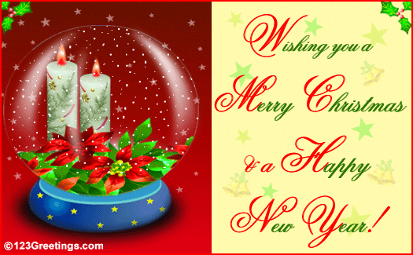

Slide 9


