Slide 1
АЛЬТМАН
Мария Витальевна
Учитель английского языка
Измайловская Гимназия №1508
Организация общения на уроке английского языка»
по теме «Выбор профессии

Slide 2






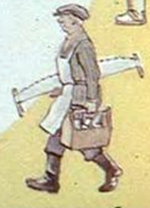

JOB FOR LIFE

Slide 3

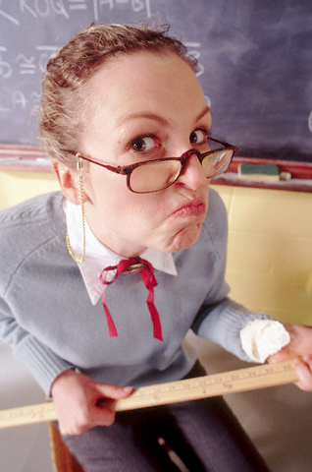
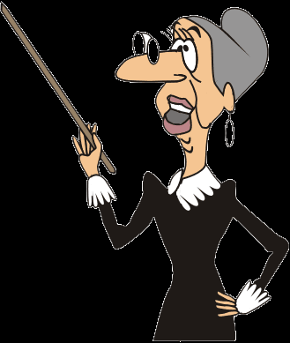
Who would like to work at school?!

Slide 4

“A NEW JOB – A NEW LIFE”

Slide 5

HAVE YOUR OWN BUSINESS MAKE A CAREER MAKE A FORTUNE MAKE A LIVING MAKE A MISTAKE | GET PROMOTION GET THE SACK DO WELL DO YOUR BEST DO SOMETHING ABOUT IT

Slide 6
I want to change my job because (teaching is too/not very...)
BACKBREAKING EXHAUSTING TIRESOME DANGEROUS MONOTONOUS BORING TIME-CONSUMING FULL TIME NOT RESPECTED | SATISFYING FULFILLING REWARDING CREATIVE CHALLENGING EXCITING PLEASANT PRESTIGIOUS

Slide 7
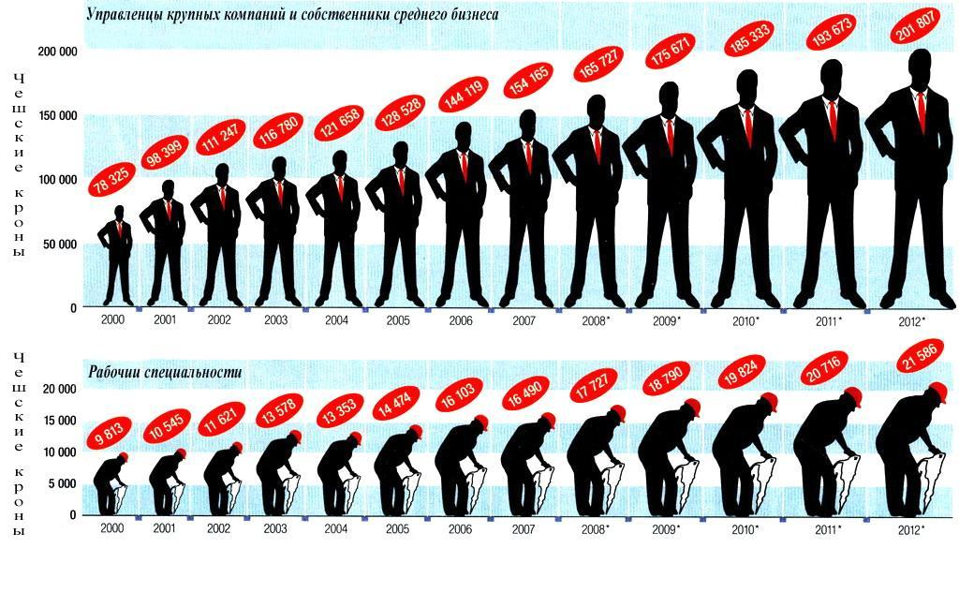
RUSSIAN JOB MARKET
What professions have good employment
prospects?
What professions are in demand?
What professions are overcrowded?

Slide 8


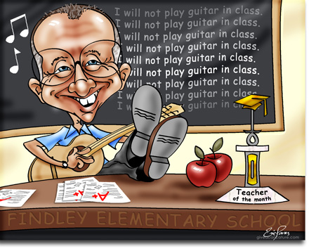
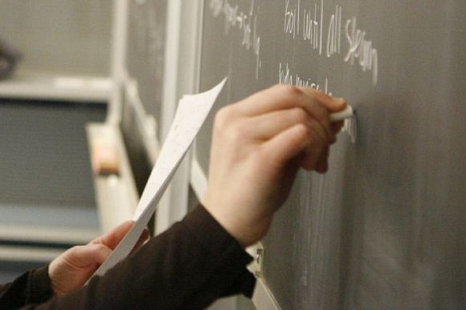
hardworking
patient
creative
confident

Slide 9
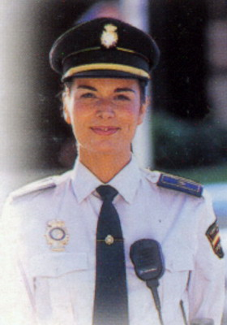
Interview with
Sandra Gimenez
What does Sandra do for a living?
Does she have good promotion and
career prospects?
What does she like about her job?
Does she want to quit? Why (not)?

Slide 10
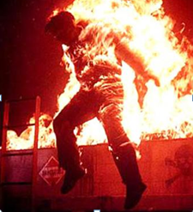
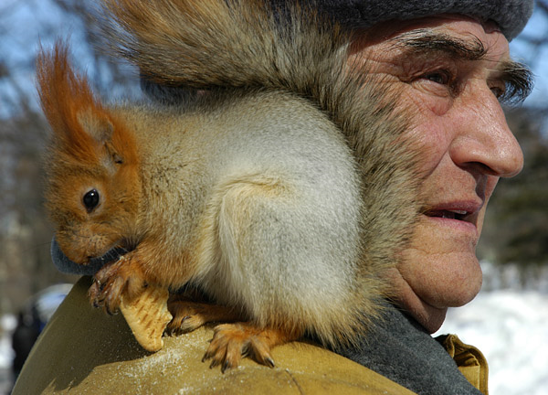





Slide 11
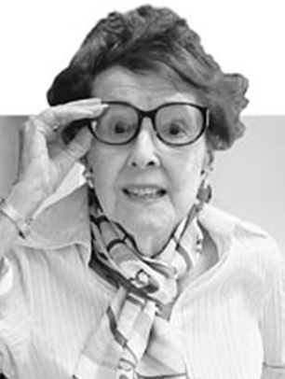


You are a FORESTRY WORKER.
Answer your partner’s questions.
These ideas may help you:
look after plants
work outdoors
quiet, healthy
lonely
tiring and monotonous
You are a teacher who wants to quit teaching;
your guests have the jobs you would like to try.
ASK YOUR GUESTS:
what he/she does for a living;
He/she is a _________________ .
if he/she has good promotion and career prospects;
Yes No
what he/she likes about his/her job
__________________________
__________________________
if he/he want to quit and why (not).
Yes No
because _______________________________________
Say which of the two jobs appeal to you more, explain your choice.

Slide 12
‘Find out what you like doing best
and get someone to pay you for doing it.’
Katherine Whitehorn

Slide 13

GET PROMOTION
DO WELL
DO YOUR BEST
MAKE A LIVING
DO SOMETHING ABOUT IT
SATISFYING
FULFILLING
REWARDING
CREATIVE
CHALLENGING
EXCITING
PLEASANT
PRESTIGIOUS

Slide 14

THE BEST OF THE BEST

