Slide 1
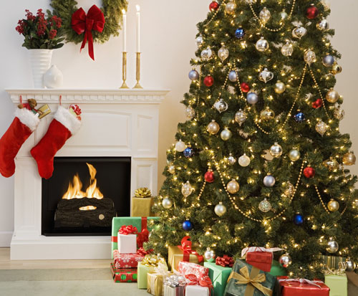
Merry Christmas

Slide 2
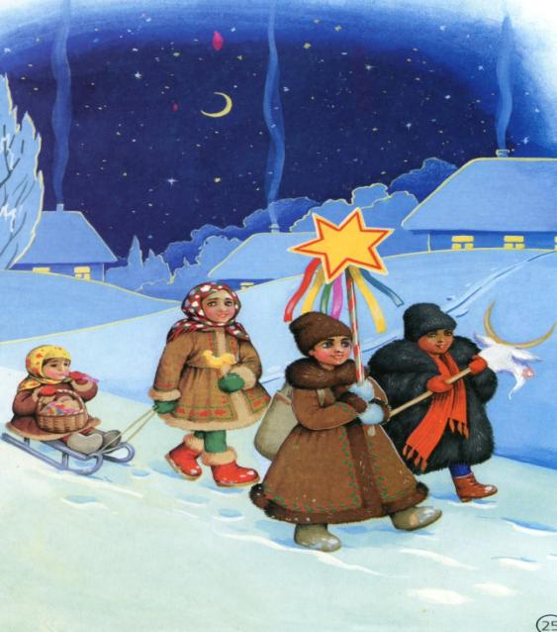

Slide 3

“Christmas is coming”
Christmas is coming,
The geese are getting fat,
Please put a penny
In the old man's hat.
If you haven't got a penny,
A ha'penny will do,
If you haven't got a ha'penny,
Then God bless you.

Slide 4
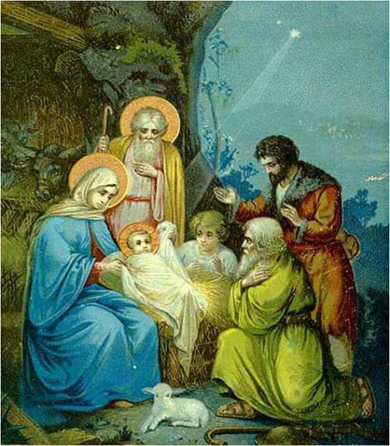
The 25th of December
is Christ’s Birthday

Slide 5

Christmas tree

Slide 6

Christmas tree
O, Christmas tree, O, Christmas tree! 2 раза
O, tree of green, unchanging!
Your boughs, so green in summer time
Do brave the snow of winter.
O, Christmas tree, O, Christmas tree
O, tree of green, unchanging!
Like little stars your candles bright
Send to the world a light

Slide 7
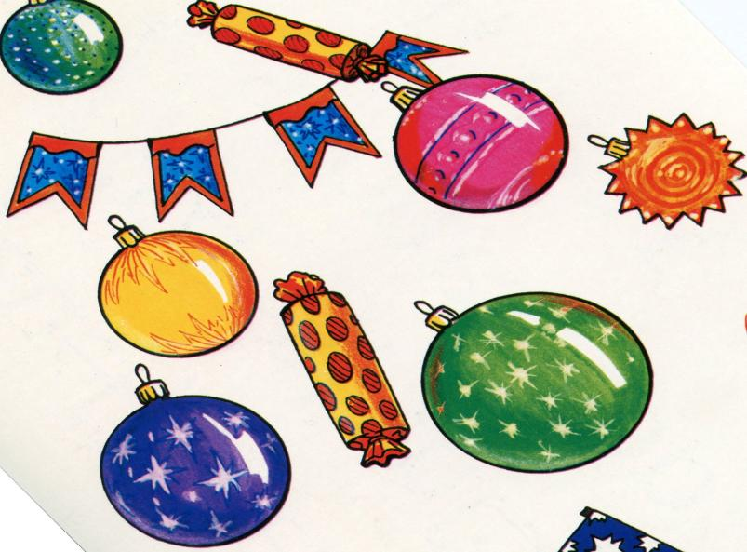

Slide 8
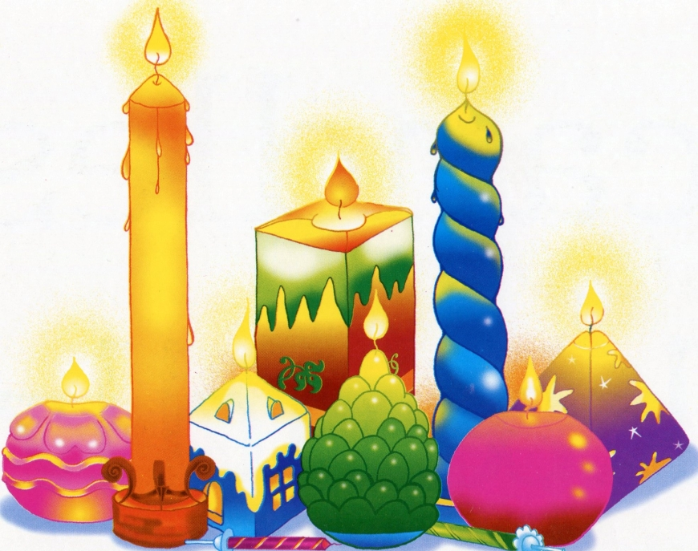


Slide 9

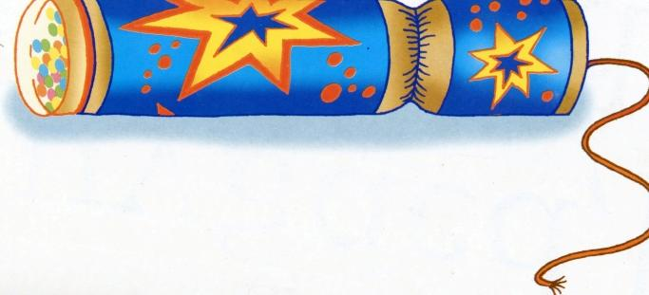


Slide 10
Snowballs, snowballs,
Round go they .
If you touch a snowball,
You quickly run away

Slide 11
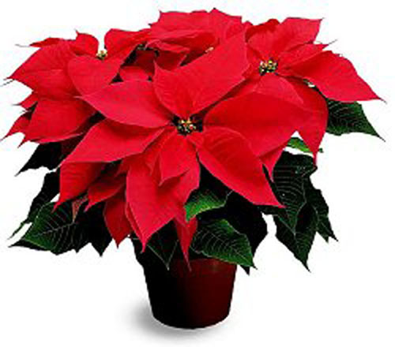

Slide 12
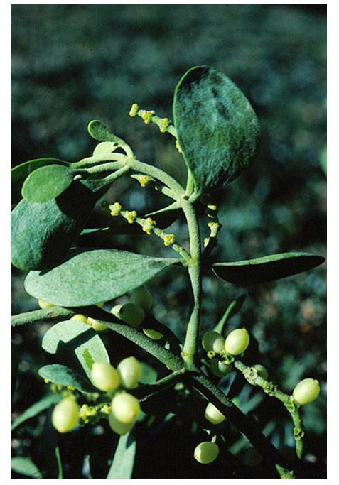
Mistletoe - омела

Slide 13
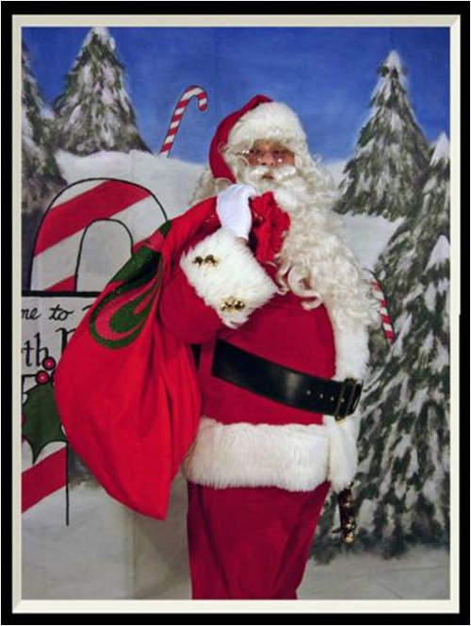
Santa Claus (Father Christmas)

Slide 14
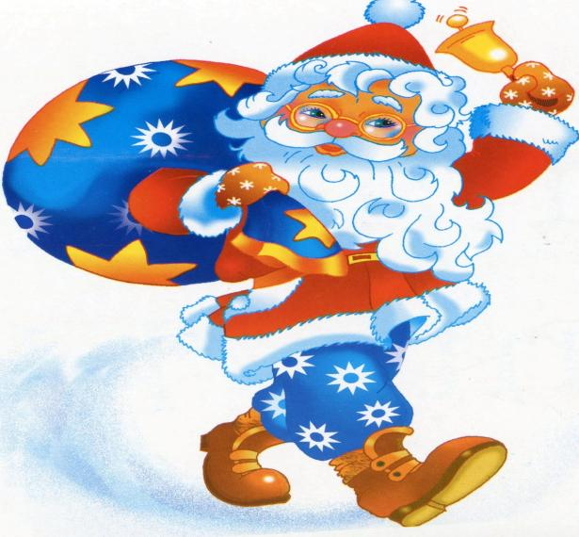


Slide 15
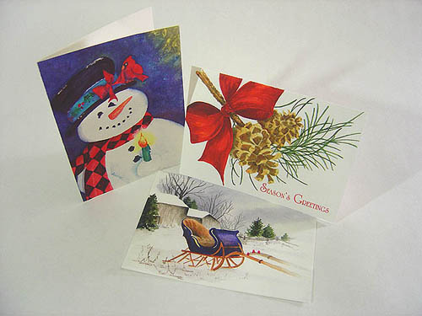
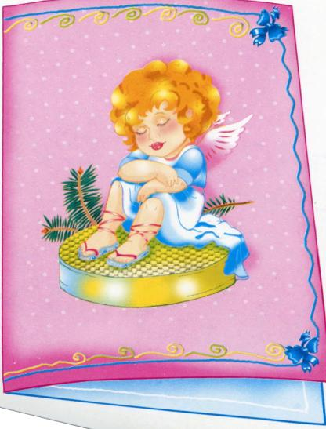
Christmas Card

Slide 16
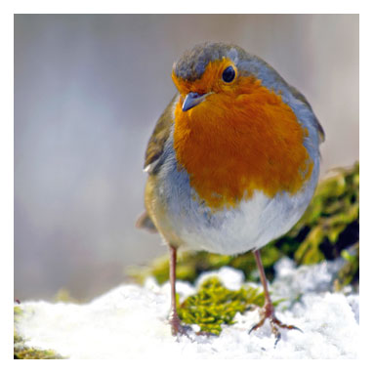
Robin

Slide 17
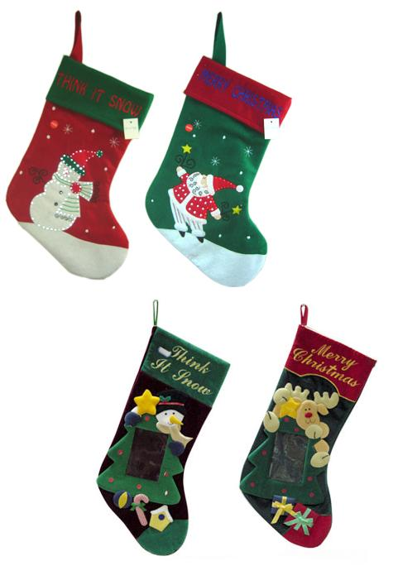
Christmas Stockings

Slide 18
Presents. Presents in the socks,
Presents, presents in the socks,
In the socks,
In the socks,
Look in the sock at twelve o’clock

Slide 19
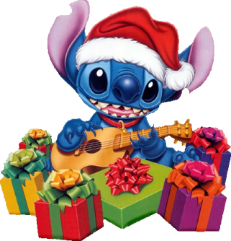
The 26th of December
is Boxing Day

Slide 20
We Wish You A Merry Christmas
We wish you a merry Christmas (х3)
And a happy new year
We all want some figgy pudding (х3)
Now bring out some here.
We won't go until we get some (х3)
So bring it right here.
We wish you a merry Christmas
And a happy new year.

Slide 21
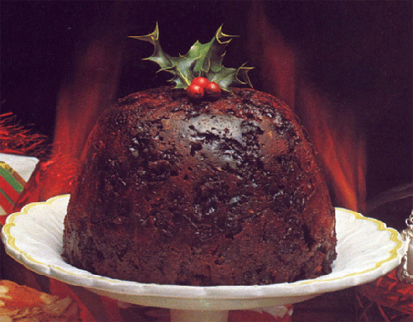
Christmas Pudding

Slide 22
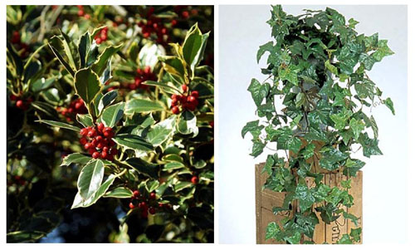
Holly – остролист

Slide 23
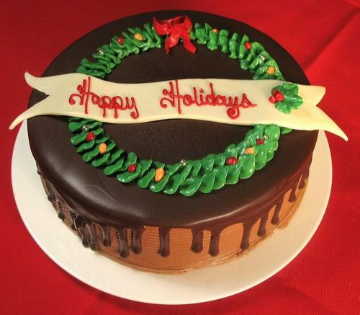
Twelfth cake on
The Twelfth night
(on the eve of 6th of January)

Slide 24
Carol–
рождественский гимн
We wish You a Merry Christmas
We wish you a merry Christmas (х3)
And a happy new year.
We wish you a merry Christmas (х3)
And a happy new year.
Good tidings we bring to you and your kin.
We wish you a merry Christmas
And a happy new year.
We all want some figgy pudding (х3)
And a cup of good cheer.
We won't go until we get some (х3)
So bring it right here.
Good tidings we bring to you and your kin.
We wish you a merry Christmas
And a happy new year.
A happy new year.

Slide 25
Dashing through the snow
In a one-horse open sleigh
O'er the fields we go
Laughing all the way;
Bells on bob-tail ring
Making spirits bright
What fun it is to ride and sing
A sleighing song tonight!
Chorus:
O! Jingle bells, jingle bells,
Jingle all the way!
O what fun it is to ride,
In a one-horse open sleigh, hey!
Jingle bells, jingle bells,
Jingle all the way!
O what fun it is to ride,
In a one-horse open sleigh

