Slide 1
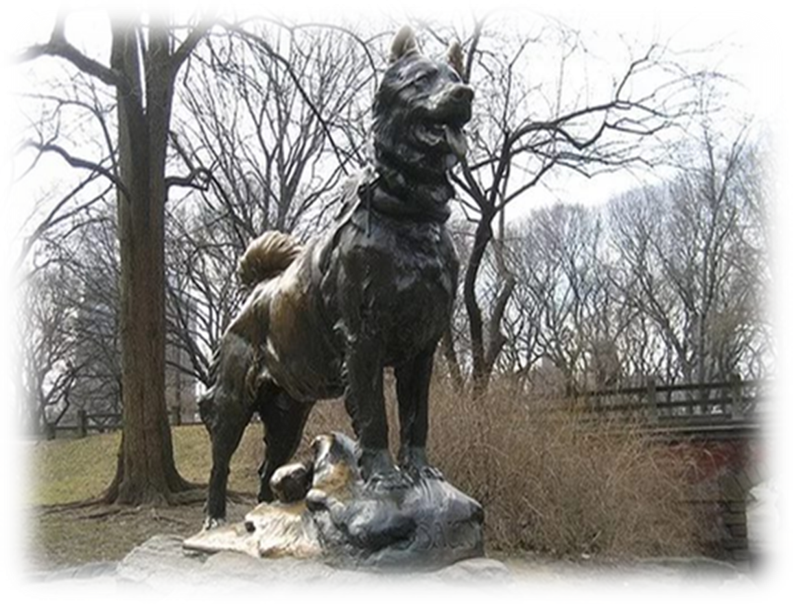
ТЕМА РАБОТЫ «The most famous dogs. »
Teacher: Ergakova E.A.

Slide 2
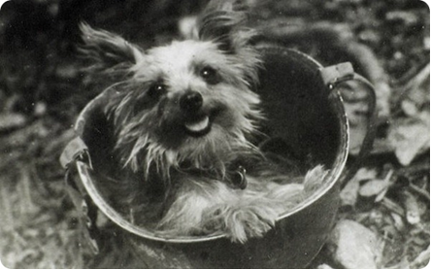
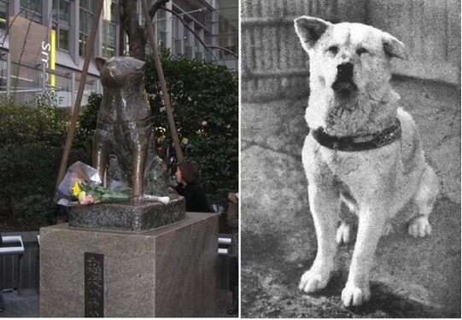
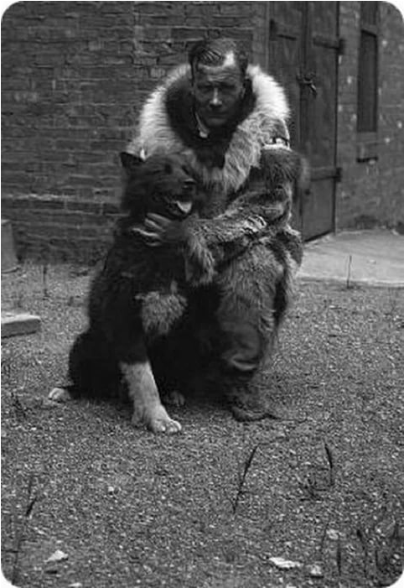
The most famous dogs.

Slide 3
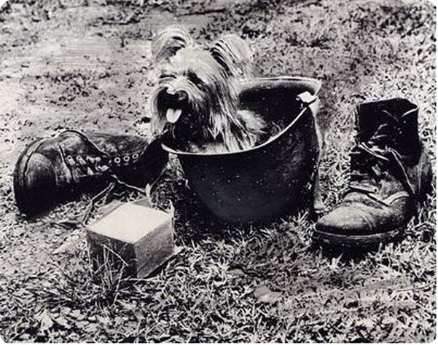
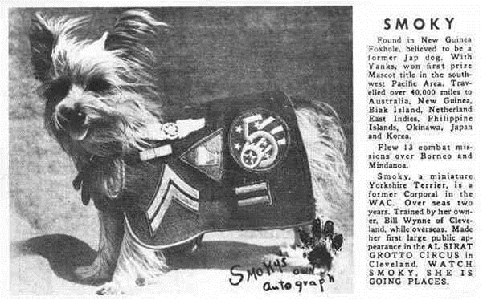
1. Smoky (1943 – 21 February 1957), a Yorkshire terrier.

Slide 4
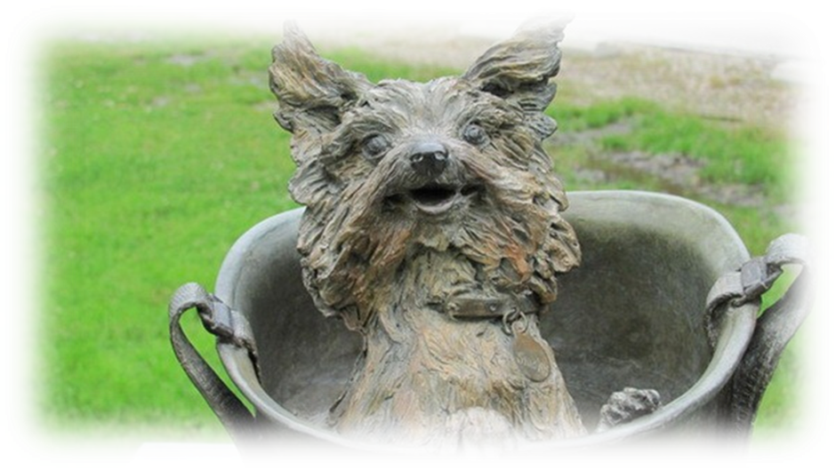
Smoky was a famous war dog who served in World War II. In February 1944, Smoky was found by an American soldier in an abandoned foxhole in the New Guinea jungle. Smoky took part in twelve combat missions and awarded eight battle stars.

Slide 5
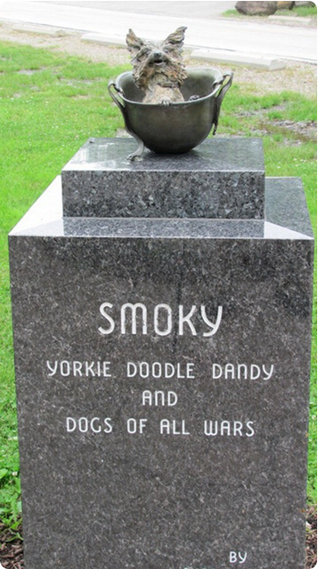
This monument is dedicated to “Smoky, the Yorkie Doodle Dandy, and the Dogs of All Wars".
November 11, 2005, on Veterans Day, a bronze life-size sculpture of Smoky sitting in a GI helmet, atop a two-ton blue granite base, was unveiled there.

Slide 6
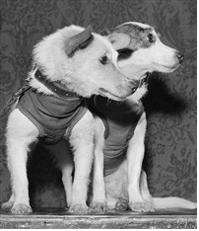
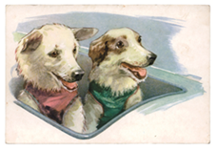
2.Belka and Strelka.

Slide 7
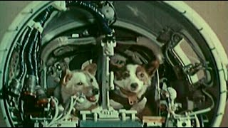
They were the first animals- Soviet cosmonauts. Belka and Strelka are the names of the first dogs from the Soviet Union that flew into space aboard the “Sputnik». The launch of the ship took place on August 19, 1960.

Slide 8
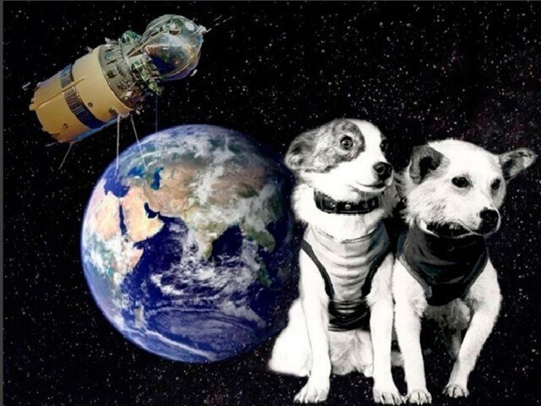
The flight lasted more than 25 hours and ended on August 20 with the successful landing.
Dogs returned to Earth alive and unharmed. During the flight, the spaceship made 17 full turns around the Earth.

Slide 9
3)Hachikō(November 10, 1923 – March 8, 1935)

Slide 10
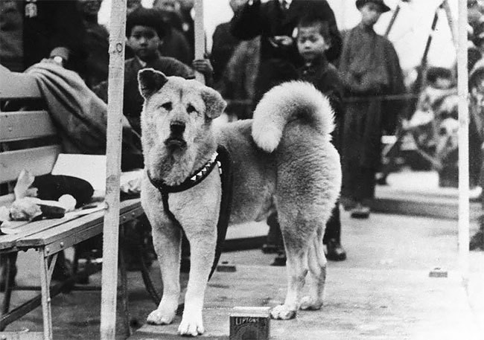
It was an Akita dog born on a farm near the city of Ōdate. He is well known for his loyalty to his owner. His owner, Professor Eisaburo Uyeno and he were best friends right from the start.
Every day Hachikō accompanied his owner to Shibuya train station when he left for a work. When he came back, the professor always found the dog waiting for him.

Slide 11
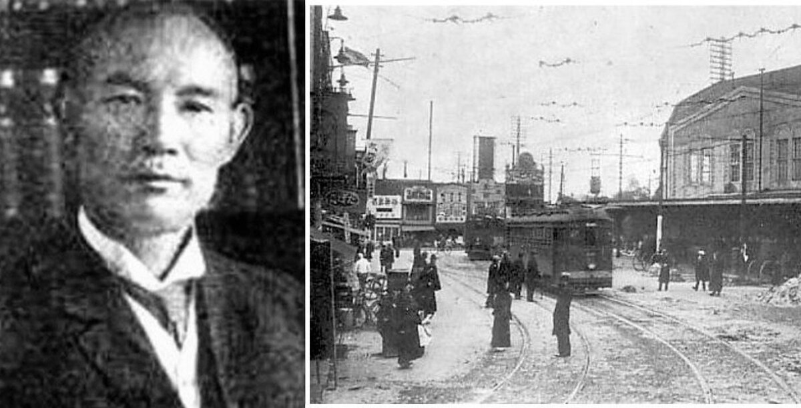
Sadly, the professor died suddenly at work in 1925 before he could return home. At that time Hachikō was still young dog. But he loved his owner so much that he continued to wait at the station every day. Sometimes, he stayed there for days at a time. All people at the station knew him and often gave him some food.

Slide 12
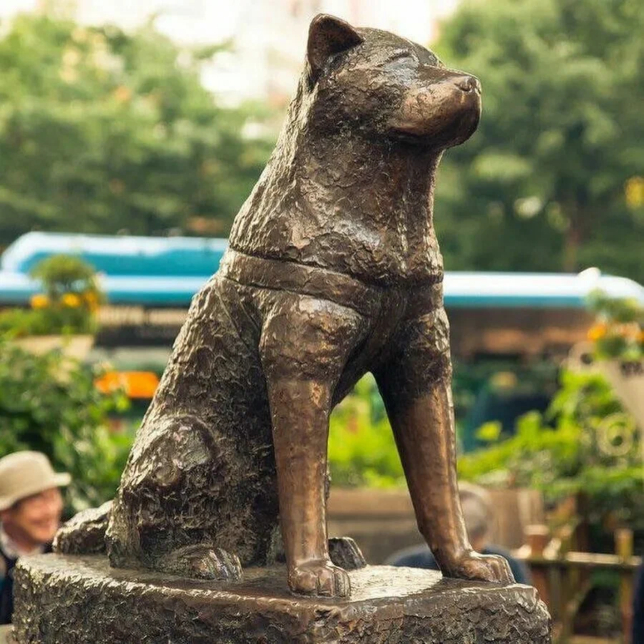
In 1934, a statue of him was put outside the station. In 1935, Hachikō died at the place he last saw his owner alive.
In front of the Shibuya train station in Tokyo, there is a life-size bronze statue of a dog. The statue looks very small among huge neon sings, but it isn’t difficult to find it.
People started to use it as a meeting point in 1934. Today you can see hundreds of people waiting there for their friends to arrive.

Slide 13
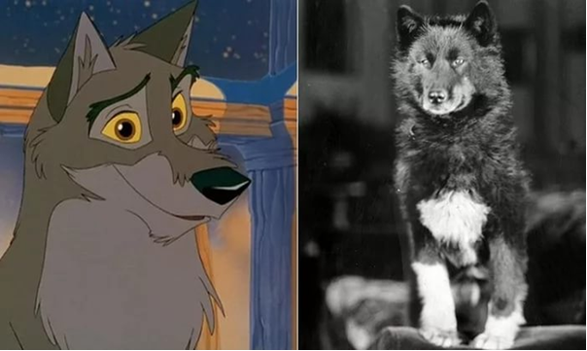
4. Balto.

Slide 14
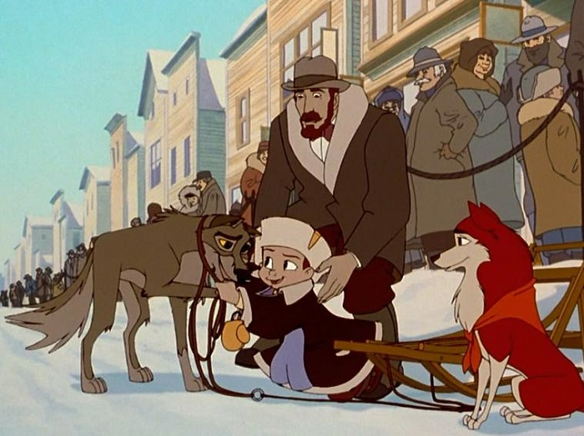
In 1925, Balto became a hero. He rescued the children of Nome, Alaska from a diphtheria epidemic. Balto was the lead dog in a team that travelled about 675 miles / 1086 km in just 127,5 hours to bring serum to stop an outbreak.
The serum was in Anchorage, but the lone aircraft that could quickly deliver the medicine had been dismantled for the winter. In desperation, officials turned to the only remaining alternative – sled dogs – and Balto delivered!

Slide 15
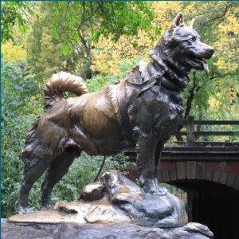
For two years after the serum run, the heroic dog and some of his teammates travelled the continental United States as part of travelling show, and after his death, his body was mounted and put on display at the Cleveland Museum of Natural History.
Balto was a world-famous celebrity, and he was honored with a life size statue in New York City’s Central Park.
The annual Sled Dog Race commemorates Balto’s historic run.

Slide 16
Say, What dog(s) is it about?
1 . He is well known for his loyalty to his owner.
2.The annual Sled Dog Race commemorates his historic run.
3. They were the first animals- Soviet cosmonauts.
4. He served in World War II.
5. The launch of the ship took place on August 19, 1960.
6. In 1934, a statue of him was put outside the station.
7. He awarded eight battle stars.
8. He was the lead dog in a team.
9. People started to use this statue of a dog as a meeting point.

