Slide 1


Slide 2
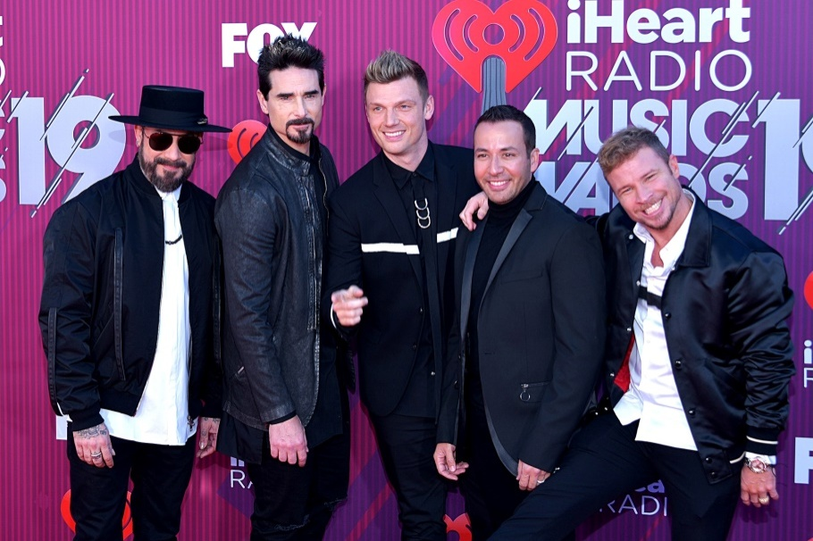


Backstreet Boys

Slide 3




Backstreet Boys

Slide 4
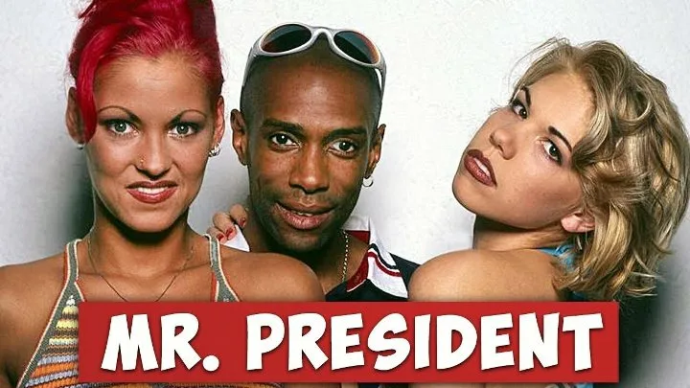

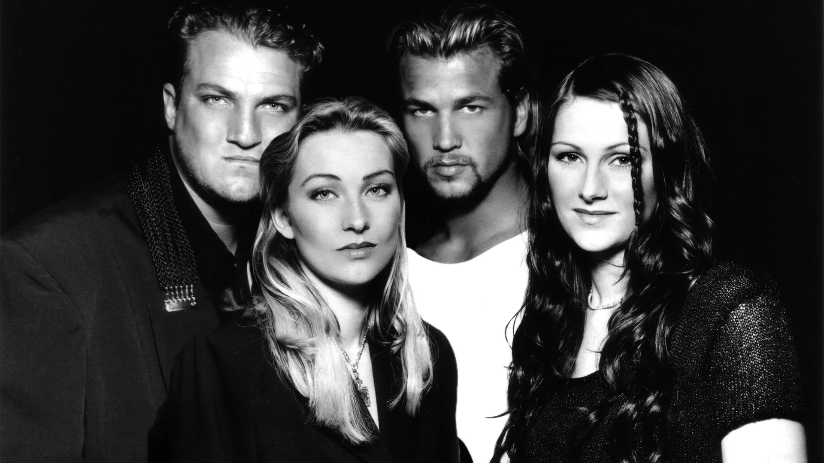
Mo-Do
Ace Of Base

Slide 5



Mo-Do, Mr.President, Ace Of Base

Slide 6

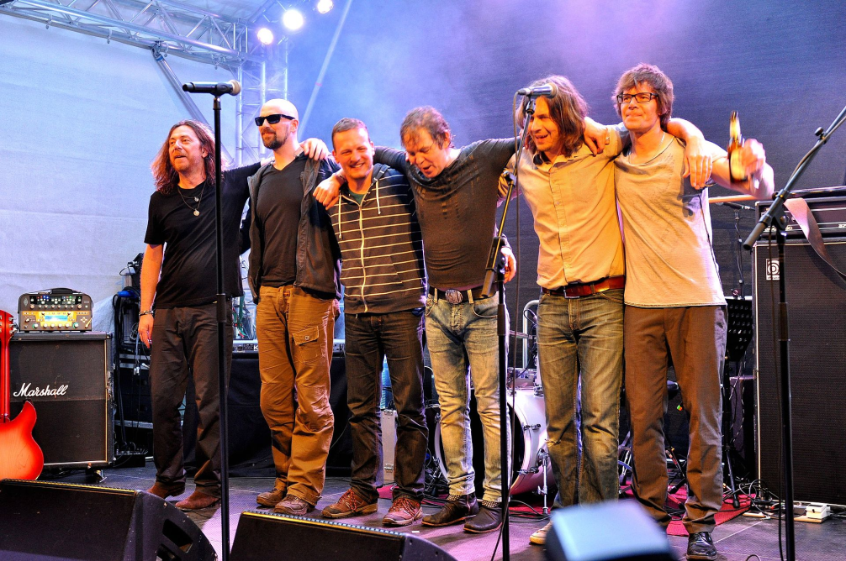

Fools Garden

Slide 7
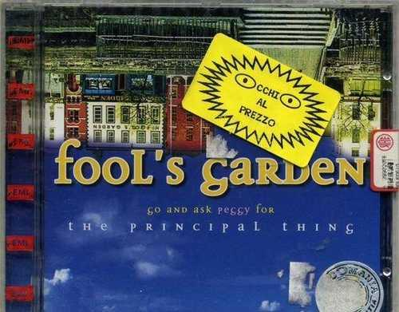



Fools Garden

Slide 8
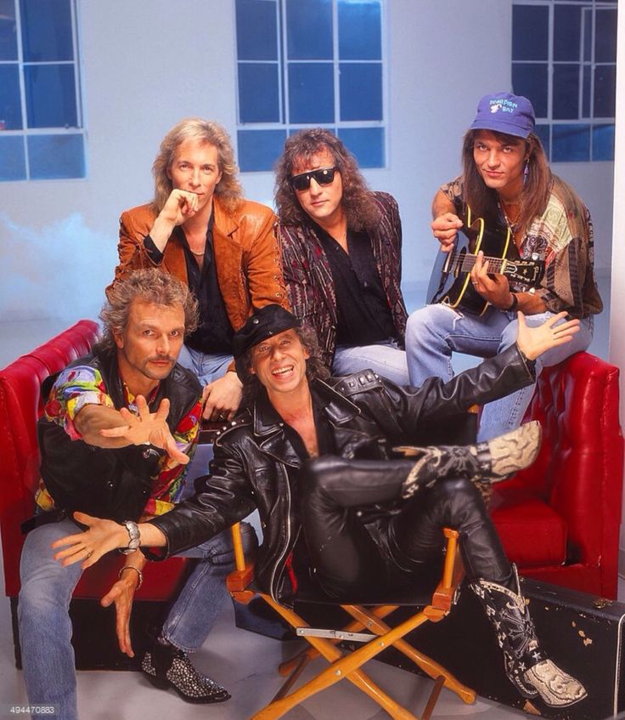
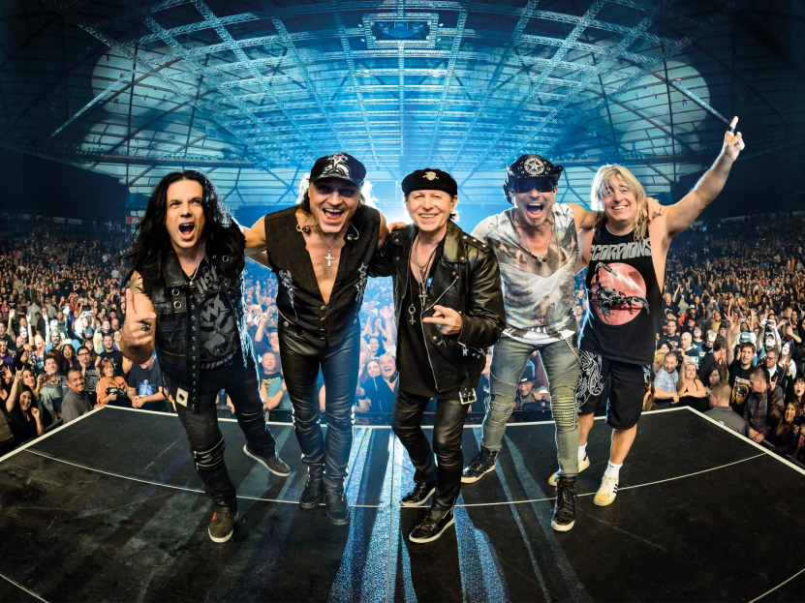
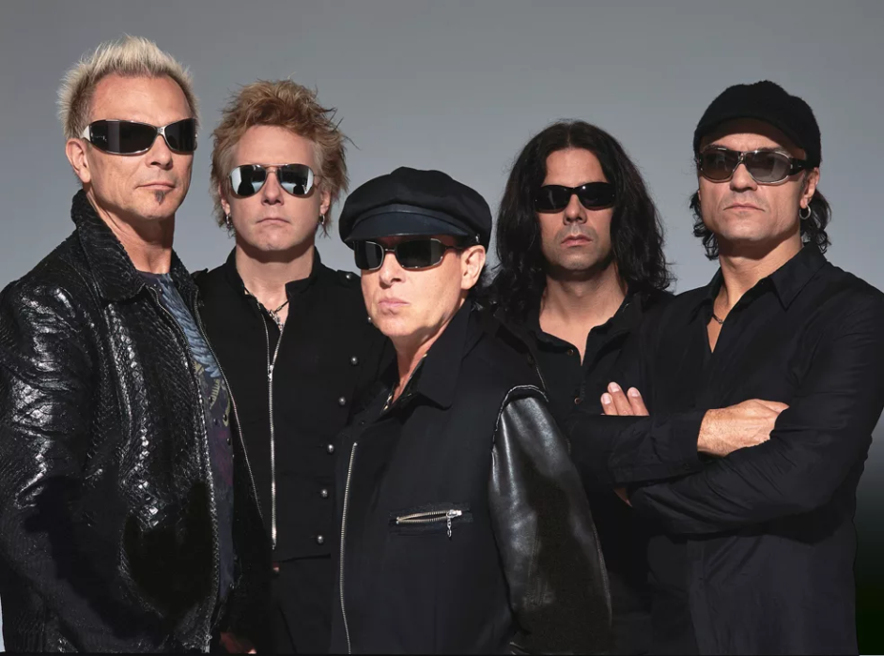
Scorpions

Slide 9

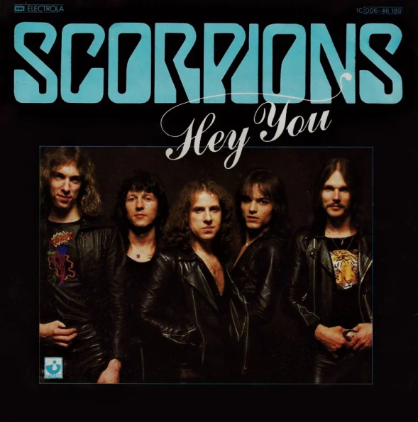


Scorpions

Slide 10


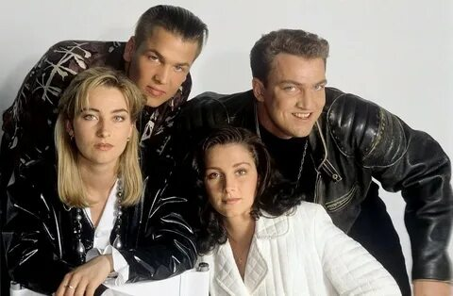
Ace Of Base

Slide 11



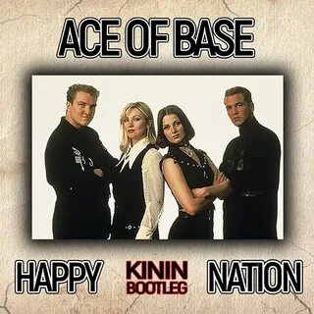
Ace Of Base

Slide 12
Ресурсы
https://yandex.ru/images/search?pos=12&from=tabbar&img_url=https%3A%2F%2Fwww.outkick.com%2Fwp-content%2Fuploads%2FGettyImages-89938282-scaled.jpg&text=бэкстрит+бойс+альбомы&rpt=simage&lr=47
https://yandex.ru/images/search?text=эйс+оф+бейс+альбомы&pos=1&rpt=simage&img_url=https%3A%2F%2Fwww.slate.fr%2Fsites%2Fdefault%2Ffiles%2Fphotos%2Face-greatesthits.jpg&from=tabbar&lr=47
https://yandex.ru/images/search?text=fools+garden+альбомы&pos=17&rpt=simage&img_url=https%3A%2F%2Fsun9-9.userapi.com%2Fgh7wlmGkAQhjxTvVx3evIeJv1sMYxNhLwdQ3sQ%2FXWXceUbl1GI.jpg&from=tabbar&lr=47
https://yandex.ru/images/search?text=+mo+do+альбомы&pos=2&rpt=simage&img_url=https%3A%2F%2Fi4.imageban.ru%2Fout%2F2022%2F06%2F01%2Fd5e1caaa180820f36ac485910d3c1d05.png&from=tabbar&lr=47
https://yandex.ru/images/search?text=mr+president+&pos=10&rpt=simage&img_url=https%3A%2F%2Fi.mycdn.me%2Fimage%3Fid%3D897252142272%26t%3D50%26plc%3DWEB%26tkn%3D*XpGsimJL7GkVXSrvOHhjDAdMkJ0%26fn%3Dexternal_8&from=tabbar&lr=47
https://yandex.ru/images/search?text=scorpions+альбомы&pos=21&rpt=simage&img_url=https%3A%2F%2Fsun9-29.userapi.com%2Fimpg%2F9AXFDfseCFiPNu1kz9XDCPr076sXyyJaCuSDQw%2F_XBr15x0hqQ.jpg%3Fsize%3D604x508%26quality%3D96%26sign%3D6e81a74ff6824f30ca37a548b9494dcc%26type%3Dalbum&from=tabbar&lr=47

