Slide 1
SpainPolandUKFranceRussiaNewZealandUSACanadaAustraliaItaly

Slide 2
What is the word?

Slide 3
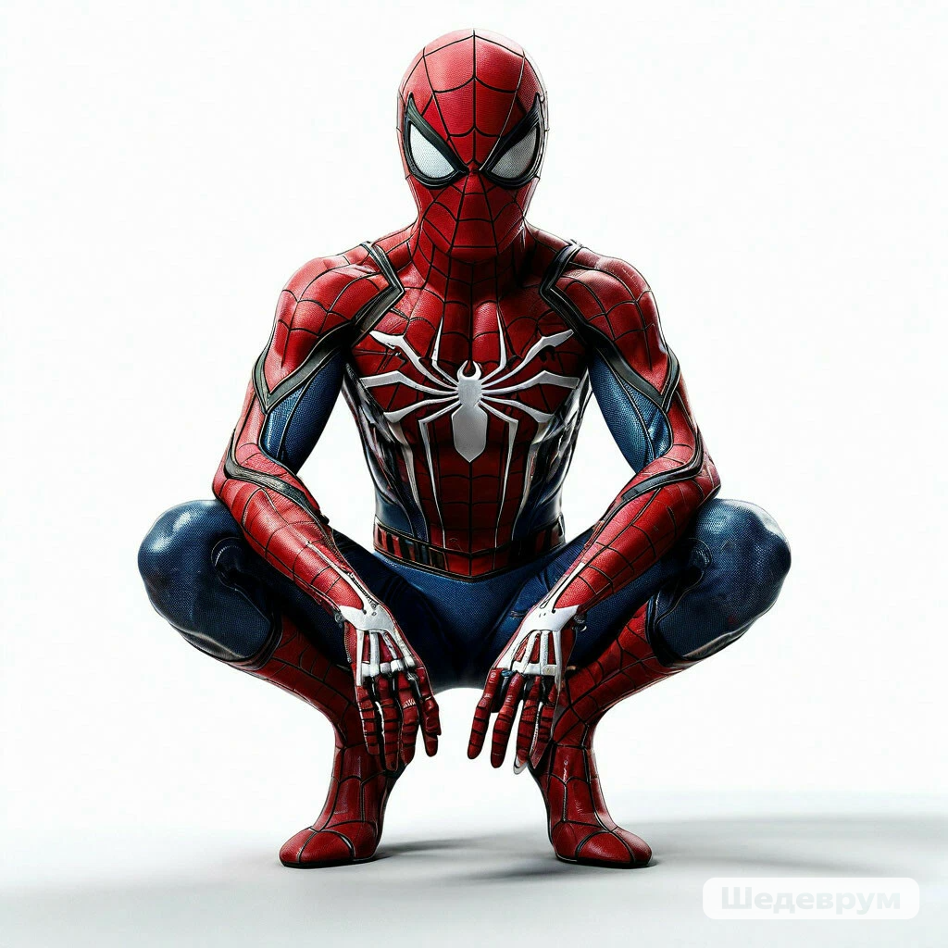
Who is he?

Slide 4

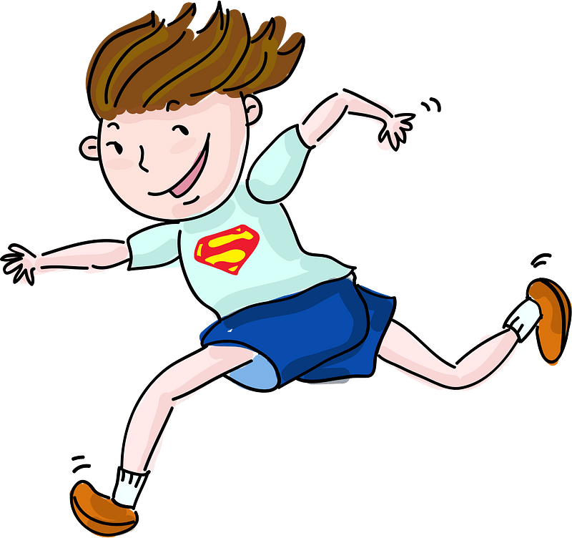
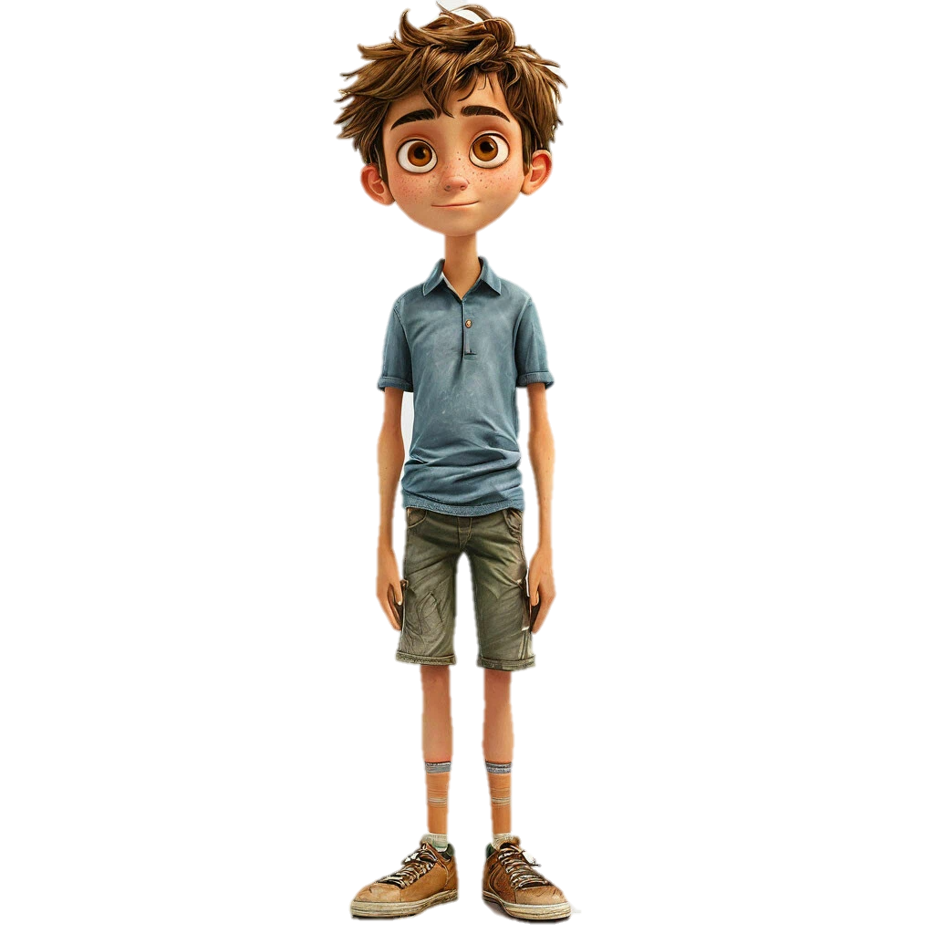
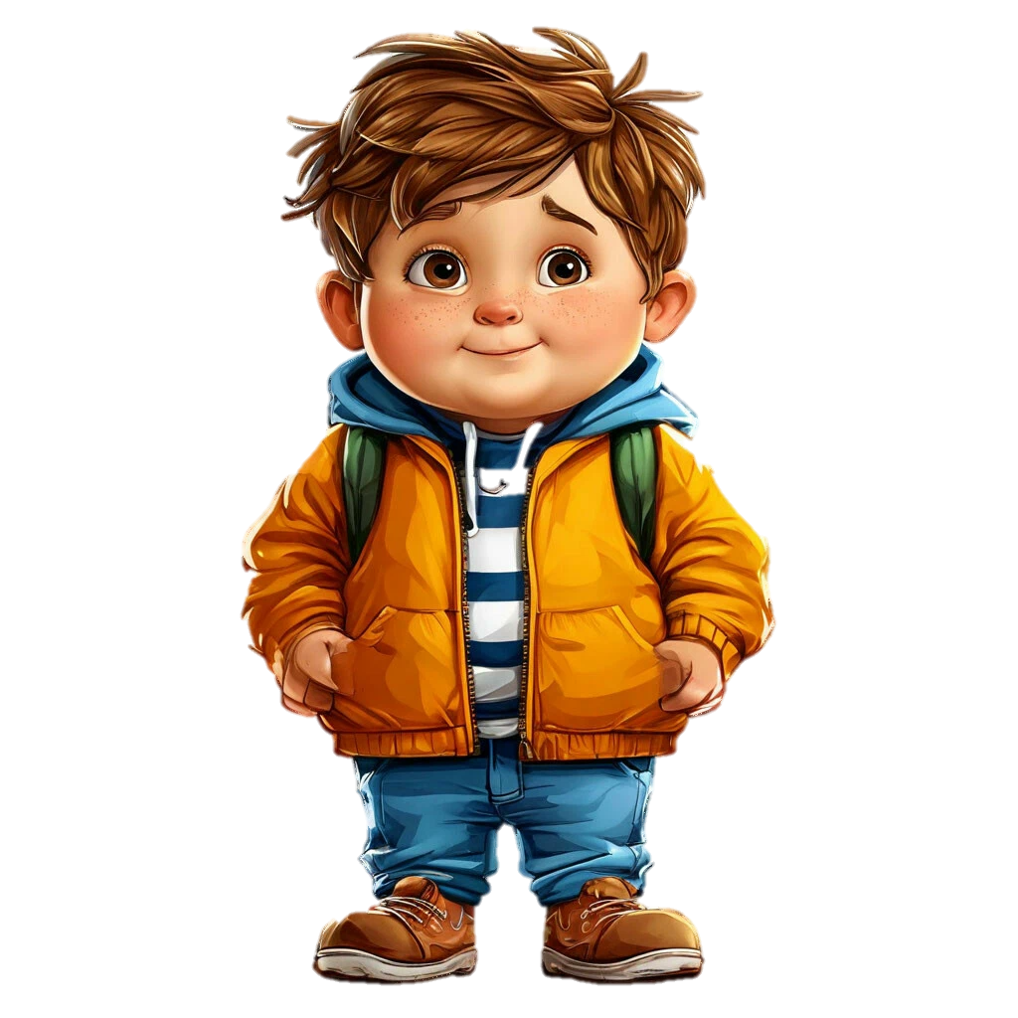
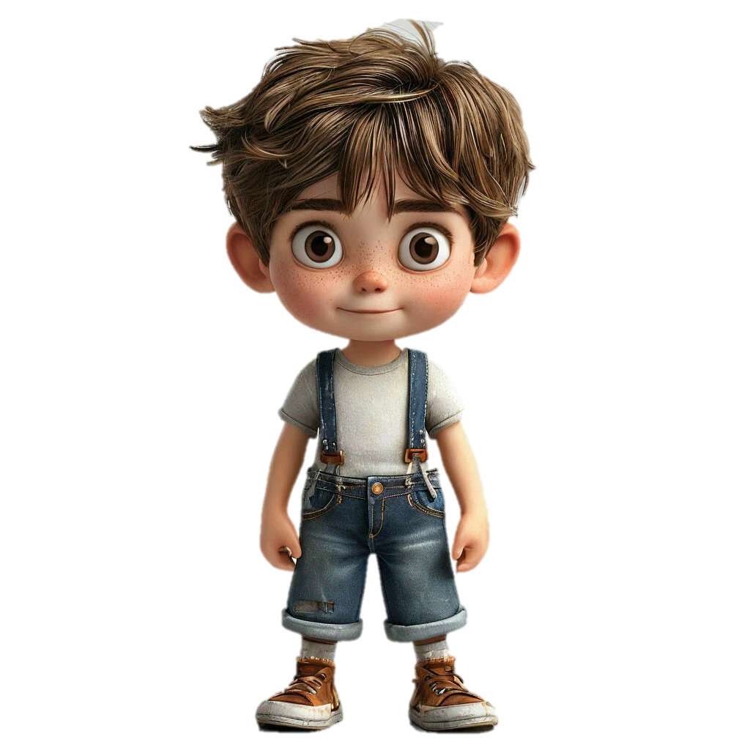
He is….

Slide 5
About spider man
This is spider man. He is from the ___. He is ____.He is tall. He is ____. He can ___. He can. He can’t ___. He has got ___, but he hasn’t got ____

Slide 6
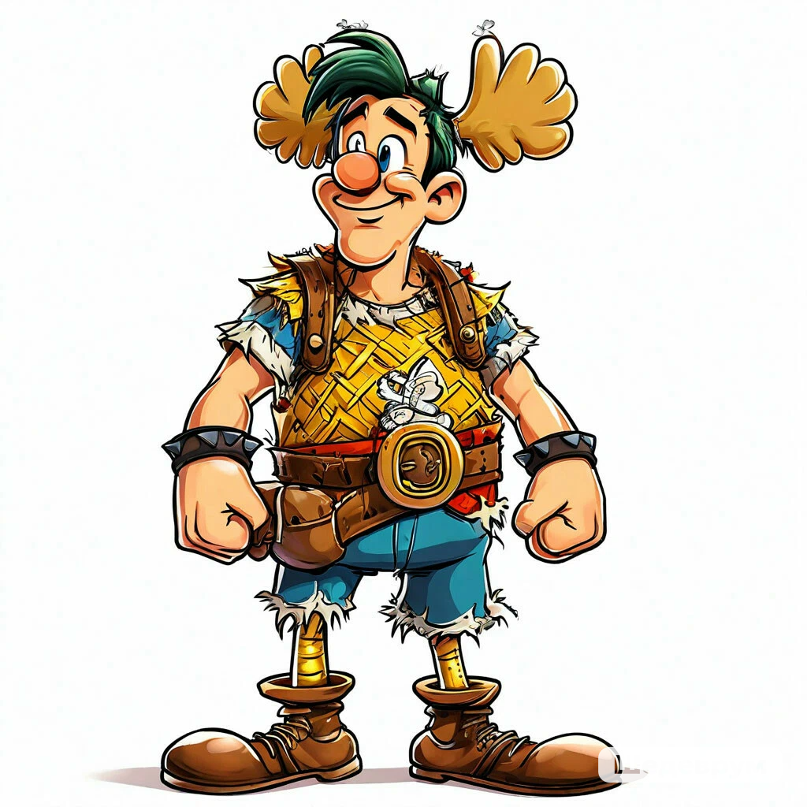
Can describe Asterix?
Work in pairs

