Slide 1

Department of Education and Science of the city of Moscow
State Budget General Education Establishment of the city of Moscow
“School No. 1440”
PROCRASTINATION AMONG TEENAGERS
By Potevskaya Olga Valerievna
School No. 1440
Moscow, 2025

Slide 2
Problem
A high level of procrastination among adolescents leads to a decrease in the success and productivity.
Relevance
exploring the phycological aspects of procrastination;
creating strategies to help adolescents;
personal experience and desire to help peers.
*Procrastination is not just “putting things off,” but a complex psychological phenomenon associated with emotional regulation. According to Steel (2007), 80–95% of students procrastinate regularly, which confirms the scale of the problem.

Slide 3


Purpose
- finding solutions to the problem of procrastination among teenagers.
Work tasks
Study the concept and causes of procrastination.
Distinguish procrastination from laziness.
Conduct a survey among teenagers.
Develop tools for assistance (application, booklet, posters).

Slide 4
Hypothesis
Procrastination is a common problem among teenagers, often linked to anxiety and other negative emotions, but in some cases, it may serve as a protective mechanism against overload.
Research methods
Interview with a psychologist;
Questionnaire among teenagers.

Slide 5
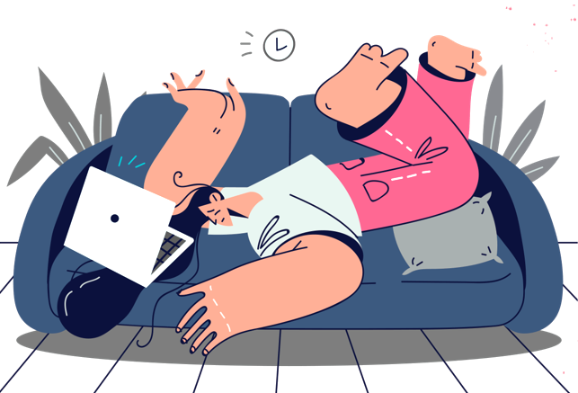
What is procrastination?
Procrastination is the tendency to put off even important and urgent tasks, which leads to stress, guilt and decreased productivity. This is one of the main barriers to achieving goals.
Examples
Inability to start a project (lack of motivation or fear of failure).
Endless reading of news or watching videos (replacing productive activities with something more pleasant).
Procrastination due to information overload (working with information without starting a task).

Slide 6

Signs of procrastination
Postponing tasks until the last moment.
Avoidance of new experiences.
Physical discomfort when performing unpleasant tasks.
Waiting for the 'right mood'.

Slide 7
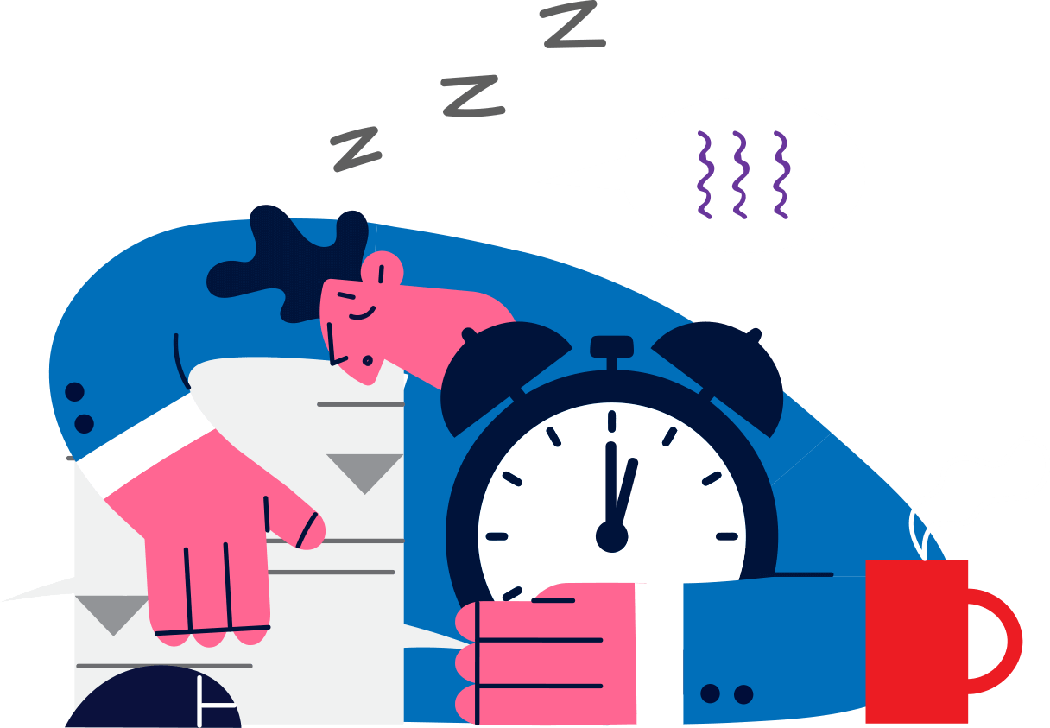
Reasons for procrastination
Low self—esteem - fear of failure.
Perfectionism - fear of the possible imperfect.
Self—restraint - unwillingness to become successful.
Disobedience - non-agreement with a task.
Tiredness - no resources to complete the task.

Slide 8
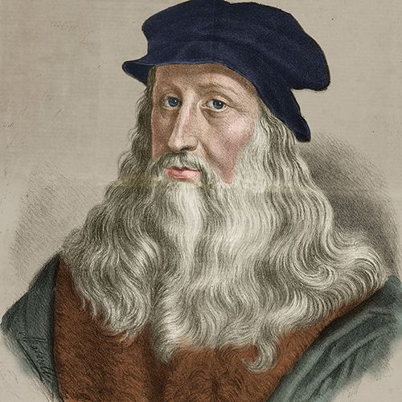

Famous procrastinators
Leonardo da Vinci: Worked on the Mona Lisa for 16 years!
Bill Gates: Skipped classes at university.

Slide 9
Laziness & Procrastination
Procrastination:
- there is awareness of the importance of the task.
- replacing the task with other activities.
Laziness:
- no motivation
- passivity

Slide 10

Signs of mental health
Procrastination can be a manifestation of adaptive mechanisms
Intuitive prioritization
Protection from burnout
Time for idea maturation/inspiration
Avoidance of uncertainty
Adaptation to complex tasks

Slide 11
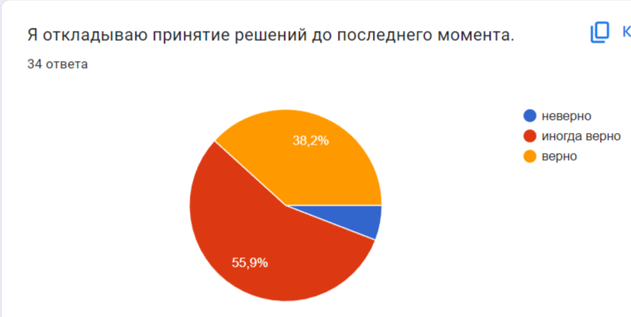
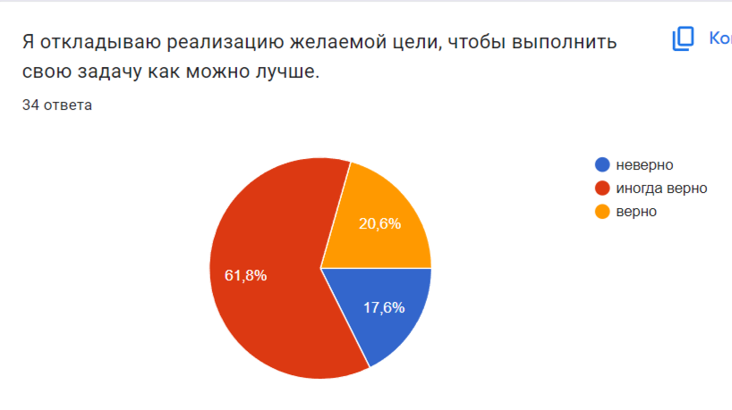
Survey results
78% of the respondents procrastinate daily.
40% experience anxiety due to delays.
60% associate procrastination with perfectionism.

Slide 12

How to overcome? Project outcomes
Mobile application:
Task tracker
techniques
Anti-stress exercises
Booklet:
Checklist
Techniques “5 steps against procrastination.”
Planner
Posters:
Motivational quotes + advice

Slide 13
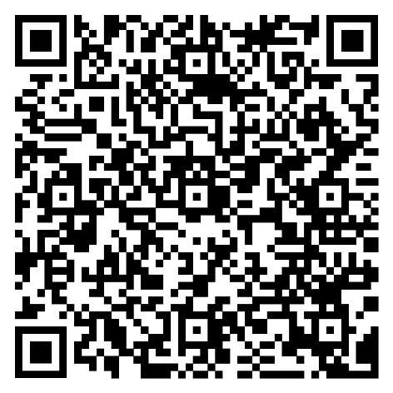
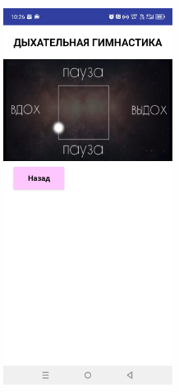
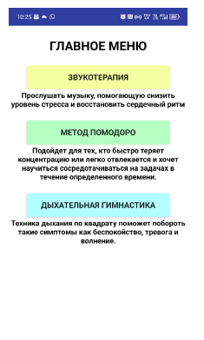
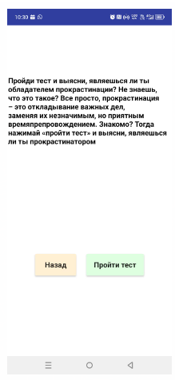
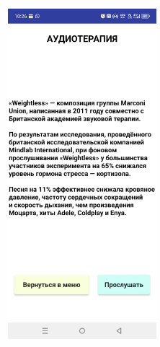
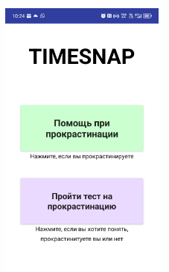
Mobile application

Slide 14


Booklet

Slide 15

Motivational posters

Slide 16

Motivational posters

Slide 17

Conclusion
Procrastination is not a final sentence.
It is important to develop self-regulation and self-compassion.
Chronic procrastination requires the help of a psychologist.

Slide 18


Thank you for your attention !

