Slide 1
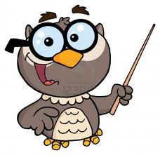
Spotlight -4
Module 2
My Town.
The Presentation is made by
S.V. Komagorkina, the English teacher,
School No.3, Kolomna town.

Slide 2
Key to the game «Bingo»
garage
station
hospital
post office
cafe
theatre

Slide 3
Key to the test
Green Yellow
1. Where’s 1. e)
2. It’s 2. d)
3. café 3. b)
4. in 4. a)
5. Queen Street 5. c)

Slide 4

Thank you for your attention!

