Slide 1

Developing Speaking for RSE Past 4
Teacher: Soboleva Anna Alexandrovna

Slide 2

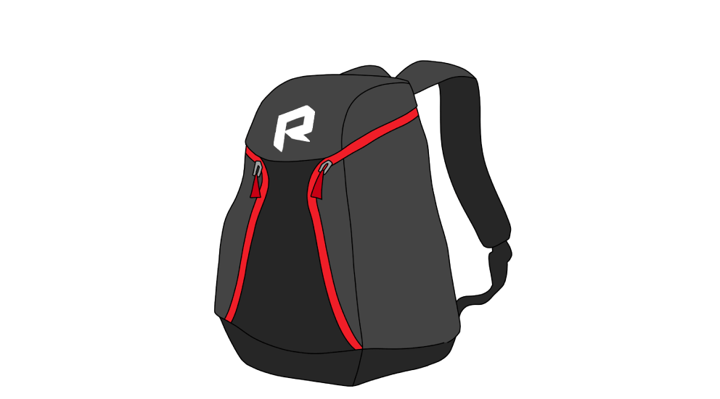
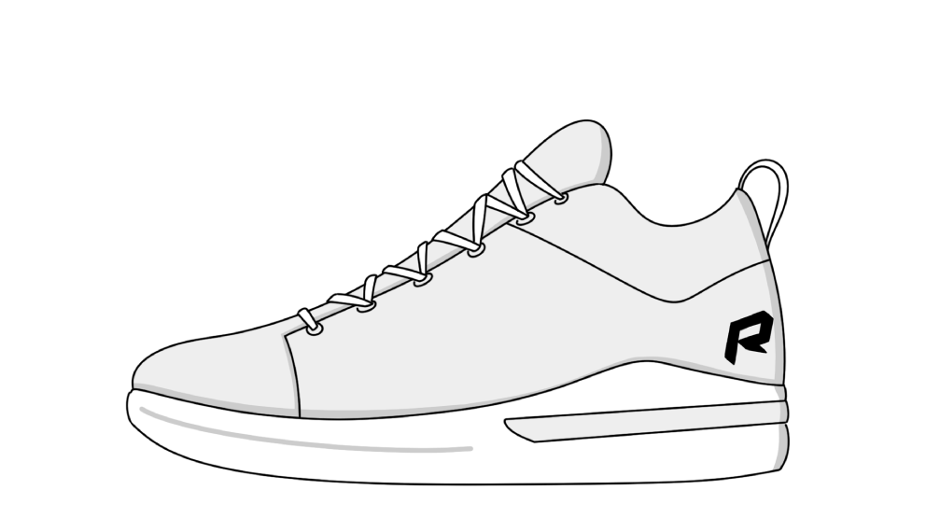
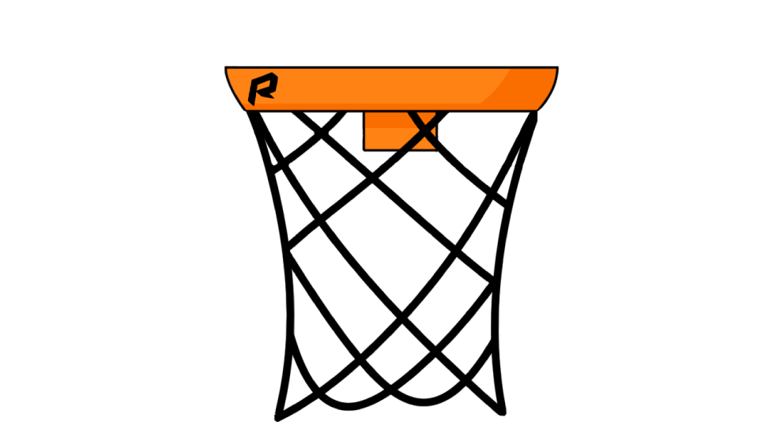
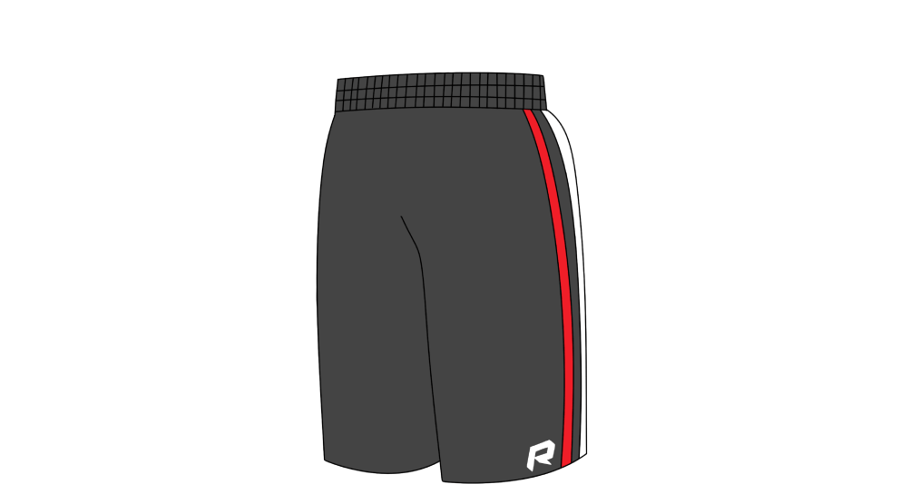

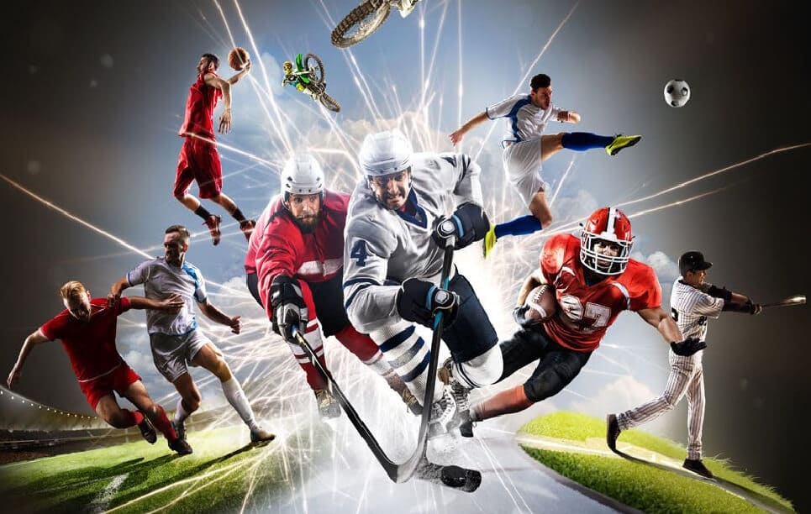
What kinds of equipment do you need to play basketball? Why do you need them?
Net
Choose
Whistle
Shorts
Shoes
Bag
Ball
Helmet

Slide 3

You hear a boy telling a friend about climbing a mountain with his father. What does he remember most clearly about reaching the top?
being glad that he’d followed his father’s advice
feeling quite a bit of physical discomfort
enjoying the beauty of the scenery around him
Have you ever climbed a mountain? What was it like?

Slide 4

Grammar questions - past simple
When did you last enter a competition?
How did you feel?
When did you last watch a competitive event?
How did you feel as a spectator?

Slide 5
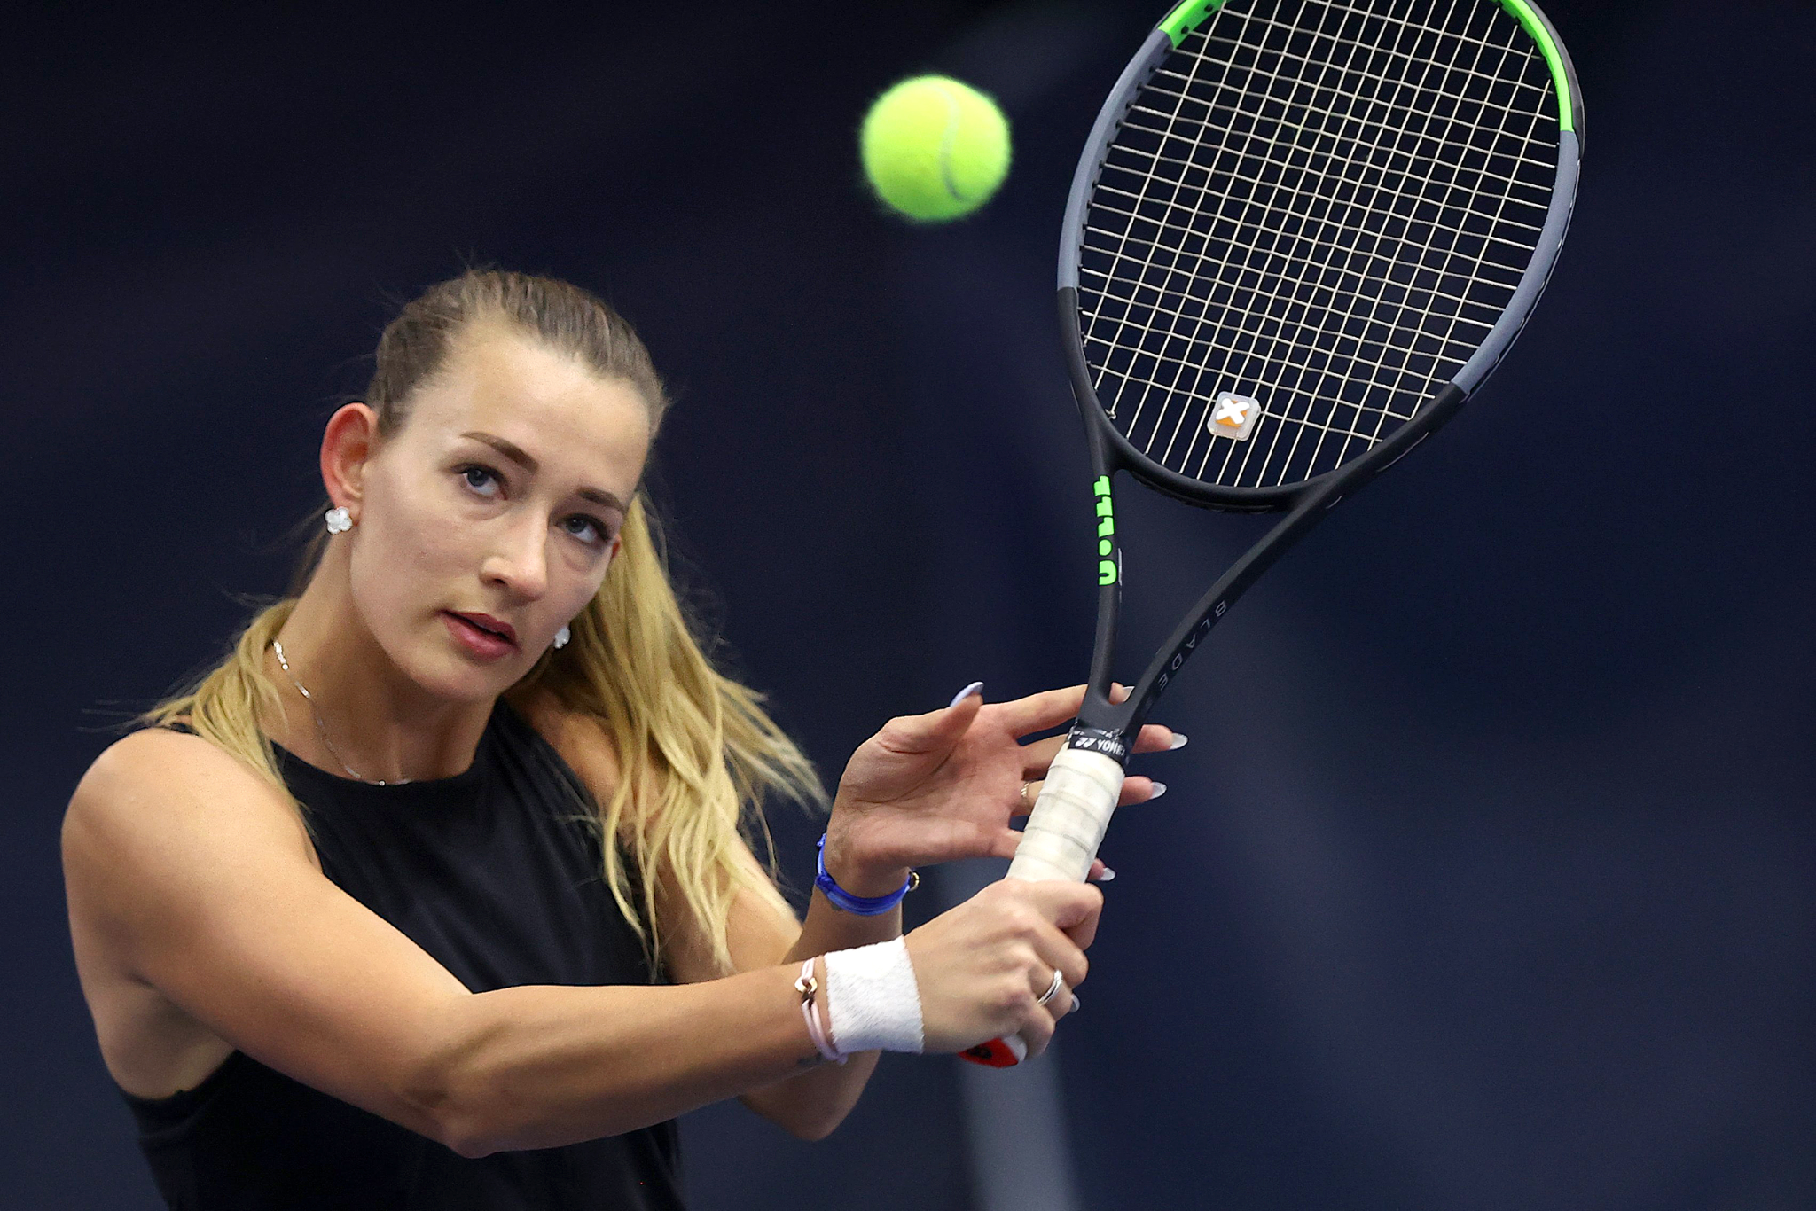
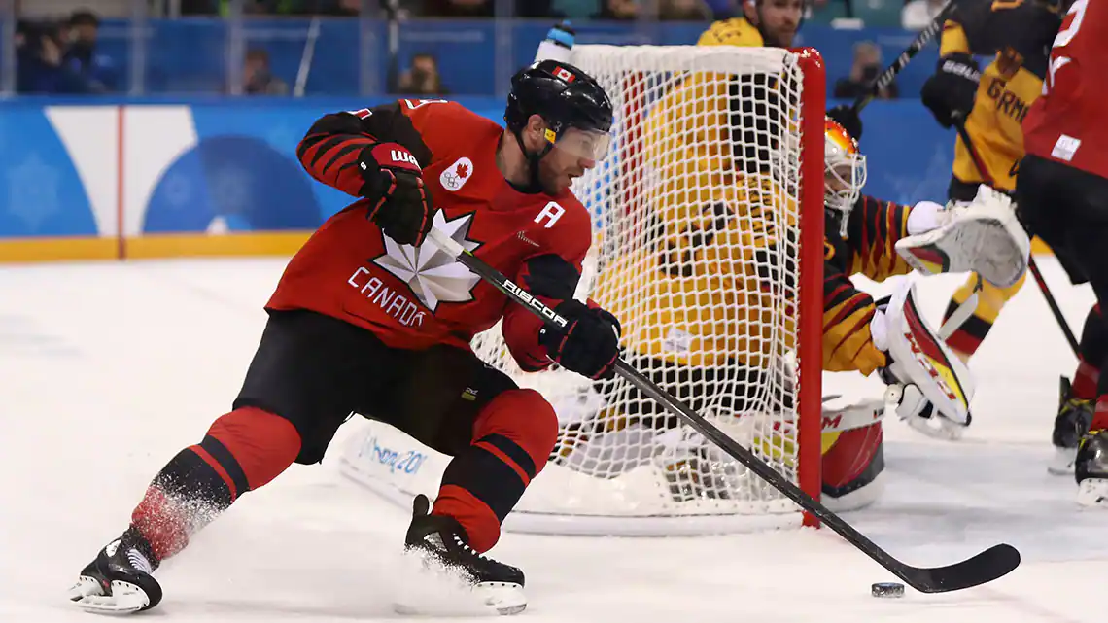
Sort out the words into the topic groups:
figure skating, motor races, volleyball, skiing, skating, curling, snowboarding, biathlon, cycling, rugby, diving, baseball,
ice hockey, windsurfing, yachting, wrestling, ski jumping.
winter kinds of sport | summer kinds of sport

Slide 6
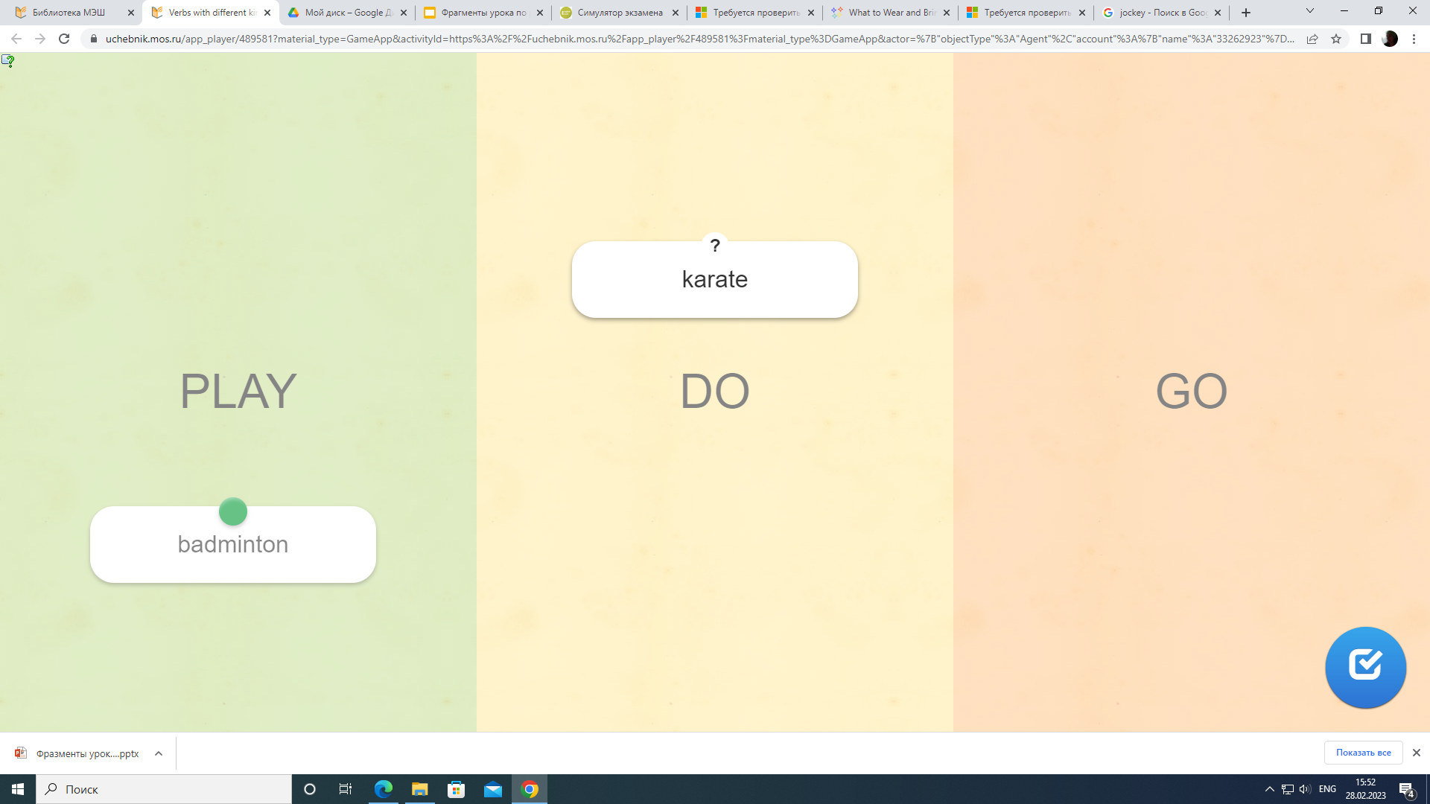

МЭШ ID:
340836
Verbs with different kinds of sports
LearningApps

Slide 7

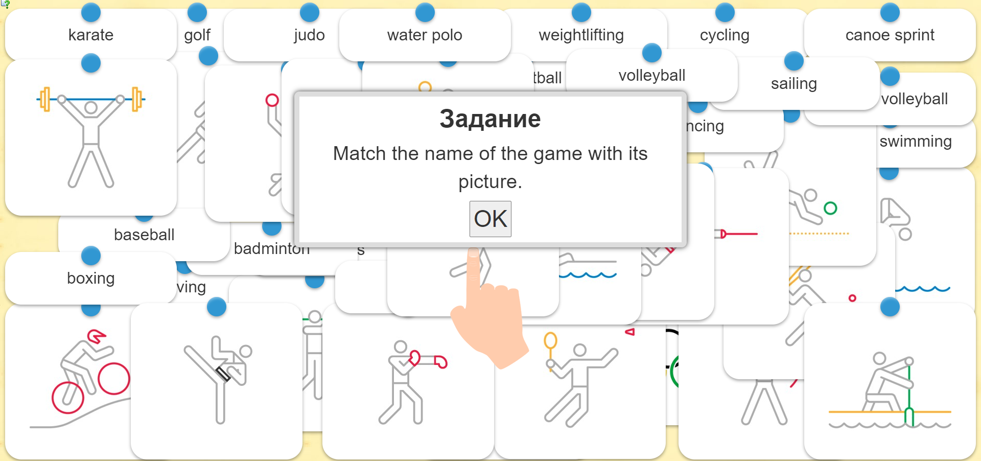
LearningApps
ID МЭШ: 297043

Slide 8
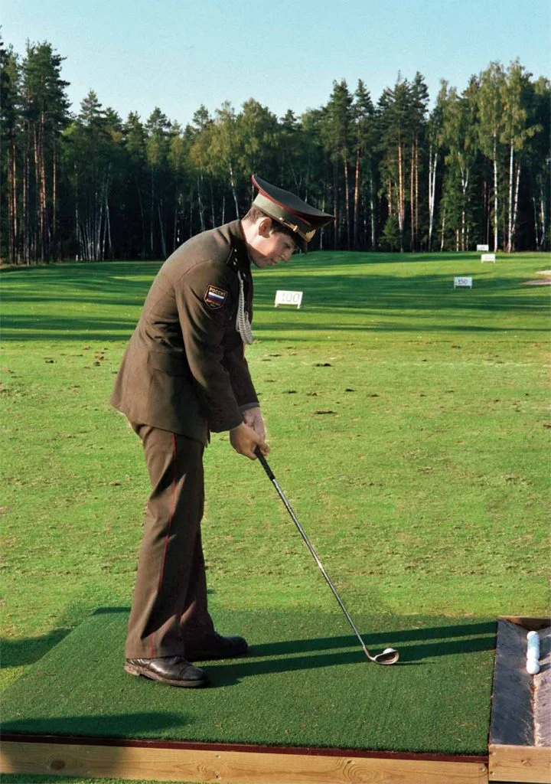
Complete the following table with the appropriate words.
Sports | Sportsman | The place the sport is played
volleyball | volleyball player
 | jockey
American football
 | boxer | ring
swimming |  | pool
 | hockey player
soccer | soccer player
golf |  | course

Slide 9
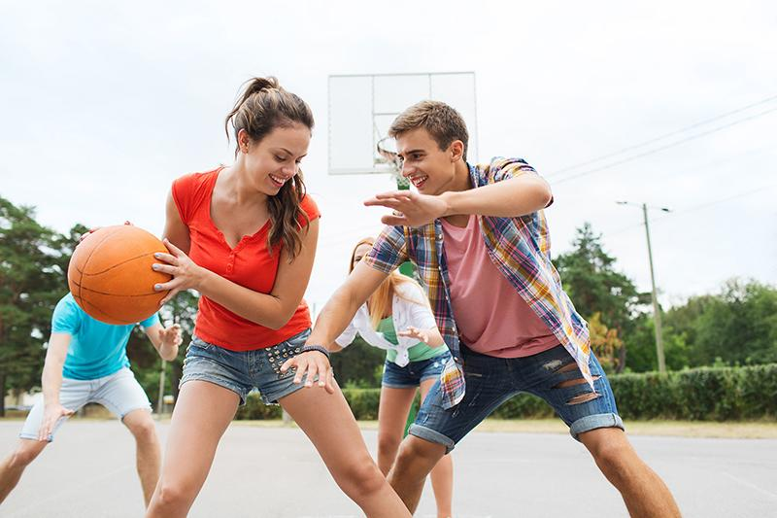
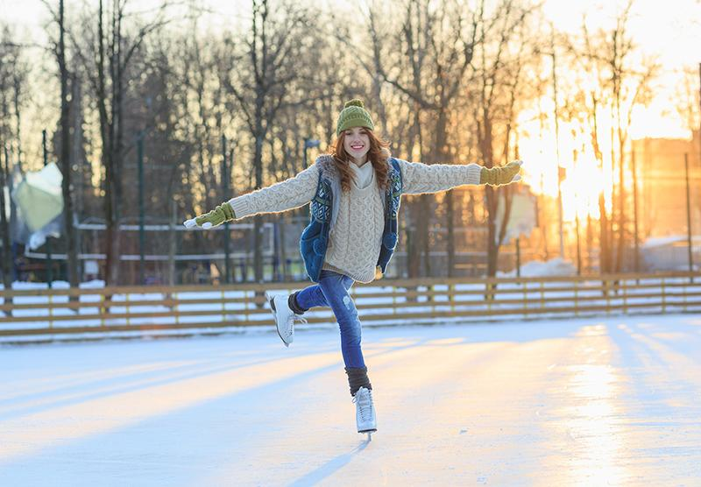
Study the pictures and read the instruction carefully.
Imagine that you and your friend are doing a school project “Sports in every season”. You have found some illustrations and want to share the news. Leave a voice message to your friend. In 2.5. minutes be ready to:
explain the choice of the illustrations for the project by briefly describing them and noting the differences;
mention the advantages (1-2) of the two kinds of sports;
mention the disadvantages (1-2) of the two kinds of sports;
express your opinion on the subject of the project – which kinds of sports you prefer and why.
You will speak for not more than 3 minutes (12-15 sentences). You have to talk continuously.
Notes:
Follow-up questions

Slide 10
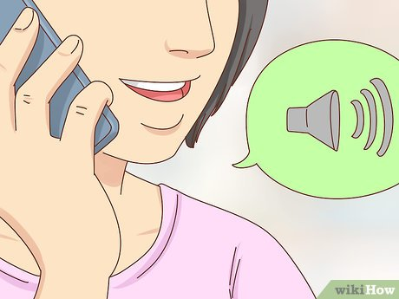
Step 1.
Start with an introduction
"Sports for every season"

Slide 11
Step 2. Describe and say why this picture is a good choice.
"Sports for every season"

Slide 12
Step 3. Explain the choice of the illustrations for the project by briefly describing them and noting the differences.
What are the differences?
"Sports for every season"

Slide 13
Step 4. Mention the advantages (1-2) of the two kinds of sports;
"Sports for every season"

Slide 14
Step 5. mention the disadvantages (1-2) of the two kinds of sports.

Slide 15
Step 6. Mention the disadvantages (1-2) of the two kinds of sports.

Slide 16
Step 7. Express your opinion on the subject of the project – which kinds of sports you prefer and why.

Slide 17

Creative hometask
Choose two photographs for the project “Sport in every season”.
Create a voice message and present them to your friend.
Follow the instructions:
Imagine that you and your friend are doing a school project “Sports in every season”. You have found some illustrations and want to share the news. Leave a voice message to your friend. In 2.5. minutes be ready to:
explain the choice of the illustrations for the project by briefly describing them and noting the differences;
mention the advantages (1-2) of the two kinds of sports;
mention the disadvantages (1-2) of the two kinds of sports;
express your opinion on the subject of the project – which kinds of sports you prefer and why.
You will speak for not more than 3 minutes (12-15 sentences). You have to talk continuously.
Notes:
Follow-up questions

