Slide 1
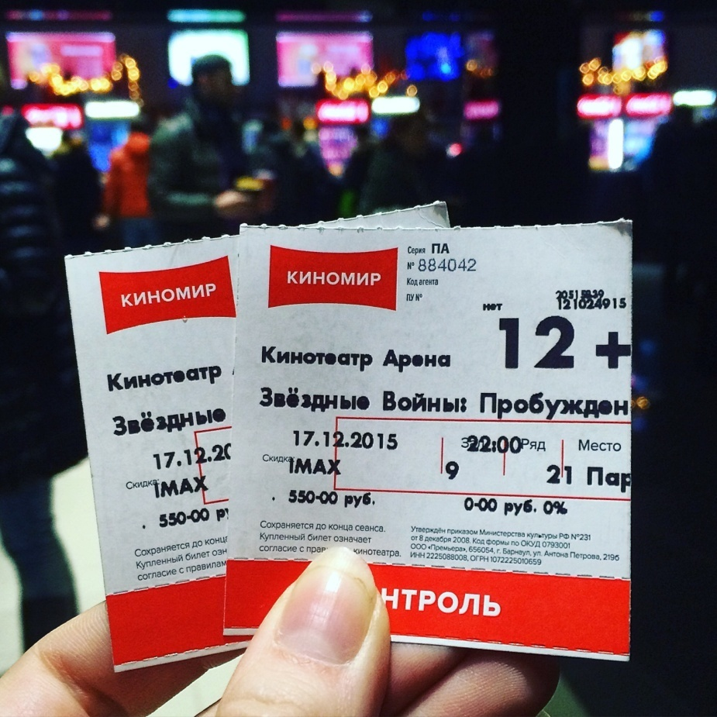
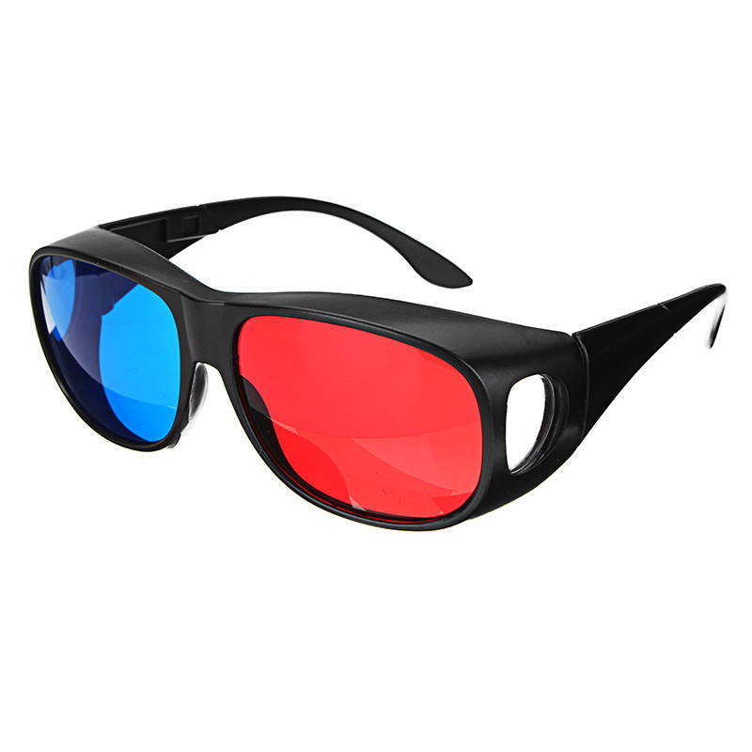
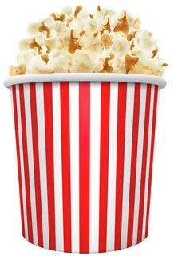
cartoon
comedy
horror
Science-fiction
documentary

Slide 2
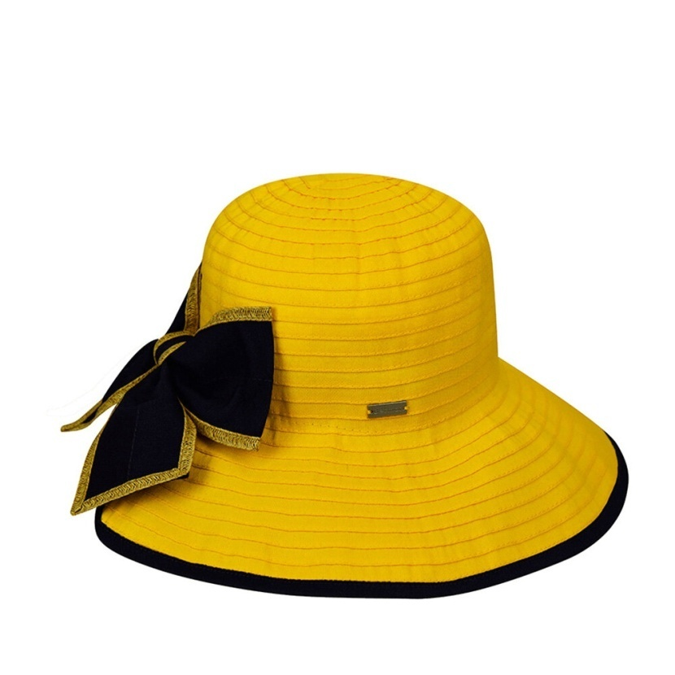
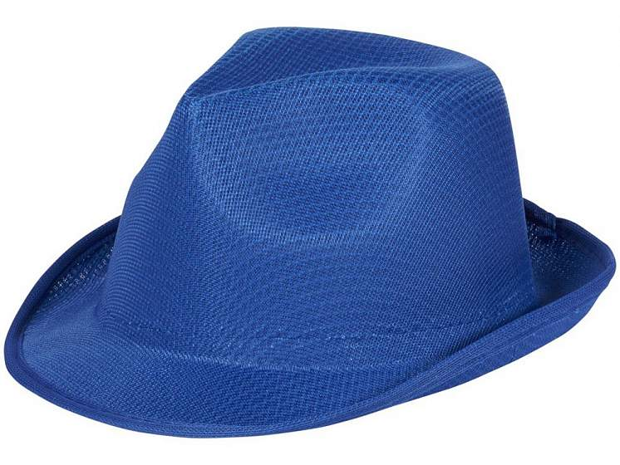
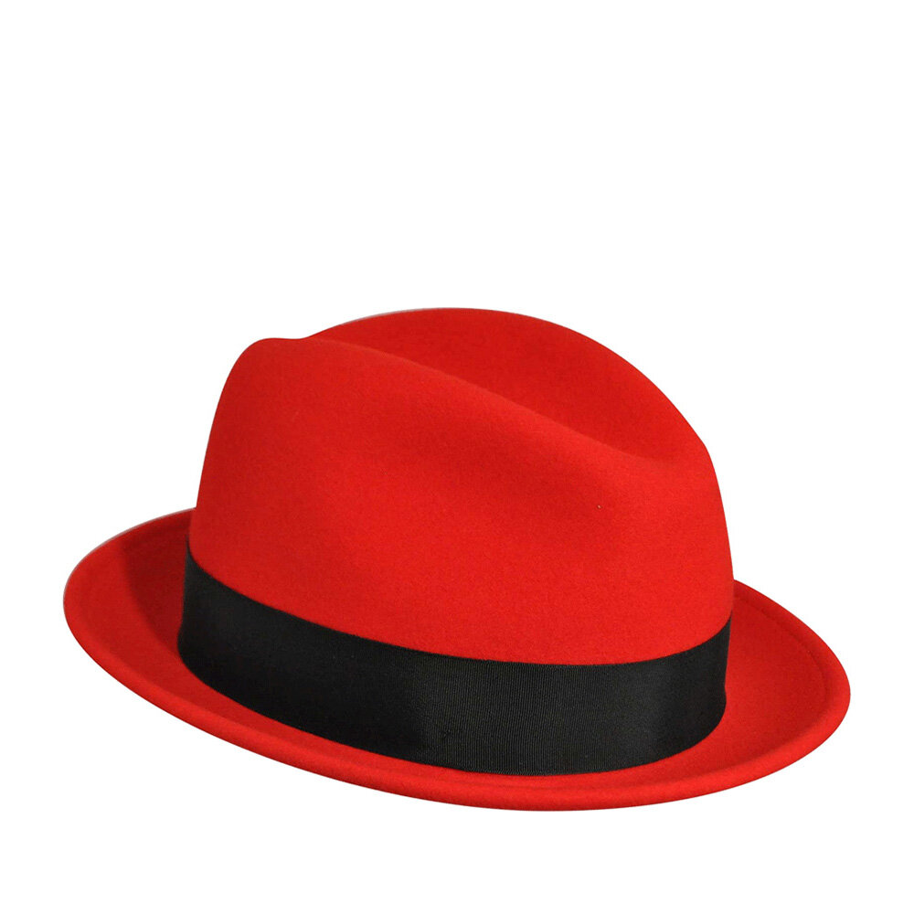
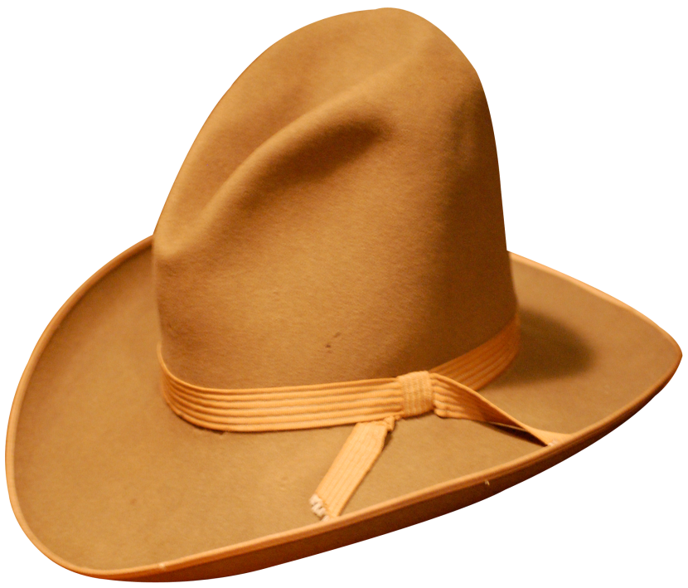
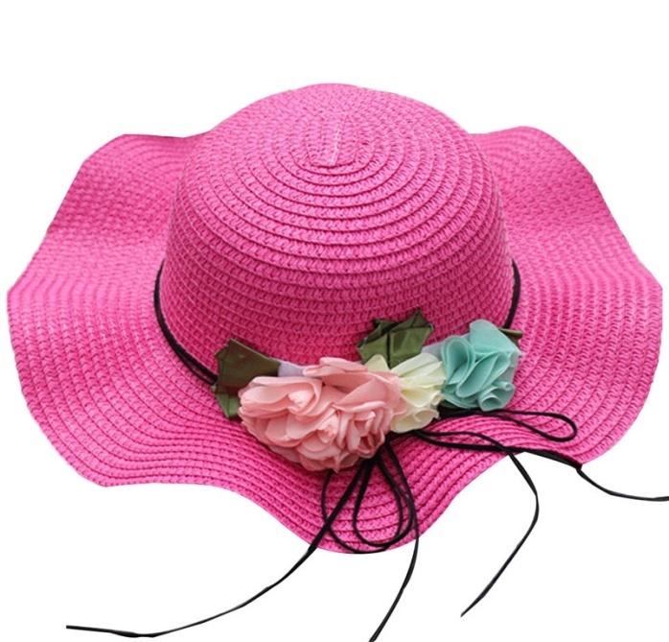

Slide 3
Hats
A yellow hat: make up 2 sentences which are true and 2 sentences which are false.
A blue hat: write down 10 adjectives.
A red hat: write 3 questions to the text.
A brown hat :write down all the types of films.
A pink hat :retell the text in 5 sentences.

Slide 4
The types of films which pupils of our school prefer
I’m surprised to see that…
I find it interesting that…

Slide 5
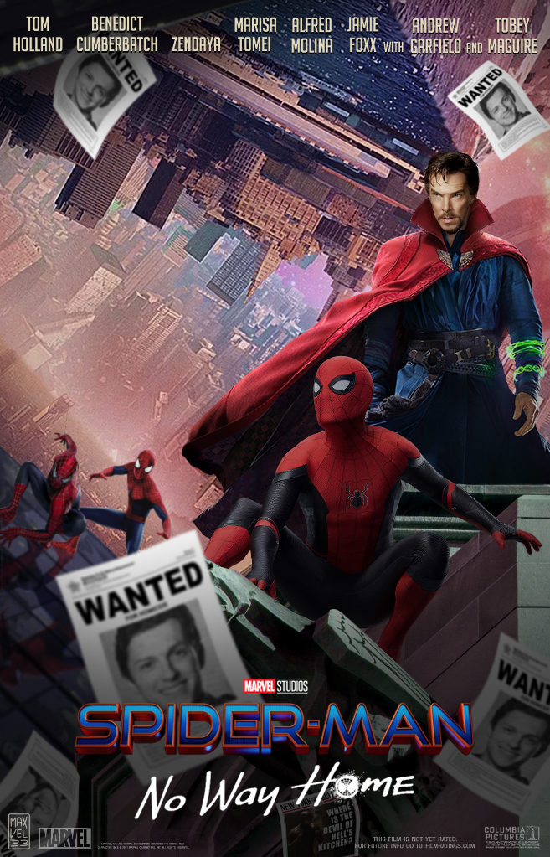
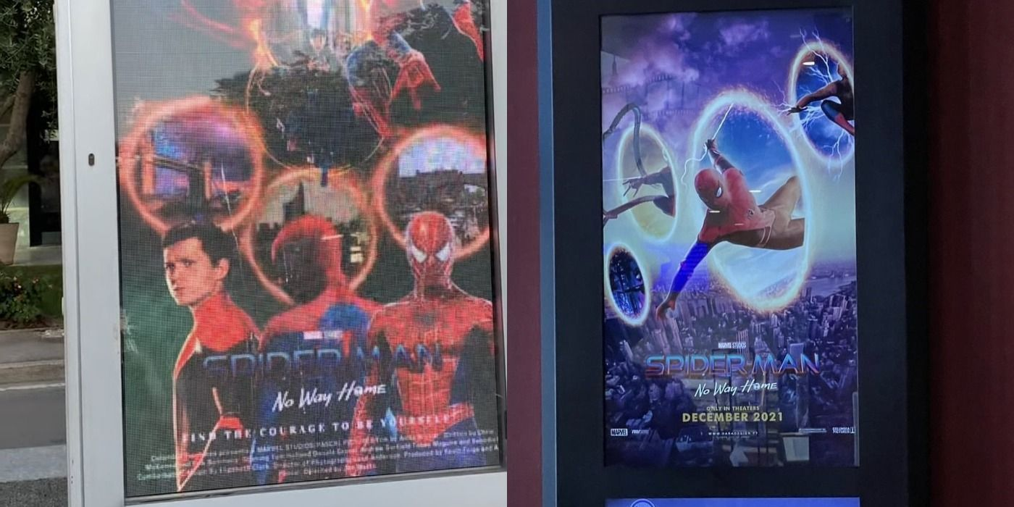
https://yandex.ru/video/preview/6639383608645425535

Slide 6
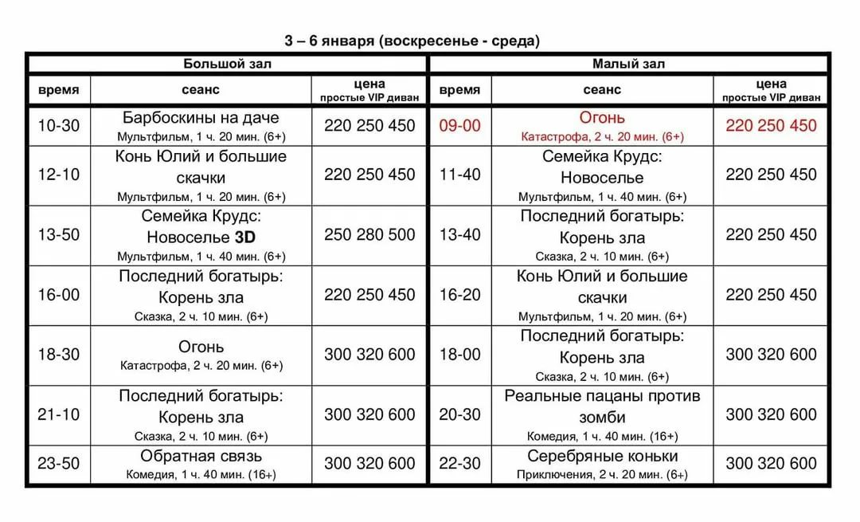
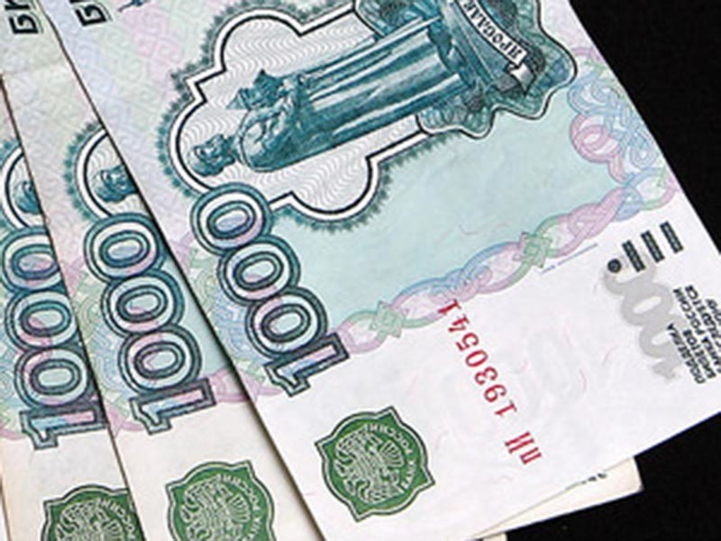
Imagine you have 3000 roubles.How many tickets can you buy?

Slide 7
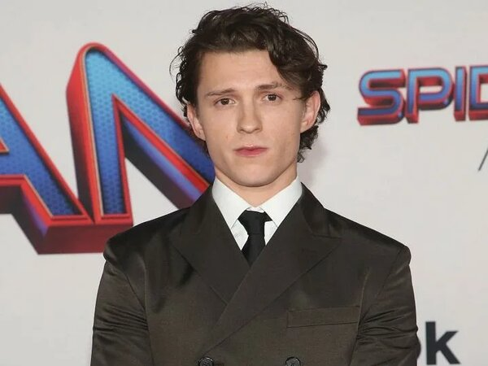
An Interview with a Film-star

Slide 8



