Slide 1

American High Schools

Slide 2

Aims
Today we are going to compare different Education Systems;
We are going to train skills of oral speaking and listening;
We are going to enlarge our vocabulary.

Slide 3

Past Simple:
Questions about your school

Slide 4
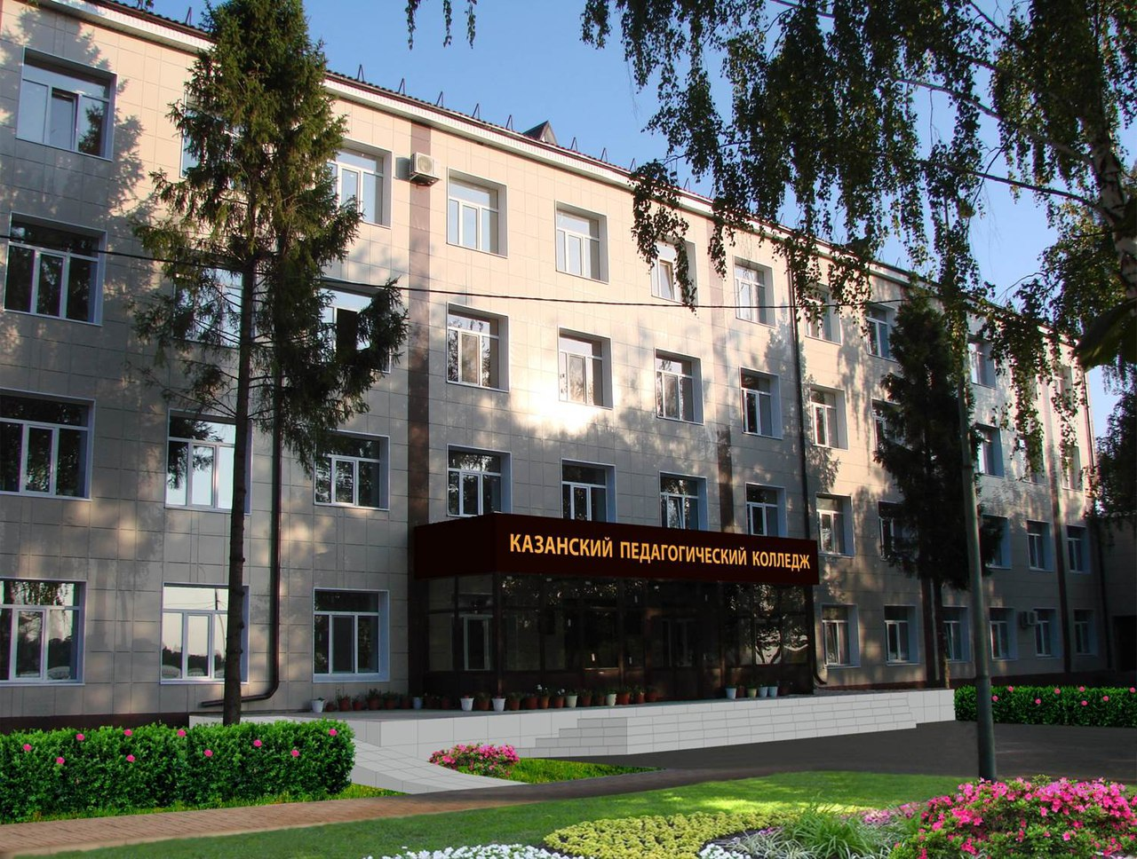
Present Simple
Questions about your college

Slide 5


Slide 6

Look through the diagram and answer the following questions:
1.How old are students when they
start school?
2.How many years do they learn in elementary school?
3.At what age do they go to junior
high school?
4.How many grades are there in high school?
5.How old are students when they leave school?
6.What are the(ninth) graders called?

Slide 7


Slide 8
 | American High School
Subjects
School life (a typical day at school)
Sporting activities
Extra-curricular activities

Slide 9

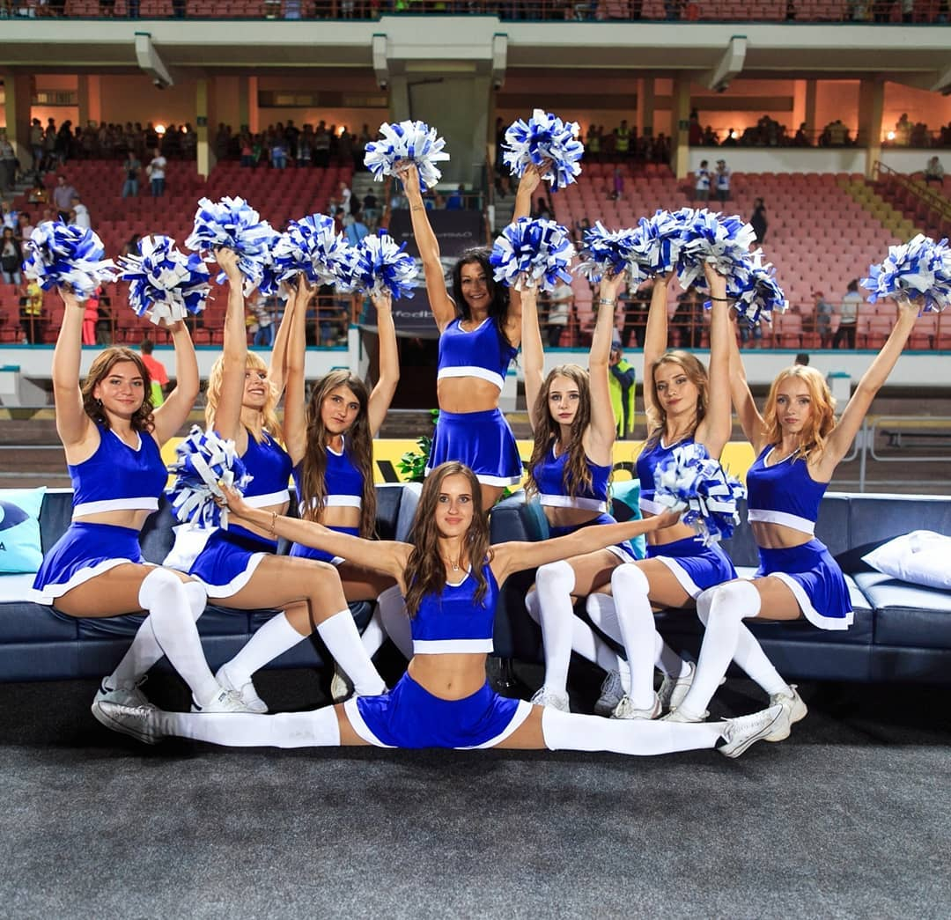
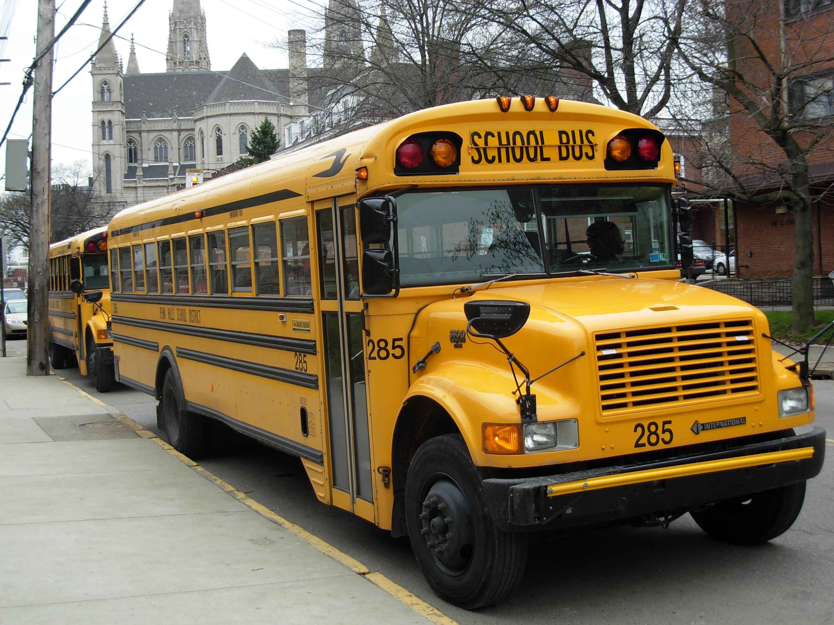
1.What subjects can you study at an American school?
2. How do students get to school?
3.Where do they put away their coats and lunch?
4.How many hours of classes have they got?
5. How often do they get a report card?
6.What do students grades depend on?
7. What sports do American students do?
8.What extra-curricular activities have they got?

Slide 10

Ex.4p.57 Dialogue.
Would you like to spend a year in an American high school? What would you like or wouldn’t like. Discuss with your partner.
-Would you like to spend a year at an American high school?
-I don’t know. I…

Slide 11

Say what new facts about an American high school you have learnt. Begin with…
I have learnt that…
I have never known/heard that…
It was interesting for me to learnt that…

Slide 12

«Russian School System».
-How is American system similar/different to the one in our country? Draw a diagram. Use the following:
Primary (Elementary) School (age)
Junior Secondary (Middle) School (age)
Senior Secondary School (age)
«Russian School System».

Slide 13
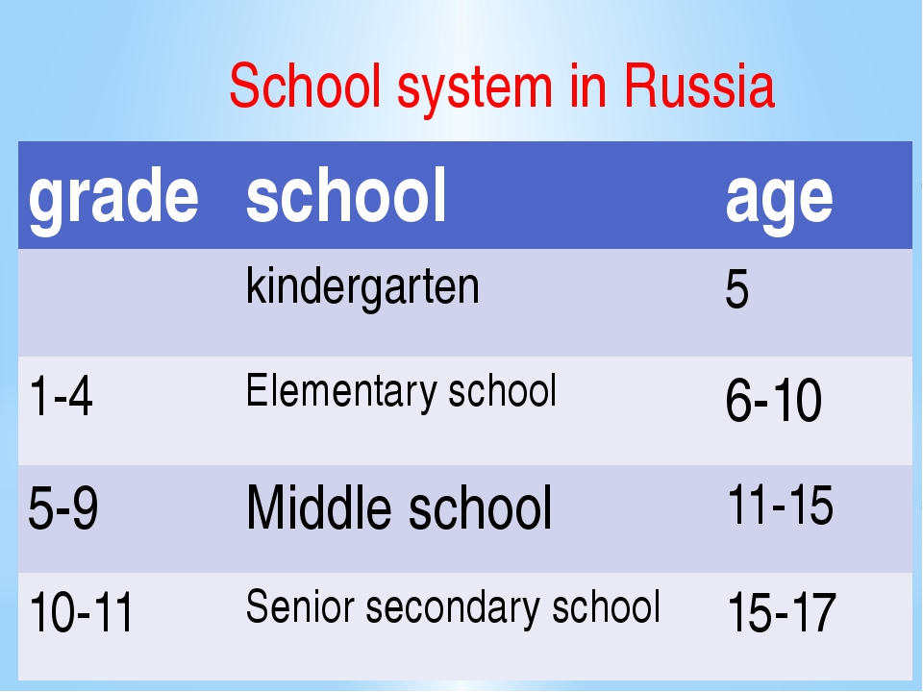
Look at this table and answer the following questions:
-How old are students when they:
start school
go to elementary school
go to middle school
leave school

Slide 14
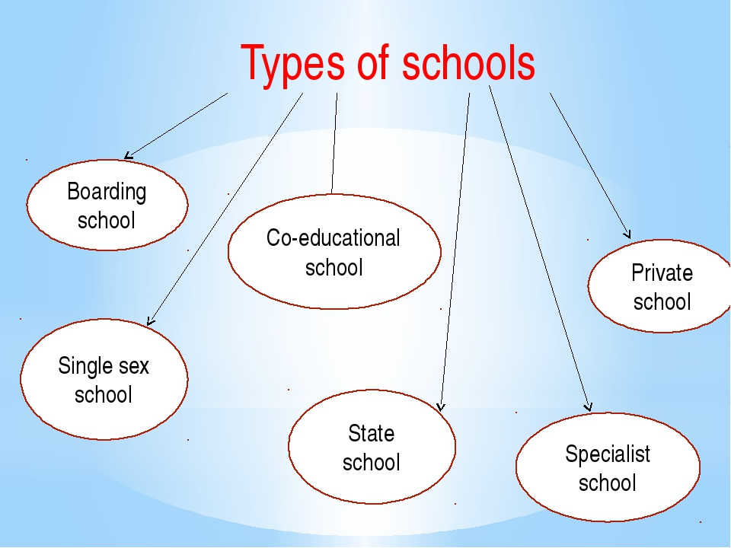

Slide 15

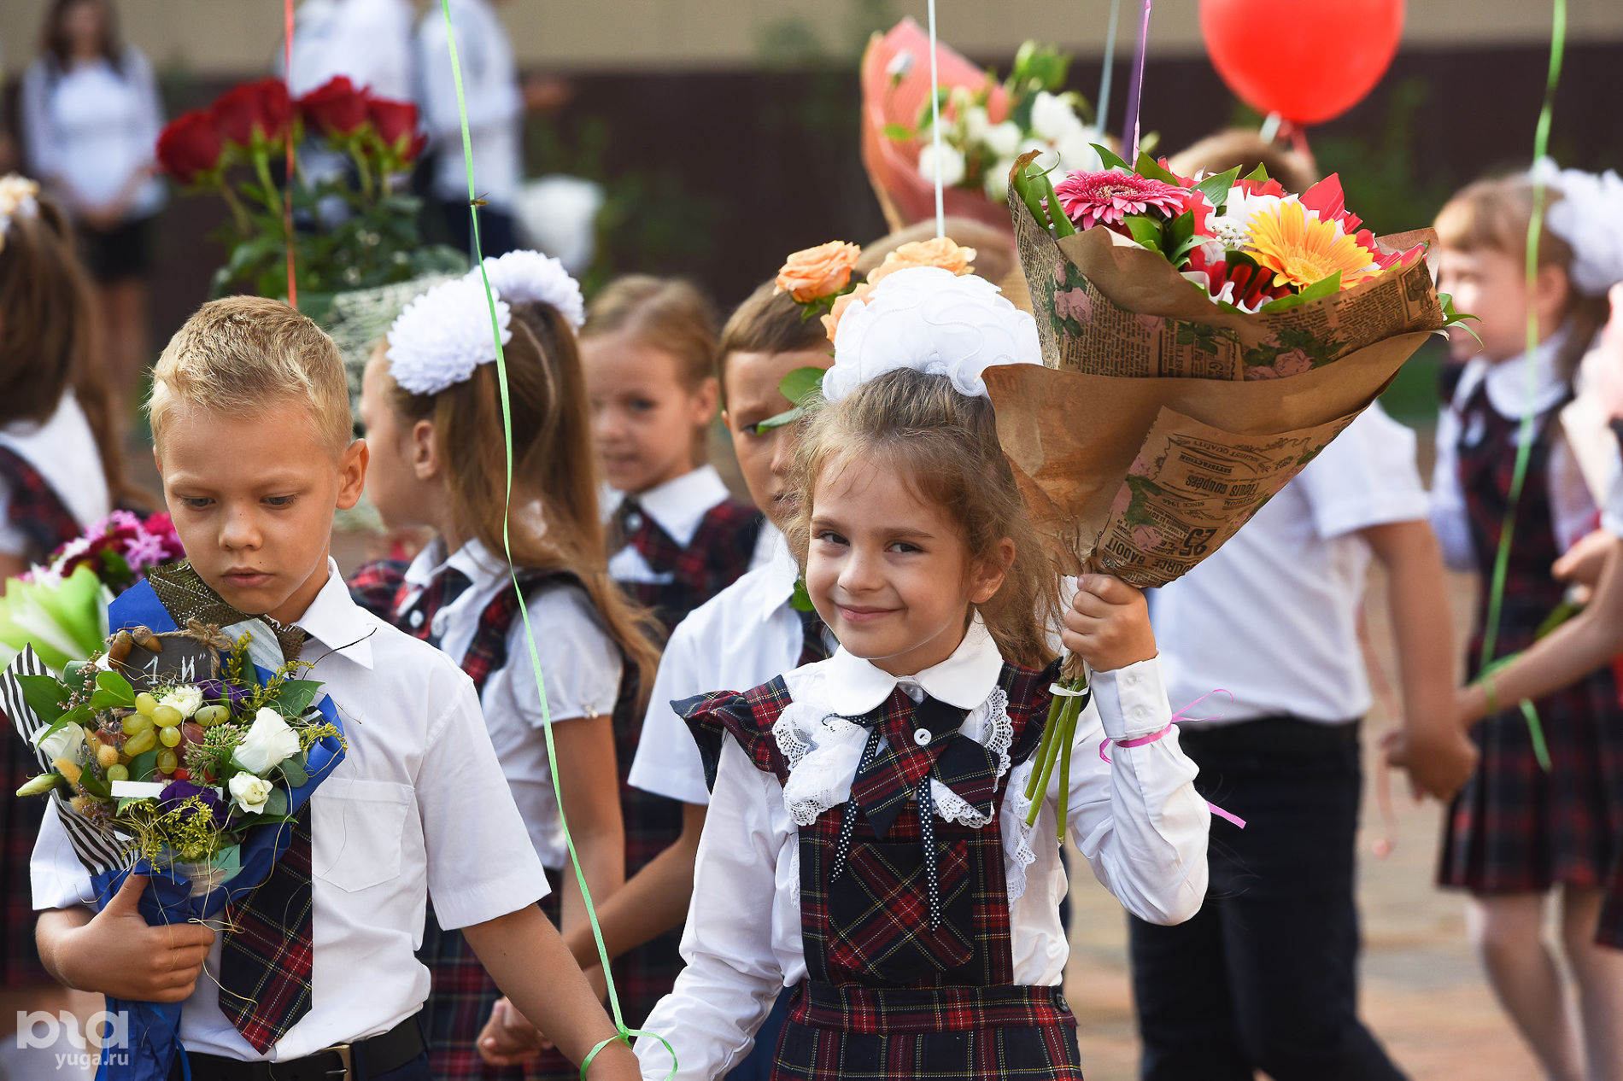
Ex.5 Work in groups. Design a leaflet inviting students from abroad to spend a year at Russian school. Write about:
1.subjects
2.school life (a typical day at school)
3.sports activities
4.extra-curricular activities.

Slide 16

Thank you
for your attention !

