Slide 1
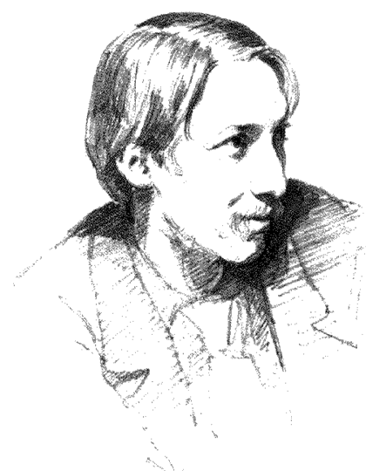
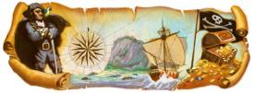
Robert Louis Stevenson
Гуила Н.А.,ГБОУ СОШ №347, СПб

Slide 2
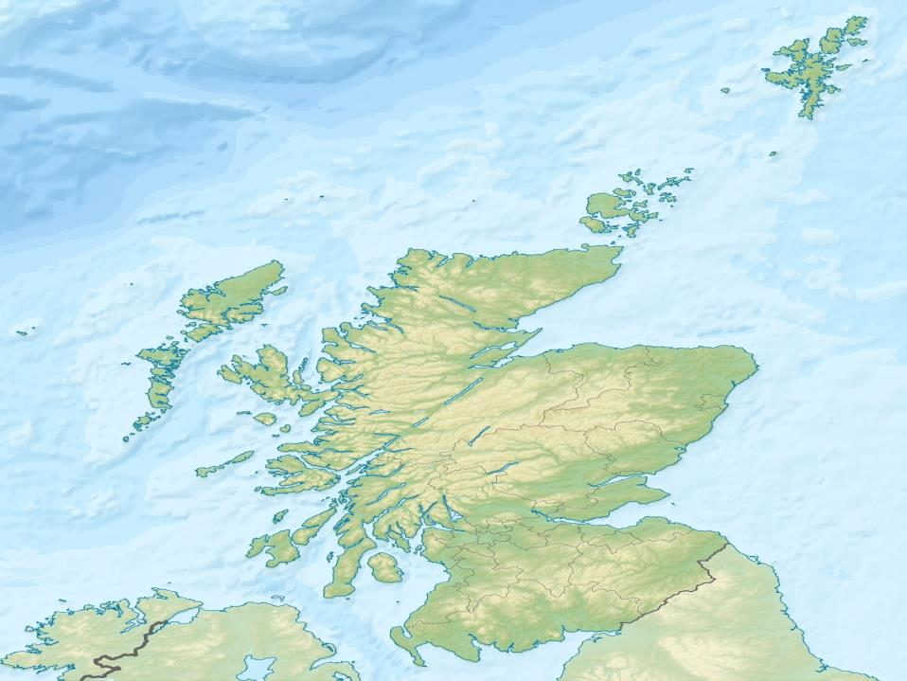
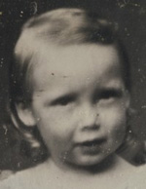
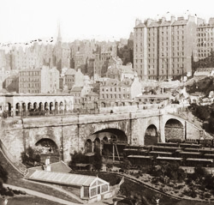
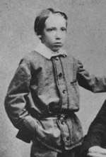
Robert Louis Stevenson was a Scottish novelist, poet, essayist and travel writer.
He was born in Edinburgh in 1850.

Slide 3
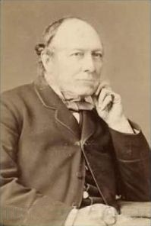
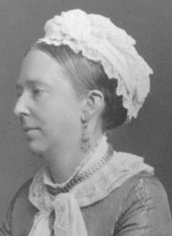
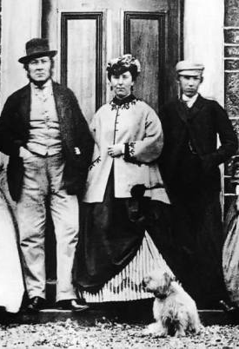
He was the only son of Margaret and Thomas Stevenson.
Both his father and grandfather were marine engineers.
They built lighthouses.

Slide 4
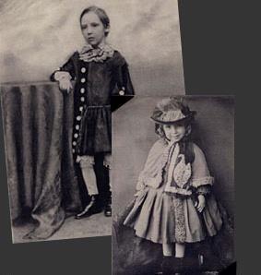
Since his childhood Stevenson suffered from tuberculosis.
During his early years, he spent much of his time in bed, composing stories before he had learnt to read.

Slide 5
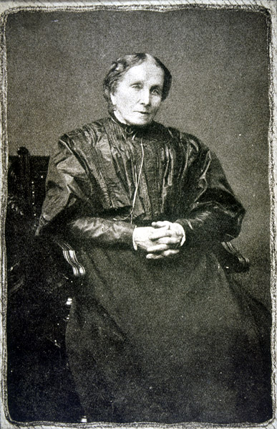
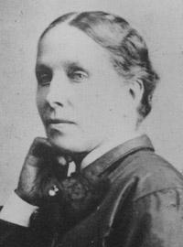
Stevenson was largely raised by his nanny Alison Cunningham “Cummy”. She was deeply devoted and loyal to the Stevensons and loved RLS.

Slide 6

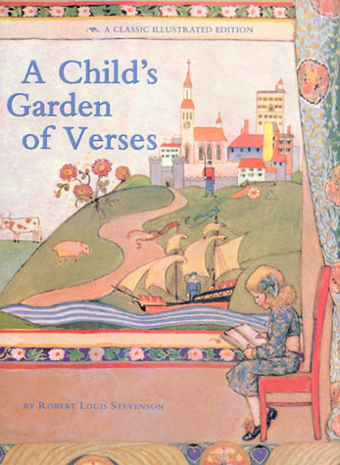
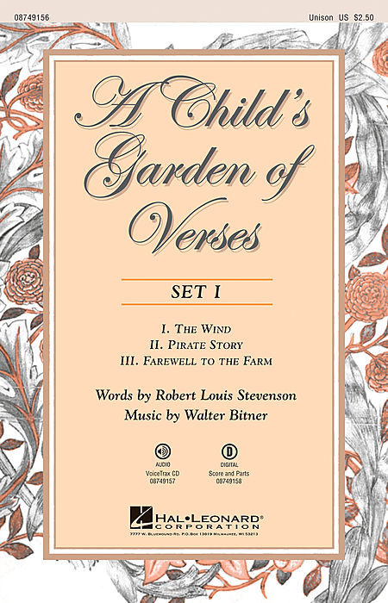
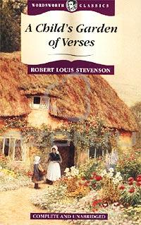
She cared for him tenderly in illness, reading to him as he lay sick in bed and telling tales. When he could not sleep, kept awake at night by violent coughing, his nurse would stay awake with him, often until dawn. Late he devoted to her A Child’s Garden of Verses.

Slide 7
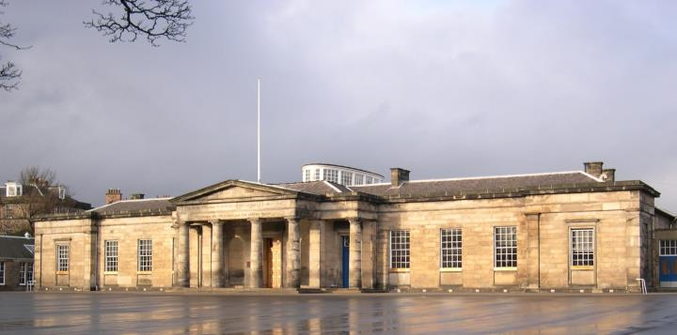
An only child, strange-looking and eccentric, Stevenson found it hard to fit in when he was sent to a nearby school at the age of six, a problem repeated at the age of eleven when he went on to the Edinburgh Academy. His frequent illnesses often kept him away from his first school, and he was often taught by private tutors.

Slide 8
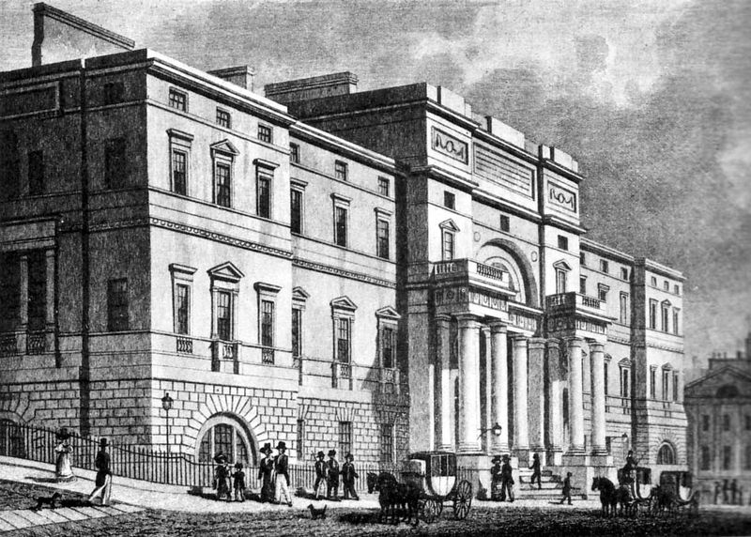
In 1867 he entered the University of Edinburgh to study engineering. In 1871 he changed to the study of law.

Slide 9
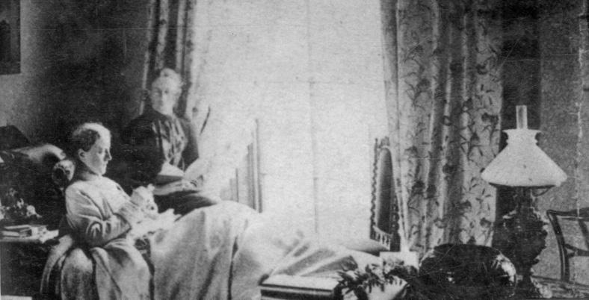
He had a “weak chest” and had to spend a large part of his life outside Britain. At first it was a tour by canoe along the picturesque rivers and canals of France and Belgium. While travelling, he turned to writing and wrote about his unusual journey.

Slide 10
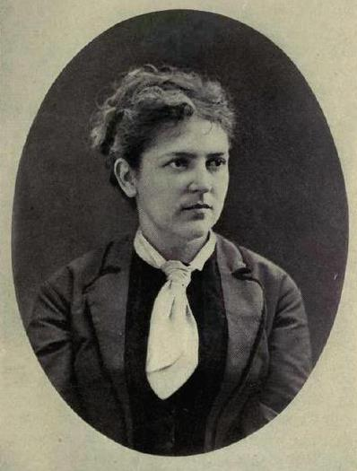
In France he first met Fanny Vandegrift Osbourne , a married woman with two children, Belle and Lloyd. Funny was 10 years older than Stevenson.

Slide 11
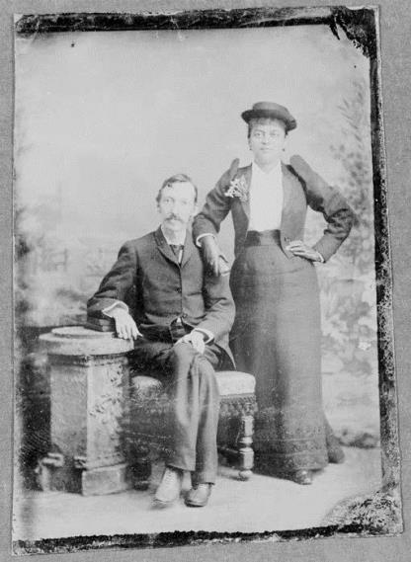
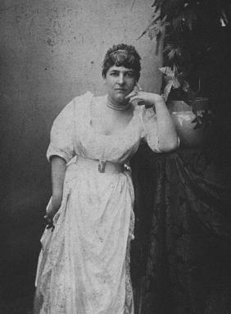
She returned to the United States to get a divorce. Stevenson followed her to California where they were married in 1880.

Slide 12
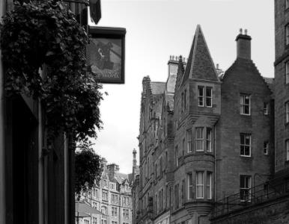
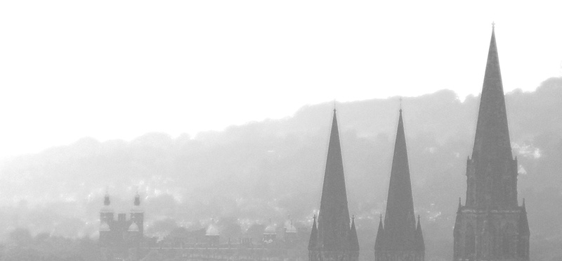
Between 1880 and 1887, Stevenson searched in vain for a place of residence suitable to his state of health. He spent his summers at various places in Scotland and England.

Slide 13
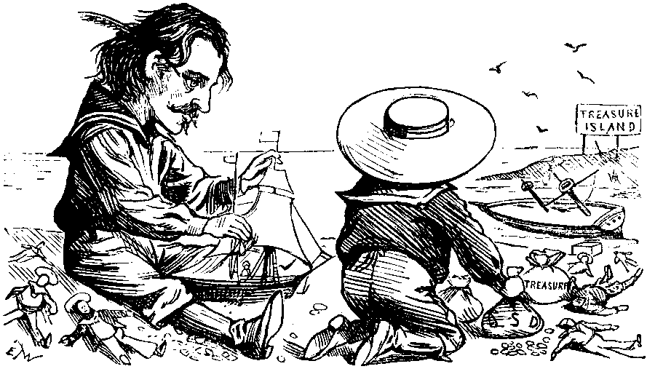
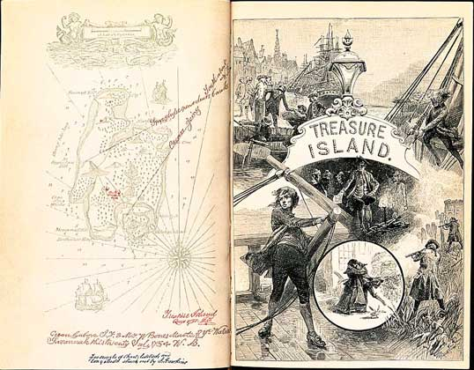
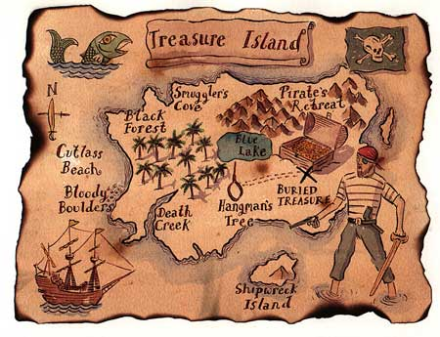
Stevenson loved his stepson very much and often used to play with him.
During a rainy holiday in Scotland when Lloyd was 12, they drew a map, which inspired Stevenson to write “ Treasure island.” It was published in 1883. He dedicated the novel to his stepson.

Slide 14

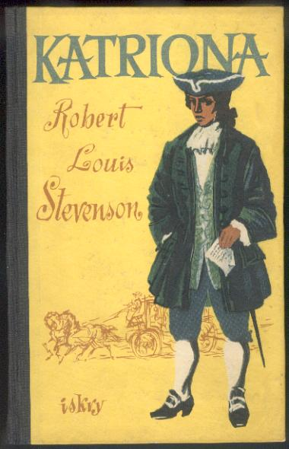
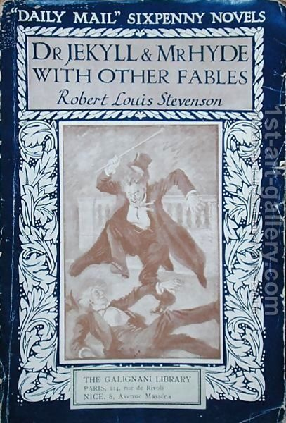
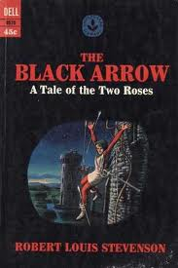
Among Stevenson’s works from the 1880’s are a Child’s Garden of Verses (1885), Kidnapped ( 1886) and its continuation Catriona (1893), The Strange Case of Dr. Jekyll and Mr. Hyde(1886), the Black Arrow (1888), The Master of Ballantrae (1889).

Slide 15
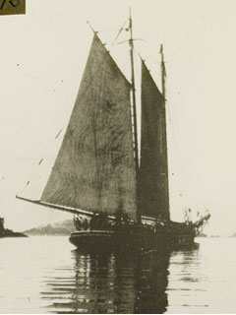
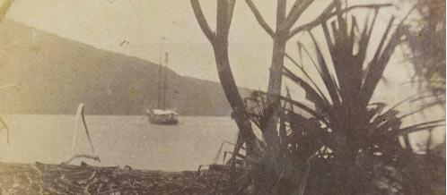
In June 1888, Stevenson chartered the yacht Casco and sailed with his family from San Francisco.
In search of better health they sailed to the Pacific Islands where the climate was good.
The salt sea air and thrill of adventure for a time restored his health.

Slide 16
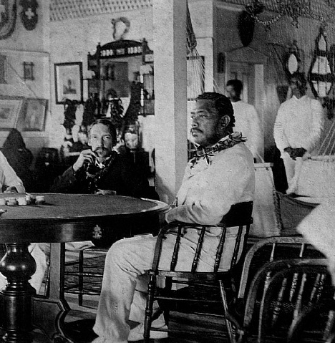
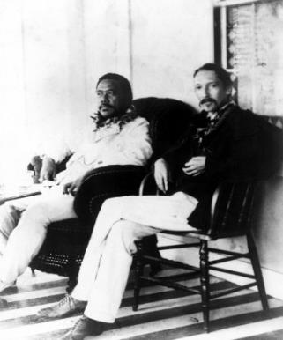
For nearly three years he wandered the eastern and central Pacific, visiting important island groups. He also spent time at the Hawaiian Islands where he became a good friend of King Kalakaua, with whom Stevenson spent much time.

Slide 17
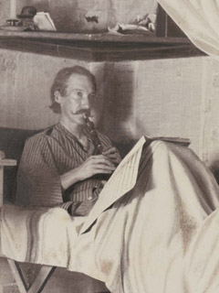
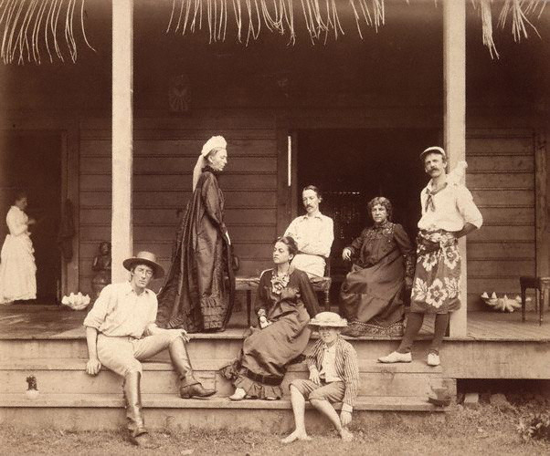
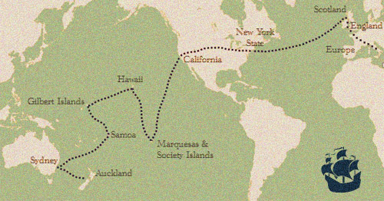


In 1889 the family decided to settle in the Samoan islands. They bought a house that was called "Vailima," or "Five Waters.”

Slide 18
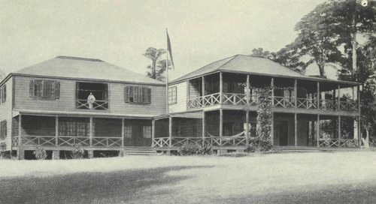
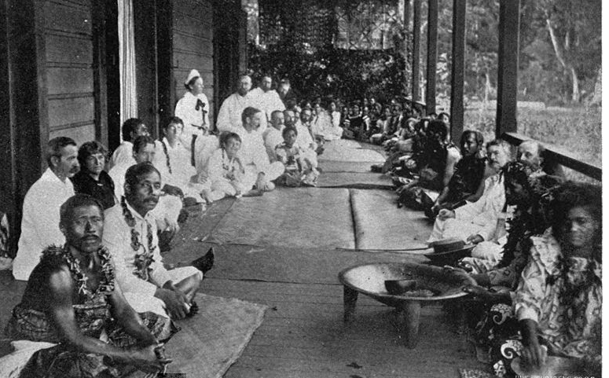
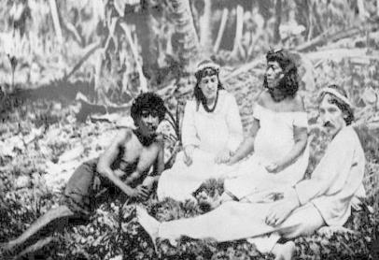

Stevenson himself took the native name Tusitala (Samoan for “a storyteller”). He made friends with the Samoans, who respected him and asked him for advice.

Slide 19
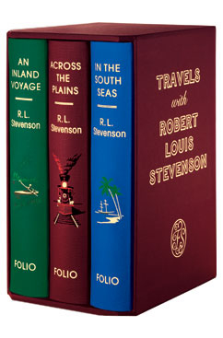
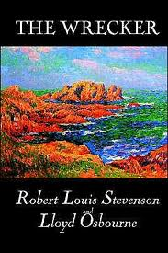
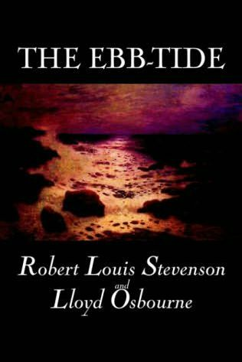
He wrote about the Pacific islands in several of his late works: In the South Seas(1896), The Wrecker (1892), The Ebb-Tide (1894)

Slide 20
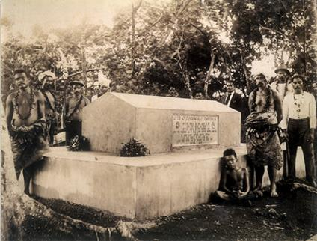
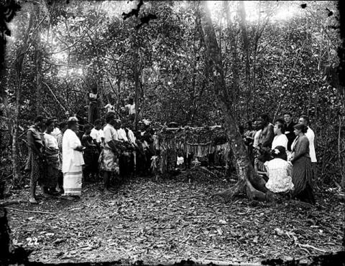
They lived in the South Seas until Stevenson’s sudden death in 1894.
He died on December 3, 1894 and was buried at the top of Mount Vaea above his home in Vailima far from his beloved Scotland.

Slide 21
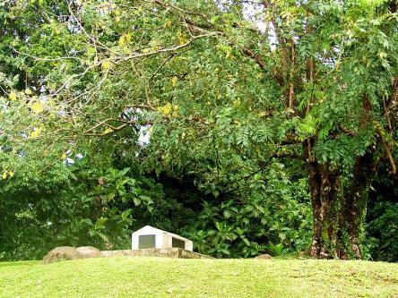
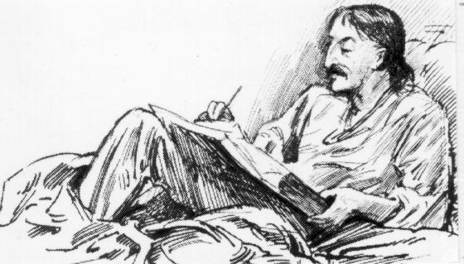
Under the wide and starry sky, Dig the grave and let me lie. Glad did I live and gladly die, And I laid me down with a will.
This be the verse you grave for me: Here he lies where he longed to be; Home is the sailor, home from sea, And the hunter home from the hill.
Под широким и звездным небом Выкопайте могилу и положите меня в нее, Я радостно жил и умирать мне легко. Выполните мою последнюю волю.
На моем надгробном камне выбейте такие строки: Он лежит, где хотел лежать, Он - дома, моряк возвратился домой с моря, Охотник возвратился домой с холма.

Slide 22
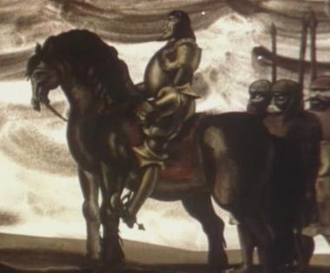
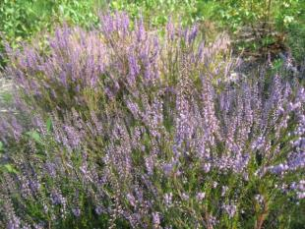
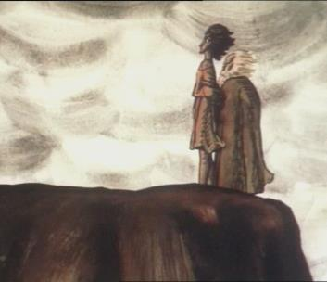

During his final years RLS published two more collections of poems Underwoods(1887) and Ballads (1890)
The most famous poem of this period is Heather Ale.
RLS wrote the following poem with the sub-title “A Galloway legend”
He turned to the ancient history of Scotland for inspiration.

Slide 23
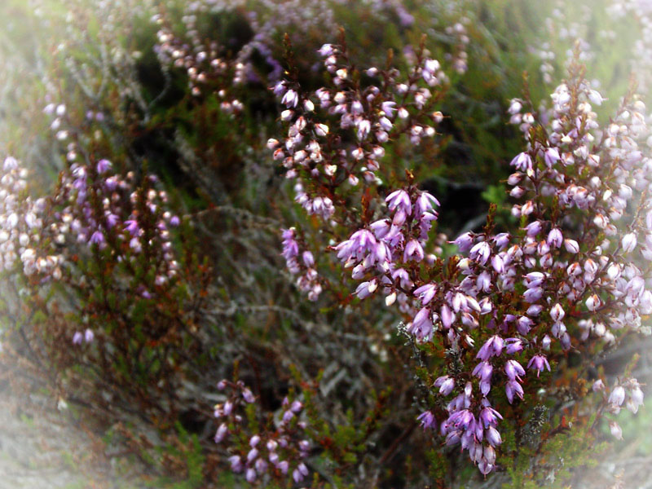

Slide 24





Slide 25




Slide 26

www.robert-louis-stevenson.org

