Slide 1
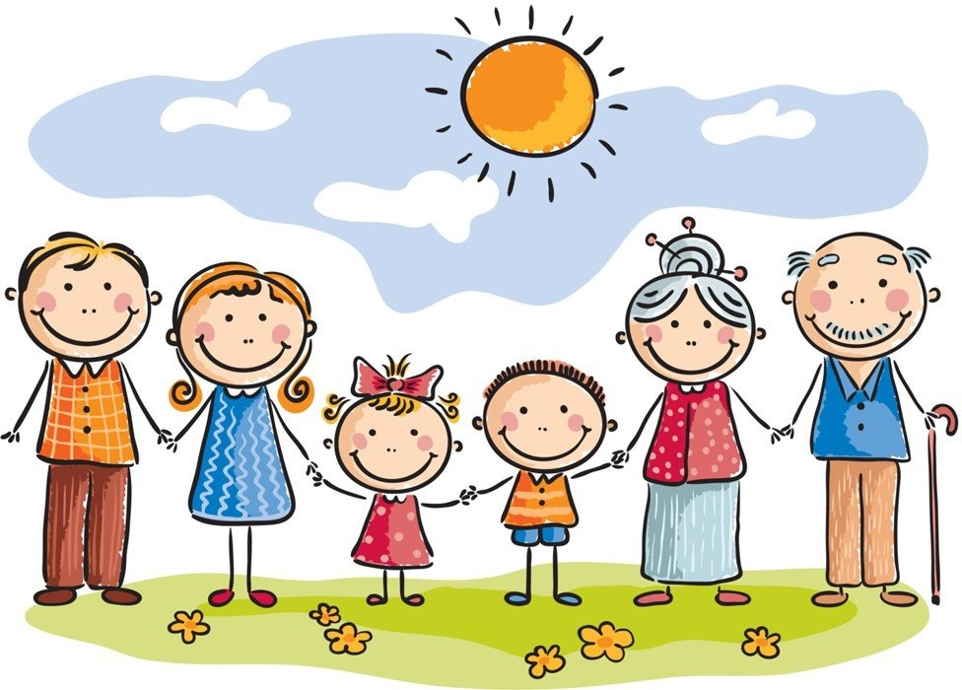
FAMILY HISTORY
“Jobs and careers”
подготовила учитель английского языка : Михеева О.Б.

Slide 2


Slide 3

I am glad to see You!!!

Slide 4

Do you remember ….?

Slide 5
Phonetics. Listen. Repeat and read!
I want to be an actor, Dad. I want to go on stage. You should be a banker, Tom, and earn a decent wage. I want to be a barber, Dad. I want to do people’s hair. You should be a pilot Tom, and work for British Air. I want to be a clown, Dad. I think I am very funny. You should be a driver, Tom, and earn a lot of money.

Slide 6
Phonetics. Listen. Repeat and read!
I want to be a barman, Dad, so I can be always happy, dear! A barman! You are joking, Tom. That isn’t a career! I want to go into politics, Dad, and put the country right. I think that’s an excellent idea. Let’s tell your mother tonight!

Slide 7
Speech Practice. General questions
Yes\ no questions
(Ко всему предложению)
Are there many professions in the world?\ Yes, there are. There are many…
What are they?\ They are …doctors, drivers, bakers,….

Slide 8
Speech Practice:
3) Are you a pupil?\ Yes, I am. I am…
4) Is your brother a student?\ No, he is not\ He is …

Slide 9
Speech Practice:
5) Does a pilot fly in the airplane?\ Yes, he does. A pilot flies…
6) Do nurses help doctors?\ Yes, they do. Nurses help…

Slide 10
Speech Practice:
7) Do vets help sick* animals?\ Yes, they do. Vets help…
8) Do farmers work in the fields?\Yes, they do. Farmers work…

Slide 11
Speech Practice :
9) Does your mother work in a hospital?\ No, she doesn’t. My mother works…
10) Are you dreaming to become a journalist?\ Yes, I am. I am dreaming….

Slide 12
Proverbs about Professions
1)He works best who knows his trade
Дело ….

Slide 13
Proverbs about Professions
2)He that will not work shall not eat
Кто ....

Slide 14
Proverbs about Professions
3)A bad workman blames his tools
У плохого…

Slide 15
Proverbs about Professions
4)No pain, no gain
Без труда…

Slide 16

New Vocabulary :

Slide 17
Career
To make a career in medicine
Wonderful career

Slide 18
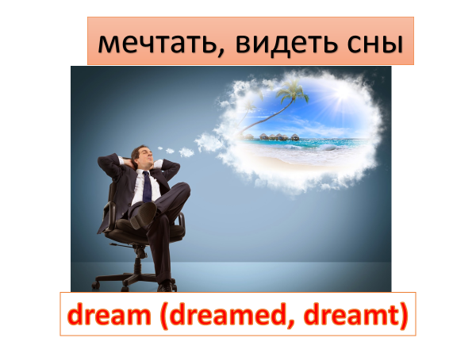
New Vocabulary :

Slide 19
Dream
She dreams to become a doctor.

Slide 20

New Vocabulary :

Slide 21
To get\ got
He got “5” and “4” in Russian.

Slide 22

New Vocabulary :

Slide 23
Interest
A place of interest

Slide 24

New Vocabulary :

Slide 25
interested
to be interested in Sport

Slide 26
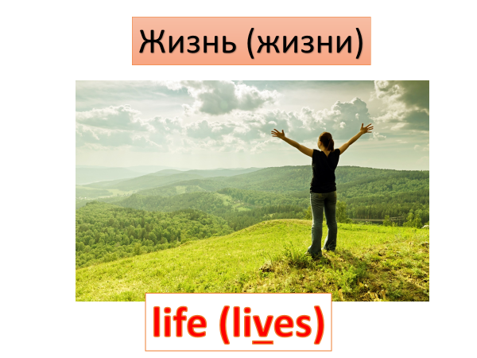
New Vocabulary :

Slide 27
Life
My granny lived a long life.

Slide 28
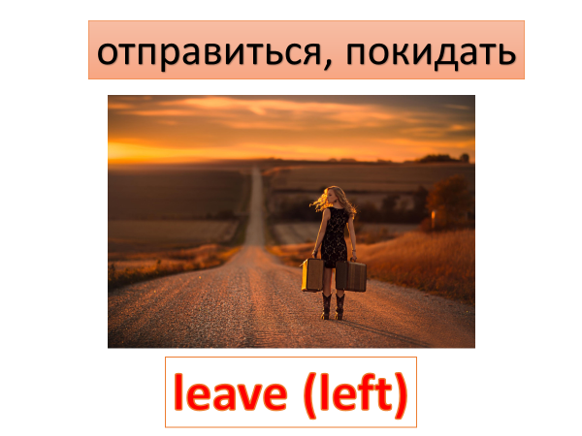
New Vocabulary :

Slide 29
to leave\ left
After school Margaret Barker left her house and went to London

Slide 30
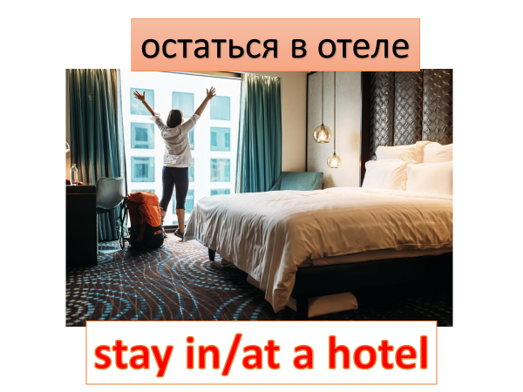
New Vocabulary :

Slide 31
to stay
He stayed at a five-star* hotel.

Slide 32

New Vocabulary :

Slide 33
to spend
He spent all his money.

Slide 34

Let’s Fix Active Vocabulary of Our Previous Lessons :
We’ll do some exercises and play games games :

Slide 35
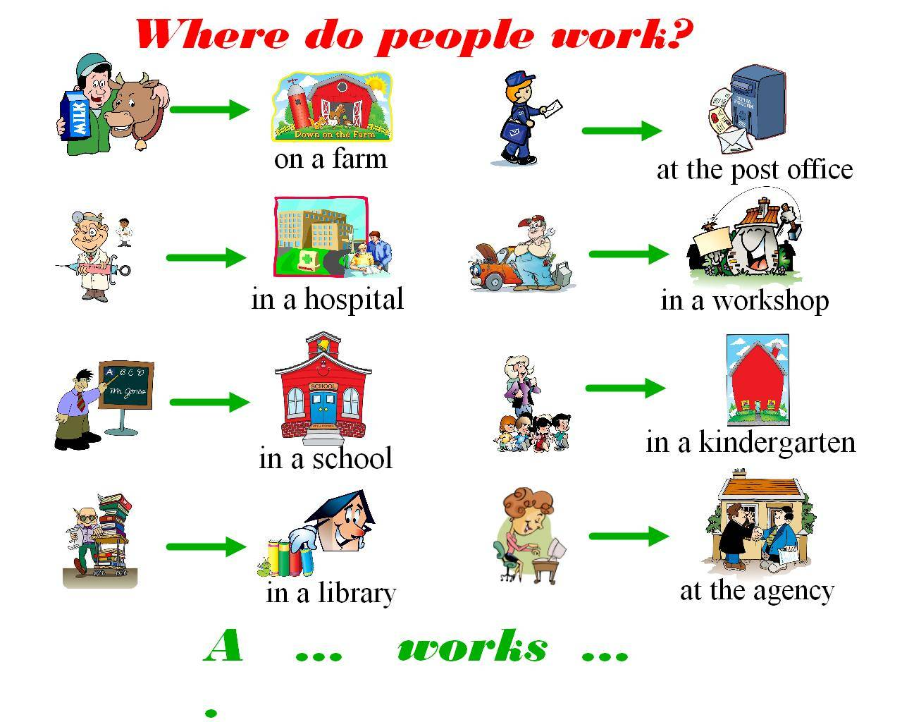

Slide 36
Game:
«Answer questions in one word»
1)Who gives medicines and pills?
-A nurse
2)Who teachers kids English, Russian and Math?
3)Who bakes bread?

Slide 37
Answer questions in one word
4) Who drives a taxi?
5) Who feeds cows and pigs?
6)Who plays football?
7)Who writes in newspapers and magazines?

Slide 38
Game “Find a pair” :
What do they do?
1)A singer… a)cooks food
2) A chef.. b) works at the shop
3) A shop-assistant c) sings songs
4)A dentist d) takes care of teeth

Slide 39
Game : Find a pair :
What do they do?
5)A student … e)drives a bus
6) A fireman... f) teaches kids at school
7) A teacher… g)fights a fire
8)A bus driver… h) studies at the university

Slide 40
Find a pair :
What do they do?
9)A doctor … i) helps a doctor
10) A police officer... j) works at the hospital
11) A nurse… k) woks at the library
12)A librarian l)works at the police station

Slide 41
Game “What is True about YOU ?”
It is true. It is false.
I am dreaming about new TV set .
2)I ‘d like to spend more time in my school.

Slide 42
What is True about YOU :
3)My dream is to become a sportsman.
4)I am interested in History.
It is true. It is false.

Slide 43
What is True about YOU :
5)I am not interested in football.
6)I want to get a new computer soon.
7)I think I will never leave my family.
It is true. It is false.

Slide 44
What is True about YOU :
8)I will live in Yekaterinburg in the future.
9)I like to stay in the country with my grandmother in summer.
It is true. It is false.

Slide 45
What is True about YOU :
10) He gets many presents for his birthday.
11) My best dream is to have a good friend.
It is true. It is false.

Slide 46
What is True about YOU :
12)I want to have a wonderful career.
13)My school life is very interesting.
It is true. It is false.

Slide 47
WORDWALL
игровое онлайн-задание на повторение ЛЕ
https://wordwall.net/ru/resource/29288773

Slide 48

Сompose and act out the dialogue:
Supporting cliches for dialogues are in Activity Sheets

Slide 49
Dialogue : “My Common Interests”
A: May I ask you some questions, please?
B:
A: What are your hobbies?
B:
A: Do you play any musical instrument? \ Do you like to sing song\to dance\ to play hockey\to go fishing.
B:
A: What do you like to do in spare (свободное время) time?
B:
A: What are you going to be?
B:
A: That’s a very important (важный) and useful (полезный) job.
B:
A: I wish you good luck.
B: Thanks.

Slide 50

LET’S RELAX AND SING A SONG :

Slide 51

PEOPLE’S SONG

Slide 52

Are You fond of Family Stories?
Let’s learn to tell them!
Today we’ll listen to the stories about
Margaret and Richard Barker

Slide 53
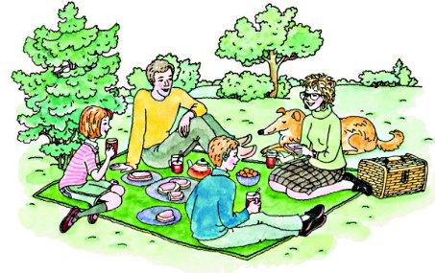
Richard and Margaret Baker’s Family :

Slide 54
Richard Baker’s Family Story
1)Richard Barker ‘s parents are….. (teachers, workers, farmers).
2) Richard spent his childhood on his ….
3)They had many ….
4) Richard helped …..on the farm.
5) He was interested in ....
6)He wanted to know how to ….
7)But he had ... (a computer, a dream, a book of tales)
8) He wanted to become ...
9) When he was 18 (eighteen), he went to...
10) When he was 26, he....
11) They …and had 2 children- a …and a ….
12) They are a very happy….
13) Richard loves his job and ….very much.

Slide 55
Margaret Baker’s Family Story
1)Margaret Barker was born in … (Paris , Blackpool, San Diego) 2)Her father was …. 3)There was ….in Blackpool. 4) Margaret had a talent to.... 5) She could sing … and…. 6) After school she went to…. 7) Soon she became a … 8) In London she met ... 9) He was a ... 10)They loved each other and.... 11) Margaret worked at ….and Richard worked at …. 12) Now they are a very happy ….. 13) They have a son and …. 14) At the weekend they listen …or go …. 15) In summer they like....

Slide 56
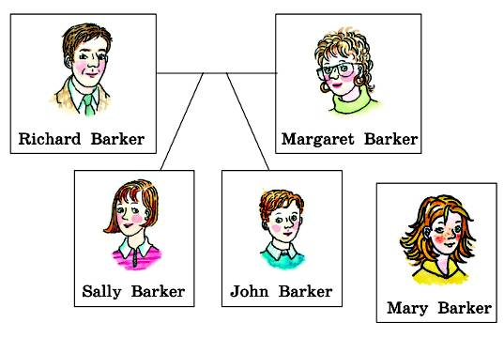
They are a very happy Family

Slide 57
Making self-control, self-assessment of students' own activities during the lesson
There is a self-assessment table in your Activity Sheets. Fill it out , please!
Student's Self-Assessment of the English Lesson\
Cамооценка учащегося на уроке
английского языка
Name: Unit \ topic: Grade:
 | I know the words (Я знаю слова по теме урока) | I can use the words in the sentences (Я умею использовать слова в предложениях) | I can listen and understand English texts (Я умею слушать и понимать английские тексты и выполнять упражнение на понимание их содержания) | I can ask and answer the questions on the topic… (Я умею задавать вопросы по теме раздела и отвечать на них) | I can read and understand texts on the topic… (Я могу читать и понимать тексты по нашей теме) | I can speak on the topic “…..” (Я умею рассказывать о…)
Excellent (Отлично) 5
Well (Хорошо) 4
Not very well (Не очень хорошо) 3
Bad (Плохо) 2

Slide 58

Homework :
Prepare a story on the topic
"My family history.
A page from a personal diary"

Slide 59


Slide 60


