Slide 1
Формирование функциональной грамотности на уроке английского языка на примере упражнения «How to make “right” Valentine Card» Part 1
Подготовила: Кулахметова Наталья Николаевна, преподаватель английского языка БПОУ УР «Радиомеханический техникум им. В.А.Шутова» г. Ижевск, Удмуртская республика

Slide 2

Can we spend a fun Valentine’s Day?
Of course, we can. If we use these tips.
They are from the Net but all of them really work!

Slide 3
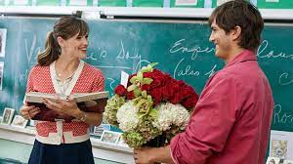
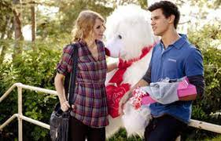
How can we spend a fun Valentine’s Day?
Choose a favorite series or romantic movie and spend the day like its characters:

Slide 4
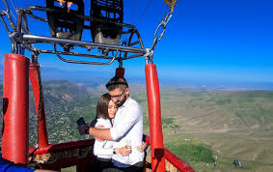
How can we spend a fun Valentine’s Day?
You may prepare a surprise trip. How? Where to? You will decide…

Slide 5
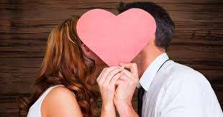
How can we spend a fun Valentine’s Day?
Arrange Challenges for your couple.

Slide 6
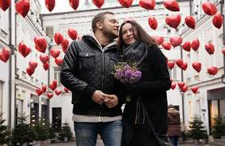
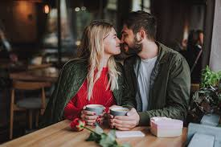
How can we spend a fun Valentine’s Day?
Ask her out on the first date.

Slide 7
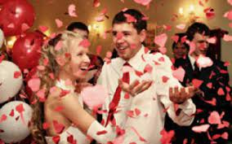
How can we spend a fun Valentine’s Day?
Organize a party for single friends.

Slide 8

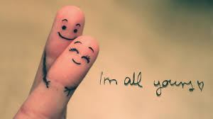
How can we spend a fun Valentine’s Day?
Declaration of love in a foreign language!

