Slide 1


Slide 2
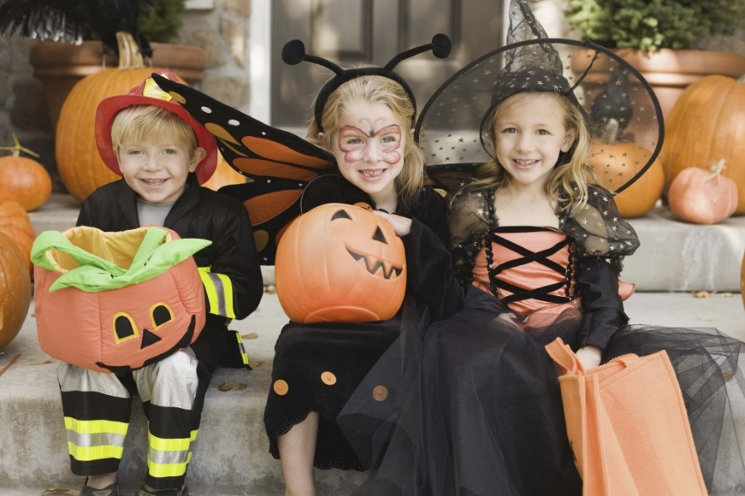
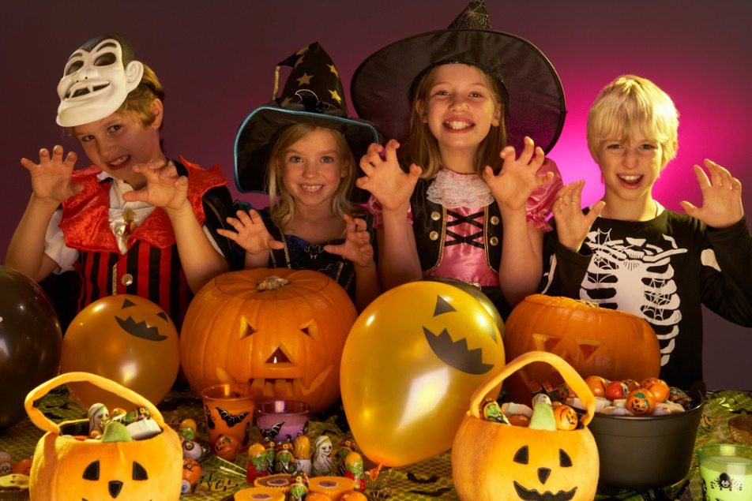
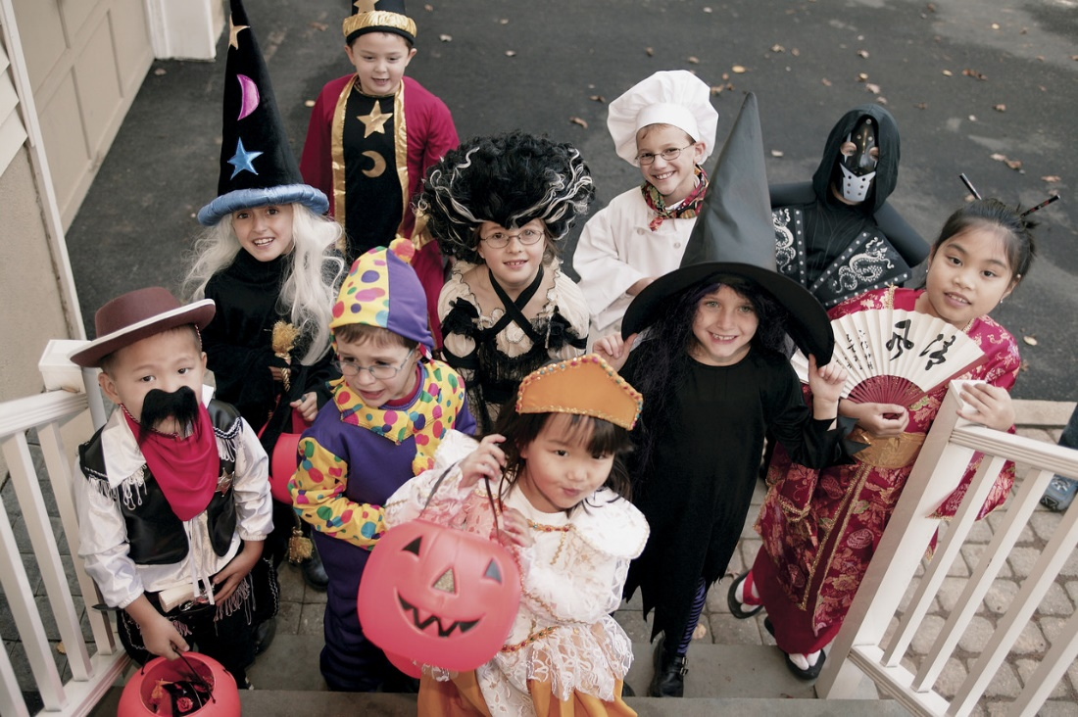
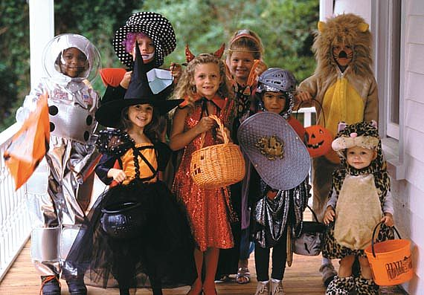

Slide 3

Halloween Spirit

Slide 4
-revise Past Simple
- learn new words describing emotions and feelings
(? Did)

Slide 5
I feel ……. when
I work for a long time.
I feel ……. when
I’m on holiday.
I feel ……. when
I have nothing to do.
I feel …….when
I’m alone in the dark.
I feel……..when
I don’t understand something.
I feel………. when
I fight with best friend.
I feel……….. when
I’m late for a lesson.
I feel…….on Halloween.
.

Slide 6
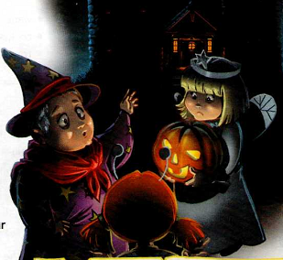
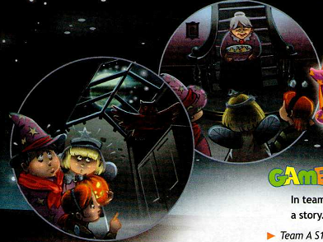
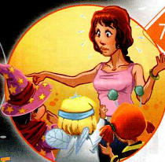
the children look
the children look
the old woman looks
the woman looks
In the first picture,
In the second picture,
In the third picture,
In the fourth picture,

Slide 7
Match the words
scared
worried
bored
tired
puzzled
miserable
excited
stressed
a) уставший
b) несчастный
c) обеспокоенный
d) испуганный
e) напряженный
f) скучающий
g) восхищенный
h) озадаченный

Slide 8
 |  |  |  |  |  | ³
 |  |  |  | ² |  |  |  | ⁶ |  | ⁷
 |  | ⁴
 |  | ⁵
По горизонтали: | По вертикали:
1. несчастный 2. напряженный 4. уставший 5. обеспокойный | 3. скучающий 6. испуганный 7. восхищенный

Slide 9
¹m | i | s | e | r | a | ³b | l | e
 |  |  |  |  |  | o
 |  |  |  | ²s | t | r | e | ⁶s | s | ⁷e | d
 |  |  |  |  |  | e |  | c |  | x
 |  | ⁴t | i | r | e | d |  | a |  | c
 |  |  |  |  |  |  |  | r |  | i
 |  |  |  |  |  |  |  | e |  | t
 |  | ⁵w | o | r | r | i | e | d |  | e
 |  |  |  |  |  |  |  |  |  | d
По горизонтали: | По вертикали:
1. несчастный 2. напряженный 4. уставший 5. обеспокойный | 3. скучающий 6. испуганный 7. восхищенный

Slide 10


Slide 11
It was Halloween night so my brothers and I decided to go trick or treating. We were very excited.
By the time we got to the last house in the street, it was very late and we were tired. The house looked empty, but we knocked anyway. The door opened on its own.
Although we were scared, we decided to go in and
have a look. Suddenly, we heard a loud noise and a
huge creature jumped out in front of us.
“Don’t be afraid, it’s just an owl,” said a voice from behind us.
We turned around and saw an old lady at the bottom of the stairs. She rushed over and introduced herself.
“Hello, I’m Mrs Shade. Let me give you some treats,
you naughty little ghosts!”
When we finally got home, our Mum was very worried.
“Where were you?” she shouted, the moment we
walked in.
“Don’t worry mum. We were at Mrs Shade’s house,
you know the big one at the end of the street. She gave
us treats and…”
Mum looked puzzled. “What on earth are you talking about?” she said. “Mrs Shade died ten years ago!”
knocked - постучали
huge - огромный
creature - создание
rush – помчаться
owl - сова
introduce - представиться
naughty - непослушный
ghost - привидение
what on earth…? – что же такое…?
die- умирать

Slide 12
Mark the sentences
T (true), F (false) or DS (doesn’t say).
The children’s costumes were scary.
2. There was an owl in the house.
3. The old lady offered the children some treats.
Mum believed the children’s story.
DS
T
T
F

Slide 13
-Past Simple
(? Did)
Ved / V2

Slide 14
1. She (say) that Mrs. Shade (die) ten years ago.
2. The children (go) trick or treating.
3. It (be) Halloween night.
4. They (see) an old lady at the stairs.
5. They (get) to the dark old house.
6. She (give) them some treats.
7. When they (get) home, Mum (look) puzzled

Slide 15
said[sed]
say [sei] -
die-
go-
be-
see[si:] -
get-
give -
look-
died
went
was
saw[sɔ:]
got
gave[geiv]
looked

Slide 16
1. It was Halloween night.
2. The children went trick or treating.
3. They got to the dark old house.
4. They saw an old lady at the stairs.
5. She gave them some treats.
6. When they got home, Mum looked puzzled.
7. She said that Mrs. Shade died ten years ago

Slide 17
1. ….. was ……
2……… went ……...
3. ……. got …………….
4. …… saw ………..
5. …… gave........
6. ….. got ….., ….. looked …....
7. ….. said ………died ………

Slide 18
new words describing emotions and feelings
learnt…
revised….
known….
During our lesson
we have
Past Simple
some irregular verbs

Slide 19
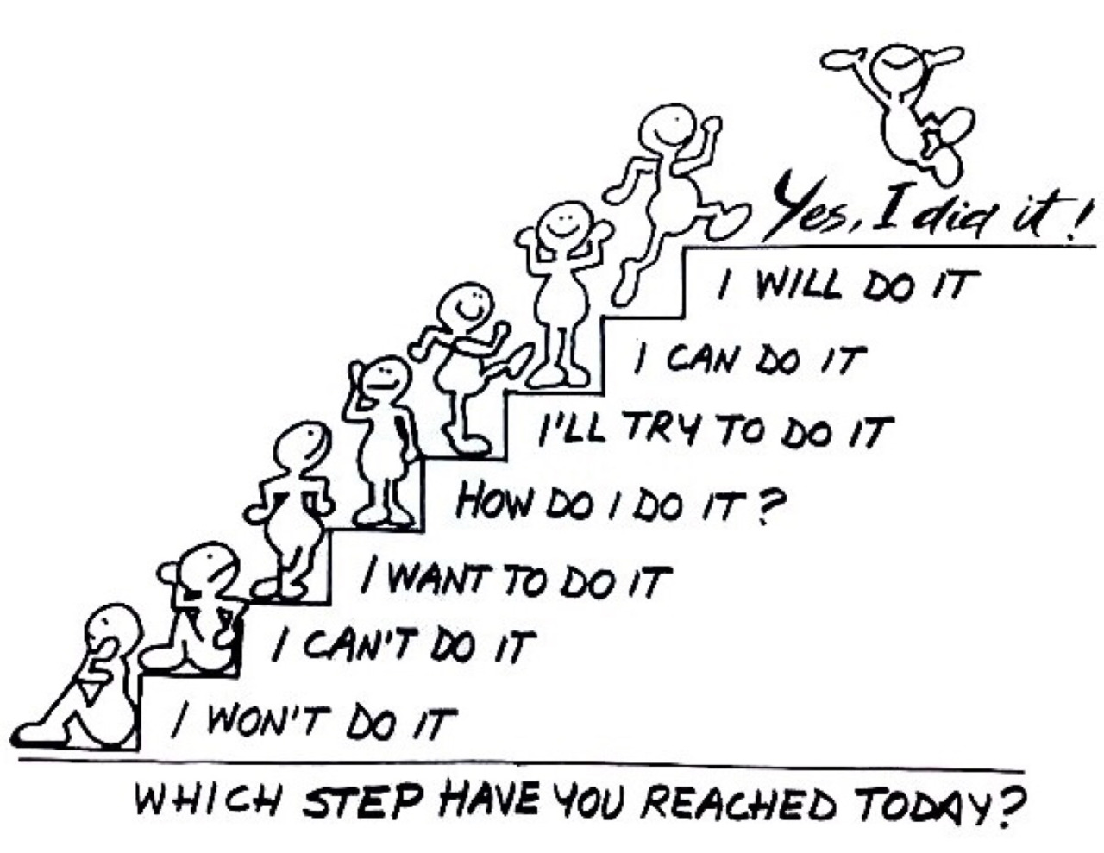
What was difficult for you to do?
What was the most interesting?
What didn’t you know
but can do now?
Was the lesson successful?
Why do you thing so?

Slide 20
Hometask:
p.68 ex. 2

Slide 21
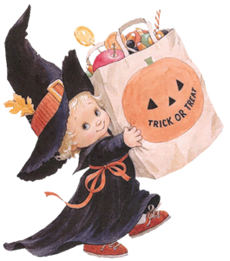
Thank you for the lesson.
Good-bye!
Have a nice day!

