Slide 1
I like snails
English teachers :
Ivendikova Natalia,
Cherkasova Vera

Slide 2
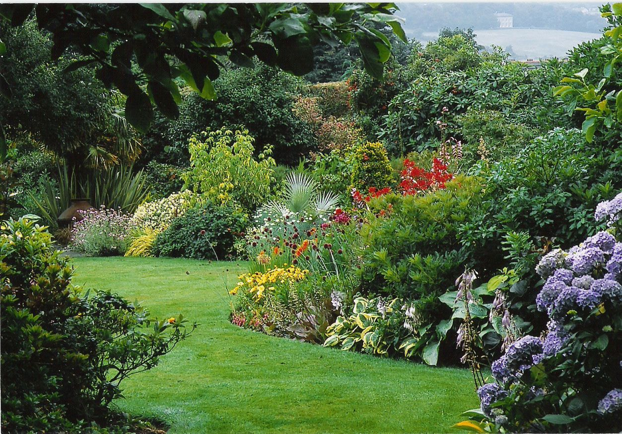
What is it?
It`s a garden.

Slide 3
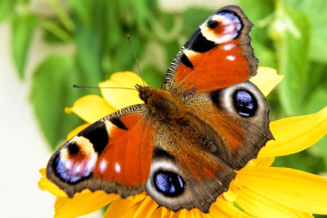

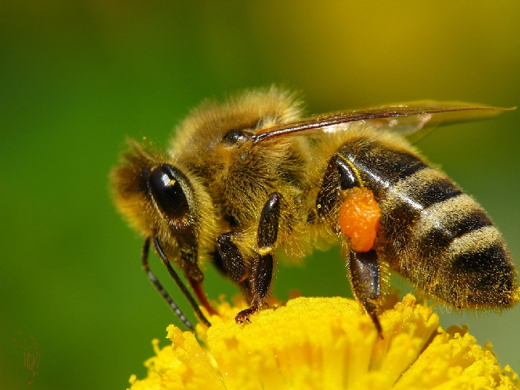
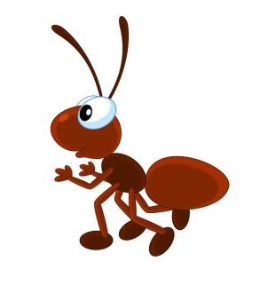
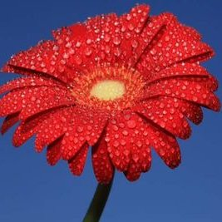
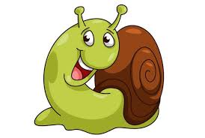
It`s a garden.

Slide 4
What is it?
It`s a tree.

Slide 5
What is it?
It`s a flower.

Slide 6
It`s a bee.

Slide 7
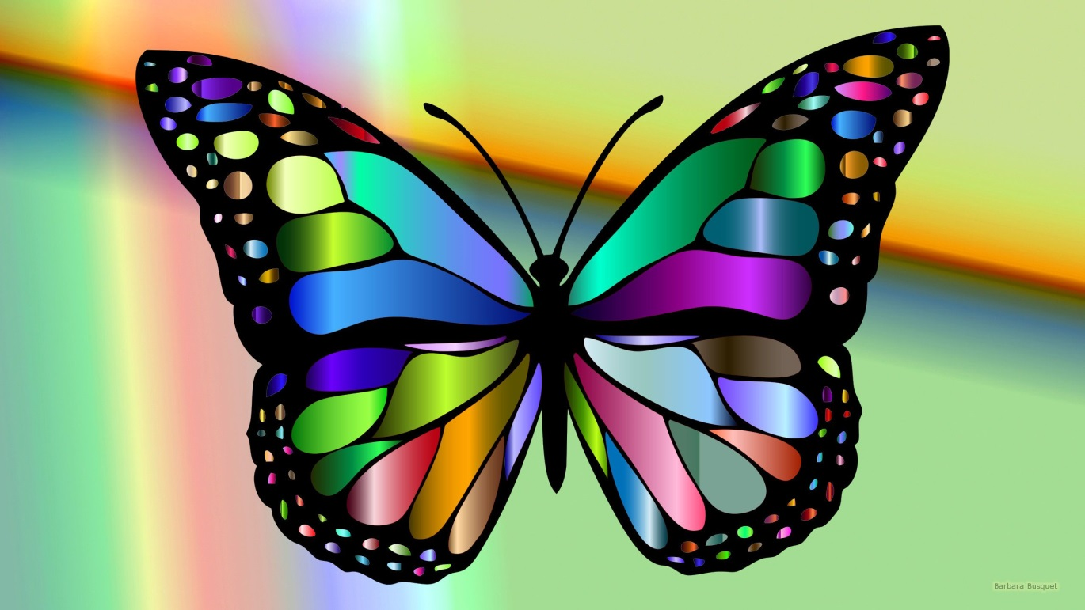
It`s a butterfly.

Slide 8
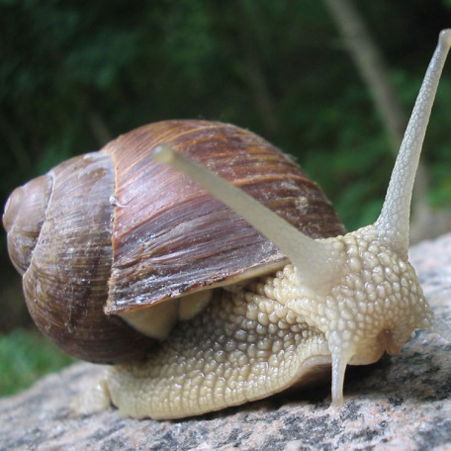
It`s a snail.

Slide 9
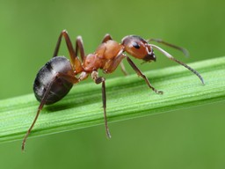
It`s an ant.

Slide 10
GAME “What animal do you like?”

Slide 11
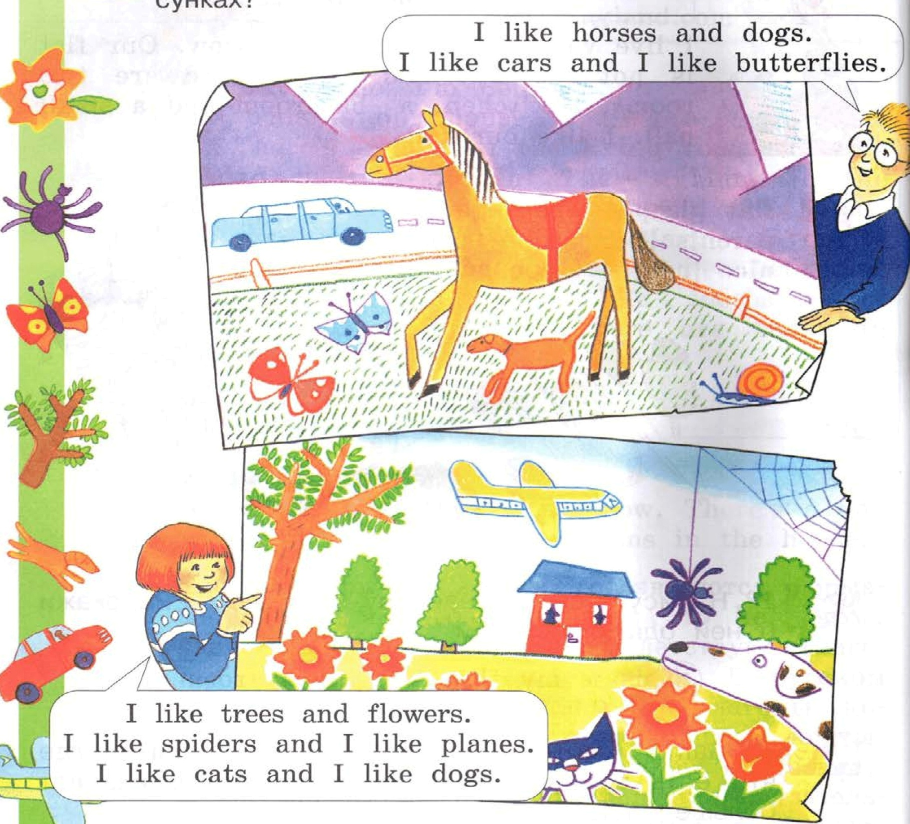

Slide 12
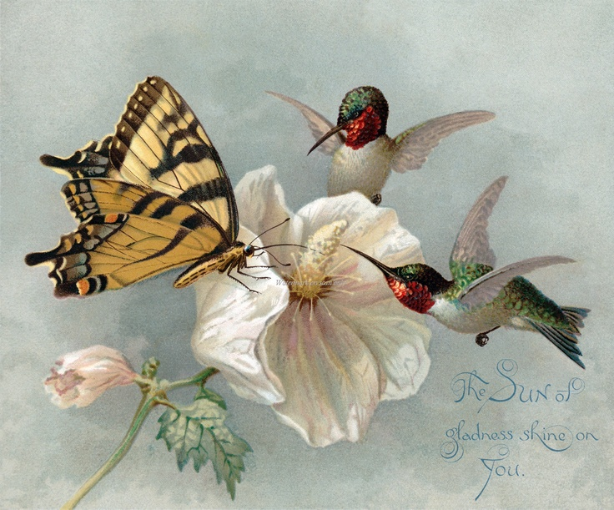
There’s a butterfly.

Slide 13
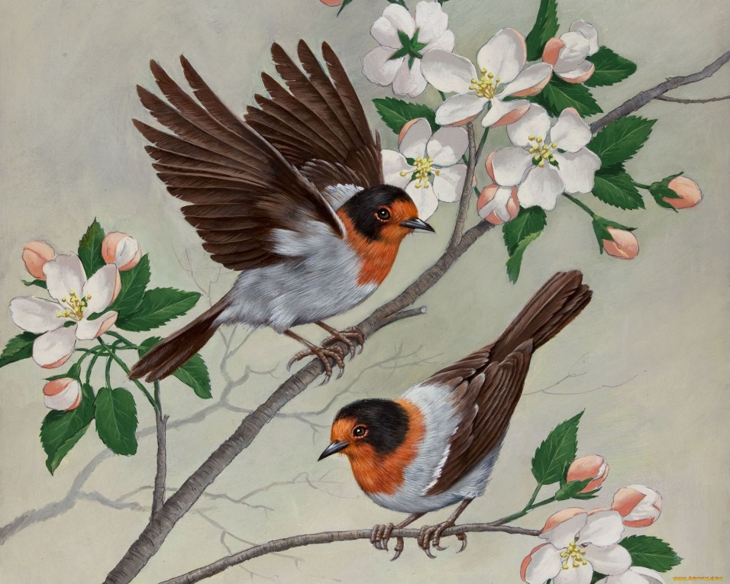
There isn’t a butterfly.

Slide 14
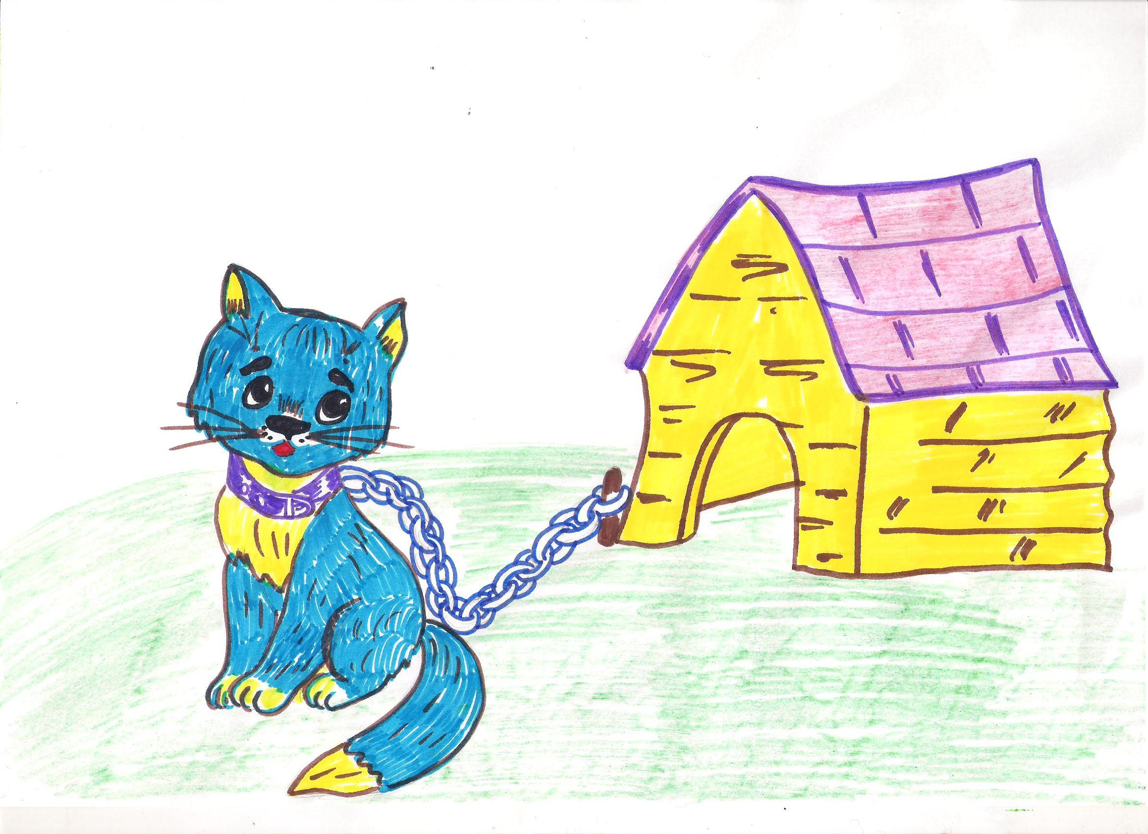
It’s a dog.
No, it isn’t.
It’s a cat.

Slide 15
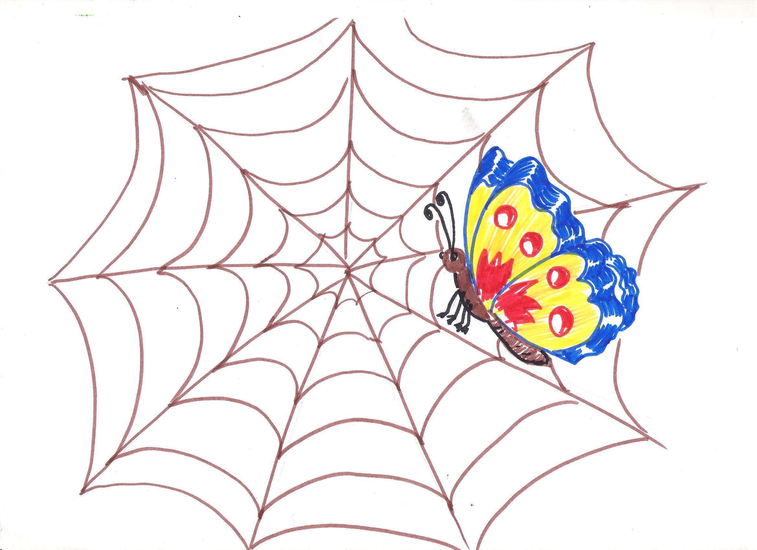
It’s a spider .
No, it isn’t.
It’s a butterfly .

Slide 16
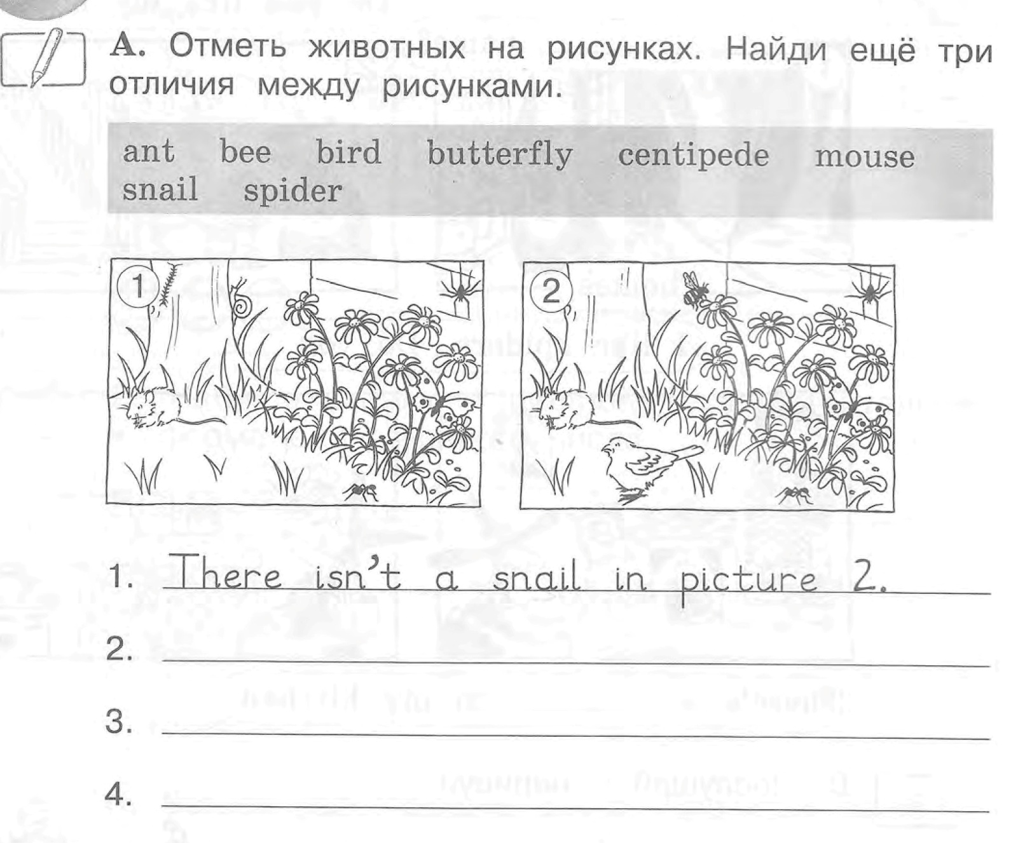
Homework:

