Slide 1

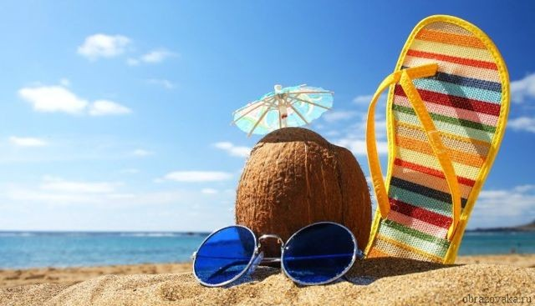



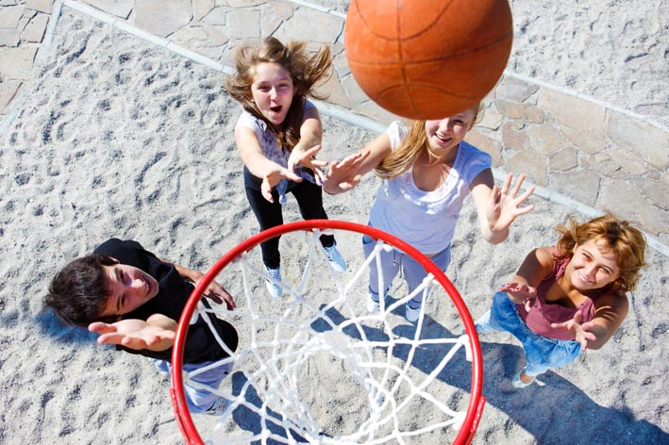
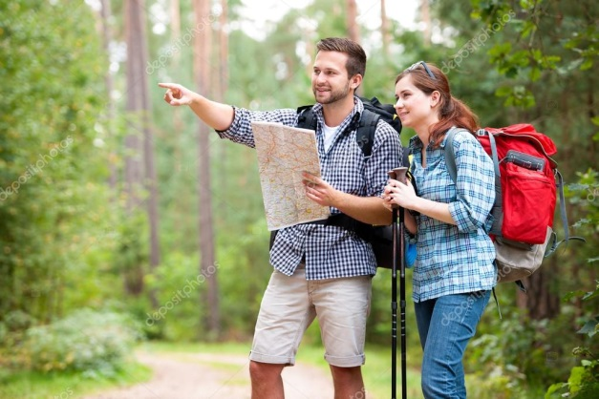
“Business before pleasure”

Slide 2
clubbing
free time
books
friends
Leisure of youth
park
hobby
camping
movies

Slide 3
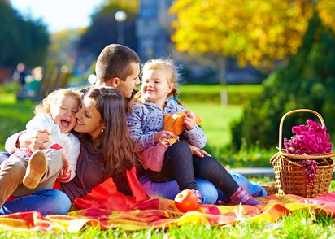
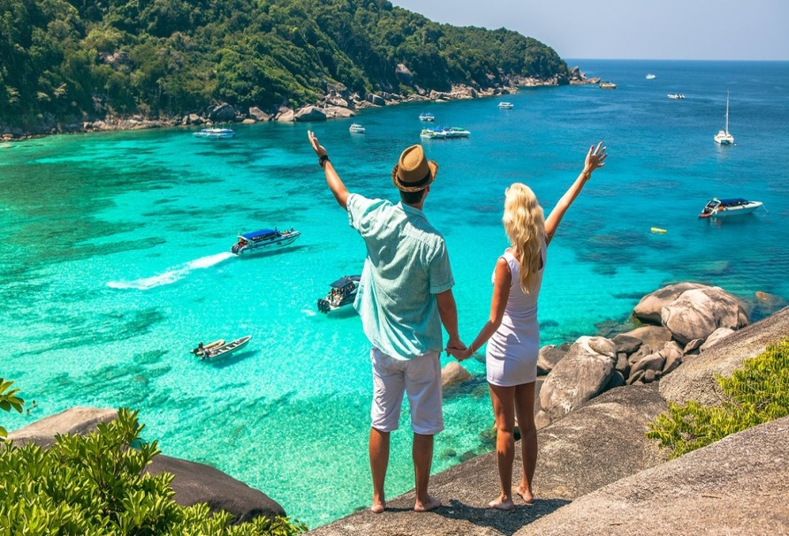
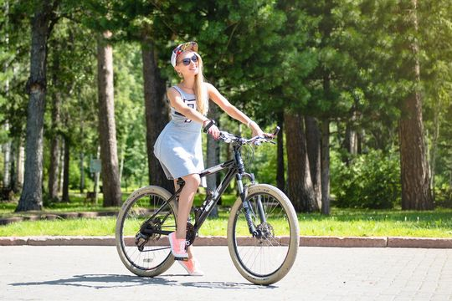
• where and when the photo was taken
• what/who is in the photo
• what is happening
• why you decided to show the picture to your friend

Slide 4

How do you spend your leisure time?
Play out the dialogue in pairs.

Slide 5
They are engaged in sport __________,
literature, scientific and music societies.
American ________ people also like
to ___________________with each other
and spend a lot of time ___________.

Slide 6
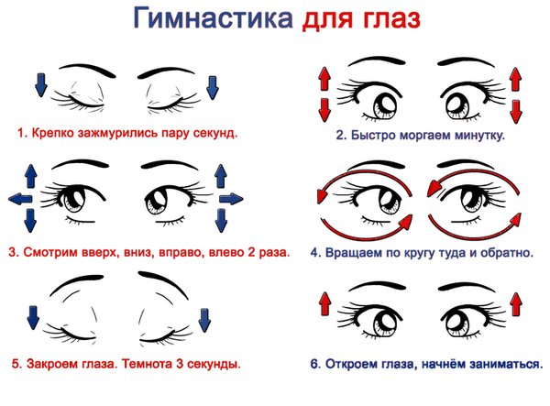
Close your eyes, open your eyes, look up, look down,
look ahead, look to the left, look to the right,
and turn your eyes round.

Slide 7
Test
https://drive.google.com/open?id=1Ctv2RBObNYzX8a53ZNPvlKoSNHIVlQ5JuuZrL78FVFo

Slide 8
Did you like the lesson today?

Slide 9
