Slide 1
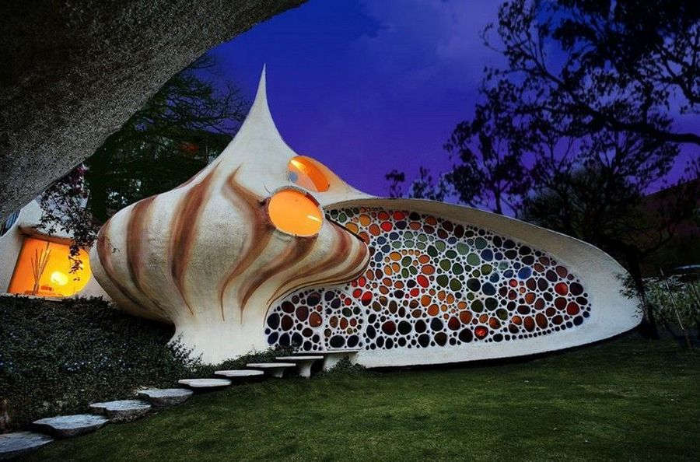
The Nautilus House

Slide 2

What unusual things can you find in the Nautilus house?
Listen and find out the information
p.27

Slide 3
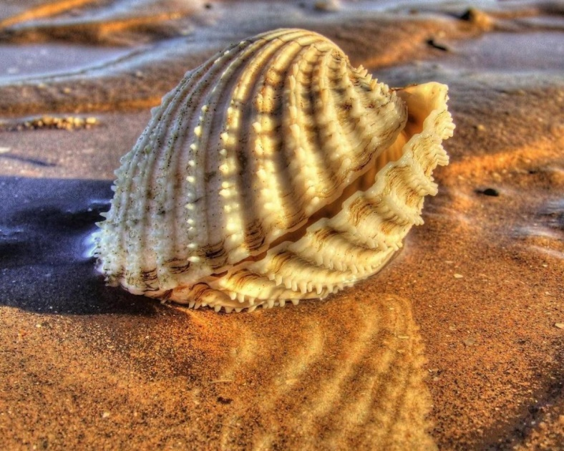
Phonetic activities
She sells sea shells
On the sea shore.
The shells she sells are seashells. I’m sure.

Slide 4
Shape
Seashell
Spiral staircase
Grass carpet
Stream
View
Earthquake-proof
Friendly to the environment

Slide 5
saesehll
seashell
sahep
shape
siparl scasetair
spiral staircase
garss cartep
grass carpet
seamrt
stream
vwie
view
friendly to the environment
firenlyd to the evinrontenm
quakeearth-poorf
earthquake-proof

Slide 6
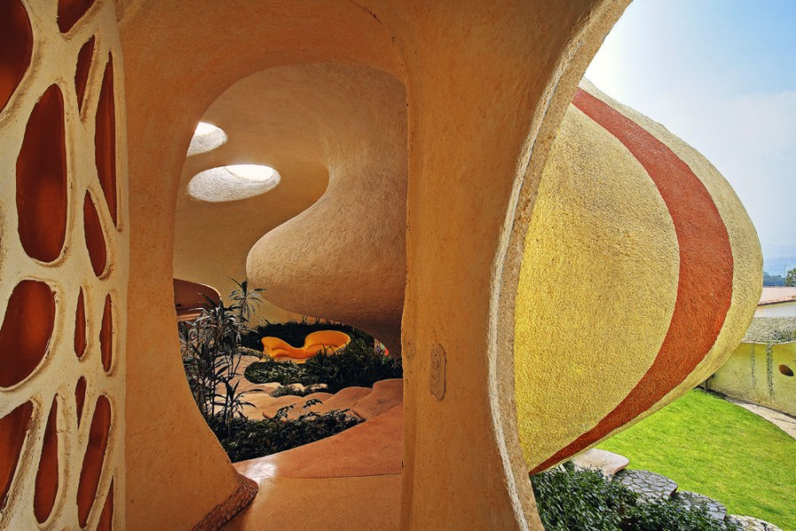
What do you think it is like living in a shell?

Slide 7
Imagine you are living in a shell
Shape
Seashell
Spiral staircase
Grass carpet
Stream
View
Earthquake-proof
Friendly to the environment

Slide 8
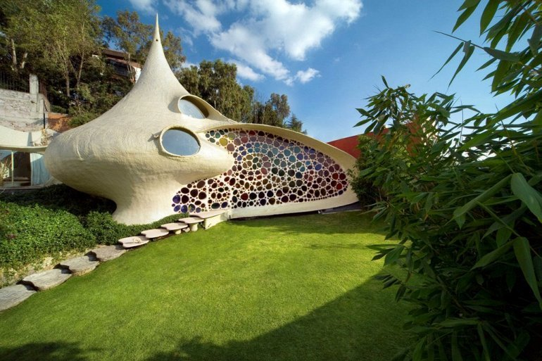
What do you like in the houses? Why?

Slide 9
What’s the title of the lesson?
What interesting did you find about the house?
What was difficult to do?

Slide 10
Home task
Compare your house to the Nautilus House.
Write about: number of rooms, what there is inside the house, garden.
Ex.6 p.27

Slide 11

Thank you

