Slide 1
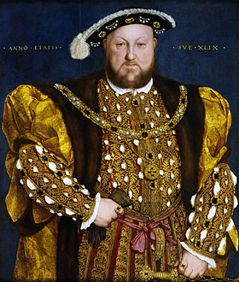
Henry VIII
Выполнила
учитель английского языка
Иванова Наталия Евгеньевна

Slide 2
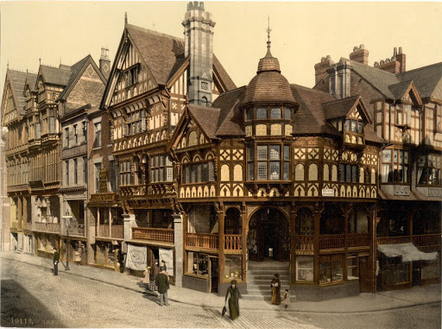
Henry VIII is best known for his direct participation in the English Reformation, which made England, for the most part, a Protestant nation.

Slide 3
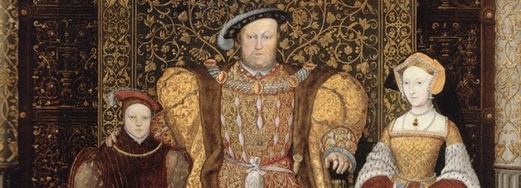
Henry was born on June 28, 1491 in Greenwich. He was the third child of Henry VII and Elizabeth of York.
In 1509, after the death of Henry VII, the Prince of Wales became king at the age of seventeen.
In 1512, Henry VIII, at the head of his fleet, sailed for the first time to the shores of France on the flagship ‘Mary Rose’, where he won the battle near Brest.
In 1513, he marched out of the city of Calais, preparing to make his first overland campaign against the French. He managed to capture only two small towns. In the next twelve years, he fought in France with varying success. In the years 1522-23, Henry approached Paris. But by 1525 the military treasury was empty, and he was forced to conclude a peace treaty.

Slide 4
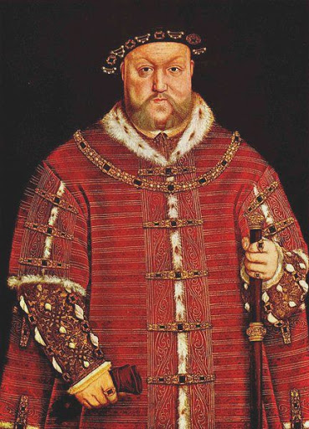
In the second half of his reign, King Henry went on to fight his political opponents. One of his first victims was Edmund de la Paul, Duke of Suffolk. The last of the significant figures executed by King Henry was the son of the Duke of Norfolk, the prominent English poet Henry Howard, Earl of Surrey.

Slide 5
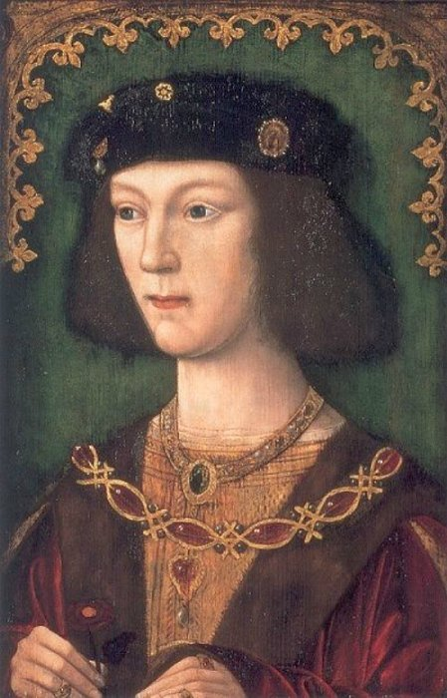
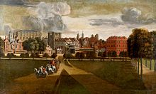
Henry VIII was married six times.
From the first three marriages, he had 10 children, of whom only three survived - the eldest daughter Maria from the first marriage, the youngest daughter Elizabeth from the second, and son Edward from the third. All of them subsequently ruled. The last three marriages of Henry were childless.

Slide 6
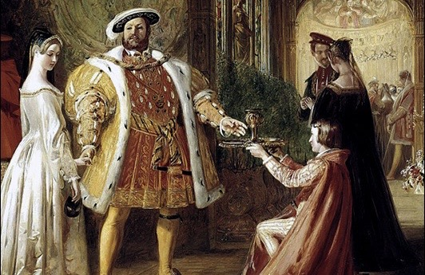
In the last years of his life, Henry began to suffer from obesity. The king could only move with the help of special mechanisms. Towards the end of his life, Henry's body was covered with painful tumors.
Death overtook Henry VIII at the age of 55, on January 28, 1547 in the Whitehall Palace. The king’s last words were: “Monks! Monks! Monks! ”

Slide 7
