Slide 1

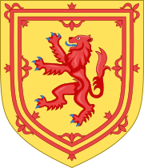
Scotland
Выполнила
учитель английского языка
Иванова Наталия Евгеньевна

Slide 2
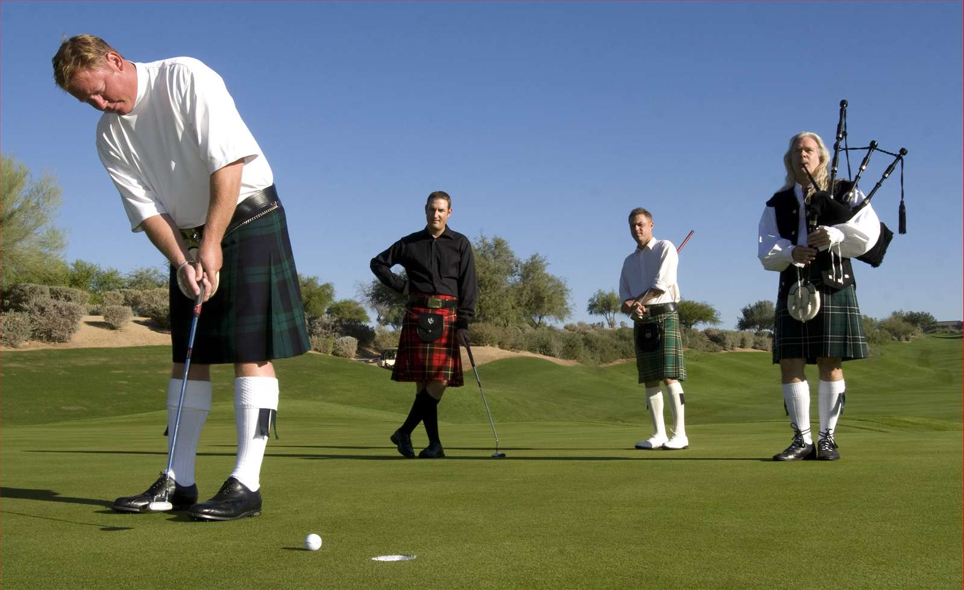
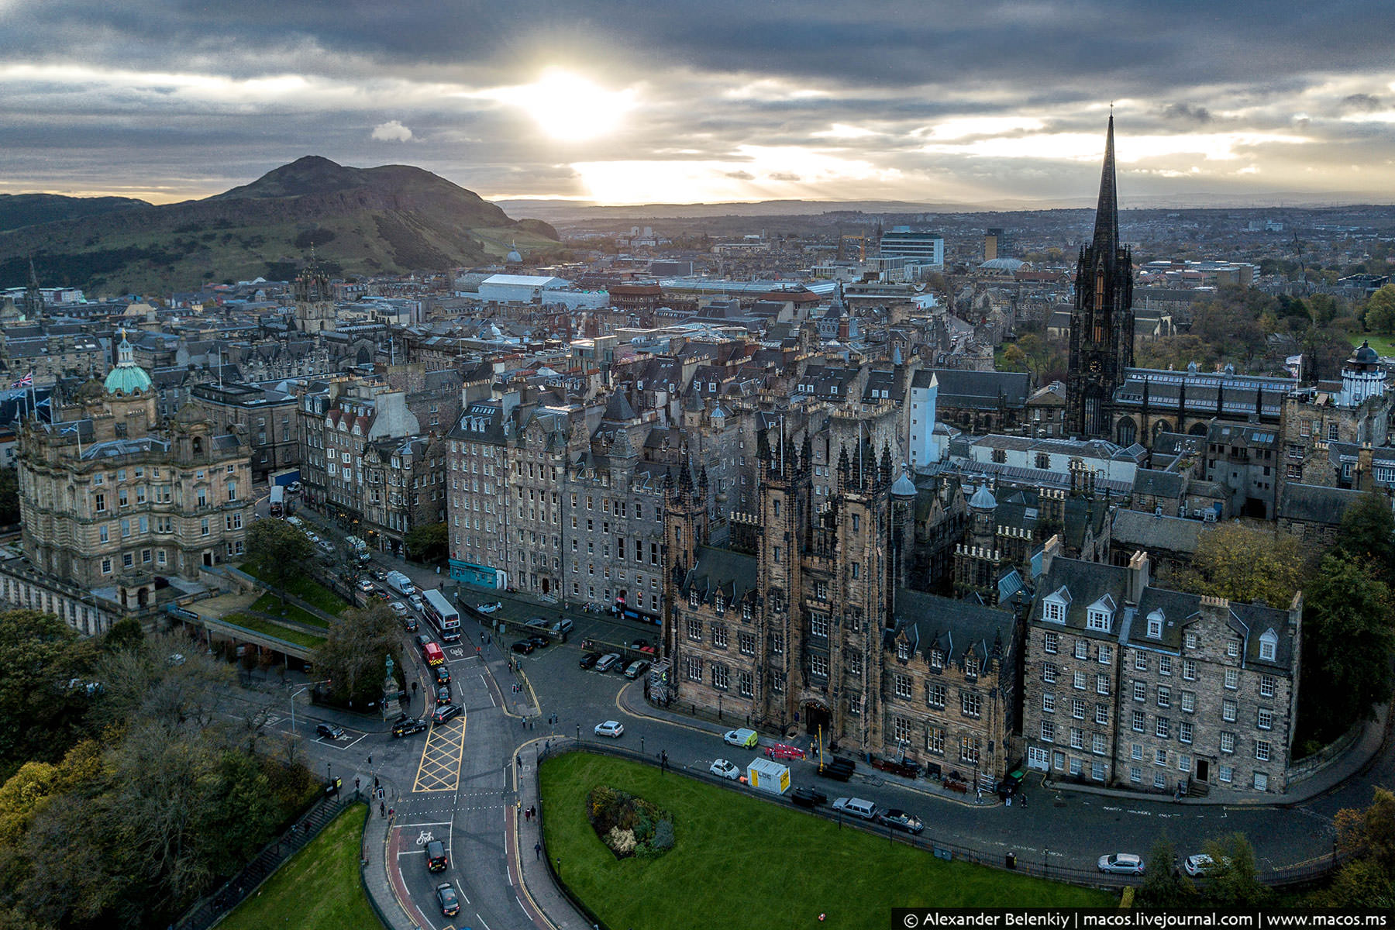
Scotland is the northernmost country in the United Kingdom of Great Britain and Northern Ireland. Scotland has a population of 5 million people. The biggest cities in the country are Edinburgh and Glasgow. Scotland is the home of golf. The first games in this sport took place on the Old Cors field in St. Andrus in the 15th century.

Slide 3
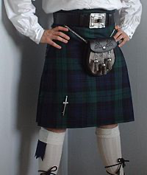
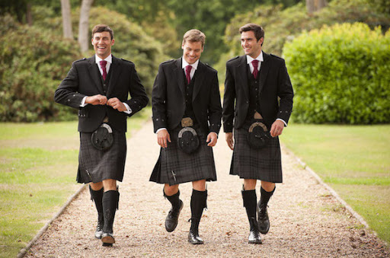
The Scottish national costume is a traditional men's costume, the main distinguishing feature of which is a small kilt - a men's skirt with large folds at the back of the knee, sewn from a checked woollen fabric - tartan.

Slide 4
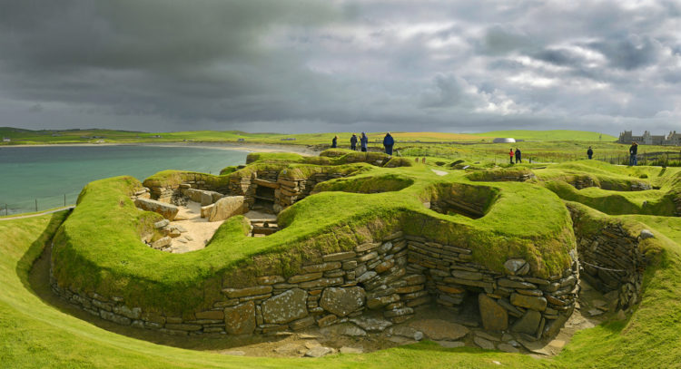
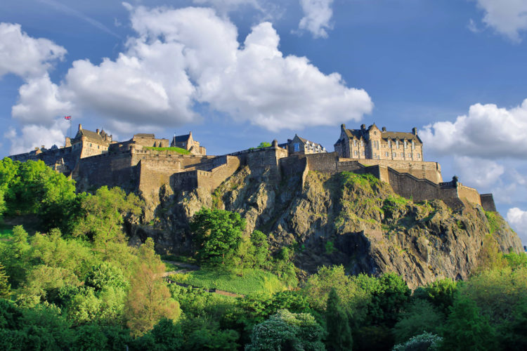
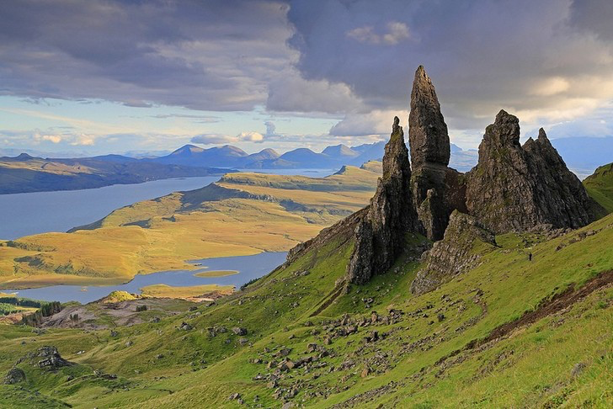
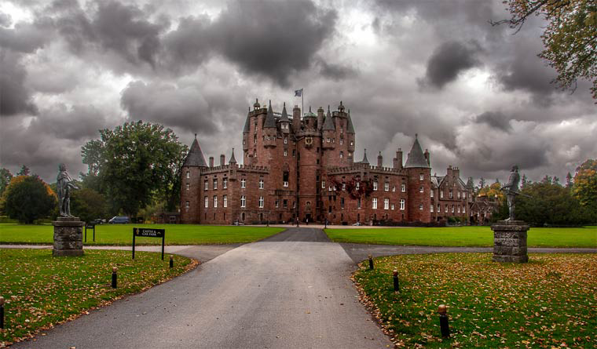
The Sights of Scotland

Slide 5
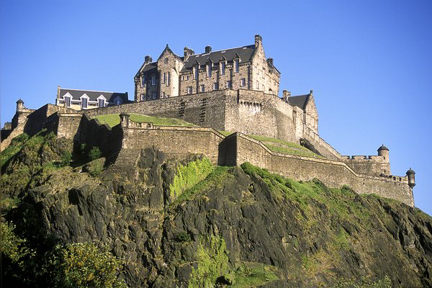
Edinburgh castle
This is the main attraction of Scotland. The main value of the fortress is represented by a source of drinking water. It is protected by the Well Tower in the Middle Courtyard.

Slide 6
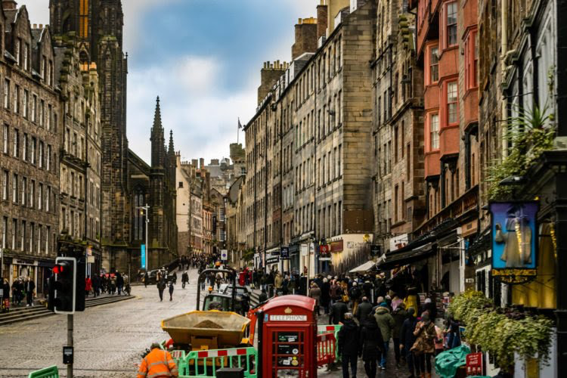
Royal Mile in Edinburgh
This attraction of Scotland is a few streets passing in the very centre of the city. Their total length is approximately one Scottish mile, and the famous Edinburgh Castle and Holyrood Palace connect the streets.

Slide 7
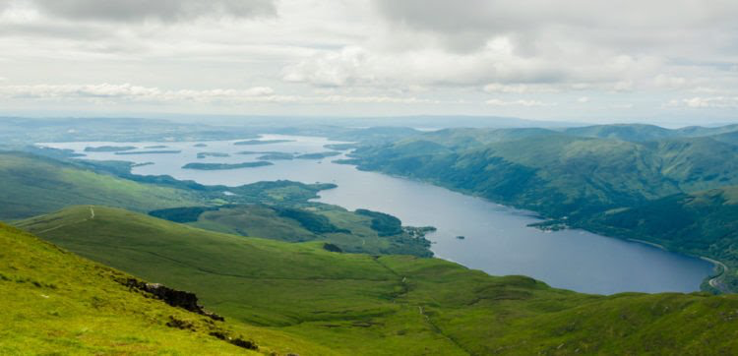
Loch Lomond Lake
This Scotland landmark is surrounded by hundreds of steep hills, medieval castles. The lake is 24 miles long with a large number of islands. The smallest of them periodically disappear during high tides. Hardworking Scottish people live on large ones for many years.

Slide 8
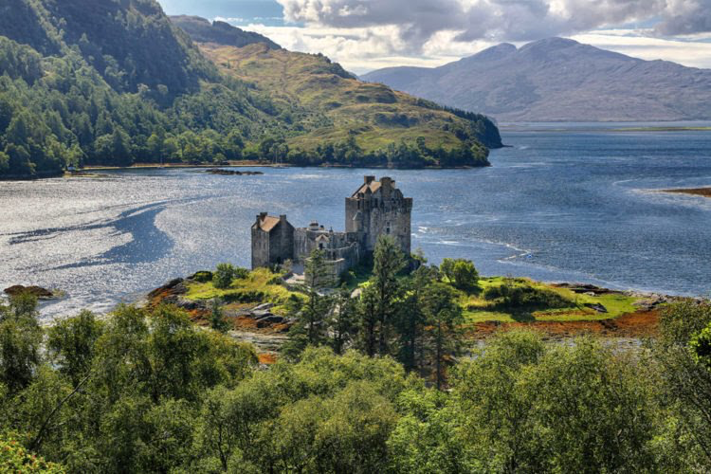
Eilean Donan Castle
This Scotland attraction is located on the Isle of Skye. Getting to it is not easy, but it's worth it. The magnificent building is surrounded by the mountains, and it is situated in the middle of the lake. The castle was repeatedly used as a film set for feature films that have gained worldwide popularity.

Slide 9
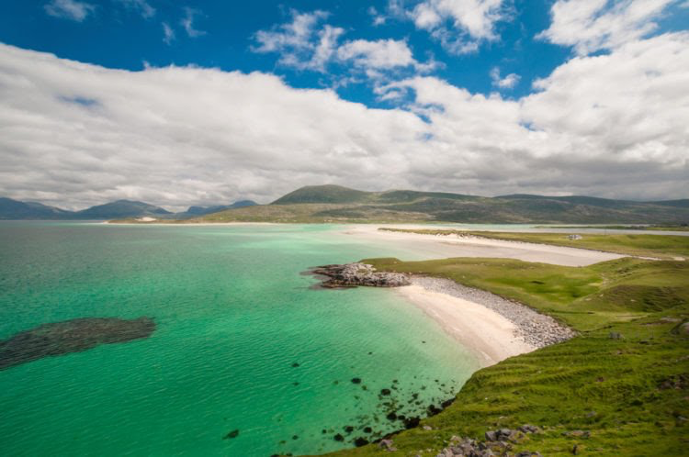
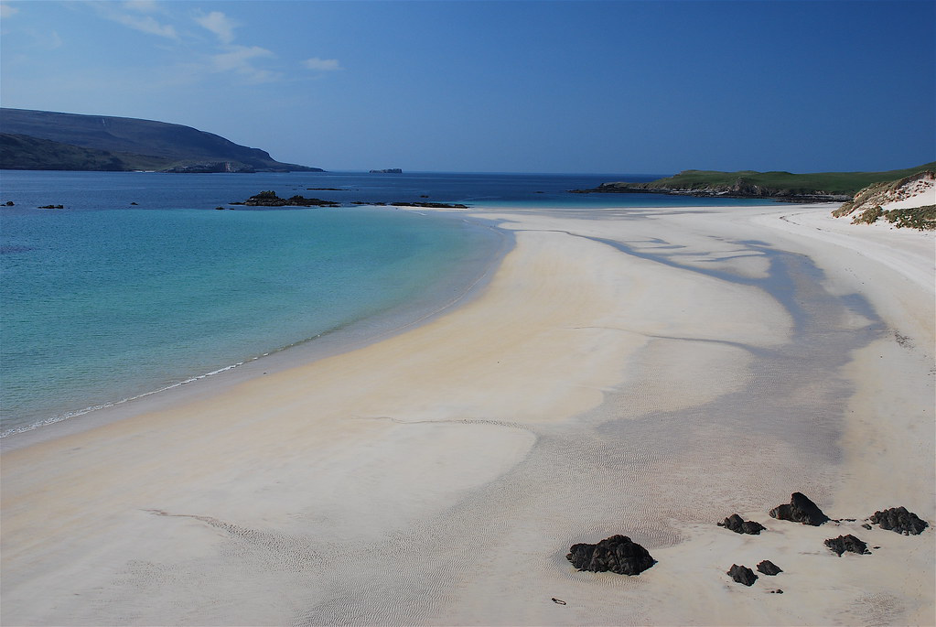
Luskentyre Beach
Its main feature is that with proper lighting, the water near the shore becomes like the Bahamas. The sand has the appearance of talcum powder. During low tide, the bay transforms into a gigantic beach. The picture is perfectly complemented by low desert mountains.

Slide 10
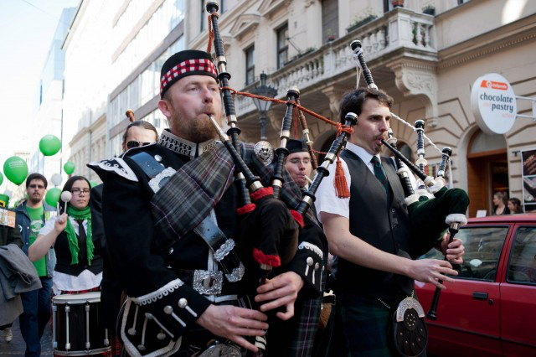
Thank you for your attention!

