Slide 1

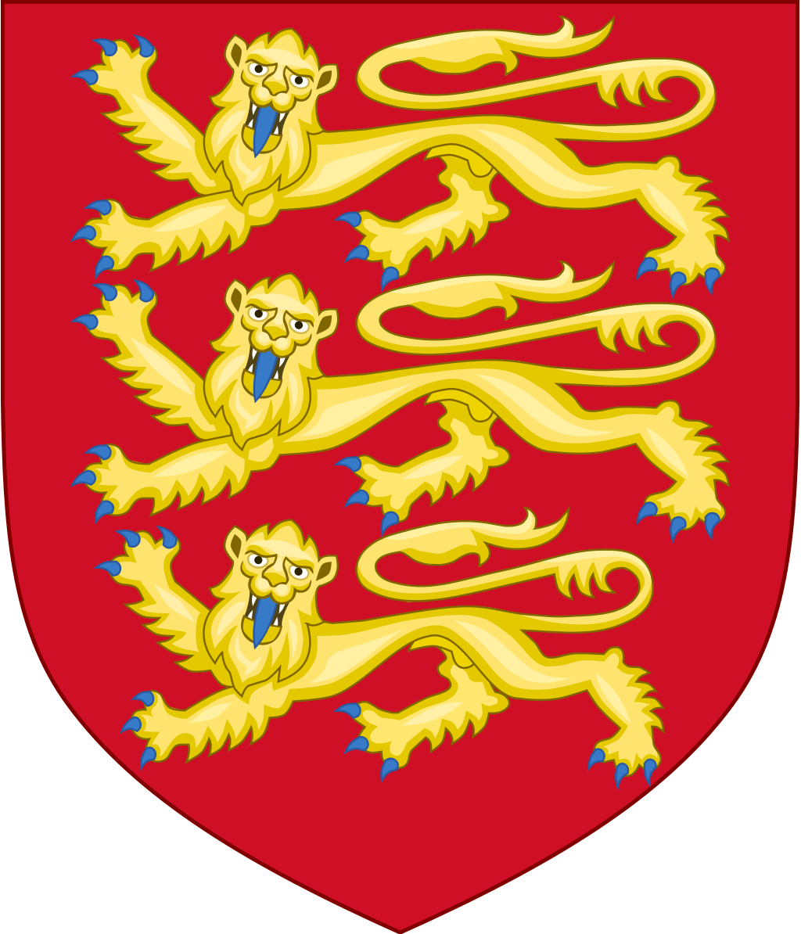
England
Выполнила
учитель английского языка
Иванова Наталия Евгеньевна

Slide 2
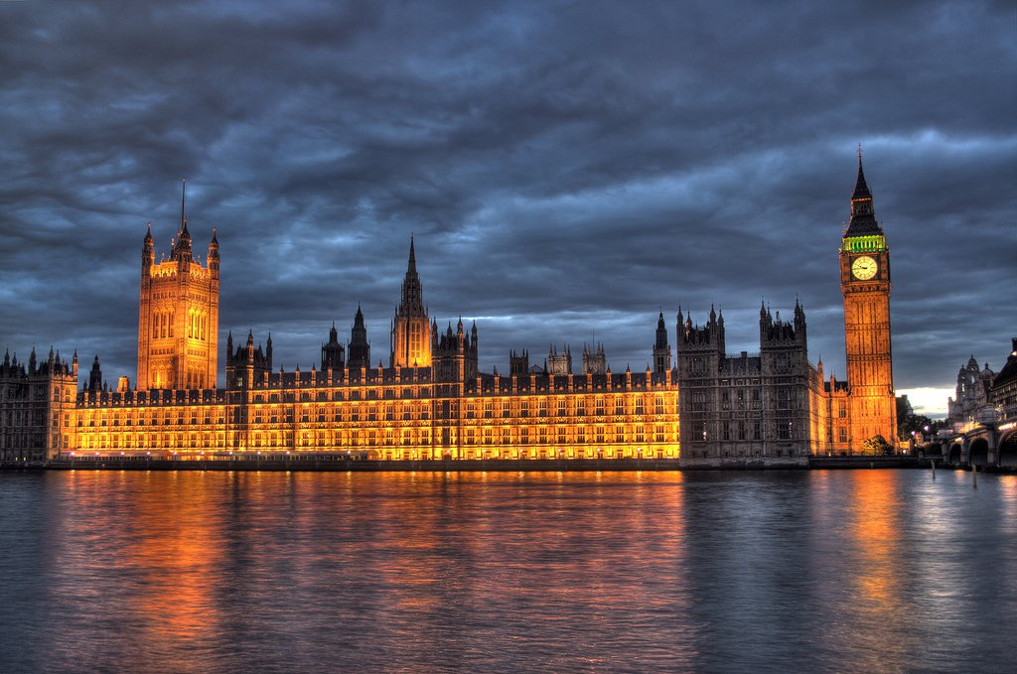
England is the largest administrative and political part of the United Kingdom of Great Britain and Northern Ireland. England's population is 84% ​​of the total UK population. The capital is London, the largest city in the United Kingdom.

Slide 3
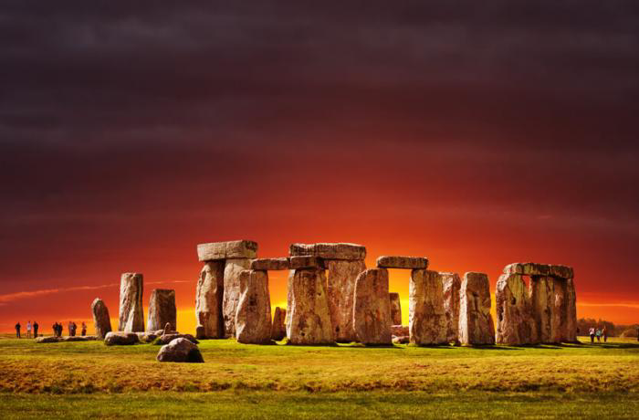
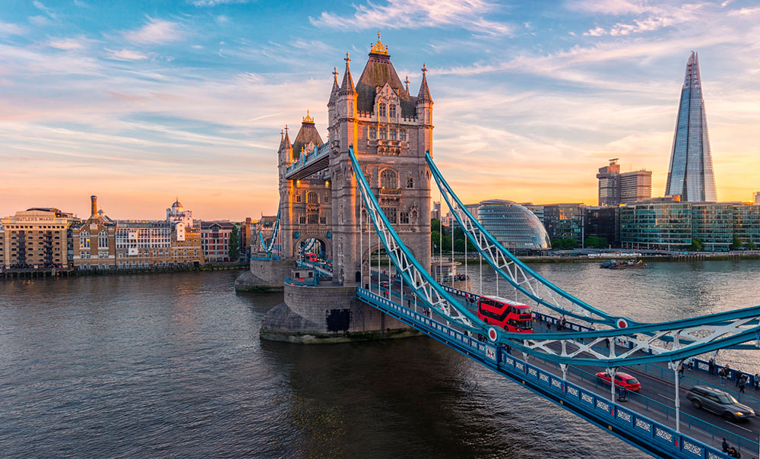
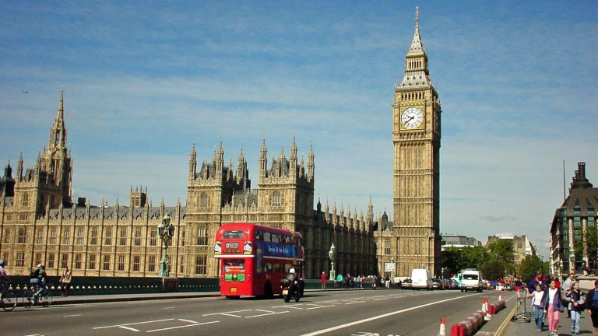
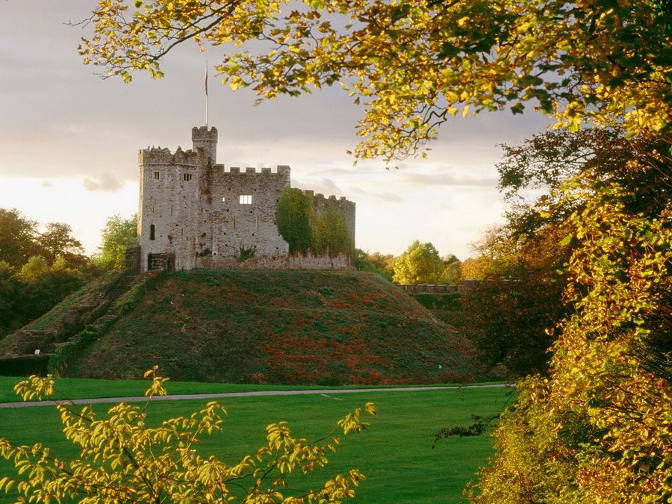
English sights

Slide 4
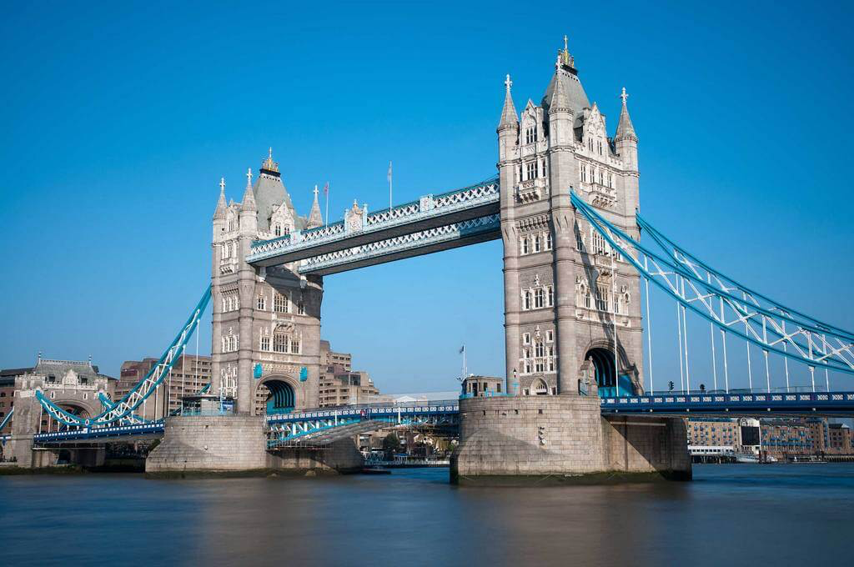
Tower Bridge
The total length of the bridge is 244 meters. The height of the towers is 65 meters. At a height of 44 meters there is a gallery between the towers, it is used as an observation and museum platform. There are lifting wings between the towers. They are bred about 4-5 times a week.

Slide 5
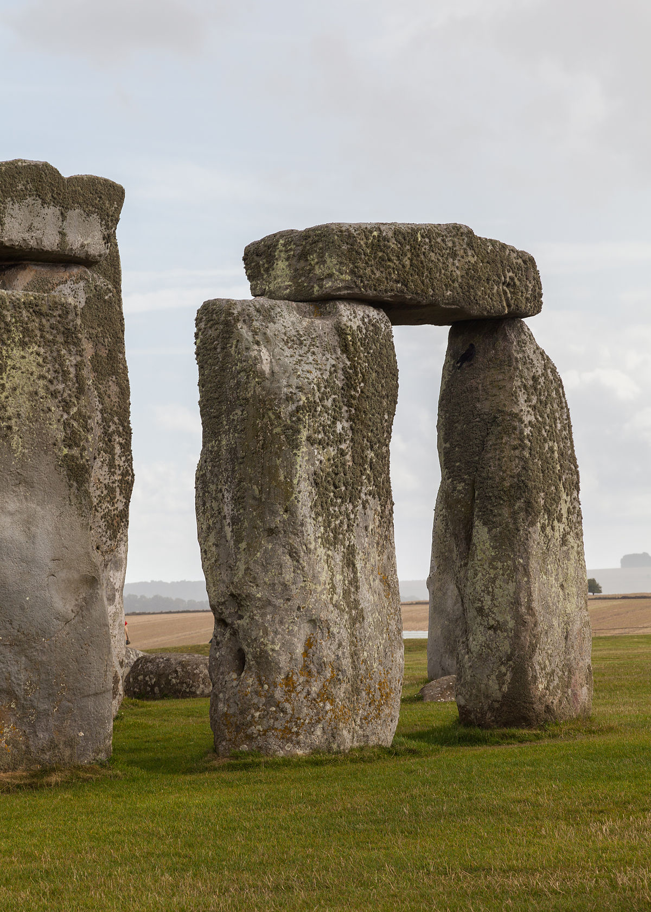
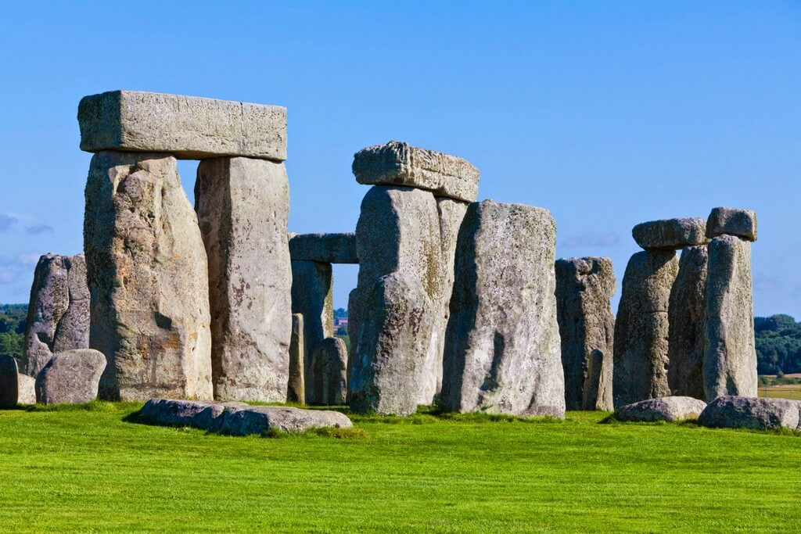
Stonehenge
This archaeological site is considered to be one of the most mystical in the world. It consists of stone blocks weighing up to 45 tons, arranged in rings or in the form of a horseshoe. The facility is protected by UNESCO.

Slide 6
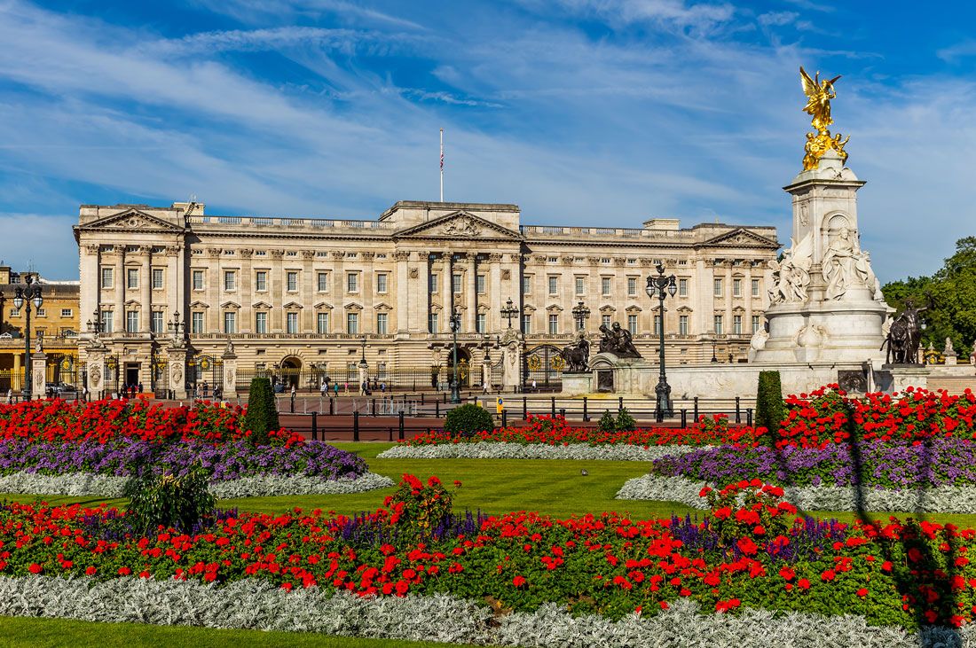
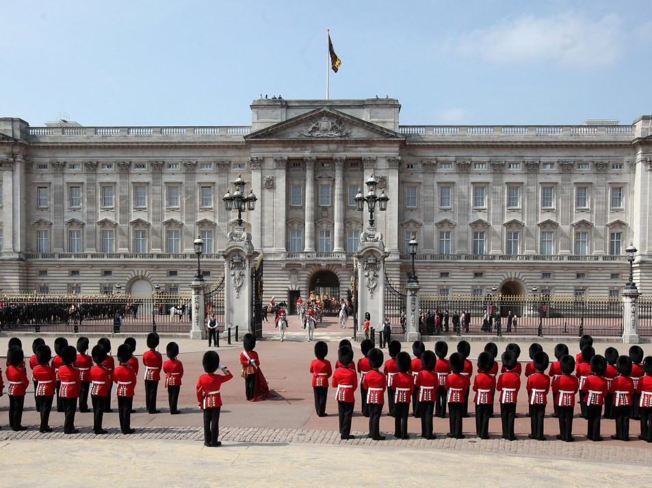
Buckingham Palace
It is a residence of the British monarchs. For visitors, the inspection is available only two months a year during the Queen's vacation - in August and September. 19 of 775 rooms of the castle are offered for inspection, including the throne room, the art gallery, the ballroom. There is an interesting royal garden with flamingos which live near the lake and waterfalls.

Slide 7
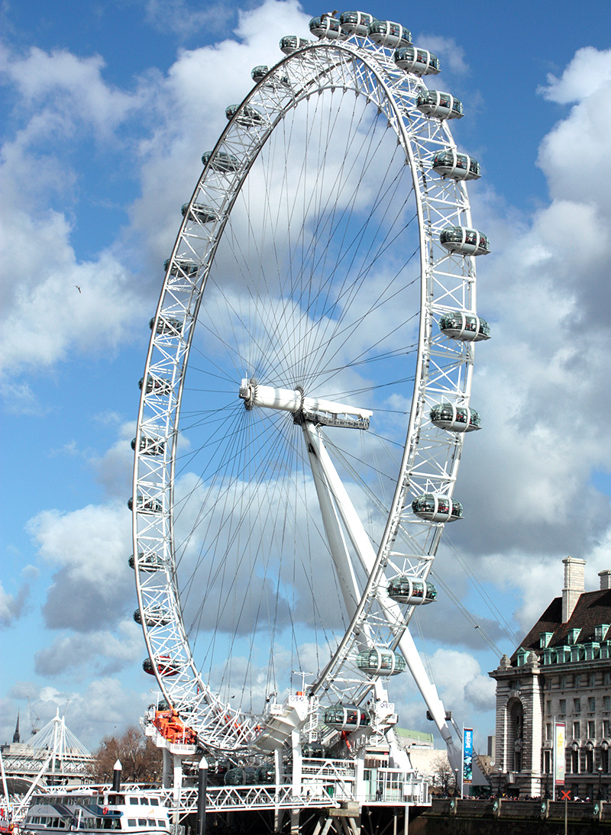
The London Eye
The London Eye is a big wheel on the bank of the River Thames. 32 cabins-capsules symbolise the number of suburbs in London. One cabin can accommodate up to 25 people. The height of the attraction is 135 meters. The overview from its top reaches 40 km in clear weather. One full turn takes about 30 minutes.

Slide 8
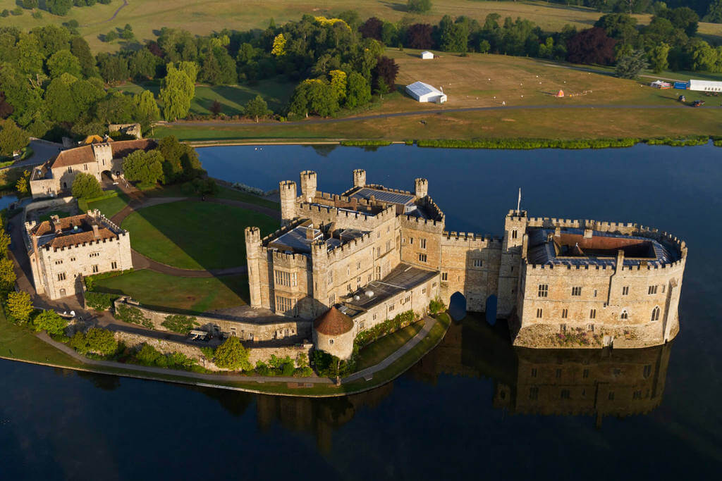
Leeds Castle
It is located on the islands of the Len River. During the wartime it could hold a siege for a long time due to its location. It was the residence of the kings of England for a long time. Currently it is popular with tourists as a monument of architecture and history. The interior is recreated in the style of the castle of the XV century. There is an exhibition of art of the XVIII century. There is a great park with exotic birds.

Slide 9
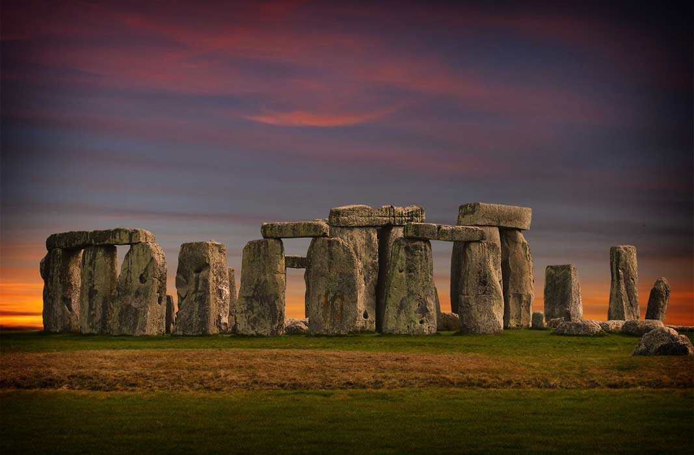
Thank you for your attention!

