Slide 1

Урок-викторина “Who Wants to Be the Champion?” (topic «Sport», 6 класс)
Презентация учителя английского языка ГБОУ Школа №1239 Маккавеевой Е.Е

Slide 2
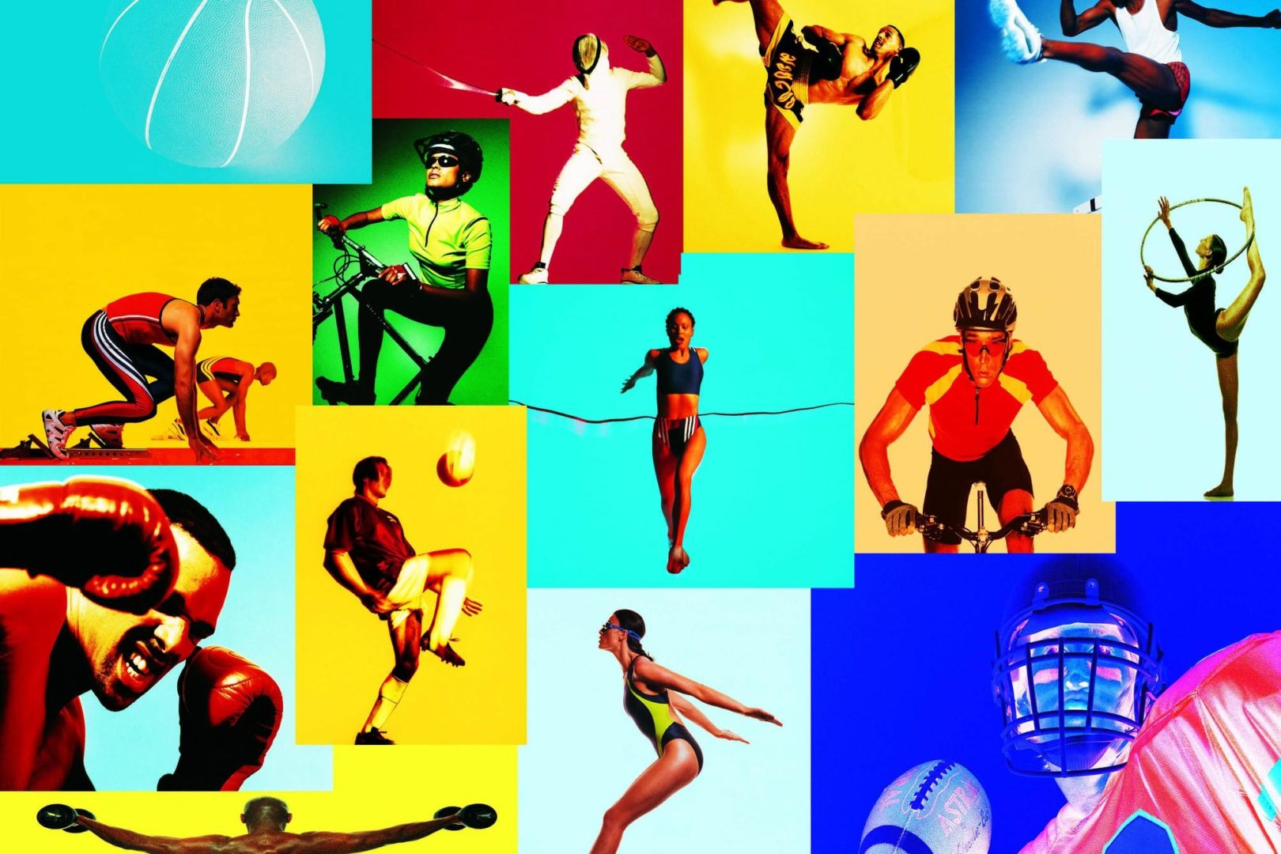
Sector 1
Preliminaries. «Go or Play» Task. Different kinds of sport

Slide 3

1-1 Preliminaries. «Go and Play» Task . Задание «Different kinds of sport»
See the names of different kinds of sport. Your task is to write them down into two columns. Write down the kinds of sport you play in the first column. And in the second those you go.

Slide 4
1-1 Preliminaries. «Go and Play» Task .
Задание «Different kinds of sport».
football, cycling, swimming, basketball, diving, ice-hockey, skating, tennis, table tennis, skiing, horse-riding, golf.

Slide 5
Answers:
Play: football, basketball, ice-hockey, tennis, table tennis, golf.
Go: swimming, diving, skating, skiing, horse-riding.

Slide 6
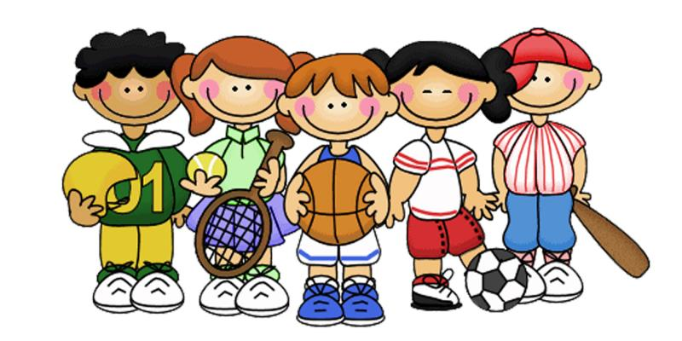
Sector 2. Guess game.

Slide 7
Guess game.
You read several sentences about the British popular sports and games but the names of them are given in the right-hand column. You read the sentences very attentively and try to guess the right name.

Slide 8
Read the sentences about the British sports attentively and try to guess the right name.
1) | People in England began to play …. as early as 1550. | golf
2) | …. is one of the oldest British sports that existed in Saxon times. | cricket
3) | …. is the sport that began to develop in Scotland. | football
4) | …. was first played in England in 1872, whose first championship was at Wimbledon. | boxing
5) | …. is a game invented and developed in England which is nowadays played all over the world. | tennis

Slide 9
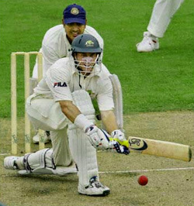
2-1 People in England began to play …. as early as 1550.
cricket

Slide 10
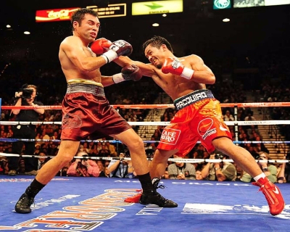
2-2. … is one of the oldest British sports that existed in Saxon times.
Boxing

Slide 11

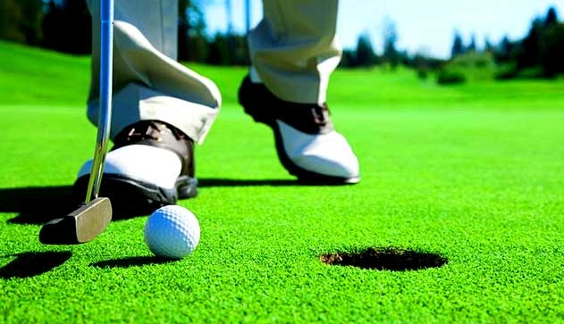
2-3 ….is the sport that began to develop in Scotland.
Golf

Slide 12
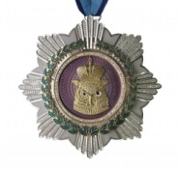
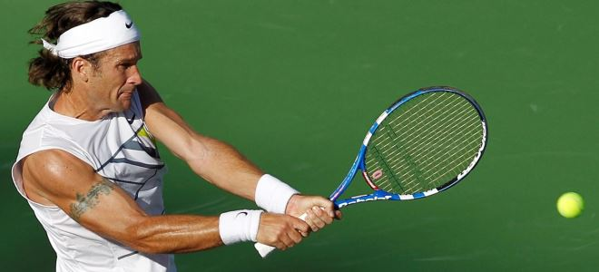
2-4…. was first played in England in 1872, whose first championship was at Wimbledon.
Tennis

Slide 13

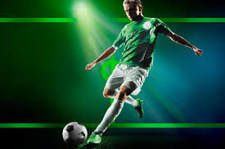
2-5… is a game invented and developed in England which is nowadays played all over the world.
Football

Slide 14
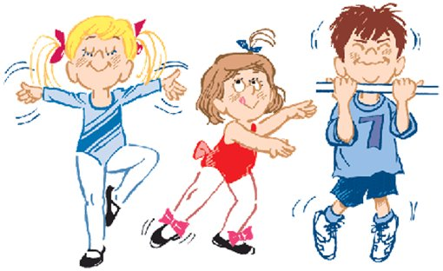
SPORT
Sector 3

Slide 15
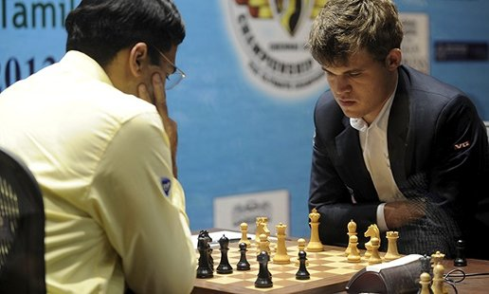
3-1 It is a game of two players. Each of them starts with 16 different playing pieces to move on a board. The aim is to move your pieces so that your opponent’s king will be taken.
(Chess)

Slide 16
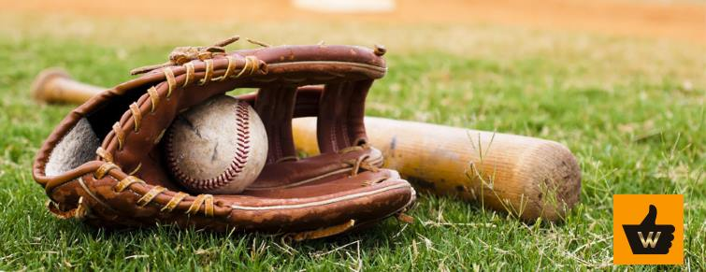
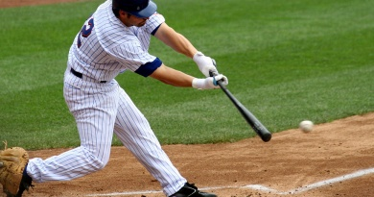
3-2 It is a game between two teams and is played on a field with a bat and a small white ball. Each team consists of 9 players. The team takes turns playing in the field and batting the ball.
(Baseball)

Slide 17
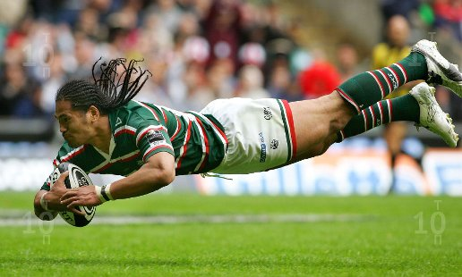
3-3 It is an outdoor game played by two teams with an oval (egg-shaped) ball that you kick or carry.
(Rugby)

Slide 18
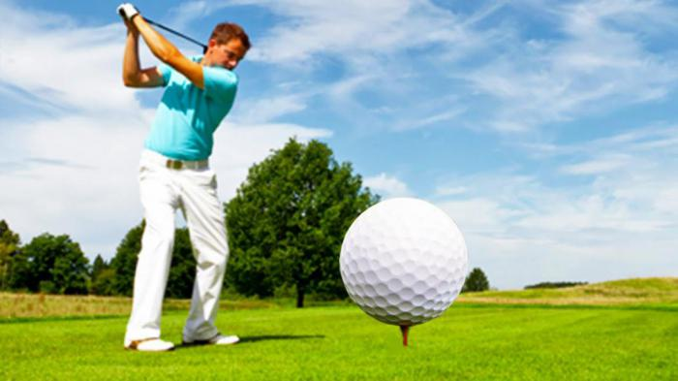
3-4 It is a game in which the players hit a small white into holes in the ground.
(Golf)

Slide 19
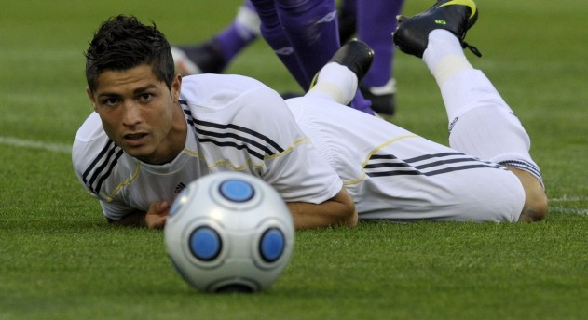
3-5 It is a game played by two teams of eleven players who try to kick a ball into the other team’s gate. The team with the most points wins.
(Football)

Slide 20
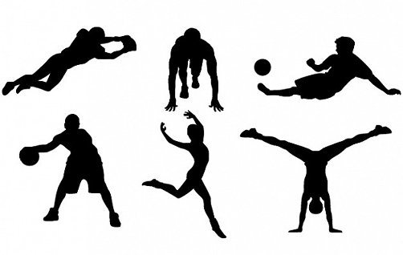
PERSON
Sector 4

Slide 21
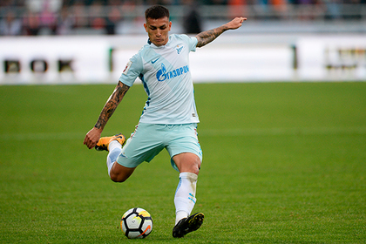
4-1 How is called a person who plays football?
a football player

Slide 22
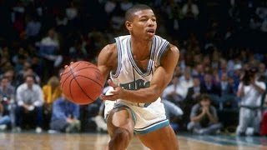
4-2 How is called a person who plays basketball?
a basketball player

Slide 23
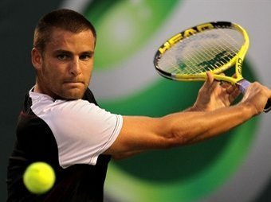
4-3 How is called a person who plays tennis?
a tennis player

Slide 24
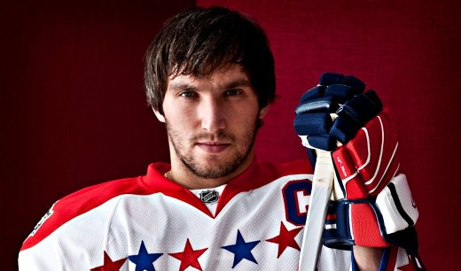
4-4 How is called a person who plays hockey?
a hockey player

Slide 25
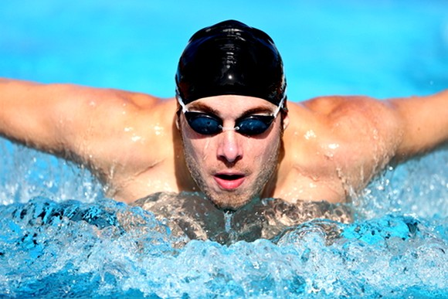
4-5 How is called a person who does swimming?
a swimmer

Slide 26
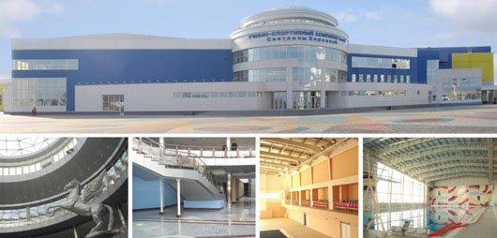
PLACE
Sector 5

Slide 27
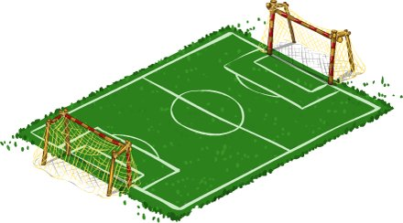
5-1 Where is football played?
a football ground/ a stadium

Slide 28
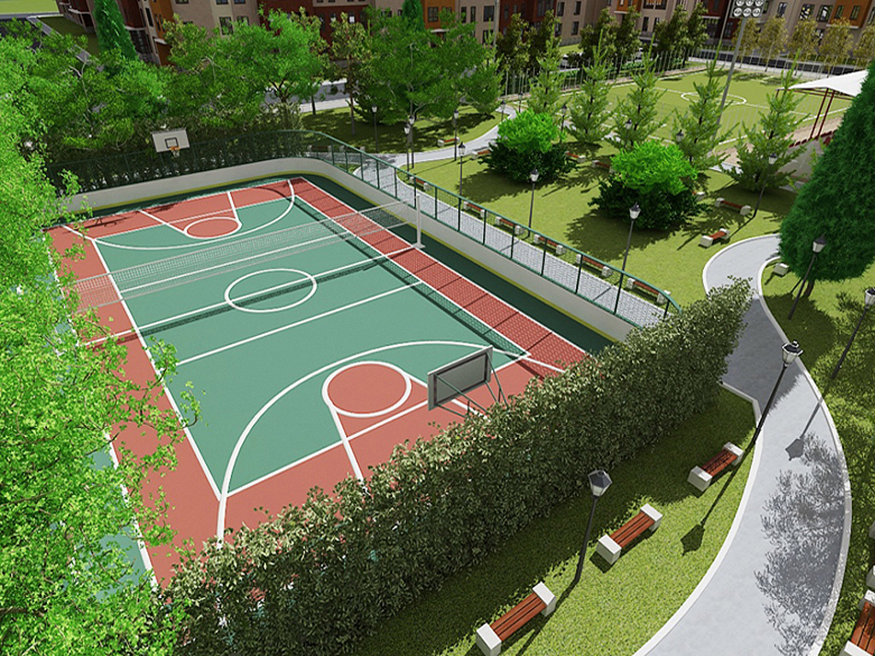
5-2 Where is basketball played?
outdoor surfaces or the basketball court

Slide 29
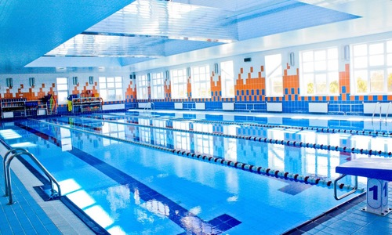
5-3 Where can you do swimming?
a swimming-pool

Slide 30
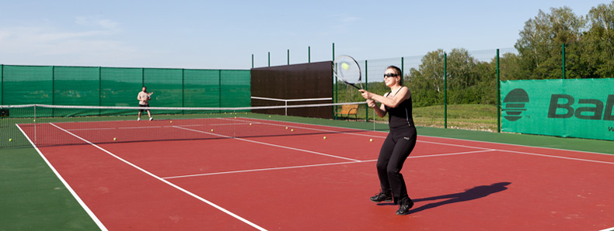
5-4 Where can you play tennis?
a tennis court

Slide 31
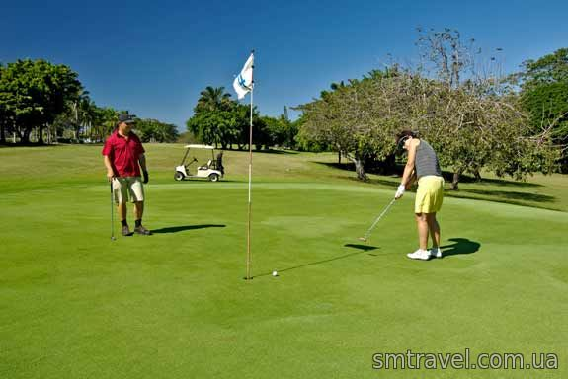
5-5 Where can you play golf?
a ground for golf

Slide 32
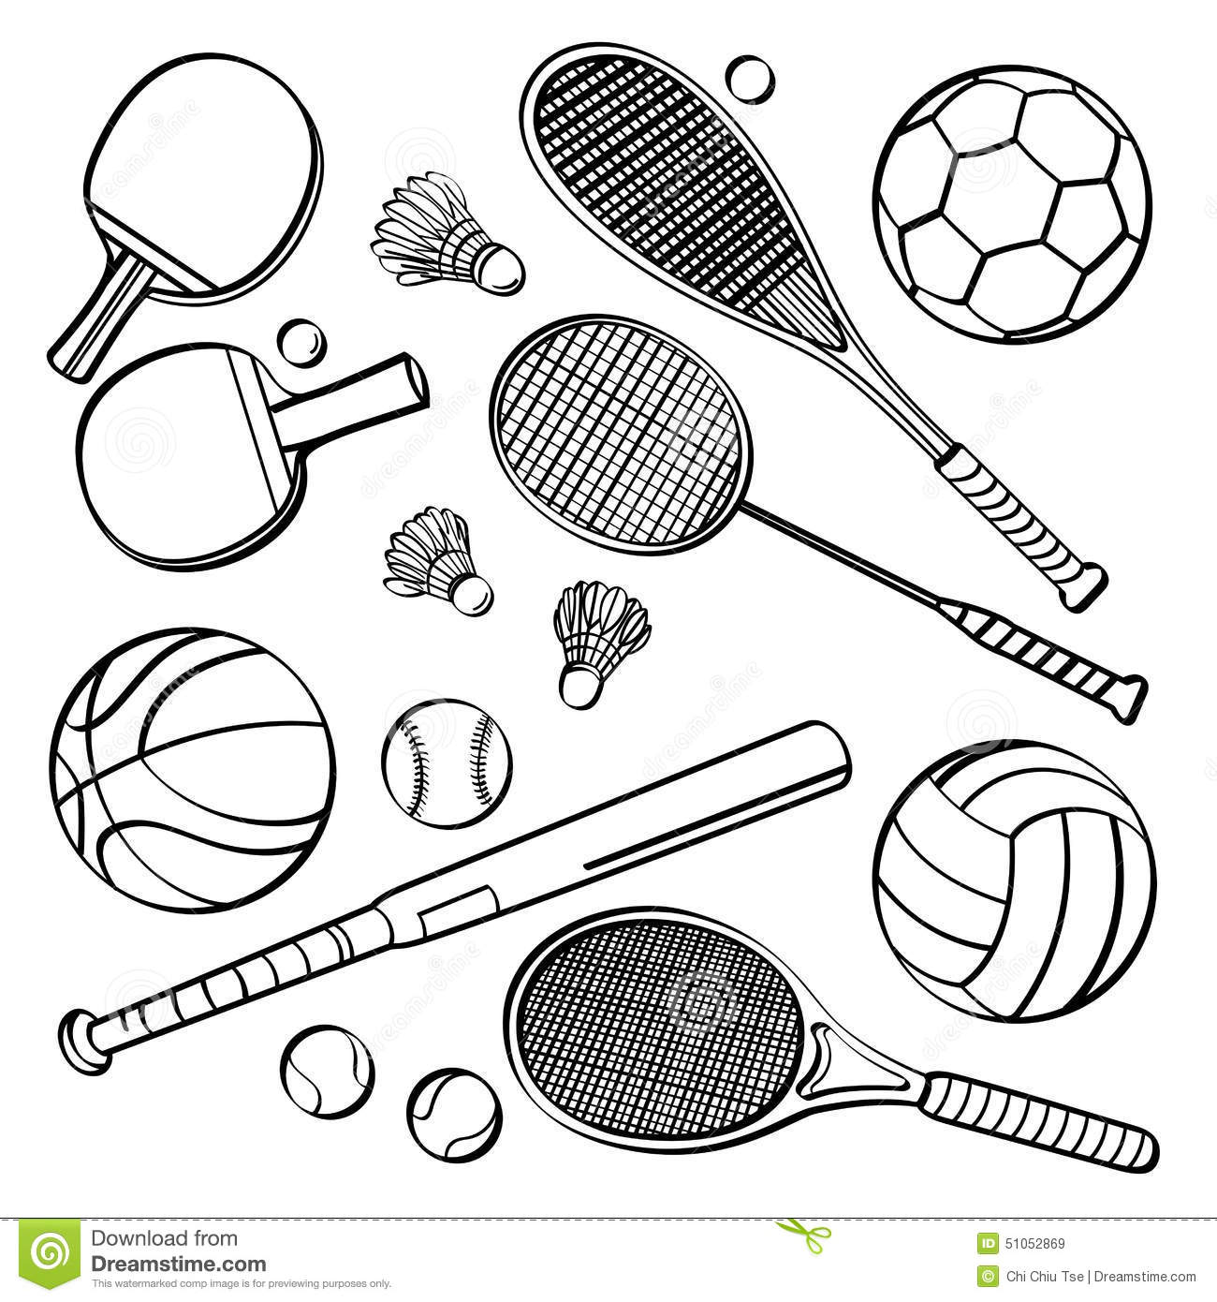
EQUIPMENT
Sector 6

Slide 33
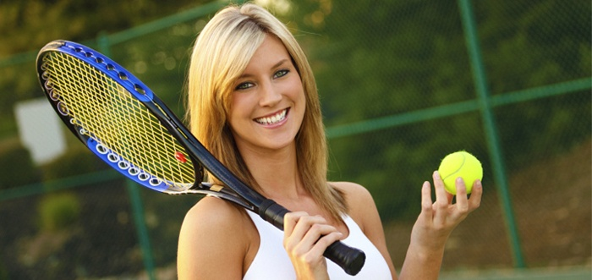
6-1 What do you need to play tennis?
a racket, a tennis ball

Slide 34
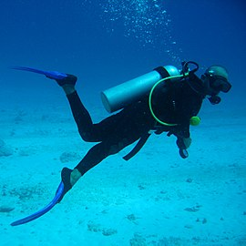
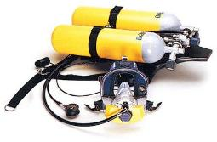
6-2 What equipment do you need for diving?
personal diving equipment
an aqualung

Slide 35

6-3 What do you need to play basketball?
the first basket
a ball
the second basket

Slide 36
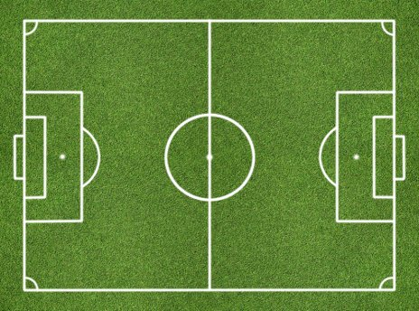
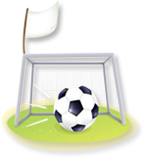
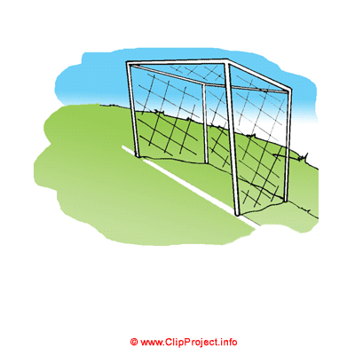
6-4 What do you need to play football?
a football ball, two gates

Slide 37
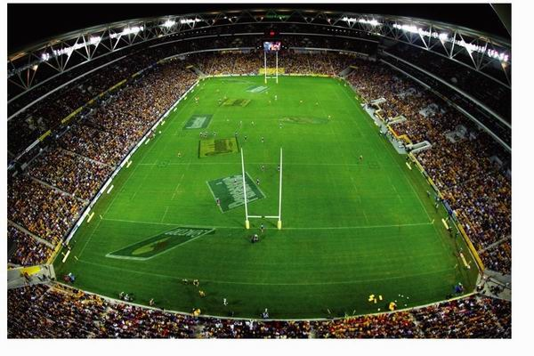

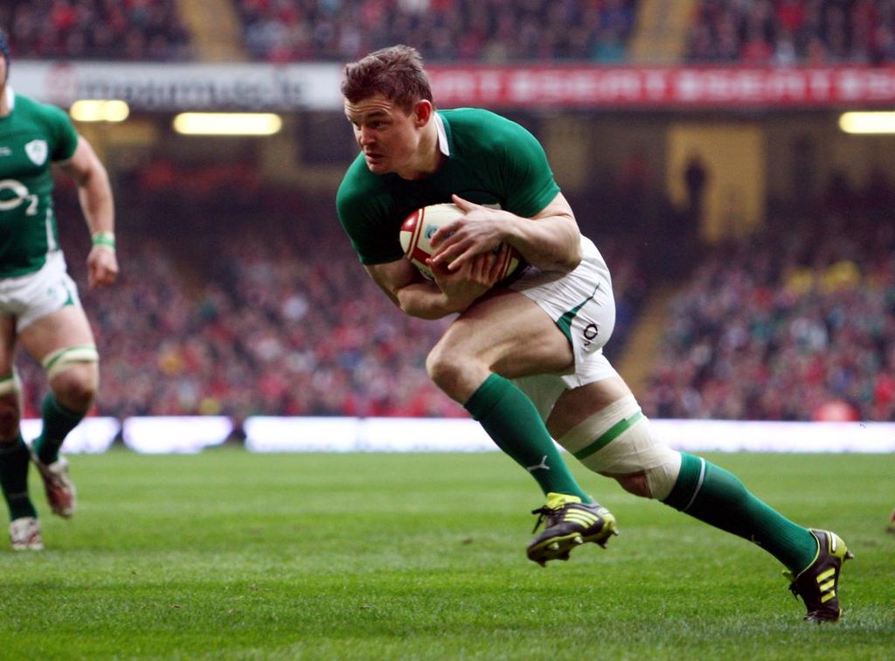
6-5 What do you need to play rugby?
а
an oval ball, two gates

Slide 38


Sector 7

Slide 39
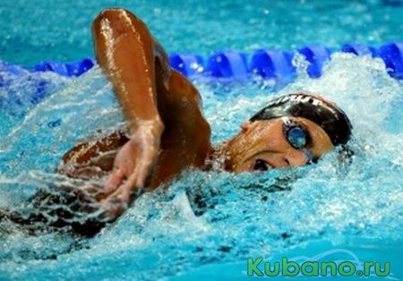
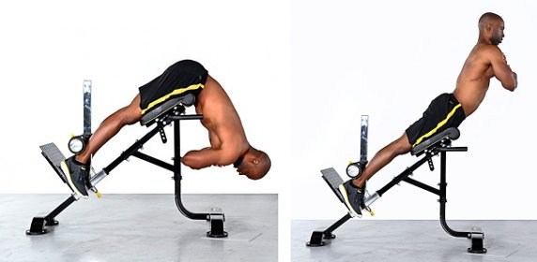
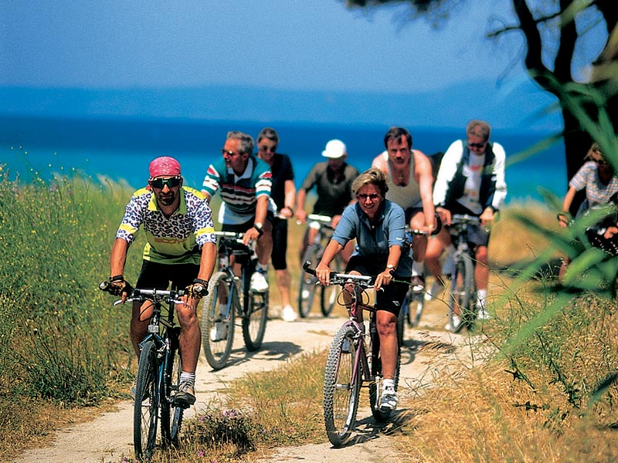

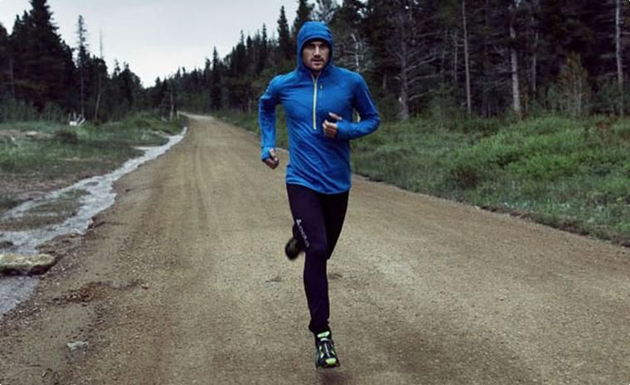
7-1 Kinds of Sport Mentioned in the Interview

Slide 40
7-2 Kinds of Sport Harry Does
Sometimes he just has a good walk

Slide 41
7-3 True or False Statements
Sport becomes more popular today. (True)
Harry is a professional sportsman. (False)
He goes to the gym once a week. (False)
On Saturday Harry plays tennis or goes for a run. (True)
Harry considers running, swimming and cycling as more effective kinds of sport. (True)
Harry thinks walking is also good for keeping fit. (True)

Slide 42

Sector 8
There are some sportsmen who helped to make history in sport. They are world famous. Do you know them?

Slide 43
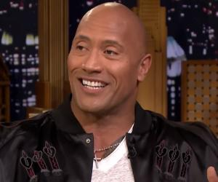
8-1 He is an American actor and retired professional wrestler.
Dwayne Johnson

Slide 44
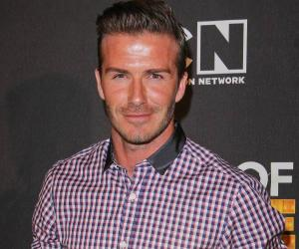
8-2 He is a former English professional football player.
David Robert Joseph Beckham

Slide 45
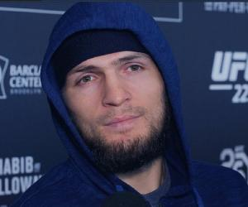
8-3 This sportsman is a Russian mixed martial artist.
Khabib Nurmagomedov

Slide 46
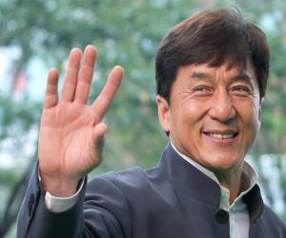
8-4 An actor, action choreographer, comedian, director, producer, martial artist, screenwriter, entrepreneur, singer and stunt performer, is a truly multi-faceted personality.
Jackie Chan, Hong Konger

Slide 47
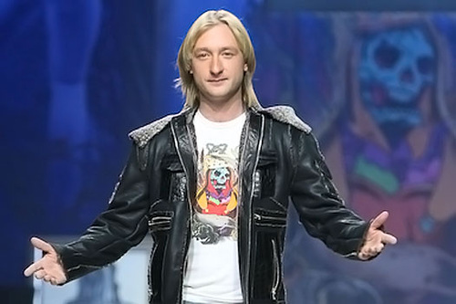
8-5 This man is a Russian former figure skater. He is an Olympic, World and European medalist.
Evgeni Plushenko

Slide 48

Sector 9. «Mixed up Letters»

Slide 49
9-1 Put the letters in the words on the topic “Sport” in a logical order.
еrccso (soccer);
bongxi (boxing);
rfiusng (surfing);
tmpoitinoc (competition);
rocsaebi (aerobics);
sinent (tennis);
ykeoch (hockey).

Slide 50

Sector 10. The Final.
If necessary…

Slide 51
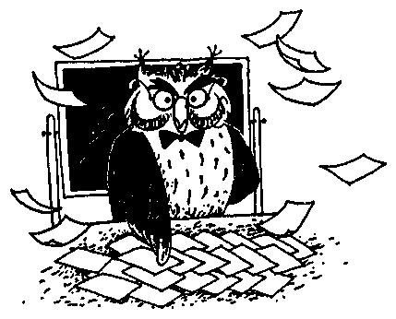
10–1 The Final
Make as many words as you can out of the word
horseracing.
Write them down.

Slide 52
Answers:
Hi! Oh! Horse, race, rose, sing, rice, ring, sin, ace, he, she, her, his, or, case, nice, era, sea, sir, gas, nose, go, noise, racing, age, gear, hear, air, score.
.

Slide 53


Slide 54


The End.
Good Luck!

