Slide 1
Keep calm (the history of project)
Подготовила: Кулахметова Наталья Николаевна, преподаватель английского языка БПОУ УР «Радиомеханический техникум им. В.А. Шутова» г. Ижевск

Slide 2

Keep calm and
This agitation poster produced in the UK in 1939 at the beginning of World War II.
Initially, the poster was issued by the English Ministry of Information in 1939 at the beginning of World War II. Two and a half million copies were printed, but the poster was not widely distributed.

Slide 3
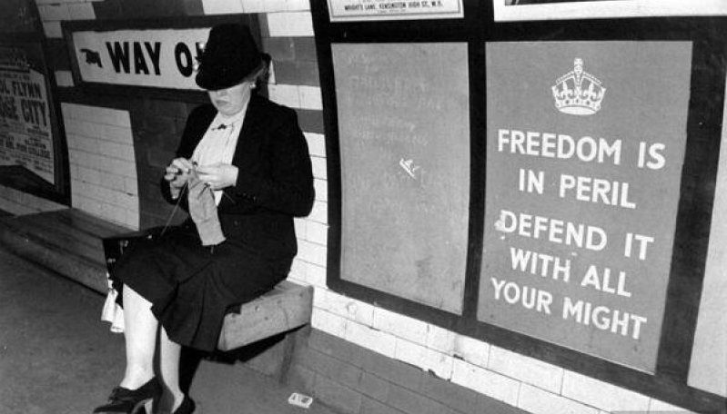
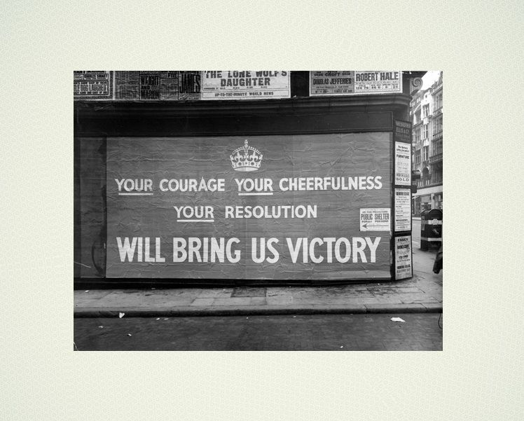
With such heroic appeals the British government appealed to its people.
Keep calm and …
Свобода под угрозой! Защищай ее своей силой!
Ваша отвага, ваша бодрость и решимость принесет нам победу!

Slide 4
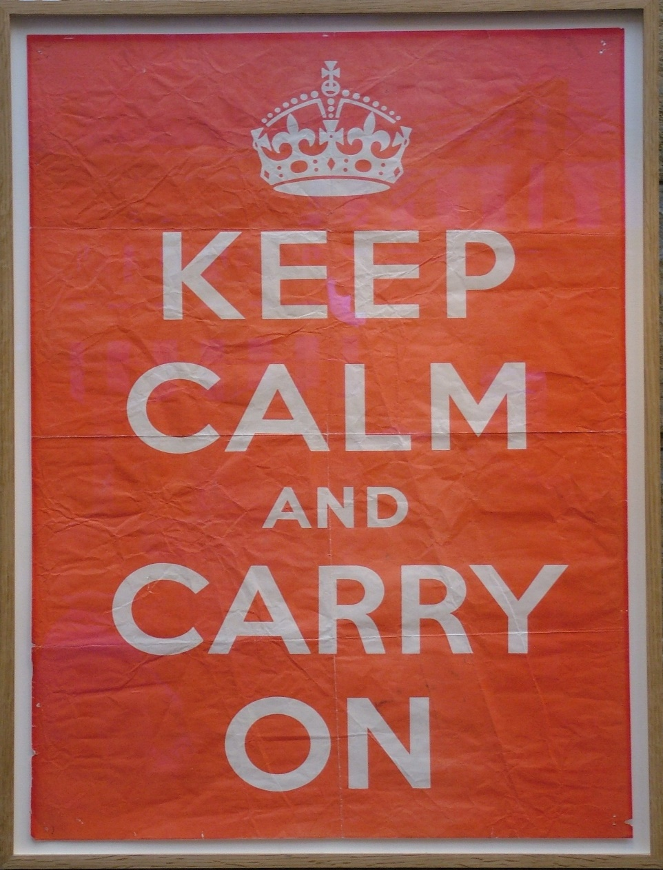
Keep calm and …
In September 1939, these posters were circulated and hung throughout England: in store windows, at railway stations.
These posters were made in the same style and had only two colors: white letters on a red background.
The inscriptions were made in a special beautiful font, which would be difficult to fake for the enemy.

Slide 5
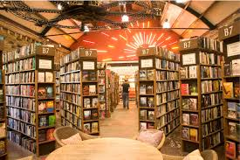
Keep calm and
The entire batch of the poster lay in storage throughout the war. Half a century later, in the small town of Alnwik, in the attic of his bookstore, the “Keep Calm” (Сохраняйте спокойствие и продолжайте в том же духе) poster was found by Stuart Manley. The British and his wife really liked the symbolic poster from the past, and they decided to decorate the window of their bookstore “Barter books” with them.

Slide 6





Keep calm and
Until 2005, although posters were sold, they were not very popular until a note appeared in one of the newspapers. The note was about the “keep calm” poster, the author offered it as a Christmas souvenir. Then the real sales boom began.
The British themselves note that this slogan is the standard of English restraint and firmness of character. Since 2009, the picture-poster has become the property of the whole world, having hit the Internet.

Slide 7


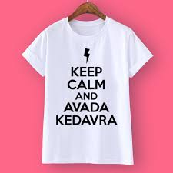
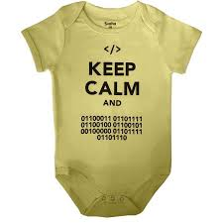

Keep calm and …
After the phrase tightly entered into everyday life, they began to actively parody it. Parodies are of a different nature, most often with a touch of irony or overt sarcasm.

Slide 8
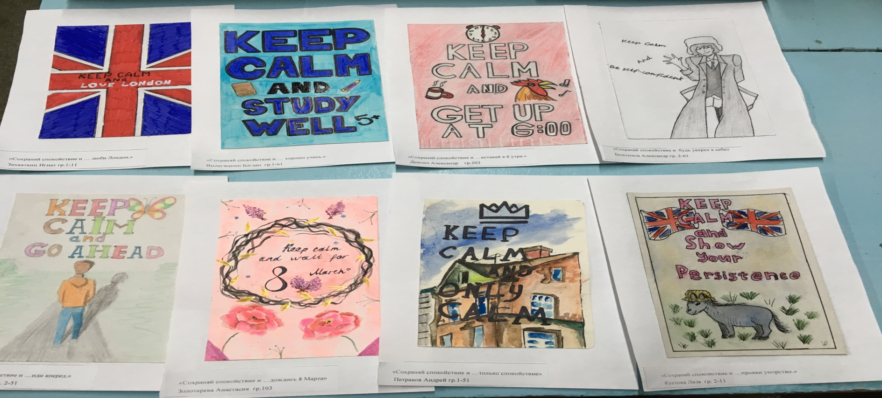
Keep calm Project in “Radiomechanical technical school” (Izhevsk). Ideas on the cards. The samples of our students’ works:

Slide 9
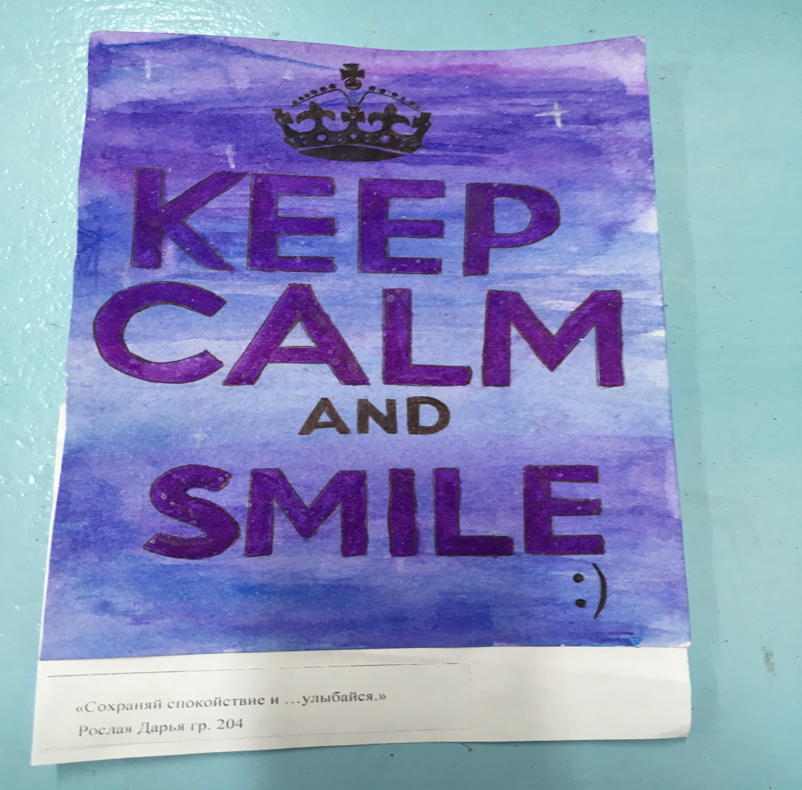
Good luck and thank you for your attention!

