Slide 1






Slide 2
ALL WORK AND NO PLAY MAKES JACK A DULL BOY

Slide 3


Slide 4
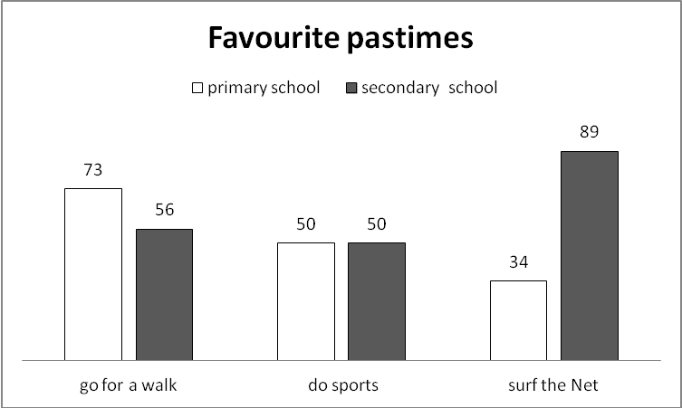

Slide 5


Slide 7
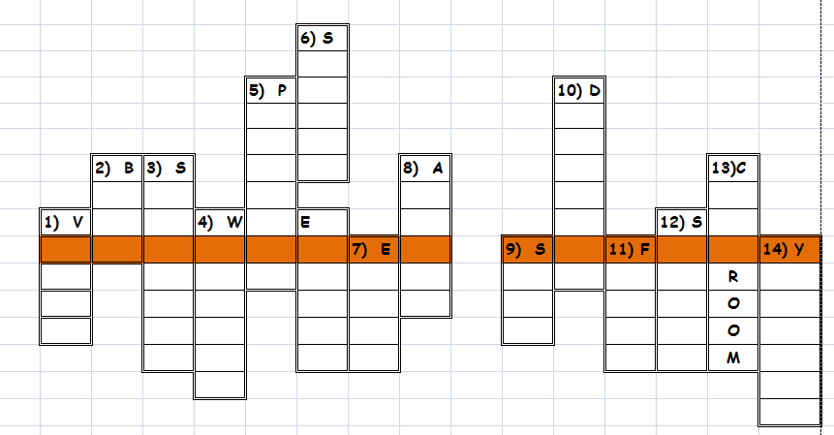

Slide 8
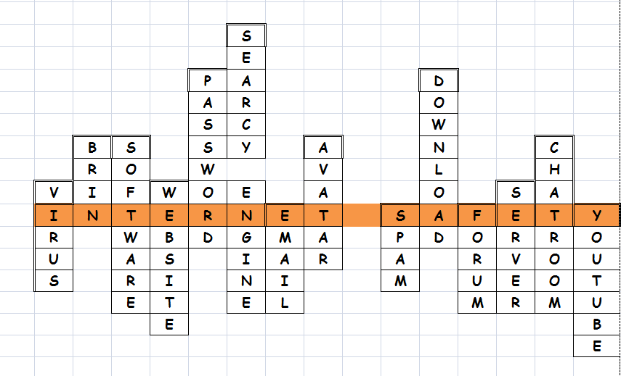
H
H

Slide 9
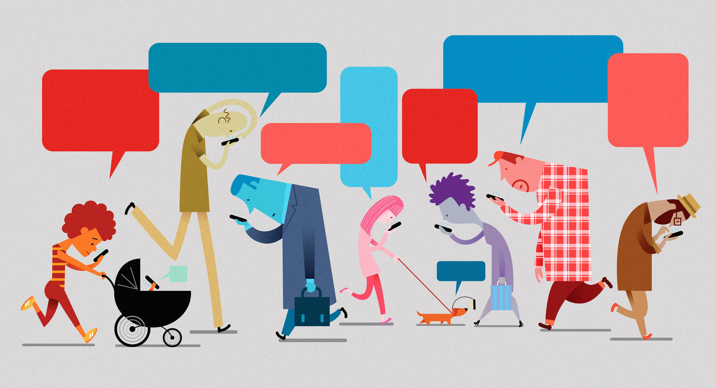

Slide 10
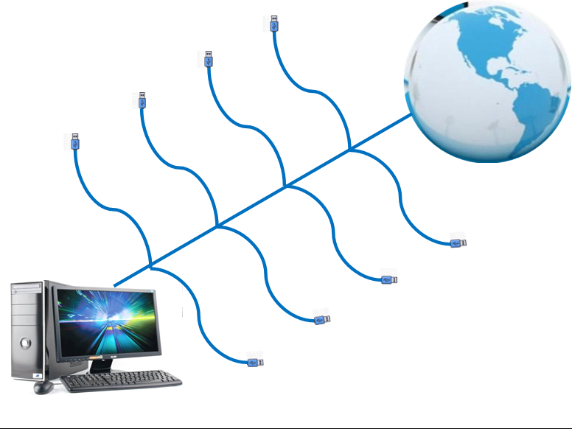


Slide 11

harmful content
hackers
spam
illegal and harmful actions
cheating on studies
health problems
depression
addiction

Slide 12

DOS
DON'TS

Slide 13


