Slide 1
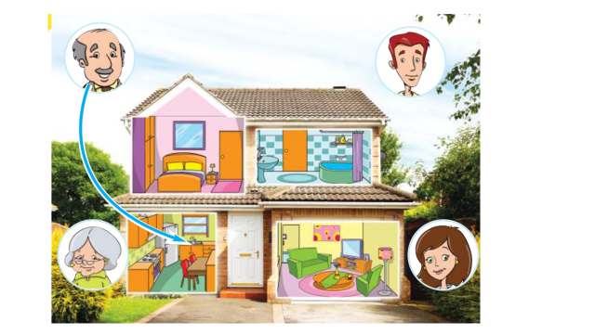

Slide 2
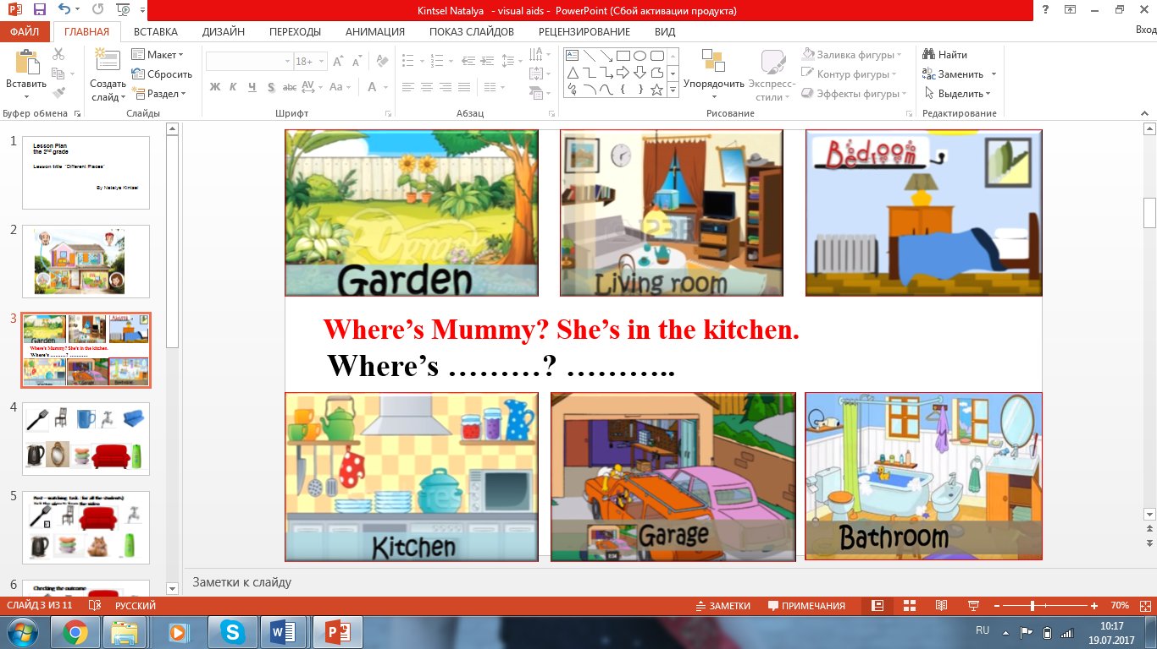
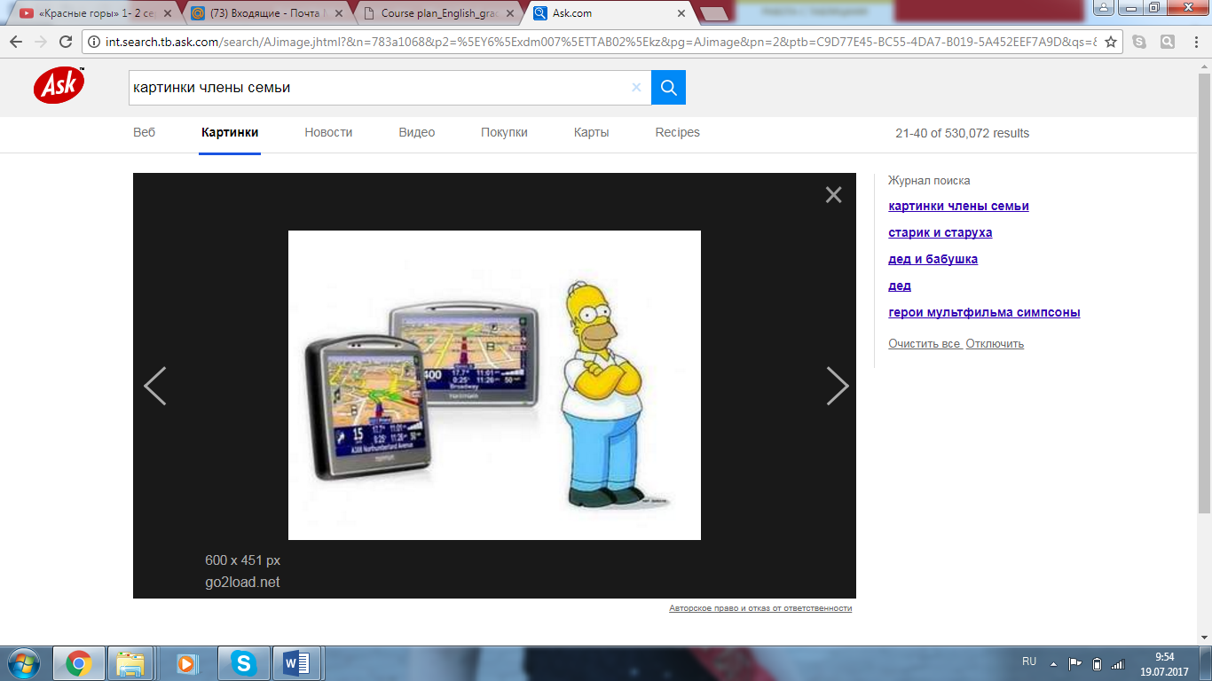


Slide 3

- Where is it?
- In the….

Slide 4
Father sleeps in a garage/ bedroom/bathroom.
Mother cooks in a kitchen/living room/garage.
Sister watches TV in the garden/bathroom/garage.
Granny washes in the garden/ living room/bathroom.

Slide 5
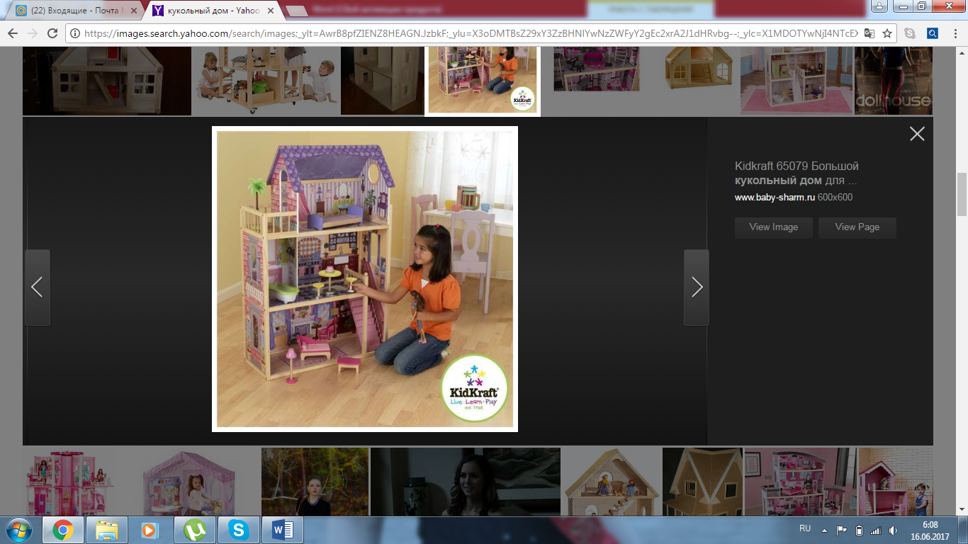
I have a house.
I have a living room.
I have a …….

Slide 6
Grade: 2
Unit 4: “The World Around Us”
Lesson title: “Different Places”
by Natalya Kintsel,
English teacher
school-gymnasium # 6
after Abai Kunanbaev,
the town of Stepnogorsk

Slide 7
Learning objectives
Lesson objectives
2.L6 understand some specific information in short, slow, carefully articulated talk on routine and familiar topics
2.S2 ask questions in order to satisfy basic needs and find information on familiar topics and classroom routines
2.S3 use a limited range of basic words, phrases and short sentences to describe objects, activities and classroom routines
2.R6 understand with considerable and particularly visual support, some specific information in short, simple texts on familiar topics
2.W3 write short phrases to identify people, places and objects
By the end of the lesson, students will be able to:
Recognize words and directions pronounced by a teacher or in a video and follow them
use the vocabulary of places, names of rooms, furniture, family, etc. to describe the house and ask questions and answer the teacher and classmates’ questions
identify the definition of names of the rooms and places in short texts
record his or her understanding/knowledge by writing (not less than) four facts about the house

Slide 8
Methods of active learning
Eliciting (Teacher uses eliciting to revise topical vocabulary at the beginning of the lesson)
Pair work (Making up a dialogue using paper puppets and the structure “Where is ….? She’s/He’s in the……” and reading the text in pairs )
3by3 drilling strategy (At the stage of revising topic vocabulary and making word combinations “adjective + object”)
Singing the song with movements together (Energizer )
TPS method (While doing post-watching and post-reading activities)
Self-assessment “The tree of mood”, Voting (At the end of the lesson teacher uses voting and “The tree of mood” to get feedback)
.
Methods of active learning

Slide 9
Differentiation approaches
Differentiation by task
Differentiation by pace
Differentiation by outcome
Differentiation by support
Differentiation by home task

Slide 10
Criteria-based assessment
Throughout the lesson such types of formative assessment were applied:
Peer assessment
Self- assessment
Teacher-based assessment
Criteria-based assessment
Feedback (Voting, “Traffic light”)

Slide 11
Influence of my coach and colleagues’ knowledge within microteaching and group presentations
Microteaching has influenced the approaches to my planning the lesson.
I used some methods and strategies which were presented by my trainer during the course and some of them were applied by my colleagues in their plans.
Using such methods as eliciting, using paper puppets and TPS-strategy is aimed at active learning development
My colleagues’ and the trainer’s feedback had a positive impact on my lesson planning, as it contributed to acquisition of knowledge and some teaching experience.
For example: I was advised to use 3 by 3 drilling strategy to introduce topic vocabulary, TPR method.
Feedback received from my trainer and colleagues influenced my lesson planning positively, as it contributed to my practical teaching experience.
For example: my trainer advised my to use 3 by 3 drilling strategy to revise topical vocabulary and get the students to make up word combinations. My colleagues also advised me TPS method while students’ doing exercises.
I still have some difficulties. So in future I’m going to improve my planning practice and teaching. I’m going to focus on TPR method because I have understood that it is very effective with primary learners. It develops their listening skills. This method is flexible and I can adapt it to different situations and content.
Also I’m going to use Inductive approach because this approach involves all students in learning process and tend to participate more actively. It is focused on students’ capacities and abilities.
A lot of methods and strategies were presented during the course.
According to my students’ needs I consider the most effective for active learning such strategies as eliciting, TPS method, 3by3 drilling strategy and various types of questioning.
I find them very effective in teaching primary students and developing their communicative skills.
These methods can be used in different situations and content because they help teacher to involve students and have them motivated within the lesson.

