Slide 1
TIME TO GET TO KNOW THEM BETTER – ПОРА ПОЗНАКОМИТЬСЯ ПОБЛИЖЕ

Slide 2
Over 1000 phrasal verbs help you to improve English.

Slide 3
Phrasal verbS–признак, по которому можно опознать английский язык. Лингвисты между собой шутят: произносим «фразовый глагол», имеем ввиду «английский язык».

Slide 4
Phrasal verb is a combination of a verb and an adverb or a verb and a preposition, or both, in which the combination has a meaning different from the meaning of the words considered separately: "Catch on" is a phrasal verb meaning to understand.

Slide 5
What is a phrasal verb? Phrasal verbs are verbs which have a main verb and a particle which, together, create one meaning Phrasal verbs are verbs with adjectives Phrasal verbs are verbs in different meanings

Slide 6
Происхождение фразовых глаголов можно отследить до самых ранних древнеанглийских письменных источников.
The man walked out. — Человек вышел. (направление)
The man stood by. — Человек стоял рядом.
(место)

Slide 7
OUT: приключения одного наречия

Slide 8
phrasal verbS are verbs which have a main verb and a particle. What is a particle?
Particles are prepositions
Particles are adverbs and prepositions
Particles are adverbs

Slide 9
В сочетании с различными элементами основной глагол может приобретать самые разные значения, на первый взгляд, мало связанные друг с другом по смыслу. Например: look — смотреть look for — искать look after — заботиться

Slide 10
Можно учить фразовые глаголы по наречию или предлогу.
eat out — обедать в ресторане check out — выезжать из гостиницы give out — раздавать что-то бесплатно come out — оказываться, выясняться work out — тренироваться
go out — развлекаться вне дома

Slide 11
What do particles mean in phrasal verbs?
Clear basic meaning
Various meanings
Clear basic meaning & Various meanings

Slide 12
Подбирая синонимы к phrasal verbs вы создаете ассоциативную связь , которая поможет не просто быстрее выучить, но и вспомнить глагол. Всё, что базируется на ассоциациях, всегда легче понять и принять.
call smth. of - cancel - отменять что-нибудь;
carry on - continue - продолжать;
come back - return - возвращаться

Slide 13
A phrasal verb can often be replaced by single verb with more or less the same meaning because:
single - verbs are more formal
it is shorter to pronounce
single verbs are foreign words

Slide 14
Replace the underlined verbs in these sentences with phrasal verbs made using the verbs and particles from the boxes below.
make chase brush leave fall | up for out aside out
1.They just ignored my complaints; it made me very angry.
2. I believed his story about having lost all his money. How stupid I was!
3.I couldn’t understand what he was saying with all the noise.

Slide 15
 | Get on
He got on the bus.(entered the bus) | I’m trying to get on with my work(continue doing my work) | Sam and Lea get on really well.(are friendly)

Slide 16
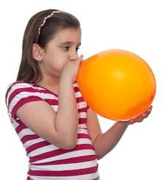


Literal(basic) meaning Blow up a balloon(fill with air) | Blow up a building (make it explode) | Someone blows up (suddenly becomes very angry)

Slide 17
Translate: You can pick up something from the floor.You can pick up a language or bad habits.The weather can pick up.You can pick up a bargain.A radio can pick up a signal.The economy can pick up.You can pick someone up in your car.

Slide 18
Phrasal verb + object 1 Match a verb in A with an object in B.
A 1 sort out d 2 put out ___ 3 fill in 4 find out 5 try on 6 try out ___ 7 bring up 8 clear up ___ 9 take back ___ 10 work out 11 put away 12 turn off ___ | В a clothes in a shop b children с the answer d a problem e the television f toys in the cupboard g a form h something you don’t want to a shop i a new idea, a new drug j a fire к information L a mess

Slide 19
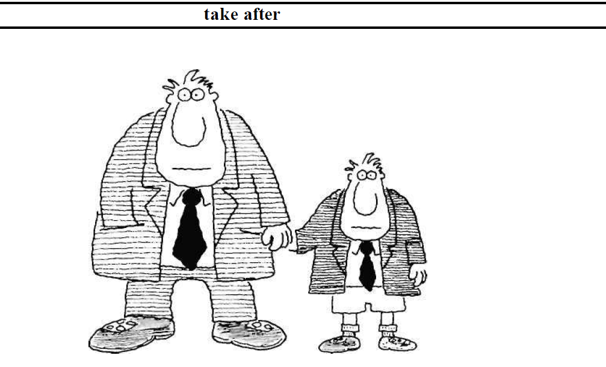
Определите значение фразовых глаголов по вопросам-подсказкам и картинкам
Do you think these two people are related?
What do you think their relationship is?
Do you think they look alike?
Think of another way of saying take after.

Slide 20
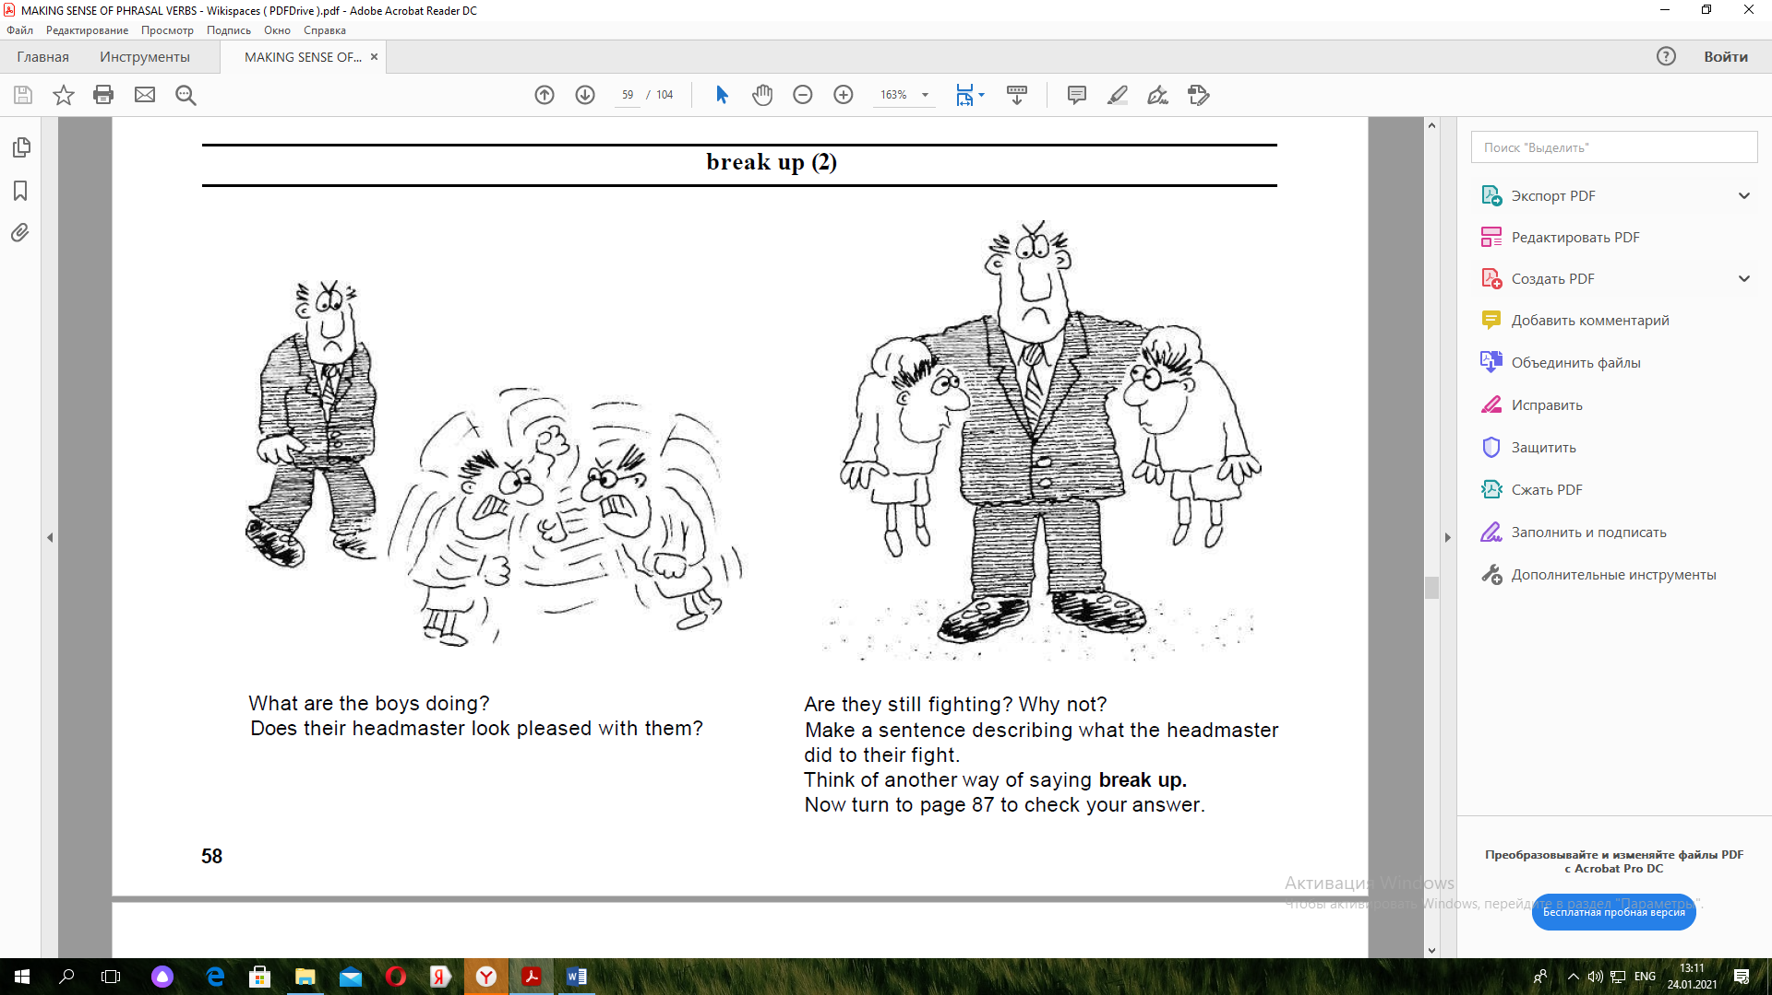
What are the boys doing? Does their headmaster look pleased with them? Are they still fighting? Why not? Think of another way of saying break up.

Slide 21
https://www.youtube.com/watch?v=PjaPYWMjBVc The song by Shakira “Try everything” Петь песни с фразовыми глаголами – весело и эффективно. Подпеваем и выписываем фразовые глаголы.

